Slide 1
God’s Road to
God’s Road to
SUCCESS
IS AHEAD
Notes:
Https://pixabay.com/en/career-road-away-way-of-life-479578/
Copyright © 2006−2020. All rights reserved. Bible Point is a registered trademark of Dennis Henderson. All other trademarks acknowledged.
Bible Point contains graphics from Bible Point artists. These illustrations belong to Bible Point and the respective artists. You may use the designs and illustrations for graphical illustration of lessons free and without special permission, provided they are not used in any way that maligns the Christian faith. Furthermore, republication or production of any illustration by any other graphic service whether it be in book, in a machine-readable form, or in any other design resource is strictly prohibited. Furthermore, they cannot be duplicated or resold as any other form of publishing, clip art, or graphic resource.
So What does it mean? (A simple translations of the legal jargon)
So, if you don’t own the presentation(s), graphic(s), and text(s) how can you legally use them? The purchase of the license allows you to use all the images in the product. However, the actual ownership and copyright of the presentation(s), graphic(s), and text(s) remain the property of Bible Point and its licensors. If you had plans on using this product in your “for sale” work—think again!
License Agreement
Article 1: License Grant
All the graphics and text in Bible Point presentations (excluding quotes from the Bible and stated sources) are the intellectual and real property of Bible Point and its licensors, and is protected by law, including United States copyright laws and international treaties. Bible Point grants to you a license:
1. To use the presentation in a single church, single school, or single office of a Christian organization.
2. To make a single archival back-up copy of the program.
3. To modify the presentation(s) and merge with other presentations in a single church, school, or Christian organization.
4. To transfer to another party if that party agrees to accept the terms and conditions of this agreement, and you do not retain any copies of the presentation, whether printed, machine readable, modified, or merged form.
Article 2: Terms
This license is effective until terminated. You may terminate the license at any time by destroying the presentation(s), graphic(s), or text(s) together with all copies, modifications and merged portions in any form. Bible Point may terminate your license if you fail to comply with this Agreement. You agree, upon such termination, for any reason, to destroy the presentation(s), graphics, and text(s) with all copies, modifications, and merged portions in any form.
Article 3: Disclaimers
1. Bible Point presentations, graphics, and texts are licensed to you As Is. You, the consumer, bear the entire risk relating to the quality and performance of the presentation(s), graphic(s), or text(s). In no event will Bible Point be liable for damages resulting from any defect.
2. Thirty-day limited warrantee on disks. Bible Point warrants the disks to be free of defects in material and workmanship under normal use for 30 days after purchase. During the 30-day period you may return a defective presentation, graphic, or text with proof of purchase and it will be replaced without charge, unless the presentation is damaged by misuse.
Article 4: General
1. You may not sub-license, assign, or transfer the license of the presentation(s), graphic(s), or text(s) except as provided by this Agreement.
2. This Agreement will be governed by the laws of the State of Michigan.
So What does it mean? (A simple translations of the legal jargon)
May I let someone borrow or copy my licensed Bible Point presentation (even after I modified it)? As long as it is within your local church, or single school, or the immediate office of a Christian organization you may. Otherwise, please refer the person interested in borrowing to: http://www.biblepoint.com or E-mail: biblepoint@comcast.net with any related questions.

Slide 2
God’s Road to
God’s Road to
SUCCESS
Involves Preparation
and How to Find It
Notes:
https://pixabay.com/en/career-road-away-way-of-life-479578/

Slide 3
Preparation involves ...

Slide 4
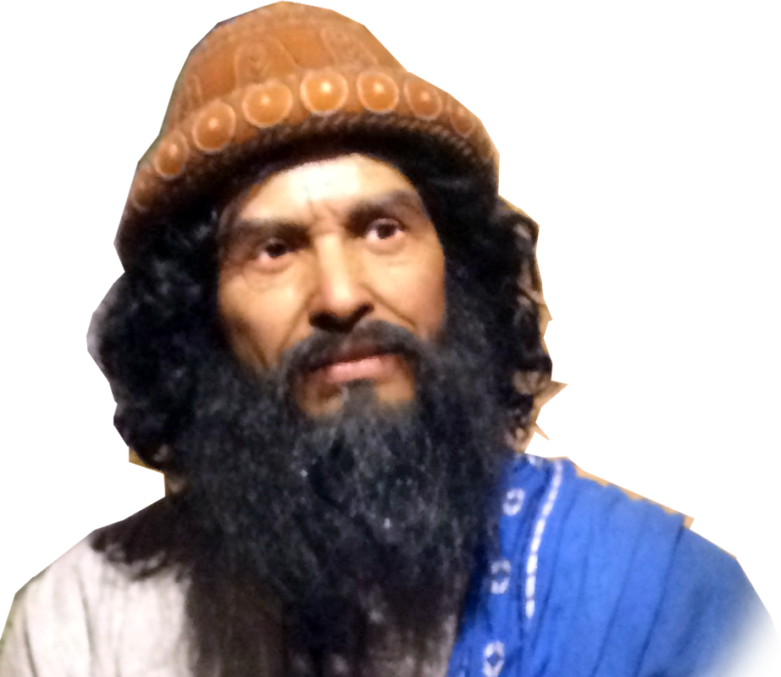
Renewing Your Commitment 1-7
5:2 the LORD said to Joshua,
"Make flint knives and circumcise the Israelites again."

Slide 5
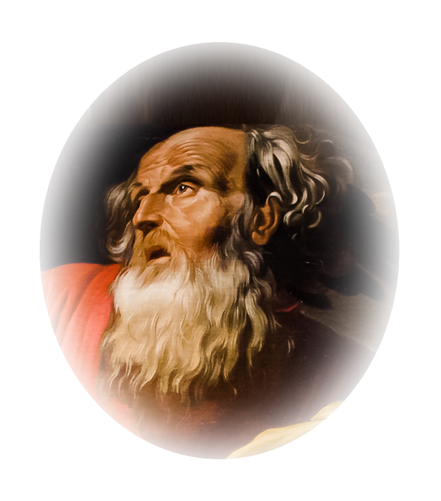
Renewing Your Commitment 1-7
Gen 17:11-14 ¹¹ You are to undergo circumcision, and it will be the sign of the covenant between me and you.

Slide 6
Renewing Your Commitment 1-7
¹² For the generations to come every male among you who is eight days old must be circumcised, .... they must be circumcised. My covenant in your flesh is to be an everlasting covenant.

Slide 7
Renewing Your Commitment 1-7
¹⁴ Any uncircumcised male, who has not been circumcised in the flesh, will be cut off from his people; he has broken my covenant."

Slide 8
Renewing Your Commitment 1-7
¹⁴ Any uncircumcised male, who has not been circumcised in the flesh, will be cut off from his people; he has broken my covenant."
Israel had broken the covenant!

Slide 9
Renewing Your Commitment 1-7
⁴ ... All those who came out of Egypt--all the men of military age--died in the desert on the way after leaving Egypt. ⁵ All the people that came out had been circumcised, but all the people born in the desert during the journey from Egypt had not.

Slide 10
Renewing Your Commitment 1-7
⁶ ... all the men who were of military age when they left Egypt had died, since they had not obeyed the LORD. .... ⁷ So he raised up their sons in their place, and these were the ones Joshua circumcised. They were still uncircumcised because they had not been circumcised on the way

Slide 11
Renewing Your Commitment 1-7
² At that time the LORD said to Joshua, "Make flint knives and circumcise the Israelites again."
³ So Joshua made flint knives and circumcised the Israelites at Gibeath Haaraloth.

Slide 12
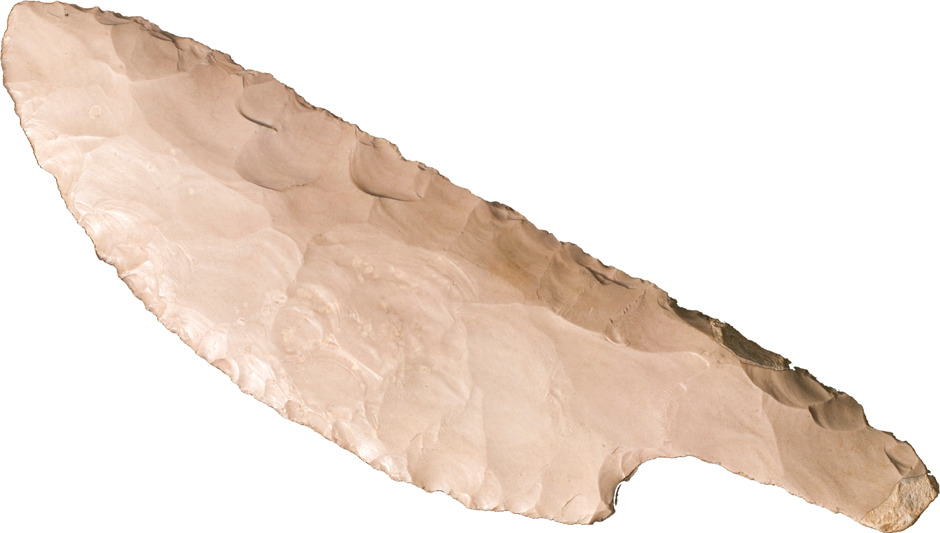
Testing Your Faith 5:8
⁸ And after the whole nation had been circumcised, they remained where they were in camp until they were healed.

Slide 13
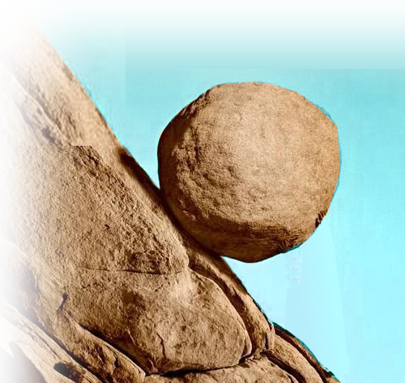
Removing Your Reproach 5:9
⁹ Then the LORD said to Joshua,
"Today I have rolled away the reproach of Egypt from you."
REPROACH

Slide 14
Removing Your Reproach 5:9
⁹ Then the LORD said to Joshua,
"Today I have rolled away the reproach of Egypt from you."
So the place has been called Gilgal to this day.
REPROACH

Slide 15
Remembering Your Salvation 5:10
¹⁰ On the evening of the fourteenth day of the month, while camped at Gilgal on the plains of Jericho, the Israelites celebrated the Passover.

Slide 16
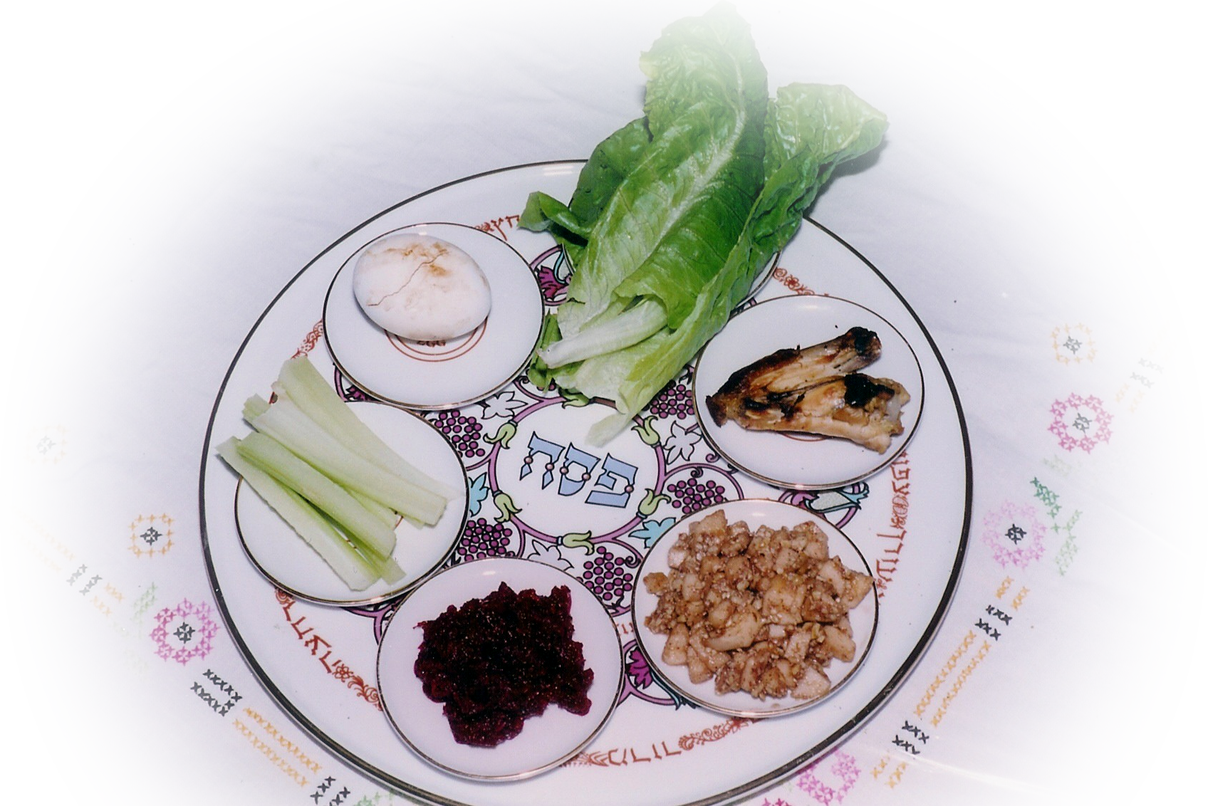
Remembering Your Salvation 5:10
¹⁰ On the evening of the fourteenth day of the month, while camped at Gilgal on the plains of Jericho, the Israelites celebrated the Passover.

Slide 17
Enjoying Your Blessings 5:11
¹¹ The day after the Passover, that very day, they ate some of the produce of the land: unleavened bread and roasted grain.

Slide 18
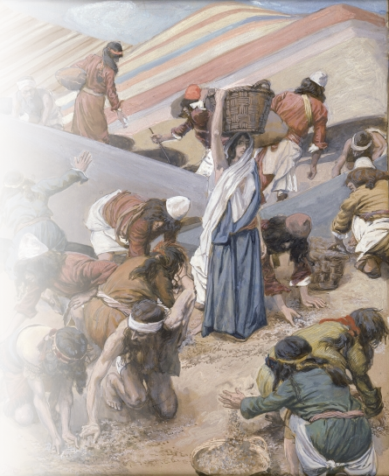
Forgetting Your Past 5:12
¹² The manna stopped the day after they ate this food from the land; there was no longer any manna for the Israelites, but that year they ate of the produce of Canaan.

Slide 19
Focusing on Your Future 5:12
¹² The manna stopped the day after they ate this food from the land; there was no longer any manna for the Israelites, but that year they ate of the produce of Canaan.
Notes:
There was no turning back.
I have decided to follow Jesus song.

Slide 20
Summing it all up:
You can prepare for success right NOW!

Slide 21
Summing it all up:
You can prepare for success right NOW!
By cutting off and rolling away the world.

Slide 22
Summing it all up:
You can prepare for success right NOW!
By cutting off and rolling away the world.
By feasting off the fruit of the New Life.
Notes:
John 15 – bear much fruit

Slide 23
God’s Road to
Let’s PRAY

