Slide 1
God’s Road to
God’s Road to
SUCCESS
IS AHEAD
Notes:
Https://pixabay.com/en/career-road-away-way-of-life-479578/
Copyright © 2006−2020. All rights reserved. Bible Point is a registered trademark of Dennis Henderson. All other trademarks acknowledged.
Bible Point contains graphics from Bible Point artists. These illustrations belong to Bible Point and the respective artists. You may use the designs and illustrations for graphical illustration of lessons free and without special permission, provided they are not used in any way that maligns the Christian faith. Furthermore, republication or production of any illustration by any other graphic service whether it be in book, in a machine-readable form, or in any other design resource is strictly prohibited. Furthermore, they cannot be duplicated or resold as any other form of publishing, clip art, or graphic resource.
So What does it mean? (A simple translations of the legal jargon)
So, if you don’t own the presentation(s), graphic(s), and text(s) how can you legally use them? The purchase of the license allows you to use all the images in the product. However, the actual ownership and copyright of the presentation(s), graphic(s), and text(s) remain the property of Bible Point and its licensors. If you had plans on using this product in your “for sale” work—think again!
License Agreement
Article 1: License Grant
All the graphics and text in Bible Point presentations (excluding quotes from the Bible and stated sources) are the intellectual and real property of Bible Point and its licensors, and is protected by law, including United States copyright laws and international treaties. Bible Point grants to you a license:
1. To use the presentation in a single church, single school, or single office of a Christian organization.
2. To make a single archival back-up copy of the program.
3. To modify the presentation(s) and merge with other presentations in a single church, school, or Christian organization.
4. To transfer to another party if that party agrees to accept the terms and conditions of this agreement, and you do not retain any copies of the presentation, whether printed, machine readable, modified, or merged form.
Article 2: Terms
This license is effective until terminated. You may terminate the license at any time by destroying the presentation(s), graphic(s), or text(s) together with all copies, modifications and merged portions in any form. Bible Point may terminate your license if you fail to comply with this Agreement. You agree, upon such termination, for any reason, to destroy the presentation(s), graphics, and text(s) with all copies, modifications, and merged portions in any form.
Article 3: Disclaimers
1. Bible Point presentations, graphics, and texts are licensed to you As Is. You, the consumer, bear the entire risk relating to the quality and performance of the presentation(s), graphic(s), or text(s). In no event will Bible Point be liable for damages resulting from any defect.
2. Thirty-day limited warrantee on disks. Bible Point warrants the disks to be free of defects in material and workmanship under normal use for 30 days after purchase. During the 30-day period you may return a defective presentation, graphic, or text with proof of purchase and it will be replaced without charge, unless the presentation is damaged by misuse.
Article 4: General
1. You may not sub-license, assign, or transfer the license of the presentation(s), graphic(s), or text(s) except as provided by this Agreement.
2. This Agreement will be governed by the laws of the State of Michigan.
So What does it mean? (A simple translations of the legal jargon)
May I let someone borrow or copy my licensed Bible Point presentation (even after I modified it)? As long as it is within your local church, or single school, or the immediate office of a Christian organization you may. Otherwise, please refer the person interested in borrowing to: http://www.biblepoint.com or E-mail: biblepoint@comcast.net with any related questions.

Slide 2
God’s Road to
God’s Road to
SUCCESS
may seem like “Déjà Vu”
and How to Find It
Notes:
https://pixabay.com/en/career-road-away-way-of-life-479578/

Slide 3
What is Déjà Vu?
God’s Road to
God’s Road to
SUCCESS
may seem like “Déjà Vu”
and How to Find It

Slide 4
What is Déjà Vu?
God’s Road to
God’s Road to
SUCCESS
It’s that “feeling of having already experienced the present situation.”
may seem like “Déjà Vu”
and How to Find It

Slide 5
God had given some pretty big SUCCESS in the past!
God’s Road to
God’s Road to
SUCCESS
may seem like “Déjà Vu”
and How to Find It

Slide 6
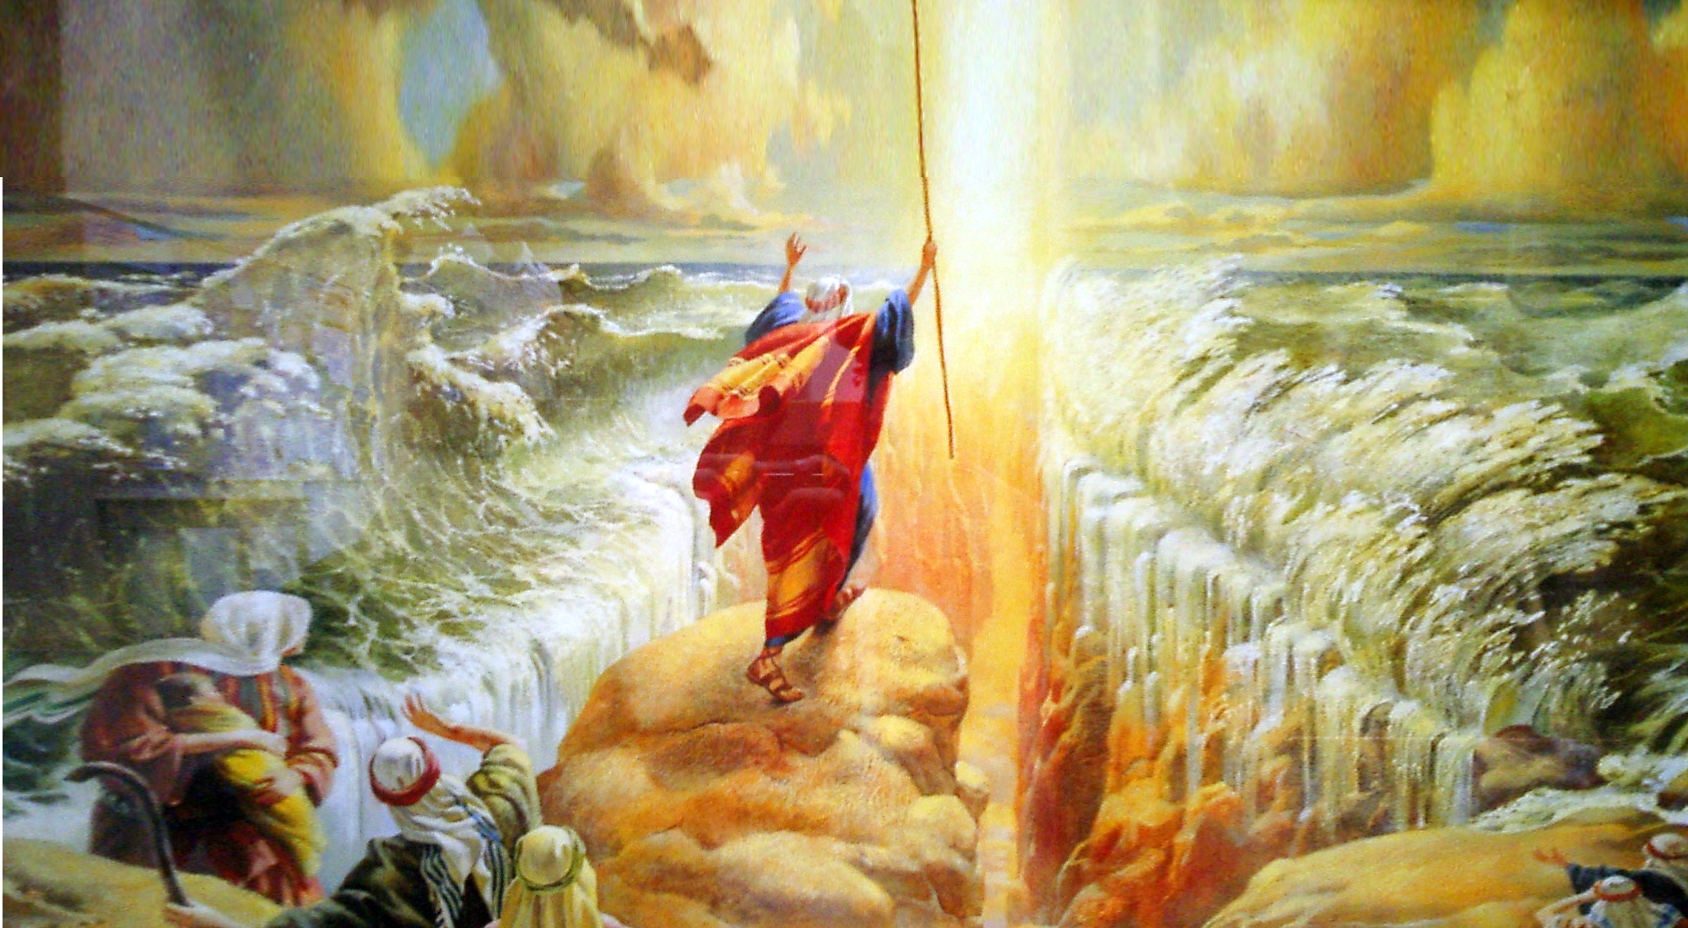
“... Stand still, and see the salvation of the LORD, which He will accomplish for you today.” (Exodus 14:13 NKJ)
Notes:
Parting Red Sea = FREE = https://www.flickr.com/photos/bjornb/6503847

Slide 7
In order to experience God’s Déjà Vu SUCCESS you must ...
God’s Road to
God’s Road to
God’s Road to
SUCCESS
may seem like “Déjà Vu”
may seem like “Déjà Vu”
and How to Find It

Slide 8
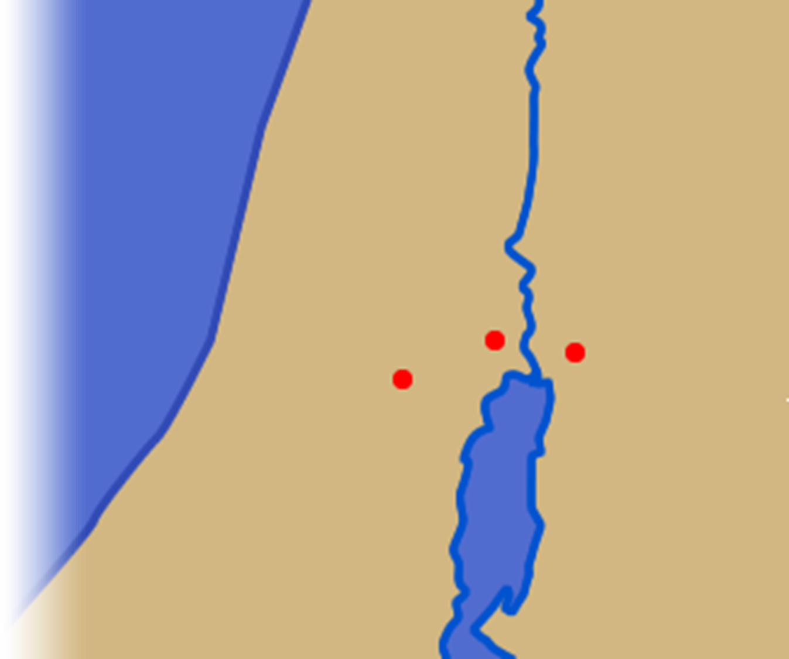
Follow God’s Lead 3:1-4
Jordan River
^{3:1} Early in the morning Joshua and all the Israelites set out from Shittim and went to the Jordan, where they camped before crossing over.
Jericho
Shittim
Jerusalem

Slide 9
Follow God’s Lead 3:1-4
Jordan River
^{3:1} Early in the morning Joshua and all the Israelites set out from Shittim and went to the Jordan, where they camped before crossing over.
Jericho
Shittim
Jerusalem

Slide 10
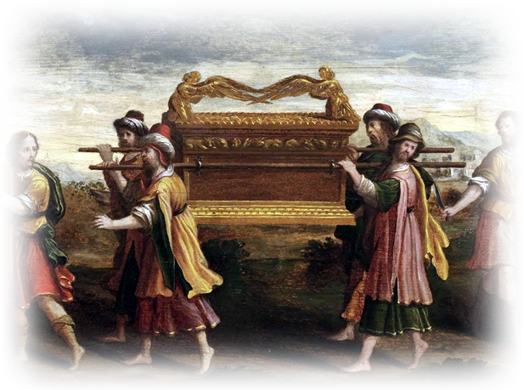
Follow God’s Lead 3:1-4
Jordan River
² After three days the officers went throughout the camp, ³ giving orders ... : "When you see the ark of the covenant of the LORD your God, and the priests, who are Levites, carrying it, you are to move out from your positions and follow it.
Jericho
Shittim
Jerusalem
Notes:
Ark of the Covenant = FREE = https://upload.wikimedia.org/wikipedia/commons/2/2d/Cembalodeckel_%C3%9Cberf%C3%BChrung_der_Bundeslade_c1600.jpg
Nothing has really changed—when you see God leading, follow it.
How does He lead? By His Holy Spirit—
He guides -- ¹³ But when he, the Spirit of truth, comes, he will guide you into all truth. (Joh 16:13 NIV)
He leads-- The Spirit himself bears witness with our spirit that we are children of God, (Rom 8:16 ESV)
He convicts -- When he comes, he will convict the world of guilt in regard to sin and righteousness and judgment: (Joh 16:8 NIV)
He teaches --But the Helper, the Holy Spirit, whom the Father will send in my name, he will teach you all things and bring to your remembrance all that I have said to you. (Joh 14:26 ESV)
He bears witness-- The Spirit himself bears witness with our spirit that we are children of God, (Rom 8:16 ESV)
You know in the heart of your heart when God is speaking to you and pointing to you what you need to do—it is always in harmony with His Word and Righteousness.

Slide 11
Consecrate Yourself 3:5-7
⁵ Joshua told the people, "Consecrate yourselves, for tomorrow the LORD will do amazing things among you."
Notes:
Consecrate = “set apart and dedicate to God” = be HOLY!
From the beginning God wanted a holy people–
I am the LORD your God; consecrate yourselves and be holy, because I am holy. Do not make yourselves unclean by any creature that moves about on the ground. (Lev 11:44 NIV)
I am the LORD who brought you up out of Egypt to be your God; therefore be holy, because I am holy. (Lev 11:45 NIV)
Speak to the entire assembly of Israel and say to them: 'Be holy because I, the LORD your God, am holy. (Lev 19:2 NIV)
'Consecrate yourselves and be holy, because I am the LORD your God. (Lev 20:7 NIV)
You are to be holy to me because I, the LORD, am holy, and I have set you apart from the nations to be my own. (Lev 20:26 NIV)
He still wants a “holy people”
To the church of God in Corinth, to those sanctified in Christ Jesus and called to be holy, (1Co 1:2 NIV)
For he chose us in him before the creation of the world to be holy a (Eph 1:4 NIV)
But just as he who called you is holy, so be holy in all you do; (1Pe 1:15 NIV)
or it is written: "Be holy, because I am holy." (1Pe 1:16 NIV)

Slide 12
Consecrate Yourself 3:5-7
⁶ Joshua said to the priests, "Take up the ark of the covenant and pass on ahead of the people." So they took it up and went ahead of them.
Notes:
Once consecrated then take up the cross as they took up the ark
After they had purified themselves and made themselves holy before the Lord – they took it up.

Slide 13
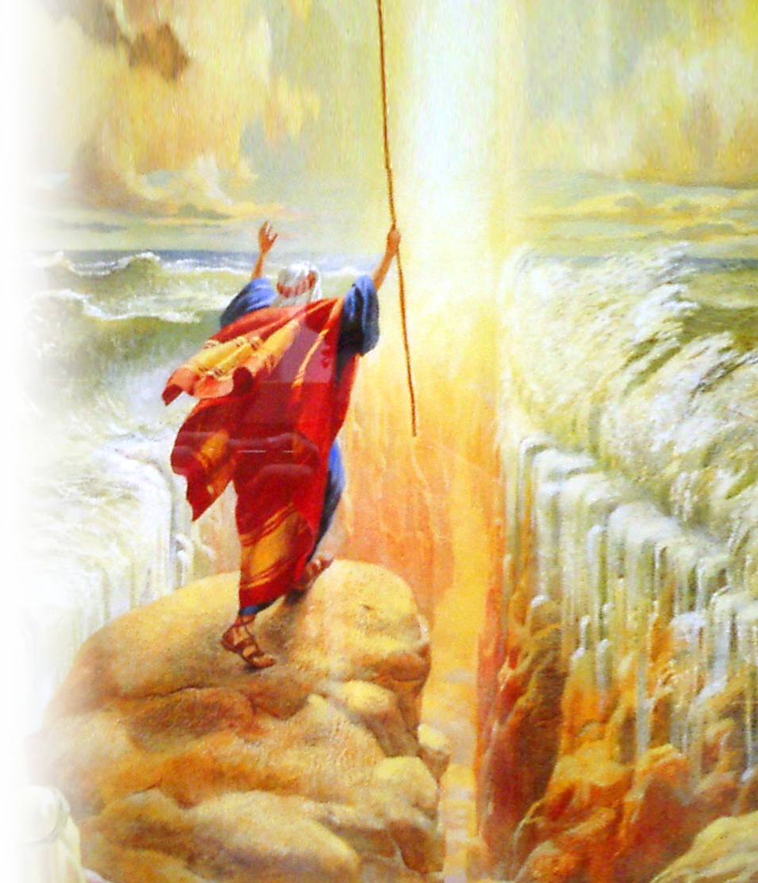
Consecrate Yourself 3:5-7
⁷ And the LORD said to Joshua, "Today I will begin to exalt you in the eyes of all Israel, so they may know that I am with you as I was with Moses.
Notes:
God was with Moses in a Pillar of Cloud and parted the Red Sea – here God was with Joshua without the pillar of cloud.
Listen, the features of the event are very similar –Déjà Vu like—but still unique. Instead of a cloud – the ark of the covenant represented God’s presence.

Slide 14
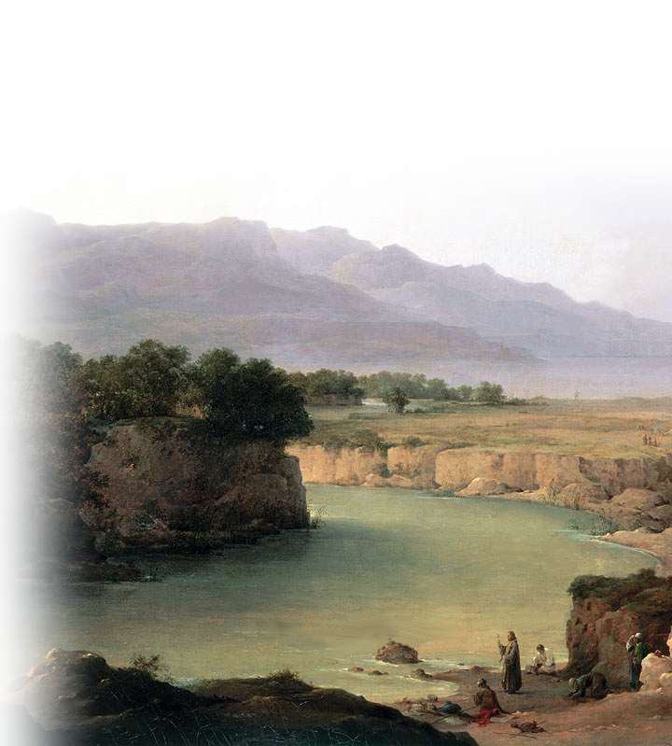
Step Out and Stand Still 3:8
⁸ Tell the priests who carry the ark of the covenant: 'When you reach the edge of the Jordan's waters, go and stand in the river.' "
Notes:
Moses said “stand still and see the salvation of God.
You too need to step out in faith and stand still (rely on that) in faith in Jesus Christ to see Jesus move into action in our life.
Crossing the Jordan is a picture of leaving Egypt and all your wandering in the wilderness behind and claiming the promise and possessing it –claiming all the blessings God has for us.
But it takes a step of faith. Here, they are told to take the step.

Slide 15
Listen to God’s Word 3:9
⁹ Joshua said to the Israelites, "Come here and listen to the words of the LORD your God.
Notes:
I cannot over emphasize the need to be in God’s Word.
Sanctify them by the truth; your word is truth. (Joh 17:17 NIV)

Slide 16
Expect the Miraculous 3:10-13
¹⁰ This is how you will know that the living God is among you and that he will certainly drive out before you the Canaanites, Hittites, Hivites, Perizzites, Girgashites, Amorites and Jebusites.

Slide 17
Expect the Miraculous 3:10-13
¹⁰ This is how you will know that the living God is among you and that he will certainly drive out before you the Canaanites, Hittites, Hivites, Perizzites, Girgashites, Amorites and Jebusites. ¹¹ See, the ark of the covenant of the Lord of all the earth will go into the Jordan ahead of you.

Slide 18
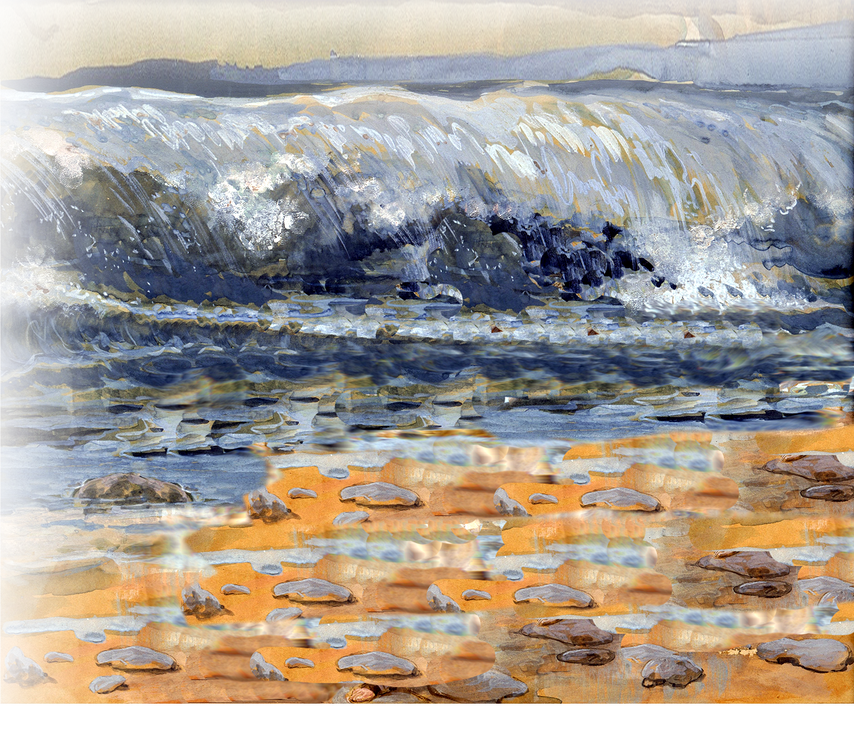
Expect the Miraculous 3:10-13
... ¹³ And as soon as the priests who carry the ark of the LORD--the Lord of all the earth--set foot in the Jordan, its waters flowing downstream will be cut off and stand up in a heap."
Notes:
https://eyeofprophecy.files.wordpress.com/2015/06/jordan-crossing.jpg
When you step out in faith, God will do the miraculous. But not until you step out in faith.

Slide 19
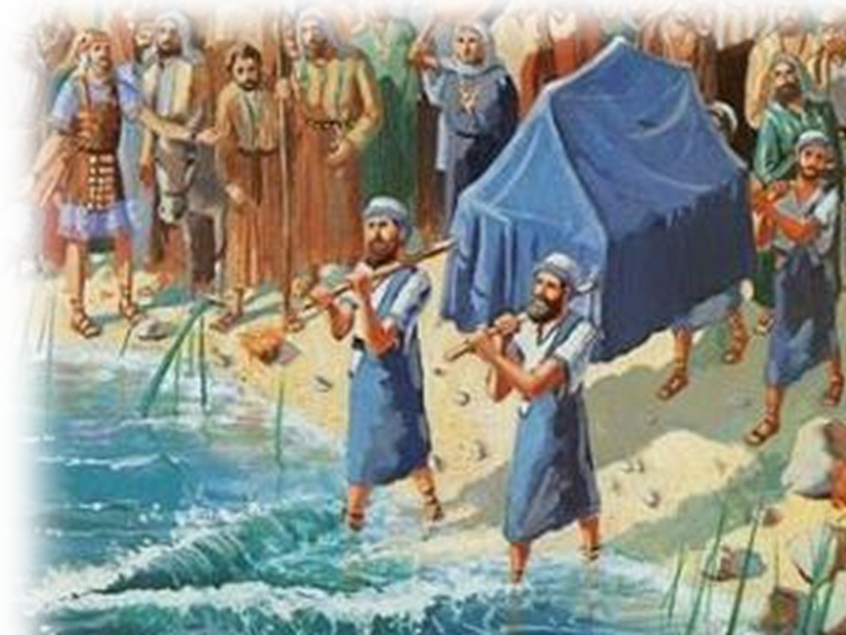
Go Forward 3:14-16
¹⁴ So ... the priests carrying the ark of the covenant went ahead of them. ¹⁵ Now the Jordan is at flood stage all during harvest. Yet as soon as the priests who carried the ark reached the Jordan and their feet touched the water's edge,
Notes:
https://eyeofprophecy.files.wordpress.com/2015/06/jordan-crossing.jpg
They went forward—you must too.

Slide 20
Go Forward 3:14-16
¹⁶ the water from upstream stopped flowing. It piled up in a heap a great distance away, at a town called Adam in the vicinity of Zarethan, while the water flowing down to the Sea of the Arabah (the Salt Sea) was completely cut off.
So the people crossed over opposite Jericho.
Notes:
Water a& sand = FREE = https://pixabay.com/en/ocean-girl-walking-sea-summer-931776/

Slide 21
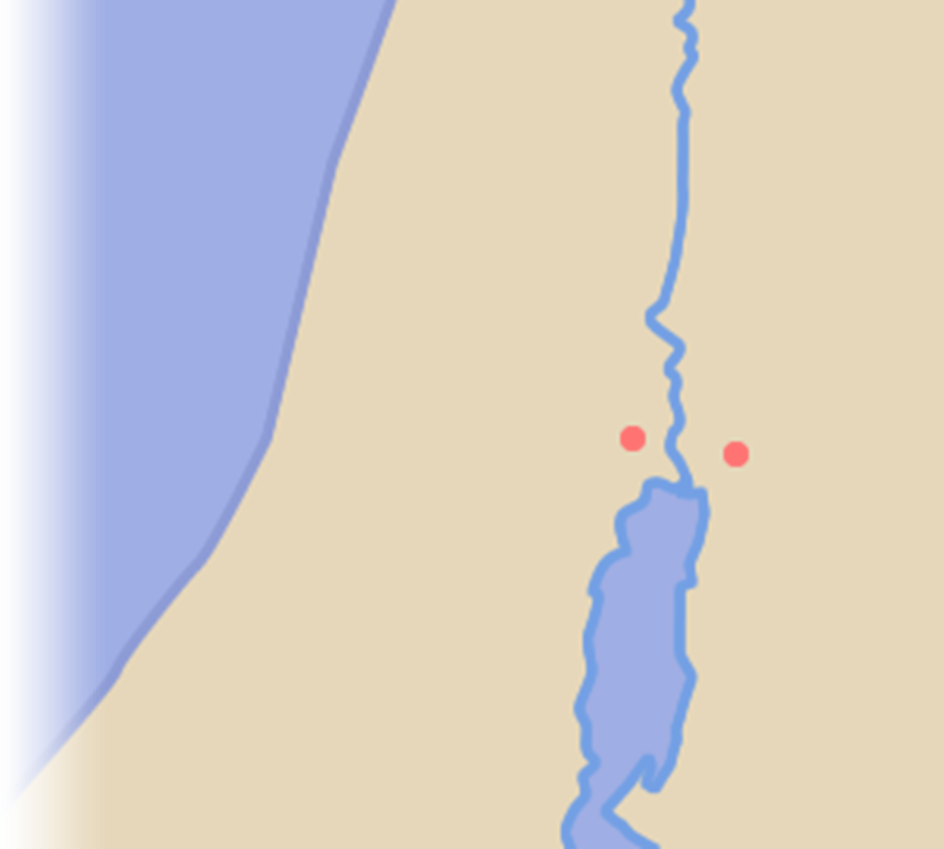
Go Forward 3:14-16
Jordan River
¹⁶ the water from upstream stopped flowing. It piled up in a heap a great distance away, at a town called Adam in the vicinity of Zarethan, while the water flowing down to the Sea of the Arabah (the Salt Sea) was completely cut off.
So the people crossed over opposite Jericho.
Adam
Jericho
Shittim
Notes:
Water a& sand = FREE = https://pixabay.com/en/ocean-girl-walking-sea-summer-931776/

Slide 22
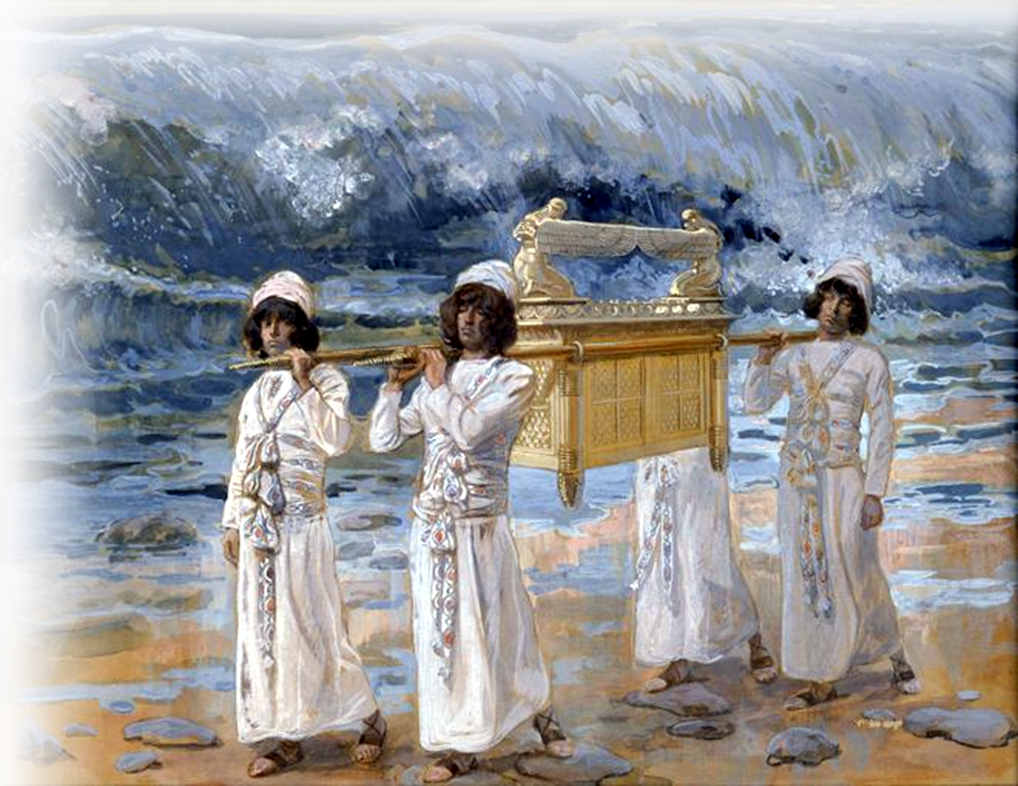
That’s experiencing God’s Success!
¹⁷ The priests who carried the ark of the covenant of the LORD stood firm on dry ground in the middle of the Jordan, while all Israel passed by until the whole nation had completed the crossing on dry ground.

Slide 23
That’s experiencing God’s Success!
^{4:23} For the LORD your God dried up the Jordan before you until you had crossed over. The LORD your God did to the Jordan just what he had done to the Red Sea when he dried it up before us until we had crossed over.

Slide 24
That’s How you experience God’s
^{4:23} For the LORD your God dried up the Jordan before you until you had crossed over. The LORD your God did to the Jordan just what he had done to the Red Sea when he dried it up before us until we had crossed over.

Slide 25
Now that was God’s Déjà Vu Success!

Slide 26
Now that was God’s Déjà Vu Success!

Slide 27
Now that was God’s Déjà Vu Success!
That day the LORD exalted Joshua in the sight of all Israel; and they revered him all the days of his life, just as they had revered Moses. 4:14

Slide 28
That’s Experiencing God’s Success!
Remember it ...

Slide 29
That’s Experiencing God’s Success!
Remember it ...
^{Jos 4:1} ... the Lord said ... ³ “... tell them to take up twelve stones from the middle of the Jordan ... and to carry them over with you and put them down at the place where you stay tonight.”

Slide 30
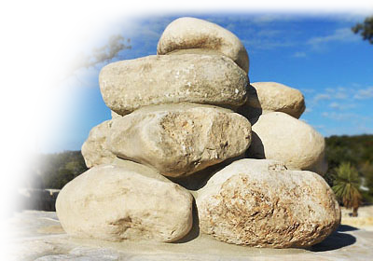
That’s Experiencing God’s Success!
Remember it ...
^{Jos 4:1} ... the Lord said ... ³ “... tell them to take up twelve stones from the middle of the Jordan ... and to carry them over with you and put them down at the place where you stay tonight.”

Slide 31
That’s Experiencing God’s Success!
Remember it ...
In the future, when your children ask you, 'What do these stones mean?‘ .... Tell them that the flow of the Jordan was cut off .... These stones are to be a memorial to the people of Israel forever."

Slide 32
Here’s the point ...
⁴ For everything that was written in the past was written to teach us, so that through endurance and the encouragement of the Scriptures we might have hope. (Romans 15:4)

Slide 33
Here’s the point ...
¹¹ These things happened to them as examples and were written down as warnings for us, on whom the fulfillment of the ages has come. (1Cor 10:11)

Slide 34
Here’s the point ...
What He has done in the past – He can repeat at any time He chooses!

Slide 35
Here’s the point ...
What He has done in the past – He can repeat at any time He chooses!
³⁷ For nothing is impossible with God." (Luke 1:37)

Slide 36
God’s Road to
Let’s PRAY

