Slide 1
God’s Road to
God’s Road to
SUCCESS
IS AHEAD
Notes:
Https://pixabay.com/en/career-road-away-way-of-life-479578/
Copyright © 2006−2020. All rights reserved. Bible Point is a registered trademark of Dennis Henderson. All other trademarks acknowledged.
Bible Point contains graphics from Bible Point artists. These illustrations belong to Bible Point and the respective artists. You may use the designs and illustrations for graphical illustration of lessons free and without special permission, provided they are not used in any way that maligns the Christian faith. Furthermore, republication or production of any illustration by any other graphic service whether it be in book, in a machine-readable form, or in any other design resource is strictly prohibited. Furthermore, they cannot be duplicated or resold as any other form of publishing, clip art, or graphic resource.
So What does it mean? (A simple translations of the legal jargon)
So, if you don’t own the presentation(s), graphic(s), and text(s) how can you legally use them? The purchase of the license allows you to use all the images in the product. However, the actual ownership and copyright of the presentation(s), graphic(s), and text(s) remain the property of Bible Point and its licensors. If you had plans on using this product in your “for sale” work—think again!
License Agreement
Article 1: License Grant
All the graphics and text in Bible Point presentations (excluding quotes from the Bible and stated sources) are the intellectual and real property of Bible Point and its licensors, and is protected by law, including United States copyright laws and international treaties. Bible Point grants to you a license:
1. To use the presentation in a single church, single school, or single office of a Christian organization.
2. To make a single archival back-up copy of the program.
3. To modify the presentation(s) and merge with other presentations in a single church, school, or Christian organization.
4. To transfer to another party if that party agrees to accept the terms and conditions of this agreement, and you do not retain any copies of the presentation, whether printed, machine readable, modified, or merged form.
Article 2: Terms
This license is effective until terminated. You may terminate the license at any time by destroying the presentation(s), graphic(s), or text(s) together with all copies, modifications and merged portions in any form. Bible Point may terminate your license if you fail to comply with this Agreement. You agree, upon such termination, for any reason, to destroy the presentation(s), graphics, and text(s) with all copies, modifications, and merged portions in any form.
Article 3: Disclaimers
1. Bible Point presentations, graphics, and texts are licensed to you As Is. You, the consumer, bear the entire risk relating to the quality and performance of the presentation(s), graphic(s), or text(s). In no event will Bible Point be liable for damages resulting from any defect.
2. Thirty-day limited warrantee on disks. Bible Point warrants the disks to be free of defects in material and workmanship under normal use for 30 days after purchase. During the 30-day period you may return a defective presentation, graphic, or text with proof of purchase and it will be replaced without charge, unless the presentation is damaged by misuse.
Article 4: General
1. You may not sub-license, assign, or transfer the license of the presentation(s), graphic(s), or text(s) except as provided by this Agreement.
2. This Agreement will be governed by the laws of the State of Michigan.
So What does it mean? (A simple translations of the legal jargon)
May I let someone borrow or copy my licensed Bible Point presentation (even after I modified it)? As long as it is within your local church, or single school, or the immediate office of a Christian organization you may. Otherwise, please refer the person interested in borrowing to: http://www.biblepoint.com or E-mail: biblepoint@comcast.net with any related questions.

Slide 2
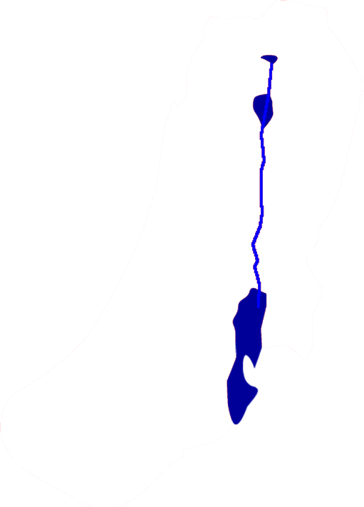
A little Background
The Successful Strategy so far ...
Notes:
Review

Slide 3
A little Background
The Successful Strategy so far ...
1. Cut through middle of land 3-8

Slide 4
A little Background
The Successful Strategy so far ...
1. Cut through middle of land 3-8
2. Southern campaign 9-10

Slide 5
A little Background
The Successful Strategy so far ...
1. Cut through middle of land 3-8
2. Southern campaign 9-10
3. Norther Campaign 11-13

Slide 6
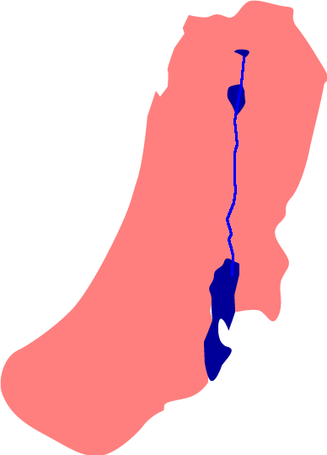
A little Background
The Successful Strategy so far ...
1. Cut through middle of land 3-8
2. Southern campaign 9-10
3. Norther Campaign 11-13
4. Now to Allot the Land 14-22
Notes:
Now not all the inhabitants had been eliminated – however, Israel controlled the entire land of Canaan. It was now time for them to allot the land and finish the conquest.
Kind of like “getting saved” is not all there is to being a Christian—it is living a successful Christian life after you get saved.
They were now to take possession of their allotted territories—they were to root out the World, Flesh and Devil occupied by the pagans just as we are today.
Success comes from a certain kind of believer ... One like Joshua and Caleb – especially Caleb.

Slide 7
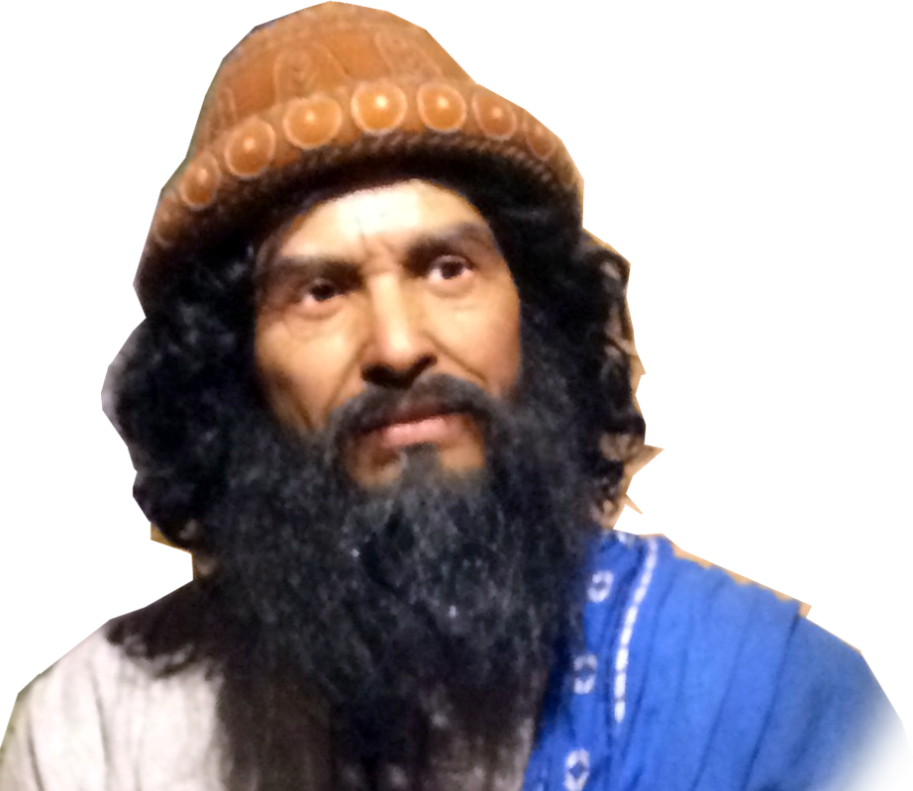
A little Background
The Successful Strategy so far ...
1. Cut through middle of land 3-8
2. Southern campaign 9-10
3. Norther Campaign 11-13
4. Now to Allot the Land 14-22
Farewell address 23-24
Notes:
Now not all the inhabitants had been eliminated – however, Israel controlled the entire land of Canaan. It was now time for them to allot the land and finish the conquest.
Kind of like “getting saved” is not all there is to being a Christian—it is living a successful Christian life after you get saved.
They were not to take possession of their allotted territories—they were to root out the World, Flesh and Devil occupied by the pagans just as we are today.
Success comes from a certain kind of believer ... One like Joshua and Caleb – especially Caleb.

Slide 8
God’s Road to
God’s Road to
SUCCESS
rewards those who are “All In”
and How to Find It
Notes:
https://pixabay.com/en/career-road-away-way-of-life-479578/

Slide 9
“All In” really means: Wholehearted”
Notes:
http://res.freestockphotos.biz/originals/12/12922-illustration-of-a-red-heart-isolated-on-a-transparent-background-or.png
Not half-hearted,
Not a faint heart,
Not a weak heart,
Not a hard heart, Not a soft heart,
Not a cold heart,
But a WHOLEHEARTED allegiance to the Lord
Like in the movies, the poker hand comes time to ante up – you sit at the table because you are betting on your good hand—you push all you have into the table and say, “I’m all in.” I’m holding nothing back.
That’s what Caleb did – not with his stuff—but with his life. “All-in”
In NT “Love the Lord your God with all your heart”

Slide 10
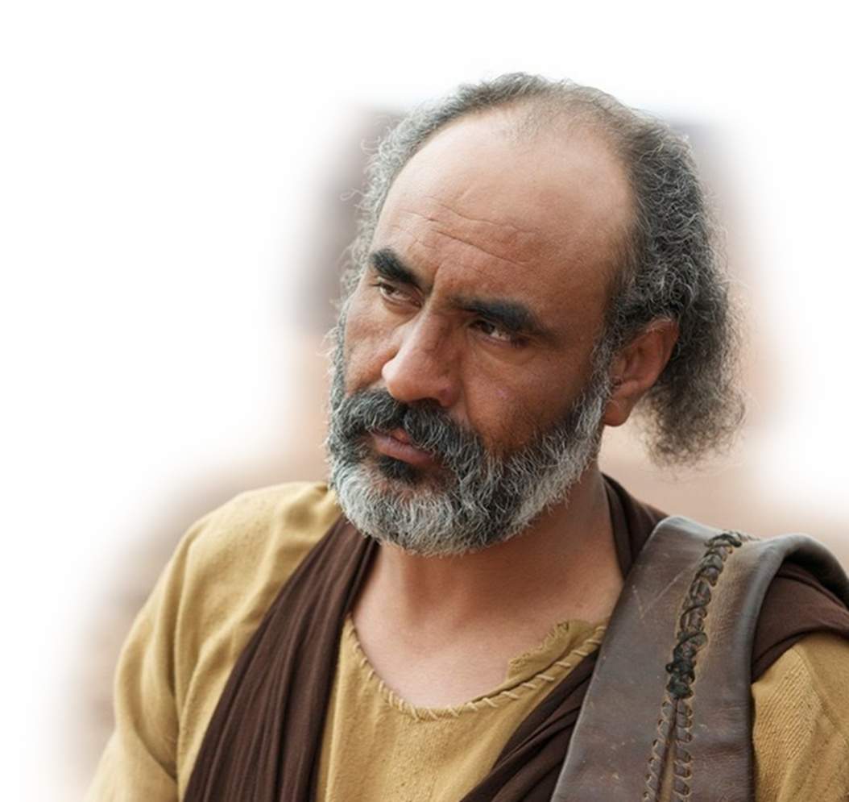
“All In” really means: Wholehearted”
Caleb’s “Wholehearted” devotion is mentioned six times:
Notes:
http://res.freestockphotos.biz/originals/12/12922-illustration-of-a-red-heart-isolated-on-a-transparent-background-or.png

Slide 11
“All In” really means: Wholehearted”
Caleb’s “Wholehearted” devotion is mentioned six times:
Num 14:24; 32:11-12;
Notes:
http://res.freestockphotos.biz/originals/12/12922-illustration-of-a-red-heart-isolated-on-a-transparent-background-or.png
²⁴ But because my servant Caleb has a different spirit and follows me [1} wholeheartedly, I will bring him into the land he went to, and his descendants will inherit it. (Num 14:24 NIV)
¹¹ 'Because they have not followed me wholeheartedly, not one of the men twenty years old or more who came up out of Egypt will see the land I promised on oath to Abraham, Isaac and Jacob-- ¹² not one except Caleb son of Jephunneh the Kenizzite and Joshua son of Nun, for they followed the LORD [2] wholeheartedly.' (Num 32:11-12 NIV)
But a WHOLEHEARTED allegiance to the Lord
In NT “Love the Lord your God with all your heart”

Slide 12
“All In” really means: Wholehearted”
Caleb’s “Wholehearted” devotion is mentioned six times:
Num 14:24; 32:11-12; Dt 1:36
Notes:
http://res.freestockphotos.biz/originals/12/12922-illustration-of-a-red-heart-isolated-on-a-transparent-background-or.png
³⁵ "Not a man of this evil generation shall see the good land I swore to give your forefathers,
³⁶ except Caleb son of Jephunneh. He will see it, and I will give him and his descendants the land he set his feet on, because he followed the LORD [3] wholeheartedly." (Deu 1:35-36 NIV)

Slide 13
“All In” really means: Wholehearted”
Caleb’s “Wholehearted” devotion is mentioned six times:
Num 14:24; 32:11-12; Dt 1:36 Josh 14:8, 9, 14
Notes:
http://res.freestockphotos.biz/originals/12/12922-illustration-of-a-red-heart-isolated-on-a-transparent-background-or.png
⁸ but my brothers who went up with me made the hearts of the people melt with fear. I, however, followed the LORD my God [4] wholeheartedly. (Jos 14:8 NIV)
⁹ So on that day Moses swore to me, 'The land on which your feet have walked will be your inheritance and that of your children forever, because you have followed the LORD my God [5] wholeheartedly.' (Jos 14:9 NIV)
¹⁴ So Hebron has belonged to Caleb son of Jephunneh the Kenizzite ever since, because he followed the LORD, the God of Israel, [6] wholeheartedly. (Jos 14:14 NIV)

Slide 14
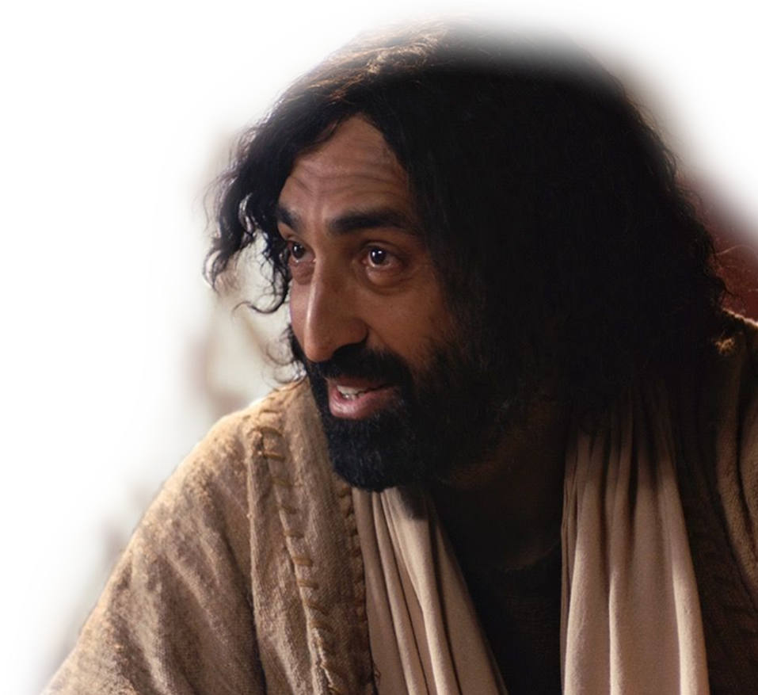
“All In” really means: Wholehearted”
Caleb’s “Wholehearted” devotion is mentioned six times:
Num 14:24; 32:11-12; Dt 1:36 Josh 14:8, 9, 14
“Love the Lord your God with all your heart” --Jesus
Notes:
http://res.freestockphotos.biz/originals/12/12922-illustration-of-a-red-heart-isolated-on-a-transparent-background-or.png

Slide 15
“All In” may also mean “Against the Flow”
Notes:
https://eoimages.gsfc.nasa.gov/images/imagerecords/57000/57927/MiddleEast.A2002067.0830.500m.jpg
All In” may mean “Against the Flow” it did for Caleb

Slide 16
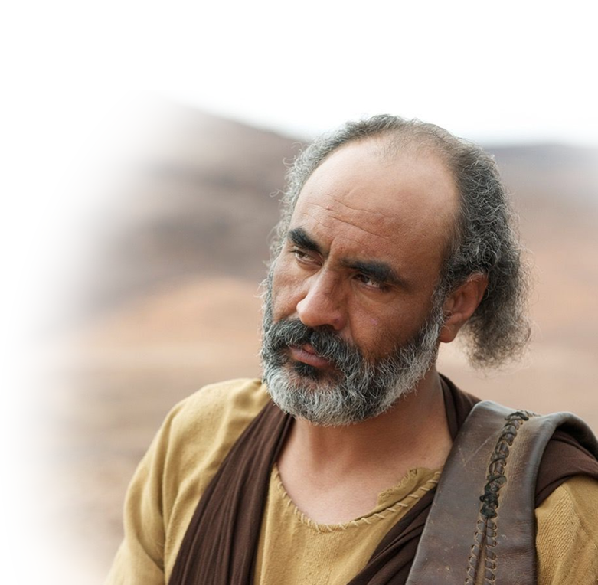
“All In” may also mean “Against the Flow”
^{14:6} Now ... Caleb ... said to him [Joshua],
"You know what the LORD said to Moses the man of God at Kadesh Barnea about you and me.
Notes:
https://eoimages.gsfc.nasa.gov/images/imagerecords/57000/57927/MiddleEast.A2002067.0830.500m.jpg
All In” may mean “Against the Flow” it did for Caleb

Slide 17
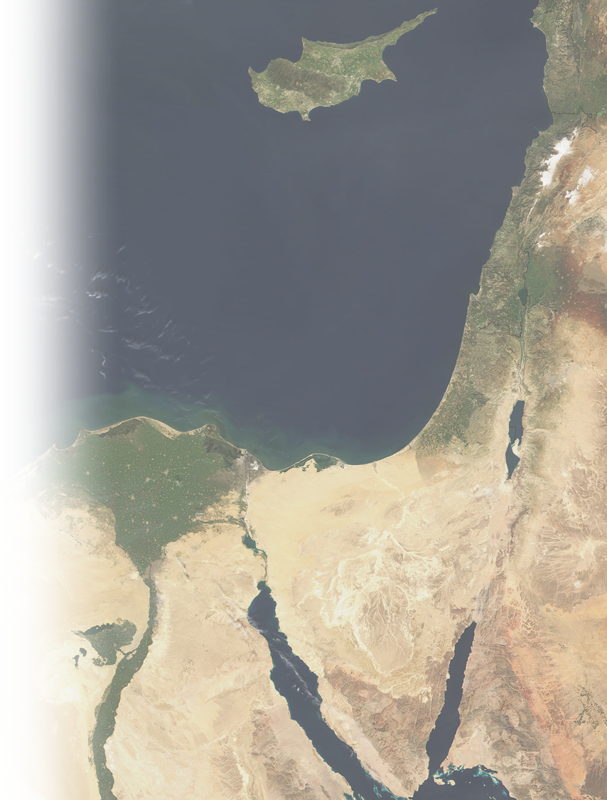
“All In” may also mean “Against the Flow”
⁷ I was forty years old when Moses the servant of the LORD sent me from Kadesh Barnea to explore the land. And I brought him back a report according to my convictions,
Notes:
All In” may mean “Against the Flow” it did for Caleb

Slide 18
“All In” may also mean “Against the Flow”
⁷ I was forty years old when Moses the servant of the LORD sent me from Kadesh Barnea to explore the land. And I brought him back a report according to my convictions,
Notes:
All In” may mean “Against the Flow” it did for Caleb

Slide 19
“All In” may also mean “Against the Flow”
⁷ I was forty years old when Moses the servant of the LORD sent me from Kadesh Barnea to explore the land. And I brought him back a report according to my convictions,
Notes:
All In” may mean “Against the Flow” it did for Caleb

Slide 20
“All In” may also mean “Against the Flow”
⁷ I was forty years old when Moses the servant of the LORD sent me from Kadesh Barnea to explore the land. And I brought him back a report according to my convictions,
Notes:
All In” may mean “Against the Flow” it did for Caleb
It was hard to stand for his convictions—10 against 2.
It is hard to stand for your convictions now—regarding faith, Bible, theological issues on gender, sexual orientation, marriage, family, drugs, etc.

Slide 21
“All In” may also mean “Against the Flow”
⁸ but my brothers who went up with me made the hearts of the people melt with fear. I, however, followed the LORD my God wholeheartedly.
Notes:
All In” may mean “Against the Flow” it did for Caleb
²² not one of the men who saw my glory and the miraculous signs I performed in Egypt and in the desert but who disobeyed me and tested me ten times-- (Num 14:22 NIV)
They discouraged the people—Warning to you who would discourage the people of God—They were cut off short of the promised land.
There are consequences for opposing the work of God.

Slide 22
“All In” may also mean “Against the Flow”
⁸ but my brothers who went up with me made the hearts of the people melt with fear. I, however, followed the LORD my God wholeheartedly.
Notes:
All In” may mean “Against the Flow” it did for Caleb
I went against he flow– the flow all perished in the wilderness // the wide and narrow gate.
Caleb and Joshua were the only ones to go against the flow then, but they are not alone. Daniel did so in Dan 1, Shadrach, Meshach, and Abednego went against the flow in Dan 3
We have to go against he flow too. Against the politically correct. God spells out for us how to live—and it is not like the world.
We know our gender, we know what marriage is, we know when life begins, we know what good and evil is, because God told us! As the Creator He knows what he made us for.
²¹ For although they knew God, they neither glorified him as God nor gave thanks to him, but their thinking became futile and their foolish hearts were darkened.
²² Although they claimed to be wise, they became fools
²³ and exchanged the glory of the immortal God for images made to look like mortal man and birds and animals and reptiles.
²⁴ Therefore God gave them over in the sinful desires of their hearts to sexual impurity for the degrading of their bodies with one another.
²⁵ They exchanged the truth of God for a lie, and worshiped and served created things rather than the Creator--who is forever praised. Amen.
²⁶ Because of this, God gave them over to shameful lusts. Even their women exchanged natural relations for unnatural ones.
²⁷ In the same way the men also abandoned natural relations with women and were inflamed with lust for one another. Men committed indecent acts with other men, and received in themselves the due penalty for their perversion.
²⁸ Furthermore, since they did not think it worthwhile to retain the knowledge of God, he gave them over to a depraved mind, to do what ought not to be done.
²⁹ They have become filled with every kind of wickedness, evil, greed and depravity. They are full of envy, murder, strife, deceit and malice. They are gossips,
³⁰ slanderers, God-haters, insolent, arrogant and boastful; they invent ways of doing evil; they disobey their parents;
³¹ they are senseless, faithless, heartless, ruthless.
³² Although they know God's righteous decree that those who do such things deserve death, they not only continue to do these very things but also approve of those who practice them.
(Rom 1:21-32 NIV)
We go against our culture just as Caleb did in his day—we wholeheartedly follow the Lord.

Slide 23
“All in” may also mean for a Long Time
Notes:
“All in” may mean for 45 years, it did for Caleb

Slide 24
“All in” may also mean for a Long Time
⁷ I was forty years old ...
40 years old
Notes:
“All in” may mean for 45 years, it did for Caleb

Slide 25
“All in” may also mean for a Long Time
⁷ I was forty years old ...
¹⁰ .... So here I am today, eighty-five years old!
85 years old
40 years old
Notes:
“All in” may mean for 45 years, it did for Caleb
With the possible exception of Joshua, Caleb is the oldest man alive in the Israel nation!!!!

Slide 26
“All in” may also mean for a Long Time
⁷ I was forty years old ...
¹⁰ .... So here I am today, eighty-five years old!
¹¹ I am still as strong today as the day Moses sent me out; ...
85 years old
-
40 years old
=
45 years old
Notes:
“All in” may mean for 45 years, it did for Caleb
I don’t know how long it will be for God either to bring a revival or to return to take us out of this mess. But until He does, I will serve and worship Him with a whole heart.

Slide 27
“All In” may also mean “Battling Uphill”
Notes:
“All In” may mean “Battling Uphill” it did for Caleb

Slide 28
“All In” may also mean “Battling Uphill”
I'm just as vigorous to go out to battle now as I was then.
Notes:
“All In” may mean “Battling Uphill” it did for Caleb

Slide 29
“All In” may also mean “Battling Uphill”
I'm just as vigorous to go out to battle now as I was then.
¹² Now give me this hill country that the LORD promised me that day.
Notes:
“All In” may mean “Battling Uphill” it did for Caleb
Rather than retire, Caleb wants to show the youngin’s how it is done. He is the example even to us of “wholehearted commitment.”
This Hill refers to the region of Hebron = All the people we saw there are of great size. ³³ We saw the Nephilim there (the descendants of Anak come from the Nephilim). We seemed like grasshoppers in our own eyes, and we looked the same to them." (Num 13:32-33 NIV)

Slide 30
“All In” may also mean “Fighting Giants”
Notes:
http://biblegems-pastorcoleman.blogspot.com/2016/03/giantsmyth-or-history.html
“All In” may mean “Fighting Giants” it did for Caleb
He wants the action. Story of Will Till at first church—In his 70’s riding motor-cycle to church—Cancer survivior—wanted the young married class, not the old people. “Old people’s minds were made up, I want to shape the minds of the future for God!”

Slide 31
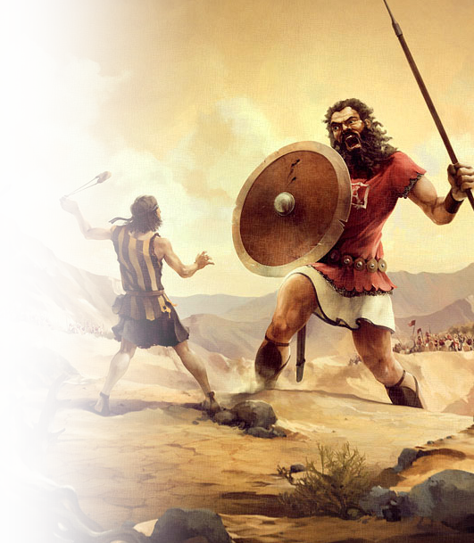
“All In” may also mean “Fighting Giants”
¹² You yourself heard then that the Anakites were there and their cities were large and fortified, but, the LORD helping me, I will drive them out just as he said.“ .... ¹⁵ (Hebron used to be called Kiriath Arba after Arba, who was the greatest man among the Anakites.)
Notes:
http://biblegems-pastorcoleman.blogspot.com/2016/03/giantsmyth-or-history.html
“All In” may mean “Fighting Giants” it did for Caleb
All the people we saw there are of great size.
³³ We saw the Nephilim there (the descendants of Anak come from the Nephilim). We seemed like grasshoppers in our own eyes, and we looked the same to them." (Num 13:32-33 NIV)
He wants the action. Story of Will Till at first church—In his 70’s riding motor-cycle to church—Cancer survivior—wanted the young married class, not the old people. “Old people’s minds were made up, I want to shape the minds of the future for God!”

Slide 32
“All In” may also mean “Fighting Giants”
¹² You yourself heard then that the Anakites were there and their cities were large and fortified, but, the LORD helping me, I will drive them out just as he said.“ .... ¹⁵ (Hebron used to be called Kiriath Arba after Arba, who was the greatest man among the Anakites.)
Notes:
“All In” may mean “Fighting Giants” it did for Caleb
²⁸ But the people who live there are powerful, and the cities are fortified and very large. We even saw descendants of Anak there. (Num 13:28 NIV)

Slide 33
“All In” may also mean “Fighting Giants”
¹² You yourself heard then that the Anakites were there and their cities were large and fortified, but, the LORD helping me, I will drive them out just as he said.“ .... ¹⁵ (Hebron used to be called Kiriath Arba after Arba, who was the greatest man among the Anakites.)
Notes:
“All In” may mean “Fighting Giants” it did for Caleb
Forty years previously Caleb said:
³⁰ Then Caleb silenced the people before Moses and said, "We should go up and take possession of the land, for we can certainly do it."
³¹ But the men who had gone up with him said, "We can't attack those people; they are stronger than we are."
³² And they spread among the Israelites a bad report about the land they had explored. They said, "The land we explored devours those living in it. All the people we saw there are of great size.
³³ We saw the Nephilim there (the descendants of Anak come from the Nephilim). We seemed like grasshoppers in our own eyes, and we looked the same to them." (Num 13:30-1 NIV)
⁸ If the LORD is pleased with us, he will lead us into that land, a land flowing with milk and honey, and will give it to us. ⁹ Only do not rebel against the LORD. And do not be afraid of the people of the land, because we will swallow them up. Their protection is gone, but the LORD is with us. Do not be afraid of them." (Num 14:8-9 NIV)

Slide 34
“All In” may also mean “Fighting Giants”
¹³ Then Joshua blessed Caleb son of Jephunneh and gave him Hebron as his inheritance.
Notes:
“All In” may mean “Fighting Giants” it did for Caleb

Slide 35
“All In” will surely mean “Blessed Rest”
Notes:
“All In” WILL mean “Blessed Rest” it did for Caleb

Slide 36
“All In” will surely mean “Blessed Rest”
¹⁴ So Hebron has belonged to Caleb son of Jephunneh the Kenizzite ever since, because he followed the LORD, the God of Israel, wholeheartedly.
Notes:
“All In” WILL mean “Blessed Rest” it did for Caleb

Slide 37
“All In” will surely mean “Blessed Rest”
¹⁴ So Hebron has belonged to Caleb son of Jephunneh the Kenizzite ever since, because he followed the LORD, the God of Israel, wholeheartedly.
Notes:
“All In” WILL mean “Blessed Rest” it did for Caleb

Slide 38
“All In” will surely mean “Blessed Rest”
¹⁵ (Hebron used to be called Kiriath Arba after Arba, who was the greatest man among the Anakites.) Then the land had rest from war.
Notes:
“All In” WILL mean “Blessed Rest” it did for Caleb
“used to be” but not any more // 2 Cor 5:17 Old is gone the new has come!
Land used to be pagan, not since Caleb arrived, His wholehearted faith changed everything.
Like Saul, who became Paul, turned the world upside down.
You can be like both Caleb and Paul with wholeheartedly
Even the land “used to have war” but now has rest!

Slide 39
“All In” will surely mean “Blessed Rest”
¹⁵ (Hebron used to be called Kiriath Arba after Arba, who was the greatest man among the Anakites.) Then the land had rest from war.
Notes:
“All In” WILL mean “Blessed Rest” it did for Caleb
Land used to be pagan, not since Caleb arrived, His wholehearted faith changed everything.
Like Saul, who became Paul, turned the world upside down.
You can be like both Caleb and Paul with wholeheard

Slide 40
“All In” will surely mean “Final Success”

Slide 41
“All In” will surely mean “Final Success”
Judges 1:20
As Moses had promised, Hebron was given to Caleb, who drove from it the three sons of Anak.

Slide 42
Conclusion: The Key to Success
Caleb’s personal testimony:
⁸ I ... followed the LORD my God wholeheartedly.

Slide 43
Conclusion: The Key to Success
Caleb’s personal testimony:
⁸ I ... followed the LORD my God wholeheartedly.
Joshua’s testimony of him:
⁹ ... you ... followed the LORD ... wholeheartedly.

Slide 44
Conclusion: The Key to Success
Caleb’s personal testimony:
⁸ I ... followed the LORD my God wholeheartedly.
Joshua’s testimony of him:
⁹ ... you ... followed the LORD ... wholeheartedly.
The Word of God’s testimony of him:
¹⁴ ... he followed the LORD ... wholeheartedly.
Notes:
Does what you say, and what other say, and what God says about you match like the did for Caleb?
It’s only a question.

Slide 45
Conclusion: The Key to Success
Caleb’s personal testimony:
⁸ I ... followed the LORD my God wholeheartedly.
Joshua’s testimony of him:
⁹ ... you ... followed the LORD ... wholeheartedly.
The Word of God’s testimony of him:
¹⁴ ... he followed the LORD ... wholeheartedly.
Caleb was
“ALL IN!”

Slide 46
God’s Road to
He had God’s
SUCCESS
as rewards for being “ALL IN”
and How to Find It
Notes:
https://pixabay.com/en/career-road-away-way-of-life-479578/

Slide 47
God’s Road to
and How to Find It
YOU CAN TOO!
Notes:
https://pixabay.com/en/career-road-away-way-of-life-479578/

Slide 48
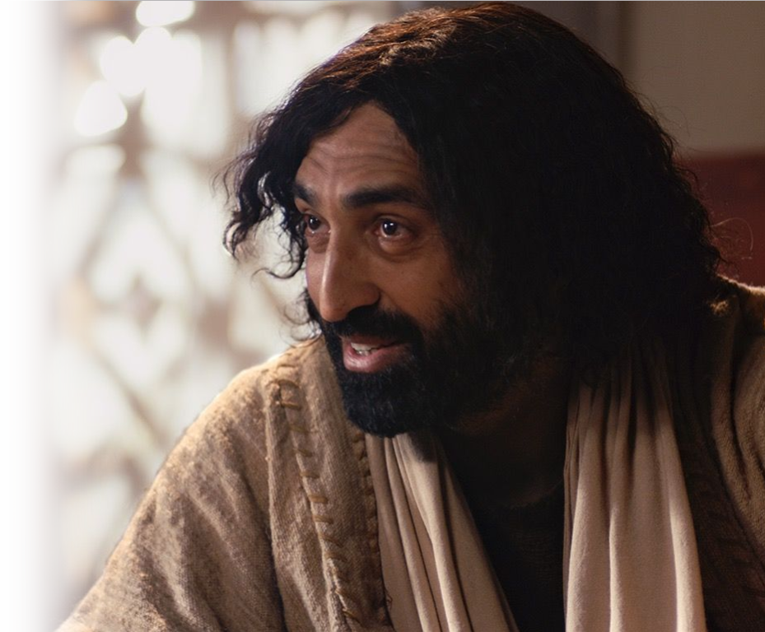
Jesus put “All In” like this ...
'Love the Lord your God with all your heart and with all your soul and with all your strength and with all your mind‘... (Luke 10:27)

Slide 49
God’s Road to
Let’s PRAY

Slide 50
A little Background to the Background
Joshua and Caleb had served as spies

