Slide 1
God’s Road to
God’s Road to
SUCCESS
Get’s Divine Assistance
and How to Find It
Notes:
Https://pixabay.com/en/career-road-away-way-of-life-479578/
Copyright © 2006−2020. All rights reserved. Bible Point is a registered trademark of Dennis Henderson. All other trademarks acknowledged.
Bible Point contains graphics from Bible Point artists. These illustrations belong to Bible Point and the respective artists. You may use the designs and illustrations for graphical illustration of lessons free and without special permission, provided they are not used in any way that maligns the Christian faith. Furthermore, republication or production of any illustration by any other graphic service whether it be in book, in a machine-readable form, or in any other design resource is strictly prohibited. Furthermore, they cannot be duplicated or resold as any other form of publishing, clip art, or graphic resource.
So What does it mean? (A simple translations of the legal jargon)
So, if you don’t own the presentation(s), graphic(s), and text(s) how can you legally use them? The purchase of the license allows you to use all the images in the product. However, the actual ownership and copyright of the presentation(s), graphic(s), and text(s) remain the property of Bible Point and its licensors. If you had plans on using this product in your “for sale” work—think again!
License Agreement
Article 1: License Grant
All the graphics and text in Bible Point presentations (excluding quotes from the Bible and stated sources) are the intellectual and real property of Bible Point and its licensors, and is protected by law, including United States copyright laws and international treaties. Bible Point grants to you a license:
1. To use the presentation in a single church, single school, or single office of a Christian organization.
2. To make a single archival back-up copy of the program.
3. To modify the presentation(s) and merge with other presentations in a single church, school, or Christian organization.
4. To transfer to another party if that party agrees to accept the terms and conditions of this agreement, and you do not retain any copies of the presentation, whether printed, machine readable, modified, or merged form.
Article 2: Terms
This license is effective until terminated. You may terminate the license at any time by destroying the presentation(s), graphic(s), or text(s) together with all copies, modifications and merged portions in any form. Bible Point may terminate your license if you fail to comply with this Agreement. You agree, upon such termination, for any reason, to destroy the presentation(s), graphics, and text(s) with all copies, modifications, and merged portions in any form.
Article 3: Disclaimers
1. Bible Point presentations, graphics, and texts are licensed to you As Is. You, the consumer, bear the entire risk relating to the quality and performance of the presentation(s), graphic(s), or text(s). In no event will Bible Point be liable for damages resulting from any defect.
2. Thirty-day limited warrantee on disks. Bible Point warrants the disks to be free of defects in material and workmanship under normal use for 30 days after purchase. During the 30-day period you may return a defective presentation, graphic, or text with proof of purchase and it will be replaced without charge, unless the presentation is damaged by misuse.
Article 4: General
1. You may not sub-license, assign, or transfer the license of the presentation(s), graphic(s), or text(s) except as provided by this Agreement.
2. This Agreement will be governed by the laws of the State of Michigan.
So What does it mean? (A simple translations of the legal jargon)
May I let someone borrow or copy my licensed Bible Point presentation (even after I modified it)? As long as it is within your local church, or single school, or the immediate office of a Christian organization you may. Otherwise, please refer the person interested in borrowing to: http://www.biblepoint.com or E-mail: biblepoint@comcast.net with any related questions.

Slide 2
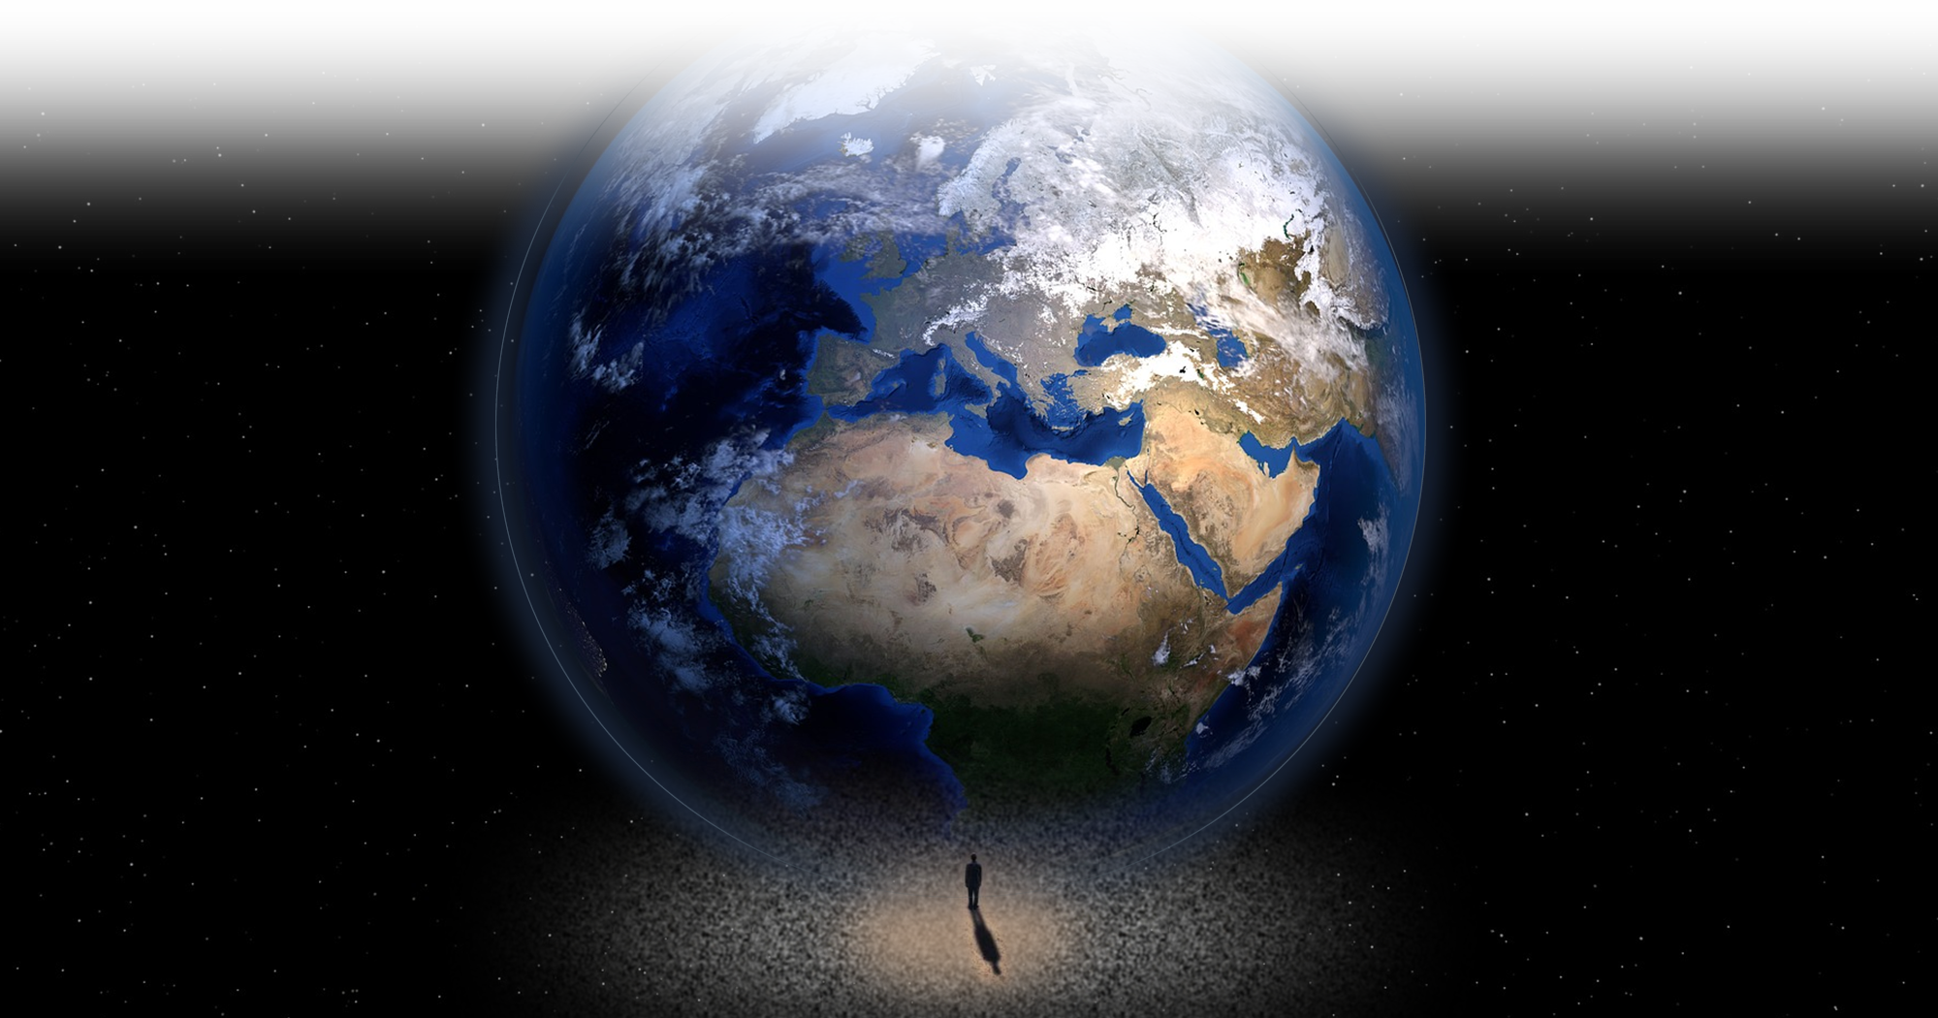
Ever felt: “The World is Against ME!”
Notes:
Earth = FREE = https://images.pexels.com/photos/87651/earth-blue-planet-globe-planet-87651.jpeg?w=1260&h=750&auto=compress&cs=tinysrgb

Slide 3
Ever felt: “The World is Against ME!”
If so, you need what Israel had ...

Slide 4
“... the Lord fought for Israel” 10:14

Slide 5
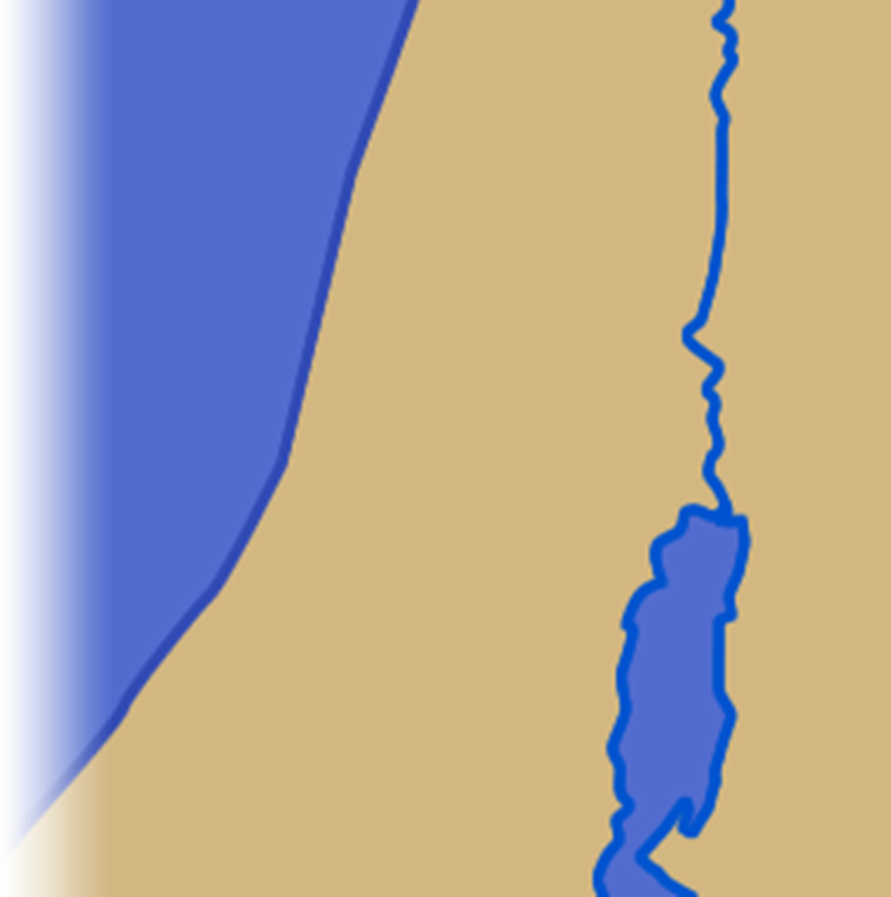
The world was against them ...
10:1 Now Adoni-Zedek king of Jerusalem heard that Joshua had taken Ai and totally destroyed it, ... and that the people of Gibeon had made a treaty of peace with Israel and were living near them. ² ... because Gibeon was an important city ...
Jerusalem

Slide 6
The world was against them ...
10:1 Now Adoni-Zedek king of Jerusalem heard that Joshua had taken Ai and totally destroyed it, ... and that the people of Gibeon had made a treaty of peace with Israel and were living near them. ² ... because Gibeon was an important city ...
Ai
Jerusalem

Slide 7
The world was against them ...
10:1 Now Adoni-Zedek king of Jerusalem heard that Joshua had taken Ai and totally destroyed it, ... and that the people of Gibeon had made a treaty of peace with Israel and were living near them. ² ... because Gibeon was an important city ...
Ai
Gibeon
Gilgal
Jerusalem

Slide 8
The world was against them ...
10:1 Now Adoni-Zedek king of Jerusalem heard that Joshua had taken Ai and totally destroyed it, ... and that the people of Gibeon had made a treaty of peace with Israel and were living near them. ² ... because Gibeon was an important city ...
Ai
Gibeon
Gilgal
Jerusalem

Slide 9
The world was against them ...
10:1 Now Adoni-Zedek king of Jerusalem heard that Joshua had taken Ai and totally destroyed it, ... and that the people of Gibeon had made a treaty of peace with Israel and were living near them. ² ... because Gibeon was an important city ...
Ai
Gibeon
Gilgal
Jerusalem

Slide 10
The world was against them ...
³ So Adoni-Zedek king of Jerusalem appealed to Hoham king of Hebron, Piram king of Jarmuth, Japhia king of Lachish and Debir king of Eglon.
Ai
Gibeon
Gilgal
Jerusalem
Hebron

Slide 11
The world was against them ...
³ So Adoni-Zedek king of Jerusalem appealed to Hoham king of Hebron, Piram king of Jarmuth, Japhia king of Lachish and Debir king of Eglon.
Ai
Gibeon
Gilgal
Jarmuth
Jerusalem
Hebron

Slide 12
The world was against them ...
³ So Adoni-Zedek king of Jerusalem appealed to Hoham king of Hebron, Piram king of Jarmuth, Japhia king of Lachish and Debir king of Eglon.
Ai
Gibeon
Gilgal
Jarmuth
Jerusalem
Lachish
Hebron

Slide 13
The world was against them ...
³ So Adoni-Zedek king of Jerusalem appealed to Hoham king of Hebron, Piram king of Jarmuth, Japhia king of Lachish and Debir king of Eglon.
Ai
Gibeon
Gilgal
Jarmuth
Jerusalem
Lachish
Eglon
Hebron

Slide 14
The world was against them ...
⁴ "Come up and help me attack Gibeon," he said, "because it has made peace with Joshua and the Israelites."
Ai
Gibeon
Gilgal
Jarmuth
Jerusalem
Lachish
Eglon
Hebron

Slide 15
The world was against them ...
⁵ Then the five kings of the Amorites ... joined forces. They moved up with all their troops and took up positions against Gibeon and attacked it.
Ai
Gibeon
Gilgal
Jarmuth
Jerusalem
Lachish
Eglon
Hebron

Slide 16
But Gibeon was Allied to Israel
^{9:15} Then Joshua made a treaty of peace with them to let them live, and the leaders of the assembly ratified it by oath. (Josh 9:15)
Ai
Gibeon
Gilgal
Jarmuth
Jerusalem
Lachish
Eglon
Hebron
Notes:
Compromise always carries a cost!

Slide 17
But Gibeon was Allied to Israel
^{9:19} "We have given them our oath by the LORD, the God of Israel, and we cannot touch them now. (Josh 9:19)
Ai
Gibeon
Gilgal
Jarmuth
Jerusalem
Lachish
Eglon
Hebron
Notes:
Compromise always carries a cost!

Slide 18
If you feel the world is against you ...

Slide 19
If you feel the world is against you ...
and you want the Lord to fight your battles … and give you success …

Slide 20
If you feel the world is against you ...
and you want the Lord to fight your battles … and give you success …
YOU MUST:

Slide 21
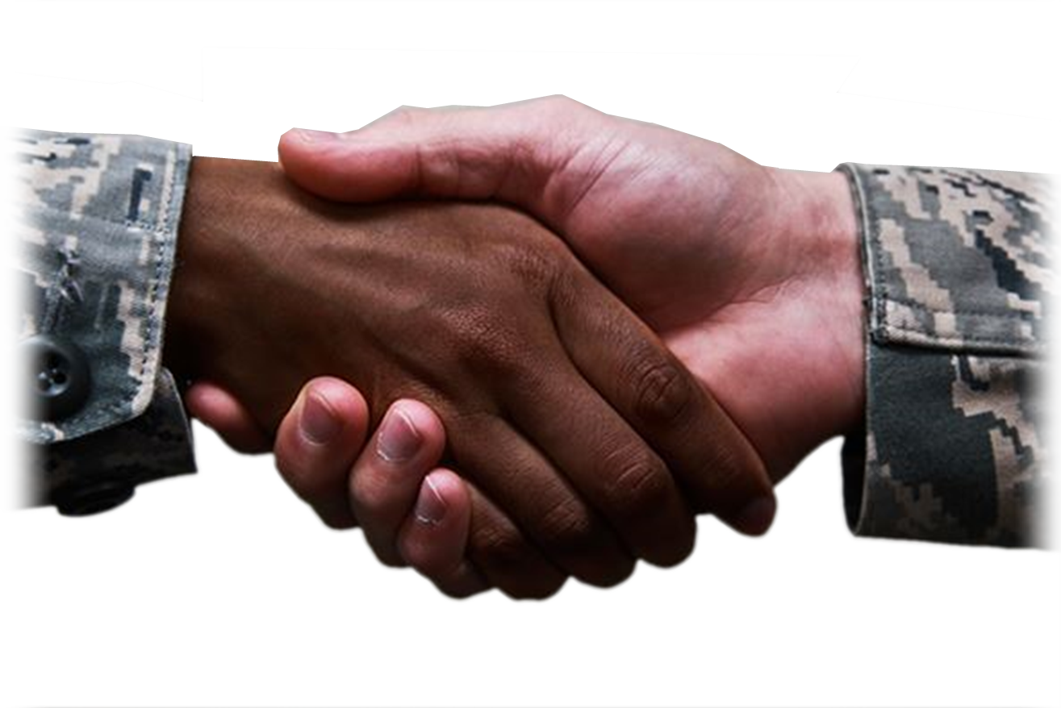
1- Keep your Promises 6-7
⁶ The Gibeonites then sent word to Joshua in the camp at Gilgal: "Do not abandon your servants. Come up to us quickly and save us! Help us, because all he Amorite kings from the hill country have joined forces against us.“
Notes:
Keep promises to God
To spouse
To family
To Church
To
Keep your vows to God Eccl. ⁴ When you make a vow to God, do not delay in fulfilling it. He has no pleasure in fools; fulfill your vow.
⁵ It is better not to vow than to make a vow and not fulfill it.
(Ecc 5:4-5 NIV)
Keep your vows to spouse Malchi ¹⁴ You ask, "Why?" It is because the LORD is acting as the witness between you and the wife of your youth, because you have broken faith with her, though she is your partner, the wife of your marriage covenant. (Mal 2:14 NIV)

Slide 22
1- Keep your Promises 6-7
⁷ So Joshua marched up from Gilgal with his entire army, including all the best fighting men.
Ai
Gibeon
Gilgal
Jarmuth
Jerusalem
Lachish
Eglon
Hebron
Notes:
Keep promises to God
To spouse
To family
To Church
To
Keep your vows to God Eccl. ⁴ When you make a vow to God, do not delay in fulfilling it. He has no pleasure in fools; fulfill your vow.
⁵ It is better not to vow than to make a vow and not fulfill it.
(Ecc 5:4-5 NIV)
Keep your vows to spouse Malchi ¹⁴ You ask, "Why?" It is because the LORD is acting as the witness between you and the wife of your youth, because you have broken faith with her, though she is your partner, the wife of your marriage covenant. (Mal 2:14 NIV)

Slide 23
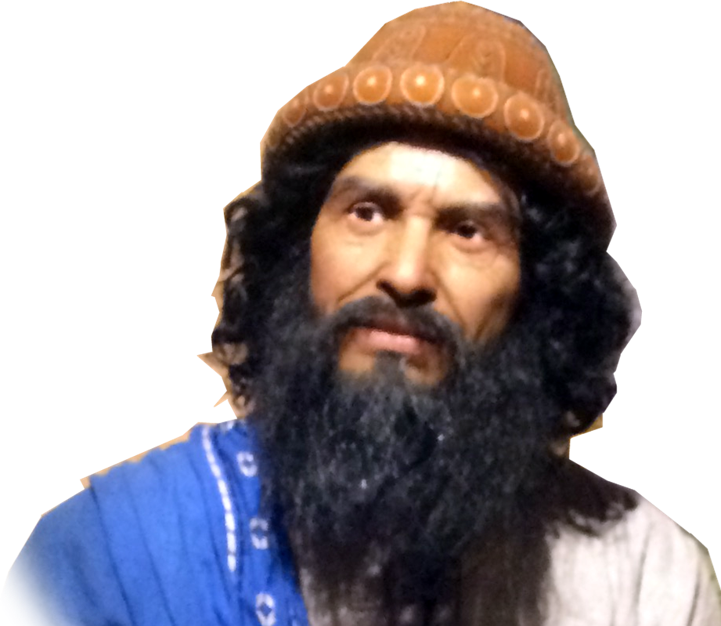
2- Trust in God’s promises 8
⁸ The LORD said to Joshua,
"Do not be afraid of them; I have given them into your hand. Not one of them will be able to withstand you."
Notes:
Sun burst = FREE =https://c.pxhere.com/photos/0f/75/sunbeam_cloud_clouds_sky_ray_of_light_romance_light_rays-1022029.jpg!d

Slide 24
3- Use your head 9
⁹ After an all-night march from Gilgal, Joshua took them by surprise.
Ai
Gibeon
Gilgal
Jarmuth
Jerusalem
Lachish
Eglon
Hebron

Slide 25
4- Watch God work 10-11
¹⁰ The LORD threw them into confusion before Israel, who defeated them in a great victory at Gibeon.
Ai
Gibeon
Gilgal
Jarmuth
Jerusalem
Lachish
Eglon
Hebron

Slide 26
4- Watch God work 10-11
¹⁰ .... Israel pursued them along the road going up to Beth Horon and cut them down all the way to Azekah and Makkedah.
Beth Horon
Ai
Gibeon
Gilgal
Jarmuth
Jerusalem
Lachish
Eglon
Hebron

Slide 27
4- Watch God work 10-11
¹⁰ .... Israel pursued them along the road going up to Beth Horon and cut them down all the way to Azekah and Makkedah.
Beth Horon
Ai
Gibeon
Gilgal
Jarmuth
Azekah
Jerusalem
Lachish
Eglon
Hebron

Slide 28
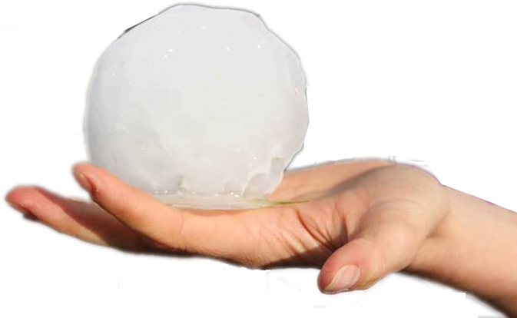
4- Watch God work 10-11
¹¹ As they fled before Israel on the road down from Beth Horon to Azekah, the LORD hurled large hailstones down on them from the sky, and more of them died from the hailstones than were killed by the swords of the Israelites.
Beth Horon
Ai
Gibeon
Gilgal
Jarmuth
Azekah
Jerusalem
Lachish
Eglon
Hebron
Notes:
I don’t know it they were as large as they will be in the end time, noted in Rev. 16:21. 100 lbs. each!!! From the sky huge hailstones of about a hundred pounds each fell upon men. And they cursed God on account of the plague of hail, because the plague was so terrible. (Rev 16:21 NIV)

Slide 29
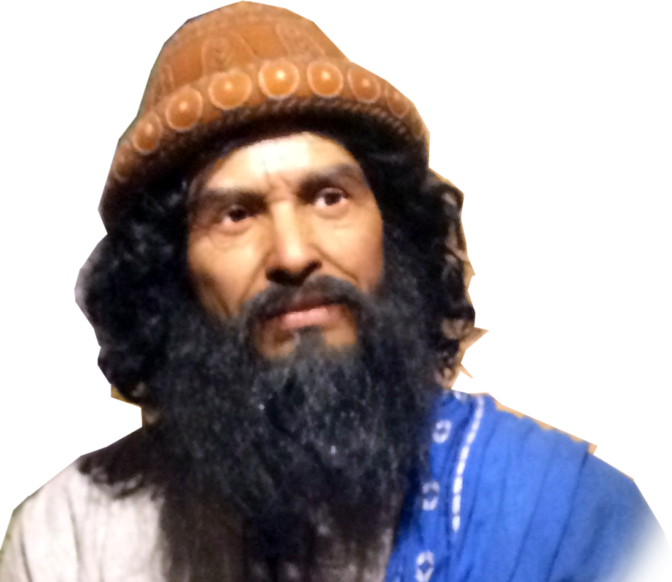
5- Pray Bold Prayers 12-13
¹² On the day the LORD gave the Amorites over to Israel, Joshua said to the LORD in the presence of Israel:
"O sun, stand still over Gibeon, O moon, over the Valley of Aijalon.“
Notes:
He prayed this bold prayer so he could complete God’s will—not his own convenience!

Slide 30
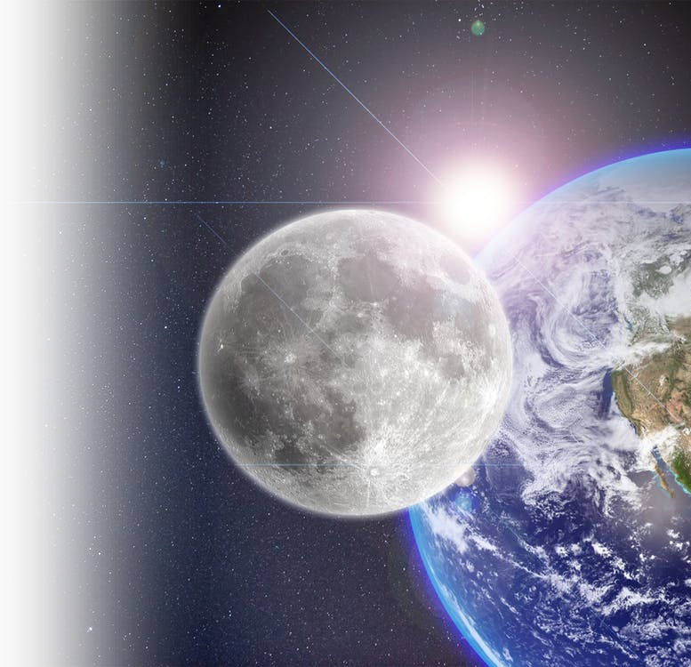
5- Pray Bold Prayers 12-13
¹³ So the sun stood still, and the moon stopped, till the nation avenged itself on its enemies, as it is written in the Book of Jashar. The sun stopped in the middle of the sky and delayed going down about a full day.
Notes:
Sun, moon, earth.

Slide 31
6- Experience an Exceptional Day 14
¹⁴ There has never been a day like it before or since, a day when the LORD listened to a man. Surely the LORD was fighting for Israel!
Notes:
Unique – so don’t try to find another like it!

Slide 32
6- Experience an Exceptional Day 14
¹⁴ There has never been a day like it before or since, a day when the LORD listened to a man. Surely the LORD was fighting for Israel!
Notes:
The normal way is a man listens/harkens/renders obedience to God—the exceptional is God listening/harkening/rendering obedience to man.
This may be the biggest miracle of all, “God hearkened unto a man!”

Slide 33
6- Experience an Exceptional Day 14
¹⁴ There has never been a day like it before or since, a day when the LORD listened to a man. Surely the LORD was fighting for Israel!
Notes:
The normal way is a man listens/harkens/renders obedience to God—the exceptional is God listening/harkening/rendering obedience to man.

Slide 34
A note about this miracle:

Slide 35
A note about this miracle:
If you cannot believe this one ... then how do you believe ...

Slide 36
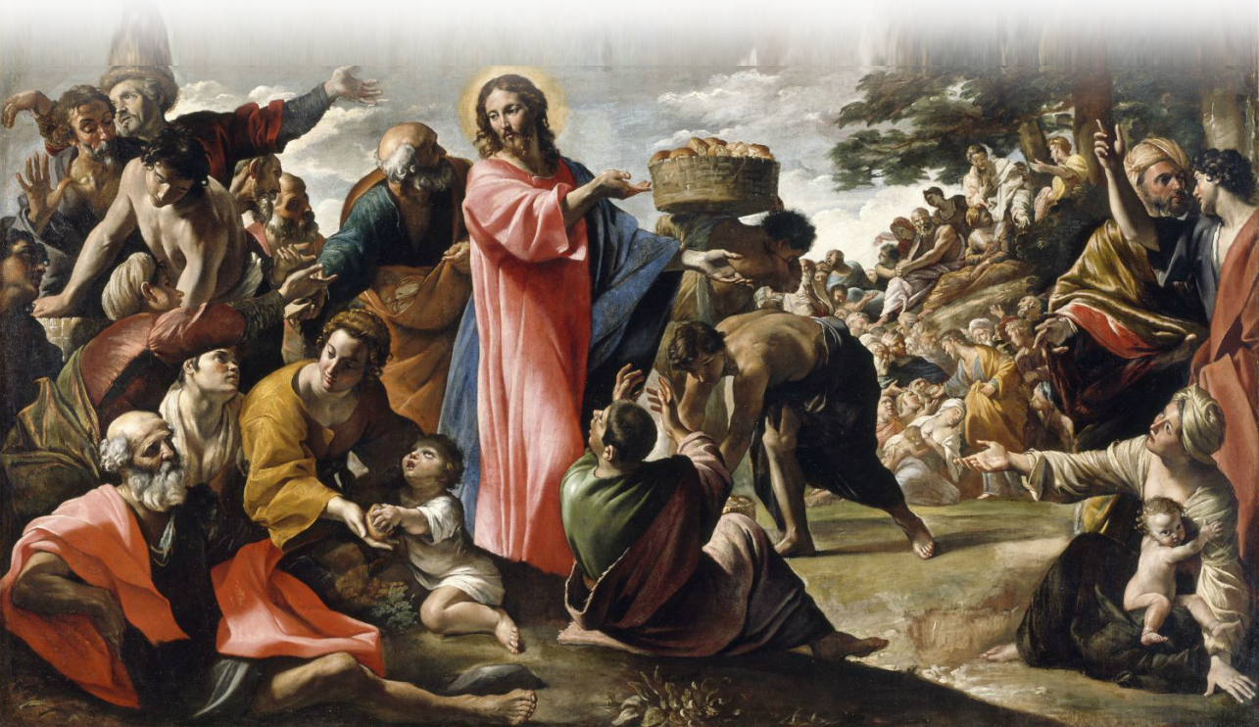
Feeding 5,000
Notes:
https://upload.wikimedia.org/wikipedia/commons/9/93/Giovanni_Lanfranco_-_Miracle_of_the_Bread_and_Fish_-_WGA12454.jpg

Slide 37
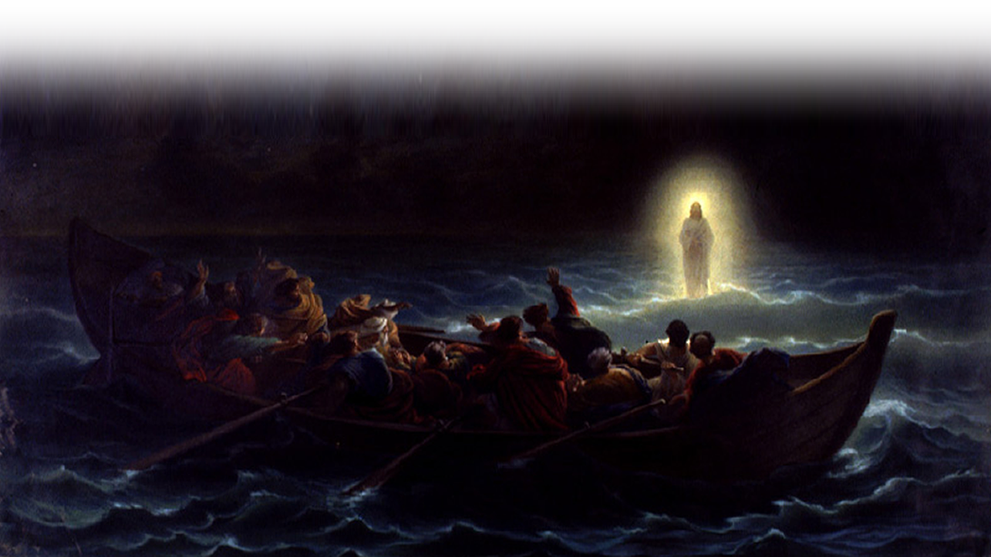
Walking on Water
Notes:
https://upload.wikimedia.org/wikipedia/commons/9/93/Am%C3%A9d%C3%A9e_Varint_-_Christ_marchant_sur_la_mer.jpg

Slide 38
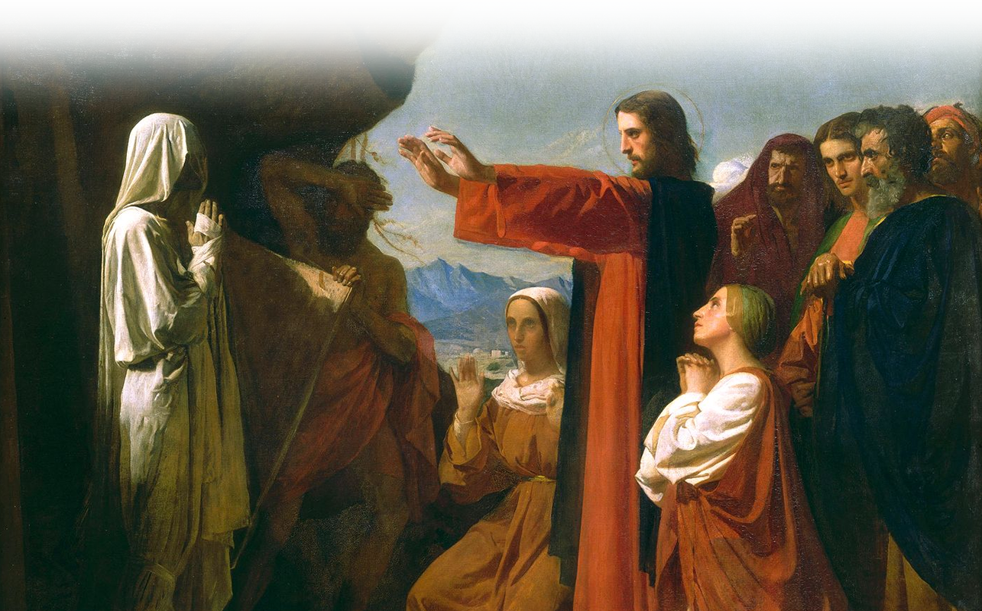
Raising Lazarus
Notes:
https://commons.wikimedia.org/wiki/File:Bonnat01.jpg

Slide 39
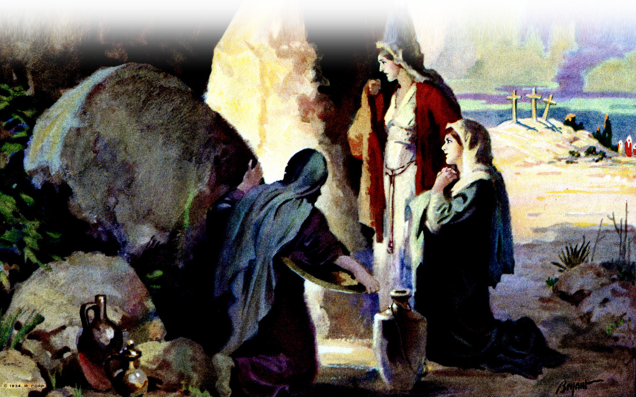
The Resurrection
Notes:
https://www.flickr.com/photos/waitingfortheword/6874715914

Slide 40
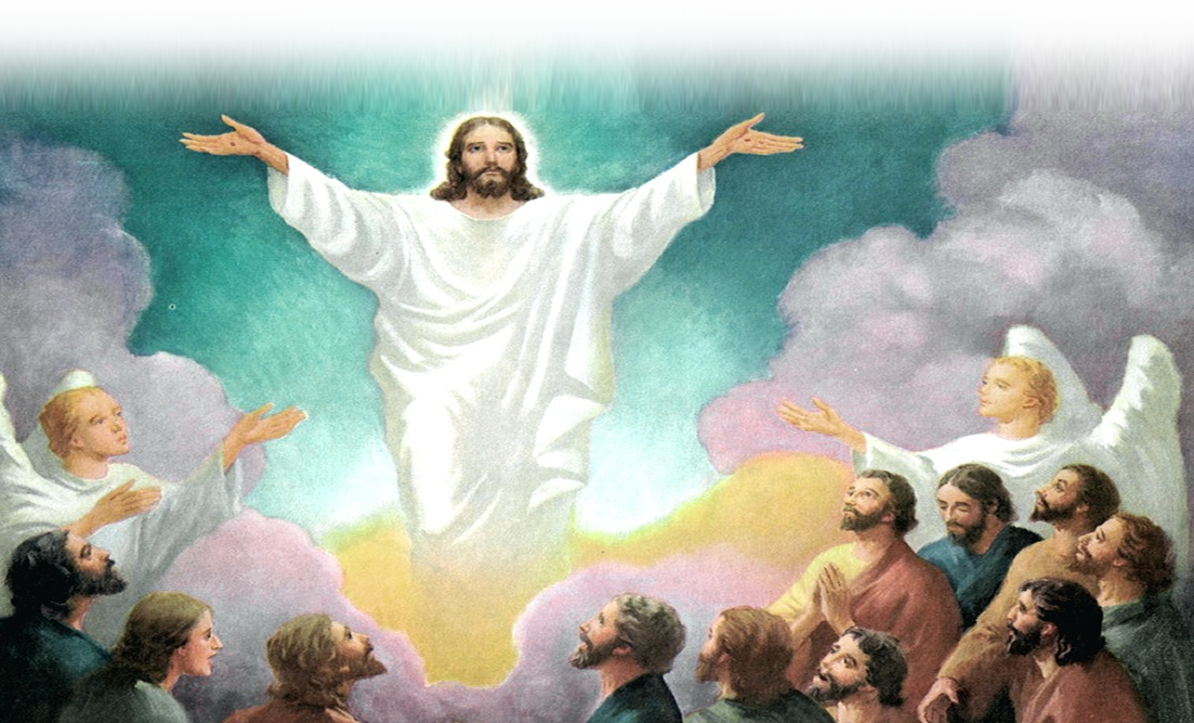
The Ascension
Notes:
https://www.flickr.com/photos/waitingfortheword/5671687592

Slide 41
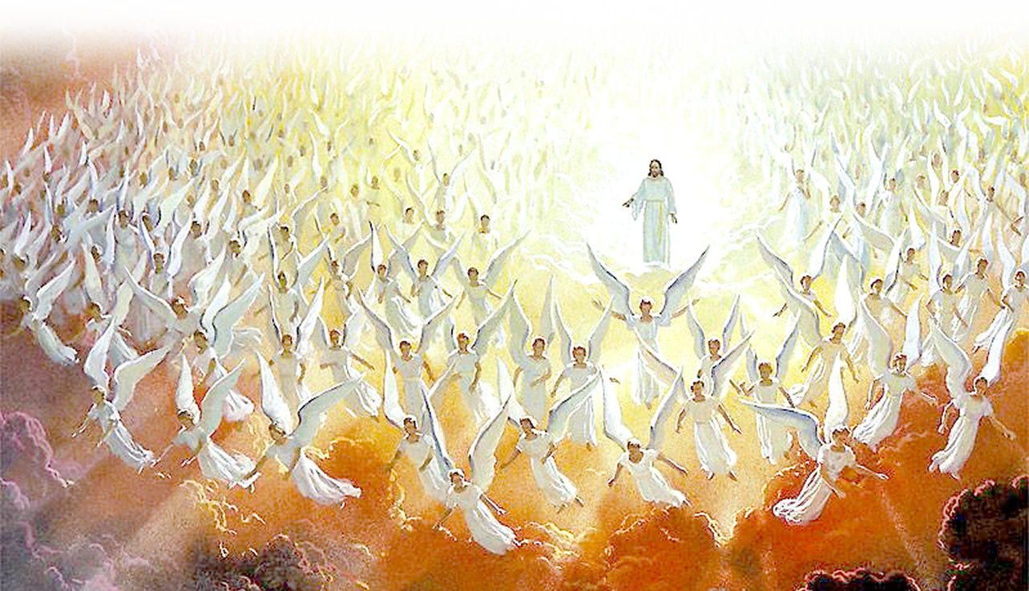
The Second Coming
Notes:
https://www.flickr.com/photos/waitingfortheword/5588150284

Slide 42
Final Thoughts
When you feel the world is against you ...

Slide 43
Final Thoughts
When you feel the world is against you ...
God will fight your battles ...

Slide 44
When you ...

Slide 45
When you ...
1- Keep your word

Slide 46
When you ...
1- Keep your word
2- Trust God’s promise

Slide 47
When you ...
1- Keep your word
2- Trust God’s promise
3- Use your head

Slide 48
When you ...
1- Keep your word
2- Trust God’s promise
3- Use your head
4- Watch God work

Slide 49
When you ...
1- Keep your word
2- Trust God’s promise
3- Use your head
4- Watch God work
5- Pray bold prayers

Slide 50
When you ...
1- Keep your word
2- Trust God’s promise
3- Use your head
4- Watch God work
5- Pray bold prayers
6- Expect exceptional things

Slide 51
God’s Road to
Let’s PRAY

