Slide 1
God’s Road to
God’s Road to
SUCCESS
IS AHEAD
Notes:
https://pixabay.com/en/career-road-away-way-of-life-479578/
Copyright © 2006−2020. All rights reserved. Bible Point is a registered trademark of Dennis Henderson. All other trademarks acknowledged.
Bible Point contains graphics from Bible Point artists. These illustrations belong to Bible Point and the respective artists. You may use the designs and illustrations for graphical illustration of lessons free and without special permission, provided they are not used in any way that maligns the Christian faith. Furthermore, republication or production of any illustration by any other graphic service whether it be in book, in a machine-readable form, or in any other design resource is strictly prohibited. Furthermore, they cannot be duplicated or resold as any other form of publishing, clip art, or graphic resource.
So What does it mean? (A simple translations of the legal jargon)
So, if you don’t own the presentation(s), graphic(s), and text(s) how can you legally use them? The purchase of the license allows you to use all the images in the product. However, the actual ownership and copyright of the presentation(s), graphic(s), and text(s) remain the property of Bible Point and its licensors. If you had plans on using this product in your “for sale” work—think again!
License Agreement
Article 1: License Grant
All the graphics and text in Bible Point presentations (excluding quotes from the Bible and stated sources) are the intellectual and real property of Bible Point and its licensors, and is protected by law, including United States copyright laws and international treaties. Bible Point grants to you a license:
1. To use the presentation in a single church, single school, or single office of a Christian organization.
2. To make a single archival back-up copy of the program.
3. To modify the presentation(s) and merge with other presentations in a single church, school, or Christian organization.
4. To transfer to another party if that party agrees to accept the terms and conditions of this agreement, and you do not retain any copies of the presentation, whether printed, machine readable, modified, or merged form.
Article 2: Terms
This license is effective until terminated. You may terminate the license at any time by destroying the presentation(s), graphic(s), or text(s) together with all copies, modifications and merged portions in any form. Bible Point may terminate your license if you fail to comply with this Agreement. You agree, upon such termination, for any reason, to destroy the presentation(s), graphics, and text(s) with all copies, modifications, and merged portions in any form.
Article 3: Disclaimers
1. Bible Point presentations, graphics, and texts are licensed to you As Is. You, the consumer, bear the entire risk relating to the quality and performance of the presentation(s), graphic(s), or text(s). In no event will Bible Point be liable for damages resulting from any defect.
2. Thirty-day limited warrantee on disks. Bible Point warrants the disks to be free of defects in material and workmanship under normal use for 30 days after purchase. During the 30-day period you may return a defective presentation, graphic, or text with proof of purchase and it will be replaced without charge, unless the presentation is damaged by misuse.
Article 4: General
1. You may not sub-license, assign, or transfer the license of the presentation(s), graphic(s), or text(s) except as provided by this Agreement.
2. This Agreement will be governed by the laws of the State of Michigan.
So What does it mean? (A simple translations of the legal jargon)
May I let someone borrow or copy my licensed Bible Point presentation (even after I modified it)? As long as it is within your local church, or single school, or the immediate office of a Christian organization you may. Otherwise, please refer the person interested in borrowing to: http://www.biblepoint.com or E-mail: biblepoint@comcast.net with any related questions.

Slide 2
God’s Road to
God’s Road to
SUCCESS
and How to Find It
and How to Find It
Notes:
https://pixabay.com/en/career-road-away-way-of-life-479578/

Slide 3
From the Morning Scripture Reading
¹ After the death of Moses ... , the LORD said to Joshua ... ² "Moses my servant is dead ....
Notes:
God has promised Joshua success – all the days of his life and that He would never leave nor forsake Joshua and Israel. Now here’s my wurstion ...

Slide 4
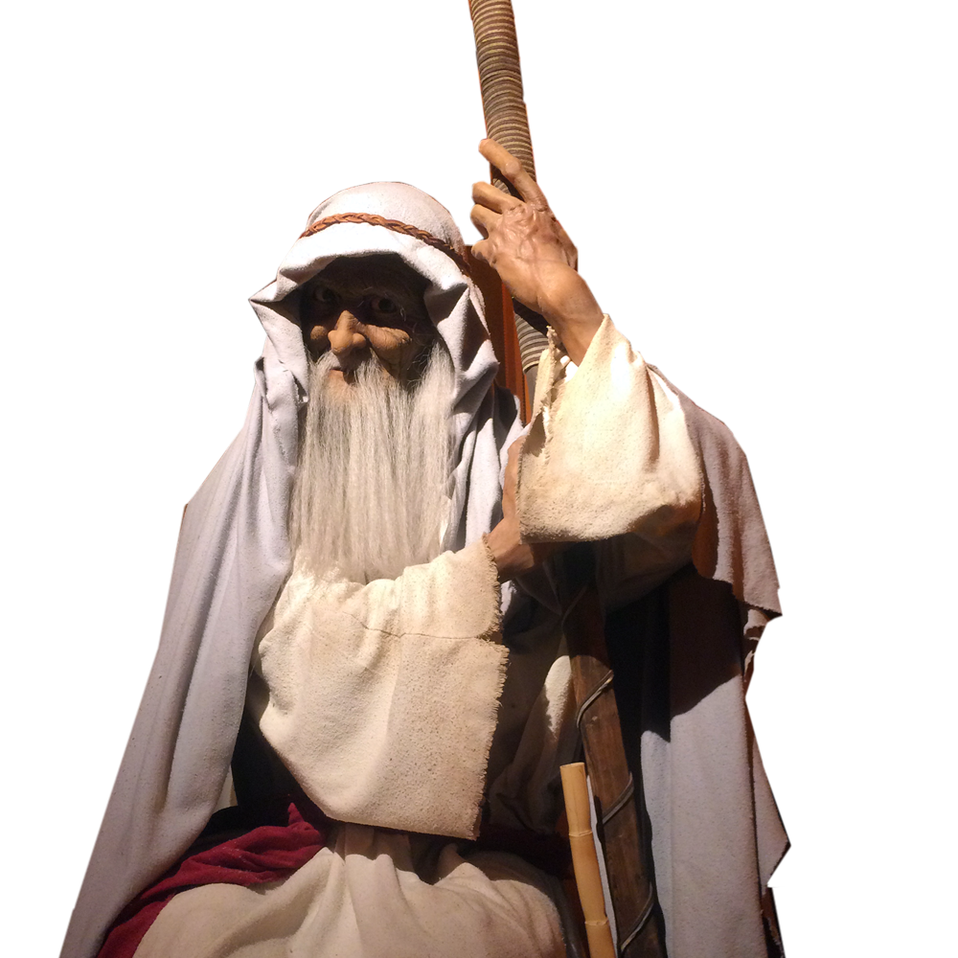
From the Morning Scripture Reading
¹ After the death of Moses ... , the LORD said to Joshua ... ² "Moses my servant is dead ....
Moses Died
Notes:
God has promised Joshua success – all the days of his life and that He would never leave nor forsake Joshua and Israel. Now here’s my wurstion ...

Slide 5
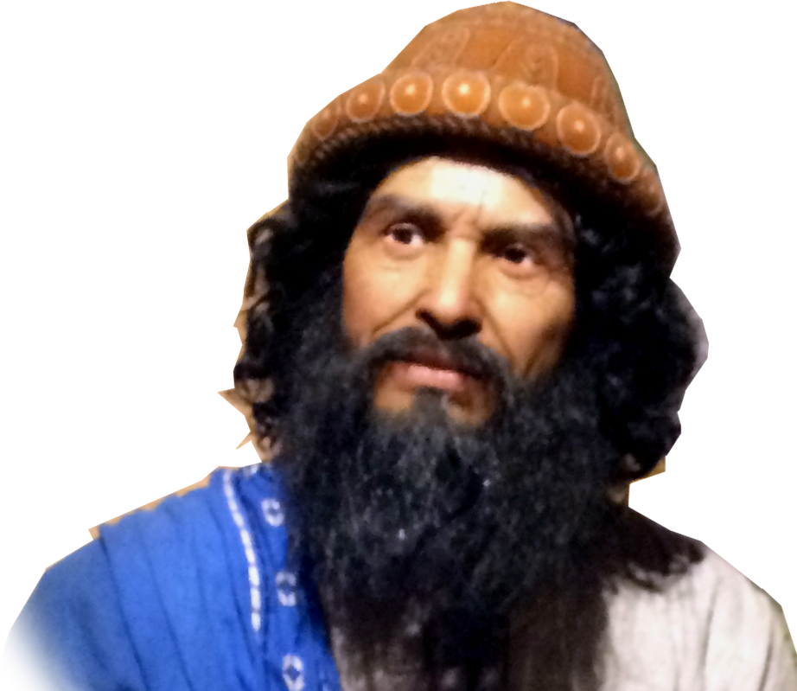
From the Morning Scripture Reading
¹ After the death of Moses ... , the LORD said to Joshua ... ² "Moses my servant is dead ....
Joshua was to fill his shoes
Notes:
God has promised Joshua success – all the days of his life and that He would never leave nor forsake Joshua and Israel. Now here’s my wurstion ...

Slide 6
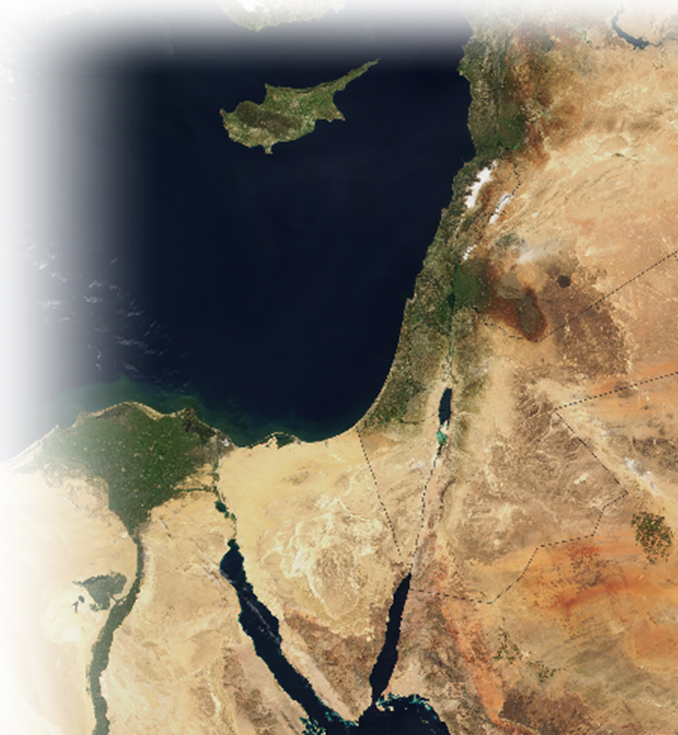
From the Morning Scripture Reading
¹ After the death of Moses ... , the LORD said to Joshua ... ² "Moses my servant is dead .... cross ... into the land I am about to give .... Now, ... ³ I will give you every place where you set your foot, as I promised Moses.
The Promised Land
Notes:
God has promised Joshua success – all the days of his life and that He would never leave nor forsake Joshua and Israel. Now here’s my wurstion ...

Slide 7
From the Morning Scripture Reading
¹ After the death of Moses ... , the LORD said to Joshua ... ² "Moses my servant is dead .... cross ... into the land I am about to give .... Now, ... ³ I will give you every place where you set your foot, as I promised Moses. ⁵ No one will be able to stand up against you all the days of your life.
The Promised Victory
Notes:
God has promised Joshua success – all the days of his life and that He would never leave nor forsake Joshua and Israel. Now here’s my wurstion ...

Slide 8
From the Morning Scripture Reading
¹ After the death of Moses ... , the LORD said to Joshua ... ² "Moses my servant is dead .... cross ... into the land I am about to give .... Now, ... ³ I will give you every place where you set your foot, as I promised Moses. ⁵ No one will be able to stand up against you all the days of your life. As I was with Moses, so I will be with you; I will never leave you nor forsake you.
The Promised Presence
Notes:
God has promised Joshua success – all the days of his life and that He would never leave nor forsake Joshua and Israel. Now here’s my wurstion ...

Slide 9
If I could guarantee you success in your life today, would you do what it takes?
Notes:
This only requires a “yes’ r “no” answer! But some of you will say, I don’t know. It depends on what it takes!

Slide 10
So What Can You Do to Find Success?

Slide 11
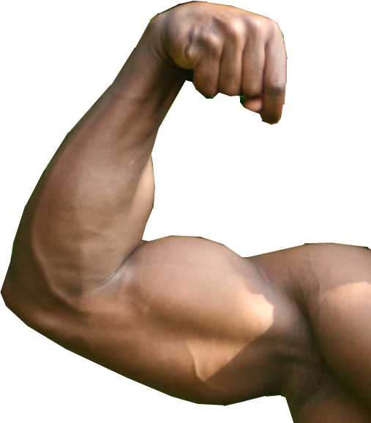
What Can You Do to Find Success?
Answer: BE STRONG & COURAGEOUS

Slide 12
What Can You Do to Find Success?
Answer: BE STRONG & COURAGEOUS
⁶ Be strong and courageous,

Slide 13
What Can You Do to Find Success?
Answer: BE STRONG & COURAGEOUS
⁶ Be strong and courageous,
⁷ Be strong and very courageous.

Slide 14
What Can You Do to Find Success?
Answer: BE STRONG & COURAGEOUS
⁶ Be strong and courageous,
⁷ Be strong and very courageous.
⁹ Be strong and courageous. Do not be terrified; do not be discouraged,
Notes:
Three times in Deuteronomy 31 the same words occur from the mouth of Moses to Joshua.

Slide 15
What Can You Do to Find Success?
Answer: BE STRONG & COURAGEOUS
⁶ Be strong and courageous,
⁷ Be strong and very courageous.
⁹ Be strong and courageous. Do not be terrified; do not be discouraged,
WHY?

Slide 16
What Can You Do to Find Success?
Answer: BE STRONG & COURAGEOUS
⁶ Be strong and courageous,
⁷ Be strong and very courageous.
⁹ Be strong and courageous. Do not be terrified; do not be discouraged,
For God has not given us a spirit of fear, but of power and of love and of a sound mind. 2 Tim 1:7 (NKJ)
Notes:
So let me ask, have you ever been afraid? I mean really afraid? Because when you do you likewise feel POWERLESS—you need to be strong.
You likewise feel self-absorbed (what’s going to happen to ME!) And finally you become irrational. You think the worst possible scenario of what will happen. That is an unsound mind.
Here’s what I mean: The giants took the wind out of the sails of the Israelites 40 years earlier—we can’t take them they are giants, with high towering walls and we are just grasshoppers in their sight. --They rendered themselves powerless—and so do you. Nobody has it as bad as i do. This problem is insurmountable. Maybe its a gigantic debt, or a mammoth health issue, a relationship problem—but you are rendered powerless.
You become self-absorbed—woe is me. No one has it as bad as me. I’m doomed. What use is living. But has not given us a spirit of fear—the opposite is power (courage) and love. Love is self-sacrificial giving. Illu with Fireman.
The lack of a sound mind is letting you mind go down the path of the “hypothetical what if”. Here’s what I mean, the doctor calls and leaves a message “Your test results are back, please call the office for the details.”

Slide 17
Where Will You Find Success?

Slide 18
Where Will You Find Success?
Answer: In the land!
² ... get ready to cross the Jordan River into the land I am about to give to them

Slide 19
Where Will You Find Success?
Answer: In the land!
⁶ ... you will lead these people to inherit the land I swore to their forefathers to give them.

Slide 20
Where Will You Find Success?
Answer: In the land!
¹¹ ... go in and take possession of the land the LORD your God is giving you for your own.
Notes:
When it comes to eternal life, God has made the preparation in Jesus Christ. He has sworn it in the Bible. But we must take it to actually possess it.
From time to time I will be speaking to children about the gift of God which is eternal life. I will have a package wrapped as an object lesson. I will studer over the name as I try to read the recipents name: Who -soooo- ev – Whoso-ev-----er. Will whosoever come and get it? Someone starts, but hesitates, then another, then therir is a race. I ask, is that your name? Yes, it is everyones. So what do you wohso ever have to do to get this gift? Nothing, I just need to take it.
Here’s the point—you can know about God’s promised land—but you have to take it. The same is true regarding eternal life.

Slide 21
Where Will You Find Success?
Answer: In the land!
¹³ "Remember ... 'The LORD your God is giving you rest and has granted you this land.'
Notes:
Once they entered the land and took possession of it – then they could rest in the land.

Slide 22
Where Will You Find Success?
Answer: In the land!
¹³ ... stay in the land
Notes:
Why would you ever want to leave God’s land of blessing– that flowed with milk an honey?

Slide 23
Where Will You Find Success?
Answer: In the land!
In “the land” was the place of God’s Will.
Notes:
“in the land” is the metaphor for being in God’s Will.
God has a place for you to be. You must discover what it is that He wants for your life. Where He will bless you, prospser you, be with your.

Slide 24
Where Will You Find Success?
Answer: In the land!
In “the land” was the place of God’s Will.
Get Ready to do it
Notes:
You must get ready to do His will.

Slide 25
Where Will You Find Success?
Answer: In the land!
In “the land” was the place of God’s Will.
Get Ready to do it
He swore/revealed to do it
Notes:
We’re talking about what he has for you based upon His word. What has He called you to do?

Slide 26
Where Will You Find Success?
Answer: In the land!
In “the land” was the place of God’s Will.
Get Ready to do it
He swore/revealed to do it
Take possession of it
Notes:
Take hold of it.

Slide 27
Where Will You Find Success?
Answer: In the land!
In “the land” was the place of God’s Will.
Get Ready to do it
He swore/revealed to do it
Take possession of it
Rest in it
Notes:
Then rest in the blessing flowing from it.

Slide 28
Where Will You Find Success?
Answer: In the land!
In “the land” was the place of God’s Will.
Get Ready to do it
He swore/revealed to do it
Take possession of it
Rest in it
Stay in it
Notes:
Don’t leave God’s will.

Slide 29
How Will You Find Success?

Slide 30
How Will You Find Success?
Answer: Obey the Word!
It doesn’t get any clearer than this:
⁷ Be careful to obey all the law my servant Moses gave you; do not turn from it to the right or to the left, that you may be successful wherever you go.
Notes:
“The Law” means the bible. You see “The Law” was the 5 books of Moses – That is all the Bible there was then. Now we have so much more of God’s Will revealed in the Word of God.

Slide 31
How Will You Find Success?
Answer: Obey the Word!
It doesn’t get any clearer than this:
CAREFULLY OBEY
⁷ Be careful to obey all the law my servant Moses gave you; do not turn from it to the right or to the left, that you may be successful wherever you go.
Notes:
When you are careful you are deliberate in what you do—you don’t second guess—you verify—you check and second check. Then do it!

Slide 32
How Will You Find Success?
Answer: Obey the Word!
It doesn’t get any clearer than this:
NOT PICK AND CHOOSE
⁷ Be careful to obey all the law my servant Moses gave you; do not turn from it to the right or to the left, that you may be successful wherever you go.
Notes:
Not “Pick and Choose” like below:
Then he went away and hanged himself. (Mat 27:5 NIV)
Jesus told him, "Go and do likewise." (Luk 10:37 NIV)
"What you are about to do, do quickly," Jesus told him, (Joh 13:27 NIV)

Slide 33
How Will You Find Success?
Answer: Obey the Word!
It doesn’t get any clearer than this:
NO DETOURS
⁷ Be careful to obey all the law my servant Moses gave you; do not turn from it to the right or to the left, that you may be successful wherever you go.
Notes:
Don’t substitute it with “Pop psychology”, Political correctness, some modern fad. This is the Word of the true and living God! It is forever settled. It is inerrant, authoritative, and inspired. It is the very word of God spoken. It is His will!

Slide 34
How Will You Find Success?
Answer: Obey the Word!
It doesn’t get any clearer than this:
TALK ABOUT IT
⁸ Do not let this Book of the Law depart from your mouth; meditate on it day and night, so that you may be careful to do everything written in it. Then you will be prosperous and successful.
Notes:
Notice it says “Mouth”– not ears, or eyes. It’s more than hearing, more than reading. You must speak about it. You cannot keep this to yourself. You must tell others.

Slide 35
How Will You Find Success?
Answer: Obey the Word!
It doesn’t get any clearer than this:
MEMORIZE IT
⁸ Do not let this Book of the Law depart from your mouth; meditate on it day and night, so that you may be careful to do everything written in it. Then you will be prosperous and successful.
Notes:
Go over and over again—until you have memorized it! Psalmist has said, “I have hid Your Word in my heart that I may not sin against you.”

Slide 36
How Will You Find Success?
Answer: Obey the Word!
It doesn’t get any clearer than this:
DO IT
⁸ Do not let this Book of the Law depart from your mouth; meditate on it day and night, so that you may be careful to do everything written in it. Then you will be prosperous and successful.
Notes:
To do meant for them to get up, pack up the camp, move out, cross the Jordan River and take the land form a hostile adversary.
God’s Word will tell you too what you must do—and it may not be easy. It may call on you to ask forgiveness from a long standing foe.
It may mean you must change careers to do what God wants you to do – Story o Stan Lightfoot
Bottom line – you must do it!

Slide 37
How Will You Find Success?
Answer: Obey the Word!
It doesn’t get any clearer than this:
REALIZE IT
⁸ Do not let this Book of the Law depart from your mouth; meditate on it day and night, so that you may be careful to do everything written in it. Then you will be prosperous and successful.
Notes:
When you do –God will prosper you– you will be successful.

Slide 38
Why Will You Find Success?

Slide 39
Why Will You Find Success?
Answer: God Will Be With You!

Slide 40
Why Will You Find Success?
Answer: God Will Be With You!
⁷ ...that you may be successful ....

Slide 41
Why Will You Find Success?
Answer: God Will Be With You!
⁷ ...that you may be successful ....
⁸ ... you will be prosperous and successful.

Slide 42
Why Will You Find Success?
Answer: God Will Be With You!
⁷ ...that you may be successful ....
⁸ ... you will be prosperous and successful.
⁹ Have I not commanded you? Be strong and courageous. Do not be terrified; do not be discouraged, for the LORD your God will be with you wherever you go.

Slide 43
I asked at the beginning today ... “If I could guarantee you success in your life today, would you do what it takes?”
Notes:
That only takes a “yes” or “no” answer. Still someone will say, “I don’t know.” Why, because they don’t want to commit—thinking if they don’t commit that gets them off the hook . How shallow.
If you have said, “Yes, I will”

Slide 44
So do what it takes to:

Slide 45
So do what it takes to:
Be Strong in the Lord

Slide 46
So do what it takes to:
Be Strong in the Lord
+ Be Fearless in your faith

Slide 47
So do what it takes to:
Be Strong in the Lord
+ Be Fearless in your faith
+ Be in God’s Will

Slide 48
So do what it takes to:
Be Strong in the Lord
+ Be Fearless in your faith
+ Be in God’s Will
+ Be Obedient to the Word

Slide 49
So do what it takes to:
Be Strong in the Lord
+ Be Fearless in your faith
+ Be in God’s Will
+ Be Obedient to the Word

Slide 50
So do what it takes to:
Be Strong in the Lord
+ Be Fearless in your faith
+ Be in God’s Will
+ Be Obedient to the Word

Slide 51
So do what it takes to:
Be Strong in the Lord
+ Be Fearless in your faith
+ Be in God’s Will
+ Be Obedient to the Word

Slide 52
So do what it takes to:
Be Strong in the Lord
+ Be Fearless in your faith
+ Be in God’s Will
+ Be Obedient to the Word
= God will be with YOU!

Slide 53
So do what it takes to:
Be Strong in the Lord
+ Be Fearless in your faith
+ Be in God’s Will
+ Be Obedient to the Word
= God will be with YOU! = That equals SUCCESS!
Notes:
So ask yourself, Ami I fearlessly in God’s will and in His word? What more can I do to achieve God’s success in my life?

Slide 54
God’s Road to
Let’s PRAY

