Slide 1
JAMES
A FAITH THAT WORKS
Notes:
BACKGROUND = https://pixabay.com/en/gears-cogs-machine-machinery-1236578/
Copyright © 2006−2021. All rights reserved. Bible Point is a registered trademark of Dennis Henderson. All other trademarks acknowledged.
Bible Point contains graphics from Bible Point artists. These illustrations belong to Bible Point and the respective artists. You may use the designs and illustrations for graphical illustration of lessons free and without special permission, provided they are not used in any way that maligns the Christian faith. Furthermore, republication or production of any illustration by any other graphic service whether it be in book, in a machine-readable form, or in any other design resource is strictly prohibited. Furthermore, they cannot be duplicated or resold as any other form of publishing, clip art, or graphic resource.
So What does it mean? (A simple translations of the legal jargon)
So, if you don’t own the presentation(s), graphic(s), and text(s) how can you legally use them? The purchase of the license allows you to use all the images in the product. However, the actual ownership and copyright of the presentation(s), graphic(s), and text(s) remain the property of Bible Point and its licensors. If you had plans on using this product in your “for sale” work—think again!
License Agreement
Article 1: License Grant
All the graphics and text in Bible Point presentations (excluding quotes from the Bible and stated sources) are the intellectual and real property of Bible Point and its licensors, and is protected by law, including United States copyright laws and international treaties. Bible Point grants to you a license:
1. To use the presentation in a single church, single school, or single office of a Christian organization.
2. To make a single archival back-up copy of the program.
3. To modify the presentation(s) and merge with other presentations in a single church, school, or Christian organization.
4. To transfer to another party if that party agrees to accept the terms and conditions of this agreement, and you do not retain any copies of the presentation, whether printed, machine readable, modified, or merged form.
Article 2: Terms
This license is effective until terminated. You may terminate the license at any time by destroying the presentation(s), graphic(s), or text(s) together with all copies, modifications and merged portions in any form. Bible Point may terminate your license if you fail to comply with this Agreement. You agree, upon such termination, for any reason, to destroy the presentation(s), graphics, and text(s) with all copies, modifications, and merged portions in any form.
Article 3: Disclaimers
1. Bible Point presentations, graphics, and texts are licensed to you As Is. You, the consumer, bear the entire risk relating to the quality and performance of the presentation(s), graphic(s), or text(s). In no event will Bible Point be liable for damages resulting from any defect.
2. Thirty-day limited warrantee on disks. Bible Point warrants the disks to be free of defects in material and workmanship under normal use for 30 days after purchase. During the 30-day period you may return a defective presentation, graphic, or text with proof of purchase and it will be replaced without charge, unless the presentation is damaged by misuse.
Article 4: General
1. You may not sub-license, assign, or transfer the license of the presentation(s), graphic(s), or text(s) except as provided by this Agreement.
2. This Agreement will be governed by the laws of the State of Michigan.
So What does it mean? (A simple translations of the legal jargon)
May I let someone borrow or copy my licensed Bible Point presentation (even after I modified it)? As long as it is within your local church, or single school, or the immediate office of a Christian organization you may. Otherwise, please refer the person interested in borrowing to: http://www.biblepoint.com or E-mail: dennis@DrDH.net with any related questions.

Slide 2
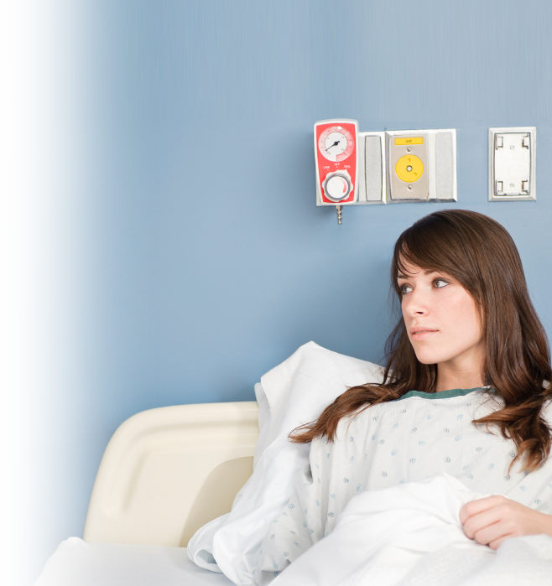
When
Sickness
Strikes!

Slide 3
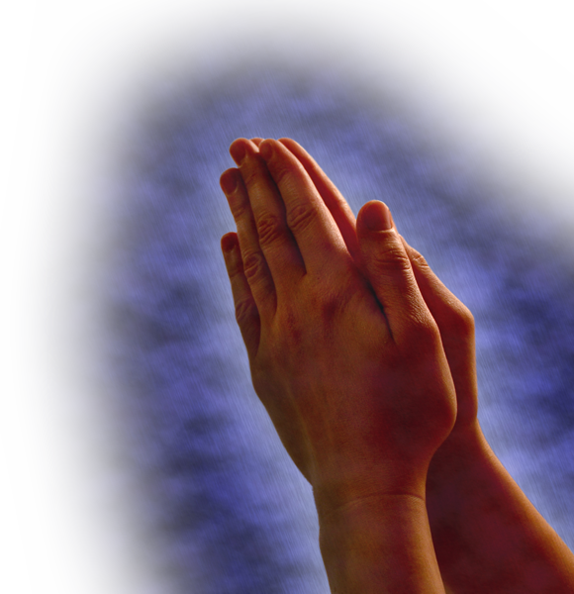
Is any one of you in trouble?
He should pray.

Slide 4
Is any one of you in trouble?
He should pray.
Are any of you suffering hardships? You should pray. (Jam 5:13 NLT)

Slide 5

Is any one of you in trouble?
He should pray.
Is anyone happy?
Let him sing songs of praise.
Notes:
https://www.flickr.com/photos/65487073@N03/6679741465

Slide 6
Is any one of you in trouble?
He should pray.
Is anyone happy?
Let him sing songs of praise.
¹⁴ Is any one of you...

Slide 7
Is any one of you in trouble?
He should pray.
Is anyone happy?
Let him sing songs of praise.
¹⁴ Is any one of you...
sick?

Slide 8
Is any one of you in trouble?
He should pray.
Is anyone happy?
Let him sing songs of praise.
¹⁴ Is any one of you...
sick?
Actually it is a pretty
severe sickness ...

Slide 9
The PRESCRIPTION
is Prayer
Notes:
Sick woman = iStock_000011674146Small.jpg

Slide 10
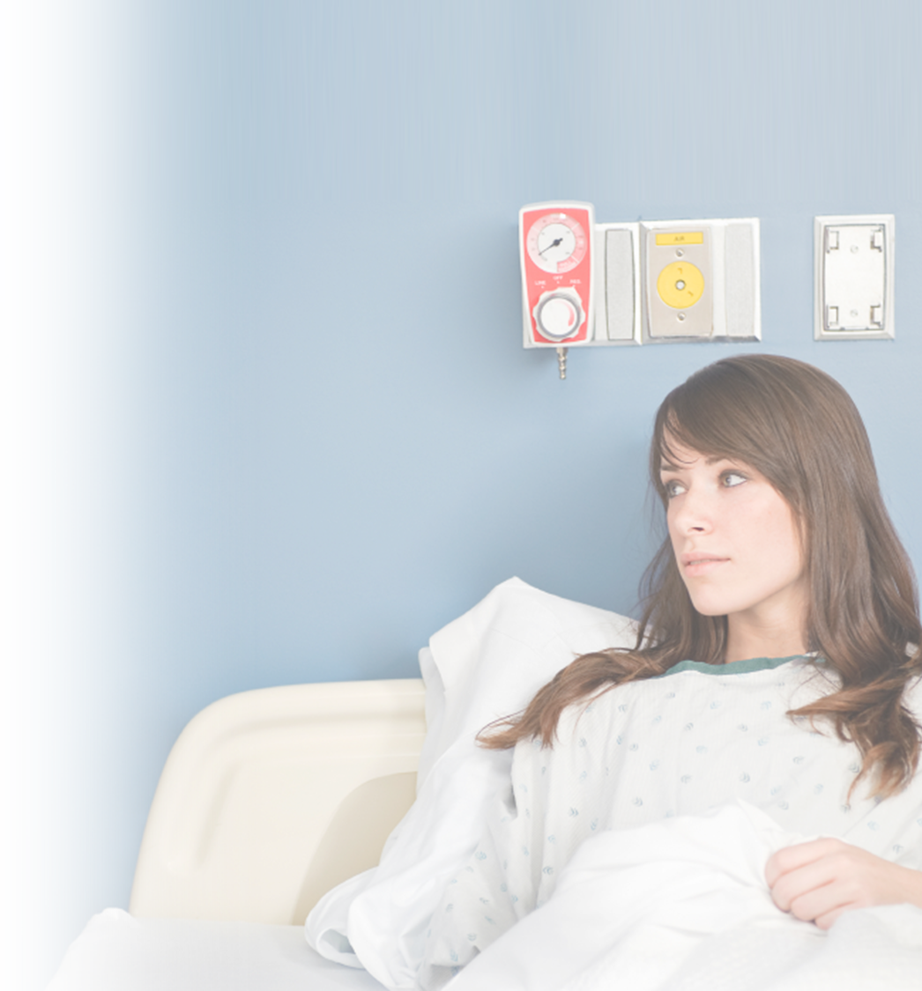
1. Pray for the Seriously Sick
¹⁴ Is any one of you sick?
He should call the elders of the church to pray over him and anoint him with oil in
the name of the Lord.
to be weak, feeble, to be without strength, powerless, to be sick

Slide 11
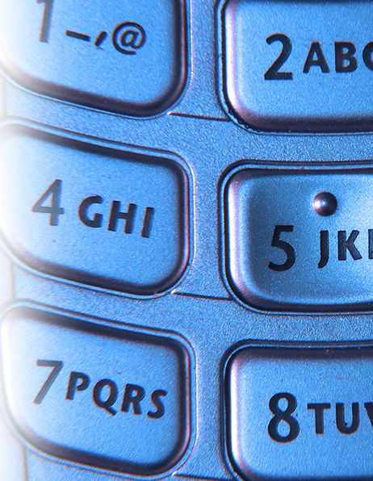
2. Call for the Elders to Pray
¹⁴ Is any one of you sick? He should call the elders of the church to pray over him and anoint him with oil in the name of the Lord.

Slide 12
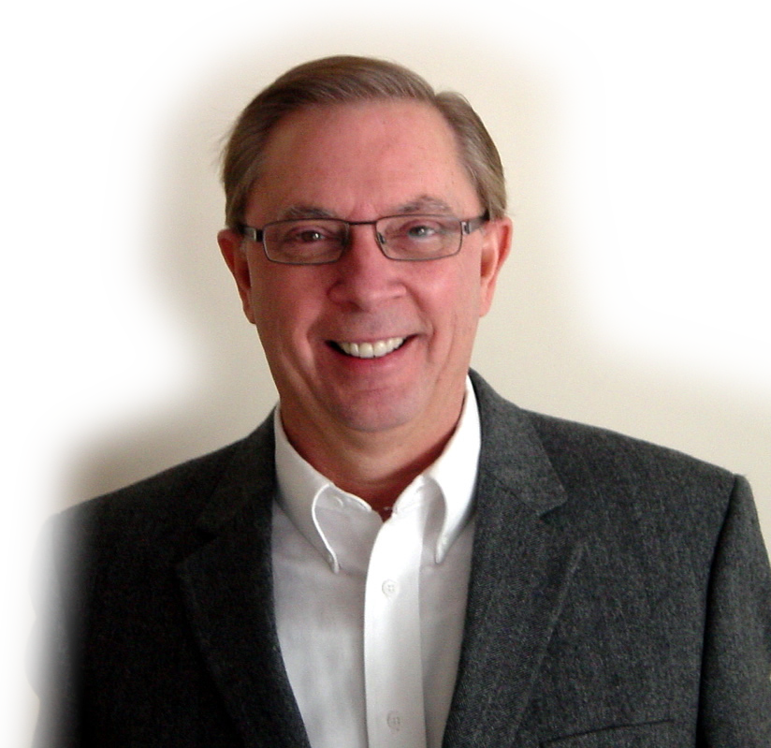
2. Call for the Elders to Pray
¹⁴ Is any one of you sick? He should call the elders of the church to pray over him and anoint him with oil in the name of the Lord.

Slide 13
3. The Elders are to Pray
¹⁴ Is any one of you sick? He should call the elders of the church to pray over him and anoint him with oil in the name of the Lord.

Slide 14
3. The Elders are to Pray
¹⁴ Is any one of you sick? He should call the elders of the church to pray over him and anoint him with oil in the name of the Lord.

Slide 15
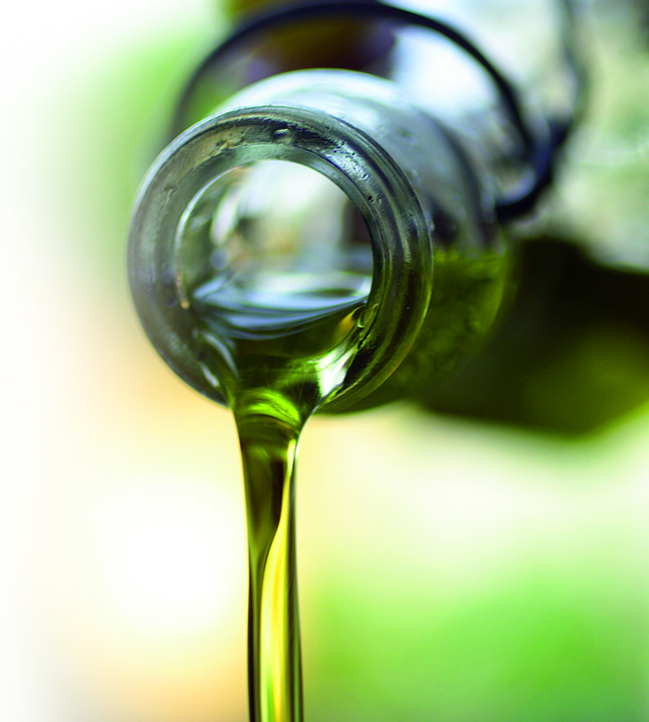
4. Pray with Anointing Oil
¹⁴ Is any one of you sick? He should call the elders of the church to pray over him and anoint[ing] him with oil in the name of the Lord.

Slide 16
4. Pray with Anointing Oil
¹⁴ Is any one of you sick? He should call the elders of the church to pray over him and anoint[ing] him with oil in the name of the Lord.
The word used here is αλειφω = rub (as to apply medicine)

Slide 17
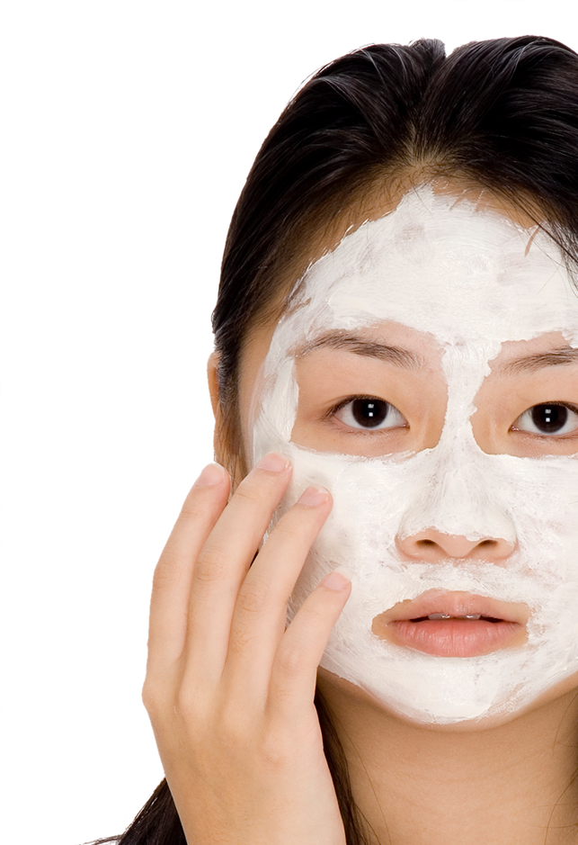
4. Pray with Anointing Oil
¹⁴ Is any one of you sick? He should call the elders of the church to pray over him and anoint[ing] him with oil in the name of the Lord.
The word used here is αλειφω = rub (as to apply medicine)

Slide 18

4. Pray with Anointing Oil
¹⁴ Is any one of you sick? He should call the elders of the church to pray over him and anoint[ing] him with oil in the name of the Lord.
The word used here is αλειφω = rub (as to apply medicine)
NOT χριω =
ceremonially, symbolic ritual

Slide 19
4. Pray with Anointing
¹⁷ But when you fast, put oil on your head and wash your face, (Mat 6:17 )
¹⁴ Is any one of you sick? He should call the elders of the church to pray over him and anoint[ing] him with oil in the name of the Lord.
The word used here is αλειφω = rub (as to apply medicine)

Slide 20
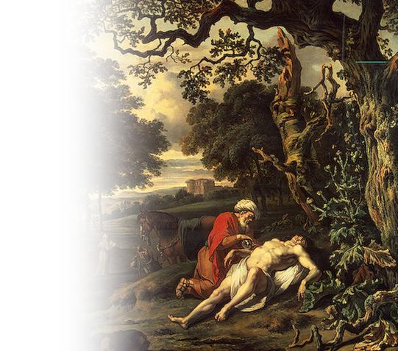
4. Pray with Anointing Oil
He went to him and bandaged his wounds, pouring on oil and wine. (Luke 10:34)
¹⁴ Is any one of you sick? He should call the elders of the church to pray over him and anoint[ing] him with oil in the name of the Lord.
The word used here is αλειφω = rub (as to apply medicine)

Slide 21
4. Pray with Anointing Oil
He went to him and bandaged his wounds, pouring on oil and wine. (Luke 10:34)
¹⁴ Is any one of you sick? He should call the elders of the church to pray over him and anoint[ing] him with oil in the name of the Lord.
... for I am the LORD, who heals you. (Exo 15:26)
The word used here is αλειφω = rub (as to apply medicine)

Slide 22
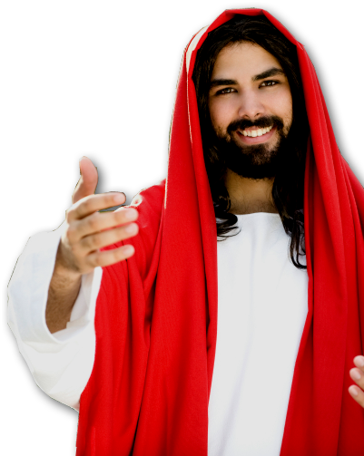
4. Pray with Anointing Oil
¹⁴ Is any one of you sick? He should call the elders of the church to pray over him and anoint[ing] him with oil in the name of the Lord.
The word used here is αλειφω = rub (as to apply medicine)
NOT χριω =
ceremonially, symbolic ritual

Slide 23
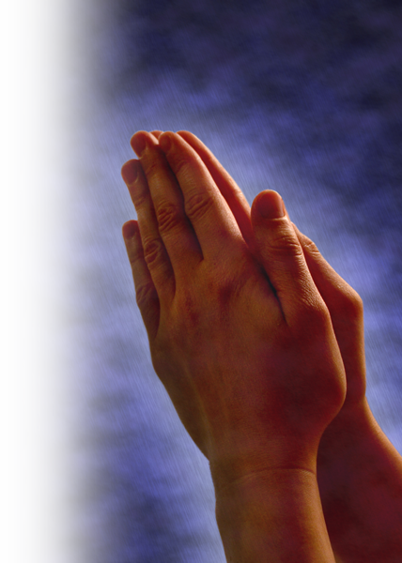
5. Key Ingredient in Prayer = Elders’ FAITH
¹⁵ And the prayer offered in faith will make the sick person well; the Lord will raise him up. If he has sinned, he will be forgiven.
Notes:
Mzrk 2 he saw their faith.

Slide 24
The EFFECTIVENESS
of Prayer
Notes:
Sick woman = iStock_000011674146Small.jpg

Slide 25
Prayer is Effective for WELLNESS! 15
¹⁵ And the prayer offered in faith will make the sick person well; the Lord will raise him up. If he has sinned, he will be forgiven.

Slide 26
Prayer is Effective for WELLNESS! 15
¹⁵ And the prayer offered in faith will make the sick person well; the Lord will raise him up. If he has sinned, he will be forgiven.

Slide 27
Prayer is Effective for FORGIVENESS! 15
¹⁵ And the prayer offered in faith will make the sick person well; the Lord will raise him up. If he has sinned, he will be forgiven.

Slide 28
Prayer is Effective for FORGIVENESS! 15
¹⁵ And the prayer offered in faith will make the sick person well; the Lord will raise him up. If he has sinned, he will be forgiven.

Slide 29
Prayer is Effective for FORGIVENESS! 15
¹⁵ And the prayer offered in faith will make the sick person well; the Lord will raise him up. If he has sinned, he will be forgiven.
Not all sickness is related to immediate sin:

Slide 30
Prayer is Effective for FORGIVENESS! 15
¹⁵ And the prayer offered in faith will make the sick person well; the Lord will raise him up. If he has sinned, he will be forgiven.
Not all sickness is related to immediate sin:
Man born blind (John 9:2)

Slide 31
Prayer is Effective for FORGIVENESS! 15
¹⁵ And the prayer offered in faith will make the sick person well; the Lord will raise him up. If he has sinned, he will be forgiven.
Not all sickness is related to immediate sin:
Man born blind (John 9:2)
Paul’s “thorn in my flesh” (2Co 12:7 )

Slide 32
Prayer is Effective for FORGIVENESS! 15
¹⁵ And the prayer offered in faith will make the sick person well; the Lord will raise him up. If he has sinned, he will be forgiven.
SOME sickness is related to immediate sin:

Slide 33
Prayer is Effective for FORGIVENESS! 15
¹⁵ And the prayer offered in faith will make the sick person well; the Lord will raise him up. If he has sinned, he will be forgiven.
SOME sickness is related to immediate sin:
²⁹ For anyone who eats and drinks [the Lord’s Supper] without recognizing the body of the Lord eats and drinks judgment on himself.

Slide 34
Prayer is Effective for FORGIVENESS! 15
¹⁵ And the prayer offered in faith will make the sick person well; the Lord will raise him up. If he has sinned, he will be forgiven.
SOME sickness is related to immediate sin:
³⁰ That is why many among you are weak and sick, and a number of you have fallen asleep. (1Co 11:29-30)

Slide 35
Prayer is Effective with CONFESSION! 16
¹⁶ Therefore confess your sins to each other and pray for each other so that you may be healed. The prayer of a righteous man is powerful and effective.

Slide 36
Prayer is Effective with CONFESSION! 16
¹⁶ Therefore confess your sins to each other and pray for each other so that you may be healed. The prayer of a righteous man is powerful and effective.
⁹ If we confess our sins, he is faithful and just and will forgive us our sins and purify us from all unrighteousness.
(1John 1:9)

Slide 37
Prayer is Effective for HEALING! 16
¹⁶ Therefore confess your sins to each other and pray for each other so that you may be healed. The prayer of a righteous man is powerful and effective.

Slide 38
Prayer is Effective for HEALING! 16
¹⁶ Therefore confess your sins to each other and pray for each other so that you may be healed. The prayer of a righteous man is powerful and effective.
WHY?

Slide 39
Prayer is Effective for HEALING! 16
¹⁶ Therefore confess your sins to each other and pray for each other so that you may be healed. The prayer of a righteous man is powerful and effective.
BECAUSE

Slide 40
The ILLUSTRATION
of Prayer
Notes:
Sick woman = iStock_000011674146Small.jpg

Slide 41
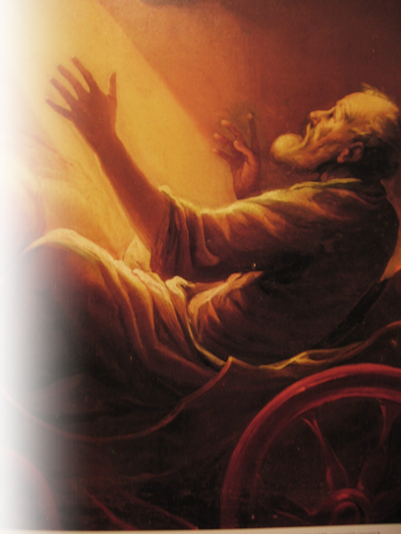
Prayer is ILLUSTRATED! 17-18
ELIJAH
¹⁷ Elijah was a man just like us. He prayed earnestly that it would not rain, and it did not rain on the land for three and a half years.
Notes:
Elijah = http://upload.wikimedia.org/wikipedia/commons/3/36/ACifrondi_Elia_sul_carro_di_fuoco.JPG

Slide 42
Prayer is ILLUSTRATED! 17-18
ELIJAH
¹⁸ Again he prayed, and the heavens gave rain, and the earth produced its crops.
Notes:
Elijah = http://upload.wikimedia.org/wikipedia/commons/3/36/ACifrondi_Elia_sul_carro_di_fuoco.JPG

Slide 43
Prayer is ILLUSTRATED! 17-18
ELIJAH
¹⁷ Elijah was a man just like us. He prayed earnestly that it would not rain, and it did not rain on the land for three and a half years.
Notes:
Elijah = http://upload.wikimedia.org/wikipedia/commons/3/36/ACifrondi_Elia_sul_carro_di_fuoco.JPG

Slide 44
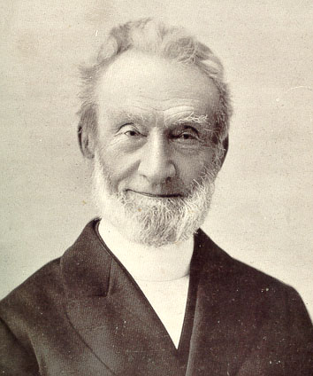
Prayer is ILLUSTRATED! 17-18
ELIJAH
¹⁷ Elijah was a man just like us. He prayed earnestly that it would not rain, and it did not rain on the land for three and a half years.
Notes:
George Muller photo: http://en.wikipedia.org/wiki/File:George_Muller.jpg
(September 27, 1805 – March 10, 1898) Müller prayed about everything and expected each prayer to be answered. Once, whilst crossing the Atlantic, his ship ran into thick fog. He explained to the captain that he needed to be in Quebec by the following afternoon, but Captain Dutton said that he was slowing the ship down for safety and Müller's appointment would have to be missed. Müller asked to use the chartroom to pray for the lifting of the fog. The captain followed him down, claiming it would be a waste of time. After Müller prayed, the captain started to pray, but Müller stopped him; partly because of the captain's unbelief, but mainly because he believed the prayer had already been answered. When the two men went back to the bridge, they found the fog had lifted. The captain became a Christian shortly afterwards^{[18]}
There have been times in my life where I have sensed the urging of the Spirit of God to pray. Once I was with a parishioner who was elderly and terrified of the pending surgery she was facing—she was afraid that she would die. From that prompting of the Spirit, I said, “You are not going to die.” She said, “How do you know?” I said, “You are too scared to die! God has said ‘Even Though I pass through the valley of death I will fear no evil for You are with me.’ (Psa 23:4) You are to scared to die. God will give you a peace because he will be with you. You are not going to die.” I then prayed for God to give her peace. He did and she survived. Just over a year later, she fell ill again, she told her daughter, “I’m ready for the Lord to take me home.” The daughter was with her and said she slipped peacefully into eternity.
That’s the way it is with the righteous!

Slide 45
The REMINDER
for Prayer
Notes:
Sick woman = iStock_000011674146Small.jpg

Slide 46
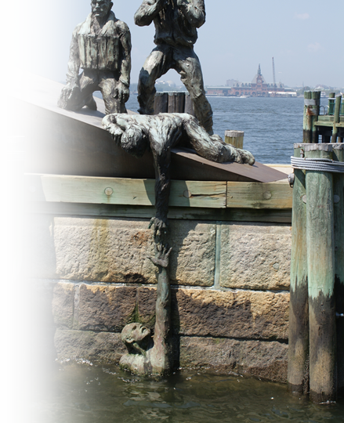
Pray for Backsliders! 19-20
¹⁹ My brothers, if one of you should wander from the truth and someone should bring him back,
Notes:
Rescue statues NY City = Bible Point photo

Slide 47
Pray for Salvation! 19-20
²⁰ remember this: Whoever turns a sinner from the error of his way will save him from death and cover over a
multitude of sins.

Slide 48
Invitation to you!
Examine your heart before the Lord’s Supper.

Slide 49
Invitation to you!
Examine your heart before the Lord’s Supper.
Afterward the Lord’s Supper
Prayer with Anointing Oil

Slide 50
Invitation to you!
Examine your heart before the Lord’s Supper.
Afterward the Lord’s Supper
Prayer with Anointing Oil
Business Meeting

Slide 51
Let’s Pray!

