Slide 1
JAMES
A FAITH THAT WORKS
Notes:
BACKGROUND = https://pixabay.com/en/gears-cogs-machine-machinery-1236578/
Copyright © 2006−2021. All rights reserved. Bible Point is a registered trademark of Dennis Henderson. All other trademarks acknowledged.
Bible Point contains graphics from Bible Point artists. These illustrations belong to Bible Point and the respective artists. You may use the designs and illustrations for graphical illustration of lessons free and without special permission, provided they are not used in any way that maligns the Christian faith. Furthermore, republication or production of any illustration by any other graphic service whether it be in book, in a machine-readable form, or in any other design resource is strictly prohibited. Furthermore, they cannot be duplicated or resold as any other form of publishing, clip art, or graphic resource.
So What does it mean? (A simple translations of the legal jargon)
So, if you don’t own the presentation(s), graphic(s), and text(s) how can you legally use them? The purchase of the license allows you to use all the images in the product. However, the actual ownership and copyright of the presentation(s), graphic(s), and text(s) remain the property of Bible Point and its licensors. If you had plans on using this product in your “for sale” work—think again!
License Agreement
Article 1: License Grant
All the graphics and text in Bible Point presentations (excluding quotes from the Bible and stated sources) are the intellectual and real property of Bible Point and its licensors, and is protected by law, including United States copyright laws and international treaties. Bible Point grants to you a license:
1. To use the presentation in a single church, single school, or single office of a Christian organization.
2. To make a single archival back-up copy of the program.
3. To modify the presentation(s) and merge with other presentations in a single church, school, or Christian organization.
4. To transfer to another party if that party agrees to accept the terms and conditions of this agreement, and you do not retain any copies of the presentation, whether printed, machine readable, modified, or merged form.
Article 2: Terms
This license is effective until terminated. You may terminate the license at any time by destroying the presentation(s), graphic(s), or text(s) together with all copies, modifications and merged portions in any form. Bible Point may terminate your license if you fail to comply with this Agreement. You agree, upon such termination, for any reason, to destroy the presentation(s), graphics, and text(s) with all copies, modifications, and merged portions in any form.
Article 3: Disclaimers
1. Bible Point presentations, graphics, and texts are licensed to you As Is. You, the consumer, bear the entire risk relating to the quality and performance of the presentation(s), graphic(s), or text(s). In no event will Bible Point be liable for damages resulting from any defect.
2. Thirty-day limited warrantee on disks. Bible Point warrants the disks to be free of defects in material and workmanship under normal use for 30 days after purchase. During the 30-day period you may return a defective presentation, graphic, or text with proof of purchase and it will be replaced without charge, unless the presentation is damaged by misuse.
Article 4: General
1. You may not sub-license, assign, or transfer the license of the presentation(s), graphic(s), or text(s) except as provided by this Agreement.
2. This Agreement will be governed by the laws of the State of Michigan.
So What does it mean? (A simple translations of the legal jargon)
May I let someone borrow or copy my licensed Bible Point presentation (even after I modified it)? As long as it is within your local church, or single school, or the immediate office of a Christian organization you may. Otherwise, please refer the person interested in borrowing to: http://www.biblepoint.com or E-mail: dennis@DrDH.net with any related questions.

Slide 2

When You SUFFER!

Slide 3
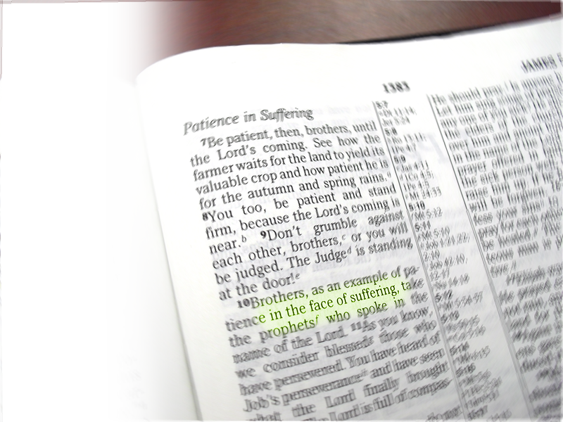
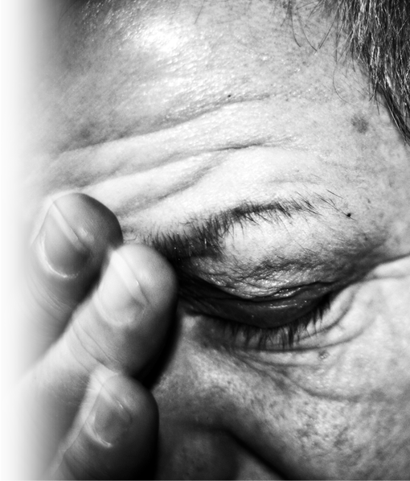
“in the face of suffering”
Notes:
Bible = Bible Point photo.

Slide 4
“in the face of suffering”
Seven ways to show that
your faith works:
Notes:
Bible = Bible Point photo.

Slide 5
1-Be Patient
⁷ Be patient, then, brothers,
until the Lord's coming.
Notes:
Crucifixion = http://www.sxc.hu/browse.phtml?f=download&id=510815
Empty tomb = Bible Point photo
Jesus = istock photo --

Slide 6
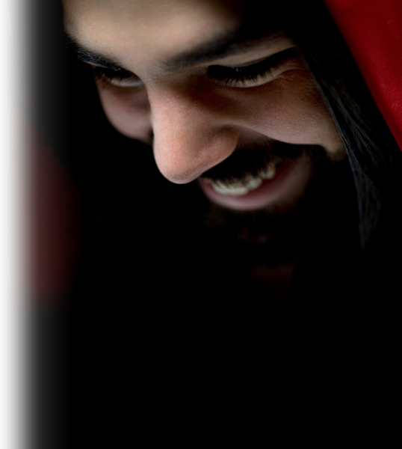
1-Be Patient – to 2nd Coming
⁷ Be patient, then, brothers,
until the Lord's coming.
Notes:
Crucifixion = http://www.sxc.hu/browse.phtml?f=download&id=510815
Empty tomb = Bible Point photo
Jesus = istock photo --

Slide 7
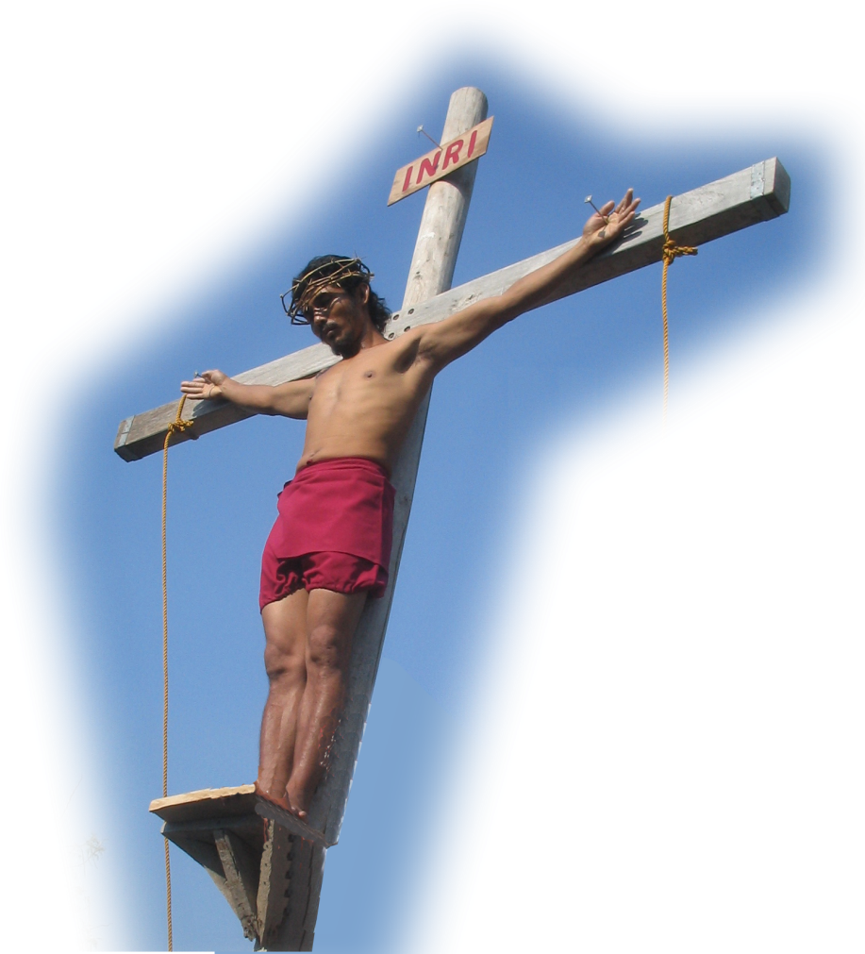
1-Be Patient – to 2nd Coming
⁷ Be patient, then, brothers,
until the Lord's coming.
Notes:
Crucifixion = http://www.sxc.hu/browse.phtml?f=download&id=510815
Empty tomb = Bible Point photo
Jesus = istock photo --

Slide 8
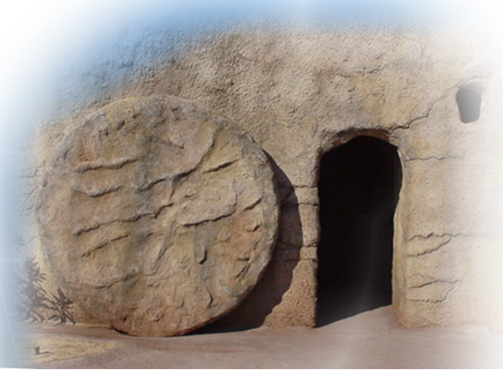
1-Be Patient – to 2nd Coming
⁷ Be patient, then, brothers,
until the Lord's coming.
Notes:
Crucifixion = http://www.sxc.hu/browse.phtml?f=download&id=510815
Empty tomb = Bible Point photo
Jesus = istock photo --

Slide 9
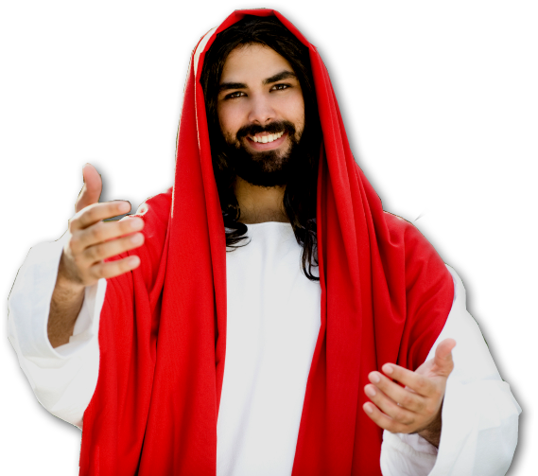
1-Be Patient – to 2nd Coming
⁷ Be patient, then, brothers,
until the Lord's coming.
Notes:
Crucifixion = http://www.sxc.hu/browse.phtml?f=download&id=510815
Empty tomb = Bible Point photo
Jesus = istock photo --

Slide 10



1-Be Patient – to 2nd Coming
⁷ Be patient, then, brothers,
until the Lord's coming.
Notes:
Crucifixion = http://www.sxc.hu/browse.phtml?f=download&id=510815
Empty tomb = Bible Point photo
Jesus = istock photo --

Slide 11
1-Be Patient – to 2nd Coming
⁷ Be patient, then, brothers,
until the Lord's coming.
Notes:
Crucifixion = http://www.sxc.hu/browse.phtml?f=download&id=510815
Empty tomb = Bible Point photo
Jesus = istock photo --

Slide 12
1-Be Patient – to 2nd Coming
⁷ Be patient, then, brothers,
until the Lord's coming.
Notes:
Crucifixion = http://www.sxc.hu/browse.phtml?f=download&id=510815
Empty tomb = Bible Point photo
Jesus = istock photo --

Slide 13
1-Be Patient – to 2nd Coming
⁷ Be patient, then, brothers,
until the Lord's coming.
Notes:
Crucifixion = http://www.sxc.hu/browse.phtml?f=download&id=510815
Empty tomb = Bible Point photo
Jesus = istock photo --

Slide 14
1-Be Patient – to 2nd Coming
⁷ Be patient, then, brothers,
until the Lord's coming.
Notes:
Crucifixion = http://www.sxc.hu/browse.phtml?f=download&id=510815
Empty tomb = Bible Point photo
Jesus = istock photo --

Slide 15
1-Be Patient – to 2nd Coming
⁷ Be patient, then, brothers,
until the Lord's coming.
Notes:
Crucifixion = http://www.sxc.hu/browse.phtml?f=download&id=510815
Empty tomb = Bible Point photo
Jesus = istock photo --

Slide 16

1-Be Patient – to 2nd Coming
⁷ Be patient, then, brothers,
until the Lord's coming.
Notes:
Crucifixion = http://www.sxc.hu/browse.phtml?f=download&id=510815
Empty tomb = Bible Point photo
Jesus = istock photo –
Chruch = http://farm1.static.flickr.com/1/63194_1c00ef227a.jpg

Slide 17
1-Be Patient – to 2nd Coming
⁷ Be patient, then, brothers,
until the Lord's coming.
Notes:
Crucifixion = http://www.sxc.hu/browse.phtml?f=download&id=510815
Empty tomb = Bible Point photo
Jesus = istock photo --

Slide 18
1-Be Patient – to 2nd Coming
⁷ Be patient, then, brothers,
until the Lord's coming.
Notes:
Crucifixion = http://www.sxc.hu/browse.phtml?f=download&id=510815
Empty tomb = Bible Point photo
Jesus = istock photo --

Slide 19
1-Be Patient – to 2nd Coming
⁷ Be patient, then, brothers,
until the Lord's coming.
Notes:
Crucifixion = http://www.sxc.hu/browse.phtml?f=download&id=510815
Empty tomb = Bible Point photo
Jesus = istock photo --

Slide 20
1-Be Patient – to 2nd Coming
⁷ Be patient, then, brothers,
until the Lord's coming.
Notes:
Crucifixion = http://www.sxc.hu/browse.phtml?f=download&id=510815
Empty tomb = Bible Point photo
Jesus = istock photo --

Slide 21

1-Be Patient – to 2nd Coming
⁷ Be patient, then, brothers,
until the Lord's coming.
Notes:
Crucifixion = http://www.sxc.hu/browse.phtml?f=download&id=510815
Empty tomb = Bible Point photo
Jesus = istock photo –
Lightning: http://www.sxc.hu/

Slide 22
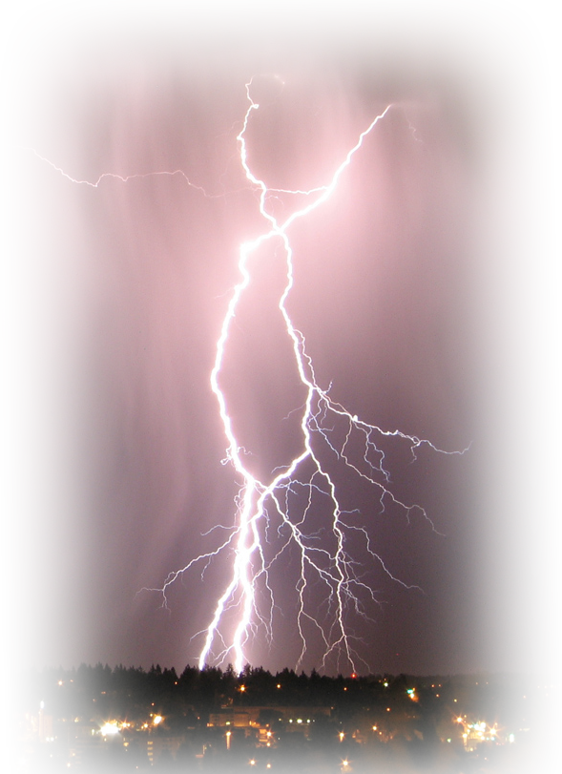
1-Be Patient – to 2nd Coming
⁷ Be patient, then, brothers,
until the Lord's coming.
Notes:
Crucifixion = http://www.sxc.hu/browse.phtml?f=download&id=510815
Empty tomb = Bible Point photo
Jesus = istock photo –
Lightning: http://www.sxc.hu/

Slide 23
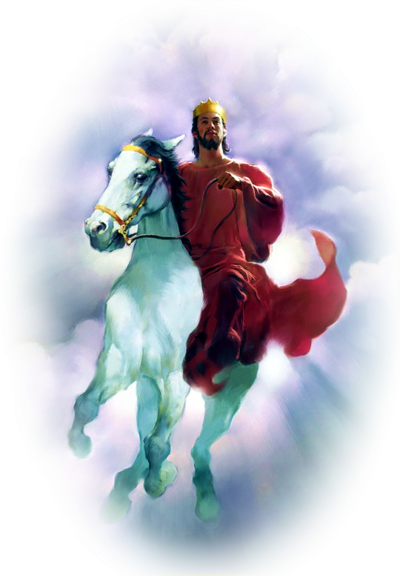
1-Be Patient – to 2nd Coming
⁷ Be patient, then, brothers,
until the Lord's coming.
Notes:
Crucifixion = http://www.sxc.hu/browse.phtml?f=download&id=510815
Empty tomb = Bible Point photo
Jesus = istock photo –
Lightning: http://www.sxc.hu/
Jesus on horse = flicker image

Slide 24
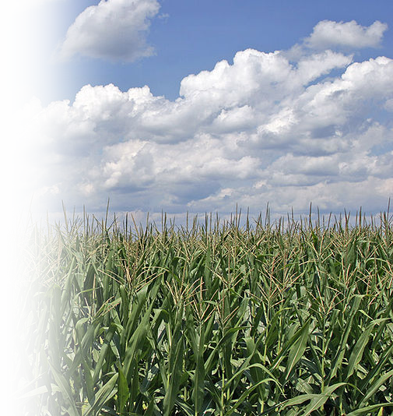
1-Be Patient
⁷ Be patient, then, brothers,
until the Lord's coming.
See how the farmer waits for the land to yield its valuable crop and how patient he is for the autumn and spring rains.

Slide 25
1-Be Patient
⁴ They will say, "Where is this 'coming' he promised? .... ⁸ But do not forget this one thing, dear friends: With the Lord a day is like a thousand years, and a thousand years are like a day. ⁹ The Lord is not slow in keeping his promise, as some understand slowness. He is patient with you, not wanting anyone to perish, but everyone to come to repentance. (2 Peter 3:4-9)

Slide 26
1-Be Patient
2 DAYS
⁴ They will say, "Where is this 'coming' he promised? .... ⁸ But do not forget this one thing, dear friends: With the Lord a day is like a thousand years, and a thousand years are like a day. ⁹ The Lord is not slow in keeping his promise, as some understand slowness. He is patient with you, not wanting anyone to perish, but everyone to come to repentance. (2 Peter 3:4-9)

Slide 27
1-Be Patient
2 DAYS
⁴ They will say, "Where is this 'coming' he promised? .... ⁸ But do not forget this one thing, dear friends: With the Lord a day is like a thousand years, and a thousand years are like a day. ⁹ The Lord is not slow in keeping his promise, as some understand slowness. He is patient with you, not wanting anyone to perish, but everyone to come to repentance. (2 Peter 3:4-9)

Slide 28

2-Be STEADFAST
⁸ You too, be patient and stand firm, because the Lord's coming is near.
Literally:
“make your
heart firm”
Notes:
Heart = http://www.sxc.hu/browse.phtml?f=download&id=1266399
Grass = http://www.sxc.hu/browse.phtml?f=download&id=1280453

Slide 29
2-Be STEADFAST
⁸ You too, be patient and stand firm, because the Lord's coming is near.
“crown of righteousness”... unto all them also that love his appearing. 2Ti 4:8 KJV
Literally:
“make your
heart firm”
Notes:
Heart = http://www.sxc.hu/browse.phtml?f=download&id=1266399
Grass = http://www.sxc.hu/browse.phtml?f=download&id=1280453

Slide 30

3-Be HAPPY
⁹ Don't grumble against each other, brothers, or you will be judged. The Judge is standing at the door!
Notes:
HPPY FACE = http://www.publicdomainpictures.net/view-image.php?image=33364&picture=smiley

Slide 31
3-Be HAPPY
⁹ Don't grumble against each other, brothers, or you will be judged. The Judge is standing at the door!
KUWITYERBELIACHIN
Notes:
HPPY FACE = http://www.publicdomainpictures.net/view-image.php?image=33364&picture=smiley

Slide 32
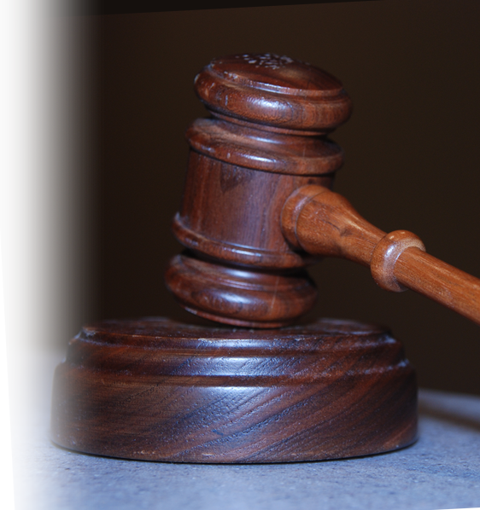
3-Be HAPPY
⁹ Don't grumble against each other, brothers, or you will be judged. The Judge is standing at the door!
Notes:
Gavel = http://www.sxc.hu/browse.phtml?f=download&id=952313

Slide 33
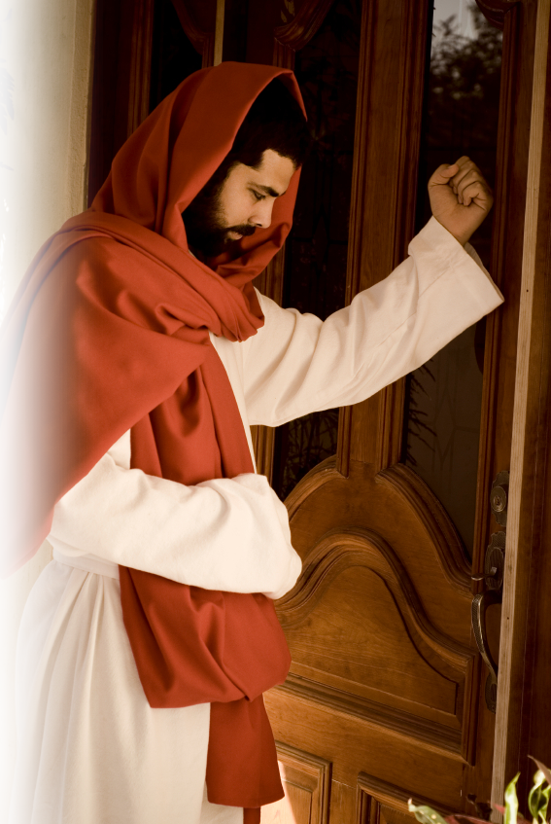
3-Be HAPPY
⁹ Don't grumble against each other, brothers, or you will be judged. The Judge is standing at the door!
Notes:
Jesus at door: iStock_000003455310Small

Slide 34

4-Be EXEMPLARY
¹⁰ Brothers, as an example
of patience in the face
of suffering, take the
prophets who spoke in
the name of the Lord.

Slide 35
4-Be EXEMPLARY
¹⁰ Brothers, as an example
of patience in the face
of suffering, take the
prophets who spoke in
the name of the Lord.

Slide 36
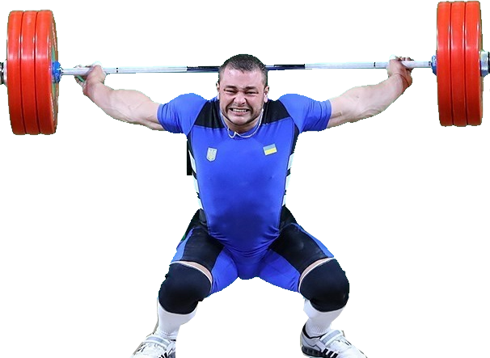
5-Be PERSEVERING
¹¹ As you know, we consider blessed those who have persevered. ....
Notes:
https://en.wikipedia.org/wiki/Dmytro_Chumak_(weightlifter)#/media/File:Dmytro_Chumak_Rio_2016.jpg

Slide 37
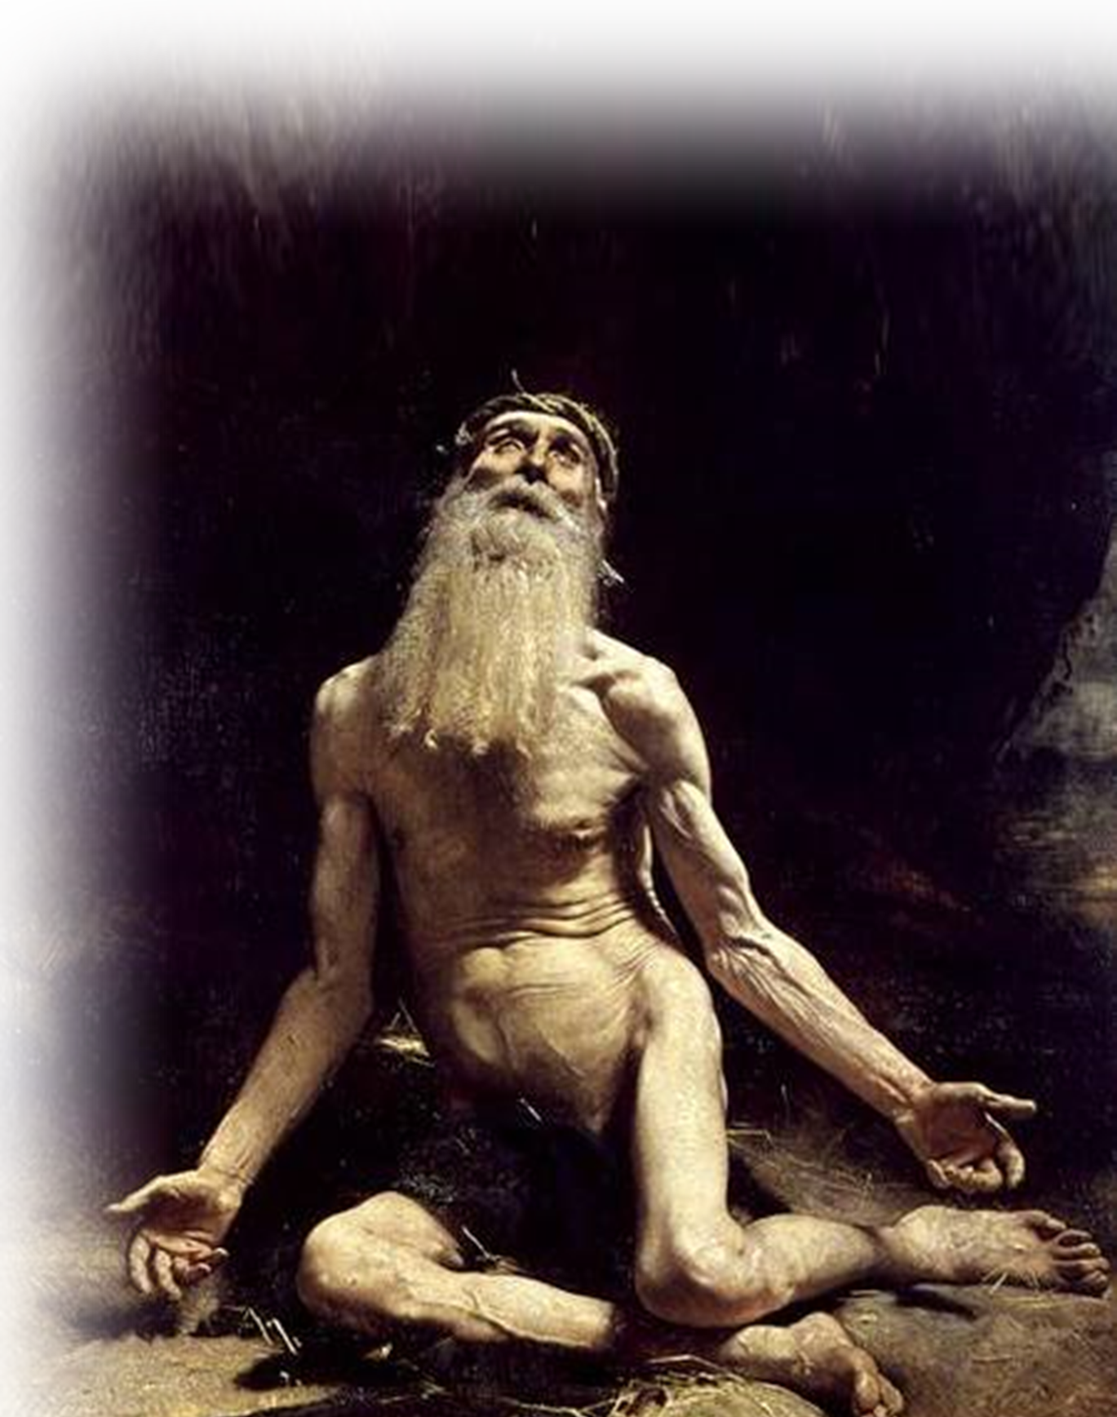
6-Be EXPECTANT
¹¹ .... You have heard of Job's perseverance and have seen what the Lord finally brought about. The Lord is full of compassion and mercy.
Notes:
JOB = http://commons.wikimedia.org/wiki/File:Blake_Job_3.jpg

Slide 38
6-Be EXPECTANT
¹¹ .... You have heard of Job's perseverance and have seen what the Lord finally brought about. The Lord is full of compassion and mercy.

Slide 39
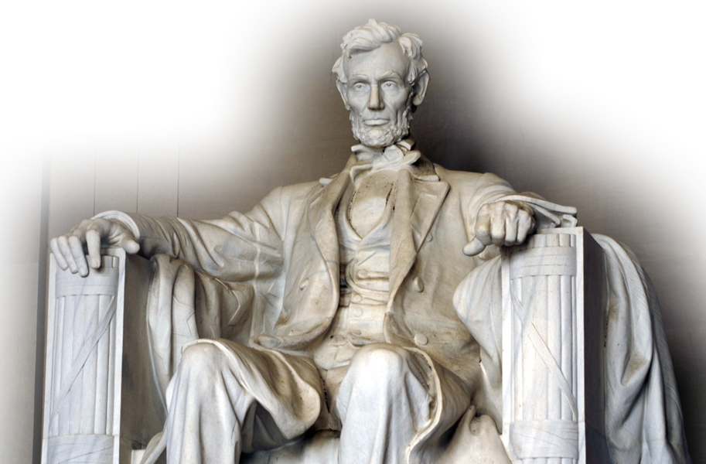
7-Be HONEST
¹² Above all, my brothers, do not swear--not by heaven or by earth or by anything else. Let your "Yes" be yes,
and your "No," no,
or you will be
condemned.

Slide 40
Let’s wrap this up ...
No one enjoys suffering ...

Slide 41
Let’s wrap this up ...
No one enjoys suffering ...
But the hope of Christ’s return motivate us to:

Slide 42
Let’s wrap this up ...
No one enjoys suffering ...
But the hope of Christ’s return motivate us to:
1- Be Patient

Slide 43
Let’s wrap this up ...
No one enjoys suffering ...
But the hope of Christ’s return motivate us to:
1- Be Patient
2- Be Steadfast

Slide 44
Let’s wrap this up ...
No one enjoys suffering ...
But the hope of Christ’s return motivate us to:
1- Be Patient
2- Be Steadfast
3- Be Happy

Slide 45
Let’s wrap this up ...
No one enjoys suffering ...
But the hope of Christ’s return motivate us to:
1- Be Patient
2- Be Steadfast
3- Be Happy
4- Be Exemplary

Slide 46
Let’s wrap this up ...
No one enjoys suffering ...
But the hope of Christ’s return motivate us to:
1- Be Patient
2- Be Steadfast
3- Be Happy
4- Be Exemplary
5- Be Persevering

Slide 47
Let’s wrap this up ...
No one enjoys suffering ...
But the hope of Christ’s return motivate us to:
1- Be Patient
2- Be Steadfast
3- Be Happy
4- Be Exemplary
5- Be Persevering
6- Be Expectant

Slide 48
Let’s wrap this up ...
No one enjoys suffering ...
But the hope of Christ’s return motivate us to:
1- Be Patient
2- Be Steadfast
3- Be Happy
4- Be Exemplary
5- Be Persevering
6- Be Expectant
7- Be Honest

Slide 49
Let’s wrap this up ...
No one enjoys suffering ...
But the hope of Christ’s return motivate us to:
1- Be Patient
2- Be Steadfast
3- Be Happy
4- Be Exemplary
5- Be Persevering
6- Be Expectant
7- Be Honest
That is the evidence of
A FAITH THAT WORKS!

Slide 50
Let’s Pray

