Slide 1
JAMES
A FAITH THAT WORKS
Notes:
BACKGROUND = https://pixabay.com/en/gears-cogs-machine-machinery-1236578/
Copyright © 2006−2021. All rights reserved. Bible Point is a registered trademark of Dennis Henderson. All other trademarks acknowledged.
Bible Point contains graphics from Bible Point artists. These illustrations belong to Bible Point and the respective artists. You may use the designs and illustrations for graphical illustration of lessons free and without special permission, provided they are not used in any way that maligns the Christian faith. Furthermore, republication or production of any illustration by any other graphic service whether it be in book, in a machine-readable form, or in any other design resource is strictly prohibited. Furthermore, they cannot be duplicated or resold as any other form of publishing, clip art, or graphic resource.
So What does it mean? (A simple translations of the legal jargon)
So, if you don’t own the presentation(s), graphic(s), and text(s) how can you legally use them? The purchase of the license allows you to use all the images in the product. However, the actual ownership and copyright of the presentation(s), graphic(s), and text(s) remain the property of Bible Point and its licensors. If you had plans on using this product in your “for sale” work—think again!
License Agreement
Article 1: License Grant
All the graphics and text in Bible Point presentations (excluding quotes from the Bible and stated sources) are the intellectual and real property of Bible Point and its licensors, and is protected by law, including United States copyright laws and international treaties. Bible Point grants to you a license:
1. To use the presentation in a single church, single school, or single office of a Christian organization.
2. To make a single archival back-up copy of the program.
3. To modify the presentation(s) and merge with other presentations in a single church, school, or Christian organization.
4. To transfer to another party if that party agrees to accept the terms and conditions of this agreement, and you do not retain any copies of the presentation, whether printed, machine readable, modified, or merged form.
Article 2: Terms
This license is effective until terminated. You may terminate the license at any time by destroying the presentation(s), graphic(s), or text(s) together with all copies, modifications and merged portions in any form. Bible Point may terminate your license if you fail to comply with this Agreement. You agree, upon such termination, for any reason, to destroy the presentation(s), graphics, and text(s) with all copies, modifications, and merged portions in any form.
Article 3: Disclaimers
1. Bible Point presentations, graphics, and texts are licensed to you As Is. You, the consumer, bear the entire risk relating to the quality and performance of the presentation(s), graphic(s), or text(s). In no event will Bible Point be liable for damages resulting from any defect.
2. Thirty-day limited warrantee on disks. Bible Point warrants the disks to be free of defects in material and workmanship under normal use for 30 days after purchase. During the 30-day period you may return a defective presentation, graphic, or text with proof of purchase and it will be replaced without charge, unless the presentation is damaged by misuse.
Article 4: General
1. You may not sub-license, assign, or transfer the license of the presentation(s), graphic(s), or text(s) except as provided by this Agreement.
2. This Agreement will be governed by the laws of the State of Michigan.
So What does it mean? (A simple translations of the legal jargon)
May I let someone borrow or copy my licensed Bible Point presentation (even after I modified it)? As long as it is within your local church, or single school, or the immediate office of a Christian organization you may. Otherwise, please refer the person interested in borrowing to: http://www.biblepoint.com or E-mail: dennis@DrDH.net with any related questions.

Slide 2
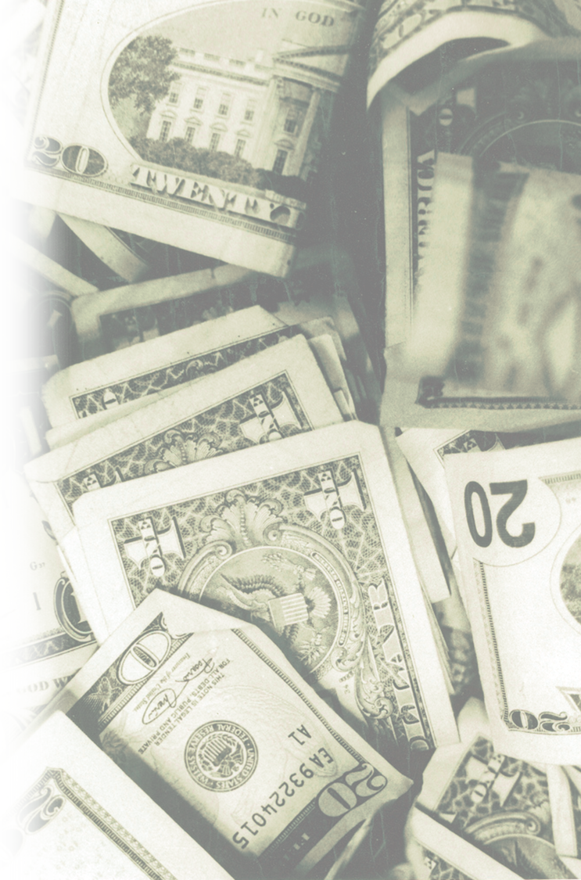
When Money
is all that MATTERS!

Slide 3
Two Extremes Today:
God wants me rich ...

Slide 4
Two Extremes Today:
God wants me rich ...
The “Prosperity Gospel”

Slide 5
Two Extremes Today:
God wants me rich ...
The “Prosperity Gospel”
God wants me poor ...

Slide 6
Two Extremes Today:
God wants me rich ...
The “Prosperity Gospel”
God wants me poor ...
The “Vow of Poverty Gospel”

Slide 7
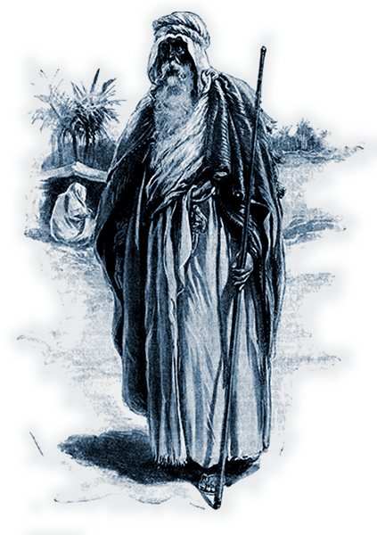
Abraham was Rich

Slide 8
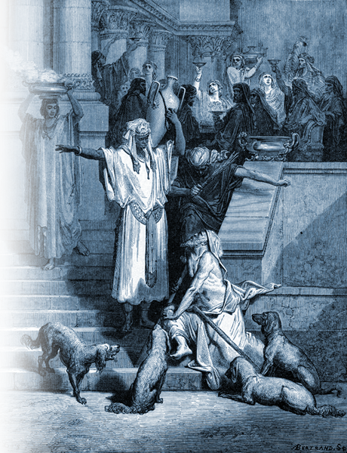
Dives was Rich!
Notes:
Free photo: http://upload.wikimedia.org/wikipedia/commons/5/59/Gustave_Dore_Lazarus_and_the_Rich_Man.jpg

Slide 9
Dives was Rich!
Notes:
Free photo: http://upload.wikimedia.org/wikipedia/commons/5/59/Gustave_Dore_Lazarus_and_the_Rich_Man.jpg

Slide 10
Lazarus was Poor!
Notes:
Free photo: http://upload.wikimedia.org/wikipedia/commons/5/59/Gustave_Dore_Lazarus_and_the_Rich_Man.jpg

Slide 11
Lazarus was Rich!
Notes:
Free photo: http://upload.wikimedia.org/wikipedia/commons/5/59/Gustave_Dore_Lazarus_and_the_Rich_Man.jpg

Slide 12
Dives was Poor!
Notes:
Free photo: http://upload.wikimedia.org/wikipedia/commons/5/59/Gustave_Dore_Lazarus_and_the_Rich_Man.jpg
Dives and Lazarus -- punch at the end is about faith that works--called "repentance." If someone went to them from the dead they will repent (i.e. believe so strongly that they change their lives). Here's the punch to the story. Jesus said they have the law and the prophets (the Word of God) let them hear the Word, for they will not be persuaded (convinced) even though someone would be raised from the dead.

Slide 13
Two Extremes Today:
God wants me rich ...
The “Prosperity Gospel”
God wants me poor ...
The “Vow of Poverty Gospel”
Truth: God wants us to honor
Him with His wealth!

Slide 14
Two Extremes Today:
God wants me rich ...
The “Prosperity Gospel”
God wants me poor ...
The “Vow of Poverty Gospel”
Truth: ⁷ ...What do you have that
you did not receive? (1Cor 4:7)

Slide 15
Two Extremes Today:
God wants me rich ...
The “Prosperity Gospel”
God wants me poor ...
The “Vow of Poverty Gospel”
Truth: ² Moreover it is required
in stewards, that a man be
found faithful. (1Cor 4:2 KJV)

Slide 16
It’s how you use your wealth

Slide 17
It’s how you use your wealth
WARNING
about Abusing Wealth

Slide 18
It’s how you use your wealth
WARNING
about Abusing Wealth
^{5:1} Now listen, you rich people,
weep and wail because of the
misery that is coming upon you.
Notes:
Nine times James has addressed his readers as “my brothers.” 1:2,16, 19; 2:1, 5, 14,;3:1; 10,12.
Now he addresses not “my brothers” but “you rich people.” It’s as if he is distinguishing between believers and rich people. Perhaps like Dives and Lazarus.

Slide 19
It’s how you use your wealth
WARNING
about Abusing Wealth
^{5:1} Now listen, you rich people,
weep and wail because of the
misery that is coming upon you.

Slide 20
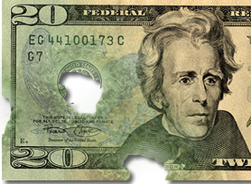
WARNING: Money Corrupts
² Your wealth has rotted,
and moths have
eaten your clothes.
Notes:
20 dollar bill free =http://farm1.static.flickr.com/58/211332277_87657ead52.jpg

Slide 21
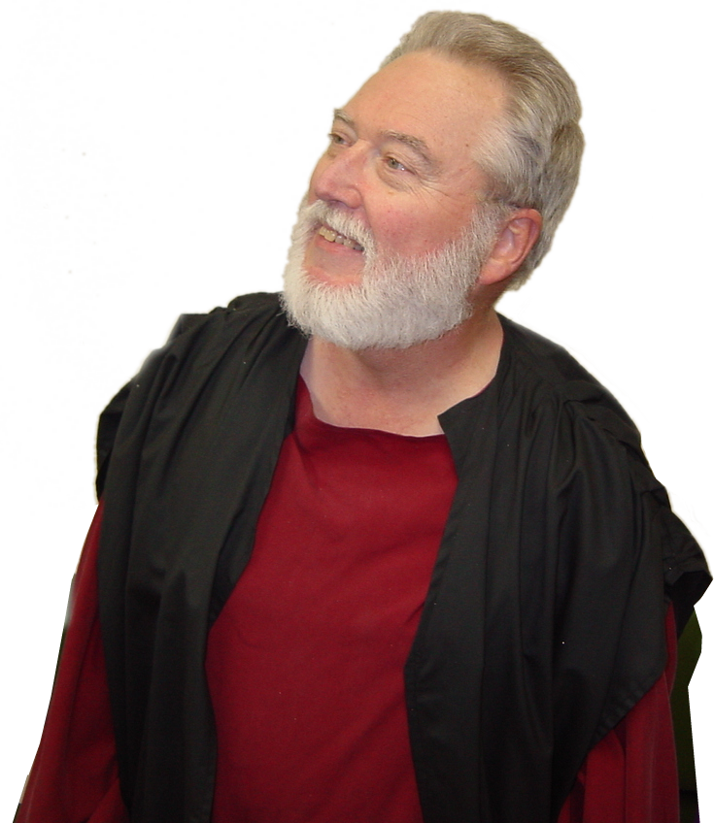
CONSIDER: Your Ways!
Haggai 1
Notes:
² This is what the LORD Almighty says: "These people say, 'The time has not yet come for the LORD's house to be built.' "
³ Then the word of the LORD came through the prophet Haggai:
⁴ "Is it a time for you yourselves to be living in your paneled houses, while this house remains a ruin?"
⁵ Now this is what the LORD Almighty says: "Give careful thought to your ways.
⁶ You have planted much, but have harvested little. You eat, but never have enough. You drink, but never have your fill. You put on clothes, but are not warm. You earn wages, only to put them in a purse with holes in it."
⁷ This is what the LORD Almighty says: "Give careful thought to your ways.
⁸ Go up into the mountains and bring down timber and build the house, so that I may take pleasure in it and be honored," says the LORD.
⁹ "You expected much, but see, it turned out to be little. What you brought home, I blew away. Why?" declares the LORD Almighty. "Because of my house, which remains a ruin, while each of you is busy with his own house.
¹⁰ Therefore, because of you the heavens have withheld their dew and the earth its crops.
¹¹ I called for a drought on the fields and the mountains, on the grain, the new wine, the oil and whatever the ground produces, on men and cattle, and on the labor of your hands."
(Hag 1:2-11 NIV)

Slide 22
CONSIDER: Your Ways!
Haggai 1
“Consider your ways” 1:5 (KJV)

Slide 23
CONSIDER: Your Ways!
Haggai 1
“Consider your ways” 1:5 (KJV)
“Give careful thought to your ways” (NIV)

Slide 24
CONSIDER: Your Ways!
Haggai 1
“Consider your ways” 1:5 (KJV)
“Give careful thought to your ways” (NIV)
“Look what’s happening to you!” (NLT)

Slide 25

CONSIDER: Your Ways!
Haggai 1
“Consider your ways” 1:5 (KJV)
“Give careful thought to your ways” (NIV)
“Look what’s happening to you!” (NLT)
“Set your heart on your ways” (DLH)

Slide 26
CONSIDER: Your Ways!
Haggai 1
“Consider your ways” 1:5 (KJV)
“Give careful thought to your ways” (NIV)
“Look what’s happening to you!” (NLT)
“Set your heart on your ways” (DLH)
Self
Examination

Slide 27

CONSIDER: Your Ways!
⁶ You have planted much
Notes:
Planting = FREEE = from http://www.sxc.hu/browse.phtml?f=download&id=428778

Slide 28
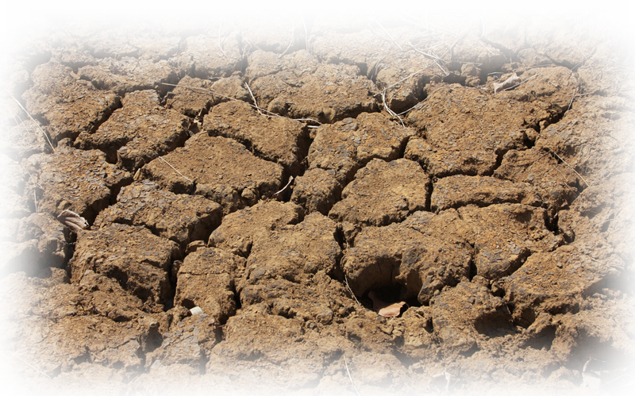
CONSIDER: Your Ways!
but have harvested little. …
Notes:
Planting = FREEE = from http://www.sxc.hu/browse.phtml?f=download&id=428778
Parched land = FREE = from http://www.sxc.hu/browse.phtml?f=download&id=1210033

Slide 29

CONSIDER: Your Ways!
You drink, …
Notes:
Pouring water = FREE = from http://commons.wikimedia.org/wiki/File:Stilles_Mineralwasser.jpg

Slide 30

CONSIDER: Your Ways!
You drink, but never have your fill. …
Notes:
Pouring water = FREE = from http://commons.wikimedia.org/wiki/File:Stilles_Mineralwasser.jpg
Modified Water Gauge = FREE = from http://www.sxc.hu/browse.phtml?f=download&id=1126306

Slide 31

CONSIDER: Your Ways!
You eat, …
Notes:
Hungry Jacks = FREE =with credit to http://www.flickr.com/photos/pdra/2279526616/

Slide 32
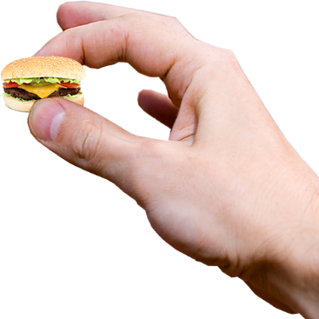
CONSIDER: Your Ways!
You eat, but never have enough.
Notes:
Hungry Jacks = FREE =with credit to http://www.flickr.com/photos/pdra/2279526616/
Modified hand = FREE = from http://www.dreamstime.com/keys-in-the-hand-stock-photography-imagefree2589062
Burger = FREE = from http://www.sxc.hu/browse.phtml?f=download&id=1097101

Slide 33

CONSIDER: Your Ways!
You put on clothes,
Notes:
Cold woman = FREE = from http://www.sxc.hu/photo/1330908

Slide 34
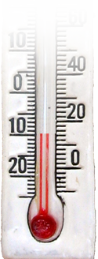
CONSIDER: Your Ways!
You put on clothes, but are not warm.
Notes:
Cold woman = FREE = from http://www.sxc.hu/photo/1330908
Thermometer = FREE = from http://www.dreamstime.com/decorative-thermometer-free-stock-photography-imagefree691557

Slide 35
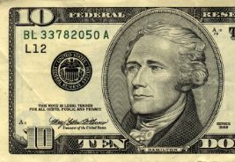
CONSIDER: Your Ways!
You earn wages,
Notes:
Bill = FREE = from BiblePoint photos

Slide 36
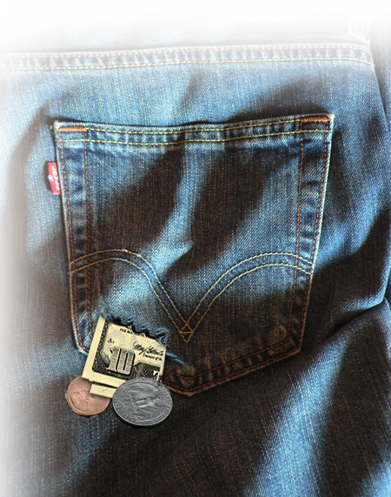
CONSIDER: Your Ways!
You earn wages, only to
put them in a purse with
holes in it."
Notes:
Bill = FREE = from BiblePoint photos
Pocket = FREE = from http://commons.wikimedia.org/wiki/File:Levi%27s_506_back_pocket.jpg

Slide 37
WARNING: Money Corrupts
² Your wealth has rotted,
and moths have
eaten your clothes.
Notes:
20 dollar bill free =http://farm1.static.flickr.com/58/211332277_87657ead52.jpg
² This is what the LORD Almighty says: "These people say, 'The time has not yet come for the LORD's house to be built.' "
³ Then the word of the LORD came through the prophet Haggai:
⁴ "Is it a time for you yourselves to be living in your paneled houses, while this house remains a ruin?"
⁵ Now this is what the LORD Almighty says: "Give careful thought to your ways.
⁶ You have planted much, but have harvested little. You eat, but never have enough. You drink, but never have your fill. You put on clothes, but are not warm. You earn wages, only to put them in a purse with holes in it."
⁷ This is what the LORD Almighty says: "Give careful thought to your ways.
⁸ Go up into the mountains and bring down timber and build the house, so that I may take pleasure in it and be honored," says the LORD.
⁹ "You expected much, but see, it turned out to be little. What you brought home, I blew away. Why?" declares the LORD Almighty. "Because of my house, which remains a ruin, while each of you is busy with his own house.
¹⁰ Therefore, because of you the heavens have withheld their dew and the earth its crops.
¹¹ I called for a drought on the fields and the mountains, on the grain, the new wine, the oil and whatever the ground produces, on men and cattle, and on the labor of your hands."
(Hag 1:2-11 NIV)

Slide 38
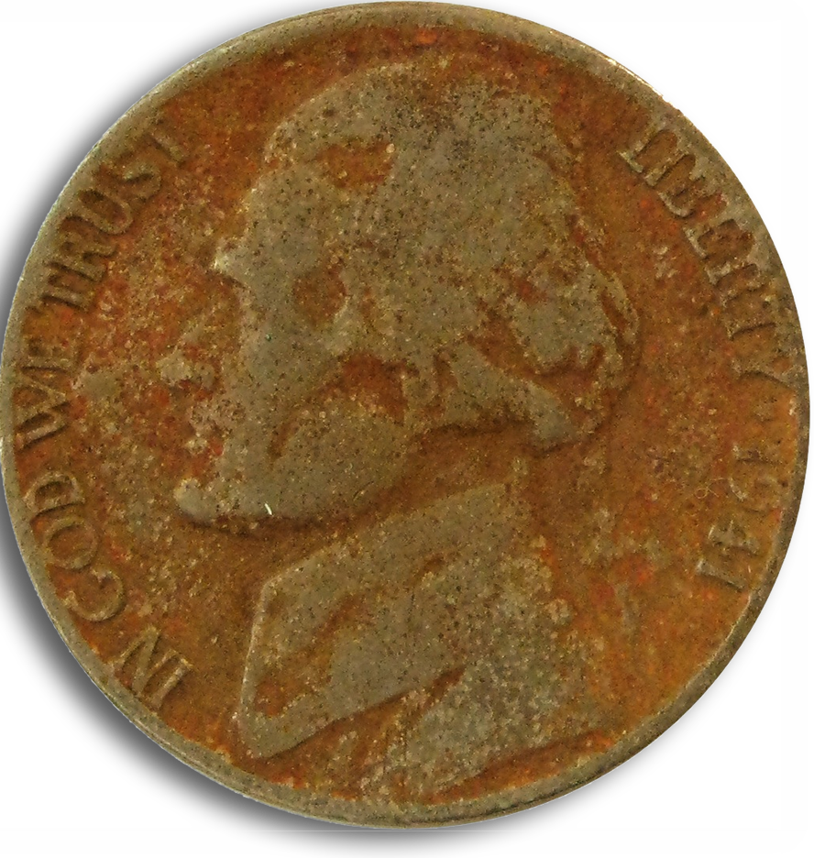
WARNING: Money Corrupts
³ Your gold and silver
are corroded. Their corrosion will testify
against you
Notes:
Corroded nickel free at = flickr.com/photos/pagedooley/837062067/

Slide 39
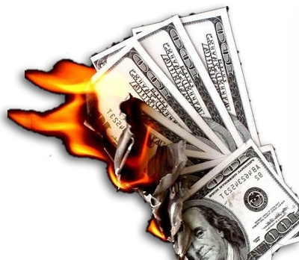
WARNING: Money Corrupts
³ Your gold and silver
are corroded. Their corrosion will testify
against you and eat your flesh like fire. You have hoarded wealth in the last days.
Notes:
Burning 100 dollar bills free from = http://farm4.static.flickr.com/3038/3040508093_50104084b2.jpg
² This is what the LORD Almighty says: "These people say, 'The time has not yet come for the LORD's house to be built.' "
³ Then the word of the LORD came through the prophet Haggai:
⁴ "Is it a time for you yourselves to be living in your paneled houses, while this house remains a ruin?"
⁵ Now this is what the LORD Almighty says: "Give careful thought to your ways.
⁶ You have planted much, but have harvested little. You eat, but never have enough. You drink, but never have your fill. You put on clothes, but are not warm. You earn wages, only to put them in a purse with holes in it."
⁷ This is what the LORD Almighty says: "Give careful thought to your ways.
⁸ Go up into the mountains and bring down timber and build the house, so that I may take pleasure in it and be honored," says the LORD.
⁹ "You expected much, but see, it turned out to be little. What you brought home, I blew away. Why?" declares the LORD Almighty. "Because of my house, which remains a ruin, while each of you is busy with his own house.
¹⁰ Therefore, because of you the heavens have withheld their dew and the earth its crops.
¹¹ I called for a drought on the fields and the mountains, on the grain, the new wine, the oil and whatever the ground produces, on men and cattle, and on the labor of your hands."
(Hag 1:2-11 NIV)

Slide 40
WARNING: Money Corrupts
³ Your gold and silver
are corroded. Their corrosion will testify
against you and eat your flesh like fire. You have hoarded wealth in the last days.
WHY?
Notes:
Burning 100 dollar bills free from = http://farm4.static.flickr.com/3038/3040508093_50104084b2.jpg
² This is what the LORD Almighty says: "These people say, 'The time has not yet come for the LORD's house to be built.' "
³ Then the word of the LORD came through the prophet Haggai:
⁴ "Is it a time for you yourselves to be living in your paneled houses, while this house remains a ruin?"
⁵ Now this is what the LORD Almighty says: "Give careful thought to your ways.
⁶ You have planted much, but have harvested little. You eat, but never have enough. You drink, but never have your fill. You put on clothes, but are not warm. You earn wages, only to put them in a purse with holes in it."
⁷ This is what the LORD Almighty says: "Give careful thought to your ways.
⁸ Go up into the mountains and bring down timber and build the house, so that I may take pleasure in it and be honored," says the LORD.
⁹ "You expected much, but see, it turned out to be little. What you brought home, I blew away. Why?" declares the LORD Almighty. "Because of my house, which remains a ruin, while each of you is busy with his own house.
¹⁰ Therefore, because of you the heavens have withheld their dew and the earth its crops.
¹¹ I called for a drought on the fields and the mountains, on the grain, the new wine, the oil and whatever the ground produces, on men and cattle, and on the labor of your hands."
(Hag 1:2-11 NIV)

Slide 41
WARNING: Money Corrupts
³ Your gold and silver
are corroded. Their corrosion will testify
against you and eat your flesh like fire. You have hoarded wealth in the last days.
Because
Notes:
Burning 100 dollar bills free from = http://farm4.static.flickr.com/3038/3040508093_50104084b2.jpg
² This is what the LORD Almighty says: "These people say, 'The time has not yet come for the LORD's house to be built.' "
³ Then the word of the LORD came through the prophet Haggai:
⁴ "Is it a time for you yourselves to be living in your paneled houses, while this house remains a ruin?"
⁵ Now this is what the LORD Almighty says: "Give careful thought to your ways.
⁶ You have planted much, but have harvested little. You eat, but never have enough. You drink, but never have your fill. You put on clothes, but are not warm. You earn wages, only to put them in a purse with holes in it."
⁷ This is what the LORD Almighty says: "Give careful thought to your ways.
⁸ Go up into the mountains and bring down timber and build the house, so that I may take pleasure in it and be honored," says the LORD.
⁹ "You expected much, but see, it turned out to be little. What you brought home, I blew away. Why?" declares the LORD Almighty. "Because of my house, which remains a ruin, while each of you is busy with his own house.
¹⁰ Therefore, because of you the heavens have withheld their dew and the earth its crops.
¹¹ I called for a drought on the fields and the mountains, on the grain, the new wine, the oil and whatever the ground produces, on men and cattle, and on the labor of your hands."
(Hag 1:2-11 NIV)

Slide 42

CONSIDER: Your Ways!
^{Haggai 1:4} "Is it a time for you yourselves to be living in your paneled houses, while this house remains a ruin?"
Notes:
Mansion = FREE = from http://www.sxc.hu/photo/1207390

Slide 43
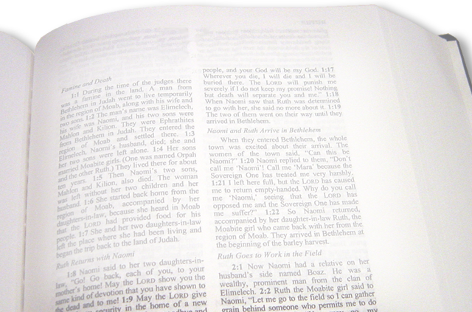
CONSIDER: Your Ways!
9 "You expected much, but see, it turned out to be little. What you brought home, I blew away. Why?" declares the LORD Almighty. "Because of my house, which remains a ruin, while each of you is busy with his own house.
Notes:
Bible = FREE = from BiblePoint photos.

Slide 44
CONSIDER: Your Ways!
9 "You expected much, but see, it turned out to be little. What you brought home, I blew away. Why?" declares the LORD Almighty. "Because of my house, which remains a ruin, while each of you is busy with his own house.
Notes:
Bible = FREE = from BiblePoint photos.

Slide 45
CONSIDER: Your Ways!
9 "You expected much, but see, it turned out to be little. What you brought home, I blew away. Why?" declares the LORD Almighty. "Because of my house, which remains a ruin, while each of you is busy with his own house.
Notes:
Bible = FREE = from BiblePoint photos.

Slide 46
CONSIDER: Your Ways!
9 "You expected much, but see, it turned out to be little. What you brought home, I blew away. Why?" declares the LORD Almighty. "Because of my house, which remains a ruin, while each of you is busy with his own house.
Notes:
Bible = FREE = from BiblePoint photos.

Slide 47
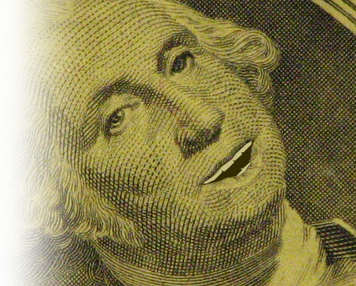
WARNING: Money Talks
⁴ Look! The wages you failed to pay the workmen who mowed your fields are crying out against you. The cries of the harvesters have reached the ears of the Lord Almighty.
Notes:
Dollar bill edited to talk free from = www.flickr.com/photos/squeakymarmot/379443016/
You are in debt. You have made purchases—workmen to mow, but haven’t paid. // Your credit card debt.
Some people say, “I can’t afford to tithe to God!” I say, “I can’t afford NOT to tithe to God!”

Slide 48
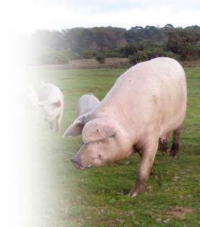
WARNING: Money Fattens
⁵ You have lived on earth in luxury and self-indulgence. You have fattened yourselves in the day of slaughter.
Notes:
Pig = free at www.geograph.org.uk/photo/277667
We as a nation are living beyond our means with nearly 20 trillion debt!
In David Black’s book Radical, he speaks of downsizing my lifestyle to upsize God’s Work!

Slide 49
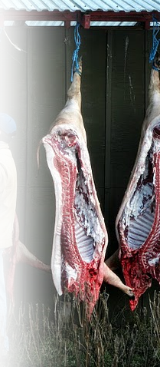
WARNING: Money Fattens
⁵ You have lived on earth in luxury and self-indulgence. You have fattened yourselves in the day of slaughter.
Notes:
Slaughter = picasaweb.google.com/.../6KsDLZjCbB0WfLtiv9zdcg
We as a nation are living beyond our means with nearly 20 trillion debt!
Believe me – the day of financial slaughter will come!

Slide 50
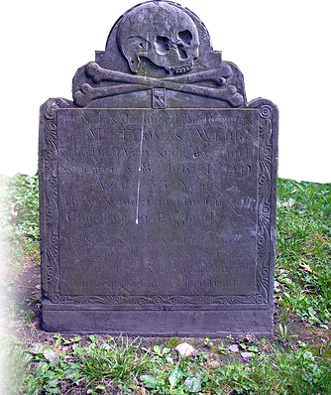
WARNING: Money Kills
⁶ You have condemned and murdered innocent men, who were not opposing you.
Notes:
Slander and Speak against are the same Greek word “Speak down.”
We as a nation are living beyond our means with nearly 20 trillion debt!
Believe me – the day of financial slaughter will come!
We are condemning and killin our children and grandchildren with a catastrophic debt.

Slide 51
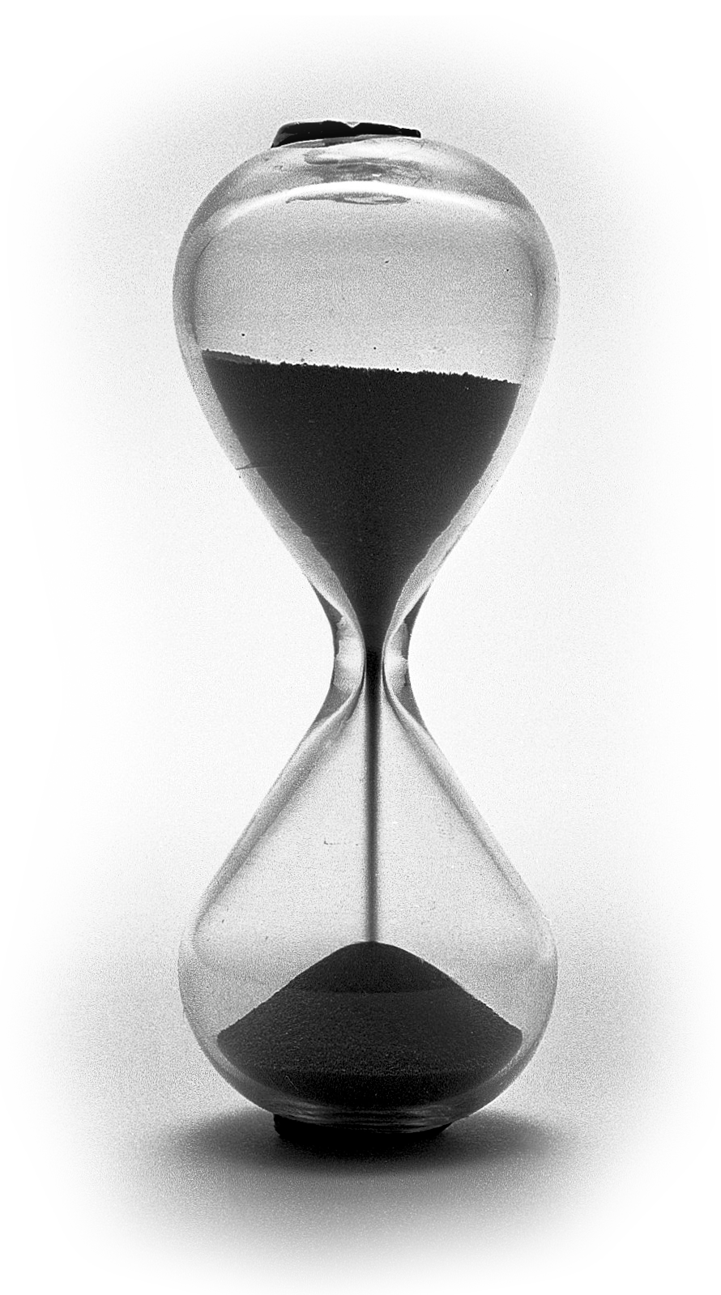
SUGGESTION: Be Patient ...
⁷ Be patient, then, brothers, until the Lord's coming.
Notes:
Be patient -- don’t go for the “get rich quick” schemes. Don’t be impatient, “I got to have it now.” Delay your gratification.

Slide 52
SUGGESTION: Be Patient Brothers
⁷ Be patient, then, brothers, until the Lord's coming.
Notes:
Be patient -- don’t go for the “get rich quick” schemes. Don’t be impatient, “I got to have it now.” Delay your gratification.
James turns from warning the rich to handing out hope to the Brothers.

Slide 53

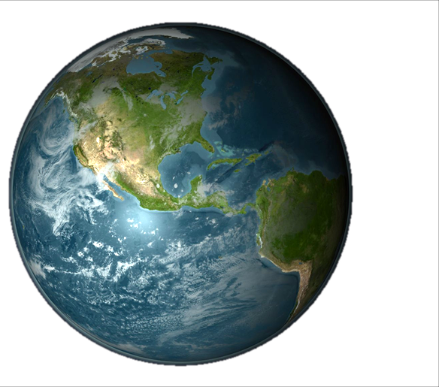
SUGGESTION: Be Patient ‘til 2nd Coming
⁷ Be patient, then, brothers, until the Lord's coming.

Slide 54
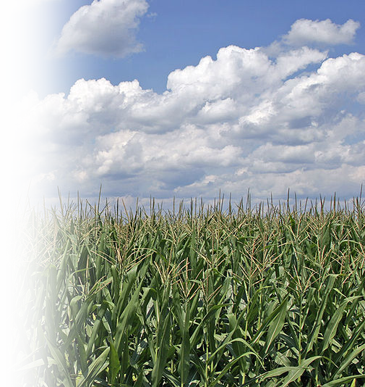
SUGGESTION: Be Patient like a Farmer
⁷ Be patient, then, brothers, until the Lord's coming. See how the farmer waits for the land to yield its valuable crop and how patient he is for the autumn and spring rains.
Notes:
Ill of patience .... The farmer.

Slide 55

SUGGESTION: Be Patient
⁸ You too, be patient and stand firm, because the Lord's coming is near.
Notes:
Slander and Speak against are the same Greek word “Speak down.”

Slide 56

SUGGESTION: Be Patient Standing Firm
⁸ You too, be patient and stand firm, because the Lord's coming is near.
Notes:
Slander and Speak against are the same Greek word “Speak down.”

Slide 57
SUGGESTION: Be Patient ‘til 2nd Coming
⁸ You too, be patient and stand firm, because the Lord's coming is near.
Notes:
Slander and Speak against are the same Greek word “Speak down.”

Slide 58
The point: Invest in what matters!

Slide 59
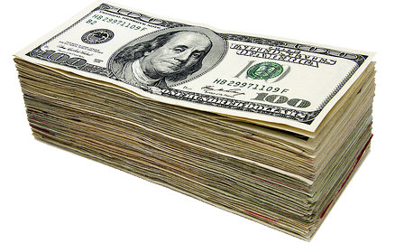
The point: Invest in what matters!
^{Mat 6:19} "Do not store up for yourselves treasures on earth, where moth and rust destroy, and where thieves break in and steal.

Slide 60
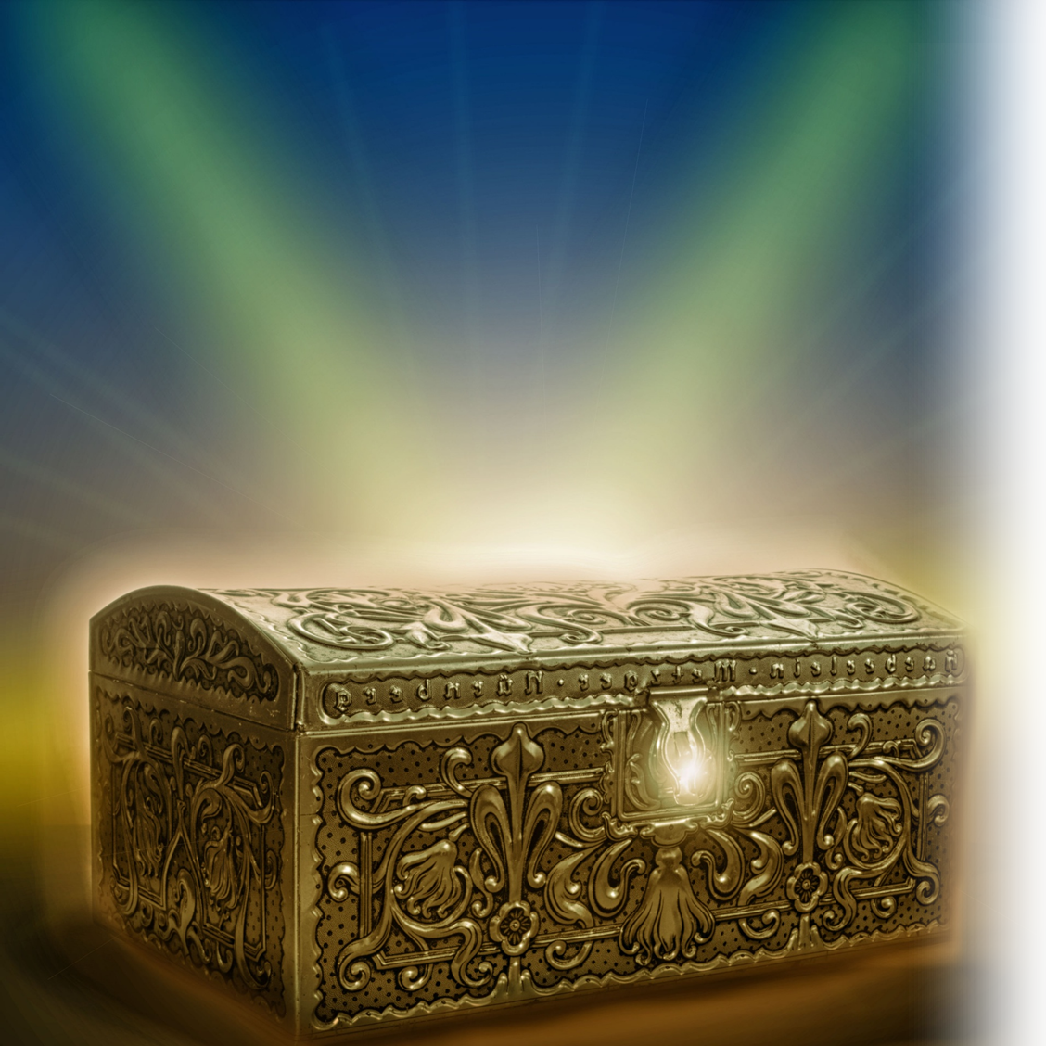
The point: Invest in what matters!
^{Mat 6:20} But store up for yourselves treasures in heaven, where moth and rust do not destroy, and where thieves do not break in and steal.
Notes:
Treasure Chest = http://www.publicdomainpictures.net/view-image.php?image=187889&picture=treasure-chest

Slide 61

The point: Invest in what matters!
^{Mat 6:21} For where your treasure is, there your heart will be also.
Notes:
Heart = http://www.publicdomainpictures.net/view-image.php?image=170867&picture=heart

Slide 62

On this “Pledge Sunday” realize:

Slide 63
On this “Pledge Sunday” realize:
It’s not how rich or poor you are
that matters ....

Slide 64
On this “Pledge Sunday” realize:
It’s how you honor the LORD
with what you have
that matters.

Slide 65
On this “Pledge Sunday” realize:
IF YOU ⁹ Honor the LORD
with your wealth, with the
firstfruits of all your crops;

Slide 66
On this “Pledge Sunday” realize:
IF YOU ⁹ Honor the LORD
with your wealth, with the
firstfruits of all your crops;

Slide 67
On this “Pledge Sunday” realize:
IF YOU ⁹ Honor the LORD
with your wealth, with the
firstfruits of all your crops;

Slide 68
On this “Pledge Sunday” realize:
IF YOU ⁹ Honor the LORD
with your wealth, with the
firstfruits of all your crops;

Slide 69
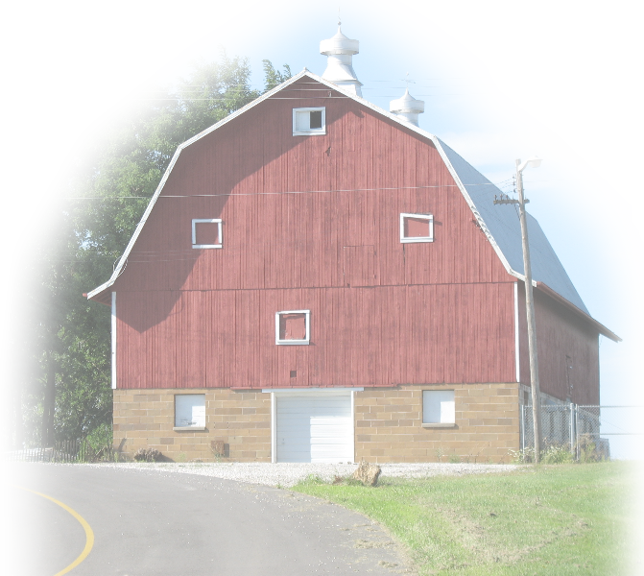
On this “Pledge Sunday” realize:
IF YOU ⁹ Honor the LORD
with your wealth, with the
firstfruits of all your crops;
¹⁰ then your barns will be
filled to overflowing, and
your vats will brim over
with new wine. (Prov 3:9-9)

Slide 70
On this “Pledge Sunday” realize:
¹⁹ And my God will meet all your needs according to his glorious riches in Christ Jesus. (Philippians 4:19)

Slide 71
Let’s Pray

