Slide 1
JAMES
A FAITH THAT WORKS
Notes:
BACKGROUND = https://pixabay.com/en/gears-cogs-machine-machinery-1236578/
Copyright © 2006−2021. All rights reserved. Bible Point is a registered trademark of Dennis Henderson. All other trademarks acknowledged.
Bible Point contains graphics from Bible Point artists. These illustrations belong to Bible Point and the respective artists. You may use the designs and illustrations for graphical illustration of lessons free and without special permission, provided they are not used in any way that maligns the Christian faith. Furthermore, republication or production of any illustration by any other graphic service whether it be in book, in a machine-readable form, or in any other design resource is strictly prohibited. Furthermore, they cannot be duplicated or resold as any other form of publishing, clip art, or graphic resource.
So What does it mean? (A simple translations of the legal jargon)
So, if you don’t own the presentation(s), graphic(s), and text(s) how can you legally use them? The purchase of the license allows you to use all the images in the product. However, the actual ownership and copyright of the presentation(s), graphic(s), and text(s) remain the property of Bible Point and its licensors. If you had plans on using this product in your “for sale” work—think again!
License Agreement
Article 1: License Grant
All the graphics and text in Bible Point presentations (excluding quotes from the Bible and stated sources) are the intellectual and real property of Bible Point and its licensors, and is protected by law, including United States copyright laws and international treaties. Bible Point grants to you a license:
1. To use the presentation in a single church, single school, or single office of a Christian organization.
2. To make a single archival back-up copy of the program.
3. To modify the presentation(s) and merge with other presentations in a single church, school, or Christian organization.
4. To transfer to another party if that party agrees to accept the terms and conditions of this agreement, and you do not retain any copies of the presentation, whether printed, machine readable, modified, or merged form.
Article 2: Terms
This license is effective until terminated. You may terminate the license at any time by destroying the presentation(s), graphic(s), or text(s) together with all copies, modifications and merged portions in any form. Bible Point may terminate your license if you fail to comply with this Agreement. You agree, upon such termination, for any reason, to destroy the presentation(s), graphics, and text(s) with all copies, modifications, and merged portions in any form.
Article 3: Disclaimers
1. Bible Point presentations, graphics, and texts are licensed to you As Is. You, the consumer, bear the entire risk relating to the quality and performance of the presentation(s), graphic(s), or text(s). In no event will Bible Point be liable for damages resulting from any defect.
2. Thirty-day limited warrantee on disks. Bible Point warrants the disks to be free of defects in material and workmanship under normal use for 30 days after purchase. During the 30-day period you may return a defective presentation, graphic, or text with proof of purchase and it will be replaced without charge, unless the presentation is damaged by misuse.
Article 4: General
1. You may not sub-license, assign, or transfer the license of the presentation(s), graphic(s), or text(s) except as provided by this Agreement.
2. This Agreement will be governed by the laws of the State of Michigan.
So What does it mean? (A simple translations of the legal jargon)
May I let someone borrow or copy my licensed Bible Point presentation (even after I modified it)? As long as it is within your local church, or single school, or the immediate office of a Christian organization you may. Otherwise, please refer the person interested in borrowing to: http://www.biblepoint.com or E-mail: dennis@DrDH.net with any related questions.

Slide 2
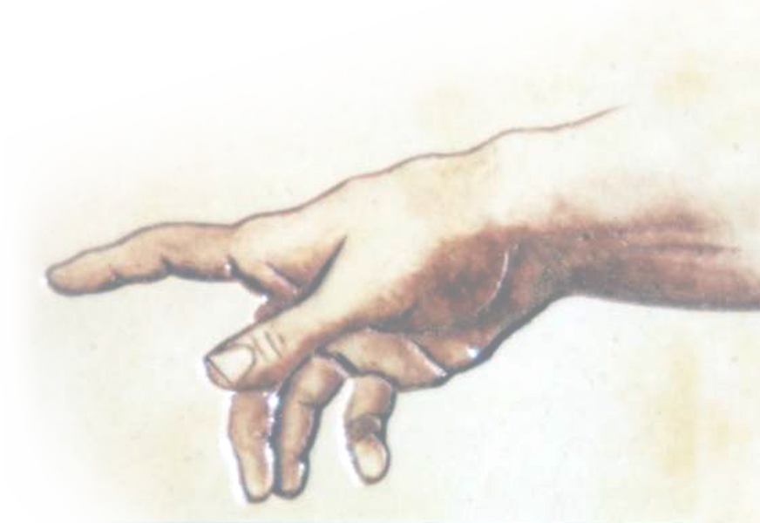
When Tempted to Play GOD!

Slide 3
We do this in two ways:
With Others 4: 11-12

Slide 4
We do this in two ways:
With Others 4: 11-12
With Ourselves 4:13-17

Slide 5
1—With Others
^{HOW?}

Slide 6
By Using Slander
¹¹ Brothers, do not slander one another.

Slide 7
By Using Slander
¹¹ Brothers, do not slander one another. Anyone who speaks against his brother...
Notes:
Slander and Speak against are the same Greek word “Speak down.”

Slide 8
By Using Slander
¹¹ Brothers, do not slander one another. Anyone who speaks against his brother...
Literally = “speak down”
“Slander is an utterance of defamatory statements injurious to the reputation or well-being of a person. A malicious
statement or report.” (Webster)
Notes:
Slander and Speak against are the same Greek word “Speak down.”

Slide 9
Slander is “Passing Judgment!”
¹¹ Brothers, do not slander one another. Anyone who speaks against his brother or judges him ...

Slide 10
Slander is “Passing Judgment!”
¹¹ Brothers, do not slander one another. Anyone who speaks against his brother or judges him ...
^{WHY?}

Slide 11
Slander is “Passing Judgment!”
¹¹ Brothers, do not slander one another. Anyone who speaks against his brother or judges him speaks against the law and judges it.

Slide 12
Slander is “Passing Judgment!”
¹¹ Brothers, do not slander one another. Anyone who speaks against his brother or judges him speaks against the law and judges it.
The Law says:
Do not seek revenge or bear a grudge against one of your people, but love your neighbor as yourself. I am the LORD. (Leviticus 19:18)

Slide 13
Slander is “Passing Judgment!”
¹¹ Brothers, do not slander one another. Anyone who speaks against his brother or judges him speaks against the law and judges it.
The Law says:
Do not seek revenge or bear a grudge against one of your people, but love your neighbor as yourself. I am the LORD. (Leviticus 19:18)
^{FURTHERMORE...}

Slide 14
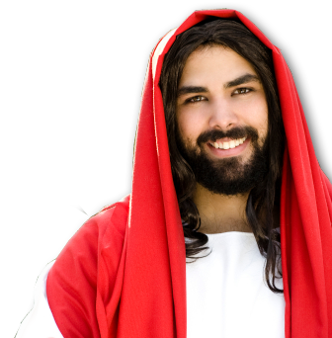
Slander is “Passing Judgment!”
¹¹ Brothers, do not slander one another. Anyone who speaks against his brother or judges him speaks against the law and judges it.
Love the Lord your God ...; and, Love your neighbor as yourself. (Luke 10:27)

Slide 15
Slander is “Passing Judgment!”
¹¹ Brothers, do not slander one another. Anyone who speaks against his brother or judges him speaks against the law and judges it.
Love the Lord your God ...; and, Love your neighbor as yourself. (Luke 10:27)
^{FURTHERMORE...}

Slide 16
Slander is “Passing Judgment!”
¹¹ Brothers, do not slander one another. Anyone who speaks against his brother or judges him speaks against the law and judges it. When you judge the law, you are not keeping it,

Slide 17

Slander is “Passing Judgment!”
¹¹ Brothers, do not slander one another. Anyone who speaks against his brother or judges him speaks against the law and judges it. When you judge the law, you are not keeping it,
but sitting in judgment on it.
GOD
LAW

Slide 18
Slander is “Passing Judgment!”
¹¹ Brothers, do not slander one another. Anyone who speaks against his brother or judges him speaks against the law and judges it. When you judge the law, you are not keeping it,
but sitting in judgment on it.
GOD
LAW

Slide 19
Slander is “Passing Judgment!”
¹¹ Brothers, do not slander one another. Anyone who speaks against his brother or judges him speaks against the law and judges it. When you judge the law, you are not keeping it,
but sitting in judgment on it.
GOD
LAW

Slide 20
Slander is “Passing Judgment!”
¹¹ Brothers, do not slander one another. Anyone who speaks against his brother or judges him speaks against the law and judges it. When you judge the law, you are not keeping it,
but sitting in judgment on it.
LAW
GOD

Slide 21
Slander is “Passing Judgment!”
¹¹ Brothers, do not slander one another. Anyone who speaks against his brother or judges him speaks against the law and judges it. When you judge the law, you are not keeping it,
but sitting in judgment on it.
LAW
GOD

Slide 22
About Judgment
The most quoted verse today ...
Judge not, that ye be
not judged. ^{(Mat 7:1 KJV)}

Slide 23
About Judgment
There are different kinds of Judgment ...

Slide 24
About Judgment
κρίνω = I separate

Slide 25
About Judgment
κρίνω = I separate
G
O
O
D
B
A
D

Slide 26
About Judgment
κρίνω = I separate
R
I
G
H
T
W
R
O
N
G

Slide 27
About Judgment
κρίνω = I separate = I judge
R
I
G
H
T
W
R
O
N
G

Slide 28
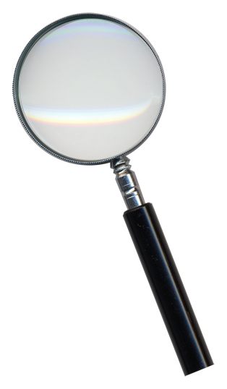
About Judgment
κρίνω = I separate = I judge
κρίνω = over + judge = I investigate
ανα
R
I
G
H
T
W
R
O
N
G

Slide 29
About Judgment
κρίνω = separate = I judge
κρίνω = from + judge = I answer
απο
Y
E
S
N
O

Slide 30

About Judgment
κρίνω = separate = I judge
κρίνω = through + judge = I discern
δια
R
I
G
H
T
W
R
O
N
G

Slide 31

About Judgment
κρίνω = separate = I judge
κρίνω = before + judge = I prejudice
προ
R
I
G
H
T
W
R
O
N
G

Slide 32
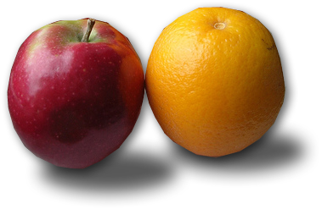
About Judgment
κρίνω = separate = I judge
κρίνω = with + judge = I compare
συν
R
I
G
H
T
W
R
O
N
G

Slide 33

About Judgment
κρίνω = separate = I judge
κρίνω = down + judge = I condemn
κατα
R
I
G
H
T
W
R
O
N
G

Slide 34

About Judgment
κρίνω = separate = I judge
κρίνω = self + judge = I examine myself
αυτο
R
I
G
H
T
W
R
O
N
G

Slide 35
Point: God expects us to judge ...
Investigate
Answer
Discern
Compare
Self-examine
Etc.

Slide 36
Point: God expects us to judge ...
Investigate
Answer
Discern
Compare
Self-examine
Etc.
1 Corinthians 2:15
The spiritual man makes judgments about all things, but he himself is not subject to any man's judgment

Slide 37
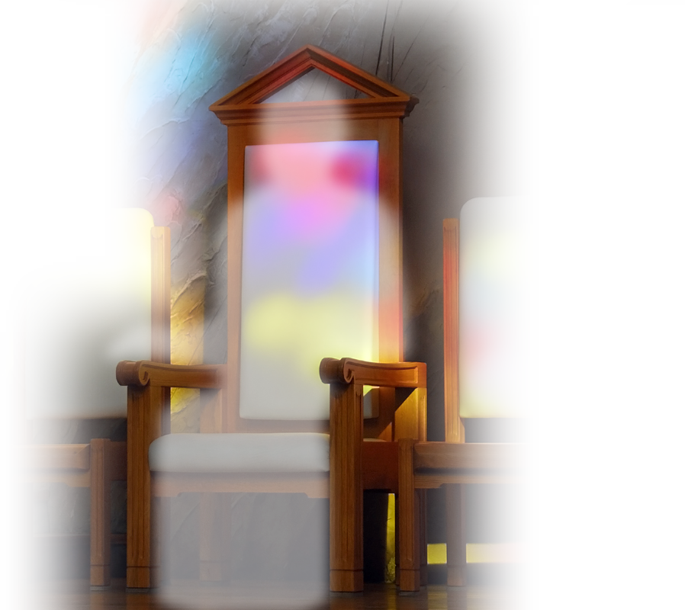
God prohibits Condemning ...
By usurping His role and acting as if we were God!

Slide 38
Slander is “Passing Judgment!”
¹² There is only one Lawgiver and Judge, the one who is able to save and destroy.

Slide 39
Slander is “Passing Judgment!”
¹² There is only one Lawgiver and Judge, the one who is able to save and destroy.
Deuteronomy 6

Slide 40
Slander is “Passing Judgment!”
¹² There is only one Lawgiver and Judge, the one who is able to save and destroy. But you--who are you to judge your neighbor?

Slide 41
2--PLAY GOD WITH OURSELVES!

Slide 42
2--PLAY GOD WITH OURSELVES!
When we think we are “in Control.”

Slide 43
2--PLAY GOD WITH OURSELVES!
When we think we are “in Control.”
Wrong Attitude!

Slide 44

1-I’m Master of my TIME!
¹³ Now listen, you who say, "Today or tomorrow we will go to this or that city, spend a year there, carry on business and make money.“

Slide 45

2-I’m Master of my WORLD!
¹³ Now listen, you who say, "Today or tomorrow we will go to this or that city, spend a year there, carry on business and make money.“

Slide 46
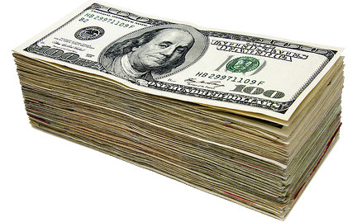
3-I’m Master of my SUCCESS!
¹³ Now listen, you who say, "Today or tomorrow we will go to this or that city, spend a year there, carry on business and make money."

Slide 47
The FUTILITY of Playing God!

Slide 48
1-Our IGNORANCE is Futile
¹⁴ Why, you do not even know what will happen tomorrow.

Slide 49
1-Our IGNORANCE is Futile
¹⁴ Why, you do not even know what will happen tomorrow. What is your life? You are a mist that appears for a little while and then vanishes.

Slide 50
1-Our IGNORANCE is Futile
¹⁴ Why, you do not even know what will happen tomorrow. What is your life? You are a mist that appears for a little while and then vanishes.

Slide 51
1-Our IGNORANCE is Futile
¹⁴ Why, you do not even know what will happen tomorrow. What is your life? You are a mist that appears for a little while and then vanishes.

Slide 52
1-Our IGNORANCE is Futile
¹⁴ Why, you do not even know what will happen tomorrow. What is your life? You are a mist that appears for a little while and then vanishes.

Slide 53
1-Our IGNORANCE is Futile
¹⁴ Why, you do not even know what will happen tomorrow. What is your life? You are a mist that appears for a little while and then vanishes.

Slide 54
1-Our IGNORANCE is Futile
¹⁴ Why, you do not even know what will happen tomorrow. What is your life? You are a mist that appears for a little while and then vanishes.

Slide 55
1-Our IGNORANCE is Futile
¹⁴ Why, you do not even know what will happen tomorrow. What is your life? You are a mist that appears for a little while and then vanishes.

Slide 56
1-Our IGNORANCE is Futile
¹⁴ Why, you do not even know what will happen tomorrow. What is your life? You are a mist that appears for a little while and then vanishes.

Slide 57
2-Our PRESUMPTION is Futile
¹⁵ Instead, you ought to say,

Slide 58
2-Our PRESUMPTION is Futile
¹⁵ Instead, you ought to say, "If it is the Lord's will, we will live and do this or that."

Slide 59
2-Our PRESUMPTION is Futile
¹⁵ Instead, you ought to say, "If it is the Lord's will, we will live and do this or that."

Slide 60
3-Our PRIDE is Futile
¹⁶ As it is, you boast and brag. All such boasting is evil.

Slide 61
4-Our OMMISION is Futile
¹⁷ Anyone, then, who knows the good he ought to do and doesn't do it, sins.

Slide 62
Story of a man ...
¹⁴ Jesus ... said to them,
"Watch out! Be on your
guard against all kinds of greed; a man's life does not consist in the abundance of his possessions.”

Slide 63
Story of a man ...
¹⁶ And he told them this parable:
"The ground of a certain rich
man produced a good crop.
¹⁷ He thought to himself,
'What shall I do? I have no
place to store my crops.’

Slide 64
Story of a man ...
¹⁸ "Then he said, 'This is what I'll do. I will tear down my barns and build bigger ones, and there I will store all my grain and my goods.

Slide 65
Story of a man ...
¹⁹ And I'll say to myself, "You have plenty of good things laid up for many years. Take life easy; eat, drink and be merry.“’

Slide 66
Story of a man ...
²⁰ "But God said to him,
'You fool!
This very night your life will be demanded from you. Then who will get what you have prepared for yourself?’

Slide 67
Story of a man ...
²¹ "This is how it will be with anyone who stores up things for himself but is not rich toward God.“ (Luke 12:14-21 )

Slide 68
Two Takeaways Today:
1- Allow God to be the God of other people’s lives ...

Slide 69
Two Takeaways Today:
1- Allow God to be the God of other people’s lives ...
2- Enthrone God as God in your own life too!

Slide 70
Let’s Pray

