Slide 1
JAMES
A FAITH THAT WORKS
Notes:
BACKGROUND = https://pixabay.com/en/gears-cogs-machine-machinery-1236578/
Copyright © 2006−2021. All rights reserved. Bible Point is a registered trademark of Dennis Henderson. All other trademarks acknowledged.
Bible Point contains graphics from Bible Point artists. These illustrations belong to Bible Point and the respective artists. You may use the designs and illustrations for graphical illustration of lessons free and without special permission, provided they are not used in any way that maligns the Christian faith. Furthermore, republication or production of any illustration by any other graphic service whether it be in book, in a machine-readable form, or in any other design resource is strictly prohibited. Furthermore, they cannot be duplicated or resold as any other form of publishing, clip art, or graphic resource.
So What does it mean? (A simple translations of the legal jargon)
So, if you don’t own the presentation(s), graphic(s), and text(s) how can you legally use them? The purchase of the license allows you to use all the images in the product. However, the actual ownership and copyright of the presentation(s), graphic(s), and text(s) remain the property of Bible Point and its licensors. If you had plans on using this product in your “for sale” work—think again!
License Agreement
Article 1: License Grant
All the graphics and text in Bible Point presentations (excluding quotes from the Bible and stated sources) are the intellectual and real property of Bible Point and its licensors, and is protected by law, including United States copyright laws and international treaties. Bible Point grants to you a license:
1. To use the presentation in a single church, single school, or single office of a Christian organization.
2. To make a single archival back-up copy of the program.
3. To modify the presentation(s) and merge with other presentations in a single church, school, or Christian organization.
4. To transfer to another party if that party agrees to accept the terms and conditions of this agreement, and you do not retain any copies of the presentation, whether printed, machine readable, modified, or merged form.
Article 2: Terms
This license is effective until terminated. You may terminate the license at any time by destroying the presentation(s), graphic(s), or text(s) together with all copies, modifications and merged portions in any form. Bible Point may terminate your license if you fail to comply with this Agreement. You agree, upon such termination, for any reason, to destroy the presentation(s), graphics, and text(s) with all copies, modifications, and merged portions in any form.
Article 3: Disclaimers
1. Bible Point presentations, graphics, and texts are licensed to you As Is. You, the consumer, bear the entire risk relating to the quality and performance of the presentation(s), graphic(s), or text(s). In no event will Bible Point be liable for damages resulting from any defect.
2. Thirty-day limited warrantee on disks. Bible Point warrants the disks to be free of defects in material and workmanship under normal use for 30 days after purchase. During the 30-day period you may return a defective presentation, graphic, or text with proof of purchase and it will be replaced without charge, unless the presentation is damaged by misuse.
Article 4: General
1. You may not sub-license, assign, or transfer the license of the presentation(s), graphic(s), or text(s) except as provided by this Agreement.
2. This Agreement will be governed by the laws of the State of Michigan.
So What does it mean? (A simple translations of the legal jargon)
May I let someone borrow or copy my licensed Bible Point presentation (even after I modified it)? As long as it is within your local church, or single school, or the immediate office of a Christian organization you may. Otherwise, please refer the person interested in borrowing to: http://www.biblepoint.com or E-mail: dennis@DrDH.net with any related questions.

Slide 2
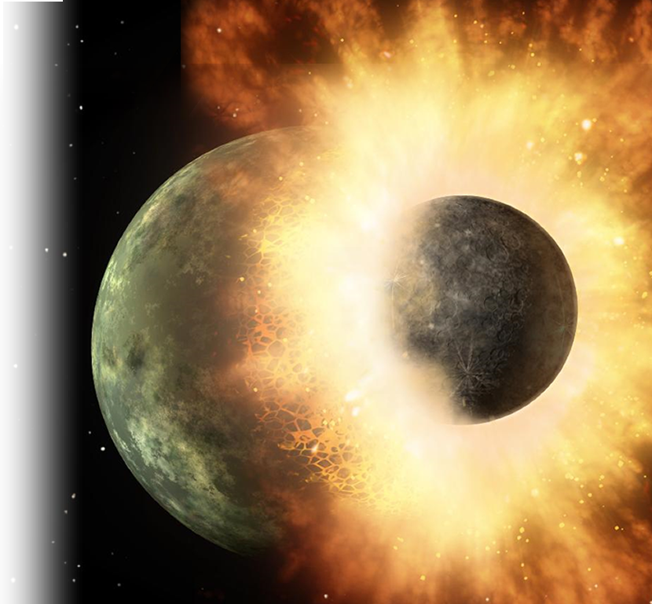
When Cantankerous
Christians
Collide!

Slide 3
From James 3:17-18
... wisdom that comes from heaven is first of all pure; then peace-loving, considerate, submissive, full of mercy and good fruit, impartial and sincere.
¹⁸ Peacemakers who sow in peace raise a harvest of righteousness.
You might think that with ...

Slide 4

“such wisdom”
FROM ABOVE
Notes:
WCAP http://www.sxc.hu/photo/1021381
hite Owl http://www.sxc.hu/photo/185851

Slide 5
“such wisdom”
FROM ABOVE
Christians would be free of:
Fighting
Quarreling
Disagreement
Arguing
Bickering
Complaining
Notes:
WCAP http://www.sxc.hu/photo/1021381
hite Owl http://www.sxc.hu/photo/185851

Slide 6
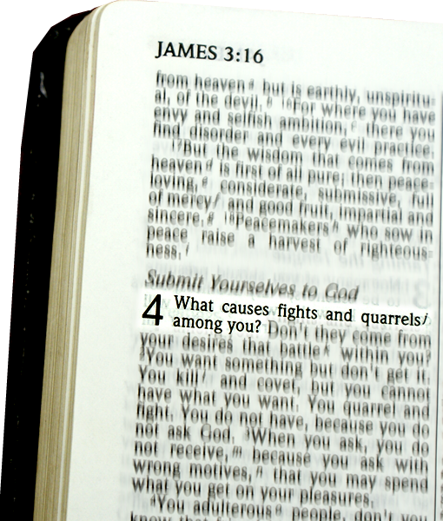
But they are not ...
4:1 What causes fights
and quarrels among you?

Slide 7

But they are not ...
“From where does such hostility come?”
4:1 What causes fights
and quarrels among you?

Slide 8
The SOURCE of Cantankerousness
Notes:
The external conflict is the manifestation of an internal LUST!

Slide 9


1—Pleasure Seeking LUST!
... Don't they come from your desires that
battle within you?
Notes:
Explosion = FREE = https://pixabay.com/en/fireball-explosion-devastation-422748/

Slide 10
1—Pleasure Seeking LUST!
... Don't they come from your desires that
battle within you?
Is it not this, that your passions are at war within you? (James 4:1 ESV)
Notes:
Explosion = FREE = https://pixabay.com/en/fireball-explosion-devastation-422748/

Slide 11
1—Pleasure Seeking LUST!
... Don't they come from your desires that
battle within you?
Is it not this, that your passions are at war within you? (James 4:1 ESV)
NT Greek Word = ἡδονῶν
“Hedonism” = pursuit of pleasure
Notes:
Explosion = FREE = https://pixabay.com/en/fireball-explosion-devastation-422748/
Greek word is ἡδονῶν We get the English word, “Hedonism” from this = pursuit of pleasure, sensual, self-indulgent.
Desires and passion for stuff, fame, fortune, meaning, purpose, food, glory, victory, winning, etc.
Next, he points out that people think that things will bring them pleasure.

Slide 12

2—Possession Seeking LUST!
² You want something
but don't get it.
Notes:
The envy turns into LUST for possessions ... Like cars, etc.
You want something because you think it will bring you great pleasure.

Slide 13

2—Possession Seeking LUST!
² You want something
but don't get it.
Notes:
Carcastle =google free
http://carwalls.com/cars/31-Lamborghini%20wallpapers.html?pag=25&t=

Slide 14

2—Possession Seeking LUST!
² You want something
but don't get it.
Notes:
Google

Slide 15
2—Possession Seeking LUST!
² You want something
but don't get it.
Notes:
Google

Slide 16
2—Possession Seeking LUST!
² You want something
but don't get it.
Possession-less
Notes:
Google

Slide 17

2—Possession Seeking LUST!
² ... You kill and covet,
but you cannot have
what you want.

Slide 18
2—Possession Seeking LUST!
² ... You kill and covet,
but you cannot have
what you want.
Possession-less
Notes:
You want something to fill the emptiness inside and you cannot have it!

Slide 19
3—Pointless Seeking LUST!
² ... You quarrel and fight. You do not have, because you do not ask God.

Slide 20
3—Pointless Seeking LUST!
² ... You quarrel and fight. You do not have, because you do not ask God.
Possession-less

Slide 21

4—Prayerless Seeking LUST!
² ... You quarrel and fight. You do not have, because you do not ask God.
Notes:
Cf. James 1: ⁵ If any of you lacks wisdom, he should ask God, who gives generously to all without finding fault, and it will be given to him.
⁶ But when he asks, he must believe and not doubt, because he who doubts is like a wave of the sea, blown and tossed by the wind.
⁷ That man should not think he will receive anything from the Lord;
⁸ he is a double-minded man, unstable in all he does.
(Jam 1:5-8 NIV)

Slide 22
5—Powerless Seeking LUST!
³ When you ask, you do not
receive,
Possession-less

Slide 23
5—Powerless Seeking LUST!
³ When you ask, you do not
receive,
WHY?
Possession-less

Slide 24
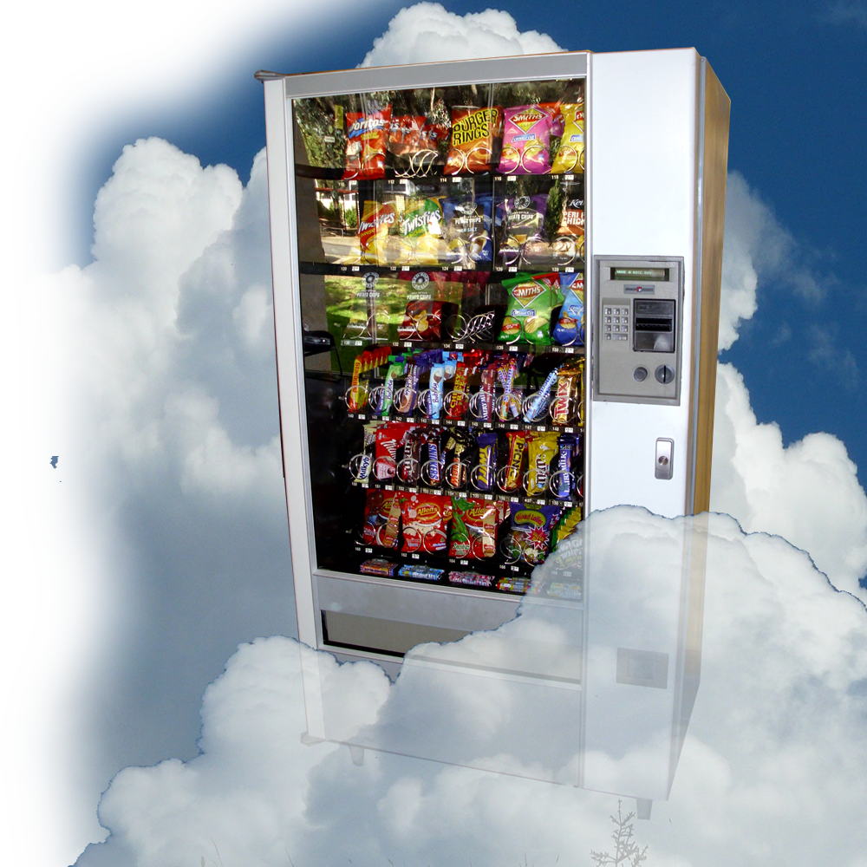
5—Powerless Seeking LUST!
³ When you ask, you do not receive, because you ask with wrong motives, that you may spend what you get on your pleasures.
Notes:
Vending = https://upload.wikimedia.org/wikipedia/commons/2/23/Snack_food_vending_machine.jpg

Slide 25

5—Powerless Seeking LUST!
³ When you ask, you do not receive, because you ask with wrong motives, that you may spend what you get on your pleasures.
Notes:
Santa http://www.dreamstime.com/thank-you-santa-free-stock-image-imagefree3394488

Slide 26
The REALITY of Cantankerousness

Slide 27
God’s Word calls cantankerous
Christians:

Slide 28
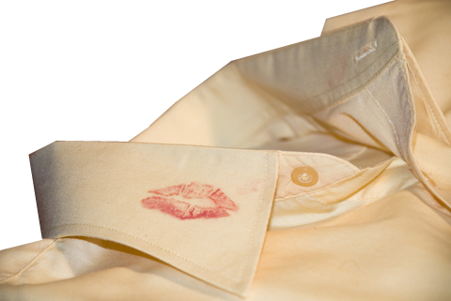
1—Adulterers
⁴ You adulterous people,
Notes:
You are Cheating on God. Like lusting for other women/men. When you have God!
Seek the Lord not pleasures, not stuff, not fame – Don’t commit adultery—Be faithful to Him!

Slide 29

2—Worldly
⁴ You adulterous people,
don't you know
that friendship
with the world
is hatred
toward God?
Notes:
1 Cor 15:33 ³³ Do not be misled: "Bad company corrupts good character." (1Co 15:33 NIV)
⁵ Do not love the world or anything in the world. If anyone loves the world, the love of the Father is not in him. (1Jo 2:15 NIV)
May I ask the hard hitting question?
Have you desired so much stuff, that you cannot truly tithe. Is your desire for cars, homes, boats, RVs, vacations, etc. (you know the stuff of the world) have you so broke you feel that you cannot give God a tenth?
James calls that “friendship with the world.”

Slide 30

3—God Haters
⁴ You adulterous people,
don't you know
that friendship
with the world
is hatred
toward God?
Notes:
When you are like that, don’t say that you love the Lord—He says you hate him.
I tell a story of the man who proposed to a woman, “I’ll be the very best husband, I’ll work hard for you, I’ll provide a home for you, I’ll be a great father, etc. I’ll be faithful, I only want one night each year to sleep with my old girlfriend.”
How does that play out?
He’s an adulterer! He is a wife hater!

Slide 31

4—Enemies of God
⁴ ... Anyone who chooses to be a friend of the world becomes an enemy of God.
Notes:
I tell a story of the man who proposed to a woman, “I’ll be the very best husband, I’ll work hard for you, I’ll provide a home for you, I’ll be a great father, etc. I’ll be faithful, I only want one night each year to sleep with my old girlfriend.”
How does that play out?
He’s an adulterer! He is a wife hater! He is an enemy to women!

Slide 32

5—Envious
⁵ Or do you think Scripture says without reason that the spirit he caused to live in us envies intensely?
Notes:
Although there is no verse for this, James appears to be saying that it is the tenor of scripture that teach the spirit God has placed within us is filled with envy? (Jam 4:5 NLT) See // Gen 6

Slide 33

6—Proud
⁶ But he gives us more grace. That is why Scripture says: "God opposes the proud but gives grace to the humble.”
Notes:
dreamstimefree_15579.jpg
Hand google-free

Slide 34
6—Proud
⁶ But he gives us more grace. That is why Scripture says: "God opposes the proud but gives grace to the humble.”
³⁴ He mocks proud mockers but gives grace to the humble. (Proverbs 3:34)
Notes:
dreamstimefree_15579.jpg
Hand google-free

Slide 35
The SOLUTION to Cantankerousness

Slide 36

Grace ...
⁶ But he gives us more grace. That is why Scripture says: "God opposes the proud but gives grace to the humble."

Slide 37
Grace ...
⁶ But he gives us more grace. That is why Scripture says: "God opposes the proud but gives grace to the humble."
³⁴ He mocks proud mockers but gives grace to the humble. (Proverbs 3:34)

Slide 38

1—Grace found in HUMILITY ...
⁶ ... "God opposes the proud but gives grace to the humble."
Notes:
http://www.sxc.hu/browse.phtml?f=download&id=788582

Slide 39

2—Grace found in SUBMISSION ...
⁷ Submit yourselves, then, to God.

Slide 40


3—Grace found in RESISTANCE ...
⁷ Submit yourselves, then, to God. Resist the devil, and he will flee from you.

Slide 41

4—Grace found in APPROACHING God
⁸ Come near to God and he will come near to you.
Notes:
http://www.sxc.hu/browse.phtml?f=download&id=994775

Slide 42
4—Grace found in APPROACHING God
⁸ Come near to God and he will come near to you.
How?
Notes:
http://www.sxc.hu/browse.phtml?f=download&id=994775

Slide 43

5—Grace found in CLEANSING ...
⁸ ... Wash your hands, you sinners, and
Notes:
http://www.sxc.hu/browse.phtml?f=download&id=614282

Slide 44
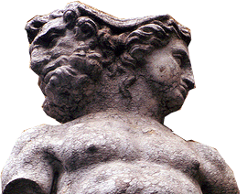
5—Grace found in CLEANSING ...
⁸ ... purify your hearts, you double-minded.
Notes:
http://www.sxc.hu/browse.phtml?f=download&id=614282

Slide 45
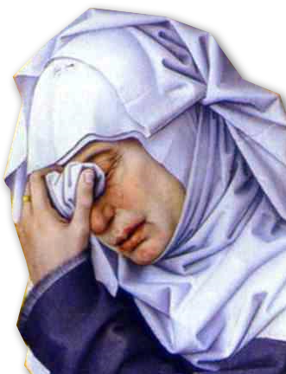
6—Grace found in CONTRITION
⁹ Grieve, mourn and wail.
Notes:
http://upload.wikimedia.org/wikipedia/commons/a/a7/Rogier_van_der_Weyden-_Deposition_-_Mourning_Woman%3B_detail.JPG

Slide 46
6—Grace found in CONTRITION
⁹ Grieve, mourn and wail.
¹⁵ For this is what the high and lofty One says-- he who lives forever, whose name is holy: "I live in a high and holy place, but also with him who is contrite and lowly in spirit, to revive the spirit of the lowly and to revive the heart of the contrite. (Isa 57:15 NIV)
Notes:
http://upload.wikimedia.org/wikipedia/commons/a/a7/Rogier_van_der_Weyden-_Deposition_-_Mourning_Woman%3B_detail.JPG

Slide 47

7—Grace found in REPENTING ...
⁹ .... Change your laughter to mourning and your joy to gloom.

Slide 48
8—Grace found in HUMILITY ...
¹⁰ Humble yourselves before the Lord, and he will lift you up

Slide 49
“he will lift you up.”

Slide 50
“he will lift you up.”

Slide 51
“he will lift you up.”

Slide 52
“he will lift you up.”

Slide 53
“he will lift you up.”

Slide 54
Take this with you ...
Cantankerous Christians are at war:

Slide 55

Take this with you ...
Cantankerous Christians are at war:

Slide 56
Take this with you ...
Cantankerous Christians are at war:
1—At war with themselves
“battle within you” 4:2

Slide 57
Take this with you ...
Cantankerous Christians are at war:
1—At war with themselves
“battle within you” 4:2
2—At war with others
“fights among you” 4:1

Slide 58
Take this with you ...
Cantankerous Christians are at war:
1—At war with themselves
“battle within you” 4:2
2—At war with others
“fights among you” 4:1
3—At war with God
“hatred toward God” 4:4
“enemy of God” 4:4

Slide 59
You can end the war ...

Slide 60
You can end the war ...
Within YOURSELF ...

Slide 61
You can end the war ...
Within YOURSELF ...
With Others ... and ...

Slide 62
You can end the war ...
Within YOURSELF ...
With Others ... and ...
With God.

Slide 63
You can end the war ...
First, you surrender ...

Slide 64
You can end the war ...
First, you surrender ...
Then, ⁷ Submit yourselves,
then, to God.

Slide 65
Finally ...
¹⁰ Humble yourselves before the Lord...

Slide 66
“he will lift you up.”

Slide 67
“he will lift you up.”

Slide 68
“he will lift you up.”

Slide 69
“he will lift you up.”

Slide 70
“he will lift you up.”

Slide 71
Let’s Pray

