Slide 1
JAMES
A FAITH THAT WORKS
Notes:
BACKGROUND = https://pixabay.com/en/gears-cogs-machine-machinery-1236578/
Copyright © 2006−2021. All rights reserved. Bible Point is a registered trademark of Dennis Henderson. All other trademarks acknowledged.
Bible Point contains graphics from Bible Point artists. These illustrations belong to Bible Point and the respective artists. You may use the designs and illustrations for graphical illustration of lessons free and without special permission, provided they are not used in any way that maligns the Christian faith. Furthermore, republication or production of any illustration by any other graphic service whether it be in book, in a machine-readable form, or in any other design resource is strictly prohibited. Furthermore, they cannot be duplicated or resold as any other form of publishing, clip art, or graphic resource.
So What does it mean? (A simple translations of the legal jargon)
So, if you don’t own the presentation(s), graphic(s), and text(s) how can you legally use them? The purchase of the license allows you to use all the images in the product. However, the actual ownership and copyright of the presentation(s), graphic(s), and text(s) remain the property of Bible Point and its licensors. If you had plans on using this product in your “for sale” work—think again!
License Agreement
Article 1: License Grant
All the graphics and text in Bible Point presentations (excluding quotes from the Bible and stated sources) are the intellectual and real property of Bible Point and its licensors, and is protected by law, including United States copyright laws and international treaties. Bible Point grants to you a license:
1. To use the presentation in a single church, single school, or single office of a Christian organization.
2. To make a single archival back-up copy of the program.
3. To modify the presentation(s) and merge with other presentations in a single church, school, or Christian organization.
4. To transfer to another party if that party agrees to accept the terms and conditions of this agreement, and you do not retain any copies of the presentation, whether printed, machine readable, modified, or merged form.
Article 2: Terms
This license is effective until terminated. You may terminate the license at any time by destroying the presentation(s), graphic(s), or text(s) together with all copies, modifications and merged portions in any form. Bible Point may terminate your license if you fail to comply with this Agreement. You agree, upon such termination, for any reason, to destroy the presentation(s), graphics, and text(s) with all copies, modifications, and merged portions in any form.
Article 3: Disclaimers
1. Bible Point presentations, graphics, and texts are licensed to you As Is. You, the consumer, bear the entire risk relating to the quality and performance of the presentation(s), graphic(s), or text(s). In no event will Bible Point be liable for damages resulting from any defect.
2. Thirty-day limited warrantee on disks. Bible Point warrants the disks to be free of defects in material and workmanship under normal use for 30 days after purchase. During the 30-day period you may return a defective presentation, graphic, or text with proof of purchase and it will be replaced without charge, unless the presentation is damaged by misuse.
Article 4: General
1. You may not sub-license, assign, or transfer the license of the presentation(s), graphic(s), or text(s) except as provided by this Agreement.
2. This Agreement will be governed by the laws of the State of Michigan.
So What does it mean? (A simple translations of the legal jargon)
May I let someone borrow or copy my licensed Bible Point presentation (even after I modified it)? As long as it is within your local church, or single school, or the immediate office of a Christian organization you may. Otherwise, please refer the person interested in borrowing to: http://www.biblepoint.com or E-mail: dennis@DrDH.net with any related questions.

Slide 2

When Confused by the World

Slide 3

Whitehall Church in Philadelphia

Slide 4
The envy of the neighborhood!

Slide 5
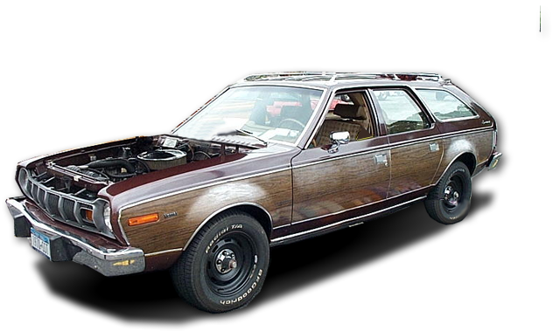

The envy of the neighborhood!

Slide 6

The envy of the neighborhood!

Slide 7

The envy of the neighborhood!

Slide 8
The envy of the neighborhood!

Slide 9

The envy of the neighborhood!

Slide 10
The envy of the neighborhood!

Slide 11

The envy of the neighborhood!

Slide 12

¹⁴ But if you harbor bitter envy and selfish ambition in your hearts, do not boast about it or deny the truth.
Notes:
SXC 1208847

Slide 13
¹⁴ But if you harbor bitter envy and selfish ambition in your hearts, do not boast about it or deny the truth.
Notes:
SXC 1208847

Slide 14
¹⁵ Such "wisdom"...
Notes:
White Owl http://www.sxc.hu/photo/185851
Dark owl http://www.sxc.hu/photo/436364

Slide 15
¹⁵ Such "wisdom"...
There are different kinds of WISDOM...
Notes:
White Owl http://www.sxc.hu/photo/185851
Dark owl http://www.sxc.hu/photo/436364

Slide 16

¹⁵ Such "wisdom"...
FROM ABOVE
BOOK SMART
Notes:
White Owl http://www.sxc.hu/photo/185851
Dark owl http://www.sxc.hu/photo/436364
CAP http://www.sxc.hu/photo/1021381

Slide 17

¹⁵ Such "wisdom"...
FROM ABOVE
FROM BELOW
BOOK SMART
STREET SMART
Notes:
White Owl http://www.sxc.hu/photo/185851
Dark owl http://www.sxc.hu/photo/436364
CAP http://www.sxc.hu/photo/1021381

Slide 18
¹⁵ Such "wisdom" does not come down from heaven but is earthly, unspiritual, of the devil.
“WORLDLY”
Notes:
White Owl http://www.sxc.hu/photo/185851
Dark owl http://www.sxc.hu/photo/436364

Slide 19

¹⁵ Such "wisdom" does not come down from heaven but is earthly, unspiritual, of the devil.
SPIRITUALLY
DEAD

Slide 20

¹⁵ Such "wisdom" does not come down from heaven but is earthly, unspiritual, of the devil.
DEMON-LIKE

Slide 21
¹⁵ Such "wisdom" does not come down from heaven but is earthly, unspiritual, of the devil.
An unholy threesome:
world, flesh, & devil

Slide 22
¹⁵ Such "wisdom" does not come down from heaven but is earthly, unspiritual, of the devil.
WHY?

Slide 23
¹⁶ For where you have envy and selfish ambition,

Slide 24
¹⁶ For where you have envy and selfish ambition,
there you find disorder
and every evil practice.

Slide 25
¹⁶ For where you have envy and selfish ambition,
there you find disorder
and every evil practice.
Emotional Disorder

Slide 26
¹⁶ For where you have envy and selfish ambition,
there you find disorder
and every evil practice.
Emotional Disorder
Intellectual Disorder

Slide 27
¹⁶ For where you have envy and selfish ambition,
there you find disorder
and every evil practice.
Emotional Disorder
Intellectual Disorder
Physical Disorder

Slide 28
¹⁶ For where you have envy and selfish ambition,
there you find disorder
and every evil practice.
Emotional Disorder
Intellectual Disorder
Physical Disorder
Marital Disorder

Slide 29
¹⁶ For where you have envy and selfish ambition,
there you find disorder
and every evil practice.
Emotional Disorder
Intellectual Disorder
Physical Disorder
Marital Disorder
Family Disorder

Slide 30
¹⁶ For where you have envy and selfish ambition,
there you find disorder
and every evil practice.
Emotional Disorder
Intellectual Disorder
Physical Disorder
Marital Disorder
Family Disorder
Social Disorder

Slide 31
¹⁶ For where you have envy and selfish ambition,
there you find disorder
and every evil practice.
Emotional Disorder
Intellectual Disorder
Physical Disorder
Marital Disorder
Family Disorder
Social Disorder
Work Disorder

Slide 32
¹⁶ For where you have envy and selfish ambition,
there you find disorder
and every evil practice.
Emotional Disorder
Intellectual Disorder
Physical Disorder
Marital Disorder
Family Disorder
Social Disorder
Work Disorder
Financial Disorder

Slide 33
¹⁶ For where you have envy and selfish ambition,
there you find disorder
and every evil practice.
Emotional Disorder
Intellectual Disorder
Physical Disorder
Marital Disorder
Family Disorder
Social Disorder
Work Disorder
Financial Disorder
Dysfunctional
Notes:
1 Corinthians 14:33 For God is not a God of disorder but of peace (1Co 14:33 NIV)

Slide 34
So much for ...¹⁵ Such "wisdom“ ...
FROM BELOW
STREET SMART
Notes:
White Owl http://www.sxc.hu/photo/185851
Dark owl http://www.sxc.hu/photo/436364
CAP http://www.sxc.hu/photo/1021381

Slide 35
Now lets look at ... ¹⁵ Such "wisdom“ ...
FROM ABOVE
BOOK SMART
Notes:
White Owl http://www.sxc.hu/photo/185851
Dark owl http://www.sxc.hu/photo/436364
CAP http://www.sxc.hu/photo/1021381

Slide 36
¹⁷ But the wisdom that comes from heaven ...
FROM ABOVE
BOOK SMART

Slide 37

¹⁷ But the wisdom that comes from heaven is first of all pure;
Notes:
Recently I was doing a paint party in Flint. I always teasingly say regarding the water we clean our brushes in, “Don’t drink the water!” But in Flint they said, “We don’t drink the water!” Why? It’s not pure! Like pure water there is pure wisdom—it is unadulterated with lies, deception, and corruption.

Slide 38

¹⁷ But the wisdom that comes from heaven is first of all pure; then peace-loving,
Notes:
Jesus said blessed are the peace-makers! Before you make peace you need to love peace.

Slide 39

¹⁷ But the wisdom that comes from heaven is first of all pure; then peace-loving, considerate,
“gentle, lenient”
Notes:
Gentle touch of hands http://www.sxc.hu/browse.phtml?f=download&id=624188

Slide 40

¹⁷ But the wisdom that comes from heaven is first of all pure; then peace-loving, considerate, submissive,
“a person open to reason”
Notes:
“A person of reason” according to Blomberg and Kamell in Zondervan Exegetical Commentary James p. 176.
Thinker from Flicker for public use. http://www.flickr.com/photos/seatbelt67/502255276/

Slide 41

¹⁷ But the wisdom that comes from heaven is first of all pure; then peace-loving, considerate, submissive, full of mercy and good fruit,
Notes:
Grapes http://www.sxc.hu/photo/1224068

Slide 42

¹⁷ But the wisdom that comes from heaven is first of all pure; then peace-loving, considerate, submissive, full of mercy and good fruit, impartial
and sincere.
Notes:
Flicker photo attributed to: http://www.google.com/imgres?imgurl=http://farm1.static.flickr.com/52/149560943_d49bb76fbd_o.jpg&imgrefurl=http://flickr.com/photos/stevan/149560943/&usg=__1fVYFJhgCblcX-ggBKSR141US8Y=&h=1024&w=766&sz=158&hl=en&start=9&itbs=1&tbnid=FisiRDUuHI4c3M:&tbnh=150&tbnw=112&prev=/images%3Fq%3Dblind%2Bjustice%26hl%3Den%26sa%3DG%26as_st%3Dy%26tbs%3Disch:1,itp:photo,iur:fmc

Slide 43
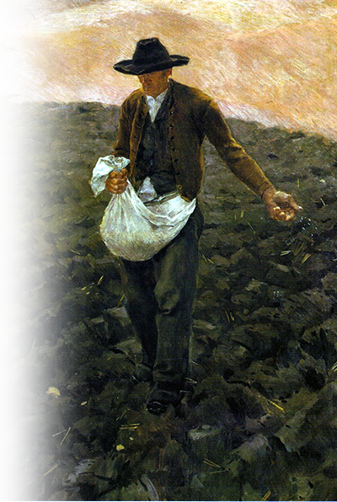
¹⁸ Peacemakers who sow in peace
Notes:
Sower from commons.wikimedia.org in public domain
http://commons.wikimedia.org/wiki/File:The_Sower_-_painting_by_Van_Gogh.jpg

Slide 44
¹⁸ Peacemakers who sow in peace
raise a harvest of righteousness.

Slide 45

¹⁸ Peacemakers who sow in peace
raise a harvest of righteousness.
Notes:
http://www.sxc.hu/browse.phtml?f=download&id=1280272 havest

Slide 46
How does this work?

Slide 47
SMART
GET ...
Notes:
White Owl http://www.sxc.hu/photo/185851
Dark owl http://www.sxc.hu/photo/436364
CAP http://www.sxc.hu/photo/1021381

Slide 48

BOOK SMART
GET ...
Notes:
White Owl http://www.sxc.hu/photo/185851
Dark owl http://www.sxc.hu/photo/436364
CAP http://www.sxc.hu/photo/1021381
Open bible http://www.sxc.hu/browse.phtml?f=download&id=1016625

Slide 49
BOOK SMART
GET ...
And then ...
Notes:
White Owl http://www.sxc.hu/photo/185851
Dark owl http://www.sxc.hu/photo/436364
CAP http://www.sxc.hu/photo/1021381
Open bible http://www.sxc.hu/browse.phtml?f=download&id=1016625

Slide 50

¹³ Who is wise and understanding among you? Let him show it by his good life, by deeds
done in the humility
that comes from
wisdom.
Notes:
Military.gov

Slide 51
book
¹³ Who is wise and understanding among you? Let him show it by his good life, by deeds
done in the humility
that comes from
wisdom.
Notes:
Military.gov

Slide 52
Remember my neighbor ...

Slide 53
So how about YOU?

Slide 54
What do YOU want to be?

Slide 55
What do YOU want to be?
You get this from a ...
“good life, by deeds
done in ... humility.”

Slide 56
What do YOU want to be?
You get this from a ...
“good life, by deeds
done in ... humility.”
A Faith that Works
for you!

Slide 57
Let’s Pray

