Slide 1
JAMES
A FAITH THAT WORKS
Notes:
BACKGROUND = https://pixabay.com/en/gears-cogs-machine-machinery-1236578/
Copyright © 2006−2021. All rights reserved. Bible Point is a registered trademark of Dennis Henderson. All other trademarks acknowledged.
Bible Point contains graphics from Bible Point artists. These illustrations belong to Bible Point and the respective artists. You may use the designs and illustrations for graphical illustration of lessons free and without special permission, provided they are not used in any way that maligns the Christian faith. Furthermore, republication or production of any illustration by any other graphic service whether it be in book, in a machine-readable form, or in any other design resource is strictly prohibited. Furthermore, they cannot be duplicated or resold as any other form of publishing, clip art, or graphic resource.
So What does it mean? (A simple translations of the legal jargon)
So, if you don’t own the presentation(s), graphic(s), and text(s) how can you legally use them? The purchase of the license allows you to use all the images in the product. However, the actual ownership and copyright of the presentation(s), graphic(s), and text(s) remain the property of Bible Point and its licensors. If you had plans on using this product in your “for sale” work—think again!
License Agreement
Article 1: License Grant
All the graphics and text in Bible Point presentations (excluding quotes from the Bible and stated sources) are the intellectual and real property of Bible Point and its licensors, and is protected by law, including United States copyright laws and international treaties. Bible Point grants to you a license:
1. To use the presentation in a single church, single school, or single office of a Christian organization.
2. To make a single archival back-up copy of the program.
3. To modify the presentation(s) and merge with other presentations in a single church, school, or Christian organization.
4. To transfer to another party if that party agrees to accept the terms and conditions of this agreement, and you do not retain any copies of the presentation, whether printed, machine readable, modified, or merged form.
Article 2: Terms
This license is effective until terminated. You may terminate the license at any time by destroying the presentation(s), graphic(s), or text(s) together with all copies, modifications and merged portions in any form. Bible Point may terminate your license if you fail to comply with this Agreement. You agree, upon such termination, for any reason, to destroy the presentation(s), graphics, and text(s) with all copies, modifications, and merged portions in any form.
Article 3: Disclaimers
1. Bible Point presentations, graphics, and texts are licensed to you As Is. You, the consumer, bear the entire risk relating to the quality and performance of the presentation(s), graphic(s), or text(s). In no event will Bible Point be liable for damages resulting from any defect.
2. Thirty-day limited warrantee on disks. Bible Point warrants the disks to be free of defects in material and workmanship under normal use for 30 days after purchase. During the 30-day period you may return a defective presentation, graphic, or text with proof of purchase and it will be replaced without charge, unless the presentation is damaged by misuse.
Article 4: General
1. You may not sub-license, assign, or transfer the license of the presentation(s), graphic(s), or text(s) except as provided by this Agreement.
2. This Agreement will be governed by the laws of the State of Michigan.
So What does it mean? (A simple translations of the legal jargon)
May I let someone borrow or copy my licensed Bible Point presentation (even after I modified it)? As long as it is within your local church, or single school, or the immediate office of a Christian organization you may. Otherwise, please refer the person interested in borrowing to: http://www.biblepoint.com or E-mail: dennis@DrDH.net with any related questions.

Slide 2
When You Need To Control
Your Tongue

Slide 3
WARNING
to Teachers
¹ Not many of you should presume to be teachers, my brothers, because you know that we who teach will be judged more strictly.

Slide 4
WARNING
to Teachers
¹ Not many of you should presume to be teachers, my brothers, because you know that we who teach will be judged more strictly.

Slide 5
THE
Principle
Talk is Cheap! So do as I do – not just as I say!

Slide 6
THE
Principle
² We all stumble in many ways. If anyone is never at fault in what he says, he is a perfect man, able to keep his whole body in check.

Slide 7
THREE SETS
of Metaphors

Slide 8


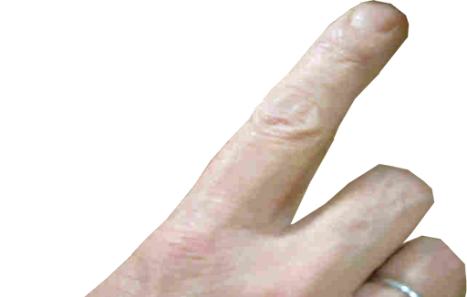
THREE SETS
of Metaphors
For Tongue Control

Slide 9
The DOMINEERING TONGUE
New Living Translation
James 3:2 Indeed, we all make many mistakes. For if we could control our tongues, we would be perfect and could also control ourselves in every other way.

Slide 10
The DOMINEERING TONGUE
New Living Translation
James 3:2 Indeed, we all make many mistakes. For if we could control our tongues, we would be perfect and could also control ourselves in every other way.
Point: Little things often control bigger things

Slide 11
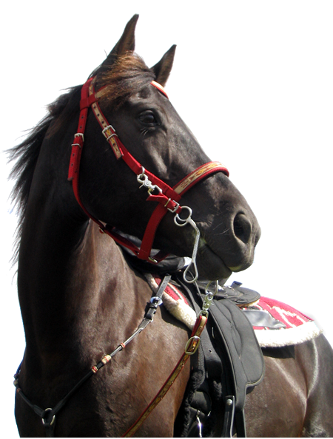
Metaphor #1: Bit
³ When we put bits into the mouths of horses to make them obey us, we can turn the whole animal.
Notes:
Horse http://www.sxc.hu/photo/678534

Slide 12
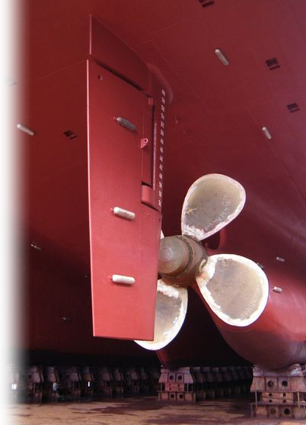
Metaphor #2: Rudder
⁴ Or take ships as an example. Although they are so large and are driven by strong winds, they are steered by a very small rudder wherever the pilot wants to go.

Slide 13
Metaphor #2: Rudder
⁵ Likewise the tongue is a small part of the body, but it makes great boasts.

Slide 14
Both have power to direct.

Slide 15
Both overcome contrary forces.

Slide 16
Need a strong hand to control.

Slide 17
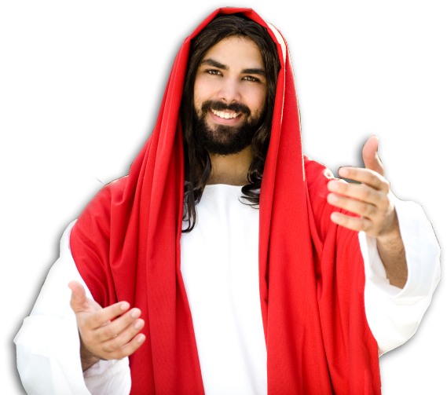
That’s why you need Jesus...
For out of the overflow of the heart the mouth speaks. (Mat 12:34)

Slide 18
The DESTRUCTIVE Tongue 3:6-8

Slide 19
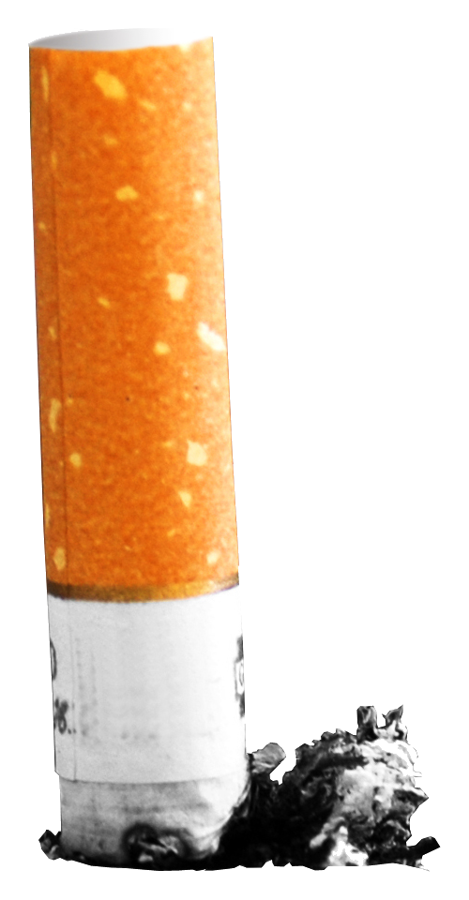
Metaphor #3: Spark
⁵ ... Consider what a great forest is set on fire by a small spark.

Slide 20
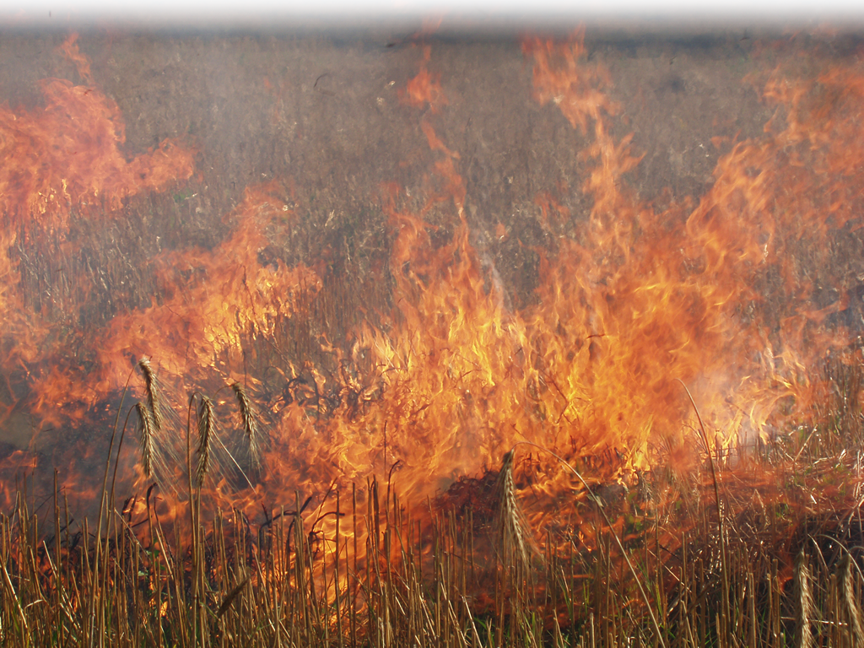
Metaphor #3: Spark
⁵ ... Consider what a great forest is set on fire by a small spark.

Slide 21
Metaphor #3: Spark
⁶ The tongue also is a fire, a world of evil among the parts of the body. It corrupts the whole person, sets the whole course of his life on fire, and is itself set on fire by hell.
Notes:
Cigarette http://www.sxc.hu/photo/1021547
Fire Dreamstime Free #719148

Slide 22
Metaphor #3: Spark
⁶ The tongue also is a fire, a world of evil among the parts of the body. It corrupts the whole person, sets the whole course of his life on fire, and is itself set on fire by hell.
Fire burns and
burns hurt!
Notes:
Cigarette http://www.sxc.hu/photo/1021547
Fire Dreamstime Free #719148

Slide 23

Metaphor #3: Spark
⁶ The tongue also is a fire, a world of evil among the parts of the body. It corrupts the whole person, sets the whole course of his life on fire, and is itself set on fire by hell.
Fire burns and
burns hurt!
Notes:
Cigarette http://www.sxc.hu/photo/1021547
Fire Dreamstime Free #719148

Slide 24
Metaphor #3: Spark
⁶ The tongue also is a fire, a world of evil among the parts of the body. It corrupts the whole person, sets the whole course of his life on fire, and is itself set on fire by hell.
Fire spreads with the more fuel you give it!
Notes:
Cigarette http://www.sxc.hu/photo/1021547
Fire Dreamstime Free #719148

Slide 25
Metaphor #3: Spark
⁶ The tongue also is a fire, a world of evil among the parts of the body. It corrupts the whole person, sets the whole course of his life on fire, and is itself set on fire by hell.
Fire spreads with the more fuel you give it!
Notes:
Cigarette http://www.sxc.hu/photo/1021547
Fire Dreamstime Free #719148

Slide 26
Metaphor #3: Spark
⁶ The tongue also is a fire, a world of evil among the parts of the body. It corrupts the whole person, sets the whole course of his life on fire, and is itself set on fire by hell.
Fire spreads with the more fuel you give it!
Notes:
Cigarette http://www.sxc.hu/photo/1021547
Fire Dreamstime Free #719148

Slide 27
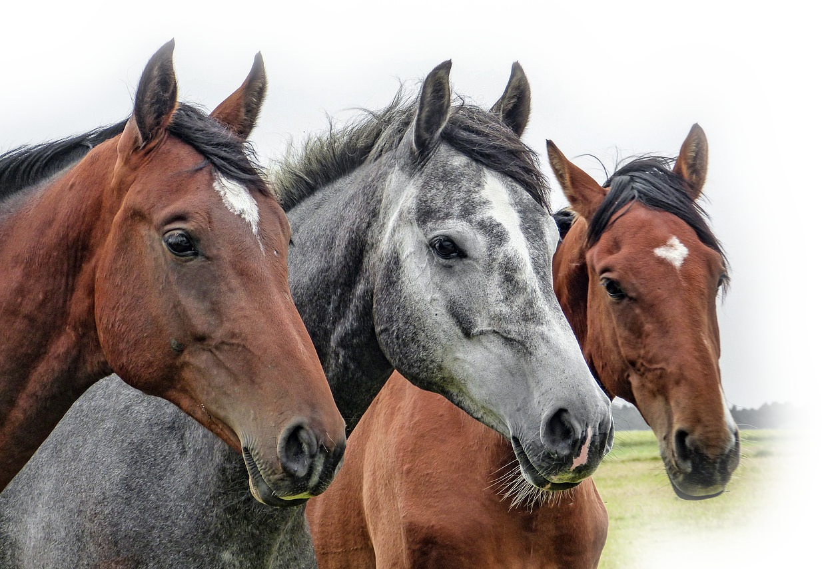
Metaphor #4: Snake
⁷ All kinds of animals, birds, reptiles and creatures of the sea are being tamed and have been tamed by man,
Notes:
Horses = https://pixabay.com/en/horses-horse-head-animals-1414889/
Parrot = https://upload.wikimedia.org/wikipedia/commons/3/34/9AM_is_too_early_for_parrots%2C_too_%284669673529%29.jpg
Snake http://www.sxc.hu/browse.phtml?f=download&id=1061420

Slide 28
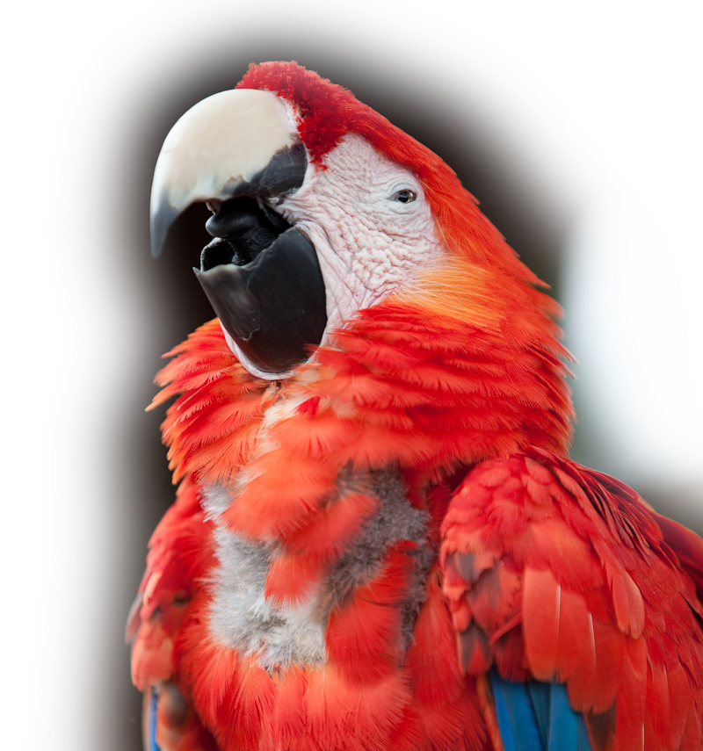
Metaphor #4: Snake
⁷ All kinds of animals, birds, reptiles and creatures of the sea are being tamed and have been tamed by man,
Notes:
Horses = https://pixabay.com/en/horses-horse-head-animals-1414889/
Parrot = https://upload.wikimedia.org/wikipedia/commons/3/34/9AM_is_too_early_for_parrots%2C_too_%284669673529%29.jpg
Snake http://www.sxc.hu/browse.phtml?f=download&id=1061420

Slide 29
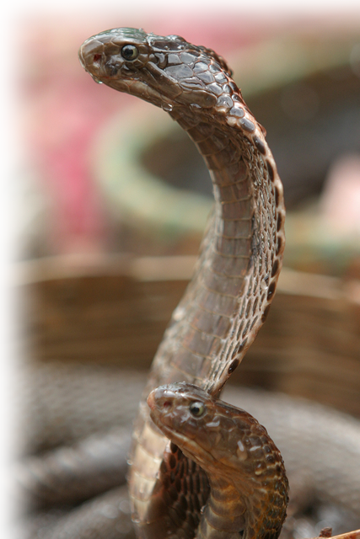
Metaphor #4: Snake
⁷ All kinds of animals, birds, reptiles and creatures of the sea are being tamed and have been tamed by man,
Notes:
Horses = https://pixabay.com/en/horses-horse-head-animals-1414889/
Parrot = https://upload.wikimedia.org/wikipedia/commons/3/34/9AM_is_too_early_for_parrots%2C_too_%284669673529%29.jpg
Snake http://www.sxc.hu/browse.phtml?f=download&id=1061420

Slide 30
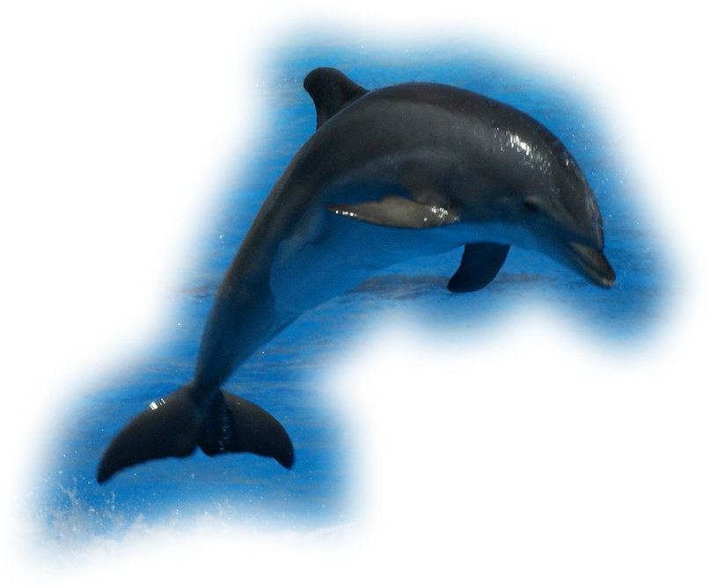
Metaphor #4: Snake
⁷ All kinds of animals, birds, reptiles and creatures of the sea are being tamed and have been tamed by man,
Notes:
Horses = https://pixabay.com/en/horses-horse-head-animals-1414889/
Parrot = https://upload.wikimedia.org/wikipedia/commons/3/34/9AM_is_too_early_for_parrots%2C_too_%284669673529%29.jpg
Snake http://www.sxc.hu/browse.phtml?f=download&id=1061420
Dolphin = https://www.flickr.com/photos/spencer77/4774656930

Slide 31
Metaphor #4: Snake
⁷ All kinds of animals, birds, reptiles and creatures of the sea are being tamed and have been tamed by man,
Notes:
Horses = https://pixabay.com/en/horses-horse-head-animals-1414889/
Parrot = https://upload.wikimedia.org/wikipedia/commons/3/34/9AM_is_too_early_for_parrots%2C_too_%284669673529%29.jpg
Snake http://www.sxc.hu/browse.phtml?f=download&id=1061420

Slide 32
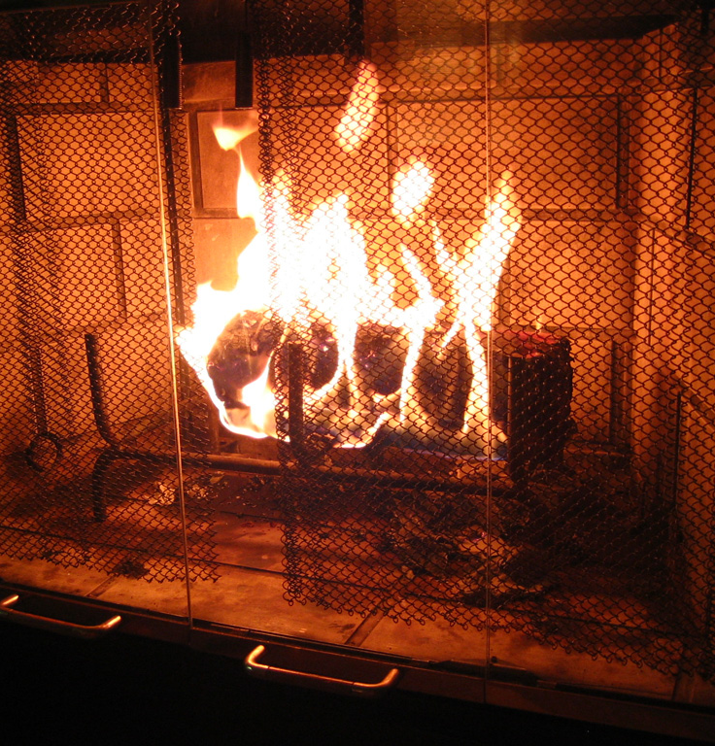
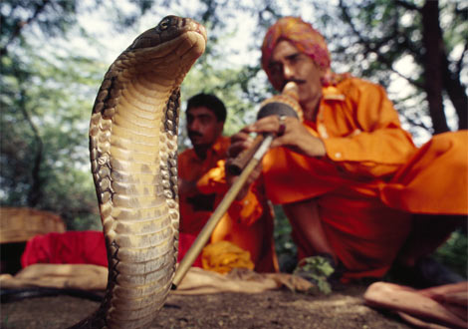
Both can be tamed:

Slide 33
Metaphor #4: Snake
⁷ All kinds of animals, birds, reptiles and creatures of the sea are being tamed and have been tamed by man,
⁸ but no man can tame the
tongue. It is a restless evil,
full of deadly poison.
Notes:
Snake http://www.sxc.hu/browse.phtml?f=download&id=1061420

Slide 34
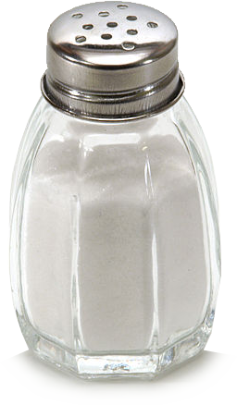
The antidote is to:
Let your conversation be always full of grace, seasoned with salt, so that you may know how to answer everyone. (Colossians 4:6)

Slide 35
The DISREPECTFUL Tongue

Slide 36
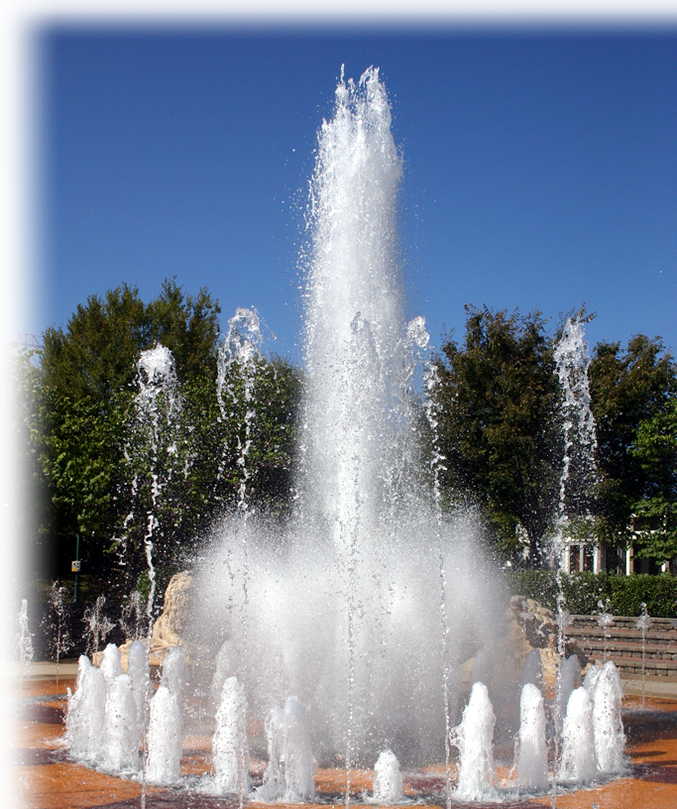
Metaphor #5: Water
¹¹ Can both fresh water and salt water flow from the same spring?

Slide 37
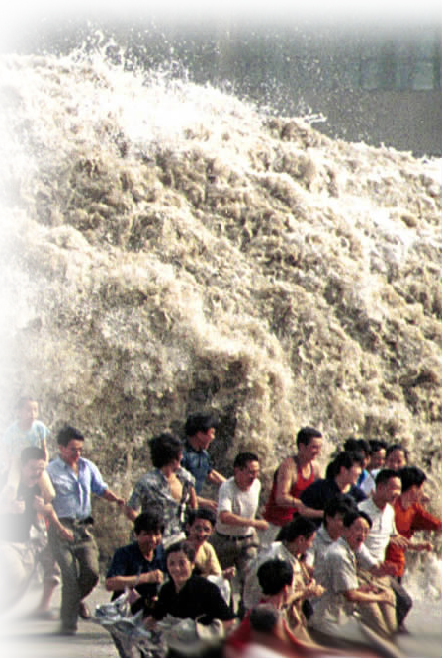
Metaphor #5: Water
¹¹ Can both fresh water and salt water flow from the same spring?

Slide 38
Metaphor #5: Water
¹¹ Can both fresh water and salt water flow from the same spring?
Life-giving or
Life-killing
(as in a Tsunami)

Slide 39
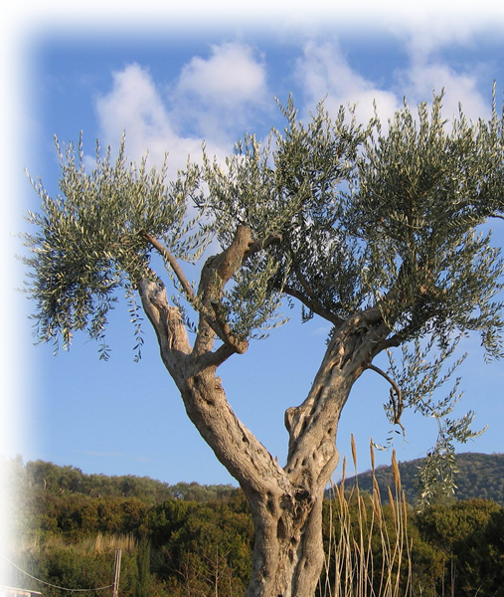
Metaphor #6: Fruit
¹² My brothers, can a fig tree bear olives, or a grapevine bear figs?
Notes:
Olive tree http://www.dreamstime.com/olive-tree-free-stock-image-imagefree444754

Slide 40
Metaphor #6: Fruit
¹² My brothers, can a fig tree bear olives, or a grapevine bear figs?
Neither can a salt spring produce fresh water.
Notes:
Olive tree http://www.dreamstime.com/olive-tree-free-stock-image-imagefree444754

Slide 41
The Point: Verses 9-10
⁹ With the tongue we praise our Lord and Father, and with it we curse men, who have been made in God's likeness.

Slide 42
The Point: Verses 9-10
⁹ With the tongue we praise our Lord and Father, and with it we curse men, who have been made in God's likeness.
¹⁰ Out of the same mouth
come praise and cursing. My
brothers, this should not be.

Slide 43
The Point: Verses 9-10
⁹ With the tongue we praise our Lord and Father, and with it we curse men, who have been made in God's likeness.
¹⁰ Out of the same mouth
come praise and cursing. My
brothers, this should not be.
So then, what “should be?”

Slide 44
A dynamic-faith so Christ will:
Hold our Bridle
Notes:
Let no corrupt communication come out of your mouth Eph 4:25

Slide 45
A dynamic-faith so Christ will:
Hold our Bridle
Pilot our Ship
Notes:
Trust in the lord ... And he will guide your paths Prov 4:5-6

Slide 46
A dynamic-faith so Christ will:
Hold our Bridle
Pilot our Ship
Blaze our Heart

Slide 47
A dynamic-faith so Christ will:
Hold our Bridle
Pilot our Ship
Blaze our Heart
Tame our Tongue

Slide 48
A dynamic-faith so Christ will:
Hold our Bridle
Pilot our Ship
Blaze our Heart
Tame our Tongue
Purify our Water

Slide 49
A dynamic-faith so Christ will:
Hold our Bridle
Pilot our Ship
Blaze our Heart
Tame our Tongue
Purify our Water
Prune our Vines

Slide 50
A dynamic-faith so Christ will:
Hold our Bridle
Pilot our Ship
Blaze our Heart
Tame our Tongue
Purify our Water
Prune our Vines
Our speech will be “seasoned
with salt.” (Col 4:6)

Slide 51
Only then will ...
... we ... control our tongues, ... and ... also control ourselves in every other way. (James 3:2 NLT)

Slide 52
Twelve words that bring blessing:
“Please--Thank You.”

Slide 53
Twelve words that bring blessing:
“Please--Thank You.”
“I’m sorry.”

Slide 54
Twelve words that bring blessing:
“Please--Thank You.”
“I’m sorry.”
“I love you.”

Slide 55
Twelve words that bring blessing:
“Please--Thank You.”
“I’m sorry.”
“I love you.”
“I’m praying for you.”

Slide 56
Let’s Pray

