Slide 1
JAMES
A FAITH THAT WORKS
Notes:
BACKGROUND = https://pixabay.com/en/gears-cogs-machine-machinery-1236578/
Copyright © 2006−2021. All rights reserved. Bible Point is a registered trademark of Dennis Henderson. All other trademarks acknowledged.
Bible Point contains graphics from Bible Point artists. These illustrations belong to Bible Point and the respective artists. You may use the designs and illustrations for graphical illustration of lessons free and without special permission, provided they are not used in any way that maligns the Christian faith. Furthermore, republication or production of any illustration by any other graphic service whether it be in book, in a machine-readable form, or in any other design resource is strictly prohibited. Furthermore, they cannot be duplicated or resold as any other form of publishing, clip art, or graphic resource.
So What does it mean? (A simple translations of the legal jargon)
So, if you don’t own the presentation(s), graphic(s), and text(s) how can you legally use them? The purchase of the license allows you to use all the images in the product. However, the actual ownership and copyright of the presentation(s), graphic(s), and text(s) remain the property of Bible Point and its licensors. If you had plans on using this product in your “for sale” work—think again!
License Agreement
Article 1: License Grant
All the graphics and text in Bible Point presentations (excluding quotes from the Bible and stated sources) are the intellectual and real property of Bible Point and its licensors, and is protected by law, including United States copyright laws and international treaties. Bible Point grants to you a license:
1. To use the presentation in a single church, single school, or single office of a Christian organization.
2. To make a single archival back-up copy of the program.
3. To modify the presentation(s) and merge with other presentations in a single church, school, or Christian organization.
4. To transfer to another party if that party agrees to accept the terms and conditions of this agreement, and you do not retain any copies of the presentation, whether printed, machine readable, modified, or merged form.
Article 2: Terms
This license is effective until terminated. You may terminate the license at any time by destroying the presentation(s), graphic(s), or text(s) together with all copies, modifications and merged portions in any form. Bible Point may terminate your license if you fail to comply with this Agreement. You agree, upon such termination, for any reason, to destroy the presentation(s), graphics, and text(s) with all copies, modifications, and merged portions in any form.
Article 3: Disclaimers
1. Bible Point presentations, graphics, and texts are licensed to you As Is. You, the consumer, bear the entire risk relating to the quality and performance of the presentation(s), graphic(s), or text(s). In no event will Bible Point be liable for damages resulting from any defect.
2. Thirty-day limited warrantee on disks. Bible Point warrants the disks to be free of defects in material and workmanship under normal use for 30 days after purchase. During the 30-day period you may return a defective presentation, graphic, or text with proof of purchase and it will be replaced without charge, unless the presentation is damaged by misuse.
Article 4: General
1. You may not sub-license, assign, or transfer the license of the presentation(s), graphic(s), or text(s) except as provided by this Agreement.
2. This Agreement will be governed by the laws of the State of Michigan.
So What does it mean? (A simple translations of the legal jargon)
May I let someone borrow or copy my licensed Bible Point presentation (even after I modified it)? As long as it is within your local church, or single school, or the immediate office of a Christian organization you may. Otherwise, please refer the person interested in borrowing to: http://www.biblepoint.com or E-mail: dennis@DrDH.net with any related questions.

Slide 2
When Talk is CHEAP!

Slide 3
There is a difference between:
Professing
Possessing

Slide 4
There is a difference between:
Professing
Talking
Possessing
Walking

Slide 5
There is a difference between:
Professing
Talking
Knowing
Possessing
Walking
Showing

Slide 6
There is a difference between:
Professing
Talking
Knowing
Saying
Possessing
Walking
Showing
Doing

Slide 7
What people think:
83% of Americans identify themselves as Christians. Most of the rest, 13 percent, have no religion. That leaves just 4 percent as adherents of all non-Christian religions combined — Jews, Muslims, Buddhists etc..
ABC poll 2016
Notes:
ABC Poll = http://abcnews.go.com/US/story?id=90356&page=1

Slide 8
What people think:
“84% of all Americans consider themselves to be Christian. That proportion has remained unchanged throughout the past decade.”
BarnaGroup 11-29-05

Slide 9
What people think:
“84% of all Americans consider themselves to be Christian. That proportion has remained unchanged throughout the past decade.”
BarnaGroup 11-29-05
“One-quarter of those who call themselves born again ... rely upon something other than God’s grace as their means to salvation.”
BarnaGroup 11-29-05

Slide 10
At least three kinds of Faith
according to James
1 – 2 – 3

Slide 11

1- A Dead Intellectual Faith

Slide 12
1- A Dead Intellectual Faith
[1] faith by itself ... is dead. -James 2:17

Slide 13
1- A Dead Intellectual Faith
[1] faith by itself ... is dead. -James 2:17
[2] that faith ... is useless [dead] -James 2:20

Slide 14
1- A Dead Intellectual Faith
[1] faith by itself ... is dead. -James 2:17
[2] that faith ... is useless [dead] -James 2:20
[3] faith ... is dead. -James 2:26

Slide 15
1- A Dead Intellectual Faith
What Kind of Faith is Dead?

Slide 16
1- A Dead Intellectual Faith
Answer:
A professed, “all-talk and no-show,” kind of Faith!

Slide 17
1- A Dead Intellectual Faith
James puts it like this:
¹⁴ What good is it, my brothers, if a man claims to have (professes) faith but has no deeds? Can such faith save him? (James 2:14)

Slide 18
1- A Dead Intellectual Faith
James puts it like this:
¹⁴ What good is it, my brothers, if a man claims to have (professes) faith but has no deeds? Can such faith save him? (James 2:14)
The Answer:
NO!

Slide 19
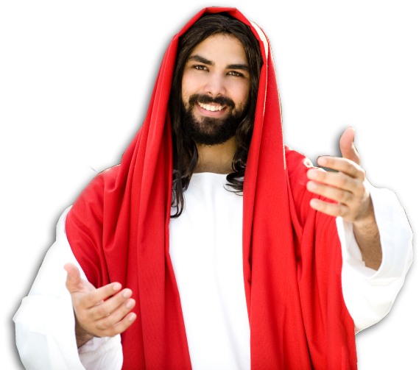
1- A Dead Intellectual Faith
Jesus put it this way:
²¹ "Not everyone
who says to me,
'Lord, Lord,' will enter the kingdom of heaven, but only he who does the will of my Father who is in heaven.

Slide 20
1- A Dead Intellectual Faith
Jesus put it this way:
²² Many will say to me on that day, 'Lord, Lord, did we not prophesy in your name, and in your name drive out demons and perform many miracles?‘

Slide 21
1- A Dead Intellectual Faith
Jesus put it this way:
²³ Then I will tell them plainly, 'I never knew you. Away from me, you evildoers!'

Slide 22
1- A Dead Intellectual Faith
Jesus put it this way:
²³ Then I will tell them plainly, 'I never knew you. Away from me, you evildoers!'
WHY?

Slide 23
1- A Dead Intellectual Faith
Previously Jesus said,
¹⁸ A good tree cannot bear bad fruit, and a bad tree cannot bear good fruit. ¹⁹ Every tree that does not bear good fruit is cut down and thrown into the fire.

Slide 24
1- A Dead Intellectual Faith
Previously Jesus said,
²⁰ Thus, by their fruit you will recognize them.

Slide 25
1- A Dead Intellectual Faith
Previously Jesus said,
²⁰ Thus, by their fruit you will recognize them.
Saving Faith
Works!

Slide 26
1- A Dead Intellectual Faith
Jesus concludes ,
²⁴ "Therefore everyone who hears these words of mine and puts them into practice is like a wise man who built his house on the rock. (Mat 7:24)

Slide 27
1- A Dead Intellectual Faith
James illustrates this for us...

Slide 28
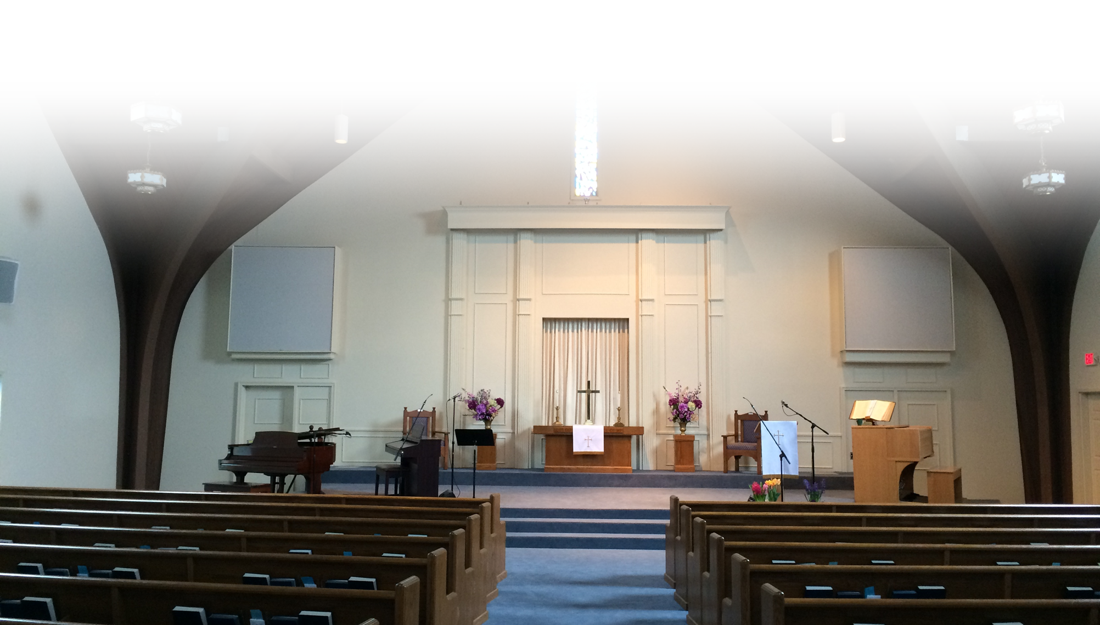
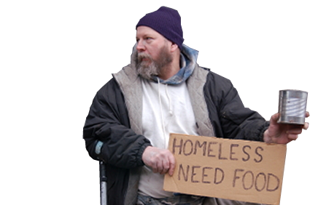
¹⁵ Suppose a brother or sister is without clothes and daily food.
¹⁶ If one of you says to him,

Slide 29
¹⁵ Suppose a brother or sister is without clothes and daily food.
¹⁶ If one of you says to him,
"Go, I wish you well;
keep warm and well fed,"

Slide 30
¹⁵ Suppose a brother or sister is without clothes and daily food.
¹⁶ If one of you says to him,
"Go, I wish you well;
keep warm and well fed,"
but does nothing
about his physical needs,
what good is it?

Slide 31
¹⁵ Suppose a brother or sister is without clothes and daily food.
¹⁷ In the same way, faith by itself, if it is
not accompanied by action, is dead.
¹⁶ If one of you says to him,
"Go, I wish you well;
keep warm and well fed,"
but does nothing
about his physical needs,
what good is it?

Slide 32
¹⁷ In the same way, faith by itself, if it is
not accompanied by action, is dead.
Likewise, just to say:
“I believe in Jesus,”
is not enough!
Saving faith is more
than just lip-service!

Slide 33
Another kind of Faith ...

Slide 34
2- A Demonic Emotional Faith

Slide 35
2- A Demonic Emotional Faith
James must have been from ...

Slide 36

2- A Demonic Emotional Faith
James must have been from ...

Slide 37
2- A Demonic Emotional Faith
¹⁸ But someone will say, "You have faith; I have deeds." Show me your faith without deeds, and I will show you my faith by what I do.
James must have been from ...

Slide 38
2- A Demonic Emotional Faith
¹⁸ But someone will say, "You have faith; I have deeds." Show me your faith without deeds, and I will show you my faith by what I do.
James must have been from ...
Put Up or
Shut up

Slide 39
2- A Demonic Emotional Faith
James adds ... ¹⁹ You believe that there is one God. Good!

Slide 40
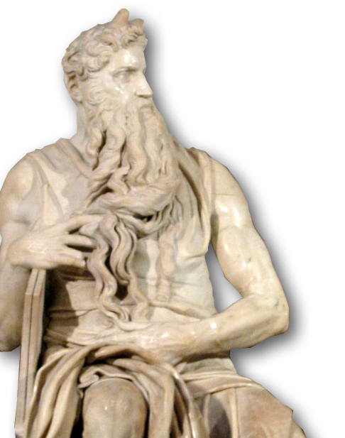
2- A Demonic Emotional Faith
James adds ... ¹⁹ You believe that there is one God. Good!

Slide 41
2- A Demonic Emotional Faith
James adds ... ¹⁹ You believe that there is one God. Good!
Hear, O Israel:
The LORD our God, the LORD is one. (Deuteronomy 6:4)

Slide 42
2- A Demonic Emotional Faith
James adds ... ¹⁹ You believe that there is one God. Good! ...
¹⁹ Even the demons believe that--and shudder.
Hear, O Israel:
The LORD our God, the LORD is one. (Deuteronomy 6:4)

Slide 43
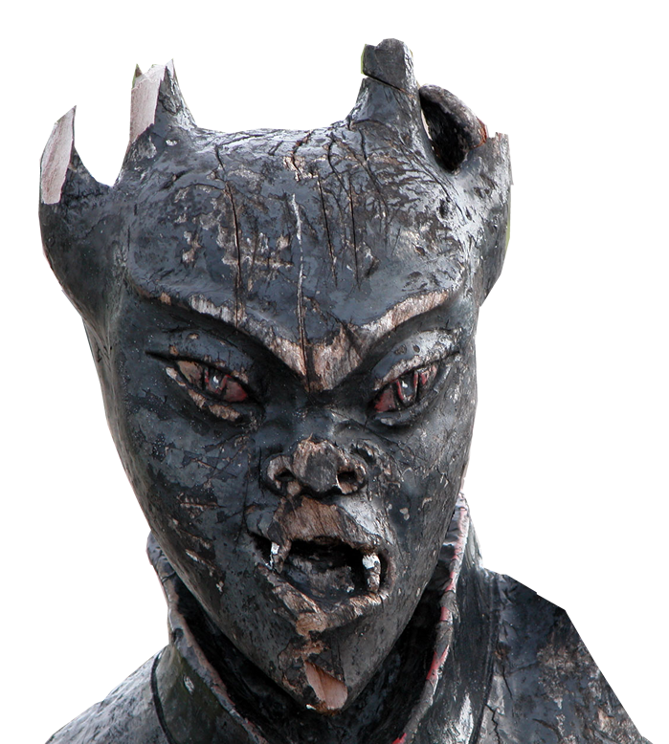
2- A Demonic Emotional Faith
Demons have faith:

Slide 44
2- A Demonic Emotional Faith
Demons have faith:
1—in God’s existence (James 2:19)

Slide 45
2- A Demonic Emotional Faith
Demons have faith:
1—in God’s existence (James 2:19)
2—in Christ’s deity (Mark 3:11-12)

Slide 46
2- A Demonic Emotional Faith
Demons have faith:
1—in God’s existence (James 2:19)
2—in Christ’s deity (Mark 3:11-12)
¹¹ Whenever the evil spirits saw him, they fell down before him and cried out, "You are the Son of God."

Slide 47
2- A Demonic Emotional Faith
Demons have faith:
1—in God’s existence (James 2:19)
2—in Christ’s deity (Mark 3:11-12)
3—in Place of punishment (Luke 8:31)

Slide 48
2- A Demonic Emotional Faith
Demons have faith:
1—in God’s existence (James 2:19)
2—in Christ’s deity (Mark 3:11-12)
3—in Place of punishment (Luke 8:31)
4—in Jesus as Judge (Mark 5:1-13)

Slide 49
2- A Demonic Emotional Faith
Demons have faith:
1—in God’s existence (James 2:19)
2—in Christ’s deity (Mark 3:11-12)
3—in Place of punishment (Luke 8:31)
4—in Jesus as Judge (Mark 5:1-13)
5—that fears God (James 2:19)
(they shudder)

Slide 50
2- A Demonic Emotional Faith
Demons have faith:
1—in God’s existence (James 2:19)
2—in Christ’s deity (Mark 3:11-12)
3—in Place of punishment (Luke 8:31)
4—in Jesus as Judge (Mark 5:1-13)
5—that fears God (James 2:19)
(they shudder)
So how is your faith any better?

Slide 51
What people think:
68% percent said in a May 2001 poll that they believe in the devil, 20% said they don't, and 12% said they aren't sure.
Gallup Poll 2001
Notes:
Gallup Poll = http://www.gallup.com/poll/7858/devil-demographic-details.aspx

Slide 52
What people think:
72% Americans say they believe in heaven — defined as a place “where people who have led good lives are eternally rewarded,” ... But at the same time, 58% of U.S. adults also believe in hell — a place “where people who have led bad lives and die without being sorry are eternally punished.”
Pew Research Center’s 2014 Religious Landscape Study

Slide 53
What people think:
“In all, 76% believe that Heaven exists, while nearly the same proportion said that there is such a thing as Hell (71%).”
“Most Americans do not expect to experience Hell first-hand: just one-half of 1% expect to go to Hell upon their death. Nearly two-thirds of Americans (64%) believe they will go to Heaven.”
BarnaGroup 11-21-03

Slide 54
2- A Demonic Emotional Faith
“Demonic Faith”
surpasses “Dead Faith,” but it too cannot save you!

Slide 55
2- A Demonic Emotional Faith
“Demonic Faith”
surpasses “Dead Faith,” but it too cannot save you!
It takes more than an intellectual and emotional faith.

Slide 56
3- A Dynamic Life-Changing Faith

Slide 57
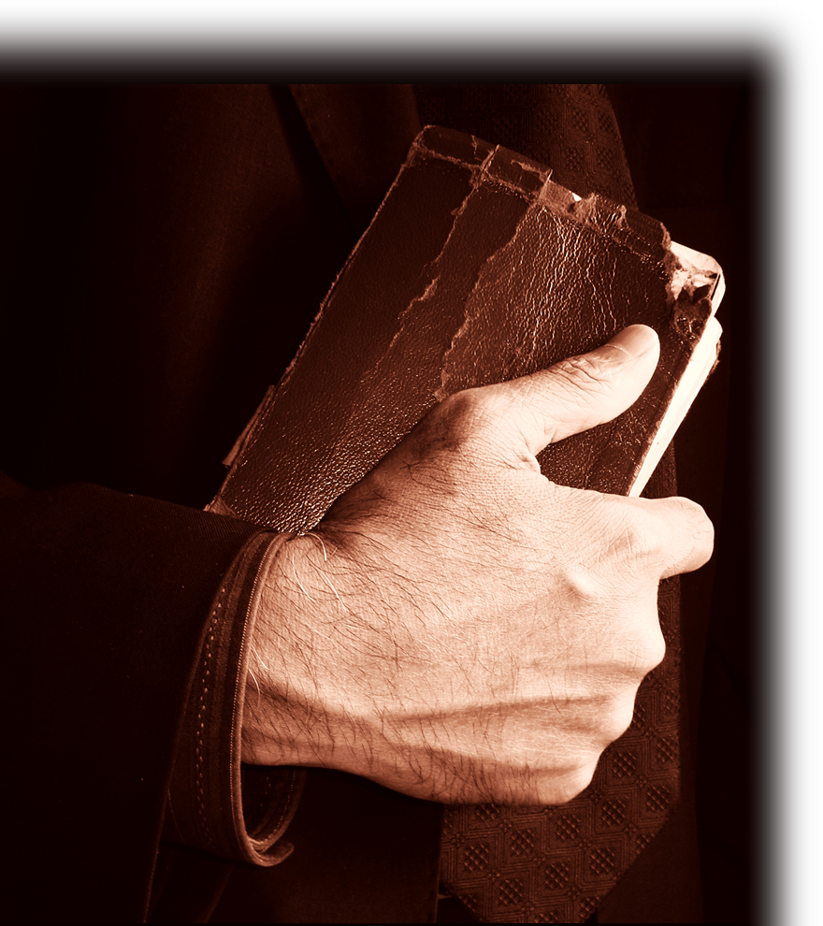
3- A Dynamic Life-Changing Faith
Yes, it take your mind

Slide 58

3- A Dynamic Life-Changing Faith
Yes, it take your mind
Yes, it take your heart
Notes:
Bible http://www.sxc.hu/browse.phtml?f=download&id=1178354
Heart sxc

Slide 59
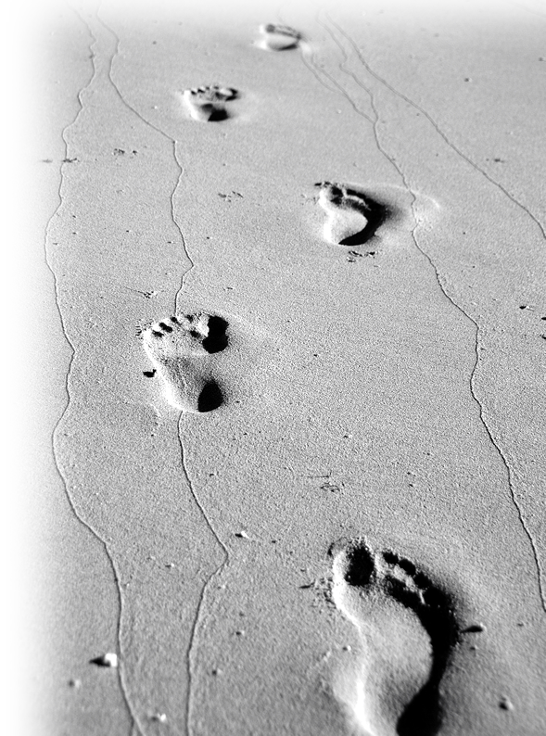
3- A Dynamic Life-Changing Faith
Yes, it take your mind
Yes, it take your heart
But it also takes your COMMITMENT!
Notes:
Bible http://www.sxc.hu/browse.phtml?f=download&id=1178354
Heart sxc
Foot prints http://www.sxc.hu/browse.phtml?f=download&id=1054206

Slide 60
3- A Dynamic Life-Changing Faith
It’s a Faith that Works!
You act on what you believe as if you believe it!

Slide 61
3- A Dynamic Life-Changing Faith
It’s a Faith that Works!
You act on what you believe as if you believe it!
²⁰ You foolish man, do you want evidence that faith without deeds is useless?

Slide 62
3- A Dynamic Life-Changing Faith
It’s a Faith that Works!
You act on what you believe as if you believe it!
²⁰ You foolish man, do you want evidence that faith without deeds is useless?
TWO EXAMPLES:

Slide 63
Abraham – the Friend of God
²¹ Was not our ancestor Abraham considered righteous for what he did when he offered his son Isaac on the altar?

Slide 64
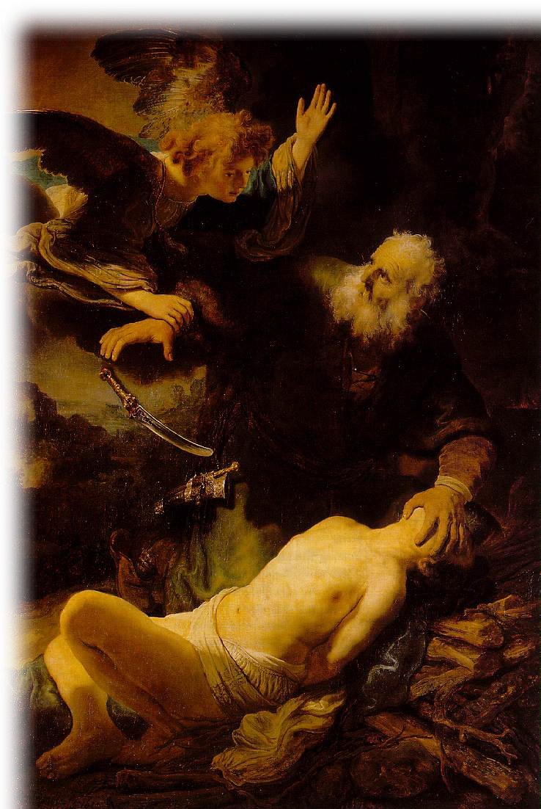
Abraham – the Friend of God
²¹ Was not our ancestor Abraham considered righteous for what he did when he offered his son Isaac on the altar?

Slide 65
Abraham – the Friend of God
²² You see that his faith and his actions were working together, and his faith was made complete by what he did.

Slide 66
Abraham – the Friend of God
²² You see that his faith and his actions were working together, and his faith was made complete by what he did.

Slide 67
Abraham – the Friend of God
²³ And the scripture was fulfilled that says,
"Abraham believed God, and it was credited to him as righteousness," and he was called God's friend.

Slide 68
Abraham – the Friend of God
When did he believe?
²³ And the scripture was fulfilled that says,
"Abraham believed God, and it was credited to him as righteousness," and he was called God's friend.
Genesis 22

Slide 69

Abraham – the Friend of God
When did he believe?
²³ And the scripture was fulfilled that says,
"Abraham believed God, and it was credited to him as righteousness," and he was called God's friend.
¹⁷ By faith Abraham, when God tested him, offered Isaac as a sacrifice.... ¹⁹ Abraham reasoned that God could raise the dead,
Genesis 15
Genesis 22

Slide 70
Abraham – the Friend of God
Abraham – the Friend of God
²⁴ You see that a person is justified by what he does and not by faith alone.
Genesis 15
Genesis 22

Slide 71
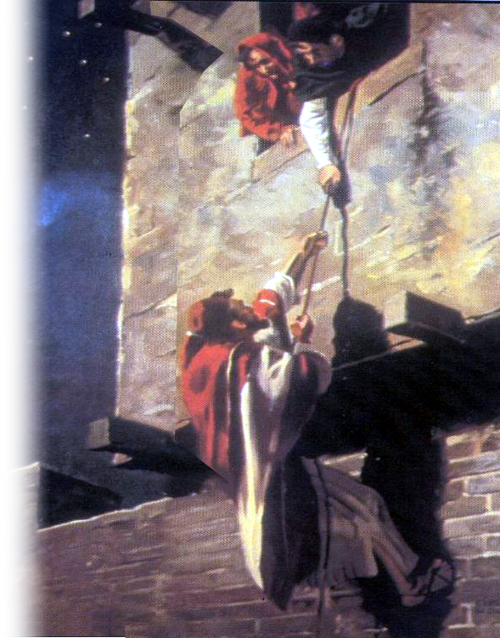
Rahab–the Prostitute
²⁵ In the same way, was not even Rahab the prostitute considered righteous for what she did when she gave lodging to the spies and sent them off in a different direction?

Slide 72
Rahab–the Prostitute
²⁵ In the same way, was not even Rahab the prostitute considered righteous for what she did when she gave lodging to the spies and sent them off in a different direction?
Heb 11³¹ By faith the prostitute Rahab, because she welcomed the spies, was not killed with those who were disobedient.

Slide 73
The point is:
They both demonstrated their faith in action – they had a faith that worked!

Slide 74
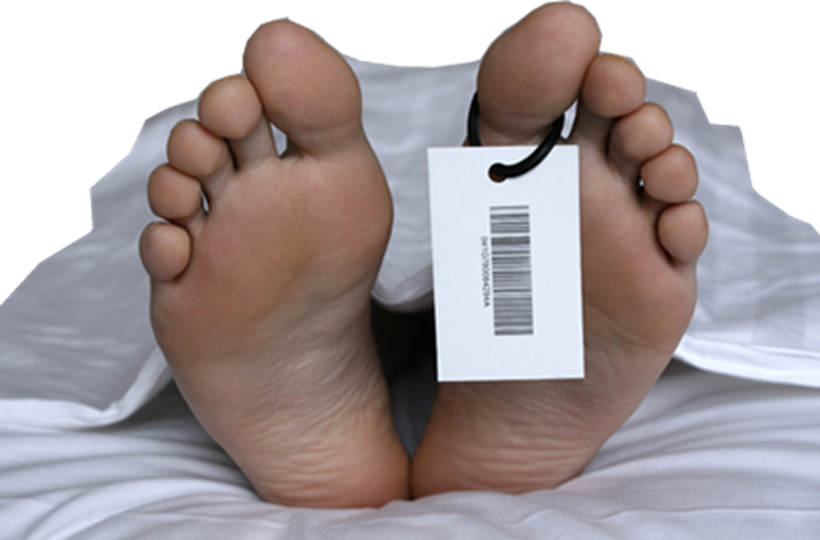
James wraps up saying:
²⁶ As the body without the spirit is dead,

Slide 75
James wraps up saying:
²⁶ As the body without the spirit is dead,

Slide 76
James wraps up saying:
²⁶ As the body without the spirit is dead,

Slide 77
James wraps up saying:
²⁶ As the body without the spirit is dead,

Slide 78
James wraps up saying:
²⁶ As the body without the spirit is dead,
so faith without deeds is dead.
WORKS
FAITH

Slide 79
The Big Question Today:
What kind of faith do you have:
Dead Intellectual Faith?

Slide 80
The Big Question Today:
What kind of faith do you have:
Dead Intellectual Faith?
Demonic Emotional Faith?

Slide 81
The Big Question Today:
What kind of faith do you have?
Dead Intellectual Faith?
Demonic Emotional Faith?
Dynamic Life-Changing
Faith?

Slide 82
You can have ...
A life-changing faith when you believe:

Slide 83
You can have ...
A life-changing faith when you believe:
with your head,
with your heart, and
with your will.
Notes:
Your will – Romans 12:1 “Present yourself (as Abraham presented Isaac) a living sacrifice!!!”
You choose to live it!

Slide 84
You can have ...
A life-changing faith when you believe:
with your head,
with your heart, and
with your will.
Now is the time to replace
a “Cheap Talk with a
Genuine Walk?”
Notes:
Story of John Burke -- Knew it, loved it, --but never appropriated it.

Slide 85
Let’s Pray

