Slide 1
JAMES
A FAITH THAT WORKS
Notes:
BACKGROUND = https://pixabay.com/en/gears-cogs-machine-machinery-1236578/
Copyright © 2006−2021. All rights reserved. Bible Point is a registered trademark of Dennis Henderson. All other trademarks acknowledged.
Bible Point contains graphics from Bible Point artists. These illustrations belong to Bible Point and the respective artists. You may use the designs and illustrations for graphical illustration of lessons free and without special permission, provided they are not used in any way that maligns the Christian faith. Furthermore, republication or production of any illustration by any other graphic service whether it be in book, in a machine-readable form, or in any other design resource is strictly prohibited. Furthermore, they cannot be duplicated or resold as any other form of publishing, clip art, or graphic resource.
So What does it mean? (A simple translations of the legal jargon)
So, if you don’t own the presentation(s), graphic(s), and text(s) how can you legally use them? The purchase of the license allows you to use all the images in the product. However, the actual ownership and copyright of the presentation(s), graphic(s), and text(s) remain the property of Bible Point and its licensors. If you had plans on using this product in your “for sale” work—think again!
License Agreement
Article 1: License Grant
All the graphics and text in Bible Point presentations (excluding quotes from the Bible and stated sources) are the intellectual and real property of Bible Point and its licensors, and is protected by law, including United States copyright laws and international treaties. Bible Point grants to you a license:
1. To use the presentation in a single church, single school, or single office of a Christian organization.
2. To make a single archival back-up copy of the program.
3. To modify the presentation(s) and merge with other presentations in a single church, school, or Christian organization.
4. To transfer to another party if that party agrees to accept the terms and conditions of this agreement, and you do not retain any copies of the presentation, whether printed, machine readable, modified, or merged form.
Article 2: Terms
This license is effective until terminated. You may terminate the license at any time by destroying the presentation(s), graphic(s), or text(s) together with all copies, modifications and merged portions in any form. Bible Point may terminate your license if you fail to comply with this Agreement. You agree, upon such termination, for any reason, to destroy the presentation(s), graphics, and text(s) with all copies, modifications, and merged portions in any form.
Article 3: Disclaimers
1. Bible Point presentations, graphics, and texts are licensed to you As Is. You, the consumer, bear the entire risk relating to the quality and performance of the presentation(s), graphic(s), or text(s). In no event will Bible Point be liable for damages resulting from any defect.
2. Thirty-day limited warrantee on disks. Bible Point warrants the disks to be free of defects in material and workmanship under normal use for 30 days after purchase. During the 30-day period you may return a defective presentation, graphic, or text with proof of purchase and it will be replaced without charge, unless the presentation is damaged by misuse.
Article 4: General
1. You may not sub-license, assign, or transfer the license of the presentation(s), graphic(s), or text(s) except as provided by this Agreement.
2. This Agreement will be governed by the laws of the State of Michigan.
So What does it mean? (A simple translations of the legal jargon)
May I let someone borrow or copy my licensed Bible Point presentation (even after I modified it)? As long as it is within your local church, or single school, or the immediate office of a Christian organization you may. Otherwise, please refer the person interested in borrowing to: http://www.biblepoint.com or E-mail: dennis@DrDH.net with any related questions.

Slide 2
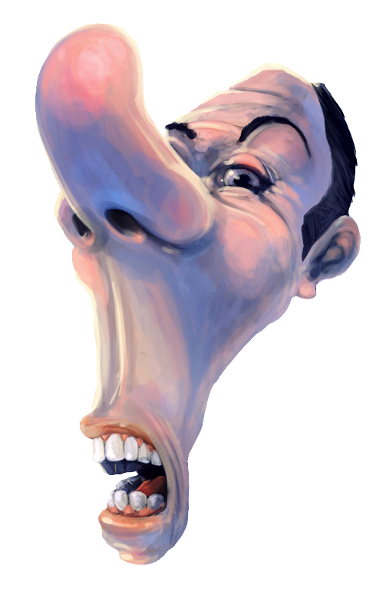
When
You’ve
Been
“Snobbed”

Slide 3
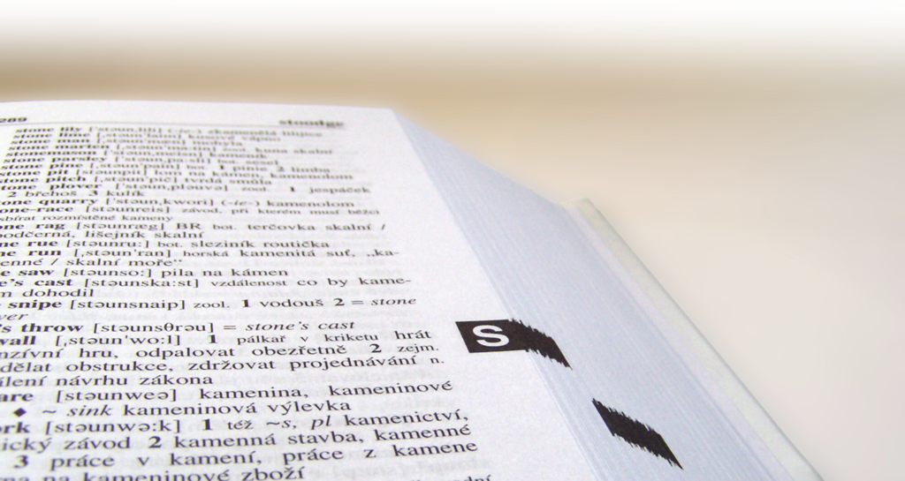
Webster says a “snob” is a person who:

Slide 4
“Attaches great importance to wealth, social position, etc., and has contempt for inferiors ...” or

Slide 5
“regards himself as better than others in some specific way and behaves undemocratically;
as an intellectual snob.”

Slide 6
Some things ought not to be in Christianity!

Slide 7
Some things ought not to be in Christianity!
Such as:
Prejudice

Slide 8
Some things ought not to be in Christianity!
Such as:
Prejudice
Inquisitions

Slide 9
Some things ought not to be in Christianity!
Such as:
Prejudice
Inquisitions
and Snobbery!

Slide 10

It is INCOMPATIBLE . . .
¹ My brothers, as believers in our glorious Lord Jesus Christ, don't show favoritism.
Notes:
Snobbery exists when you are your own favorite.
Romans 12:3 Do not think of yourself more highly than you ought, but rather think of yourself with sober judgment, in accordance with the measure of faith God has given you. (Rom 12:3 NIV)
Phil 2:8-8 Let this mind be in you ...

Slide 11
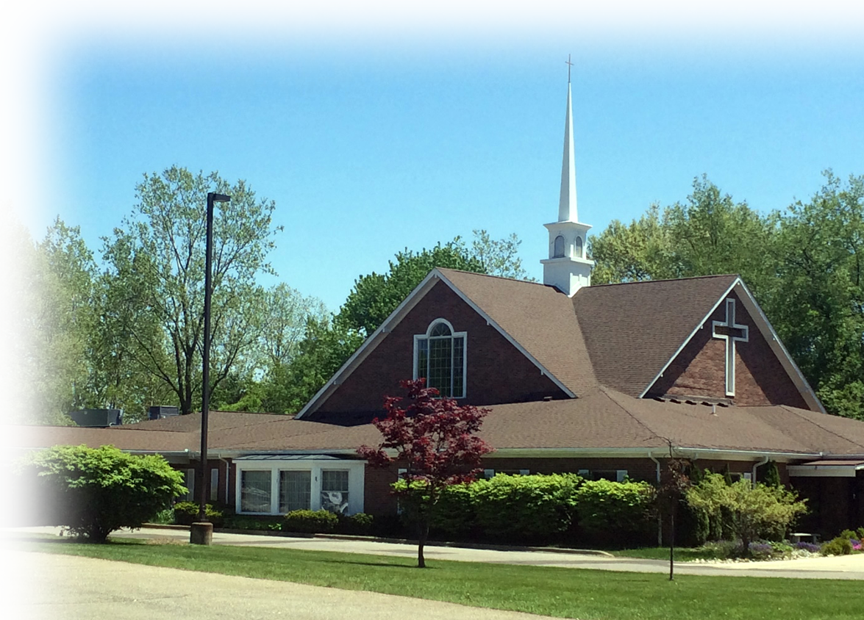
It is INCOMPATIBLE with
¹ My brothers, as believers in our glorious Lord Jesus Christ,
don't show favoritism.
OUR FAMILY

Slide 12

It is INCOMPATIBLE with
¹ My brothers, as believers in our glorious Lord Jesus Christ,
don't show favoritism.
OUR FAITH
Notes:
We’re saved by grace through faith – not of ourselves ... So we cannot boast. Eph 2:8-9

Slide 13
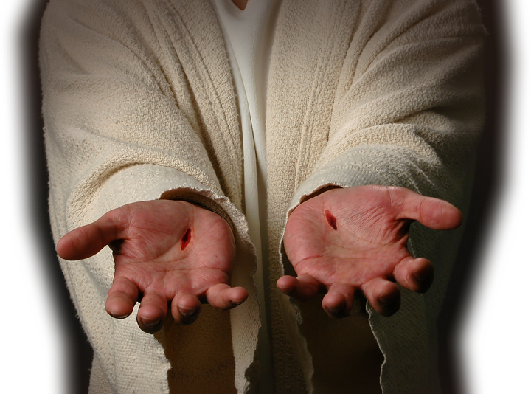
It is INCOMPATIBLE with
¹ My brothers, as believers in our glorious Lord Jesus Christ,
don't show favoritism.
OUR LORD
Notes:
The Lord did not die any more for me than you! Snobbery is incmpatiable

Slide 14
Snobbery is ILLUSTRATED
By a NOT SO
hypothetical
situation

Slide 15
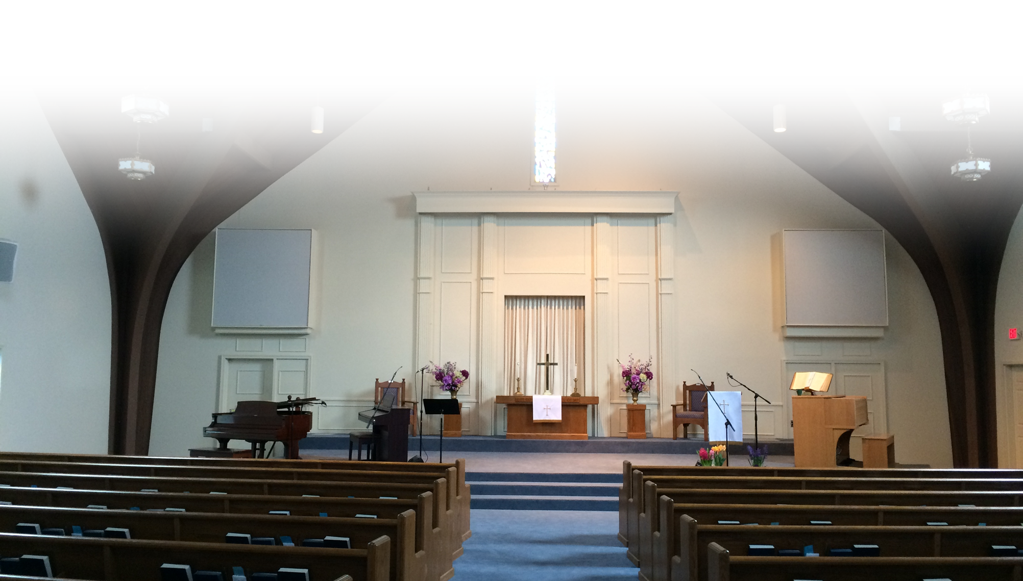
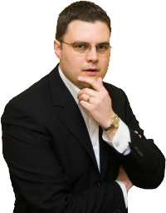
The Situation
² Suppose a man comes into your meeting wearing a gold ring and fine clothes,

Slide 16
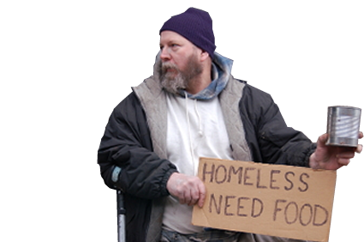
The Situation
and a poor man in shabby clothes also comes in.

Slide 17
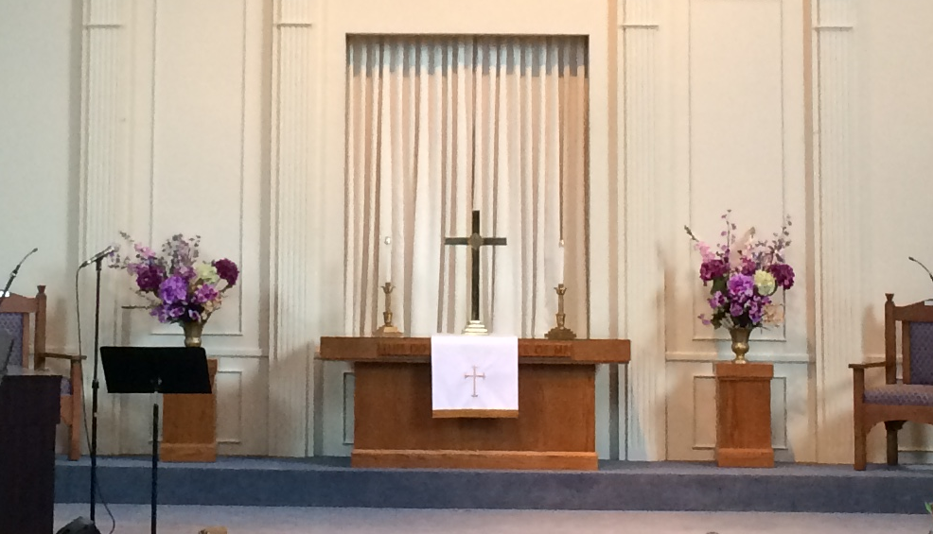
The Reaction
³ If you show special attention to the man wearing fine clothes and say, "Here's a good seat for you ...

Slide 18
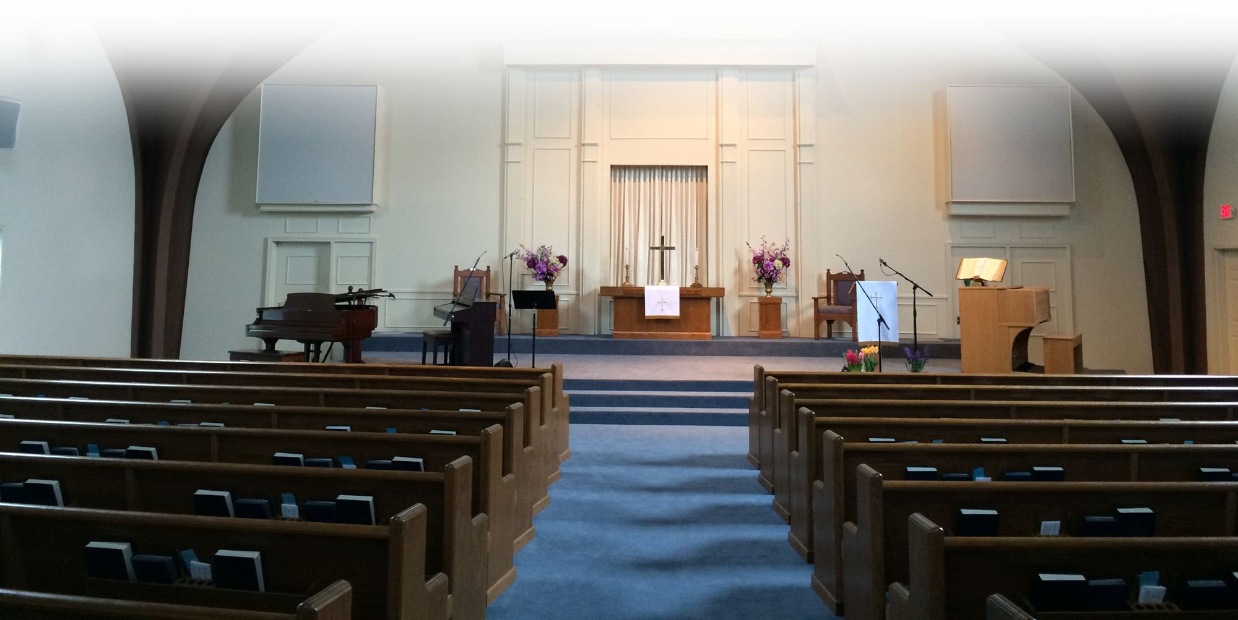
The Reaction
³ ... but say to the poor man, "You stand there" or "Sit on the floor by my feet,”

Slide 19

The Motivation
⁴ have you not discriminated
among yourselves and become
judges with evil thoughts?
Notes:
Discrimination is purely on the external appearance.
You set yourself up as judge of the book by it’s cover—and in doing so misrepresented with evil thoughts.

Slide 20
The Point: It should not be!
Church is to be a place where class distinctions break down. Where color of skin is meaningless. Where political parties are insignificant. Where money, status, rank, name, title, apparel, smell,
size, looks, personality, and age
all mean nothing.
Notes:
WE only see a brother or sister for whom Christ Died!

Slide 21
3. Snobbery is INEXCUSABLE
For several
reasons ...

Slide 22

[1] For God’s Sake!
⁵ Listen, my dear brothers: Has not God chosen those who are poor in the eyes of the world to be rich in faith and to inherit the kingdom he promised those who love him?
⁶ But you have insulted the poor ....

Slide 23
[1] For God’s Sake!
²⁷ But God chose the foolish things of the world to shame the wise; God chose the weak things of the world to shame the strong. ²⁸ He chose the lowly things of this world and the despised things--and the things that are not--to nullify the things that are, ²⁹ so that no one may boast before him. (1Co 1:27-29 NIV)

Slide 24
[1] For God’s Sake!
²⁷ But God chose the foolish things of the world to shame the wise; God chose the weak things of the world to shame the strong. ²⁸ He chose the lowly things of this world and the despised things--and the things that are not--to nullify the things that are, ²⁹ so that no one may boast before him. (1Co 1:27-29 NIV)

Slide 25
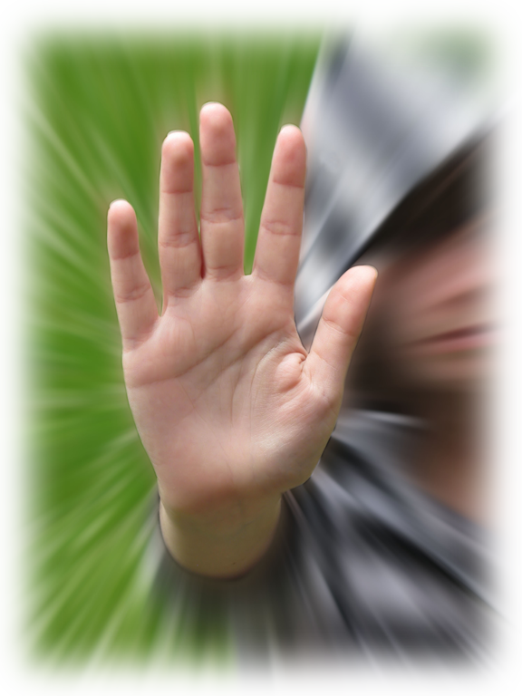
[2] For Logic Sake!
⁶ ...Is it not the rich who are exploiting you? Are they not the ones who are dragging you into court?
⁷ Are they not the ones who are slandering the noble name of him to whom you belong?
Notes:
Sxc #1182571

Slide 26
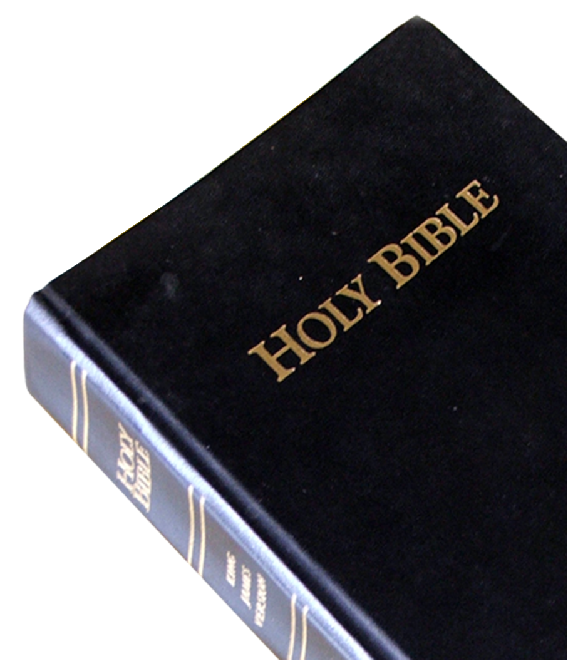
[3] For Scripture Sake!
⁸ If you really keep the royal law found in Scripture, "Love your neighbor as yourself," you are doing right.

Slide 27
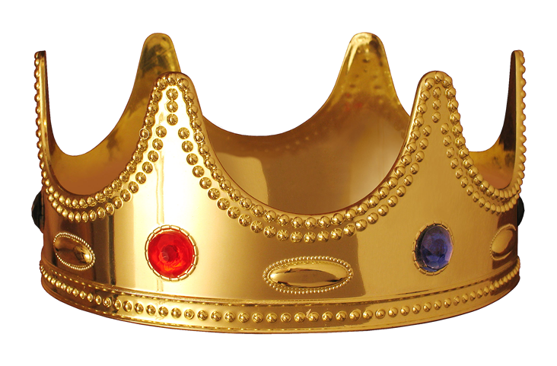
[3] For Scripture Sake!
⁸ If you really keep the royal law found in Scripture, "Love your neighbor as yourself," you are doing right.
Notes:
Kings were to write out the Law themselves, thus the royal law!
¹⁴ When you come to the land the LORD your God is giving you and take it over and live in it and then say, "I will select a king like all the nations surrounding me,"
....
¹⁸ When he sits on his royal throne he must make a copy of this law on a scroll given to him by the Levitical priests.
¹⁹ It must be with him constantly and he must read it as long as he lives, so that he may learn to revere the LORD his God and observe all the words of this law and these statutes and carry them out.
²⁰ Then he will not exalt himself above his fellow citizens or turn from the commandments to the right or left, and he and his descendants will enjoy many years ruling over his kingdom in Israel.
(Deu 17:14-20 NET)

Slide 28
[3] For Scripture Sake!
⁸ If you really keep the royal law found in Scripture, "Love your neighbor as yourself," you are doing right.
Leviticus 19:18
Notes:
but love your neighbor as yourself. I am the LORD. (Lev 19:18 NIV)

Slide 29
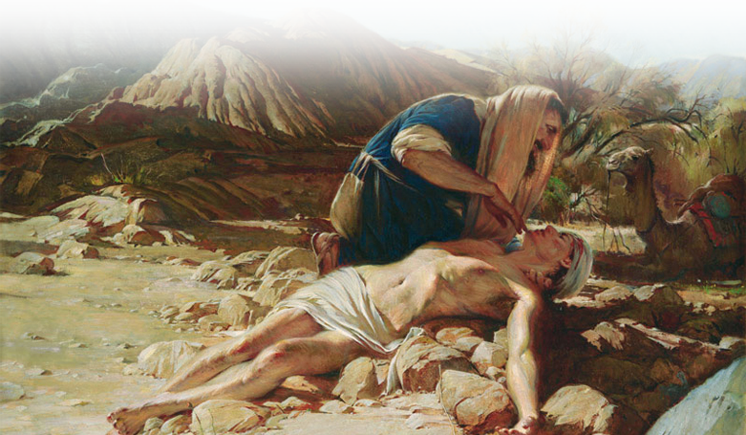
[3] For Scripture Sake!
⁸ If you really keep the royal law found in Scripture, "Love your neighbor as yourself," you are doing right.
Luke 10
Notes:
²⁵ On one occasion an expert in the law stood up to test Jesus. "Teacher," he asked, "what must I do to inherit eternal life?"
²⁶ "What is written in the Law?" he replied. "How do you read it?"
²⁷ He answered: " 'Love the Lord your God with all your heart and with all your soul and with all your strength and with all your mind'; and, 'Love your neighbor as yourself.' "
²⁸ "You have answered correctly," Jesus replied. "Do this and you will live."
²⁹ But he wanted to justify himself, so he asked Jesus, "And who is my neighbor?"
³⁰ In reply Jesus said: "A man was going down from Jerusalem to Jericho, when he fell into the hands of robbers. They stripped him of his clothes, beat him and went away, leaving him half dead.
³¹ A priest happened to be going down the same road, and when he saw the man, he passed by on the other side.
³² So too, a Levite, when he came to the place and saw him, passed by on the other side.
³³ But a Samaritan, as he traveled, came where the man was; and when he saw him, he took pity on him.
³⁴ He went to him and bandaged his wounds, pouring on oil and wine. Then he put the man on his own donkey, took him to an inn and took care of him.
³⁵ The next day he took out two silver coins and gave them to the innkeeper. 'Look after him,' he said, 'and when I return, I will reimburse you for any extra expense you may have.'
³⁶ "Which of these three do you think was a neighbor to the man who fell into the hands of robbers?"
³⁷ The expert in the law replied, "The one who had mercy on him." Jesus told him, "Go and do likewise." (Luk 10:25-37 NIV)

Slide 30

[4] For Sin Sake!
⁹ But if you show favoritism, you sin

Slide 31
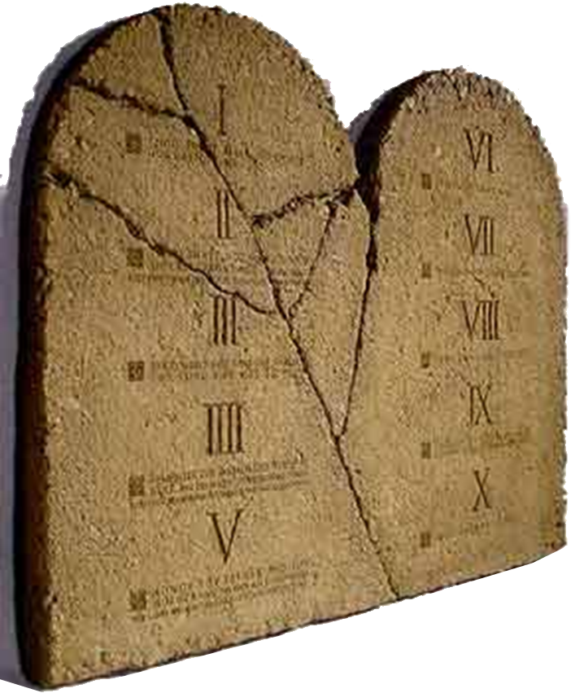
[4] For Sin Sake!
⁹ But if you show favoritism, you sin and
are convicted by the
law as lawbreakers.

Slide 32
[4] For Sin Sake!
⁹ But if you show favoritism, you sin and
are convicted by the
law as lawbreakers.
Why?

Slide 33
[4] For Sin Sake!
⁹ But if you show favoritism, you sin and
are convicted by the
law as lawbreakers.
¹⁰ For whoever keeps
the whole law and yet
stumbles at just one
point is guilty of
breaking all of it.

Slide 34
[4] For Sin Sake!
¹¹ For he who said, "Do not commit adultery," also said, "Do not
murder." If you do not
commit adultery but
do commit murder,
you have become a lawbreaker.

Slide 35
How to ELIMINATE Snobbery
Four ACTIONS
worth taking...

Slide 36

1- Act on the Word of God
¹² Speak and act as those who are going to be judged by the law that gives freedom,

Slide 37
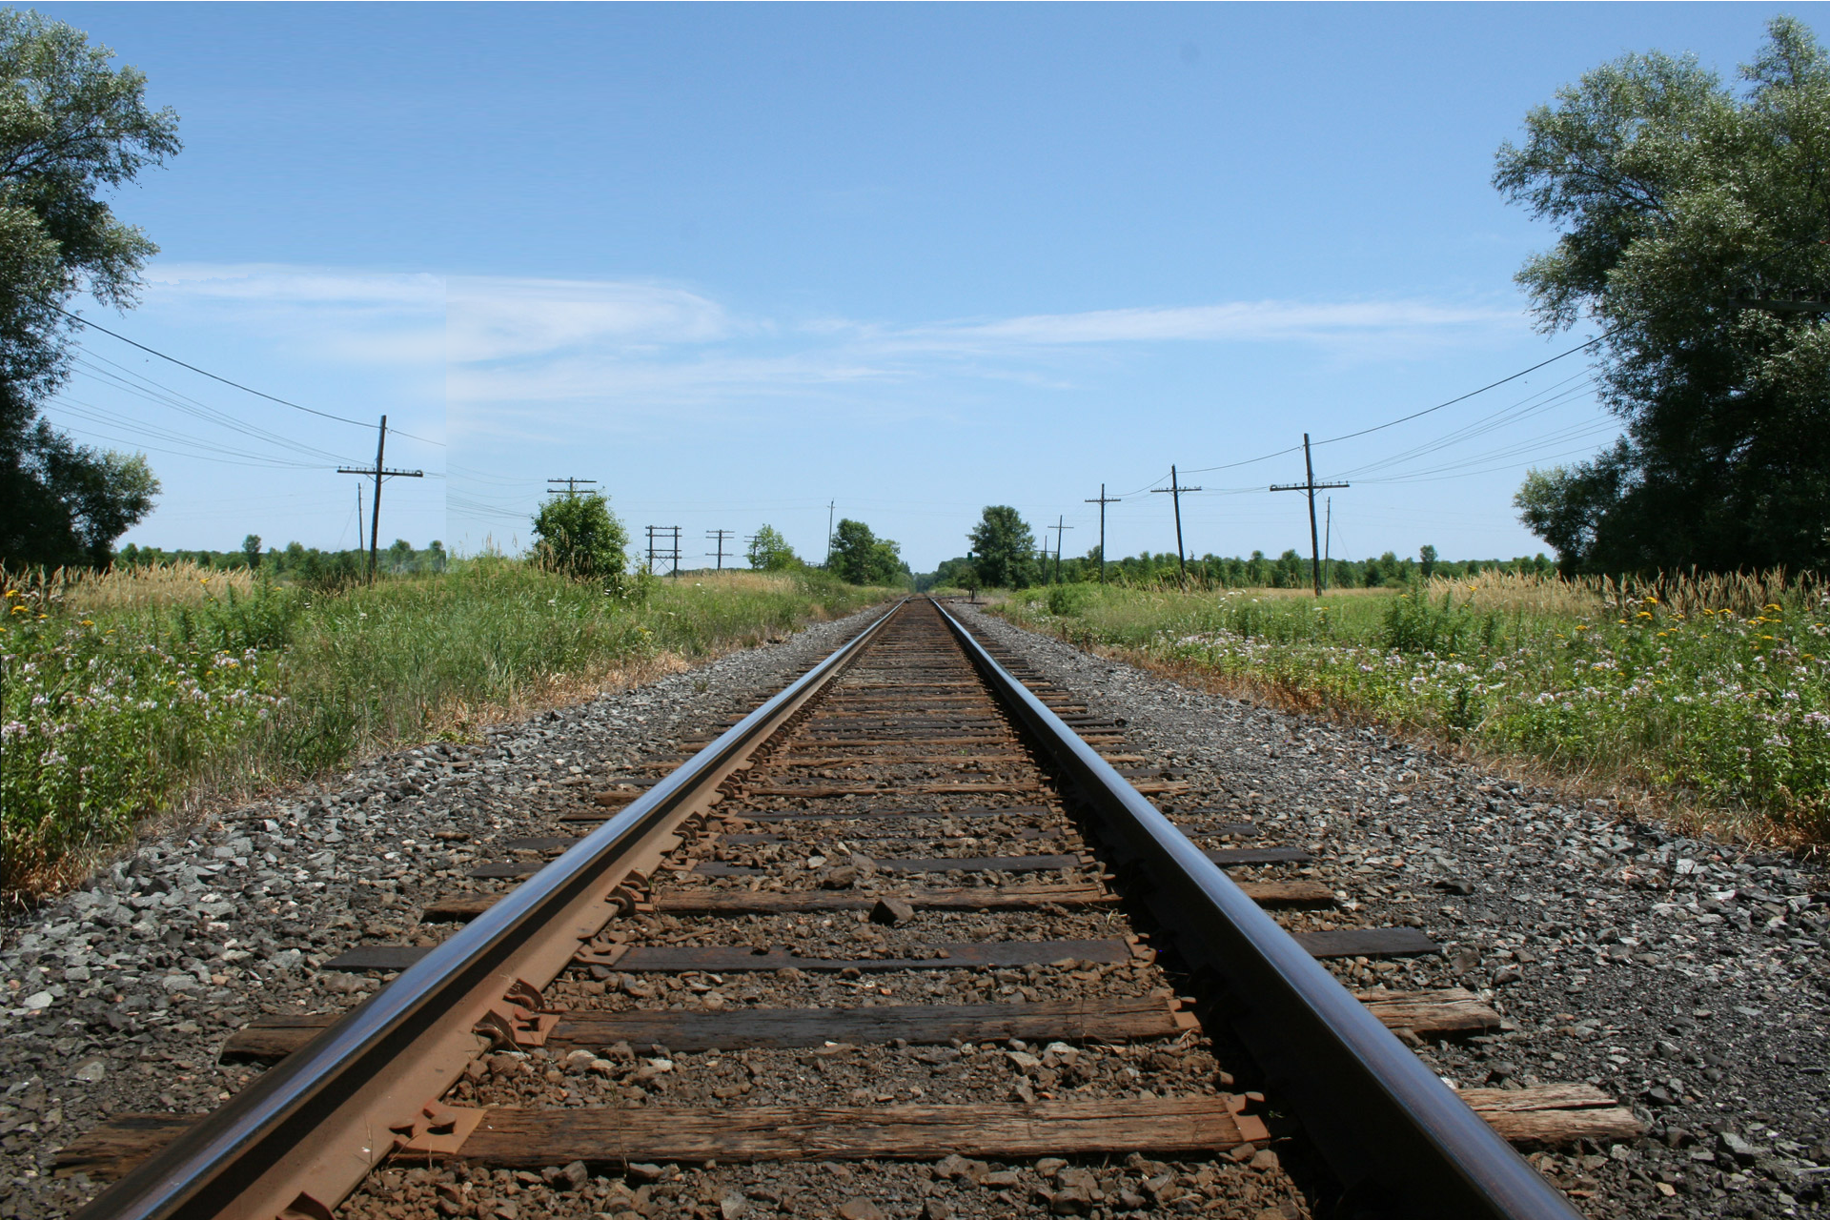
Does the Law of the Tracks ...
Limit or Free?
Notes:
SXC #1114895

Slide 38
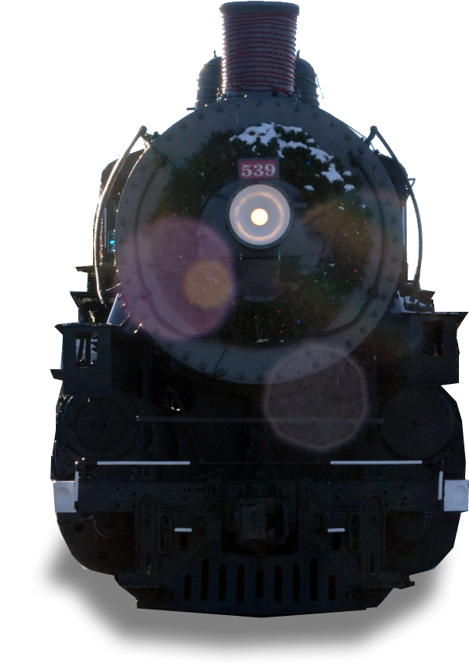
Is the train most free ...
Is the train most free ...
On the tracks?
Notes:
SXC #1114895

Slide 39
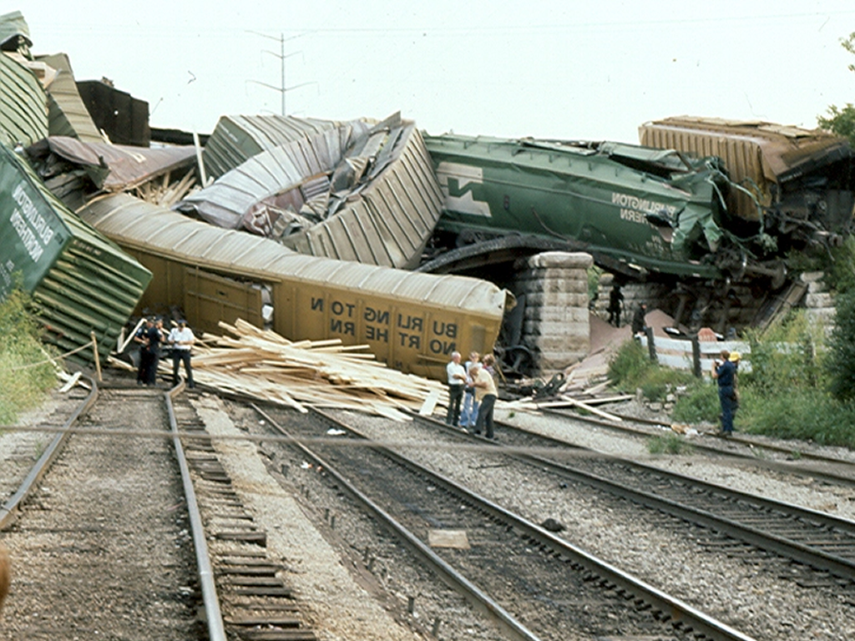
Is the train most free ...
Off the tracks?
Notes:
SXC #1114895

Slide 40
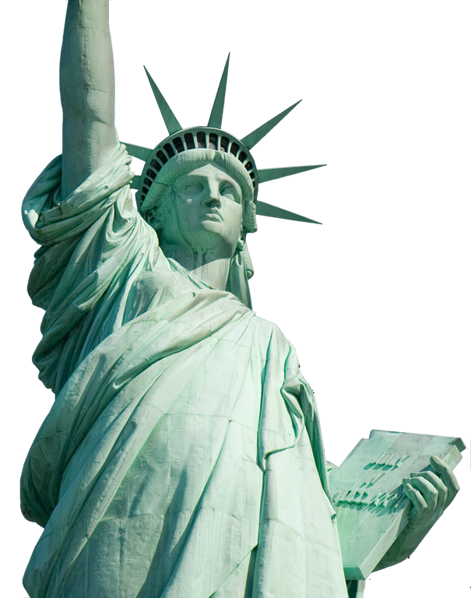
2- Act on Freedom of God
¹² Speak and act as those who are going to be judged by the law that gives freedom,

Slide 41

3- Act on the Love of God
¹² Speak and act as those who are going to be judged by the law that gives freedom,
⁸ ... "Love your neighbor as yourself,"
Notes:
Love fulfills the law
The second is this: 'Love your neighbor as yourself.' There is no commandment greater than these." (Mar 12:31 NIV)

Slide 42



4- Act on the Judgment of God
¹² Speak and act as those who are going to be judged by the law that gives freedom,
Notes:
¹⁰ You, then, why do you judge your brother? Or why do you look down on your brother? For we will all stand before God's judgment seat. (Rom 14:10 NIV)
¹⁰ For we must all appear before the judgment seat of Christ, that each one may receive what is due him for the things done while in the body, whether good or bad. (2Co 5:10 NIV)

Slide 43
4- Act on the Judgment of God
¹² Speak and act as those who are going to be judged by the law that gives freedom,
¹⁰ You, then, why do you judge your brother? Or why do you look down on your brother? For we will all stand before God's judgment seat. (Romans 14:10)
Notes:
¹⁰ You, then, why do you judge your brother? Or why do you look down on your brother? For we will all stand before God's judgment seat. (Rom 14:10 NIV)
¹⁰ For we must all appear before the judgment seat of Christ, that each one may receive what is due him for the things done while in the body, whether good or bad. (2Co 5:10 NIV)

Slide 44
4- Act on the Judgment of God
¹² Speak and act as those who are going to be judged by the law that gives freedom,
¹⁰ For we must all appear before the judgment seat of Christ, that each one may receive what is due him for the things done while in the body, whether good or bad. (2Corinthians 5:10)
Notes:
¹⁰ You, then, why do you judge your brother? Or why do you look down on your brother? For we will all stand before God's judgment seat. (Rom 14:10 NIV)
¹⁰ For we must all appear before the judgment seat of Christ, that each one may receive what is due him for the things done while in the body, whether good or bad. (2Co 5:10 NIV)

Slide 45
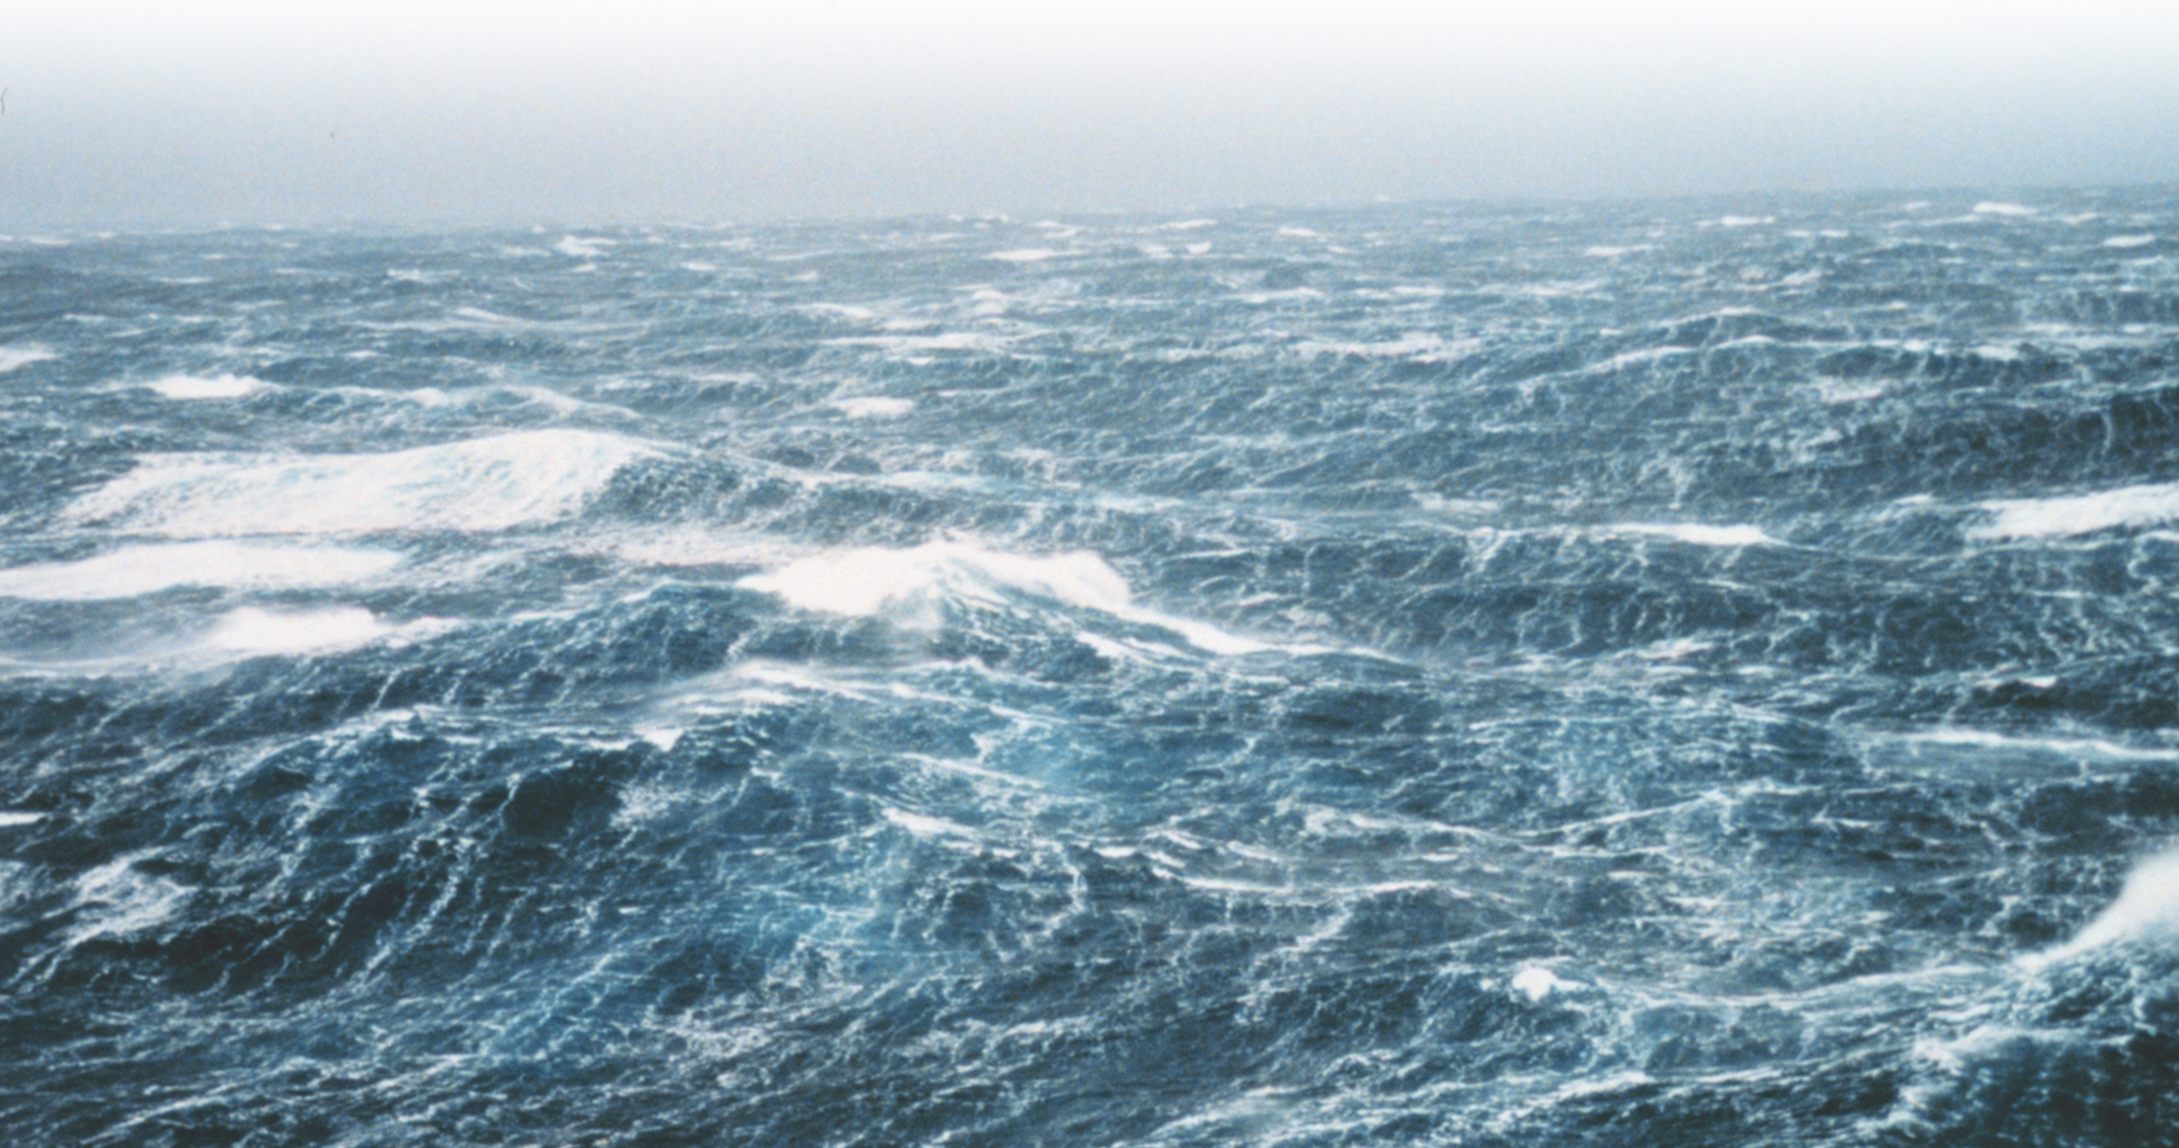
4- Act on the Judgment of God
¹³ because judgment without mercy will be shown to anyone who has not been merciful.
Notes:
https://upload.wikimedia.org/wikipedia/commons/4/40/Tissot_The_Pharisee_and_the_publican_Brooklyn.jpg

Slide 46
4- Act on the Judgment of God
¹³ because judgment without mercy will be shown to anyone who has not been merciful.
Like the Great Flood
Notes:
https://upload.wikimedia.org/wikipedia/commons/4/40/Tissot_The_Pharisee_and_the_publican_Brooklyn.jpg

Slide 47

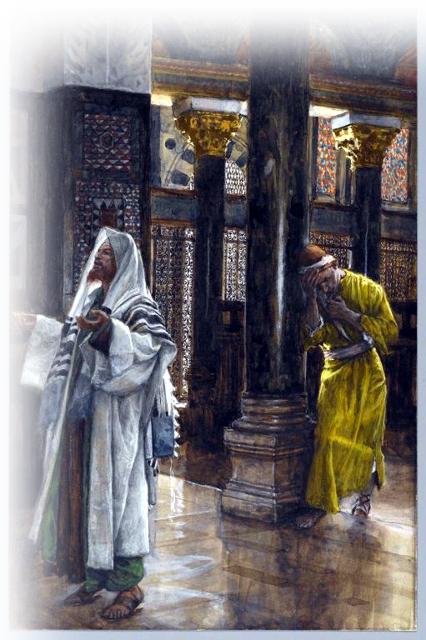
5- Act on the MERCY of God
¹³ because judgment without mercy will be shown to anyone who has not been merciful. Mercy triumphs over judgment!
Notes:
SXC #1245969
⁹ To some who were confident of their own righteousness and looked down on everybody else, Jesus told this parable:
¹⁰ "Two men went up to the temple to pray, one a Pharisee and the other a tax collector.
¹¹ The Pharisee stood up and prayed about himself: 'God, I thank you that I am not like other men--robbers, evildoers, adulterers--or even like this tax collector.
¹² I fast twice a week and give a tenth of all I get.'
¹³ "But the tax collector stood at a distance. He would not even look up to heaven, but beat his breast and said, 'God, have mercy on me, a sinner.'
¹⁴ "I tell you that this man, rather than the other, went home justified before God. For everyone who exalts himself will be humbled, and he who humbles himself will be exalted."
(Luk 18:9-14 NIV)

Slide 48

What can we take away TODAY?

Slide 49
What can we take away TODAY?
1. ACT out the Word of God!

Slide 50
What can we take away TODAY?
1. ACT out the Word of God!
2. Use your FREEDOM chose to do right!

Slide 51
What can we take away TODAY?
1. ACT out the Word of God!
2. Use your FREEDOM chose to do right!
3. LIVE AS if you will stand before God today!

Slide 52
What can we take away TODAY?
1. ACT out the Word of God!
2. Use your FREEDOM chose to do right!
3. LIVE AS if you will stand before God today!
4. LOVE others as God loved you!

Slide 53
What can we take away TODAY?
1. ACT out the Word of God!
2. Use your FREEDOM chose to do right!
3. LIVE AS if you will stand before God today!
4. LOVE others as God loved you!
5. Error on the side of MERCY and grace!

Slide 54
What can we take away TODAY?
1. ACT out the Word of God!
2. Use your FREEDOM chose to do right!
3. LIVE AS if you will stand before God today!
4. LOVE others as God loved you!
5. Error on the side of MERCY and grace!
DON’T BE A SPIRITUAL SNOB!

Slide 55
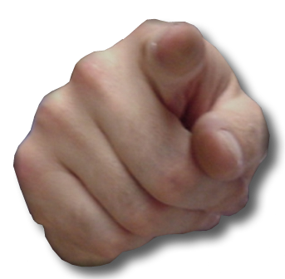
What can we take away TODAY?
1. ACT out the Word of God!
2. Use your FREEDOM chose to do right!
3. LIVE AS if you will stand before God today!
4. LOVE others as God loved you!
5. Error on the side of MERCY and grace!
BE A SPIRITUAL BLESSING!

Slide 56
Let’s Pray

