Slide 1
JAMES
A FAITH THAT WORKS
Notes:
BACKGROUND = https://pixabay.com/en/gears-cogs-machine-machinery-1236578/
Copyright © 2006−2021. All rights reserved. Bible Point is a registered trademark of Dennis Henderson. All other trademarks acknowledged.
Bible Point contains graphics from Bible Point artists. These illustrations belong to Bible Point and the respective artists. You may use the designs and illustrations for graphical illustration of lessons free and without special permission, provided they are not used in any way that maligns the Christian faith. Furthermore, republication or production of any illustration by any other graphic service whether it be in book, in a machine-readable form, or in any other design resource is strictly prohibited. Furthermore, they cannot be duplicated or resold as any other form of publishing, clip art, or graphic resource.
So What does it mean? (A simple translations of the legal jargon)
So, if you don’t own the presentation(s), graphic(s), and text(s) how can you legally use them? The purchase of the license allows you to use all the images in the product. However, the actual ownership and copyright of the presentation(s), graphic(s), and text(s) remain the property of Bible Point and its licensors. If you had plans on using this product in your “for sale” work—think again!
License Agreement
Article 1: License Grant
All the graphics and text in Bible Point presentations (excluding quotes from the Bible and stated sources) are the intellectual and real property of Bible Point and its licensors, and is protected by law, including United States copyright laws and international treaties. Bible Point grants to you a license:
1. To use the presentation in a single church, single school, or single office of a Christian organization.
2. To make a single archival back-up copy of the program.
3. To modify the presentation(s) and merge with other presentations in a single church, school, or Christian organization.
4. To transfer to another party if that party agrees to accept the terms and conditions of this agreement, and you do not retain any copies of the presentation, whether printed, machine readable, modified, or merged form.
Article 2: Terms
This license is effective until terminated. You may terminate the license at any time by destroying the presentation(s), graphic(s), or text(s) together with all copies, modifications and merged portions in any form. Bible Point may terminate your license if you fail to comply with this Agreement. You agree, upon such termination, for any reason, to destroy the presentation(s), graphics, and text(s) with all copies, modifications, and merged portions in any form.
Article 3: Disclaimers
1. Bible Point presentations, graphics, and texts are licensed to you As Is. You, the consumer, bear the entire risk relating to the quality and performance of the presentation(s), graphic(s), or text(s). In no event will Bible Point be liable for damages resulting from any defect.
2. Thirty-day limited warrantee on disks. Bible Point warrants the disks to be free of defects in material and workmanship under normal use for 30 days after purchase. During the 30-day period you may return a defective presentation, graphic, or text with proof of purchase and it will be replaced without charge, unless the presentation is damaged by misuse.
Article 4: General
1. You may not sub-license, assign, or transfer the license of the presentation(s), graphic(s), or text(s) except as provided by this Agreement.
2. This Agreement will be governed by the laws of the State of Michigan.
So What does it mean? (A simple translations of the legal jargon)
May I let someone borrow or copy my licensed Bible Point presentation (even after I modified it)? As long as it is within your local church, or single school, or the immediate office of a Christian organization you may. Otherwise, please refer the person interested in borrowing to: http://www.biblepoint.com or E-mail: dennis@DrDH.net with any related questions.

Slide 2
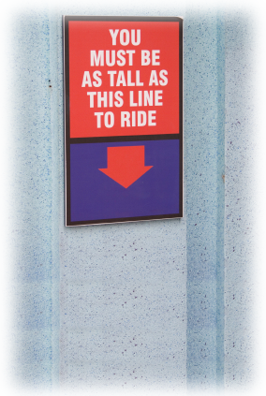
When You Don’t Seem to Measure Up

Slide 3
In three directions:
INWARDLY

Slide 4
In three directions:
INWARDLY
OUTWARDLY

Slide 5
In three directions:
INWARDLY
OUTWARDLY
UPWARDLY

Slide 6
In three directions:
INWARDLY

Slide 7
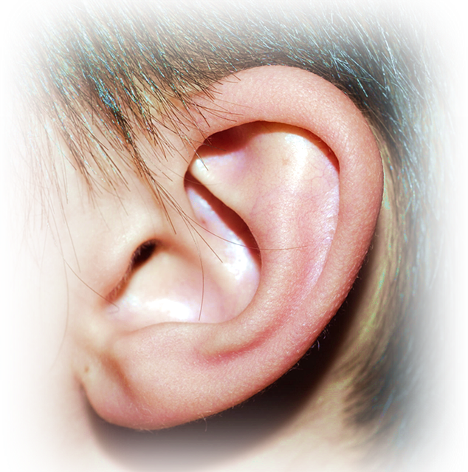
1. Open Your Ears
¹⁹ My dear brothers, take note of this: Everyone should be quick to listen,
Notes:
Sxc #1032418

Slide 8
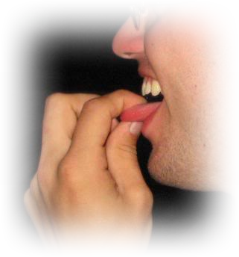
2. Hold Your Tongue
¹⁹ My dear brothers, take note of this: Everyone should be quick to listen, slow to speak

Slide 9

3. Calm Your Temper
¹⁹ My dear brothers, take note of this: Everyone should be quick to listen, slow to speak and slow to become angry,
Notes:
Sxc #722729

Slide 10
3. Calm Your Temper
¹⁹ My dear brothers, take note of this: Everyone should be quick to listen, slow to speak and slow to become angry,
WHY?
Notes:
Sxc #722729

Slide 11
²⁰ for man's anger does not bring about the righteous life that God desires.
Notes:
Sxc #722729

Slide 12
The Righteous Life
²⁰ for man's anger does not bring about the righteous life that God desires.
Notes:
Sxc #722729

Slide 13
The Righteous Life
²⁰ for man's anger does not bring about the righteous life that God desires.
Angry, Bitter Life
Notes:
Sxc #722729

Slide 14

4. Purge Your Filth!
²¹ Therefore, get rid of all moral filth and the evil that is so prevalent
Notes:
SXC 1195990

Slide 15
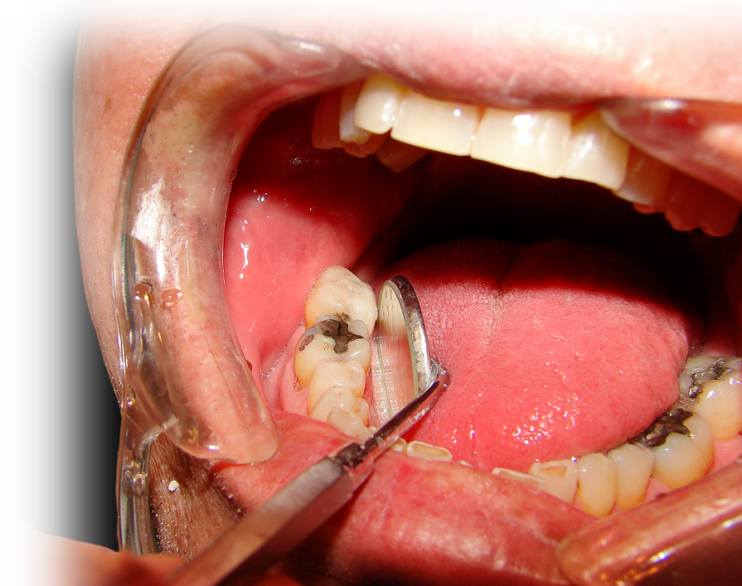
4. Purge Your Filth!
²¹ Therefore, get rid of all moral filth and the evil that is so prevalent
Notes:
Sxc #825231

Slide 16
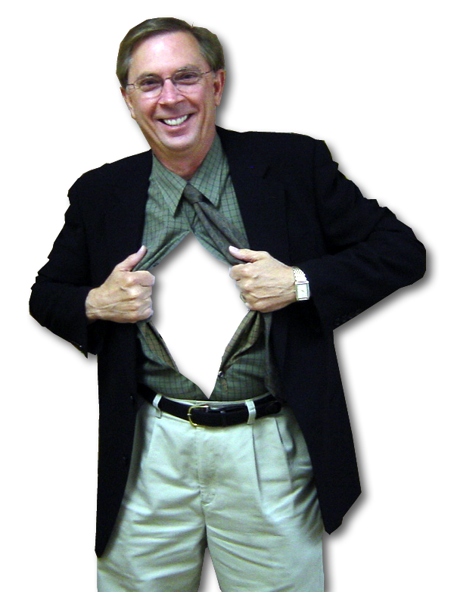
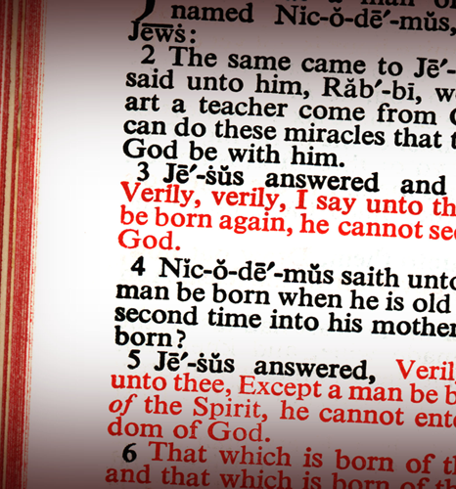
5. Accept His Word!
and humbly
accept the word planted in you,
which can
save you.
Notes:
Sxc #1080864

Slide 17
OUTWARDLY

Slide 18

Just Do It!
²² Do not merely listen to the word, and so deceive yourselves. Do what it says.

Slide 19

Just Do It!
²² Do not merely listen to the word, and so deceive yourselves. Do what it says.

Slide 20

Just Do It!
²³ Anyone who listens to the word but does not do what it says is like a man who looks at his face in a mirror ²⁴ and, after looking at himself, goes away and immediately forgets what he looks like.
Notes:
SXC #470286

Slide 21

Just Do It!
²⁵ But the man who looks intently into the perfect law that gives freedom, and continues to do this, not forgetting what he has heard, but doing it--he will be blessed in what he does.
Notes:
SXC #1212501

Slide 22
Just Do It!
²⁵ But the man who looks intently into the perfect law that gives freedom, and continues to do this, not forgetting what he has heard, but doing it--he will be blessed in what he does.
Notes:
SXC #1212501

Slide 23

Does the Law of the Tracks ...
Limit
or
Free?
Notes:
SXC #1114895

Slide 24
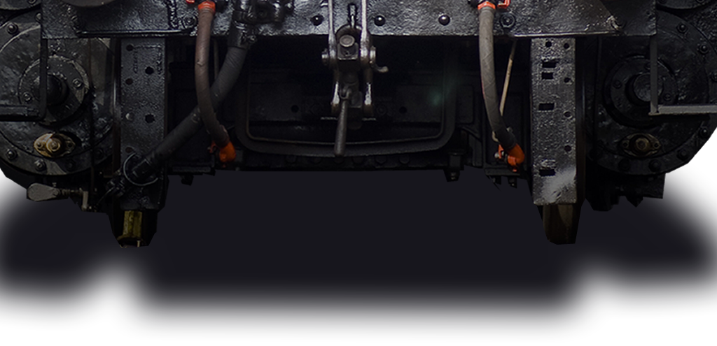
Is the train most free ...
On the tracks?
Notes:
SXC #1114895

Slide 25
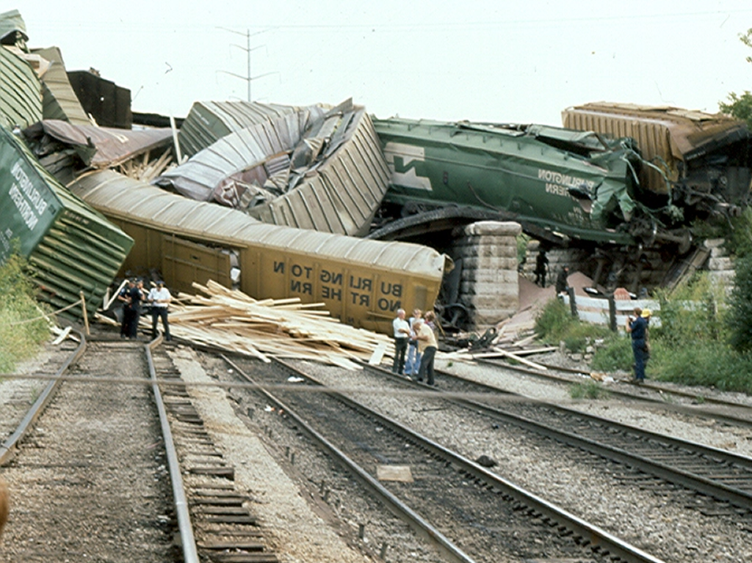
Is the train most free ...
Off the tracks?
Notes:
SXC #1114895

Slide 26
You are most free when ...
²² Do not merely listen to the word, and so deceive yourselves. Do what it says.

Slide 27
Just Do It!
²⁵ But the man who looks intently into the perfect law that gives freedom, and continues to do this, not forgetting what he has heard, but doing it--he will be blessed in what he does.
Notes:
SXC #1212501

Slide 28
UPWARDLY

Slide 29

1. Control Your Tongue
²⁶ If anyone considers himself religious and yet does not keep a tight rein on his tongue, he deceives himself and his religion is worthless.

Slide 30

2. Look after the Less Fortunate
²⁷ Religion that God our Father accepts as pure and faultless is this: to look after orphans and widows in their distress

Slide 31

2. Look after the Less Fortunate
²⁷ Religion that God our Father accepts as pure and faultless is this: to look after orphans and widows in their distress

Slide 32
2. Look after the Less Fortunate
²⁷ Religion that God our Father accepts as pure and faultless is this: to look after orphans and widows in their distress

Slide 33

3. Keep Yourself Pure
²⁷ ... and to keep oneself from being polluted by the world.

Slide 34
Take this with you ...

Slide 35
Take this with you ...
We need to get
into the WORD ...

Slide 36
Take this with you ...
We need to get
into the WORD ...
and allow the WORD
to get into us!

Slide 37
Take this with you ...
We need to get
into the WORD ...
and allow the WORD
to get into us!
ESPECIALLY ...

Slide 38
When We Don’t
Seem to Measure Up

Slide 39
When We Don’t
Seem to Measure Up
WHY?

Slide 40
BECAUSE “Accepting the Word ...” 1:21

Slide 41
BECAUSE “Accepting the Word ...” 1:21
1) Will “save you” 1:21

Slide 42
BECAUSE “Accepting the Word ...” 1:21
1) Will “save you” 1:21
2) Will “free” you 1:25

Slide 43
BECAUSE “Accepting the Word ...” 1:21
1) Will “save you” 1:21
2) Will “free” you 1:25
3) Will “bless” you 1:25

Slide 44
Let’s Pray

