Slide 1
JAMES
A FAITH THAT WORKS
Notes:
BACKGROUND = https://pixabay.com/en/gears-cogs-machine-machinery-1236578/
Copyright © 2006−2021. All rights reserved. Bible Point is a registered trademark of Dennis Henderson. All other trademarks acknowledged.
Bible Point contains graphics from Bible Point artists. These illustrations belong to Bible Point and the respective artists. You may use the designs and illustrations for graphical illustration of lessons free and without special permission, provided they are not used in any way that maligns the Christian faith. Furthermore, republication or production of any illustration by any other graphic service whether it be in book, in a machine-readable form, or in any other design resource is strictly prohibited. Furthermore, they cannot be duplicated or resold as any other form of publishing, clip art, or graphic resource.
So What does it mean? (A simple translations of the legal jargon)
So, if you don’t own the presentation(s), graphic(s), and text(s) how can you legally use them? The purchase of the license allows you to use all the images in the product. However, the actual ownership and copyright of the presentation(s), graphic(s), and text(s) remain the property of Bible Point and its licensors. If you had plans on using this product in your “for sale” work—think again!
License Agreement
Article 1: License Grant
All the graphics and text in Bible Point presentations (excluding quotes from the Bible and stated sources) are the intellectual and real property of Bible Point and its licensors, and is protected by law, including United States copyright laws and international treaties. Bible Point grants to you a license:
1. To use the presentation in a single church, single school, or single office of a Christian organization.
2. To make a single archival back-up copy of the program.
3. To modify the presentation(s) and merge with other presentations in a single church, school, or Christian organization.
4. To transfer to another party if that party agrees to accept the terms and conditions of this agreement, and you do not retain any copies of the presentation, whether printed, machine readable, modified, or merged form.
Article 2: Terms
This license is effective until terminated. You may terminate the license at any time by destroying the presentation(s), graphic(s), or text(s) together with all copies, modifications and merged portions in any form. Bible Point may terminate your license if you fail to comply with this Agreement. You agree, upon such termination, for any reason, to destroy the presentation(s), graphics, and text(s) with all copies, modifications, and merged portions in any form.
Article 3: Disclaimers
1. Bible Point presentations, graphics, and texts are licensed to you As Is. You, the consumer, bear the entire risk relating to the quality and performance of the presentation(s), graphic(s), or text(s). In no event will Bible Point be liable for damages resulting from any defect.
2. Thirty-day limited warrantee on disks. Bible Point warrants the disks to be free of defects in material and workmanship under normal use for 30 days after purchase. During the 30-day period you may return a defective presentation, graphic, or text with proof of purchase and it will be replaced without charge, unless the presentation is damaged by misuse.
Article 4: General
1. You may not sub-license, assign, or transfer the license of the presentation(s), graphic(s), or text(s) except as provided by this Agreement.
2. This Agreement will be governed by the laws of the State of Michigan.
So What does it mean? (A simple translations of the legal jargon)
May I let someone borrow or copy my licensed Bible Point presentation (even after I modified it)? As long as it is within your local church, or single school, or the immediate office of a Christian organization you may. Otherwise, please refer the person interested in borrowing to: http://www.biblepoint.com or E-mail: dennis@DrDH.net with any related questions.

Slide 2
When you’re under PRESSURE

Slide 3
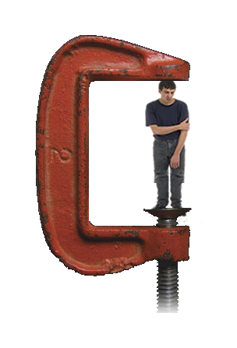
PRESSURE comes from two
Directions:
External
Pressure is
“ON US”

Slide 4
PRESSURE comes from two
Directions:
External
Pressure is
“ON US”
Trial / Test
1:2-12

Slide 5
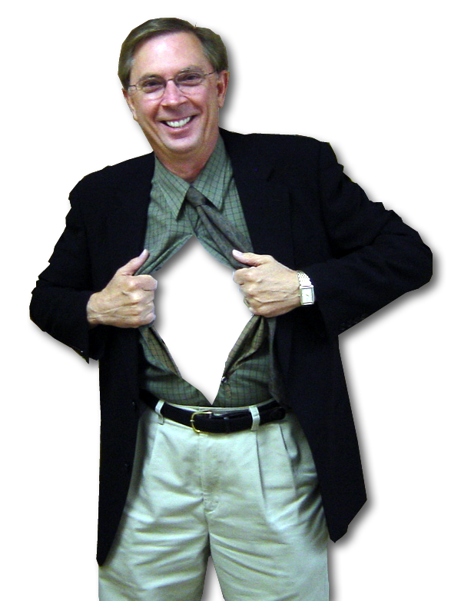
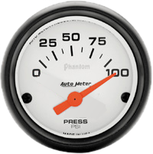
PRESSURE comes from two
Directions:
Internal
Pressure is
“IN US”

Slide 6
PRESSURE comes from two
Directions:
Internal
Pressure is
“IN US”
Temptation
1:13-18

Slide 7
How to Handle Temptation– Pressure Within Us!

Slide 8
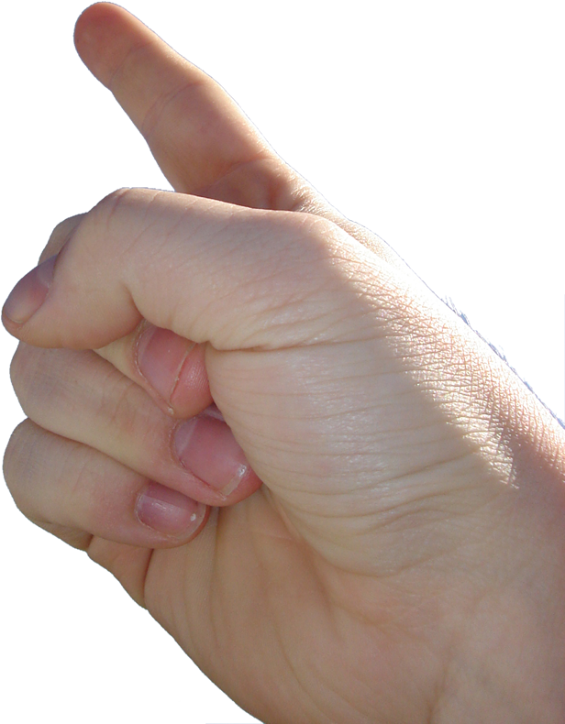
1. Don’t Blame GOD
¹³ When tempted, no one should say,

Slide 9
1. Don’t Blame GOD
¹³ When tempted, no one should say,
"God is tempting me."

Slide 10
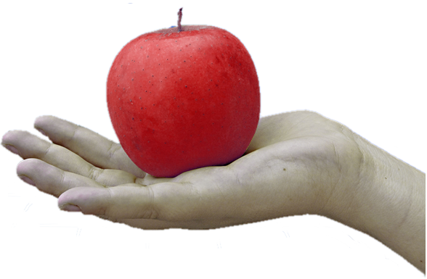
1. Don’t Blame GOD
¹³ When tempted, no one should say,
"God is tempting me."
Like
Adam & Eve

Slide 11
1. Don’t Blame GOD
¹³ When tempted, no one should say,
"God is tempting me."
Like
Adam & Eve
Why NOT?

Slide 12
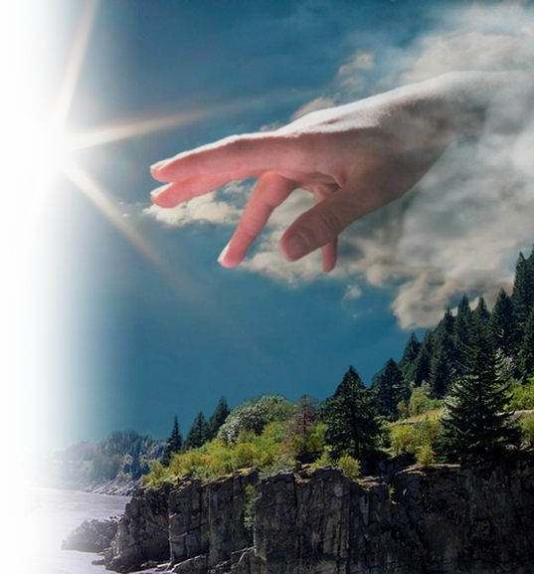
1. Don’t Blame GOD
¹³ When tempted, no
one should say,
"God is tempting me."
For God cannot be tempted by evil, nor does he tempt anyone;
EVIL

Slide 13
1. Don’t Blame GOD
¹³ When tempted, no
one should say,
"God is tempting me."
For God cannot be tempted by evil, nor does he tempt anyone;
EVIL

Slide 14
1. Don’t Blame GOD
He allows us to be tempted by the devil and our circumstances as a test of our allegiance— but He, Himself, does not tempt us with
evil!

Slide 15
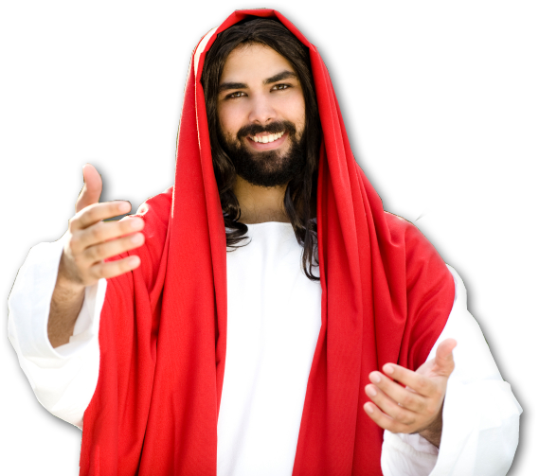
1. Don’t Blame GOD
He allows us to be tempted by the devil and our circumstances as a test of our allegiance— but He, Himself, does not tempt us with
evil!
Take Jesus for example:

Slide 16
1. Don’t Blame GOD
¹ Then Jesus was led by the Spirit into the desert to be tempted by the devil.
² After fasting forty
days and forty
nights, he was
hungry. (Mat 4:1-2 )

Slide 17
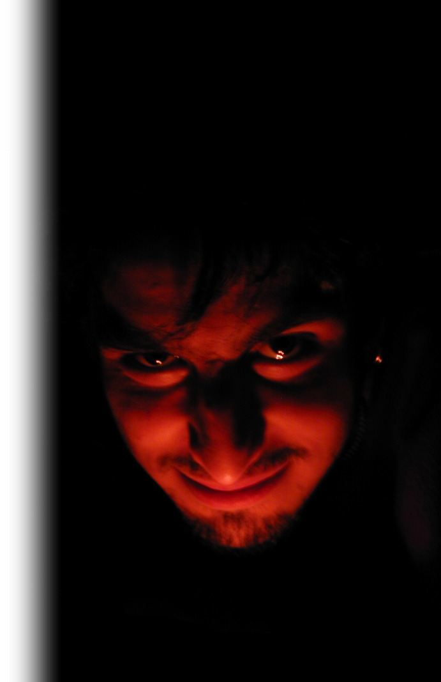
1. Don’t Blame GOD
"If you are the Son of God, tell these stones to become bread." (Mat 4:3)
Appetite for food!
Normal desire!

Slide 18
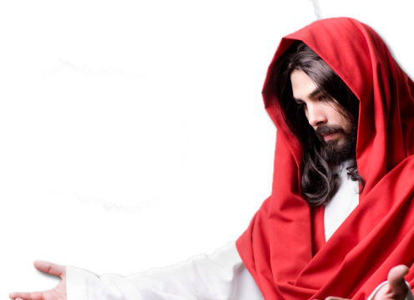
1. Don’t Blame GOD
"It is written: 'Man does not live on bread alone, but on every word that comes from the mouth of God.' " (Mat 4:4)

Slide 19
1. Don’t Blame GOD
"If you are the Son of God," he said, "throw yourself down.” (Mat 4:6)
Appetite for life!
Normal desire!

Slide 20
1. Don’t Blame GOD
"It is also written:
'Do not put the Lord your God to the test.'" (Mat 4:7)

Slide 21
1. Don’t Blame GOD
"All this I will give you, if you will bow down and worship me." (Mat 4:9)
Appetite for success!
Normal desire!

Slide 22
1. Don’t Blame GOD
"Away from me, Satan! For it is written: 'Worship the Lord your God, and serve him only.' " (Mat 4:10)

Slide 23
1. Don’t Blame GOD
"Away from me, Satan! For it is written: 'Worship the Lord your God, and serve him only.' " (Mat 4:10)
¹¹ Then the devil left him, and angels came and attended him.

Slide 24
1. Don’t Blame GOD
Yes, God allows us to be tested—
But He does not tempt us to do evil.

Slide 25
So Instead of Blaming God ...

Slide 26
2. Look INSIDE
¹⁴ but each one is tempted when, by his own evil desire,
Food
Drink
Happiness
Shelter
We all have desires
Sex
Rest

Slide 27
2. Look INSIDE
¹⁴ but each one is tempted when, by his own evil desire,
Gluttony
Drunkenness
Hedonism
Materialism
We all have desires
Immorality
Laziness

Slide 28
2. Look INSIDE
¹⁴ but each one is tempted when, by his own evil desire,
The real issue is:
How are you handling your desires?

Slide 29
3. Consider the PROCESS
1) External

Slide 30
3. Consider the PROCESS
1) External
2) evil desire,

Slide 31
3. Consider the PROCESS
1) External
2) evil desire,

Slide 32
3. Consider the PROCESS
1) External
2) evil desire,
3) dragged away
and enticed.

Slide 33
3. Consider the PROCESS
1) External
2) evil desire,
3) dragged away
and enticed.
4) desire conceived,

Slide 34
3. Consider the PROCESS
1) External
2) evil desire,
3) dragged away
and enticed.
4) desire conceived,
5) gives birth to sin;

Slide 35
3. Consider the PROCESS
1) External
2) evil desire,
3) dragged away
and enticed.
4) desire conceived,
5) gives birth to sin;
6) and sin, when it is
full-grown,

Slide 36
3. Consider the PROCESS
1) External
2) evil desire,
3) dragged away
and enticed.
4) desire conceived,
5) gives birth to sin;
6) and sin, when it is
full-grown,
7) gives birth to death.

Slide 37
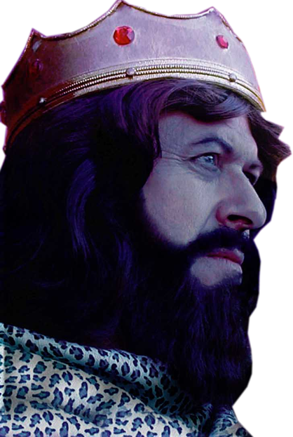
3. Consider the PROCESS
1) External
2) evil desire,
3) dragged away
and enticed.
4) desire conceived,
5) gives birth to sin;
6) and sin, when it is
full-grown,
7) gives birth to death.
King David

Slide 38
3. Consider the PROCESS
1) External Innocent look
2) evil desire,
3) dragged away
and enticed.
4) desire conceived,
5) gives birth to sin;
6) and sin, when it is
full-grown,
7) gives birth to death.

Slide 39
3. Consider the PROCESS
1) External Innocent look
2) evil desire, Internal desire
3) dragged away
and enticed.
4) desire conceived,
5) gives birth to sin;
6) and sin, when it is
full-grown,
7) gives birth to death.

Slide 40
3. Consider the PROCESS
1) External Innocent look
2) evil desire, Internal desire
3) dragged away Allured
and enticed. by it
4) desire conceived,
5) gives birth to sin;
6) and sin, when it is
full-grown,
7) gives birth to death.

Slide 41
3. Consider the PROCESS
1) External Innocent look
2) evil desire, Internal desire
3) dragged away Allured
and enticed. by it
4) desire conceived, It “took over”
5) gives birth to sin;
6) and sin, when it is
full-grown,
7) gives birth to death.

Slide 42
3. Consider the PROCESS
1) External Innocent look
2) evil desire, Internal desire
3) dragged away Allured
and enticed. by it
4) desire conceived, It “took over”
5) gives birth to sin; “Gave in”
6) and sin, when it is
full-grown,
7) gives birth to death.

Slide 43
3. Consider the PROCESS
1) External Innocent look
2) evil desire, Internal desire
3) dragged away Allured
and enticed. by it
4) desire conceived, It “took over”
5) gives birth to sin; “Gave in”
6) and sin, when it is Guilty
full-grown,
7) gives birth to death.

Slide 44
3. Consider the PROCESS
1) External Innocent look
2) evil desire, Internal desire
3) dragged away Allured
and enticed. by it
4) desire conceived, It “took over”
5) gives birth to sin; “Gave in”
6) and sin, when it is Guilty
full-grown,
7) gives birth to death.
MISERY

Slide 45

4. Don’t FOOL YOURSELF
¹⁶ Don't be deceived,
my dear brothers.

Slide 46
4. Don’t FOOL YOURSELF
¹⁶ Don't be deceived,
my dear brothers.
1 Corinthians 10:11-13
¹¹ These things happened to them as examples and were written down as warnings for us, on whom the fulfillment of the ages has come. ¹² So, if you think you are standing firm, be careful that you don't fall!

Slide 47
4. Don’t FOOL YOURSELF
¹⁶ Don't be deceived,
my dear brothers.
¹³ No temptation has seized you except what is common to man. And God is faithful; he will not let you be tempted beyond what you can bear. But when you are tempted, he will also provide a way out so that you can stand up under it.

Slide 48
4. Don’t FOOL YOURSELF
¹⁶ Don't be deceived,
my dear brothers.
¹³ No temptation has seized you except what is common to man. And God is faithful; he will not let you be tempted beyond what you can bear. But when you are tempted, he will also provide a way out so that you can stand up under it.

Slide 49
4. Don’t FOOL YOURSELF
¹⁶ Don't be deceived,
my dear brothers.
¹³ No temptation has seized you except what is common to man. And God is faithful; he will not let you be tempted beyond what you can bear. But when you are tempted, he will also provide a way out so that you can stand up under it.

Slide 50
4. Don’t FOOL YOURSELF
¹⁶ Don't be deceived,
my dear brothers.
¹³ No temptation has seized you except what is common to man. And God is faithful; he will not let you be tempted beyond what you can bear. But when you are tempted, he will also provide a way out so that you can stand up under it.

Slide 51
4. Don’t FOOL YOURSELF
¹⁶ Don't be deceived,
my dear brothers.
¹³ No temptation has seized you except what is common to man. And God is faithful; he will not let you be tempted beyond what you can bear. But when you are tempted, he will also provide a way out so that you can stand up under it.

Slide 52
4. Don’t FOOL YOURSELF
¹⁶ Don't be deceived,
my dear brothers.
¹³ No temptation has seized you except what is common to man. And God is faithful; he will not let you be tempted beyond what you can bear. But when you are tempted, he will also provide a way out so that you can stand up under it.

Slide 53
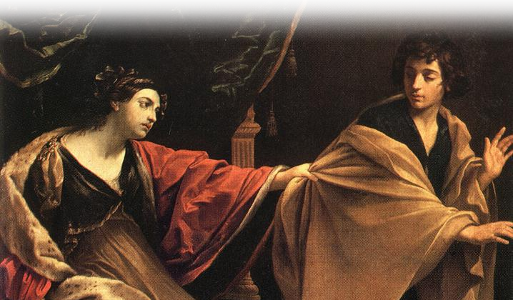
4. Don’t FOOL YOURSELF
Take the way out ... Joseph did.
¹⁶ Don't be deceived,
my dear brothers.
¹³ No temptation has seized you except what is common to man. And God is faithful; he will not let you be tempted beyond what you can bear. But when you are tempted, he will also provide a way out so that you can stand up under it.
(1Co 10:12-13)
Genesis 39

Slide 54

5. Believe GOD IS GOOD
¹⁷ Every good and perfect gift is from above, coming down from the Father of the heavenly lights, who does not change like shifting shadows.

Slide 55

6. You have a New Nature
¹⁸ He chose to give us birth through the word of truth, that we might be a kind of firstfruits of all he created.

Slide 56
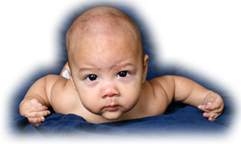
6. You have a New Nature
¹⁸ He chose to give us birth through the word of truth, that we might be a kind of firstfruits of all he created.

Slide 57
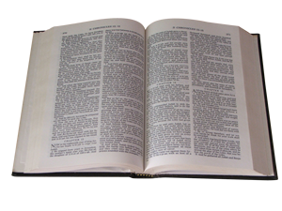
6. You have a New Nature
¹⁸ He chose to give us birth through the word of truth, that we might be a kind of firstfruits of all he created.

Slide 58
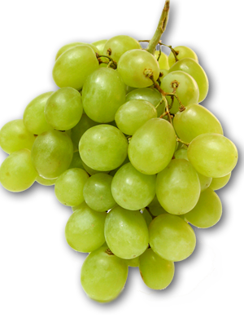
6. You have a New Nature
¹⁸ He chose to give us birth through the word of truth, that we might be a kind of firstfruits of all he created.
First fruits

Slide 59
6. You have a New Nature
¹⁸ He chose to give us birth through the word of truth, that we might be a kind of firstfruits of all he created.
More to salvation that just being saved from the penalty of sin
THE POINT:

Slide 60
6. You have a New Nature
¹⁸ He chose to give us birth through the word of truth, that we might be a kind of firstfruits of all he created.
There is also being saved from it’s power and lure!!!
THE POINT:

Slide 61
6. You have a New Nature
¹⁸ He chose to give us birth through the word of truth, that we might be a kind of firstfruits of all he created.
THE POINT:
We’ll pick up with that
next time.

Slide 62
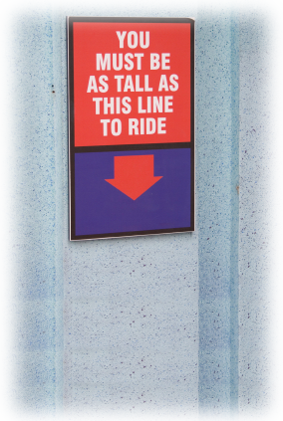
A Faith that Works...
When You Don’t Seem to Measure Up

Slide 63
So what should we take away today?

Slide 64
So what should we take away today?
I can overcome temptation

Slide 65
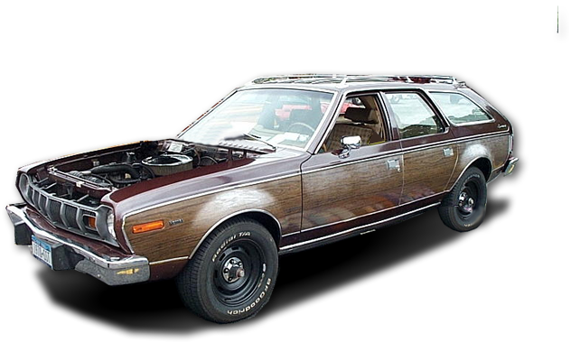

So what do we take away today?
I can overcome temptation
from without

Slide 66
So what do we take away today?
I can overcome temptation
from without and from within

Slide 67
So what do we take away today?
I can overcome temptation
from without and from within
If I WANT TO!

Slide 68
Let’s Pray

