Slide 1
JAMES
A FAITH THAT WORKS
Notes:
BACKGROUND = https://pixabay.com/en/gears-cogs-machine-machinery-1236578/
Copyright © 2006−2021. All rights reserved. Bible Point is a registered trademark of Dennis Henderson. All other trademarks acknowledged.
Bible Point contains graphics from Bible Point artists. These illustrations belong to Bible Point and the respective artists. You may use the designs and illustrations for graphical illustration of lessons free and without special permission, provided they are not used in any way that maligns the Christian faith. Furthermore, republication or production of any illustration by any other graphic service whether it be in book, in a machine-readable form, or in any other design resource is strictly prohibited. Furthermore, they cannot be duplicated or resold as any other form of publishing, clip art, or graphic resource.
So What does it mean? (A simple translations of the legal jargon)
So, if you don’t own the presentation(s), graphic(s), and text(s) how can you legally use them? The purchase of the license allows you to use all the images in the product. However, the actual ownership and copyright of the presentation(s), graphic(s), and text(s) remain the property of Bible Point and its licensors. If you had plans on using this product in your “for sale” work—think again!
License Agreement
Article 1: License Grant
All the graphics and text in Bible Point presentations (excluding quotes from the Bible and stated sources) are the intellectual and real property of Bible Point and its licensors, and is protected by law, including United States copyright laws and international treaties. Bible Point grants to you a license:
1. To use the presentation in a single church, single school, or single office of a Christian organization.
2. To make a single archival back-up copy of the program.
3. To modify the presentation(s) and merge with other presentations in a single church, school, or Christian organization.
4. To transfer to another party if that party agrees to accept the terms and conditions of this agreement, and you do not retain any copies of the presentation, whether printed, machine readable, modified, or merged form.
Article 2: Terms
This license is effective until terminated. You may terminate the license at any time by destroying the presentation(s), graphic(s), or text(s) together with all copies, modifications and merged portions in any form. Bible Point may terminate your license if you fail to comply with this Agreement. You agree, upon such termination, for any reason, to destroy the presentation(s), graphics, and text(s) with all copies, modifications, and merged portions in any form.
Article 3: Disclaimers
1. Bible Point presentations, graphics, and texts are licensed to you As Is. You, the consumer, bear the entire risk relating to the quality and performance of the presentation(s), graphic(s), or text(s). In no event will Bible Point be liable for damages resulting from any defect.
2. Thirty-day limited warrantee on disks. Bible Point warrants the disks to be free of defects in material and workmanship under normal use for 30 days after purchase. During the 30-day period you may return a defective presentation, graphic, or text with proof of purchase and it will be replaced without charge, unless the presentation is damaged by misuse.
Article 4: General
1. You may not sub-license, assign, or transfer the license of the presentation(s), graphic(s), or text(s) except as provided by this Agreement.
2. This Agreement will be governed by the laws of the State of Michigan.
So What does it mean? (A simple translations of the legal jargon)
May I let someone borrow or copy my licensed Bible Point presentation (even after I modified it)? As long as it is within your local church, or single school, or the immediate office of a Christian organization you may. Otherwise, please refer the person interested in borrowing to: http://www.biblepoint.com or E-mail: dennis@DrDH.net with any related questions.

Slide 2
When
Troubles
Just Won’t
Go Away!
Notes:
Copyright © 2006−2021. All rights reserved. Bible Point is a registered trademark of Dennis Henderson. All other trademarks acknowledged.
Bible Point contains graphics from Bible Point artists. These illustrations belong to Bible Point and the respective artists. You may use the designs and illustrations for graphical illustration of lessons free and without special permission, provided they are not used in any way that maligns the Christian faith. Furthermore, republication or production of any illustration by any other graphic service whether it be in book, in a machine-readable form, or in any other design resource is strictly prohibited. Furthermore, they cannot be duplicated or resold as any other form of publishing, clip art, or graphic resource.
So What does it mean? (A simple translations of the legal jargon)
So, if you don’t own the presentation(s), graphic(s), and text(s) how can you legally use them? The purchase of the license allows you to use all the images in the product. However, the actual ownership and copyright of the presentation(s), graphic(s), and text(s) remain the property of Bible Point and its licensors. If you had plans on using this product in your “for sale” work—think again!
License Agreement
Article 1: License Grant
All the graphics and text in Bible Point presentations (excluding quotes from the Bible and stated sources) are the intellectual and real property of Bible Point and its licensors, and is protected by law, including United States copyright laws and international treaties. Bible Point grants to you a license:
1. To use the presentation in a single church, single school, or single office of a Christian organization.
2. To make a single archival back-up copy of the program.
3. To modify the presentation(s) and merge with other presentations in a single church, school, or Christian organization.
4. To transfer to another party if that party agrees to accept the terms and conditions of this agreement, and you do not retain any copies of the presentation, whether printed, machine readable, modified, or merged form.
Article 2: Terms
This license is effective until terminated. You may terminate the license at any time by destroying the presentation(s), graphic(s), or text(s) together with all copies, modifications and merged portions in any form. Bible Point may terminate your license if you fail to comply with this Agreement. You agree, upon such termination, for any reason, to destroy the presentation(s), graphics, and text(s) with all copies, modifications, and merged portions in any form.
Article 3: Disclaimers
1. Bible Point presentations, graphics, and texts are licensed to you As Is. You, the consumer, bear the entire risk relating to the quality and performance of the presentation(s), graphic(s), or text(s). In no event will Bible Point be liable for damages resulting from any defect.
2. Thirty-day limited warrantee on disks. Bible Point warrants the disks to be free of defects in material and workmanship under normal use for 30 days after purchase. During the 30-day period you may return a defective presentation, graphic, or text with proof of purchase and it will be replaced without charge, unless the presentation is damaged by misuse.
Article 4: General
1. You may not sub-license, assign, or transfer the license of the presentation(s), graphic(s), or text(s) except as provided by this Agreement.
2. This Agreement will be governed by the laws of the State of Michigan.
So What does it mean? (A simple translations of the legal jargon)
May I let someone borrow or copy my licensed Bible Point presentation (even after I modified it)? As long as it is within your local church, or single school, or the immediate office of a Christian organization you may. Otherwise, please refer the person interested in borrowing to: http://www.biblepoint.com or E-mail: dennis@DrDH.net with any related questions.

Slide 3
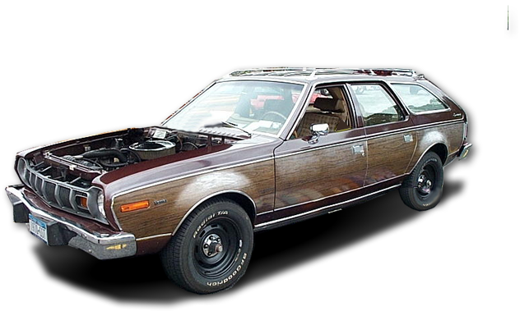


Slide 4


Slide 5


Slide 8


Slide 24
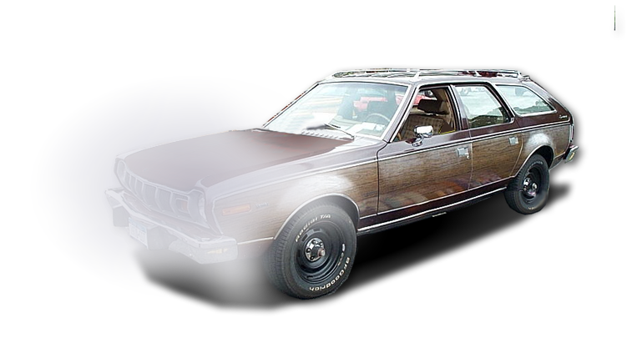

Slide 25


Slide 27


Slide 30
So What Do You Do
When Your Trouble
Just Won’t Go Away?
Notes:
Copyright © 2006−2021. All rights reserved. Bible Point is a registered trademark of Dennis Henderson. All other trademarks acknowledged.
Bible Point contains graphics from Bible Point artists. These illustrations belong to Bible Point and the respective artists. You may use the designs and illustrations for graphical illustration of lessons free and without special permission, provided they are not used in any way that maligns the Christian faith. Furthermore, republication or production of any illustration by any other graphic service whether it be in book, in a machine-readable form, or in any other design resource is strictly prohibited. Furthermore, they cannot be duplicated or resold as any other form of publishing, clip art, or graphic resource.
So What does it mean? (A simple translations of the legal jargon)
So, if you don’t own the presentation(s), graphic(s), and text(s) how can you legally use them? The purchase of the license allows you to use all the images in the product. However, the actual ownership and copyright of the presentation(s), graphic(s), and text(s) remain the property of Bible Point and its licensors. If you had plans on using this product in your “for sale” work—think again!
License Agreement
Article 1: License Grant
All the graphics and text in Bible Point presentations (excluding quotes from the Bible and stated sources) are the intellectual and real property of Bible Point and its licensors, and is protected by law, including United States copyright laws and international treaties. Bible Point grants to you a license:
1. To use the presentation in a single church, single school, or single office of a Christian organization.
2. To make a single archival back-up copy of the program.
3. To modify the presentation(s) and merge with other presentations in a single church, school, or Christian organization.
4. To transfer to another party if that party agrees to accept the terms and conditions of this agreement, and you do not retain any copies of the presentation, whether printed, machine readable, modified, or merged form.
Article 2: Terms
This license is effective until terminated. You may terminate the license at any time by destroying the presentation(s), graphic(s), or text(s) together with all copies, modifications and merged portions in any form. Bible Point may terminate your license if you fail to comply with this Agreement. You agree, upon such termination, for any reason, to destroy the presentation(s), graphics, and text(s) with all copies, modifications, and merged portions in any form.
Article 3: Disclaimers
1. Bible Point presentations, graphics, and texts are licensed to you As Is. You, the consumer, bear the entire risk relating to the quality and performance of the presentation(s), graphic(s), or text(s). In no event will Bible Point be liable for damages resulting from any defect.
2. Thirty-day limited warrantee on disks. Bible Point warrants the disks to be free of defects in material and workmanship under normal use for 30 days after purchase. During the 30-day period you may return a defective presentation, graphic, or text with proof of purchase and it will be replaced without charge, unless the presentation is damaged by misuse.
Article 4: General
1. You may not sub-license, assign, or transfer the license of the presentation(s), graphic(s), or text(s) except as provided by this Agreement.
2. This Agreement will be governed by the laws of the State of Michigan.
So What does it mean? (A simple translations of the legal jargon)
May I let someone borrow or copy my licensed Bible Point presentation (even after I modified it)? As long as it is within your local church, or single school, or the immediate office of a Christian organization you may. Otherwise, please refer the person interested in borrowing to: http://www.biblepoint.com or E-mail: dennis@DrDH.net with any related questions.

Slide 31
You take Biblical
Counter-Measures:

Slide 32
Introduction to James:
1:1 James, a servant of God and of the Lord Jesus Christ,

Slide 33
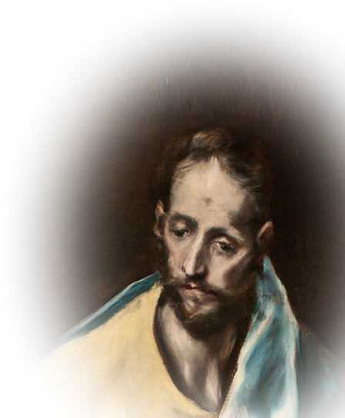
Introduction to James:
1:1 James, a servant of God and of the Lord Jesus Christ,
The Lord’s half brother

Slide 34
Introduction to James:
1:1 James, a servant of God and of the Lord Jesus Christ,
The Lord’s half brother
1--unbeliever during life
of Christ - John 7:2-8

Slide 35
Introduction to James:
1:1 James, a servant of God and of the Lord Jesus Christ,
The Lord’s half brother
1--unbeliever during life
of Christ - John 7:2-8
2--Witnessed the
resurrection - 1Cor. 15:7

Slide 36
Introduction to James:
1:1 James, a servant of God and of the Lord Jesus Christ,
3--Among those waiting for the
HS on day of Pentecost - Acts 1:14

Slide 37
Introduction to James:
1:1 James, a servant of God and of the Lord Jesus Christ,
3--Among those waiting for the
HS on day of Pentecost - Acts 1:14
4--Became a leader in the
Jerusalem church - Acts 15:13

Slide 38
Introduction to James:
1:1 James, a servant of God and of the Lord Jesus Christ,
3--Among those waiting for the
HS on day of Pentecost - Acts 1:14
4--Became a leader in the
Jerusalem church - Acts 15:13
5--”Servant of God and of the Lord
Jesus Christ” – 1:1

Slide 39
Introduction to James:
1:1 James, a servant of God and of the Lord Jesus Christ,
To the twelve tribes scattered among the nations:
Greetings.

Slide 40
Introduction to James:
1:1 James, a servant of God and of the Lord Jesus Christ,
To the twelve tribes scattered among the nations:
Greetings.
NOT SHELTERED

Slide 41
Introduction to James:
1:1 James, a servant of God and of the Lord Jesus Christ,
To the twelve tribes scattered among the nations:
Greetings.
Sounds like trouble!

Slide 42
There is trouble:
“trials of many kinds,” (James 1:2)
“testing of your faith” (Jams 1:3)
“perseveres under trial” (James 1:12)
“stood the test” (James 1:12)

Slide 43
There is trouble:
“trials of many kinds,” (James 1:2)
“testing of your faith” (James 1:3)
“perseveres under trial” (James 1:12)
“stood the test” (James 1:12)
Trial + testing = trouble

Slide 44
So What Do You Do
When Your Trouble
Just Won’t Go Away?

Slide 45
You take Biblical
Counter-Measures:

Slide 46

1- Rejoice!
² Consider it pure joy, my brothers, whenever you face trials of many kinds,

Slide 47
1- Rejoice!
² Consider it pure joy, my brothers, whenever you face trials of many kinds,
This is a mental
thing!

Slide 48
1- Rejoice!
² Consider it pure joy, my brothers, whenever you face trials of many kinds,
This is a mental
thing!
That takes control
of your emotions!

Slide 49
1- Rejoice!
² Consider it pure joy, my brothers, whenever you face trials of many kinds,

Slide 50
1- Rejoice!
² Consider it pure joy, my brothers, whenever you face trials of many kinds,
NOT “if”

Slide 51
1- Rejoice!
² Consider it pure joy, my brothers, whenever you face trials of many kinds,

Slide 52
1- Rejoice!
² Consider it pure joy, my brothers, whenever you face trials of many kinds,
Circumstantial
The righteous person faces many troubles, but the LORD comes to the rescue each time. (Psalm 34:19 NLT)

Slide 53
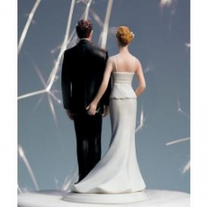
1- Rejoice!
² Consider it pure joy, my brothers, whenever you face trials of many kinds,
Circumstantial
Relational
But those who marry will face many troubles in this life, (1Co 7:28 NIV)

Slide 54

1- Rejoice!
² Consider it pure joy, my brothers, whenever you face trials of many kinds,
Circumstantial
Relational
Physical
I delight in weaknesses, in insults, in hardships, in persecutions, in difficulties. (2Co 12:10)

Slide 55

1- Rejoice!
² Consider it pure joy, my brothers, whenever you face trials of many kinds,
Circumstantial
Relational
Physical
Financial
“I know your afflictions and your poverty” (Rev 2:9)

Slide 56
They called the apostles in and had them flogged. Then they ordered them not to speak in the name of Jesus, and let them go. ⁴¹ The apostles left the Sanhedrin, rejoicing because they had been counted worthy of suffering disgrace for the Name. (Act 5:40-41)
² Consider it pure joy, my brothers, whenever you face trials of many kinds,
Circumstantial
Relational
Physical
Financial
Spiritual

Slide 57
1- Rejoice!
² Consider it pure joy, my brothers, whenever you face trials of many kinds,
Why?

Slide 58
1- Rejoice!
² Consider it pure joy, my brothers, whenever you face trials of many kinds,
Why?

Slide 59

³ because you know that the testing of your faith develops perseverance.
It is a test
of your faith!

Slide 60
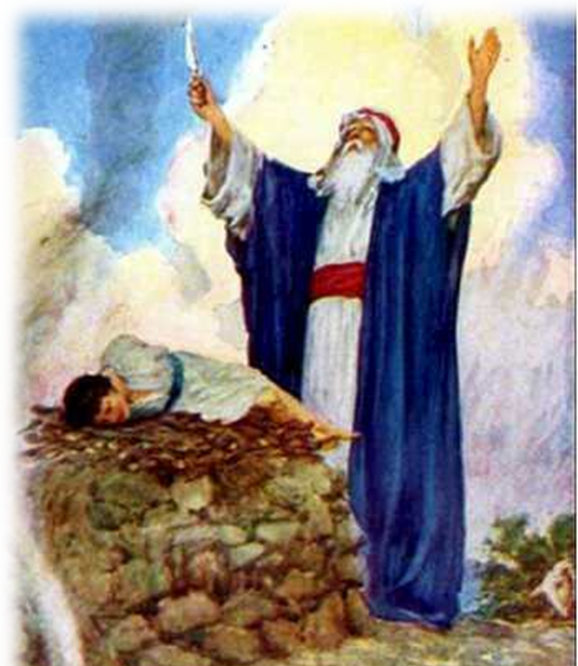
³ because you know that the testing of your faith develops perseverance.
It is a test
of your faith!

Slide 61
³ because you know that the testing of your faith develops perseverance.

Slide 62

³ because you know that the testing of your faith develops perseverance.
THE ABILITY TO REMAIN STRONG UNDER PRESSURE

Slide 63
³ because you know that the testing of your faith develops perseverance.
¹³ .... God is faithful; he will not let you be tempted beyond what you can bear. But when you are tempted, he will also provide a way out so that you can stand
up under it. (1Co 10:13)

Slide 64
2- Persevere

Slide 65
2- Persevere
⁴ Perseverance must finish its work ...

Slide 66
2- Persevere
⁴ Perseverance must finish its work ...
What
Work?

Slide 67
2- Persevere
⁴ Perseverance must finish its work so that you may be mature and complete, not lacking anything.

Slide 68
2- Persevere
⁴ Perseverance must finish its work so that you may be mature and complete, not lacking anything.
3 Works of Completing Us
His work for us = Salvation

Slide 69
2- Persevere
⁴ Perseverance must finish its work so that you may be mature and complete, not lacking anything.
3 Works of Completing Us
His work for us = Salvation
His work in us = Sanctification

Slide 70
2- Persevere
⁴ Perseverance must finish its work so that you may be mature and complete, not lacking anything.
3 Works of Completing Us
His work for us = Salvation
His work in us = Sanctification
His work through us = Service

Slide 71
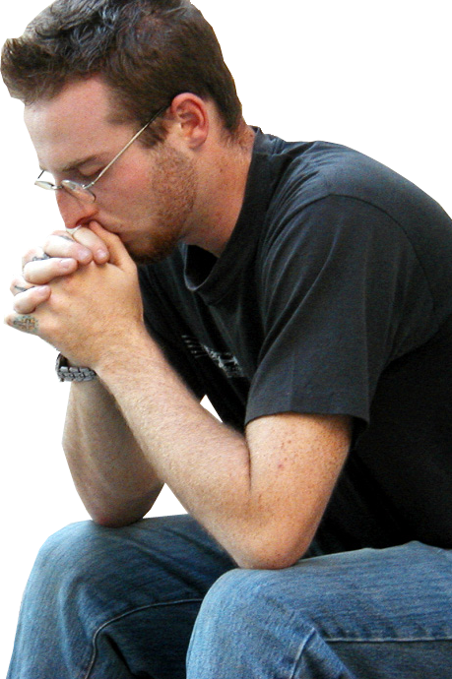
3- Pray
⁵ If any of you lacks wisdom, he should ask God, who gives generously to all without finding fault, and it will be given to him.

Slide 72
3- Pray
⁵ If any of you lacks wisdom, he should ask God, who gives generously to all without finding fault, and it will be given to him.

Slide 73
3- Pray
⁵ If any of you lacks wisdom, he should ask God, who gives generously to all without finding fault, and it will be given to him.

Slide 74
3- Pray
⁵ If any of you lacks wisdom, he should ask God, who gives generously to all without finding fault, and it will be given to him.

Slide 75
3- Pray
⁵ If any of you lacks wisdom, he should ask God, who gives generously to all without finding fault, and it will be given to him.

Slide 76
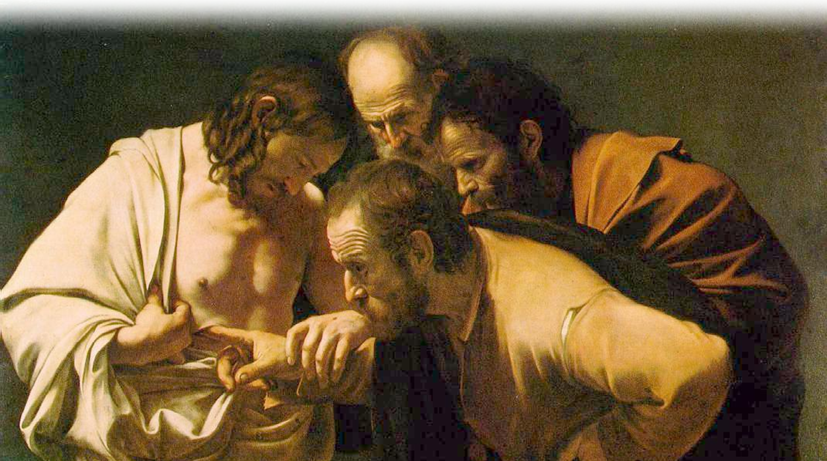
4- Believe
⁶ But when he asks, he must believe and not doubt,

Slide 77
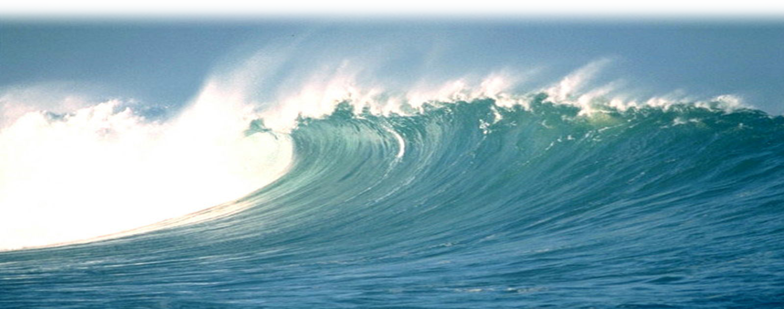
4- Believe
⁶ But when he asks, he must believe and not doubt, because he who doubts is like a wave of the sea, blown and tossed by the wind.

Slide 78

4- Believe
⁷ That man should not think he will receive anything from the Lord;

Slide 79
4- Believe
⁷ That man should not think he will receive anything from the Lord;

Slide 80
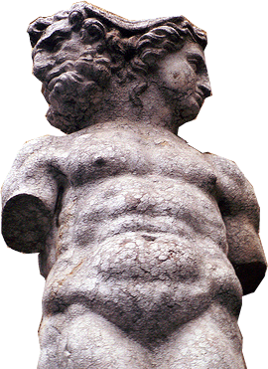
4- Believe
⁸ he is a double-minded man, unstable in all he does.

Slide 81
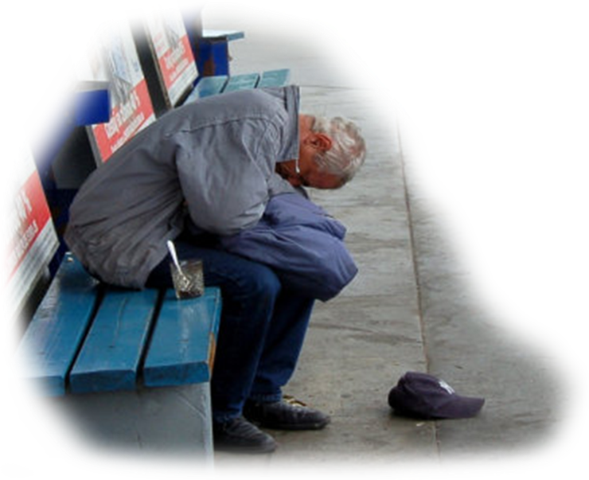
5- Take Pride
⁹ The brother in humble circumstances ought to take pride in his high position.

Slide 82
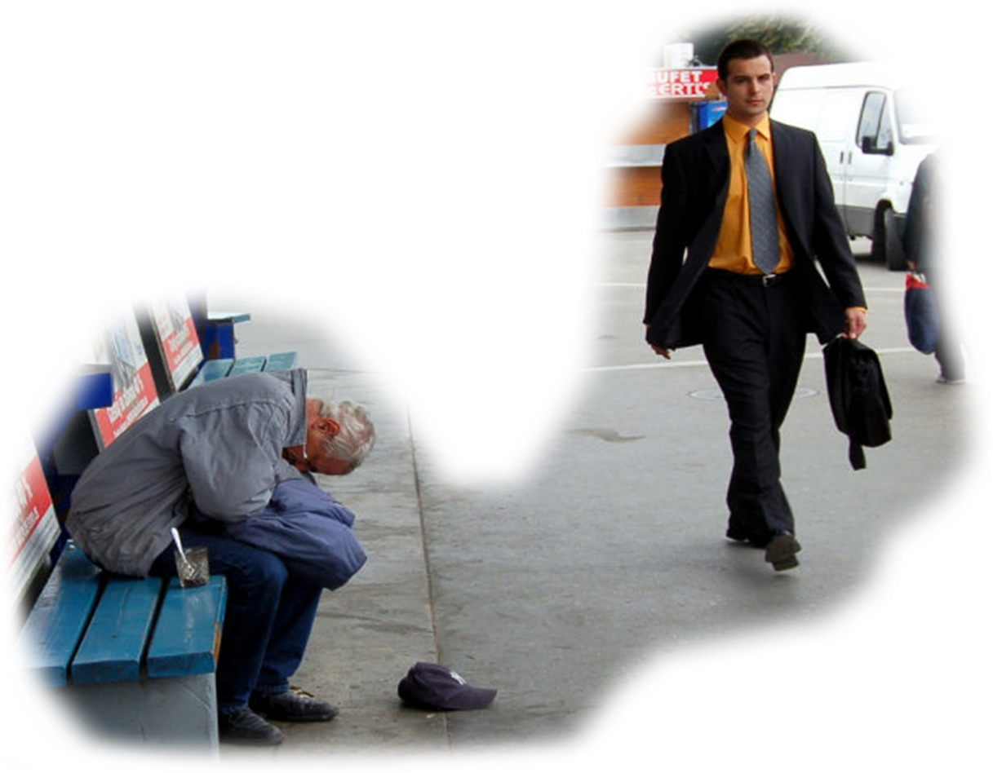
5- Take Pride
¹⁰ But the one who is rich
should take pride in his
low position,

Slide 83
5- Take Pride
¹⁰ But the one who is rich
should take pride in his
low position,
WHY?
WHY?

Slide 84

5- Take Pride
because he will pass away like a wild flower. ¹¹ For the sun rises with scorching heat and withers the plant; its blossom falls and its beauty is destroyed.

Slide 85

5- Take Pride
because he will pass away like a wild flower. ¹¹ For the sun rises with scorching heat and withers the plant; its blossom falls and its beauty is destroyed.

Slide 86
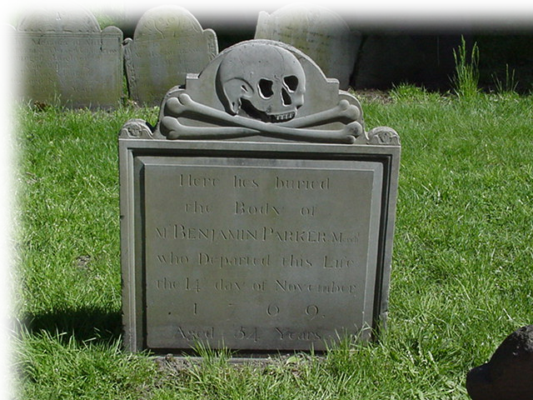
5- Take Pride
In the same way, the rich man will fade away even while he goes about his business.

Slide 87

6- Go for the Crown
¹² Blessed is the man who perseveres under trial, because when he has stood the test, he will receive the crown of life that God has promised to those who love him.

Slide 88
6- Go for the Crown
¹² Blessed is the man who perseveres under trial, because when he has stood the test, he will receive the crown of life that God has promised to those who love him.

Slide 89
6- Go for the Crown
¹² Blessed is the man who perseveres under trial, because when he has stood the test, he will receive the crown of life that God has promised to those who love him.

Slide 90
You can only ...
Rejoice in your troubles,
Persevere through your troubles,
Pray about your troubles,
Be steadfast against your troubles,
Take pride within your troubles,
Triumph over your troubles ...
ONE WAY ...

Slide 91
You must BELIEVE ...
God alone is your true JOY,
He is in control of your circumstances,
He will answer your prayer for wisdom,
He will sustain you,
He will lift you up in His time,
He will REWARD you for your faith.

Slide 92
So put your Faith to Work!
Let’s Pray.

