Slide 1
Haggai 2:20-23
“Consider Your FUTURE”
www.BiblePoint.com
2011 © Single Initiative LLC
This lesson and graphics by: D. L. Henderson, D.Min.
User License required to alter this presentation.
Contact dh@biblepoint.com
Copyright©2011
Notes:
Copyright © 2000-2012. All rights reserved. Bible Point is a registered trademark of Single Initiative, LLC. All other trademarks acknowledged.
Bible Point contains graphics from Bible Point artists. These illustrations belong to Bible Point and the respective artists. You can find owner ship in the note view of this presentation. If the graphic is licensed you may not reuse it in any other presentation. You may however go to the source and license it for your self. You may use the designs and illustrations for graphical illustration of lessons free and without special permission, provided they are FREE for reuse and are not used in any way that maligns the Christian faith. Furthermore, republication or production of any illustration by any other graphic service whether it be in book, in a machine-readable form, or in any other design resource is strictly prohibited. Furthermore, they cannot be duplicated or resold as any other form of publishing, clip art, or graphic resource.
So What does it mean? (A simple translations of the legal jargon)
So, if you don’t own the presentation(s), graphic(s), and text(s) how can you legally use them? The purchase of the license allows you to use all the images in the product. However, the actual ownership and copyright of the presentation(s), graphic(s), and text(s) remain the property of Bible Point and its licensors. Therefore, if an image says “LICENSED and NOT FOR REUSE,” you may not copy and reuse it elsewhere without securing a license from the actual owner. If you had plans on using this product in your “for sale” work—think again!
License Agreement
Article 1: License Grant
All the graphics and text in Bible Point presentations (excluding quotes from the Bible and stated sources) are the intellectual and real property of Bible Point and its licensors, and is protected by law, including United States copyright laws and international treaties. Bible Point grants to you a license:
1. To use the presentation in a single church, single school, or single office of a Christian organization.
2. To make a single archival back-up copy of the program.
3. To modify the presentation(s) and merge with other presentations in a single church, school, or Christian organization.
4. To transfer to another party if that party agrees to accept the terms and conditions of this agreement, and you do not retain any copies of the presentation, whether printed, machine readable, modified, or merged form.
Article 2: Terms
This license is effective until terminated. You may terminate the license at any time by destroying the presentation(s), graphic(s), or text(s) together with all copies, modifications and merged portions in any form. Bible Point may terminate your license if you fail to comply with this Agreement. You agree, upon such termination, for any reason, to destroy the presentation(s), graphics, and text(s) with all copies, modifications, and merged portions in any form.
Article 3: Disclaimers
1. Bible Point presentations, graphics, and texts are licensed to you As Is. You, the consumer, bear the entire risk relating to the quality and performance of the presentation(s), graphic(s), or text(s). In no event will Bible Point be liable for damages resulting from any defect.
2. Thirty-day limited warrantee on disks. Bible Point warrants the disks to be free of defects in material and workmanship under normal use for 30 days after purchase. During the 30-day period you may return a defective presentation, graphic, or text with proof of purchase and it will be replaced without charge, unless the presentation is damaged by misuse.
Article 4: General
1. You may not sub-license, assign, or transfer the license of the presentation(s), graphic(s), or text(s) except as provided by this Agreement.
2. This Agreement will be governed by the laws of the State of Michigan.
So What does it mean? (A simple translations of the legal jargon)
May I let someone borrow or copy my licensed Bible Point presentation (even after I modified it)? As long as it is within your local church, or single school, or the immediate office of a Christian organization you may. Otherwise, please refer the person interested in borrowing to: http://www.biblepoint.com or E-mail: dh@biblepoint.com with any related questions.
---------------------------------------------------------------------------------------------------------------------------
Scripture taken from the HOLY BIBLE, NEW INTERNATIONAL VERSION®. NIV®. Copyright©1973, 1978, 1984 by International Bible Society. Used by permission of Zondervan. All rights reserved.

Slide 2
Notes:
Background image = FREE = from www.dreamstime.com/free-image.php?imageid=2009251

Slide 3
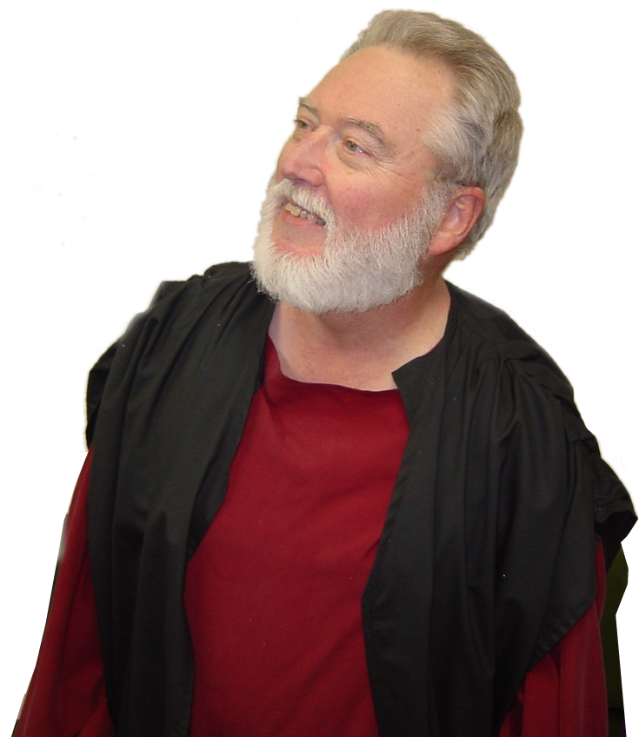
We’ve been studying …
Notes:
Haggai = FREE = from BiblePoint photos.

Slide 4
His messages are a formula:
Consider your …
Ways
Attitudes
Heart
The Result is “God will bless YOU”
Notes:
Haggai = FREE = from BiblePoint photos.

Slide 5
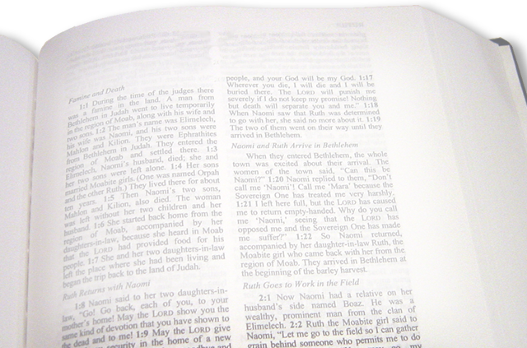
We left off with …
Haggai 2:19 “From this day on I will bless you."
That meant in 520BC
God desires to bless you NOW
Notes:
Bible = FREE = from BiblePoint photos.

Slide 6
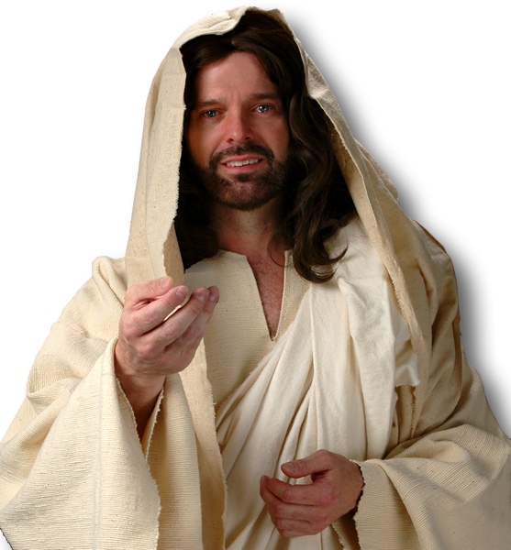
Jesus put it this way …
“I have come that they may have life, and have it to the full.” (John 10:10 NIV)
Notes:
Jesus = LICENSED and NOT FOR REUSE. To reuse elsewhere, get a license from http://www.dreamstime.com/jesus-the-bread-of-life-image1872806

Slide 7
This “NOW” blessing includes:
His pardon– of shortcomings.
His presence– “I am with you.”
His peace– both “with God” & “from God.”
His power– to overcome trials and tests
His provision– for all your needs.
YOU SEE … GOD WANTS TO BLESS YOU NOW!

Slide 8
He also wants to bless you
LATER!
NOT just later in this life…

Slide 9
But also in the
Afterlife!

Slide 10
That’s Haggai’s message:
²⁰ The word of the LORD came to Haggai a second time on the twenty-fourth day of the month:
Notes:
Haggai = FREE = from BiblePoint photos.

Slide 11
This Future Blessing has 3 parts
PART1: God will REALLY SHAKE THINGS UP
PART 2: Earthly KINGDOMS WILL FALL
PART 3: God will REWARD HIS FAITHFUL

Slide 12
1-God will shake things up
²¹ "Tell Zerubbabel governor of Judah that I will shake the heavens and the earth.
Notes:
Earth = FREE = NASA

Slide 13
So What’s the Point?
God is going to shake things up and you can’t stop Him!

Slide 14
2—Kingdoms will fall
²² I will overturn royal thrones and shatter the power of the foreign kingdoms. I will overthrow chariots and their drivers; horses and their riders will fall, each by the sword of his brother. (Hag 2:22 NIV)
Notes:
Haggai = FREE = from BiblePoint photos.

Slide 15
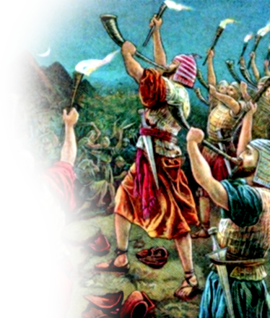
2—Kingdoms will fall
Like in Gideon’s Day
²² When the three hundred trumpets sounded, the LORD caused the men throughout the camp to turn on each other with their swords. (Judge 7:20-22 NIV)
Notes:
Gideon = FREE = Public domain

Slide 16
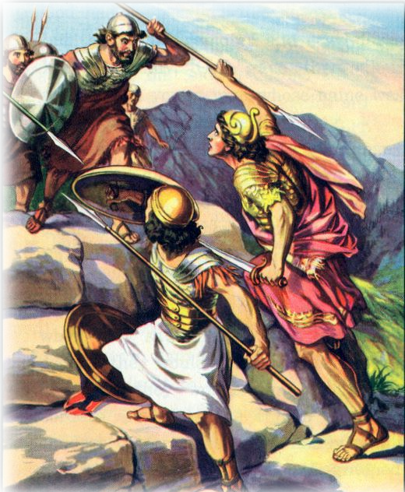
2—Kingdoms will fall
Like in Jonathan’s Day
¹⁴ … Jonathan and his armor-bearer killed some twenty men in an area of about half an acre. ¹⁵ Then panic struck the whole army--those in the camp and field, and those in the

Slide 17
2—Kingdoms will fall
Like in Jonathan’s Day
outposts and raiding parties--and the ground shook. It was a panic sent by God.
…. the tumult in the Philistine camp increased more and more. ….

Slide 18
2—Kingdoms will fall
Like in Jonathan’s Day
²⁰ Then Saul and all his men assembled and went to the battle. They found the Philistines in total confusion, striking each other with their swords. (1Samuel 14:14-20 NIV)

Slide 19
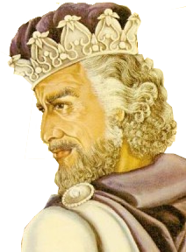
2—Kingdoms will fall
Like Jehoshaphat
2Chron. 20:15 ¹⁵ "Listen, King Jehoshaphat and all who live in Judah and Jeru-salem! This is what the LORD says to you: 'Do not be afraid or discouraged because of this vast army. For the battle is not yours, but God's.
Notes:
Bible = FREE = from BiblePoint photos.

Slide 20
2—Kingdoms will fall
Like Jehoshaphat
¹⁶ Tomorrow march down against them…. ¹⁷ You will not have to fight this battle. Take up your positions; stand firm and see the deliverance the LORD will give you, Do not be afraid… the LORD will be with you.' “
Notes:
Bible = FREE = from BiblePoint photos.

Slide 21
2—Kingdoms will fall
Like Jehoshaphat
²² As they began to sing and praise, the LORD set ambushes against the men …who were invading Judah, and …
²³ The men of Ammon and Moab rose up against the men from Mount Seir to destroy and annihilate them. After they finished slaughtering the men from Seir, they helped to destroy one another.

Slide 22
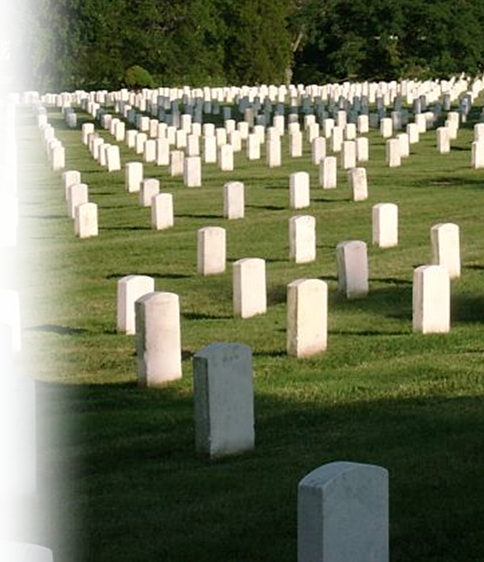
2—Kingdoms will fall
Like Jehoshaphat
²⁴ When the men of Judah came to the place that overlooks the desert and looked toward the vast army, they saw only dead bodies lying on the ground; no one had escaped.
Notes:
Bible = FREE = from BiblePoint photos.
Cemetery = FREE = from http://commons.wikimedia.org/wiki/File:ArlingtonCemetery.jpg

Slide 23
2—Kingdoms will fall
Okay we get the point. God did miracles in the past…
But how about the FUTURE?
Yes, and He will do them again!!!

Slide 24
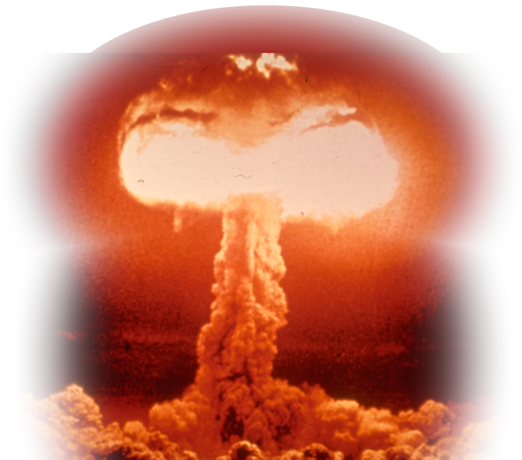
2—Kingdoms will fall
Like at Armageddon
²¹ I will summon a sword against Gog on all my mountains, declares the Sovereign LORD. Every man's sword will be against his brother. (Ezekiel 38:21 NIV)
Notes:
Atomic Explosion = FREE = from http://commons.wikimedia.org/wiki/File:FEMA_-_2720_-_Photograph_by_FEMA_News_Photo.jpg

Slide 25
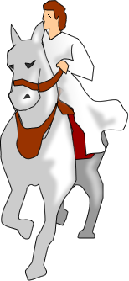
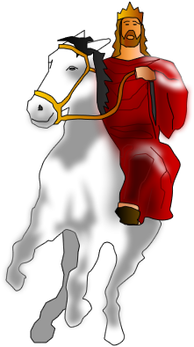
2—Kingdoms will fall
Like at Armageddon Zechariah 14:2 I will gather all the nations to Jerusalem to fight against it; ….
³ Then the LORD will go out and fight against those nations, as he fights in the day of battle. ….
Notes:
Atomic Explosion = FREE = from http://commons.wikimedia.org/wiki/File:FEMA_-_2720_-_Photograph_by_FEMA_News_Photo.jpg
Jesus Return = FREE = From BiblePoint Art

Slide 26
2—Kingdoms will fall
Like at Armageddon ¹³ On that day men will be stricken by the LORD with great panic. Each man will seize the hand of another, and they will attack each other.
(Zech 14:1-3, 13 NIV)
Notes:
Atomic Explosion = FREE = from http://commons.wikimedia.org/wiki/File:FEMA_-_2720_-_Photograph_by_FEMA_News_Photo.jpg
Jesus Return = FREE = From BiblePoint Art

Slide 27
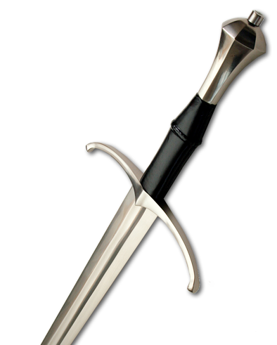
The Principle is this …
Like David said…
¹⁴ The wicked draw the sword and bend the bow to bring down the poor and needy, to slay those whose ways are upright. ¹⁵ But their swords will pierce their own hearts, and their bows will be broken. (Psalm 37:14-15 NIV)
Notes:
Sword = FREE = from http://www.sxc.hu/browse.phtml?f=download&id=560500

Slide 28
2—Kingdoms will fall
Like Haggai said …
²² I will overturn royal thrones and shatter the power of the foreign kingdoms. I will overthrow chariots and their drivers; horses and their riders will fall, each by the sword of his brother. (Hag 2:22 NIV)
Notes:
Haggai = FREE = from BiblePoint photos.

Slide 29
Here’s the point:
If God can and will topple kingdoms …
Surely, He can handle what you are facing now (in the most unusual way!)
So TRUST Him!

Slide 30
3- God will Reward His faithful

Slide 31
3- God will Reward His faithful
²³ " 'On that day,' declares the LORD Almighty,
“That day” has not yet happened!
It has yet to take place!
Notes:
Bible = FREE = from BiblePoint photos.

Slide 32
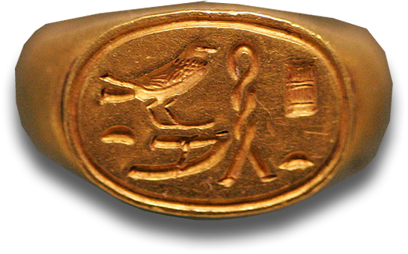
3- God will Reward His faithful
The signet ring represents honor, authority, and personal guarantee of the king, so it was highly valued.
²³ " 'On that day,' declares the LORD Almighty, 'I will take you, my servant Zerubbabel son of Shealtiel,' declares the LORD, 'and I will make you like my signet ring,
He will bear the SEAL of God!
WHY?
Notes:
Bible = FREE = from BiblePoint photos.
Signet ring = FREE = from http://commons.wikimedia.org/wiki/File:Seal_ring_Ptah_Great_with_love_E3603_mp3h8732.jpg

Slide 33
3- God will Reward His faithful
²³ " 'On that day,' declares the LORD Almighty, 'I will take you, my servant Zerubbabel son of Shealtiel,' declares the LORD, 'and I will make you like my signet ring, for I have chosen you,' declares the LORD Almighty.“ (Haggai 2:20-23 NIV)
Notes:
Bible = FREE = from BiblePoint photos.

Slide 34
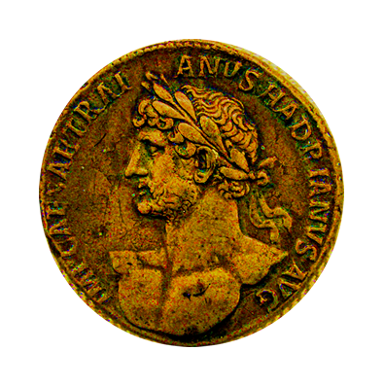
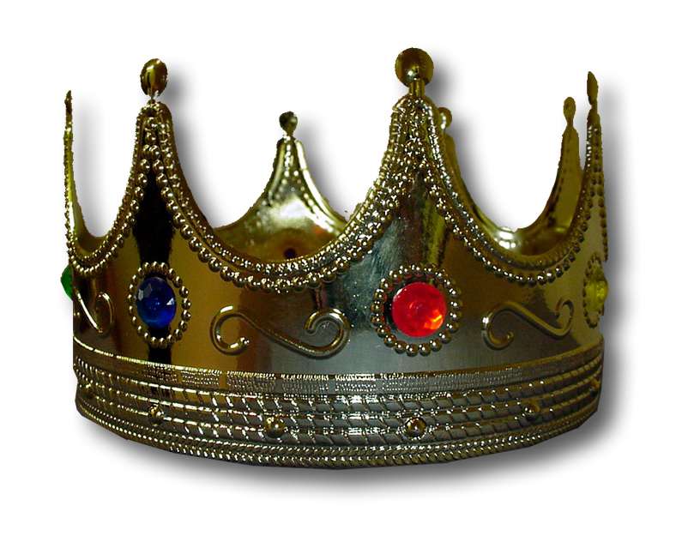
The New Testament Rewards
CROWNS
Notes:
Gem Crown = FREE = from http://www.sxc.hu/photo/211996
Roman Coin Modified = FREE = from http://commons.wikimedia.org/wiki/File:Silver_multiple_Hadrianus_AF70_CdM_Paris.jpg

Slide 35
There are “Five” crowns …

Slide 36
1- The “Forever” Crown
SUBMISSION TO GOD
²⁴ Do you not know that in a race all the runners run, but only one gets the prize? Run in such a way as to get the prize. ²⁵ Everyone who competes in the games goes into strict training. They do it to get a crown that will not last; but we do it to get a crown that will last forever.
Notes:
Roman Coin Modified = FREE = from http://commons.wikimedia.org/wiki/File:Silver_multiple_Hadrianus_AF70_CdM_Paris.jpg

Slide 37
1- The “Forever” Crown
SUBMISSION TO GOD
²⁶ Therefore I do not run like a man running aimlessly; I do not fight like a man beating the air.
²⁷ No, I beat my body and make it my slave so that after I have preached to others, I myself will not be disqualified for the prize. (1Corinthians 9:24-27 NIV)
Notes:
Roman Coin Modified = FREE = from http://commons.wikimedia.org/wiki/File:Silver_multiple_Hadrianus_AF70_CdM_Paris.jpg

Slide 38
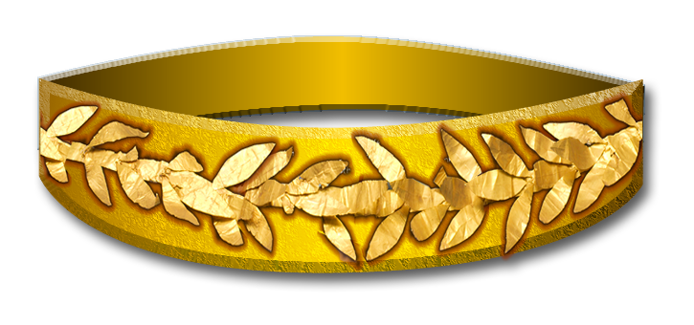
2- The “Joyful” Crown
SHARING THE FAITH
Therefore, my brothers, you whom I love and long for, my joy and crown, (Phil. 4:1 NIV)
Notes:
Crown of wreaths – FREE – modified from http://commons.wikimedia.org/wiki/File:Golden_Laurel_wreath_400BC_Staatliche_Antiken_Sammlungen_01.jpg

Slide 39
2- The “Joyful” Crown
SHARING THE FAITH
¹⁹ For what is our hope, our joy, or the crown in which we will glory in the presence of our Lord Jesus when he comes? Is it not you?
²⁰ Indeed, you are our glory and joy. (1Thes. 2:19-20 NIV)
Notes:
Crown of wreaths – FREE – modified from http://commons.wikimedia.org/wiki/File:Golden_Laurel_wreath_400BC_Staatliche_Antiken_Sammlungen_01.jpg

Slide 40
3- The “Righteous” Crown
LOVE HIS APPEARING
⁷ I have fought the good fight, I have finished the race, I have kept the faith.
⁸ Now there is in store for me the crown of righteousness, which the Lord, the righteous Judge, will award to me on that day—and not only to me, but also to all who have longed for his appearing. (2Timothy 4:7-8 NIV)
Notes:
Crown of wreaths – FREE – modified from http://commons.wikimedia.org/wiki/File:Golden_Laurel_wreath_400BC_Staatliche_Antiken_Sammlungen_01.jpg

Slide 41
4- The Crown of “Life”
ENDURE TRIALS
¹² Blessed is the man who perseveres under trial, because when he has stood the test, he will receive the crown of life that God has promised to those who love him. (James 1:12 NIV)
Notes:
Crown of wreaths – FREE – modified from http://commons.wikimedia.org/wiki/File:Golden_Laurel_wreath_400BC_Staatliche_Antiken_Sammlungen_01.jpg

Slide 42
4- The Crown of “Life”
ENDURE TRIALS
Be faithful, even to the point of death, and I will give you the crown of life. (Rev 2:10 NIV)
Notes:
Crown of wreaths – FREE – modified from http://commons.wikimedia.org/wiki/File:Golden_Laurel_wreath_400BC_Staatliche_Antiken_Sammlungen_01.jpg

Slide 43
5- The Crown of “Glory”
FAITHFUL MINISTRY
² Be shepherds of God's flock that is under your care, serving as overseers--not because you must, but because you are willing, as God wants you to be; not greedy for money, but eager to serve; ³ not lording it over those entrusted to you, but being examples to the flock.
Notes:
Crown of wreaths – FREE – modified from http://commons.wikimedia.org/wiki/File:Golden_Laurel_wreath_400BC_Staatliche_Antiken_Sammlungen_01.jpg

Slide 44
5- The Crown of “Glory”
FAITHFUL MINISTRY
⁴ And when the Chief Shepherd appears, you will receive the crown of glory that will never fade away. (1Pter 5:2-4 NIV)
Notes:
Crown of wreaths – FREE – modified from http://commons.wikimedia.org/wiki/File:Golden_Laurel_wreath_400BC_Staatliche_Antiken_Sammlungen_01.jpg

Slide 45
A Reminder …
¹¹ I am coming soon. Hold on to what you have, so that no one will take your crown. (Rev 3:11 NIV)
Notes:
Jesus = LICENSED and NOT FOR REUSE. To reuse elsewhere, get a license from http://www.dreamstime.com/jesus-the-bread-of-life-image1872806

Slide 46
Take this home …
God wants to both BLESS you NOW and REWARD you LATER.

