Slide 1
Haggai 2:10-19
“Consider Your HEART”
www.BiblePoint.com
2011 © Single Initiative LLC
This lesson and graphics by: D. L. Henderson, D.Min.
User License required to alter this presentation.
Contact dh@biblepoint.com
Copyright©2011
Notes:
Copyright © 2000-2012. All rights reserved. Bible Point is a registered trademark of Single Initiative, LLC. All other trademarks acknowledged.
Bible Point contains graphics from Bible Point artists. These illustrations belong to Bible Point and the respective artists. You can find owner ship in the note view of this presentation. If the graphic is licensed you may not reuse it in any other presentation. You may however go to the source and license it for your self. You may use the designs and illustrations for graphical illustration of lessons free and without special permission, provided they are FREE for reuse and are not used in any way that maligns the Christian faith. Furthermore, republication or production of any illustration by any other graphic service whether it be in book, in a machine-readable form, or in any other design resource is strictly prohibited. Furthermore, they cannot be duplicated or resold as any other form of publishing, clip art, or graphic resource.
So What does it mean? (A simple translations of the legal jargon)
So, if you don’t own the presentation(s), graphic(s), and text(s) how can you legally use them? The purchase of the license allows you to use all the images in the product. However, the actual ownership and copyright of the presentation(s), graphic(s), and text(s) remain the property of Bible Point and its licensors. Therefore, if an image says “LICENSED and NOT FOR REUSE,” you may not copy and reuse it elsewhere without securing a license from the actual owner. If you had plans on using this product in your “for sale” work—think again!
License Agreement
Article 1: License Grant
All the graphics and text in Bible Point presentations (excluding quotes from the Bible and stated sources) are the intellectual and real property of Bible Point and its licensors, and is protected by law, including United States copyright laws and international treaties. Bible Point grants to you a license:
1. To use the presentation in a single church, single school, or single office of a Christian organization.
2. To make a single archival back-up copy of the program.
3. To modify the presentation(s) and merge with other presentations in a single church, school, or Christian organization.
4. To transfer to another party if that party agrees to accept the terms and conditions of this agreement, and you do not retain any copies of the presentation, whether printed, machine readable, modified, or merged form.
Article 2: Terms
This license is effective until terminated. You may terminate the license at any time by destroying the presentation(s), graphic(s), or text(s) together with all copies, modifications and merged portions in any form. Bible Point may terminate your license if you fail to comply with this Agreement. You agree, upon such termination, for any reason, to destroy the presentation(s), graphics, and text(s) with all copies, modifications, and merged portions in any form.
Article 3: Disclaimers
1. Bible Point presentations, graphics, and texts are licensed to you As Is. You, the consumer, bear the entire risk relating to the quality and performance of the presentation(s), graphic(s), or text(s). In no event will Bible Point be liable for damages resulting from any defect.
2. Thirty-day limited warrantee on disks. Bible Point warrants the disks to be free of defects in material and workmanship under normal use for 30 days after purchase. During the 30-day period you may return a defective presentation, graphic, or text with proof of purchase and it will be replaced without charge, unless the presentation is damaged by misuse.
Article 4: General
1. You may not sub-license, assign, or transfer the license of the presentation(s), graphic(s), or text(s) except as provided by this Agreement.
2. This Agreement will be governed by the laws of the State of Michigan.
So What does it mean? (A simple translations of the legal jargon)
May I let someone borrow or copy my licensed Bible Point presentation (even after I modified it)? As long as it is within your local church, or single school, or the immediate office of a Christian organization you may. Otherwise, please refer the person interested in borrowing to: http://www.biblepoint.com or E-mail: dh@biblepoint.com with any related questions.
---------------------------------------------------------------------------------------------------------------------------
Scripture taken from the HOLY BIBLE, NEW INTERNATIONAL VERSION®. NIV®. Copyright©1973, 1978, 1984 by International Bible Society. Used by permission of Zondervan. All rights reserved.

Slide 2
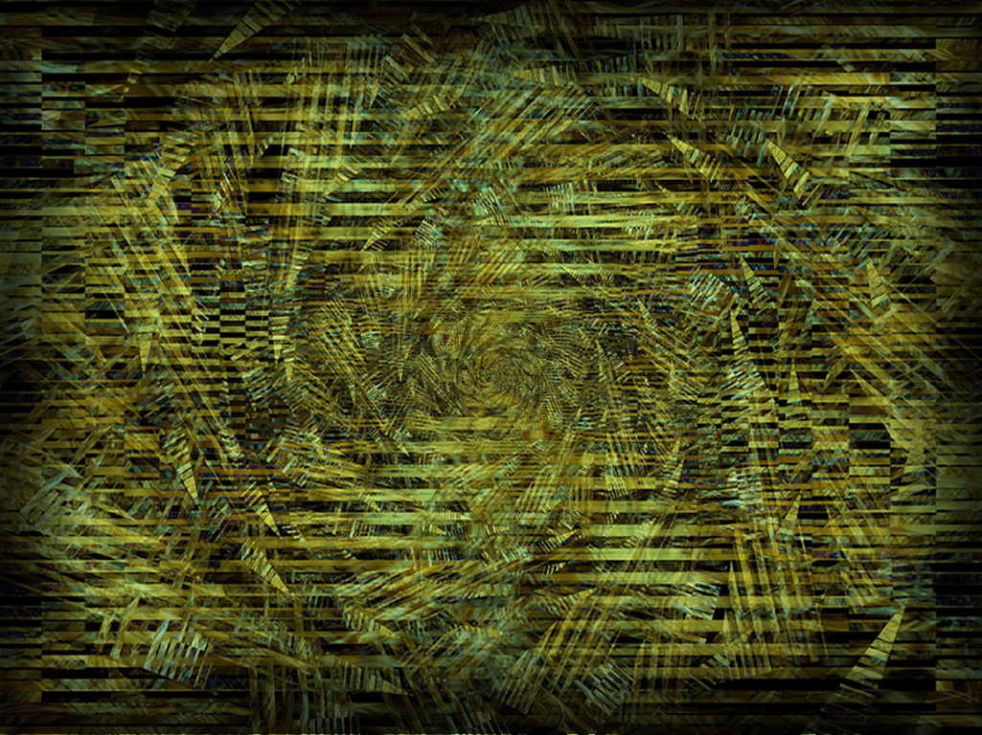
Like today…
In 520 BC
Notes:
Background image = FREE = from www.dreamstime.com/free-image.php?imageid=2009251

Slide 3
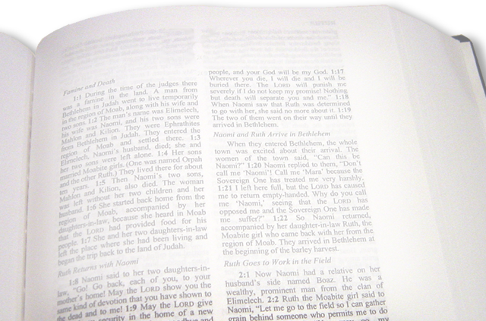
"You expected much, but see, it turned out to be little. (Hag 1:9 NIV)
55% loss
How “little?”
Notes:
Bible = FREE =from BiblePoint photos.

Slide 4
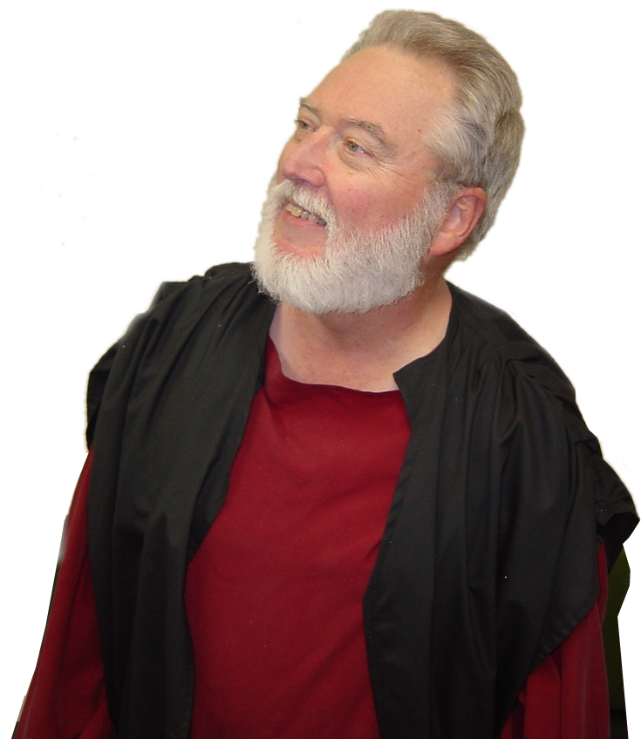
So God raised up …
Consider your …
Ways
Attitudes
Heart
Notes:
Haggai = FREE =from BiblePoint photos.

Slide 5
The English Word “heart” is missing…
But the Hebrew word “heart” (give thought) is here!

Slide 6
Furthermore, the word “defile” (unclean) is here!

Slide 7
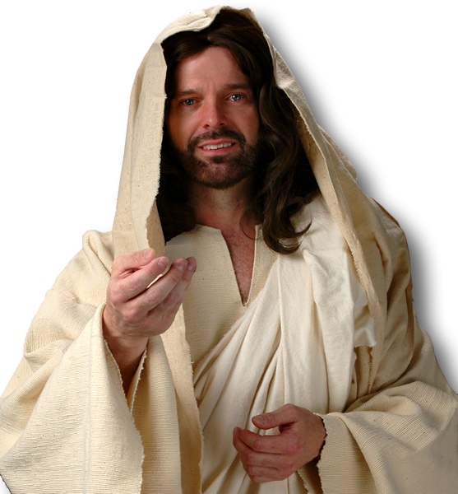
Jesus said …
"What comes out of a man is what makes him 'unclean.‘ ²¹ For from within, out of men's hearts, come evil thoughts, sexual immorality, theft, murder, adultery,
²² greed, malice, deceit, lewdness, envy, slander, arrogance and folly.
Notes:
Jesus = LICENSED and NOT FOR REUSE. To reuse elsewhere, get a license from http://www.dreamstime.com/jesus-the-bread-of-life-image1872806

Slide 8
Jesus said …
²³ All these evils come from inside and make a man 'unclean.'"
(Mar 7:20-23 NIV)
Notes:
Jesus = LICENSED and NOT FOR REUSE. To reuse elsewhere, get a license from http://www.dreamstime.com/jesus-the-bread-of-life-image1872806

Slide 9
Haggai’s message was …
¹⁰ On the twenty-fourth day of the ninth month, in the second year of Darius, the word of the LORD came to the prophet Haggai: (Hag 2:10 NIV)
Notes:
Haggai = FREE =from BiblePoint photos.

Slide 10
Two theological questions:
¹¹ "This is what the LORD Almighty says: 'Ask the priests what the law says: ¹² If a person carries consecrated meat in the fold of his garment, and that fold touches some bread or stew, some wine, oil or other food, does it become consecrated?' (Hag 2:11-12 NIV)
It’s like this …

Slide 11
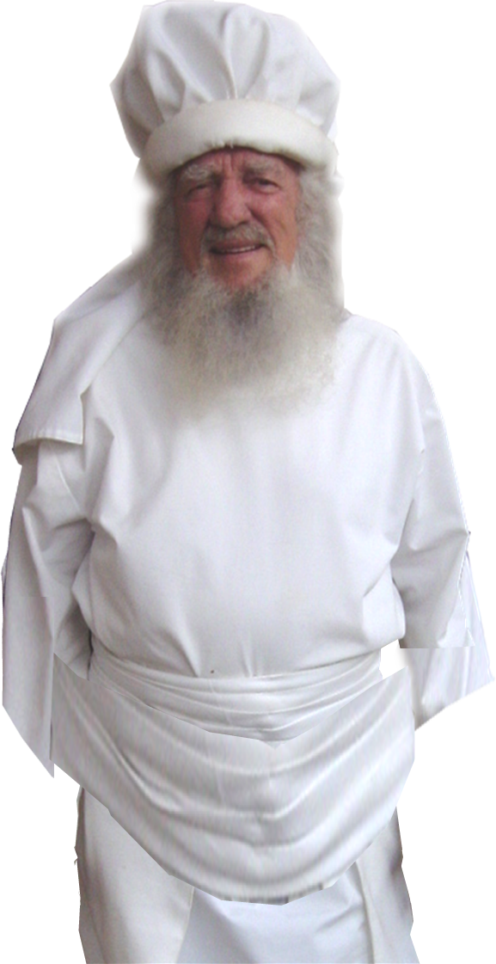
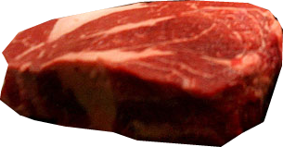
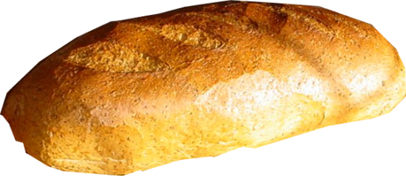
Does it become Holy?
Holy
Common
NO!
Notes:
High Priest = FREE =from BiblePoint photos.

Slide 12
2nd theological question:
¹³ Then Haggai said, "If a person defiled by contact with a dead body touches one of these things, does it become defiled? " (Hag 2:13 NIV)
It’s like this …

Slide 13
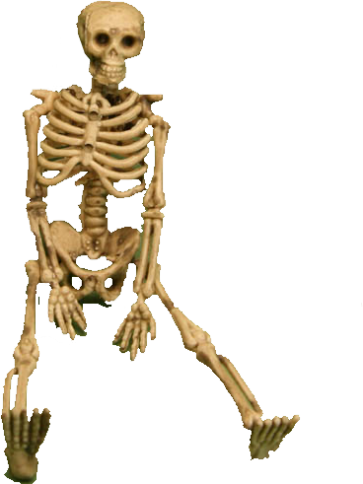
Defiled
Holy
Does it become defiled?
YES!
Notes:
High Priest = FREE =from BiblePoint photos.

Slide 14
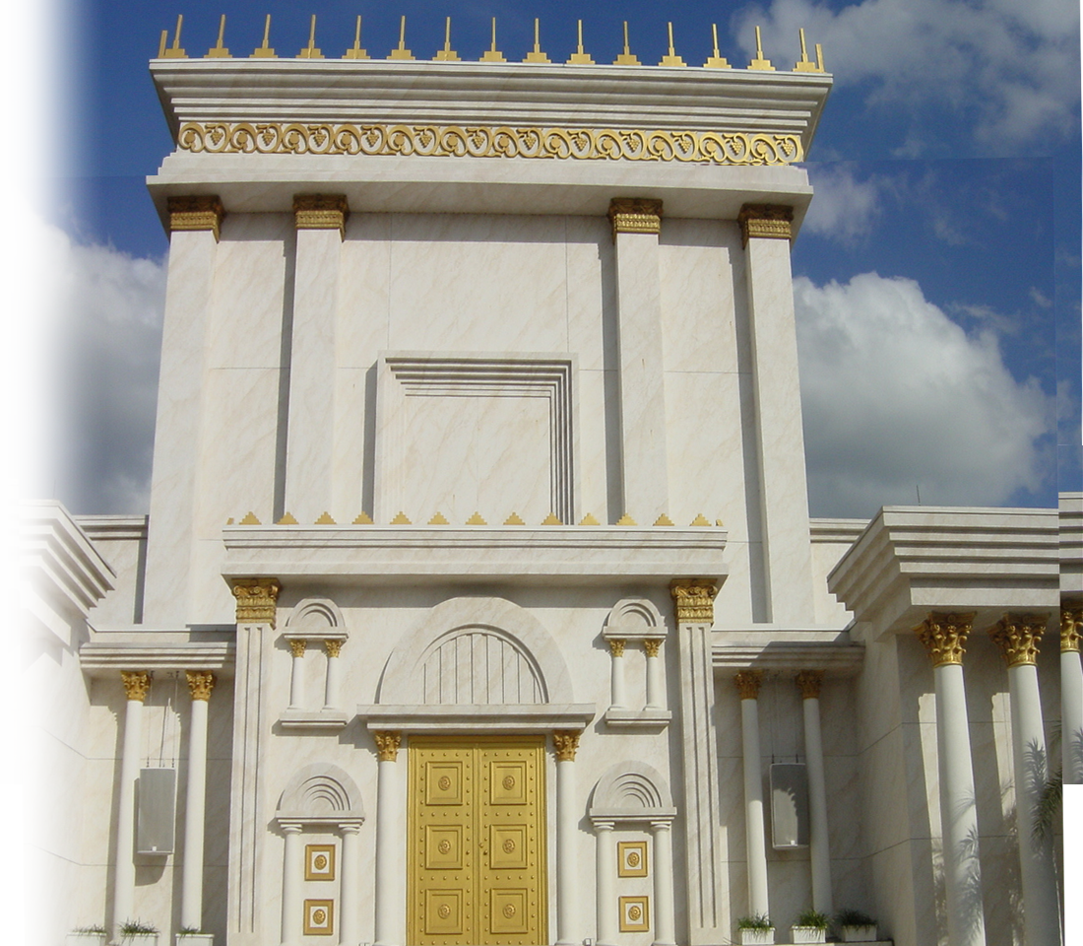
Accept the Lord
¹⁹ Do you not know that your body is a temple of the Holy Spirit, who is in you, whom you have received from God? (1Co 6:19 NIV)
Notes:
Hollow man = FREE = BiblePoint Photos
Temple = FREE = from BiblePoint photos

Slide 15
Does the Holy make the unholy holy?
Sin Against
the Lord
NO!
Notes:
Hollow man = FREE = BiblePoint Photos
Temple = FREE = from BiblePoint photos

Slide 16
Does the unholy make the holy unholy?
Sin Against
the Lord
YES!
Notes:
Hollow man = FREE = BiblePoint Photos
Temple = FREE = from BiblePoint photos

Slide 17
“Evil thoughts, sexual immoral-ity, theft, murder, adultery, ²² greed, malice, deceit, lewdness, envy, slander, arro-gance and folly. All these evils come from inside and make a man 'unclean. '” --Jesus
Does the unholy make the holy unholy?
YES!
Notes:
Hollow man = FREE = BiblePoint Photos
Temple = FREE = from BiblePoint photos

Slide 18
So what does this all mean?
¹⁴ Then Haggai said, " 'So it is with this people and this nation in my sight,' declares the LORD. 'Whatever they do and whatever they offer there is defiled. (Hag 2:14 NIV)
Notes:
Haggai= FREE =from BiblePoint photos.
Bible = FREE =from BiblePoint photos.

Slide 19
Something happened …
Between verse 14 and 15!
Read between the lines!
They changed their heart!

Slide 20
So how do we change our …
Hearts?
A-cknowledge
B-elieve
C-all
Accept
the Lord

Slide 21
What if you already have?
⁶ If we claim to have fellowship with him yet walk in the darkness, we lie and do not live by the truth. …. ⁹ If we confess our sins, he is faithful and just and will forgive us our sins and purify us from all unrighteousness. (1John 1:9 NIV)
Notes:
Bible = FREE =from BiblePoint photos.

Slide 22
They had a Heart Experience
¹⁵ “Now give careful thought to this from this day on--consider how things were … ¹⁸ … give careful thought to the day when the foundation of the LORD's temple was laid. Give careful thought: (Hag 2:15, 18 NIV)

Slide 23
They had a Heart Experience
5
¹⁵ “Now give careful thought to this from this day on--consider how things were before one stone was laid on another in the LORD's temple. (Hag 2:15 NIV)
Before
This on
536 BC
520 BC
Notes:
Bible = FREE =from BiblePoint photos.

Slide 24
They had a Heart Experience
5
¹⁶ When anyone came to a heap of twenty measures, there were only ten. When anyone went to a wine vat to draw fifty measures, there were only twenty.
55% loss
Before
This on
536 BC
520 BC
Notes:
Bible = FREE =from BiblePoint photos.

Slide 25
WHY?
5
¹⁷ I struck all the work of your hands with blight, mildew and hail, yet you did not turn to me,' declares the LORD. (Hag 2:17 NIV)
55% loss
Before
This on
536 BC
520 BC
Notes:
Bible = FREE =from BiblePoint photos.

Slide 26
They had a Heart Experience
5
¹⁸ 'From this day on, from this twenty-fourth day of the ninth month, give careful thought to the day when the foundation of the LORD's temple was laid. Give careful thought:
55% loss
Before
This on
536 BC
520 BC
Notes:
Bible = FREE =from BiblePoint photos.

Slide 27
They had a Heart Experience
5
¹⁹ Is there yet any seed left in the barn? Until now, the vine and the fig tree, the pome-granate and the olive tree have not borne fruit.
55% loss
Before
This on
536 BC
520 BC
Notes:
Bible = FREE =from BiblePoint photos.

Slide 28
They had a Heart Experience
5
¹⁹ Is there yet any seed left in the barn? Until now, the vine and the fig tree, the pome-granate and the olive tree have not borne fruit.
"From this day on I will bless you."
This on
520 BC
Notes:
Bible = FREE =from BiblePoint photos.

Slide 29
Let me do the math:
Haggai 1:1 6th Month 1st Day
Haggai 2:1 7th Month 23rd Day
(1 month and 22 days)
Haggai 2:19 9th Month 24th Day (2 months and 1 day)
Total Time= 3 months and 23 days

Slide 30
Why did God wait so long to bless them?
He wanted them to change their hearts! And be genuine about it.

Slide 31
That’s what He wants
For you too!
Notes:
Finger Pointing = FREE =from BiblePoint photos.

