Slide 1

Haggai 2:1-9
“Consider Your Attitude”
www.BiblePoint.com
2011 © Single Initiative LLC
This lesson and graphics by:
D. L. Henderson, D.Min.
User License required to alter this presentation.
Contact dh@biblepoint.com
Copyright©2011
Notes:
Copyright © 2000-2012. All rights reserved. Bible Point is a registered trademark of Single Initiative, LLC. All other trademarks acknowledged.
Bible Point contains graphics from Bible Point artists. These illustrations belong to Bible Point and the respective artists. You can find owner ship in the note view of this presentation. If the graphic is licensed you may not reuse it in any other presentation. You may however go to the source and license it for your self. You may use the designs and illustrations for graphical illustration of lessons free and without special permission, provided they are FREE for reuse and are not used in any way that maligns the Christian faith. Furthermore, republication or production of any illustration by any other graphic service whether it be in book, in a machine-readable form, or in any other design resource is strictly prohibited. Furthermore, they cannot be duplicated or resold as any other form of publishing, clip art, or graphic resource.
So What does it mean? (A simple translations of the legal jargon)
So, if you don’t own the presentation(s), graphic(s), and text(s) how can you legally use them? The purchase of the license allows you to use all the images in the product. However, the actual ownership and copyright of the presentation(s), graphic(s), and text(s) remain the property of Bible Point and its licensors. Therefore, if an image says “LICENSED and NOT FOR REUSE,” you may not copy and reuse it elsewhere without securing a license from the actual owner. If you had plans on using this product in your “for sale” work—think again!
License Agreement
Article 1: License Grant
All the graphics and text in Bible Point presentations (excluding quotes from the Bible and stated sources) are the intellectual and real property of Bible Point and its licensors, and is protected by law, including United States copyright laws and international treaties. Bible Point grants to you a license:
1. To use the presentation in a single church, single school, or single office of a Christian organization.
2. To make a single archival back-up copy of the program.
3. To modify the presentation(s) and merge with other presentations in a single church, school, or Christian organization.
4. To transfer to another party if that party agrees to accept the terms and conditions of this agreement, and you do not retain any copies of the presentation, whether printed, machine readable, modified, or merged form.
Article 2: Terms
This license is effective until terminated. You may terminate the license at any time by destroying the presentation(s), graphic(s), or text(s) together with all copies, modifications and merged portions in any form. Bible Point may terminate your license if you fail to comply with this Agreement. You agree, upon such termination, for any reason, to destroy the presentation(s), graphics, and text(s) with all copies, modifications, and merged portions in any form.
Article 3: Disclaimers
1. Bible Point presentations, graphics, and texts are licensed to you As Is. You, the consumer, bear the entire risk relating to the quality and performance of the presentation(s), graphic(s), or text(s). In no event will Bible Point be liable for damages resulting from any defect.
2. Thirty-day limited warrantee on disks. Bible Point warrants the disks to be free of defects in material and workmanship under normal use for 30 days after purchase. During the 30-day period you may return a defective presentation, graphic, or text with proof of purchase and it will be replaced without charge, unless the presentation is damaged by misuse.
Article 4: General
1. You may not sub-license, assign, or transfer the license of the presentation(s), graphic(s), or text(s) except as provided by this Agreement.
2. This Agreement will be governed by the laws of the State of Michigan.
So What does it mean? (A simple translations of the legal jargon)
May I let someone borrow or copy my licensed Bible Point presentation (even after I modified it)? As long as it is within your local church, or single school, or the immediate office of a Christian organization you may. Otherwise, please refer the person interested in borrowing to: http://www.biblepoint.com or E-mail: dh@biblepoint.com with any related questions.
---------------------------------------------------------------------------------------------------------------------------
Scripture taken from the HOLY BIBLE, NEW INTERNATIONAL VERSION®. NIV®. Copyright©1973, 1978, 1984 by International Bible Society. Used by permission of Zondervan. All rights reserved.

Slide 2

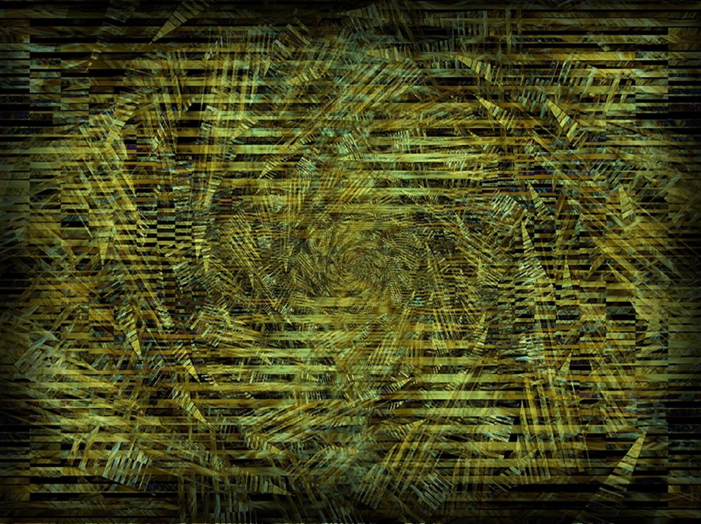

Notes:
Background image = FREE = from www.dreamstime.com/free-image.php?imageid=2009251

Slide 3


Slide 4


Slide 5
Let’s do some review

Slide 6





Slide 7

When God is
NOT in it!

Slide 8
Let’s review quickly

Slide 9
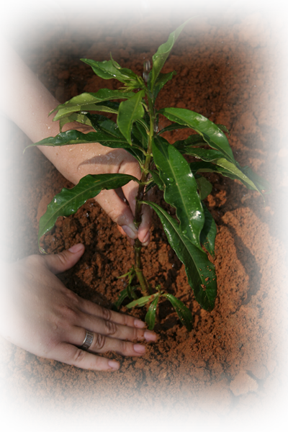
Consider what was happening:
⁶ You have planted much
Notes:
Planting = FREEE = from http://www.sxc.hu/browse.phtml?f=download&id=428778

Slide 10
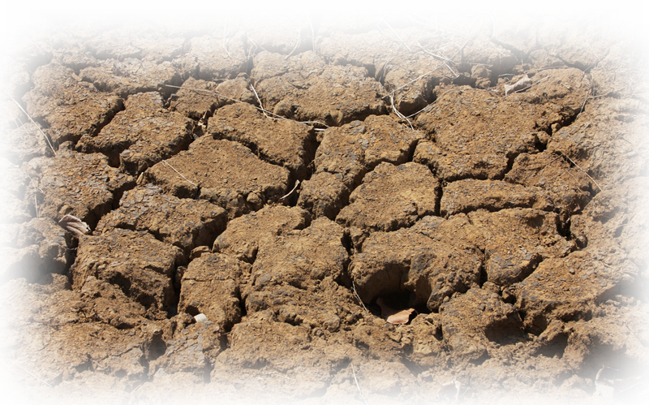
Consider what was happening:
but have harvested little. …
Notes:
Planting = FREEE = from http://www.sxc.hu/browse.phtml?f=download&id=428778
Parched land = FREE = from http://www.sxc.hu/browse.phtml?f=download&id=1210033

Slide 11

Consider what was happening:
You drink, …
Notes:
Pouring water = FREE = from http://commons.wikimedia.org/wiki/File:Stilles_Mineralwasser.jpg

Slide 12

Consider what was happening:
You drink, but never have your fill.
Notes:
Pouring water = FREE = from http://commons.wikimedia.org/wiki/File:Stilles_Mineralwasser.jpg
Modified Water Gauge = FREE = from http://www.sxc.hu/browse.phtml?f=download&id=1126306

Slide 13

Consider what was happening:
You eat, …
Notes:
Hungry Jacks = FREE =with credit to http://www.flickr.com/photos/pdra/2279526616/

Slide 14
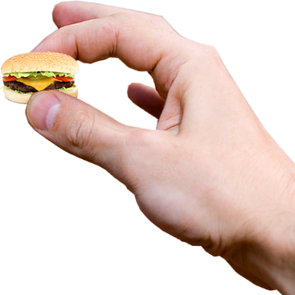
Consider what was happening:
You eat, but never have enough. …
Notes:
Hungry Jacks = FREE =with credit to http://www.flickr.com/photos/pdra/2279526616/
Modified hand = FREE = from http://www.dreamstime.com/keys-in-the-hand-stock-photography-imagefree2589062
Burger = FREE = from http://www.sxc.hu/browse.phtml?f=download&id=1097101

Slide 15

Consider what was happening:
You put on clothes,
Notes:
Cold woman = FREE = from http://www.sxc.hu/photo/1330908

Slide 16
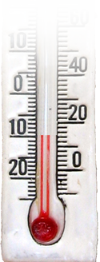
Consider what was happening:
You put on clothes, but are not warm.
Notes:
Cold woman = FREE = from http://www.sxc.hu/photo/1330908
Thermometer = FREE = from http://www.dreamstime.com/decorative-thermometer-free-stock-photography-imagefree691557

Slide 17
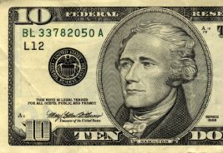
Consider what was happening:
You earn wages,

Slide 18
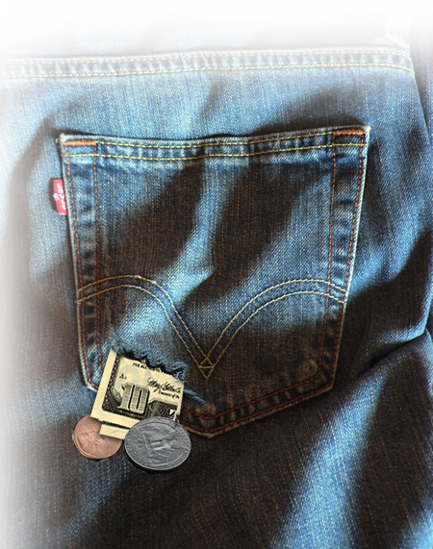
Consider what was happening:
You earn wages, only to put them in
a purse with holes in it."
Notes:
Bill = FREE = from BiblePoint photos
Pocket = FREE = from http://commons.wikimedia.org/wiki/File:Levi%27s_506_back_pocket.jpg

Slide 19
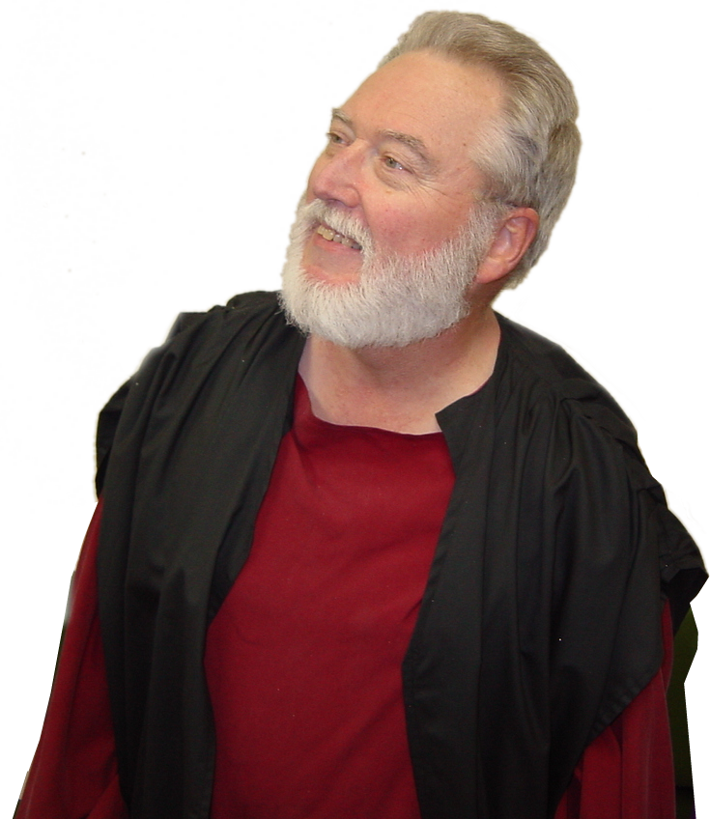
Then Haggai preached…
Now this is what the LORD Almighty says: "Give careful thought to your ways. 1:5, 1:7
Notes:
Haggai = FREE = from BiblePoint photos

Slide 20
Then Haggai preached…
9 "You expected much, but see, it turned out to be little. What you brought home, I
blew away. Why?" declares the LORD Almighty.
Notes:
Haggai = FREE = from BiblePoint photos

Slide 21
Then Haggai preached…
"Because of my house, which remains a ruin, while each of you is busy with his own house.
Wrong
Priorities
Notes:
Haggai = FREE = from BiblePoint photos

Slide 22
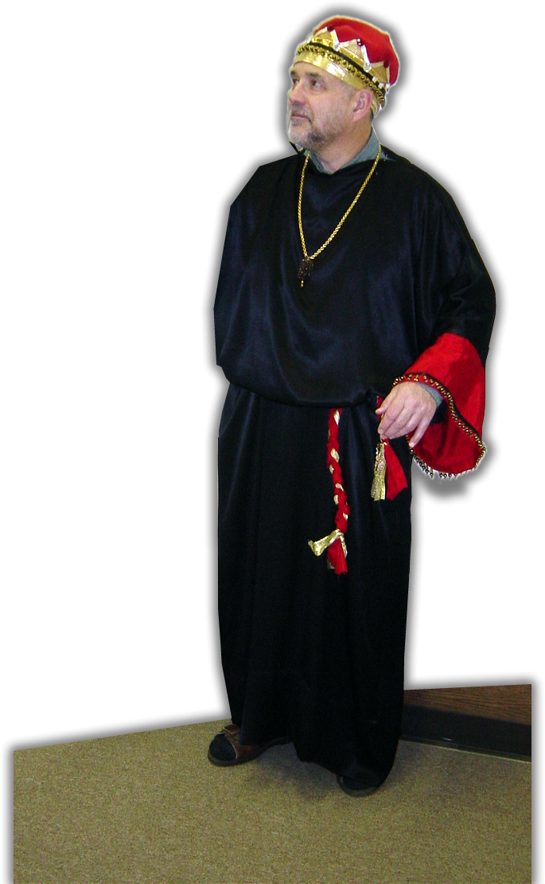
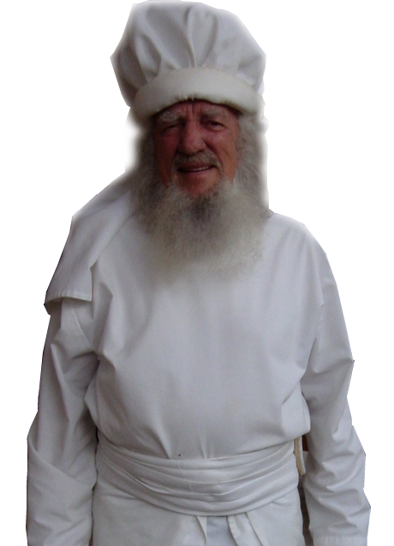
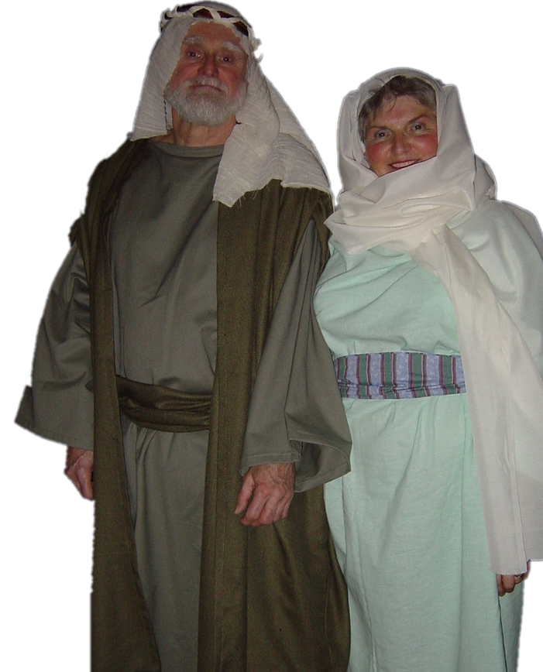
Then …
Priorities
Right

Slide 23

Remember …

Slide 24
Now a month later

Slide 27
Who needs to consider?
The Preacher
Haggai 2:1 On the twenty-first day of the seventh month, the word of the LORD came through the prophet Haggai:
Notes:
Haggai = FREE = from BiblePoint photos

Slide 28
Who needs to consider?
The Politician
² "Speak to Zerubbabel son of Shealtiel, governor of Judah, to Joshua son of Jehozadak, the high priest, and to the remnant of the people.
Notes:
Zerubbable= FREE = from BiblePoint photos

Slide 29
Who needs to consider?
The Priest
² "Speak to Zerubbabel son of Shealtiel, governor of Judah, to Joshua son of Jehozadak, the high priest, and to the remnant of the people.
Notes:
High Priest = FREE = from BiblePoint photos

Slide 30
Who needs to consider?
The People
² "Speak to Zerubbabel son of Shealtiel, governor of Judah, to Joshua son of Jehozadak, the high priest, and to the remnant of the people.
Notes:
People = FREE = from BiblePoint photos

Slide 31
But ESPECIALLY to
The Elderly

Slide 32
God said, “Ask them,” (2:2)
?
Two Rhetorical Questions
WHO remembers…
HOW does it look…
One Leading Question
IS IT NOT …

Slide 33


A little temple background:
The Tabernacle
Notes:
Tabernacle = FREE = from BiblePoint art

Slide 34
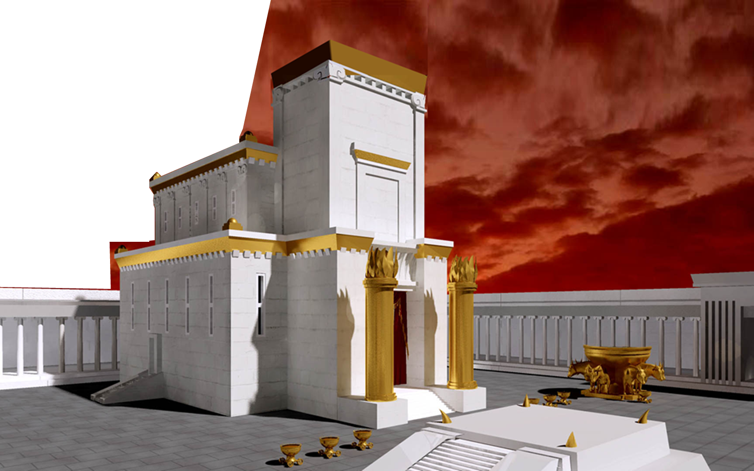
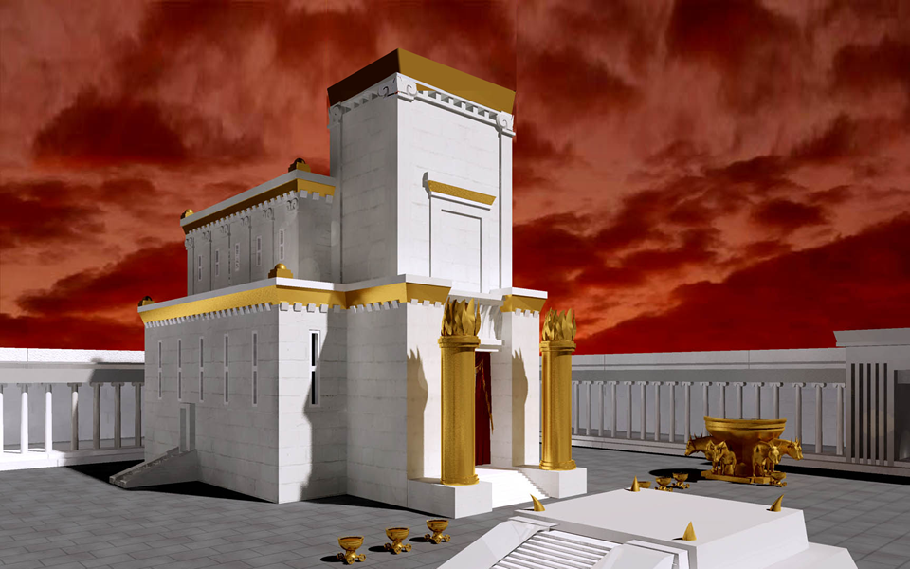
Solomon’s Temple
Notes:
Temple = FREE = from http://commons.wikimedia.org/wiki/File:Jerusalem_temple4.jpg

Slide 35
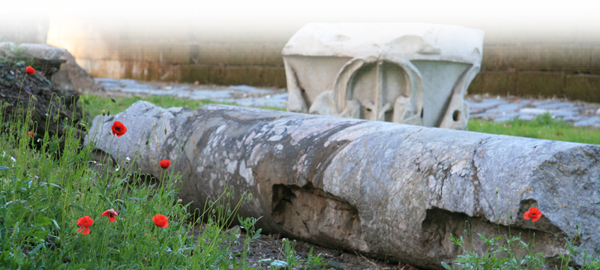
Temple Destroyed 586 BC
Notes:
Fallen Pillar = FREE = from http://www.sxc.hu/browse.phtml?f=download&id=971537

Slide 36
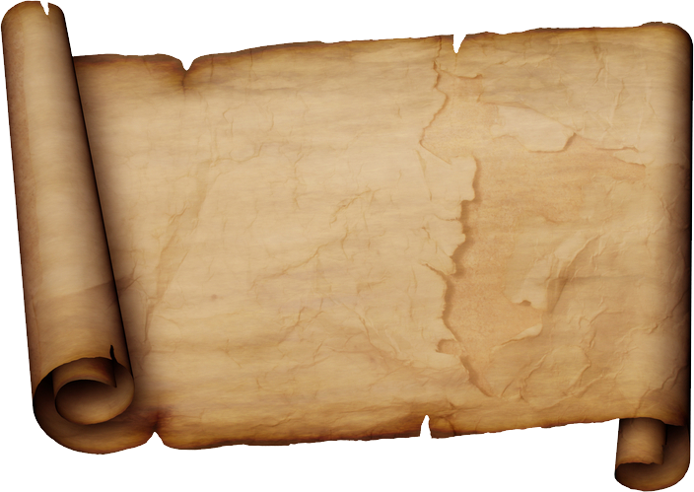
539 BC Cyrus issued a decree to rebuild the temple
Ezra ² "This is what Cyrus king of Persia says: " 'The LORD,
the God of heaven, has given
me all the kingdoms of the
earth and he has appointed
me to build a temple for him
at Jerusalem in Judah….”

Slide 37
Rebuilding started
Ezra 3:8 In the second month of the second year after their arrival at the house of God in Jerusalem, Zerubbabel …, Jeshua … and the rest of their brothers … began the work,

Slide 38
Rebuilding started
¹⁰ When the builders laid the foundation of the temple of the LORD, the priests … sang to the LORD… And all the people gave a great shout of praise to the LORD, because the foundation of the house of the LORD was laid.

Slide 39
Rebuilding started
¹² But many of the older priests and Levites and family heads, who had seen the former temple, wept aloud when they saw the foundation of this temple being laid, while many others shouted for joy.

Slide 40
Rebuilding started
¹³ No one could distinguish the sound of the shouts of joy from the sound of weeping, because the people made so much noise. And the sound was heard far away.

Slide 41
They discouraged the workers
And the work stopped in 536 BC
Now in 520 BC (16 years later)
Haggai asks,
Notes:
Haggai = FREE = from BiblePoint photos

Slide 42
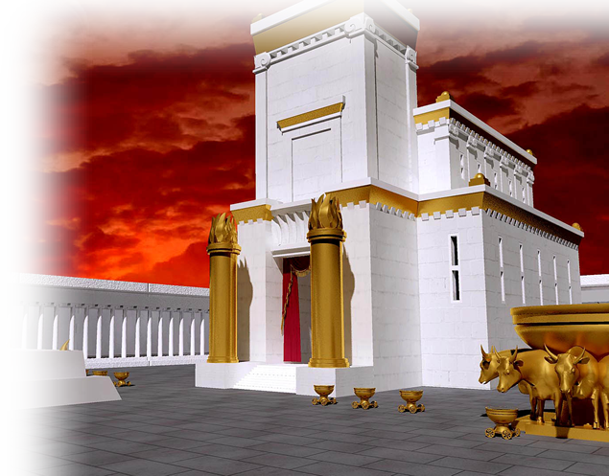
1.Who saw the former temple?
Only those over
66 years old.
Notes:
Solomon’s Temple = FREE = from http://upload.wikimedia.org/wikipedia/commons/7/72/Jerusalem_temple3.jpg

Slide 43
2. How does it look now?
Notes:
Fallen Pillar = FREE = from http://www.sxc.hu/browse.phtml?f=download&id=971537

Slide 44
3. Does it not seem to you like nothing?
ZERO

Slide 45
So how does God respond to the Elderly?
He doesn’t!

Slide 46
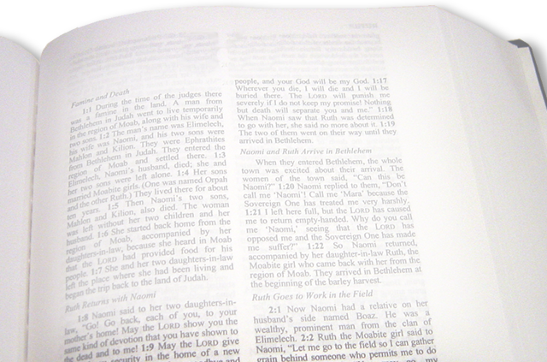
Instead …
⁴ But now be strong, O Zerubbabel,' declares the LORD. 'Be strong, O Joshua son of Jehozadak, the high priest. Be strong, all you people of the land,' declares the LORD,
Notes:
Bible = FREE = from BiblePoint photos

Slide 47
Instead …
⁴ But now be strong, O Zerubbabel,' declares the LORD. 'Be strong, O Joshua son of Jehozadak, the high priest. Be strong, all you people of the land,' declares the LORD, 'and work.
Notes:
Bible = FREE = from BiblePoint photos

Slide 48
Instead …
⁴ But now be strong, O Zerubbabel,' declares the LORD. 'Be strong, O Joshua son of Jehozadak, the high priest. Be strong, all you people of the land,' declares the LORD, 'and work. For I am with you,' declares the LORD Almighty.
Notes:
Bible = FREE = from BiblePoint photos

Slide 49
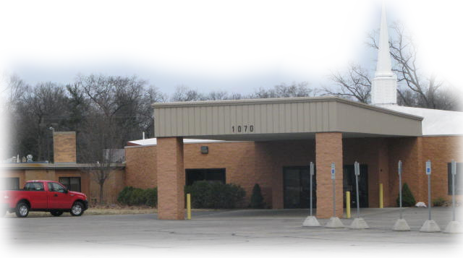
It’s time for change around here as well.
I have a dream…
for worship that attracts the young,
church growth, new outreach, …
Notes:
Church = FREE = from BiblePoint photos

Slide 50
God adds encouragement:
⁵ 'This is what I covenanted with you when you came out of Egypt. And my Spirit remains among you. Do not fear.’
Notes:
Bible = FREE = from BiblePoint photos

Slide 51
So
WHY?

Slide 52
Because God is the God of Change!
And you’ve
not seen anything yet!

Slide 53

God is going to do something in this place …
'In a little while I will once more shake the heavens and the earth, the sea and the dry land. ⁷ I will shake all nations,
Notes:
Earth = FREE = from NASA

Slide 54
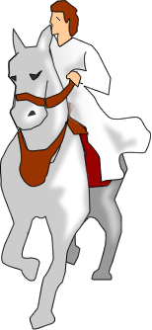
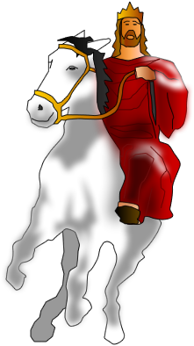
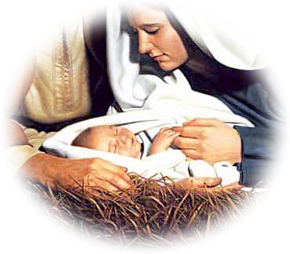
God is going to do something in this place …
and the desired of all nations will come,
Notes:
Jesus Return = FREE = From BiblePoint art

Slide 55



God is going to do something in this place …
and the desired of all nations will come, and I will fill this house with glory,'
Notes:
Jesus on Great White Throne= FREE = From BiblePoint art

Slide 56

He adds …
⁸ 'The silver is mine and the gold is mine,' declares the LORD Almighty.
Notes:
Gold = LICENSED and NOT FOR REUSE. To reuse elsewhere, get a license from http://www.bigstockphoto.com/image-2766296/stock-photo-gold-bars

Slide 57
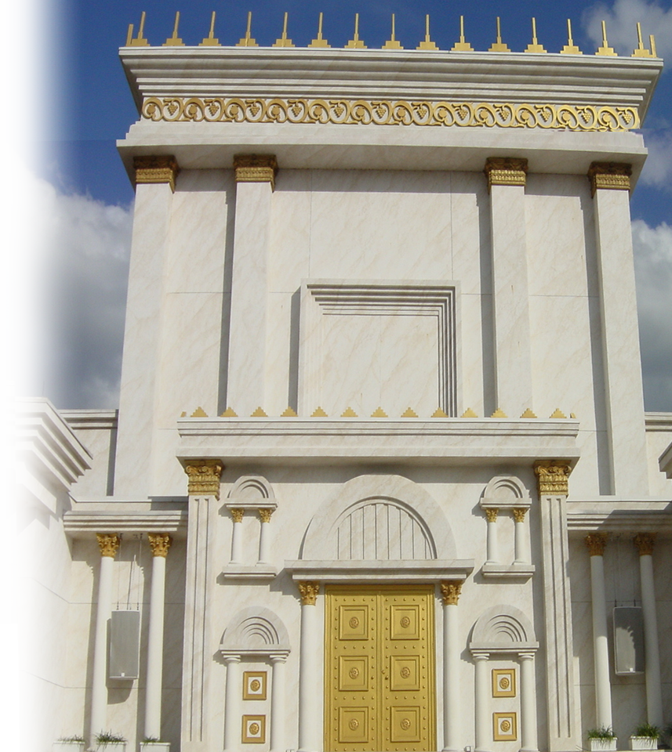
He continues …
⁹ 'The glory of this present house will be greater than the glory of the former house,' says the LORD Almighty.
Notes:
Herod’s Temple = FREE = from BiblePoint photo

Slide 58
For two reasons:
⁹ 'The glory of this present house will be greater than the glory of the former house,' says the LORD Almighty.
Jesus will be in it!
Notes:
Herod’s Temple = FREE = from BiblePoint photo

Slide 59
For two reasons:
'And in this place I will grant peace,' declares the LORD Almighty.”
Real Peace!
Notes:
Herod’s Temple = FREE = from BiblePoint photo

Slide 60
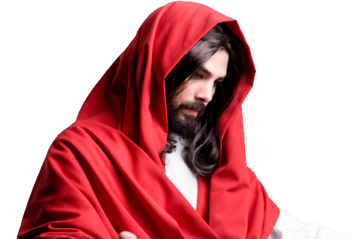
Our glory days are ahead too!
“I will build
my church”
--Jesus
Notes:
Church = FREE = from BiblePoint photos
Jesus = LICENSED and NOT FOR REUSE

Slide 61
So What’s the Point?
God is the God of Change

Slide 64
If God’s in the change …
Don’t fight it…
Embrace it …

