Slide 1
Haggai 1:1-15
“When Times are Tough”
www.BiblePoint.com
2011 © Single Initiative LLC
This lesson and graphics by: D. L. Henderson, D.Min.
User License required to alter this presentation.
Contact dh@biblepoint.com
Copyright©2011
Notes:
Copyright © 2000-2012. All rights reserved. Bible Point is a registered trademark of Single Initiative, LLC. All other trademarks acknowledged.
Bible Point contains graphics from Bible Point artists. These illustrations belong to Bible Point and the respective artists. You can find owner ship in the note view of this presentation. If the graphic is licensed you may not reuse it in any other presentation. You may however go to the source and license it for your self. You may use the designs and illustrations for graphical illustration of lessons free and without special permission, provided they are FREE for reuse and are not used in any way that maligns the Christian faith. Furthermore, republication or production of any illustration by any other graphic service whether it be in book, in a machine-readable form, or in any other design resource is strictly prohibited. Furthermore, they cannot be duplicated or resold as any other form of publishing, clip art, or graphic resource.
So What does it mean? (A simple translations of the legal jargon)
So, if you don’t own the presentation(s), graphic(s), and text(s) how can you legally use them? The purchase of the license allows you to use all the images in the product. However, the actual ownership and copyright of the presentation(s), graphic(s), and text(s) remain the property of Bible Point and its licensors. Therefore, if an image says “LICENSED and NOT FOR REUSE,” you may not copy and reuse it elsewhere without securing a license from the actual owner. If you had plans on using this product in your “for sale” work—think again!
License Agreement
Article 1: License Grant
All the graphics and text in Bible Point presentations (excluding quotes from the Bible and stated sources) are the intellectual and real property of Bible Point and its licensors, and is protected by law, including United States copyright laws and international treaties. Bible Point grants to you a license:
1. To use the presentation in a single church, single school, or single office of a Christian organization.
2. To make a single archival back-up copy of the program.
3. To modify the presentation(s) and merge with other presentations in a single church, school, or Christian organization.
4. To transfer to another party if that party agrees to accept the terms and conditions of this agreement, and you do not retain any copies of the presentation, whether printed, machine readable, modified, or merged form.
Article 2: Terms
This license is effective until terminated. You may terminate the license at any time by destroying the presentation(s), graphic(s), or text(s) together with all copies, modifications and merged portions in any form. Bible Point may terminate your license if you fail to comply with this Agreement. You agree, upon such termination, for any reason, to destroy the presentation(s), graphics, and text(s) with all copies, modifications, and merged portions in any form.
Article 3: Disclaimers
1. Bible Point presentations, graphics, and texts are licensed to you As Is. You, the consumer, bear the entire risk relating to the quality and performance of the presentation(s), graphic(s), or text(s). In no event will Bible Point be liable for damages resulting from any defect.
2. Thirty-day limited warrantee on disks. Bible Point warrants the disks to be free of defects in material and workmanship under normal use for 30 days after purchase. During the 30-day period you may return a defective presentation, graphic, or text with proof of purchase and it will be replaced without charge, unless the presentation is damaged by misuse.
Article 4: General
1. You may not sub-license, assign, or transfer the license of the presentation(s), graphic(s), or text(s) except as provided by this Agreement.
2. This Agreement will be governed by the laws of the State of Michigan.
So What does it mean? (A simple translations of the legal jargon)
May I let someone borrow or copy my licensed Bible Point presentation (even after I modified it)? As long as it is within your local church, or single school, or the immediate office of a Christian organization you may. Otherwise, please refer the person interested in borrowing to: http://www.biblepoint.com or E-mail: dh@biblepoint.com with any related questions.
---------------------------------------------------------------------------------------------------------------------------
Scripture taken from the HOLY BIBLE, NEW INTERNATIONAL VERSION®. NIV®. Copyright©1973, 1978, 1984 by International Bible Society. Used by permission of Zondervan. All rights reserved.

Slide 2
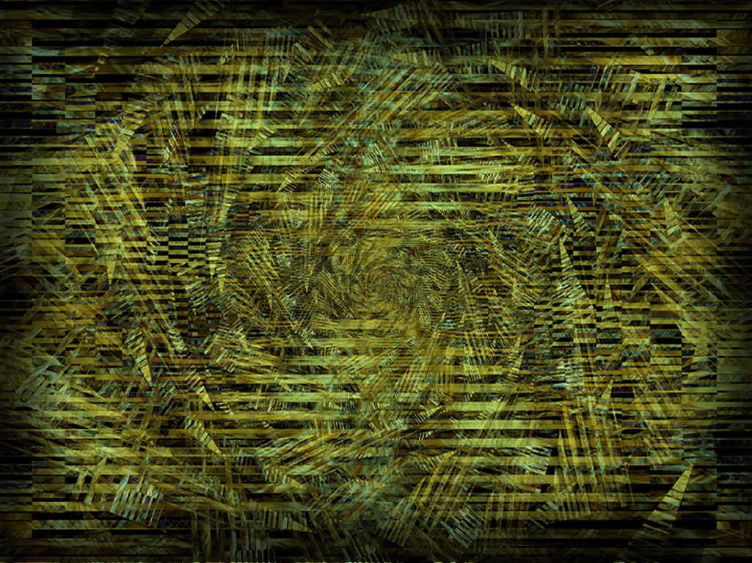
Study in the book of Haggai
Notes:
Background image = FREE = from www.dreamstime.com/free-image.php?imageid=2009251

Slide 3
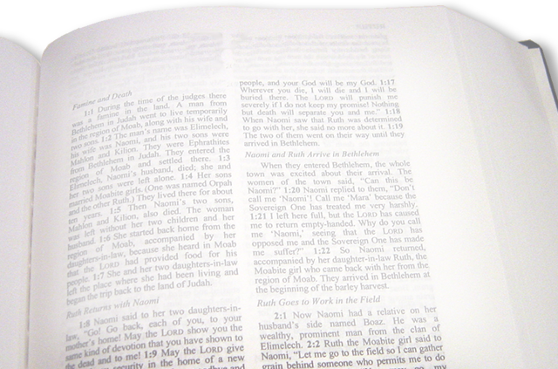
Today’s message took place in the year 520 BC
In the second year of King Darius, on the first day of the sixth month, the word of the LORD came through the prophet Haggai (Haggai 1:1 NIV)
Notes:
Bible = FREE = from BiblePoint photos.

Slide 4
It is so appropriate today …
These things happened to them as examples and were written down as warnings for us, on whom the fulfillment of the ages has come. (1Corinthians 10:11 NIV)
Notes:
Bible = FREE = from BiblePoint photos.

Slide 5
The heart of the message:
“Consider your ways” 1:5(KJV)
“Give careful thought to your ways” (NIV)
“Look what’s happening to you!” (NLT)
“Set your heart on your ways” (DLH)
Self Examination

Slide 6
Consider what was happening:

Slide 7
Consider what was happening:
⁶ You have planted much
Notes:
Planting = FREEE = from http://www.sxc.hu/browse.phtml?f=download&id=428778

Slide 8
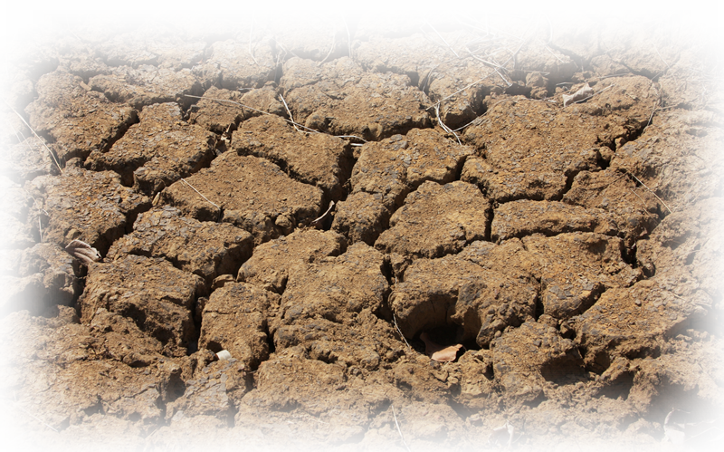
Consider what was happening:
but have harvested little. …
Notes:
Planting = FREEE = from http://www.sxc.hu/browse.phtml?f=download&id=428778
Parched land = FREE = from http://www.sxc.hu/browse.phtml?f=download&id=1210033

Slide 9
Consider what was happening:
You drink, …
Notes:
Pouring water = FREE = from http://commons.wikimedia.org/wiki/File:Stilles_Mineralwasser.jpg

Slide 10
Consider what was happening:
You drink, but never have your fill. …
Notes:
Pouring water = FREE = from http://commons.wikimedia.org/wiki/File:Stilles_Mineralwasser.jpg
Modified Water Gauge = FREE = from http://www.sxc.hu/browse.phtml?f=download&id=1126306

Slide 11
Consider what was happening:
You eat, …
Notes:
Hungry Jacks = FREE =with credit to http://www.flickr.com/photos/pdra/2279526616/

Slide 12
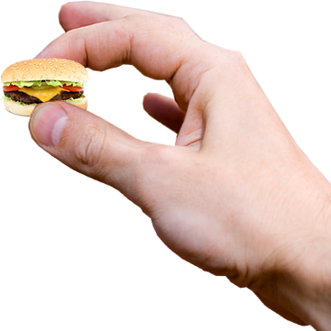
Consider what was happening:
You eat, but never have enough.
Notes:
Hungry Jacks = FREE =with credit to http://www.flickr.com/photos/pdra/2279526616/
Modified hand = FREE = from http://www.dreamstime.com/keys-in-the-hand-stock-photography-imagefree2589062
Burger = FREE = from http://www.sxc.hu/browse.phtml?f=download&id=1097101

Slide 13
Consider what was happening:
You put on clothes,
Notes:
Cold woman = FREE = from http://www.sxc.hu/photo/1330908

Slide 14
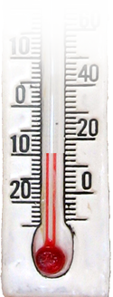
Consider what was happening:
You put on clothes, but are not warm.
Notes:
Cold woman = FREE = from http://www.sxc.hu/photo/1330908
Thermometer = FREE = from http://www.dreamstime.com/decorative-thermometer-free-stock-photography-imagefree691557

Slide 15
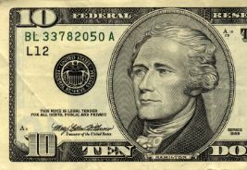
Consider what was happening:
You earn wages,
Notes:
Bill = FREE = from BiblePoint photos

Slide 16
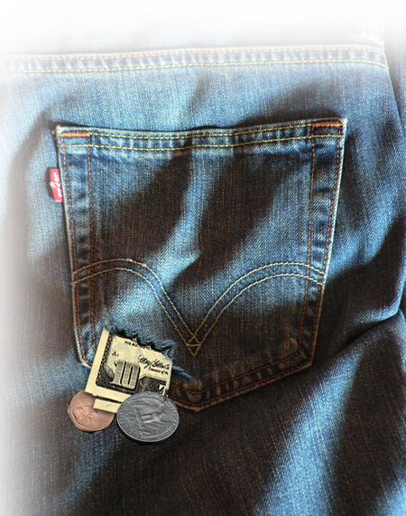
Consider what was happening:
You earn wages, only to put them in a purse with holes in it."
Notes:
Bill = FREE = from BiblePoint photos
Pocket = FREE = from http://commons.wikimedia.org/wiki/File:Levi%27s_506_back_pocket.jpg

Slide 17
Consider what’s happening:

Slide 18
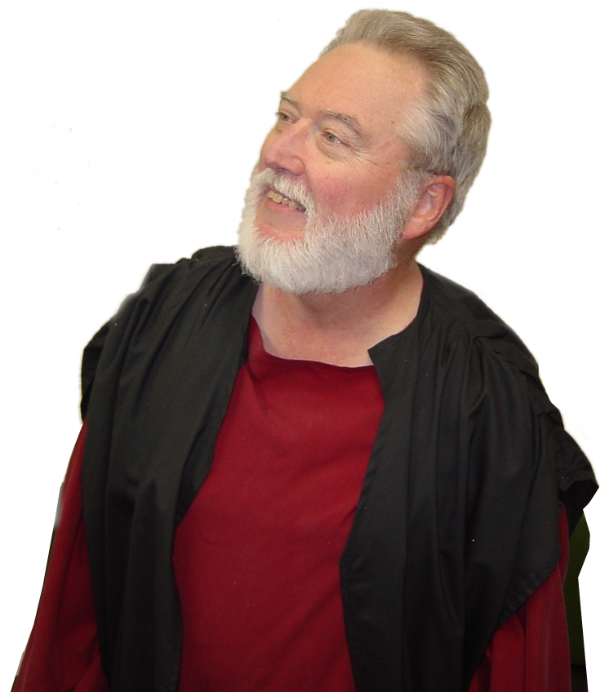
Who needs to consider?
The Preacher 1:1 “… the word of the LORD came through the prophet Haggai to Zerubbabel son of Shealtiel, governor of Judah, and to Joshua son of Jehozadak, the high priest:
Notes:
Haggai = FREE = From BiblePoint photos.

Slide 19
Who needs to consider?
The Politician 1:1 “… the word of the LORD came through the prophet Haggai to Zerubbabel son of Shealtiel, governor of Judah, and to Joshua son of Jehozadak, the high priest:
Notes:
Zerubbabel = FREE = From BiblePoint photos.

Slide 20
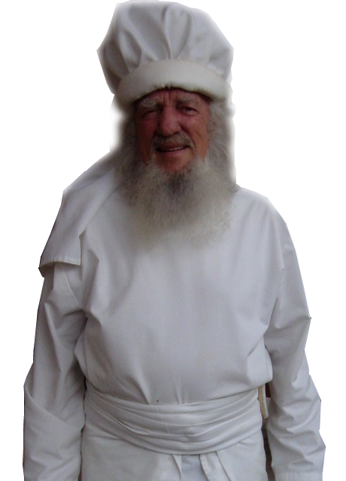
Who needs to consider?
The Priests 1:1 “… the word of the LORD came through the prophet Haggai to Zerubbabel son of Shealtiel, governor of Judah, and to Joshua son of Jehozadak, the high priest:
Notes:
Priest = FREE = From BiblePoint photos.

Slide 21
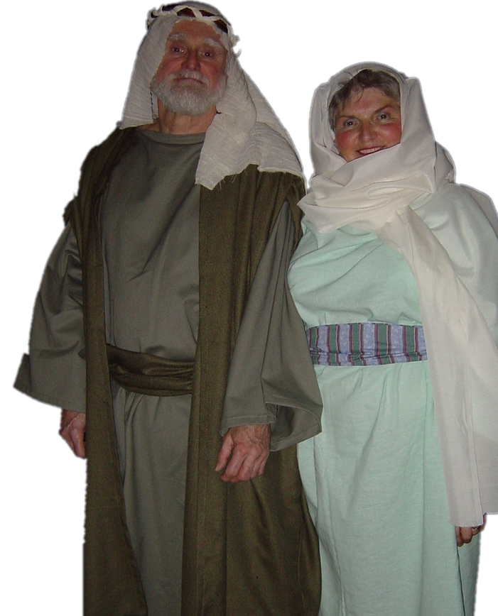
Who needs to consider?
The People 1:2 This is what the LORD Almighty says: "These people say, 'The time has not yet come for the LORD's house to be built.'"
Notes:
People = = FREE = From BiblePoint photos.

Slide 22
What to consider?
Speach 1:2 "These people say, 'The time has not yet come for the LORD's house to be built.'"
Notes:
Clock Tower = FREE = from http://upload.wikimedia.org/wikipedia/commons/5/5e/TSTClockTower.jpg

Slide 23
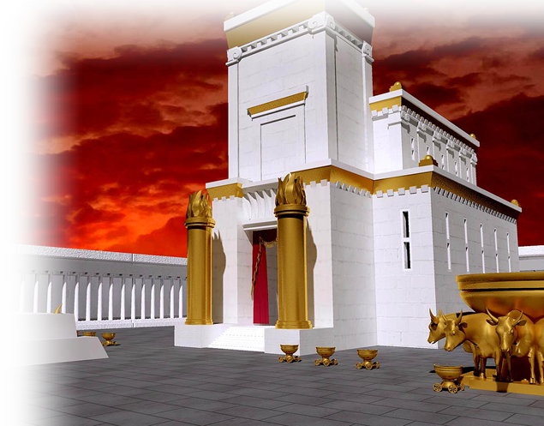
What to consider?
God’s Will 1:2 "These people say, 'The time has not yet come for the LORD's house to be built.'"
Notes:
Solomon’s Temple = FREE = from http://upload.wikimedia.org/wikipedia/commons/7/72/Jerusalem_temple3.jpg

Slide 24
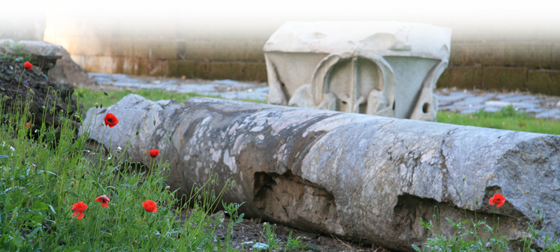
What to consider?
God’s Will 1:2 "These people say, 'The time has not yet come for the LORD's house to be built.'"
Notes:
Fallen Pillar = FREE = from http://www.sxc.hu/browse.phtml?f=download&id=971537

Slide 25
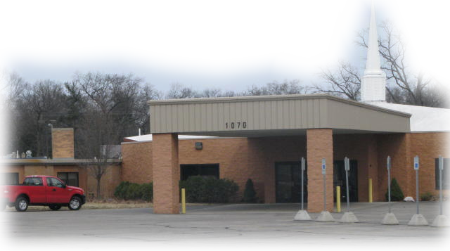
I know what you what
YOU ARE THINKING We have a building!
Notes:
Church Building = FREE = From BiblePoint photos.

Slide 26
Yes, but we need to
PAY FOR IT!
Notes:
Church Building = FREE = From BiblePoint photos.

