Slide 1
Notes:
Background picture of gift = LICENSED AND NOT FOR REUSE ELSEWHERE = To reuse elsewhere get a license from http://www.bigstockphoto.com/download/bid-2252323/
Copyright © 2000-2021. All rights reserved. Bible Point is a registered trademark of Dennis Henderson. All other trademarks acknowledged.
Bible Point contains graphics from Bible Point artists. These illustrations belong to Bible Point and the respective artists. You may use the designs and illustrations for graphical illustration of lessons free and without special permission, provided they are not used in any way that maligns the Christian faith. Furthermore, republication or production of any illustration by any other graphic service whether it be in book, in a machine-readable form, or in any other design resource is strictly prohibited. Furthermore, they cannot be duplicated or resold as any other form of publishing, clip art, or graphic resource.
So What does it mean? (A simple translations of the legal jargon)
So, if you don’t own the presentation(s), graphic(s), and text(s) how can you legally use them? The purchase of the license allows you to use all the images in the product. However, the actual ownership and copyright of the presentation(s), graphic(s), and text(s) remain the property of Bible Point and its licensors. If you had plans on using this product in your “for sale” work—think again!
License Agreement
Article 1: License Grant
All the graphics and text in Bible Point presentations (excluding quotes from the Bible and stated sources) are the intellectual and real property of Bible Point and its licensors, and is protected by law, including United States copyright laws and international treaties. Bible Point grants to you a license:
1. To use the presentation in a single church, single school, or single office of a Christian organization.
2. To make a single archival back-up copy of the program.
3. To modify the presentation(s) and merge with other presentations in a single church, school, or Christian organization.
4. To transfer to another party if that party agrees to accept the terms and conditions of this agreement, and you do not retain any copies of the presentation, whether printed, machine readable, modified, or merged form.
Article 2: Terms
This license is effective until terminated. You may terminate the license at any time by destroying the presentation(s), graphic(s), or text(s) together with all copies, modifications and merged portions in any form. Bible Point may terminate your license if you fail to comply with this Agreement. You agree, upon such termination, for any reason, to destroy the presentation(s), graphics, and text(s) with all copies, modifications, and merged portions in any form.
Article 3: Disclaimers
1. Bible Point presentations, graphics, and texts are licensed to you As Is. You, the consumer, bear the entire risk relating to the quality and performance of the presentation(s), graphic(s), or text(s). In no event will Bible Point be liable for damages resulting from any defect.
2. Thirty-day limited warrantee on disks. Bible Point warrants the disks to be free of defects in material and workmanship under normal use for 30 days after purchase. During the 30-day period you may return a defective presentation, graphic, or text with proof of purchase and it will be replaced without charge, unless the presentation is damaged by misuse.
Article 4: General
1. You may not sub-license, assign, or transfer the license of the presentation(s), graphic(s), or text(s) except as provided by this Agreement.
2. This Agreement will be governed by the laws of the State of Michigan.
So What does it mean? (A simple translations of the legal jargon)
May I let someone borrow or copy my licensed Bible Point presentation (even after I modified it)? As long as it is within your local church, or single school, or the immediate office of a Christian organization you may. Otherwise, please refer the person interested in borrowing to: http://www.biblepoint.com or E-mail: dh@biblepoint.com with any related questions.
---------------------------------------------------------------------------------------------------------------------------
Scripture taken from the HOLY BIBLE, NEW INTERNATIONAL VERSION®. NIV®. Copyright©1973, 1978, 1984 by International Bible Society. Used by permission of Zondervan. All rights reserved.

Slide 2
The New Creation!
Notes:
Background picture of gift = LICENSED AND NOT FOR REUSE ELSEWHERE = To reuse elsewhere get a license from http://www.bigstockphoto.com/download/bid-2252323/
The New Creation is what really

Slide 3
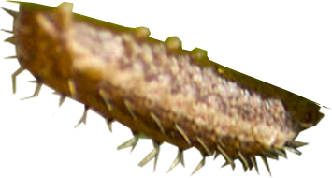
The New Creation really matters
¹⁵ ... what counts is a new creation.
Notes:
Caterpillar = FREE = from http://commons.wikimedia.org/wiki/File:Spring_Azure_Butterfly_with_a_caterpillar.jpg
Cocoon = FREE = from http://commons.wikimedia.org/wiki/File:Silkworm_%26_cocoon.jpg
Butterfly = FREE = from http://upload.wikimedia.org/wikipedia/commons/thumb/5/55/Viceroy_Butterfly.jpg/775px-Viceroy_Butterfly.jpg
The word of God tells us that God transforms our lives. He does so by GRACE – an unmerited gift.
I call it the cocoon of GRACE. I had an old life (a caterpillar life), I went into the cocoon of Grace, and came out a beautiful butterfly.
Paul has been arguing in Galatians – don’t go back to the caterpillar life. Fly like a butterfly.
I know that modern psychology teaches to go back to suppressed feeling from your past and deal with them, dredge them up, and deal with them. And some “Christian counselors” teach the same. But the GRACE of God teaches us that we just don’t live there any more. I am very leery of those who want to dredge up past sins that the blood of Jesus and the grace of God has already dealt with.
Listen, My life verse is this, forgetting that which is behind and pressing on to that which is before, I press toward the mark for the prize of the high calling in Christ Jesus (Phil 3:13-14).
Don’t go back to the caterpillar life. You are a butterfly. Forget the past and move on with Jesus to that which is before.

Slide 4
The New Creation really matters
¹⁵ ... what counts is a new creation.
Therefore, if anyone is in Christ, he is a new creation; the old has gone, the new has come! 2 Corinthians 5:17
Notes:
Caterpillar = FREE = from http://commons.wikimedia.org/wiki/File:Spring_Azure_Butterfly_with_a_caterpillar.jpg
Cocoon = FREE = from http://commons.wikimedia.org/wiki/File:Silkworm_%26_cocoon.jpg
Butterfly = FREE = from http://upload.wikimedia.org/wikipedia/commons/thumb/5/55/Viceroy_Butterfly.jpg/775px-Viceroy_Butterfly.jpg
The word of God tells us that God transforms our lives. He does so by GRACE – an unmerited gift.
I call it the cocoon of GRACE. I had an old life (a caterpillar life), I went into the cocoon of Grace, and came out a beautiful butterfly.
Paul has been arguing in Galatians – don’t go back to the caterpillar life. Fly like a butterfly.
I know that modern psychology teaches to go back to suppressed feeling from your past and deal with them, dredge them up, and deal with them. And some “Christian counselors” teach the same. But the GRACE of God teaches us that we just don’t live there any more. I am very leery of those who want to dredge up past sins that the blood of Jesus and the grace of God has already dealt with.
Listen, My life verse is this, forgetting that which is behind and pressing on to that which is before, I press toward the mark for the prize of the high calling in Christ Jesus (Phil 3:13-14).
Don’t go back to the caterpillar life. You are a butterfly. Forget the past and move on with Jesus to that which is before.

Slide 5
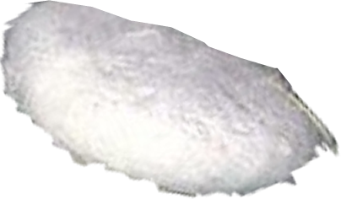
The New Creation really matters
¹⁵ ... what counts is a new creation.
Therefore, if anyone is in Christ, he is a new creation; the old has gone, the new has come! 2 Corinthians 5:17
Notes:
Caterpillar = FREE = from http://commons.wikimedia.org/wiki/File:Spring_Azure_Butterfly_with_a_caterpillar.jpg
Cocoon = FREE = from http://commons.wikimedia.org/wiki/File:Silkworm_%26_cocoon.jpg
Butterfly = FREE = from http://upload.wikimedia.org/wikipedia/commons/thumb/5/55/Viceroy_Butterfly.jpg/775px-Viceroy_Butterfly.jpg
The word of God tells us that God transforms our lives. He does so by GRACE – an unmerited gift.
I call it the cocoon of GRACE. I had an old life (a caterpillar life), I went into the cocoon of Grace, and came out a beautiful butterfly.
Paul has been arguing in Galatians – don’t go back to the caterpillar life. Fly like a butterfly.
I know that modern psychology teaches to go back to suppressed feeling from your past and deal with them, dredge them up, and deal with them. And some “Christian counselors” teach the same. But the GRACE of God teaches us that we just don’t live there any more. I am very leery of those who want to dredge up past sins that the blood of Jesus and the grace of God has already dealt with.
Listen, My life verse is this, forgetting that which is behind and pressing on to that which is before, I press toward the mark for the prize of the high calling in Christ Jesus (Phil 3:13-14).
Don’t go back to the caterpillar life. You are a butterfly. Forget the past and move on with Jesus to that which is before.

Slide 6
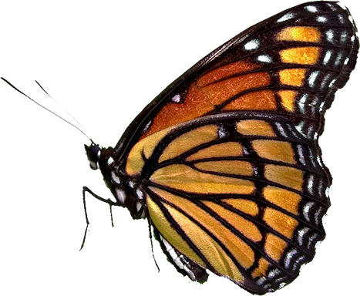
The New Creation really matters
¹⁵ ... what counts is a new creation.
Therefore, if anyone is in Christ, he is a new creation; the old has gone, the new has come! 2 Corinthians 5:17
Notes:
Caterpillar = FREE = from http://commons.wikimedia.org/wiki/File:Spring_Azure_Butterfly_with_a_caterpillar.jpg
Cocoon = FREE = from http://commons.wikimedia.org/wiki/File:Silkworm_%26_cocoon.jpg
Butterfly = FREE = from http://upload.wikimedia.org/wikipedia/commons/thumb/5/55/Viceroy_Butterfly.jpg/775px-Viceroy_Butterfly.jpg
The word of God tells us that God transforms our lives. He does so by GRACE – an unmerited gift.
I call it the cocoon of GRACE. I had an old life (a caterpillar life), I went into the cocoon of Grace, and came out a beautiful butterfly.
Paul has been arguing in Galatians – don’t go back to the caterpillar life. Fly like a butterfly.
I know that modern psychology teaches to go back to suppressed feeling from your past and deal with them, dredge them up, and deal with them. And some “Christian counselors” teach the same. But the GRACE of God teaches us that we just don’t live there any more. I am very leery of those who want to dredge up past sins that the blood of Jesus and the grace of God has already dealt with.
Listen, My life verse is this, forgetting that which is behind and pressing on to that which is before, I press toward the mark for the prize of the high calling in Christ Jesus (Phil 3:13-14).
Don’t go back to the caterpillar life. You are a butterfly. Forget the past and move on with Jesus to that which is before.

Slide 7
It matters so much we should

Slide 8
Personally Defend It
¹¹ See what large letters I use as I write to you with my own hand!
Notes:
Chapter 1– Any other gospel -- let him be accused
Chapter 2 – I have been crucified with Christ
Chapter 3 – Who has bewitched you
Chapter 4—God sent his son to redeem you
Chapter 5—It is for freedom that Christ set us free
Chapter 6—The New Creation is what really matters

Slide 9
Personally Defend It
Ch 1– Any other gospel -- let him be accused
¹¹ See what large letters I use as I write to you with my own hand!
Notes:
Chapter 1– Any other gospel -- let him be accused
Chapter 2 – I have been crucified with Christ
Chapter 3 – Who has bewitched you
Chapter 4—God sent his son to redeem you
Chapter 5—It is for freedom that Christ set us free
Chapter 6—The New Creation is what really matters

Slide 10
Personally Defend It
Ch 1– Any other gospel -- let him be accused
Ch 2 – I have been crucified with Christ
¹¹ See what large letters I use as I write to you with my own hand!
Notes:
Chapter 1– Any other gospel -- let him be accused
Chapter 2 – I have been crucified with Christ
Chapter 3 – Who has bewitched you
Chapter 4—God sent his son to redeem you
Chapter 5—It is for freedom that Christ set us free
Chapter 6—The New Creation is what really matters

Slide 11
Personally Defend It
Ch 1– Any other gospel -- let him be accused
Ch 2 – I have been crucified with Christ
Ch 3 – Who has bewitched you
¹¹ See what large letters I use as I write to you with my own hand!
Notes:
Chapter 1– Any other gospel -- let him be accused
Chapter 2 – I have been crucified with Christ
Chapter 3 – Who has bewitched you
Chapter 4—God sent his son to redeem you
Chapter 5—It is for freedom that Christ set us free
Chapter 6—The New Creation is what really matters

Slide 12
Personally Defend It
Ch 1– Any other gospel -- let him be accused
Ch 2 – I have been crucified with Christ
Ch 3 – Who has bewitched you
Ch 4—God sent his son to redeem you
¹¹ See what large letters I use as I write to you with my own hand!
Notes:
Chapter 1– Any other gospel -- let him be accused
Chapter 2 – I have been crucified with Christ
Chapter 3 – Who has bewitched you
Chapter 4—God sent his son to redeem you
Chapter 5—It is for freedom that Christ set us free
Chapter 6—The New Creation is what really matters

Slide 13
Personally Defend It
Ch 1– Any other gospel -- let him be accused
Ch 2 – I have been crucified with Christ
Ch 3 – Who has bewitched you
Ch 4—God sent his son to redeem you
Ch 5—It is for freedom that Christ set us free
¹¹ See what large letters I use as I write to you with my own hand!
Notes:
Chapter 1– Any other gospel -- let him be accused
Chapter 2 – I have been crucified with Christ
Chapter 3 – Who has bewitched you
Chapter 4—God sent his son to redeem you
Chapter 5—It is for freedom that Christ set us free
Chapter 6—The New Creation is what really matters

Slide 14
Personally Defend It
Ch 1– Any other gospel -- let him be accused
Ch 2 – I have been crucified with Christ
Ch 3 – Who has bewitched you
Ch 4—God sent his son to redeem you
Ch 5—It is for freedom that Christ set us free
Ch 6—The New Creation is what really matters
¹¹ See what large letters I use as I write to you with my own hand!
Notes:
Chapter 1– Any other gospel -- let him be accused
Chapter 2 – I have been crucified with Christ
Chapter 3 – Who has bewitched you
Chapter 4—God sent his son to redeem you
Chapter 5—It is for freedom that Christ set us free
Chapter 6—The New Creation is what really matters

Slide 15
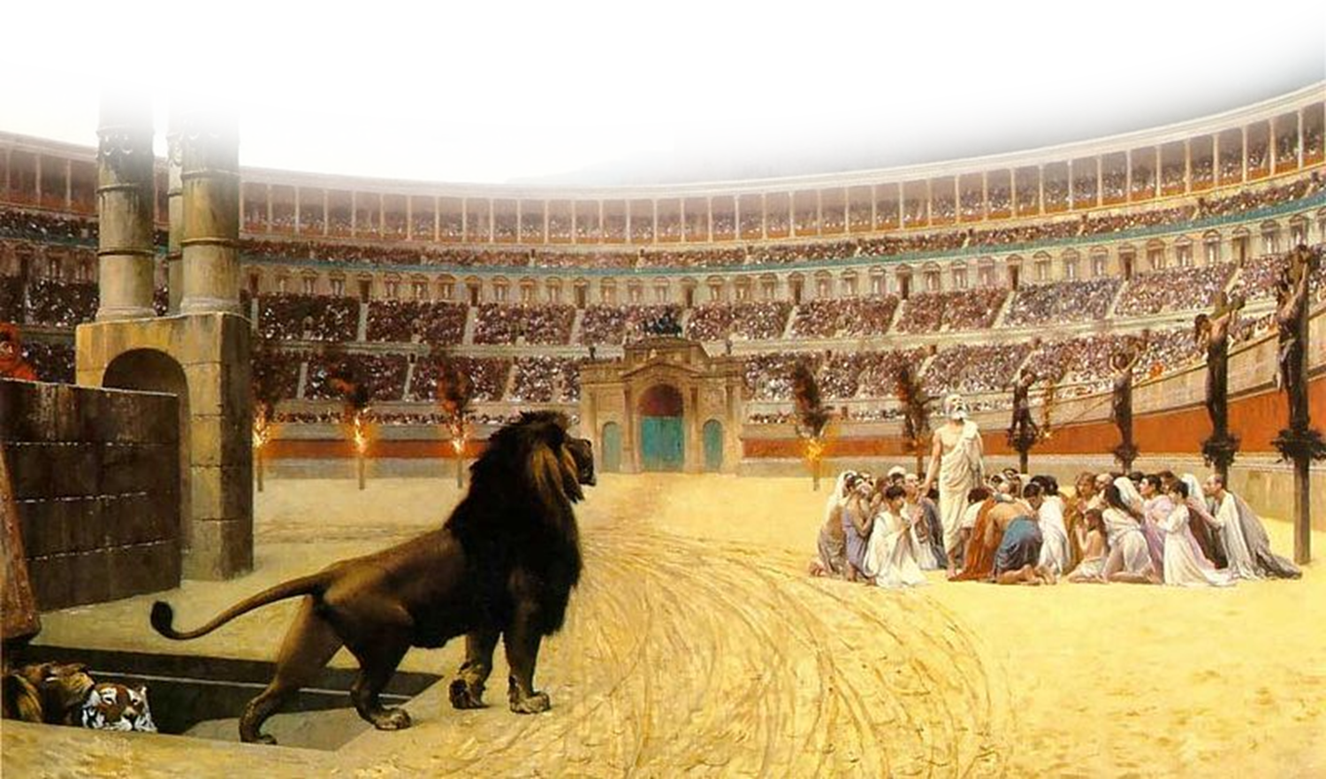
Suffer Persecution for It
¹² Those who want to make a good impression outwardly are trying to compel you to be circumcised. The only reason they do this is to avoid being persecuted for the cross of Christ.

Slide 16
Suffer Persecution for It
¹² Those who want to make a good impression outwardly are trying to compel you to be circumcised. The only reason they do this is to avoid being persecuted for the cross of Christ.
... everyone who wants to live a godly life in Christ Jesus will be persecuted, 2 Tim 3:12
Notes:
Being a Christian is not for sissies.

Slide 17
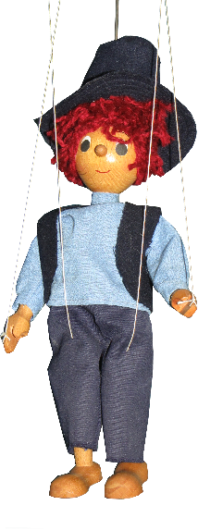
Not Be Manipulated From It
¹³ Not even those who are circumcised obey the law, yet they want you to be circumcised that they may boast about your flesh.
Notes:
Christian martyrs = FREE = from http://commons.wikimedia.org/wiki/File:The_Christian_Martyrs_Last_Prayer.jpg

Slide 18
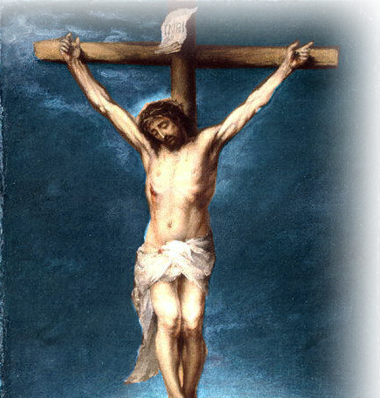
Focus on the Basis of It
¹⁴ May I never boast except in the cross of our Lord Jesus Christ,
Notes:
John 3:16 He died for the world

Slide 19
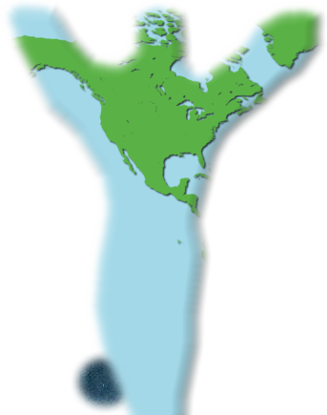
Focus on the Basis of It
¹⁴ May I never boast except in the cross of our Lord Jesus Christ, through which the world has been crucified to me,
Notes:
So the World is crucified with regard to me – since Jesus’ death s reckoned to be my death.

Slide 20
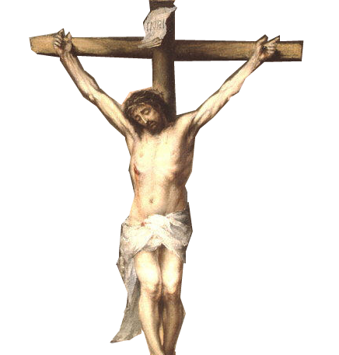
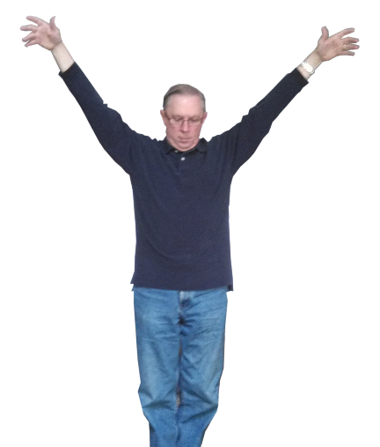
Focus on the Basis of It
¹⁴ May I never boast except in the cross of our Lord Jesus Christ, through which the world has been crucified to me, and I to the world.

Slide 21
Realize It’s All that Matters
¹⁵ Neither circumcision nor uncircumcision means anything; what counts is a new creation.

Slide 22
Realize It’s All that Matters
¹⁵ Neither circumcision nor uncircumcision means anything; what counts is a new creation.
WHY IS THIS ALL THAT MATTERS?

Slide 23
Because with it comes

Slide 24
Because with it comes
New Birth John 3:3,5

Slide 25
Because with it comes
New Birth John 3:3,5
New Life Romans 6:4

Slide 26
Because with it comes
New Birth John 3:3,5
New Life Romans 6:4
New Man Eph 2:15

Slide 27
Because with it comes
New Birth John 3:3,5
New Life Romans 6:4
New Man Eph 2:15
New Attitude Eph 4:23

Slide 28
Because with it comes
New Birth John 3:3,5
New Life Romans 6:4
New Man Eph 2:15
New Attitude Eph 4:23
New Self Eph 4:24

Slide 29
Because with it comes
New Birth John 3:3,5
New Life Romans 6:4
New Man Eph 2:15
New Attitude Eph 4:23
New Self Eph 4:24
New Covenant Heb 9:15

Slide 30
Because with it comes
New Birth John 3:3,5
New Life Romans 6:4
New Man Eph 2:15
New Attitude Eph 4:23
New Self Eph 4:24
New Covenant Heb 9:15
New Way Heb 10:20

Slide 31
Because with it comes
New Birth John 3:3,5
New Life Romans 6:4
New Man Eph 2:15
New Attitude Eph 4:23
New Self Eph 4:24
New Covenant Heb 9:15
New Way Heb 10:20
New Name Rev 2:17

Slide 32
Because with it comes
New Birth John 3:3,5
New Life Romans 6:4
New Man Eph 2:15
New Attitude Eph 4:23
New Self Eph 4:24
New Covenant Heb 9:15
New Way Heb 10:20
New Name Rev 2:17
New Song Rev 5:9

Slide 33
Because with it comes
New Birth John 3:3,5
New Life Romans 6:4
New Man Eph 2:15
New Attitude Eph 4:23
New Self Eph 4:24
New Covenant Heb 9:15
New Way Heb 10:20
New Name Rev 2:17
New Song Rev 5:9
New Home Rev 21:1,2

Slide 34
Because with it comes
New Birth John 3:3,5
New Life Romans 6:4
New Man Eph 2:15
New Attitude Eph 4:23
New Self Eph 4:24
New Covenant Heb 9:15
New Way Heb 10:20
New Name Rev 2:17
New Song Rev 5:9
New Home Rev 21:1,2
New Everything Rev 21:5

Slide 35
Because with it comes
New Birth John 3:3,5
New Life Romans 6:4
New Man Eph 2:15
New Attitude Eph 4:23
New Self Eph 4:24
New Covenant Heb 9:15
New Way Heb 10:20
New Name Rev 2:17
New Song Rev 5:9
New Home Rev 21:1,2
New Everything Rev 21:5
With Jesus Everything Changes!

Slide 36
Because with it comes
New Birth John 3:3,5
New Life Romans 6:4
New Man Eph 2:15
New Attitude Eph 4:23
New Self Eph 4:24
New Covenant Heb 9:15
New Way Heb 10:20
New Name Rev 2:17
New Song Rev 5:9
New Home Rev 21:1,2
New Everything Rev 21:5
Without Jesus You’ve Got NOTHING!

Slide 37
Paul’s Final Words

Slide 38
Final Blessing
¹⁶ Peace and mercy to all who follow this rule, even to the Israel of God.

Slide 39
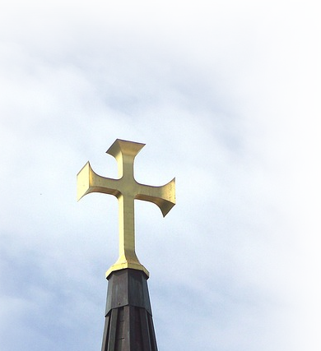
Final Blessing
¹⁶ Peace and mercy to all who follow this rule, even to the Israel of God.
Notes:
Peace clouds = NOT FOR REUSE = http://www.flickr.com/photos/snapies/3934856469/sizes/l/in/photostream/
Cross Steeple = FREE = Public Domain = http://pixabay.com/en/gold-cross-steeple-sky-clouds-70936/

Slide 40
Final Blessing
¹⁶ Peace and mercy to all who follow this rule, even to the Israel of God.
Notes:
Peace clouds = NOT FOR REUSE = http://www.flickr.com/photos/snapies/3934856469/sizes/l/in/photostream/
Cross Steeple = FREE = Public Domain = http://pixabay.com/en/gold-cross-steeple-sky-clouds-70936/

Slide 41
Final Blessing
AND
¹⁶ Peace and mercy to all who follow this rule, even to the Israel of God.
Notes:
Peace clouds = NOT FOR REUSE = http://www.flickr.com/photos/snapies/3934856469/sizes/l/in/photostream/
Cross Steeple = FREE = Public Domain = http://pixabay.com/en/gold-cross-steeple-sky-clouds-70936/

Slide 42
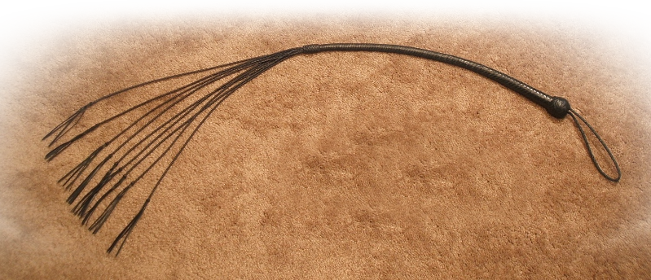
Final Appeal
¹⁷ Finally, let no one cause me trouble, for I bear on my body the marks of Jesus.
Notes:
Cat of Nine Tails whip = FREE = from http://upload.wikimedia.org/wikipedia/commons/e/e5/Cat_o%27_nine.JPG
Rod = FREE = from http://commons.wikimedia.org/wiki/File:Hot-rods_sticks_tipper_hinnerk-ruemenapf.jpg

Slide 43
Final Appeal
¹⁷ Finally, let no one cause me trouble, for I bear on my body the marks of Jesus.
Notes:
Cat of Nine Tails whip = FREE = from http://upload.wikimedia.org/wikipedia/commons/e/e5/Cat_o%27_nine.JPG
Rod = FREE = from http://commons.wikimedia.org/wiki/File:Hot-rods_sticks_tipper_hinnerk-ruemenapf.jpg

Slide 44
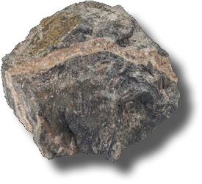
Final Appeal
¹⁷ Finally, let no one cause me trouble, for I bear on my body the marks of Jesus.
Notes:
Cat of Nine Tails whip = FREE = from http://upload.wikimedia.org/wikipedia/commons/e/e5/Cat_o%27_nine.JPG
Rod = FREE = from http://commons.wikimedia.org/wiki/File:Hot-rods_sticks_tipper_hinnerk-ruemenapf.jpg

Slide 45
Final Appeal
¹⁷ Finally, let no one cause me trouble, for I bear on my body the marks of Jesus.
See 2 Cor. 11:21-33
Notes:
Cat of Nine Tails whip = FREE = from http://upload.wikimedia.org/wikipedia/commons/e/e5/Cat_o%27_nine.JPG
Rod = FREE = from http://commons.wikimedia.org/wiki/File:Hot-rods_sticks_tipper_hinnerk-ruemenapf.jpg

Slide 46
Final Gift
¹⁸ The grace of our Lord Jesus Christ be with your spirit, brothers. Amen.

Slide 47
Let’s sum it up
God’s Grace is nothing short of ...

Slide 48
Let’s Pray!

