Slide 1
Notes:
Background picture of gift = LICENSED AND NOT FOR REUSE ELSEWHERE = To reuse elsewhere get a license from http://www.bigstockphoto.com/download/bid-2252323/
Copyright © 2000-2021. All rights reserved. Bible Point is a registered trademark of Dennis Henderson. All other trademarks acknowledged.
Bible Point contains graphics from Bible Point artists. These illustrations belong to Bible Point and the respective artists. You may use the designs and illustrations for graphical illustration of lessons free and without special permission, provided they are not used in any way that maligns the Christian faith. Furthermore, republication or production of any illustration by any other graphic service whether it be in book, in a machine-readable form, or in any other design resource is strictly prohibited. Furthermore, they cannot be duplicated or resold as any other form of publishing, clip art, or graphic resource.
So What does it mean? (A simple translations of the legal jargon)
So, if you don’t own the presentation(s), graphic(s), and text(s) how can you legally use them? The purchase of the license allows you to use all the images in the product. However, the actual ownership and copyright of the presentation(s), graphic(s), and text(s) remain the property of Bible Point and its licensors. If you had plans on using this product in your “for sale” work—think again!
License Agreement
Article 1: License Grant
All the graphics and text in Bible Point presentations (excluding quotes from the Bible and stated sources) are the intellectual and real property of Bible Point and its licensors, and is protected by law, including United States copyright laws and international treaties. Bible Point grants to you a license:
1. To use the presentation in a single church, single school, or single office of a Christian organization.
2. To make a single archival back-up copy of the program.
3. To modify the presentation(s) and merge with other presentations in a single church, school, or Christian organization.
4. To transfer to another party if that party agrees to accept the terms and conditions of this agreement, and you do not retain any copies of the presentation, whether printed, machine readable, modified, or merged form.
Article 2: Terms
This license is effective until terminated. You may terminate the license at any time by destroying the presentation(s), graphic(s), or text(s) together with all copies, modifications and merged portions in any form. Bible Point may terminate your license if you fail to comply with this Agreement. You agree, upon such termination, for any reason, to destroy the presentation(s), graphics, and text(s) with all copies, modifications, and merged portions in any form.
Article 3: Disclaimers
1. Bible Point presentations, graphics, and texts are licensed to you As Is. You, the consumer, bear the entire risk relating to the quality and performance of the presentation(s), graphic(s), or text(s). In no event will Bible Point be liable for damages resulting from any defect.
2. Thirty-day limited warrantee on disks. Bible Point warrants the disks to be free of defects in material and workmanship under normal use for 30 days after purchase. During the 30-day period you may return a defective presentation, graphic, or text with proof of purchase and it will be replaced without charge, unless the presentation is damaged by misuse.
Article 4: General
1. You may not sub-license, assign, or transfer the license of the presentation(s), graphic(s), or text(s) except as provided by this Agreement.
2. This Agreement will be governed by the laws of the State of Michigan.
So What does it mean? (A simple translations of the legal jargon)
May I let someone borrow or copy my licensed Bible Point presentation (even after I modified it)? As long as it is within your local church, or single school, or the immediate office of a Christian organization you may. Otherwise, please refer the person interested in borrowing to: http://www.biblepoint.com or E-mail: dh@biblepoint.com with any related questions.
---------------------------------------------------------------------------------------------------------------------------
Scripture taken from the HOLY BIBLE, NEW INTERNATIONAL VERSION®. NIV®. Copyright©1973, 1978, 1984 by International Bible Society. Used by permission of Zondervan. All rights reserved.

Slide 2
FAMILY!
Notes:
Background picture of gift = LICENSED AND NOT FOR REUSE ELSEWHERE = To reuse elsewhere get a license from http://www.bigstockphoto.com/download/bid-2252323/

Slide 3
Basic Premise:
Sooner or later someone in the family will go the ...
Notes:
Wrong way sign = FREE = from http://commons.wikimedia.org/wiki/File:WrongWaySign.jpg

Slide 4
Basic Premise:
Sooner or later someone in the family will go the ...
Notes:
Wrong way sign = FREE = from http://commons.wikimedia.org/wiki/File:WrongWaySign.jpg

Slide 5
Basic Premise:
Sooner or later someone in the family will go the ...
6:1 Brothers, if someone is caught in a sin,
Notes:
Wrong way sign = FREE = from http://commons.wikimedia.org/wiki/File:WrongWaySign.jpg

Slide 6
How do you love your family when your family has gone the
Sooner or later someone in the family will go the ...
6:1 Brothers, if someone is caught in a sin,
Notes:
Wrong way sign = FREE = from http://commons.wikimedia.org/wiki/File:WrongWaySign.jpg

Slide 7
RESTORE Family–if you can!
Notes:
67 Olds = FREE = from http://www.streetlegaltv.com/news/half-restored-%E2%80%9Ctwo-face%E2%80%9D-67-oldsmobile-toranado/

Slide 8
RESTORE Family–if you can!
¹ Brothers, if someone is caught in a sin, you who are spiritual should restore him gently. But watch yourself, or you also may be tempted.
Notes:
67 Olds = FREE = from http://www.streetlegaltv.com/news/half-restored-%E2%80%9Ctwo-face%E2%80%9D-67-oldsmobile-toranado/

Slide 9
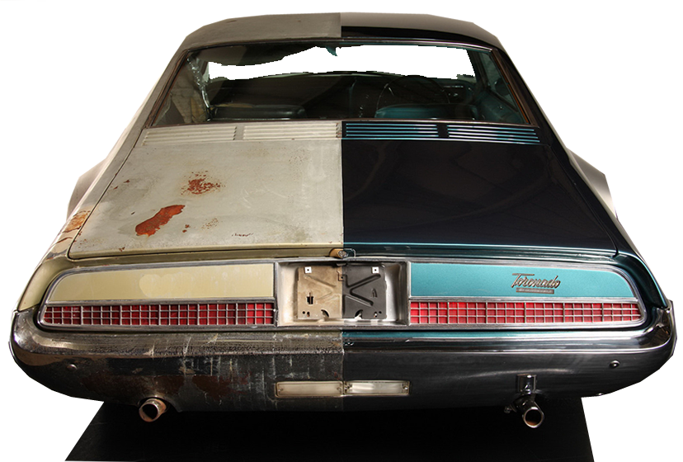
RESTORE Family–if you can!
¹ Brothers, if someone is caught in a sin, you who are spiritual should restore him gently. But watch yourself, or you also may be tempted.
Before
After
Notes:
67 Olds = FREE = from http://www.streetlegaltv.com/news/half-restored-%E2%80%9Ctwo-face%E2%80%9D-67-oldsmobile-toranado/

Slide 10
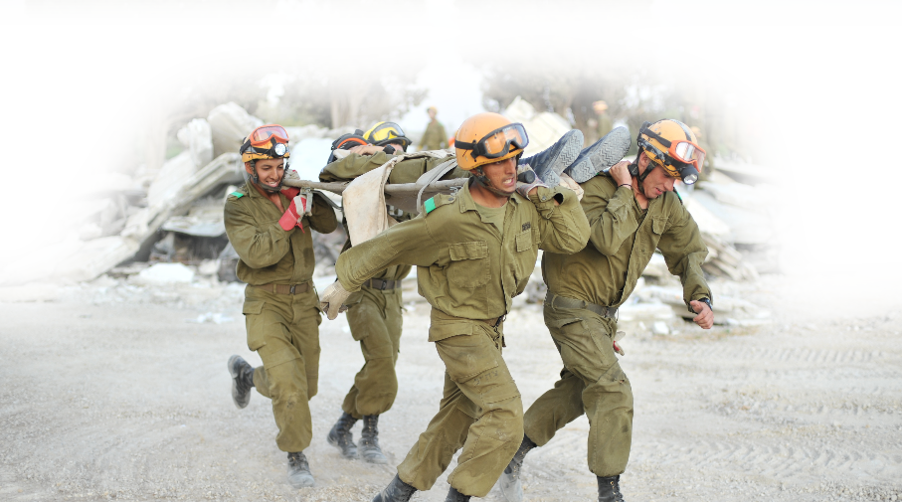
CARRY the Load–if you can!
Notes:
Carrying wounded soldier = FREE = from http://upload.wikimedia.org/wikipedia/commons/c/c3/Flickr_-_Israel_Defense_Forces_-_Carry_the_Load.jpg
He ain’t heavy he’s my brother...

Slide 11
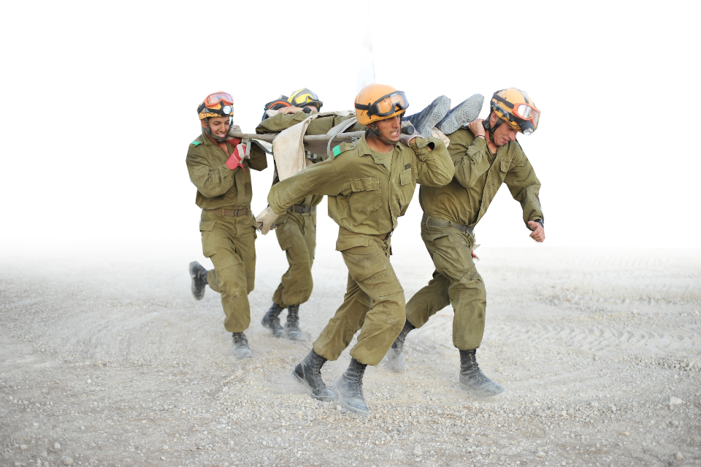
CARRY the Load–if you can!
² Carry each other's burdens, and in this way you will fulfill the law of Christ.
Notes:
Carrying wounded soldier = FREE = from http://upload.wikimedia.org/wikipedia/commons/c/c3/Flickr_-_Israel_Defense_Forces_-_Carry_the_Load.jpg
He ain’t heavy he’s my brother...

Slide 12
TEST Yourself–as you should!
Notes:
Test center = FREE = from http://commons.wikimedia.org/wiki/File:Ready_for_final_exam_at_Norwegian_University_of_Science_and_Technology.jpg
Test = Test for approval

Slide 13
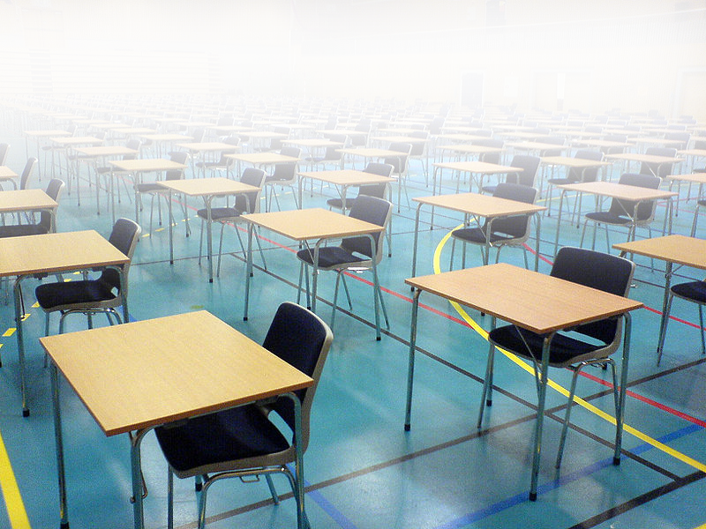
TEST Yourself–as you should!
³ If anyone thinks he is something when he is nothing, he deceives himself. ⁴ Each one should test his own actions. Then he can take pride in himself, without comparing himself to somebody else, ⁵ for each one should carry his own load.
Notes:
Test center = FREE = from http://commons.wikimedia.org/wiki/File:Ready_for_final_exam_at_Norwegian_University_of_Science_and_Technology.jpg
Test = Test for approval

Slide 14
SHARE with Others–as you must!
Notes:
Images = Licensed and not for REUSE.

Slide 15
SHARE with Others–as you must!
⁶ Anyone who receives instruction in the word must share all good things with his instructor.
Notes:
Images = Licensed and not for REUSE.

Slide 16
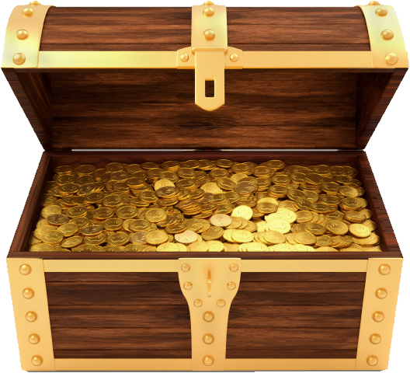
SHARE with Others–as you must!
⁶ Anyone who receives instruction in the word must share all good things with his instructor.
Notes:
Images = Licensed and not for REUSE.

Slide 17
SOW Spiritually–as you should!
Notes:
The Sower = FREE = from http://upload.wikimedia.org/wikipedia/commons/8/8a/Sowing_the_Seed_Hajdudorog.JPG

Slide 18
SOW Spiritually–as you should!
⁷ Do not be deceived: God cannot be mocked. A man reaps what he sows.
⁸ The one who sows to please his sinful nature, from that nature will reap destruction; the one who sows to please the Spirit, from the Spirit will reap eternal life.
Notes:
The Sower = FREE = from https://c.pxhere.com/photos/2e/7d/agriculture_close_up_cultivation_dig_environment_garden_ground_growth-929198.jpg!d

Slide 19
DO GOOD–as you should!
Notes:
Good Samaritan –

Slide 20
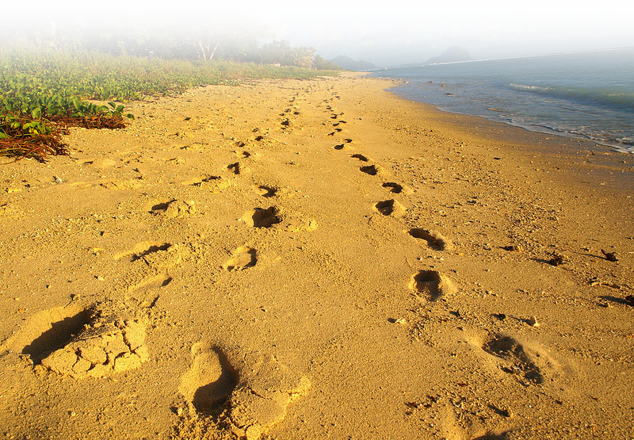
DO GOOD–as you should!
⁹ Let us not become weary in doing good, for at the proper time we will reap a harvest if we do not give up.
¹⁰ Therefore, as we have opportunity, let us do good to all people, especially to those who belong to the family of believers.
Notes:
Good Samaritan –

Slide 21
DO GOOD–as you should!
⁹ Let us not become weary in doing good, for at the proper time we will reap a harvest if we do not give up.
¹⁰ Therefore, as we have opportunity, let us do good to all people, especially to those who belong to the family of believers.
Follow in Jesus’ Steps
Notes:
Good Samaritan –

Slide 22
Imagine your family ...

Slide 23
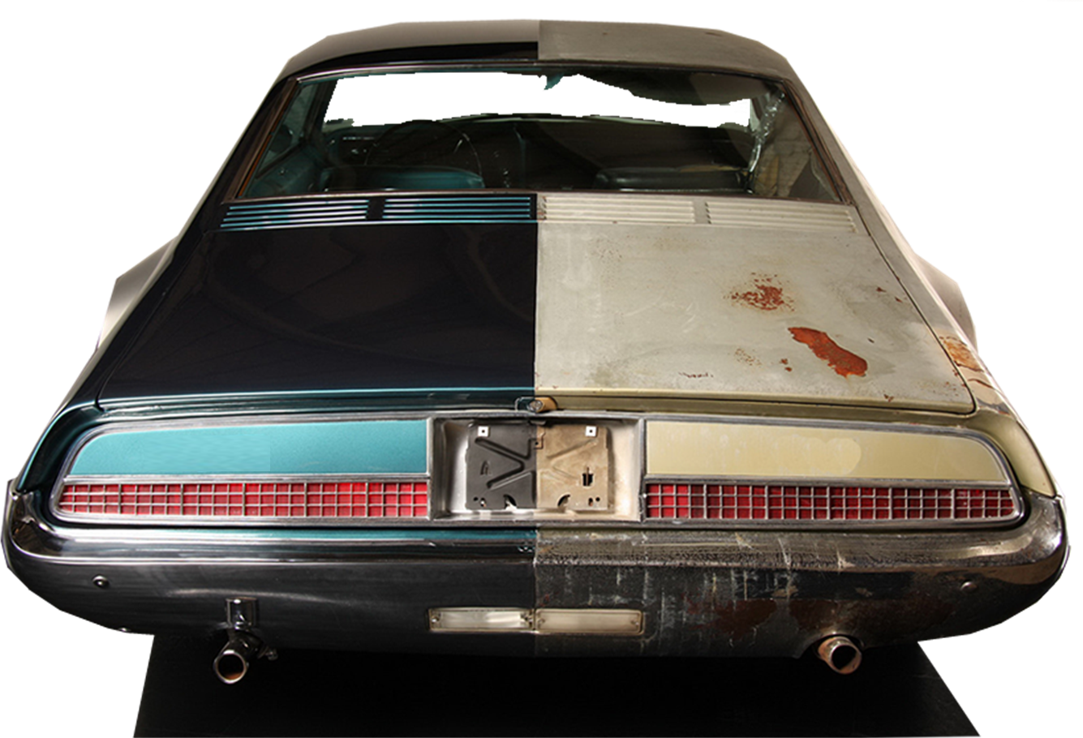
Imagine your family ...
Restored to what God intended it to be

Slide 24
Imagine your family ...
Restored to what God intended it to be
Carrying each others burdens

Slide 25
Imagine your family ...
Restored to what God intended it to be
Carrying each others burdens
Testing one’s own actions–instead of others

Slide 26
Imagine your family ...
Restored to what God intended it to be
Carrying each others burdens
Testing one’s own actions–instead of others
Generously sharing with one another

Slide 27
Imagine your family ...
Restored to what God intended it to be
Carrying each others burdens
Testing one’s own actions–instead of others
Generously sharing with one another
Sowing to the Spirit of God—not the flesh

Slide 28
Imagine your family ...
Restored to what God intended it to be
Carrying each others burdens
Testing one’s own actions–instead of others
Generously sharing with one another
Sowing to the Spirit of God—not the flesh
Preoccupied with doing good

Slide 29
Imagine your family ...
Restored to what God intended it to be
Carrying each others burdens
Testing one’s own actions–instead of others
Generously sharing with one another
Sowing to the Spirit of God—not the flesh
Preoccupied with doing good
That would be
HEAVEN
on earth!
Notes:
Clouds = FREE = https://coclouds.com/642/stratus/2014-07-11/

Slide 30
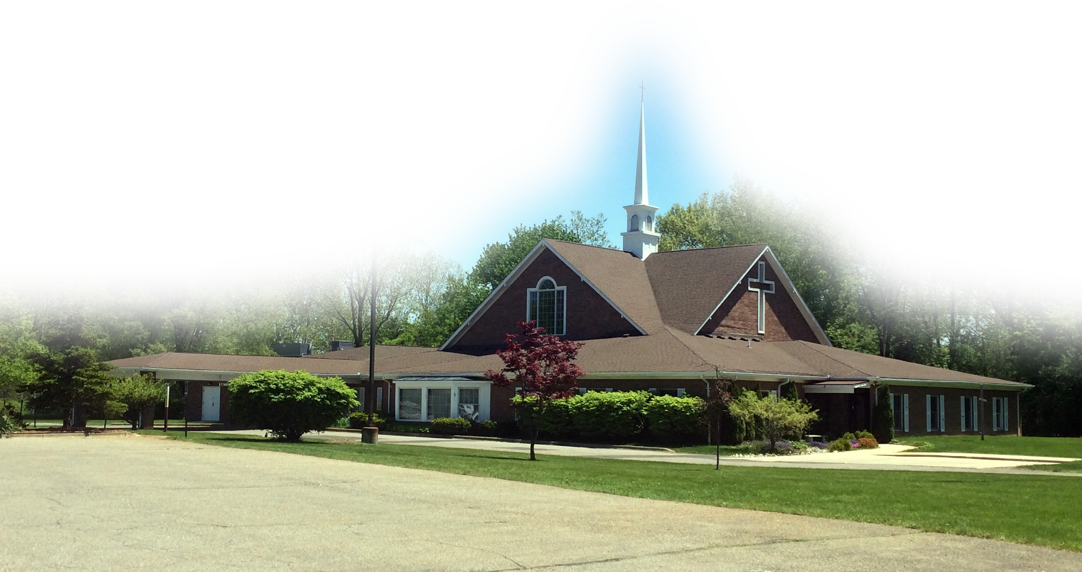
Imagine your family ...
That’s what the CHURCH FAMILY is to do

Slide 31
Now, that takes God’s ...

Slide 32
Let’s Pray!

