Slide 1
The Spirit’s Enablement!
Notes:
Background picture of gift = LICENSED AND NOT FOR REUSE ELSEWHERE = To reuse elsewhere get a license from http://www.bigstockphoto.com/download/bid-2252323/
Copyright © 2000-2021. All rights reserved. Bible Point is a registered trademark of Dennis Henderson. All other trademarks acknowledged.
Bible Point contains graphics from Bible Point artists. These illustrations belong to Bible Point and the respective artists. You may use the designs and illustrations for graphical illustration of lessons free and without special permission, provided they are not used in any way that maligns the Christian faith. Furthermore, republication or production of any illustration by any other graphic service whether it be in book, in a machine-readable form, or in any other design resource is strictly prohibited. Furthermore, they cannot be duplicated or resold as any other form of publishing, clip art, or graphic resource.
So What does it mean? (A simple translations of the legal jargon)
So, if you don’t own the presentation(s), graphic(s), and text(s) how can you legally use them? The purchase of the license allows you to use all the images in the product. However, the actual ownership and copyright of the presentation(s), graphic(s), and text(s) remain the property of Bible Point and its licensors. If you had plans on using this product in your “for sale” work—think again!
License Agreement
Article 1: License Grant
All the graphics and text in Bible Point presentations (excluding quotes from the Bible and stated sources) are the intellectual and real property of Bible Point and its licensors, and is protected by law, including United States copyright laws and international treaties. Bible Point grants to you a license:
1. To use the presentation in a single church, single school, or single office of a Christian organization.
2. To make a single archival back-up copy of the program.
3. To modify the presentation(s) and merge with other presentations in a single church, school, or Christian organization.
4. To transfer to another party if that party agrees to accept the terms and conditions of this agreement, and you do not retain any copies of the presentation, whether printed, machine readable, modified, or merged form.
Article 2: Terms
This license is effective until terminated. You may terminate the license at any time by destroying the presentation(s), graphic(s), or text(s) together with all copies, modifications and merged portions in any form. Bible Point may terminate your license if you fail to comply with this Agreement. You agree, upon such termination, for any reason, to destroy the presentation(s), graphics, and text(s) with all copies, modifications, and merged portions in any form.
Article 3: Disclaimers
1. Bible Point presentations, graphics, and texts are licensed to you As Is. You, the consumer, bear the entire risk relating to the quality and performance of the presentation(s), graphic(s), or text(s). In no event will Bible Point be liable for damages resulting from any defect.
2. Thirty-day limited warrantee on disks. Bible Point warrants the disks to be free of defects in material and workmanship under normal use for 30 days after purchase. During the 30-day period you may return a defective presentation, graphic, or text with proof of purchase and it will be replaced without charge, unless the presentation is damaged by misuse.
Article 4: General
1. You may not sub-license, assign, or transfer the license of the presentation(s), graphic(s), or text(s) except as provided by this Agreement.
2. This Agreement will be governed by the laws of the State of Michigan.
So What does it mean? (A simple translations of the legal jargon)
May I let someone borrow or copy my licensed Bible Point presentation (even after I modified it)? As long as it is within your local church, or single school, or the immediate office of a Christian organization you may. Otherwise, please refer the person interested in borrowing to: http://www.biblepoint.com or E-mail: dh@biblepoint.com with any related questions.
---------------------------------------------------------------------------------------------------------------------------
Scripture taken from the HOLY BIBLE, NEW INTERNATIONAL VERSION®. NIV®. Copyright©1973, 1978, 1984 by International Bible Society. Used by permission of Zondervan. All rights reserved.

Slide 2
We left off last week with
It is for freedom that Christ has set us free. (Gal 5:1-12)

Slide 3
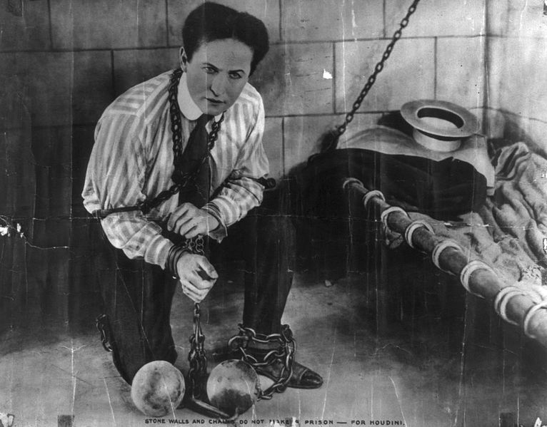
We left off last week with
It is for freedom that Christ has set us free. (Gal 5:1-12)

Slide 4
We pick up
¹³ You, my brothers, were called to be free. (Gal 5:13)

Slide 5
WE ARE FREE ...
¹³ You, my brothers, were called to be free. (Gal 5:13)
Free from the law...
But not an outlaw!
(Law breaker)
Notes:
Outlaw = FREE = from http://deviantclown.deviantart.com/art/Outlaw-Fight-Gear-Logo-Sample-56119424

Slide 6
WE ARE FREE ...
¹³ You, my brothers, were called to be free. But do not use your freedom to indulge the sinful nature; (Gal 5:13)
Notes:
007 = free =from http://freeco.deviantart.com/art/007-James-Bond-golden-movie-logo-285924545

Slide 7
WE ARE FREE ...
¹³ You, my brothers, were called to be free. But do not use your freedom to indulge the sinful nature; (Gal 5:13)
Free from the law...
But not licensed to kill! (License to sin)
Notes:
007 = free =from http://freeco.deviantart.com/art/007-James-Bond-golden-movie-logo-285924545

Slide 8
WE ARE FREE ...
¹³ You, my brothers, were called to be free. But do not use your freedom to indulge the sinful nature; rather, serve one another in love. (Gal 5:13)
Free from the law ...
Free to LOVE!

Slide 9
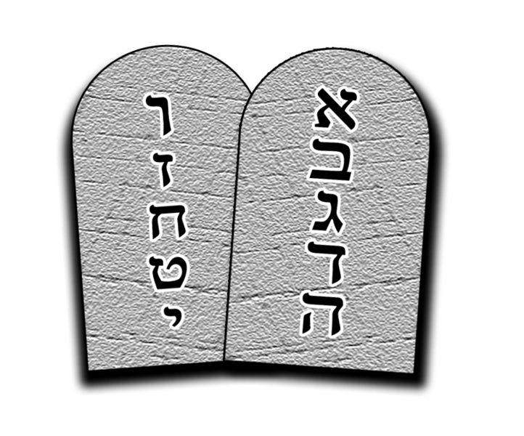
I. The Spirit enables us to Fulfill the Law of Love!
¹⁴ The entire law is summed up in a single command: "Love your neighbor as yourself." (Gal 5:13-14)
Notes:
Ten commandments = FREE = from http://commons.wikimedia.org/wiki/File:The10Commandments.png
If I love my neighbor, I will not commit adultery with his wife. I will not covet his house or possessions. I will not lie to him nor steal from him.
In fact when I live in love, I fulfill the law because I want to as an expression of love, not because I have to.

Slide 10
I. The Spirit enables us to Fulfill the Law of Love!
¹⁴ The entire law is summed up in a single command: "Love your neighbor as yourself." (Gal 5:13-14)
How does this work?
Notes:
Ten commandments = FREE = from http://commons.wikimedia.org/wiki/File:The10Commandments.png
If I love my neighbor, I will not commit adultery with his wife. I will not covet his house or possessions. I will not lie to him nor steal from him.
In fact when I live in love, I fulfill the law because I want to as an expression of love, not because I have to.

Slide 11
Pt: If you are saved you have...
Rom 5:1,5 Therefore, since we have been justified through faith... 5 ... God has poured out his love into our hearts by the Holy Spirit, whom he has given us.
LOVE

Slide 12
Pt: If you are saved you have...
Rom 5:1,5 Therefore, since we have been justified through faith... 5 ... God has poured out his love into our hearts by the Holy Spirit, whom he has given us.
LOVE

Slide 13
Pt: If you are saved you have...
¹¹ For the grace of God that brings salvation ... ¹² ... teaches us to say "No" to ungodliness and worldly passions, and to live self-controlled, upright and godly lives in this present age, .... (Titus 2:11-12)

Slide 14
Pt: If you are saved you have...
¹¹ For the grace of God that brings salvation ... ¹² ... teaches us to say "No" to ungodliness and worldly passions, and to live self-controlled, upright and godly lives in this present age, .... (Titus 2:11-12)
We don’t want to do what we did before—because we love God and others so much.

Slide 15
The flip-side is...
¹⁵ If you keep on biting and devouring each other, watch out or you will be destroyed by each other. (Gal 5:15)
WATCH OUT

Slide 16
The flip-side is...
¹⁵ If you keep on biting and devouring each other, watch out or you will be destroyed by each other. (Gal 5:15)
WATCH OUT

Slide 17
II. The Spirit enables us to Overcome the Sinful Nature
Notes:
Key to Christian living in the OT = Trust in the Lord
Key to Christian living in the Gospels = Abide in Me
Key to Christian living in the Epistles = Walk in the Spirit

Slide 18
II. The Spirit enables us to Overcome the Sinful Nature
The key to Victory
Notes:
Key to Christian living in the OT = Trust in the Lord
Key to Christian living in the Gospels = Abide in Me
Key to Christian living in the Epistles = Walk in the Spirit

Slide 19
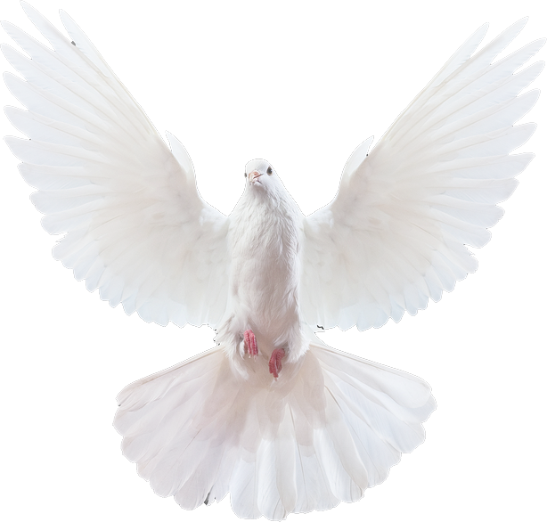
II. The Spirit enables us to Overcome the Sinful Nature
The key to Victory
¹⁶ So I say, live [walk] by the Spirit,
Notes:
Key to Christian living in the OT = Trust in the Lord
Key to Christian living in the Gospels = Abide in Me
Key to Christian living in the Epistles = Walk in the Spirit

Slide 20
II. The Spirit enables us to Overcome the Sinful Nature
The key to Victory
¹⁶ So I say, live [walk] by the Spirit,
and you will not gratify the desires of the sinful nature.
Notes:
Key to Christian living in the OT = Trust in the Lord
Key to Christian living in the Gospels = Abide in Me
Key to Christian living in the Epistles = Walk in the Spirit

Slide 21
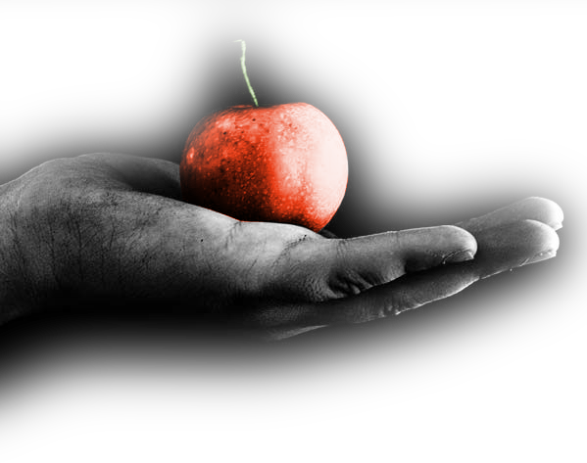
II. The Spirit enables us to Overcome the Sinful Nature
The Fact of Conflict
¹⁷ For the sinful nature desires what is contrary to the Spirit, and the Spirit what is contrary to the sinful nature. They are in conflict with each other, so that you do not do what you want.
Notes:
Forbidden fruit = FREE = from http://morganlynn.deviantart.com/art/tempt-me-with-the-evil-fruit-84300929
Hand with Bible = FREE = from http://www.flickr.com/photos/12091176@N08/4279686818/

Slide 22
II. The Spirit enables us to Overcome the Sinful Nature
The Fact of Conflict
¹⁷ For the sinful nature desires what is contrary to the Spirit, and the Spirit what is contrary to the sinful nature. They are in conflict with each other, so that you do not do what you want.
Notes:
Forbidden fruit = FREE = from http://morganlynn.deviantart.com/art/tempt-me-with-the-evil-fruit-84300929
Hand with Bible = FREE = from http://www.flickr.com/photos/12091176@N08/4279686818/

Slide 23
II. The Spirit enables us to Overcome the Sinful Nature
The Fact of Conflict
¹⁷ For the sinful nature desires what is contrary to the Spirit, and the Spirit what is contrary to the sinful nature. They are in conflict with each other, so that you do not do what you want.
Notes:
Forbidden fruit = FREE = from http://morganlynn.deviantart.com/art/tempt-me-with-the-evil-fruit-84300929
Hand with Bible = FREE = from http://www.flickr.com/photos/12091176@N08/4279686818/

Slide 24
II. The Spirit enables us to Overcome the Sinful Nature
The Victory Principle
¹⁸ But if you are led by the Spirit, you are not under law.

Slide 25
II. The Spirit enables us to Overcome the Sinful Nature
The Victory Principle
¹⁸ But if you are led by the Spirit, you are not under law.

Slide 26
The Acts of the Sinful Nature
¹⁹ ... are obvious:

Slide 27
The Acts of the Sinful Nature
¹⁹ ... are obvious: sexual immorality,

Slide 28
The Acts of the Sinful Nature
¹⁹ ... are obvious: sexual immorality, impurity

Slide 29
The Acts of the Sinful Nature
¹⁹ ... are obvious: sexual immorality, impurity and debauchery;

Slide 30
The Acts of the Sinful Nature
¹⁹ ... are obvious: sexual immorality, impurity and debauchery; ²⁰ idolatry

Slide 31
The Acts of the Sinful Nature
¹⁹ ... are obvious: sexual immorality, impurity and debauchery; ²⁰ idolatry and witchcraft;

Slide 32
The Acts of the Sinful Nature
¹⁹ ... are obvious: sexual immorality, impurity and debauchery; ²⁰ idolatry and witchcraft; hatred,

Slide 33
The Acts of the Sinful Nature
¹⁹ ... are obvious: sexual immorality, impurity and debauchery; ²⁰ idolatry and witchcraft; hatred, discord,

Slide 34
The Acts of the Sinful Nature
¹⁹ ... are obvious: sexual immorality, impurity and debauchery; ²⁰ idolatry and witchcraft; hatred, discord, jealousy,

Slide 35
The Acts of the Sinful Nature
¹⁹ ... are obvious: sexual immorality, impurity and debauchery; ²⁰ idolatry and witchcraft; hatred, discord, jealousy, fits of rage,

Slide 36
The Acts of the Sinful Nature
¹⁹ ... are obvious: sexual immorality, impurity and debauchery; ²⁰ idolatry and witchcraft; hatred, discord, jealousy, fits of rage, selfish ambition,

Slide 37
The Acts of the Sinful Nature
¹⁹ ... are obvious: sexual immorality, impurity and debauchery; ²⁰ idolatry and witchcraft; hatred, discord, jealousy, fits of rage, selfish ambition, dissensions,

Slide 38
The Acts of the Sinful Nature
¹⁹ ... are obvious: sexual immorality, impurity and debauchery; ²⁰ idolatry and witchcraft; hatred, discord, jealousy, fits of rage, selfish ambition, dissensions, factions

Slide 39
The Acts of the Sinful Nature
¹⁹ ... are obvious: sexual immorality, impurity and debauchery; ²⁰ idolatry and witchcraft; hatred, discord, jealousy, fits of rage, selfish ambition, dissensions, factions ²¹ and envy;

Slide 40
The Acts of the Sinful Nature
¹⁹ ... are obvious: sexual immorality, impurity and debauchery; ²⁰ idolatry and witchcraft; hatred, discord, jealousy, fits of rage, selfish ambition, dissensions, factions ²¹ and envy; drunkenness,

Slide 41
The Acts of the Sinful Nature
¹⁹ ... are obvious: sexual immorality, impurity and debauchery; ²⁰ idolatry and witchcraft; hatred, discord, jealousy, fits of rage, selfish ambition, dissensions, factions ²¹ and envy; drunkenness, orgies,

Slide 42
The Acts of the Sinful Nature
¹⁹ ... are obvious: sexual immorality, impurity and debauchery; ²⁰ idolatry and witchcraft; hatred, discord, jealousy, fits of rage, selfish ambition, dissensions, factions ²¹ and envy; drunkenness, orgies, and the like.

Slide 43
The Acts of the Sinful Nature
WARNING!
¹⁹ ... are obvious: sexual immorality, impurity and debauchery; ²⁰ idolatry and witchcraft; hatred, discord, jealousy, fits of rage, selfish ambition, dissensions, factions ²¹ and envy; drunkenness, orgies, and the like. I warn you, as I did before, that those who live like this will not inherit the kingdom of God.

Slide 44
The Acts of the Sinful Nature
WARNING!
¹⁹ ... are obvious: sexual immorality, impurity and debauchery; ²⁰ idolatry and witchcraft; hatred, discord, jealousy, fits of rage, selfish ambition, dissensions, factions ²¹ and envy; drunkenness, orgies, and the like. I warn you, as I did before, that those who live like this will not inherit the kingdom of God.

Slide 45
The Acts of the Sinful Nature
WARNING!
¹⁹ ... are obvious: sexual immorality, impurity and debauchery; ²⁰ idolatry and witchcraft; hatred, discord, jealousy, fits of rage, selfish ambition, dissensions, factions ²¹ and envy; drunkenness, orgies, and the like. I warn you, as I did before, that those who live like this will not inherit the kingdom of God.

Slide 46
The Acts of the Sinful Nature
¹¹ And that is what some of you were. But you were washed, you were sanctified, you were justified in the name of the Lord Jesus Christ and by the Spirit of our God. (1Cor 6:11)
¹⁹ ... are obvious: sexual immorality, impurity and debauchery; ²⁰ idolatry and witchcraft; hatred, discord, jealousy, fits of rage, selfish ambition, dissensions, factions ²¹ and envy; drunkenness, orgies, and the like. I warn you, as I did before, that those who live like this will not inherit the kingdom of God.

Slide 47
III. The Spirit enables us to Produce Spiritual Fruit

Slide 48
Key word = “But”
In contrast with the preceding
Acts of the Sinful Nature

Slide 49
Key word = “But”
In contrast with the preceding
Acts of the Sinful Nature

Slide 50
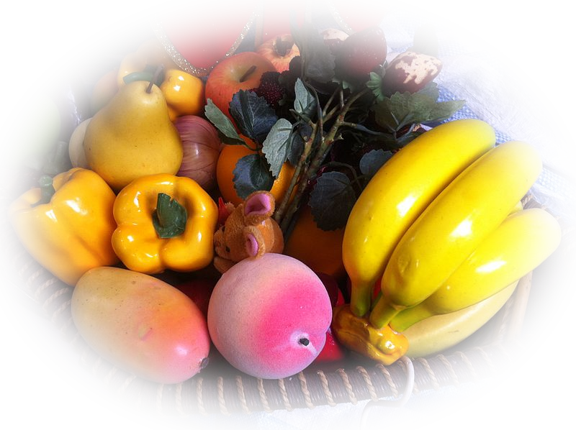
Watch out for FAKE FRUIT
Plastic Fruit
Acts of the Sinful Nature
MANIPULATED

Slide 51
Look for REAL FRUIT
Plastic Fruit vs. Genuine Fruit
Acts of the Sinful Nature
MANIPULATED
PRODUCED

Slide 52
III. The Spirit enables us to Produce Spiritual Fruit
^{22i} But the fruit of the Spirit is...

Slide 53
III. The Spirit enables us to Produce Spiritual Fruit
^{22i} But the fruit of the Spirit is...
love, joy, peace,

Slide 54
III. The Spirit enables us to Produce Spiritual Fruit
^{22i} But the fruit of the Spirit is...
love, joy, peace, patience, kindness, goodness,

Slide 55
III. The Spirit enables us to Produce Spiritual Fruit
^{22i} But the fruit of the Spirit is...
love, joy, peace, patience, kindness, goodness, faithfulness, ²³ gentleness and self-control.

Slide 56
III. The Spirit enables us to Produce Spiritual Fruit
Against such things there is no law.
^{22i} But the fruit of the Spirit is...
love, joy, peace, patience, kindness, goodness, faithfulness, ²³ gentleness and self-control.

Slide 57
Why this is all true.
Notes:
Why is this Living in the Spirit the way to go? Why is living in Grace and not under the law the way to have victory in the Christian life?
We are dead to the law, the sinful nature, passions and desires.

Slide 58
The REASON for Fruit
²⁴ Those who belong to Christ Jesus have crucified the sinful nature with its passions and desires.
Notes:
Why is this Living in the Spirit the way to go? Why is living in Grace and not under the law the way to have victory in the Christian life?
We are dead to the law, the sinful nature, passions and desires.

Slide 59
The REASON for Fruit
^{Gal 2:20} I have been crucified with Christ and I no longer live,
I DIED
I DIED

Slide 60
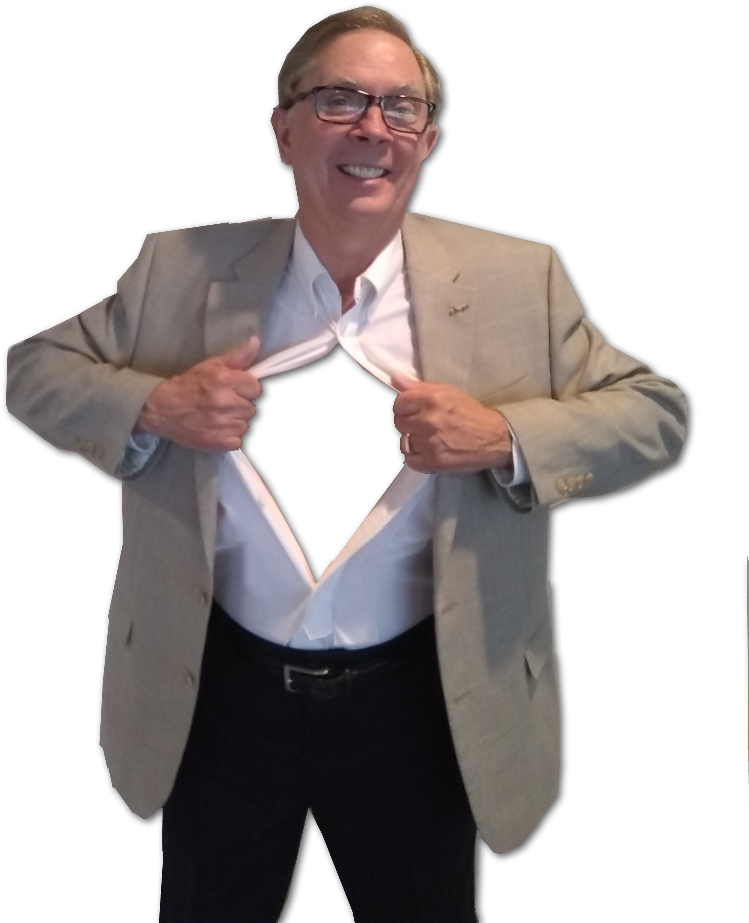
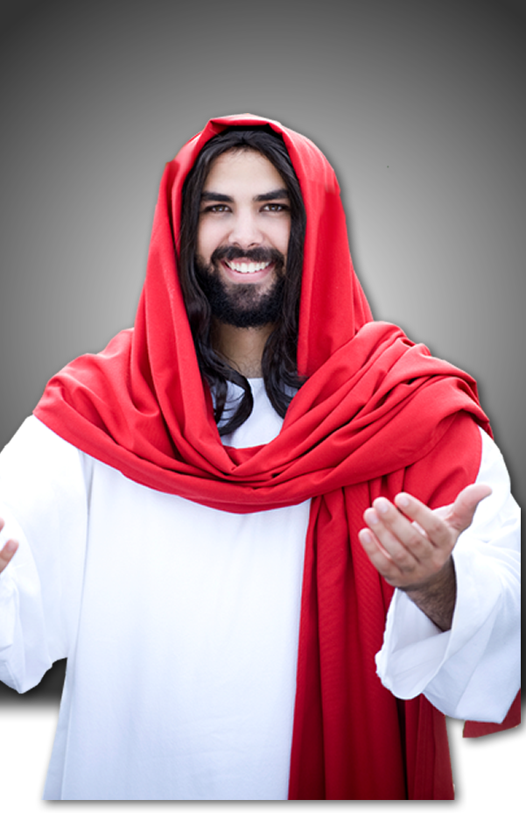
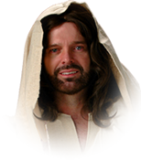
The REASON for Fruit
^{Gal 2:20} I have been crucified with Christ and I no longer live, but Christ lives in me.
I DIED
I DIED

Slide 61
The REASON for Fruit
^{Gal 2:20} I have been crucified with Christ and I no longer live, but Christ lives in me. The life I live in the body,

Slide 62
The REASON for Fruit
^{Gal 2:20} I have been crucified with Christ and I no longer live, but Christ lives in me. The life I live in the body, I live by faith in the Son of God, who loved me and gave himself for me.
FAITH

Slide 63
The REASON for Fruit
²⁴ Those who belong to Christ Jesus have crucified the sinful nature with its passions and desires.

Slide 64
The REASON for Fruit
²⁴ Those who belong to Christ Jesus have crucified the sinful nature with its passions and desires.

Slide 65
The REASON for Fruit
²⁵ Since we live by the Spirit, let us keep in step with the Spirit.

Slide 66
Final Admonition
²⁶ Let us not become conceited, provoking and envying each other.

Slide 67
Let’s Sum It Up

Slide 68
Let’s Sum It Up
It is for Freedom that Christ set us free.

Slide 69
Let’s Sum It Up
It is for Freedom that Christ set us free.
By the Spirit of God we are FREE to:

Slide 70
Let’s Sum It Up
It is for Freedom that Christ set us free.
By the Spirit of God we are FREE to:
Fulfill the law of Love

Slide 71
Let’s Sum It Up
It is for Freedom that Christ set us free.
By the Spirit of God we are FREE to:
Fulfill the law of Love
Overcome the Sinful Nature

Slide 72
Let’s Sum It Up
It is for Freedom that Christ set us free.
By the Spirit of God we are FREE to:
Fulfill the law of Love
Overcome the Sinful Nature
Produce Spiritual Fruit

Slide 73
Let’s Sum It Up
It is for Freedom that Christ set us free.
By the Spirit of God we are FREE to:
Fulfill the law of Love
Overcome the Sinful Nature
Produce Spiritual Fruit
SO LET’S KEEP IN STEP WITH HIM!

Slide 74
Let’s Pray!

