Slide 1
Notes:
Background picture of gift = LICENSED AND NOT FOR REUSE ELSEWHERE = To reuse elsewhere get a license from http://www.bigstockphoto.com/download/bid-2252323/
Copyright © 2000-2021. All rights reserved. Bible Point is a registered trademark of Dennis Henderson. All other trademarks acknowledged.
Bible Point contains graphics from Bible Point artists. These illustrations belong to Bible Point and the respective artists. You may use the designs and illustrations for graphical illustration of lessons free and without special permission, provided they are not used in any way that maligns the Christian faith. Furthermore, republication or production of any illustration by any other graphic service whether it be in book, in a machine-readable form, or in any other design resource is strictly prohibited. Furthermore, they cannot be duplicated or resold as any other form of publishing, clip art, or graphic resource.
So What does it mean? (A simple translations of the legal jargon)
So, if you don’t own the presentation(s), graphic(s), and text(s) how can you legally use them? The purchase of the license allows you to use all the images in the product. However, the actual ownership and copyright of the presentation(s), graphic(s), and text(s) remain the property of Bible Point and its licensors. If you had plans on using this product in your “for sale” work—think again!
License Agreement
Article 1: License Grant
All the graphics and text in Bible Point presentations (excluding quotes from the Bible and stated sources) are the intellectual and real property of Bible Point and its licensors, and is protected by law, including United States copyright laws and international treaties. Bible Point grants to you a license:
1. To use the presentation in a single church, single school, or single office of a Christian organization.
2. To make a single archival back-up copy of the program.
3. To modify the presentation(s) and merge with other presentations in a single church, school, or Christian organization.
4. To transfer to another party if that party agrees to accept the terms and conditions of this agreement, and you do not retain any copies of the presentation, whether printed, machine readable, modified, or merged form.
Article 2: Terms
This license is effective until terminated. You may terminate the license at any time by destroying the presentation(s), graphic(s), or text(s) together with all copies, modifications and merged portions in any form. Bible Point may terminate your license if you fail to comply with this Agreement. You agree, upon such termination, for any reason, to destroy the presentation(s), graphics, and text(s) with all copies, modifications, and merged portions in any form.
Article 3: Disclaimers
1. Bible Point presentations, graphics, and texts are licensed to you As Is. You, the consumer, bear the entire risk relating to the quality and performance of the presentation(s), graphic(s), or text(s). In no event will Bible Point be liable for damages resulting from any defect.
2. Thirty-day limited warrantee on disks. Bible Point warrants the disks to be free of defects in material and workmanship under normal use for 30 days after purchase. During the 30-day period you may return a defective presentation, graphic, or text with proof of purchase and it will be replaced without charge, unless the presentation is damaged by misuse.
Article 4: General
1. You may not sub-license, assign, or transfer the license of the presentation(s), graphic(s), or text(s) except as provided by this Agreement.
2. This Agreement will be governed by the laws of the State of Michigan.
So What does it mean? (A simple translations of the legal jargon)
May I let someone borrow or copy my licensed Bible Point presentation (even after I modified it)? As long as it is within your local church, or single school, or the immediate office of a Christian organization you may. Otherwise, please refer the person interested in borrowing to: http://www.biblepoint.com or E-mail: dh@biblepoint.com with any related questions.
---------------------------------------------------------------------------------------------------------------------------
Scripture taken from the HOLY BIBLE, NEW INTERNATIONAL VERSION®. NIV®. Copyright©1973, 1978, 1984 by International Bible Society. Used by permission of Zondervan. All rights reserved.

Slide 2
FREEDOM!
Notes:
Background picture of gift = LICENSED AND NOT FOR REUSE ELSEWHERE = To reuse elsewhere get a license from http://www.bigstockphoto.com/download/bid-2252323/

Slide 3
PREMISE:
GRACE’S FREEDOM IS SO GREAT ...
Notes:
Harry Houdini = FREE = from http://commons.wikimedia.org/wiki/File:Harry_Houdini.jpg
Harry Houdini –The only cell that Houdini could not get out of and he finally gave up on ... was already unlocked.
So it is with Christianity, grace has already unlocked our cell, so we are just wasting our time trying to do something other than accept God’s grace to get out.

Slide 4
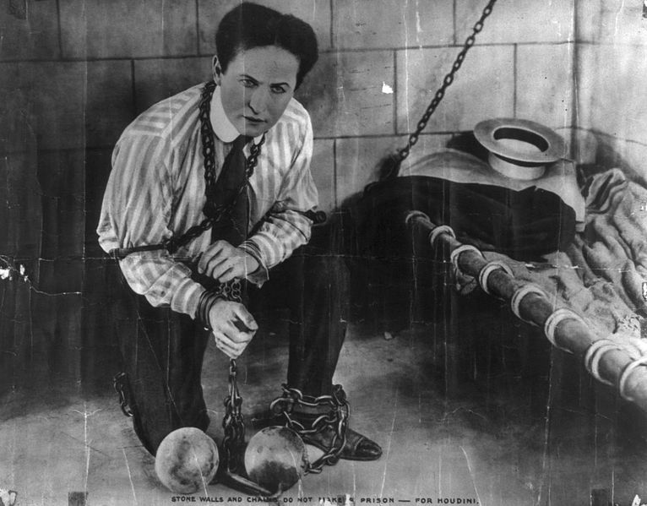
PREMISE:
GRACE’S FREEDOM IS SO GREAT ...
Notes:
Harry Houdini = FREE = from http://commons.wikimedia.org/wiki/File:Harry_Houdini.jpg
Harry Houdini –The only cell that Houdini could not get out of and he finally gave up on ... was already unlocked.
So it is with Christianity, grace has already unlocked our cell, so we are just wasting our time trying to do something other than accept God’s grace to get out.

Slide 5
PREMISE:
GRACE’S FREEDOM IS SO GREAT ...
Don’t Go Back to Legalism
Notes:
Harry Houdini = FREE = from http://commons.wikimedia.org/wiki/File:Harry_Houdini.jpg
Harry Houdini –The only cell that Houdini could not get out of and he finally gave up on ... was already unlocked.
So it is with Christianity, grace has already unlocked our cell, so we are just wasting our time trying to do something other than accept God’s grace to get out.

Slide 6
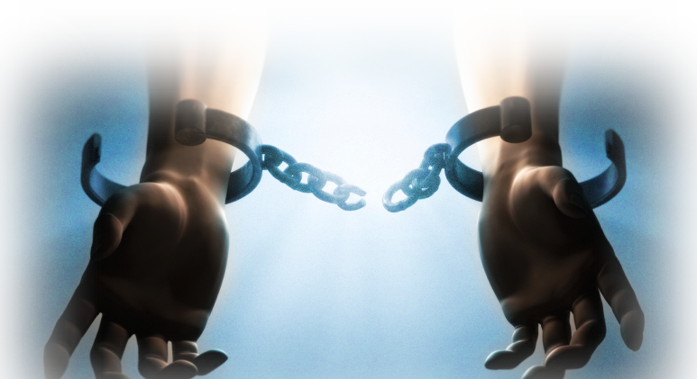
1- For FREEDOM Sake! 5:1
¹ It is for freedom that Christ has set us free. Stand firm, then, and do not let yourselves be burdened again by a yoke of slavery.

Slide 7
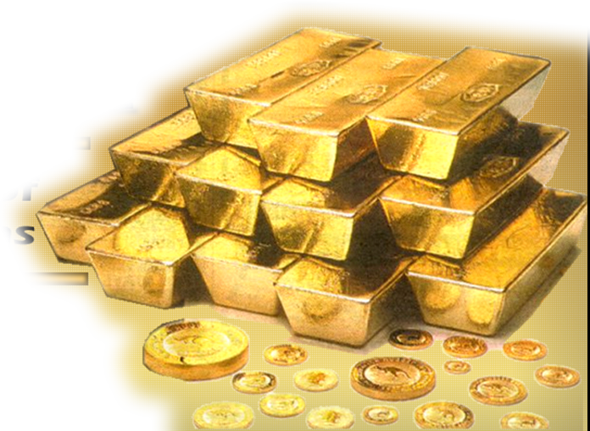
2- For VALUE Sake! 5:2-6
² Mark my words! I, Paul, tell you that if you let yourselves be circumcised, Christ will be of no value to you at all.

Slide 8
2- For VALUE Sake! 5:2-4
² Mark my words! I, Paul, tell you that if you let yourselves be circumcised,
i.e. In keeping with the law as part of your salvation, then ...

Slide 9
2- For VALUE Sake! 5:2-4
² Mark my words! I, Paul, tell you that if you let yourselves be circumcised, Christ will be of no value to you at all.

Slide 10
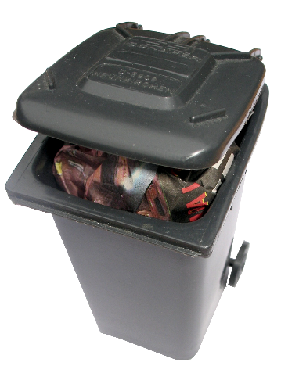
Legalism = NO VALUE
² Mark my words! I, Paul, tell you that if you let yourselves be circumcised, Christ will be of no value to you at all.
Notes:
Trash can = FREE = from http://www.rgbstock.com/photo/mgynQTS/garbage+bin+4
It’s not what you do – circumcision = no value = trash
It’s who you know! -- Jesus

Slide 11
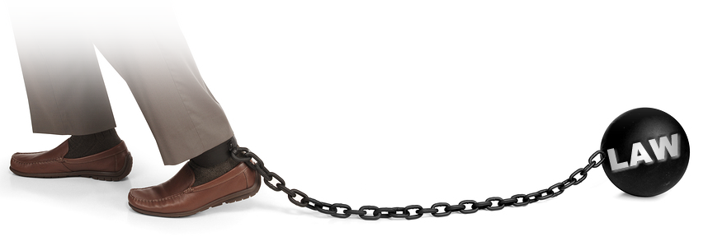
Legalism = Huge Obligation
³ Again I declare to every man who lets himself be circumcised that he is obligated to obey the whole law.
Notes:
Ball and chain = Licensed, NOT for reuse = To reuse, get a license from http://www.bigstockphoto.com/download/bid-3125716/
As soon as you open the door to law keeping—you are obligated to keep all the rules. (if you offend in one point—guilty of all)

Slide 12
Legalism = Alienates YOU!
⁴ You who are trying to be justified by law have been alienated from Christ; you have fallen away from grace.
Notes:
Woman pushing away = Licensed, NOT for Reuse = To reuse get a license from http://www.bigstockphoto.com/download/bid-3125974/
Keeping a bunch of rules does not bring you closer to Jesus—the actually push Him away.
So How do I live if not by rules? Answer: by faith. Trusting in Him in a personal relationship.

Slide 13
3- For FAITH Sake! 5:4-6
⁵ But by faith we eagerly await through the Spirit the righteousness for which we hope.

Slide 14
3- For FAITH Sake! 5:4-6
⁵ But by faith we eagerly await through the Spirit the righteousness for which we hope.

Slide 15
3- For FAITH Sake! 5:4-6
⁵ But by faith we eagerly await through the Spirit the righteousness for which we hope.
The Law brings a curse.
Faith brings a ...

Slide 16
3- For FAITH Sake! 5:4-6
⁶ For in Christ Jesus neither circumcision nor uncircumcision has any value.

Slide 17
3- For FAITH Sake! 5:4-6
⁶ For in Christ Jesus neither circumcision nor uncircumcision has any value.

Slide 18
3- For FAITH Sake! 5:4-6
⁶ For in Christ Jesus neither circumcision nor uncircumcision has any value. The only thing that counts is faith...

Slide 19
3- For FAITH Sake! 5:4-6
⁶ For in Christ Jesus neither circumcision nor uncircumcision has any value. The only thing that counts is faith expressing itself through love.
Notes:
When you accept Jesus everything changes—you are a new person. You love Jesus and the love motivates you to do the will of God in gratitude for what Jesus did for you . You will do His will without setting up rules. You will do it because you love him. Your love for Him will be expressed by devotion to His will—not keeping and checking off a list of rules.

Slide 20
4- For WINNING Sake! 5:7-8
⁷ You were running a good race. Who cut in on you and kept you from obeying the truth? ⁸ That kind of persuasion does not come from the one who calls you.
Notes:
Finish line = FREE = from http://www.flickr.com/photos/jepoirrier/1094228548/sizes/o/in/photostream/
Race of runners =
Race of go-carts = My grandson, Mason, and I went go-carting . We shared a go-cart, and we went like maniacs. We cut off every car to get in first place. One lady we cut of went into a tail spin and wound up going the wrong way. We cut them all off. In Paul’s day it was Judaisers who were cutting off.
Race of relationships =
You started out good in the relationship – but someone cut in on your dance with Jesus. Who was it? The Law, Greed, Lust, an addiction, etc.
Whatever leads you from Christ is not from the God who calls you to Christ. God never leads you astray!

Slide 21
4- For WINNING Sake! 5:7-8
⁷ You were running a good race. Who cut in on you and kept you from obeying the truth? ⁸ That kind of persuasion does not come from the one who calls you.
Notes:
Finish line = FREE = from http://www.flickr.com/photos/jepoirrier/1094228548/sizes/o/in/photostream/
Race of runners =
Race of go-carts = My grandson, Mason, and I went go-carting . We shared a go-cart, and we went like maniacs. We cut off every car to get in first place. One lady we cut of went into a tail spin and wound up going the wrong way. We cut them all off. In Paul’s day it was Judaisers who were cutting off.
Race of relationships =
You started out good in the relationship – but someone cut in on your dance with Jesus. Who was it? The Law, Greed, Lust, an addiction, etc.
Whatever leads you from Christ is not from the God who calls you to Christ. God never leads you astray!

Slide 22
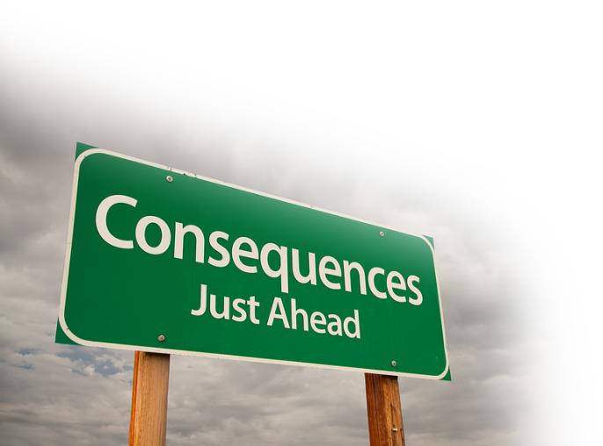
5-For CONSEQUENCES Sake! 5:910
⁹ "A little yeast works through the whole batch of dough.“ ¹⁰ I am confident in the Lord that you will take no other view. The one who is throwing you into confusion will pay the penalty, whoever he may be.
Notes:
A little yeast permeates and transforms the entire dough. Yeast is a fungus that cause bread to rise and liquids to ferment into alcohol, and can cause painful infections.
What is the yeast in this passage? Answer: Confusion.
What is the confusion about?
1–Gospel = another Gospel 1: 6-9
2- Law = lit. bewitched by false teachers to believe you need to keep the law to be completely saved 3:1
3- Freedom = lit enslaved to rule keeping God 4:9
Penalty is not named, but we are led to believe it is severe.
A little yeast in the relationship – contaminates the whole relationship.

Slide 23
5-For CONSEQUENCES Sake! 5:910
⁹ "A little yeast works through the whole batch of dough.“ ¹⁰ I am confident in the Lord that you will take no other view. The one who is throwing you into confusion will pay the penalty, whoever he may be.
Notes:
A little yeast permeates and transforms the entire dough. Yeast is a fungus that cause bread to rise and liquids to ferment into alcohol, and can cause painful infections.
What is the yeast in this passage? Answer: Confusion.
What is the confusion about?
1–Gospel = another Gospel 1: 6-9
2- Law = lit. bewitched by false teachers to believe you need to keep the law to be completely saved 3:1
3- Freedom = lit enslaved to rule keeping God 4:9
Penalty is not named, but we are led to believe it is severe.
A little yeast in the relationship – contaminates the whole relationship.

Slide 24
5-For CONSEQUENCES Sake! 5:910
⁹ "A little yeast works through the whole batch of dough.“ ¹⁰ I am confident in the Lord that you will take no other view. The one who is throwing you into confusion will pay the penalty, whoever he may be.
Notes:
A little yeast permeates and transforms the entire dough. Yeast is a fungus that cause bread to rise and liquids to ferment into alcohol, and can cause painful infections.
What is the yeast in this passage? Answer: Confusion.
What is the confusion about?
1–Gospel = another Gospel 1: 6-9
2- Law = lit. bewitched by false teachers to believe you need to keep the law to be completely saved 3:1
3- Freedom = lit enslaved to rule keeping God 4:9
Penalty is not named, but we are led to believe it is severe.
A little yeast in the relationship – contaminates the whole relationship.

Slide 25
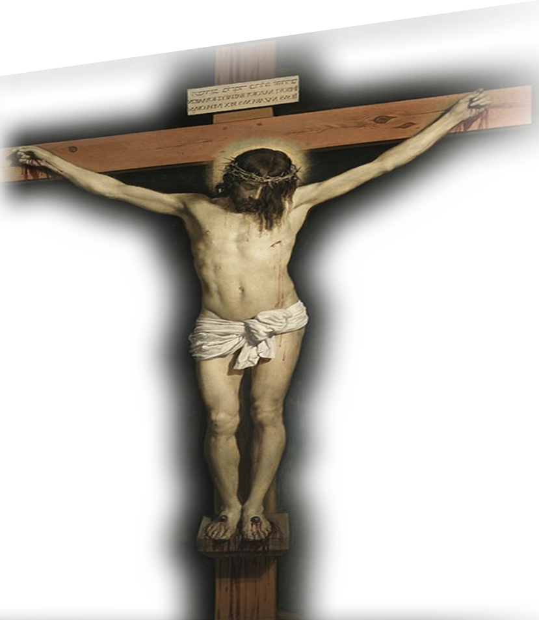
6- For The CROSS Sake! 5:11-12
¹¹ Brothers, if I am still preaching circumcision, why am I still being persecuted? In that case the offense of the cross has been abolished. ¹² As for those agitators, I wish they would go the whole way and emasculate themselves!
Notes:
Crucifixion = FREE = public domain from http://pixabay.com/en/jesus-christ-crucifixion-cross-62950/
If I am still preaching circumstances, WHICH I AM NOT, why are they persecuting me? It’s because I am not giving you law-keeping as a way of salvation.
If you could be saved, made right with God, any other way, then I would preach that – I would have told you, Paul says, but I did not.
They are persecuting me because the true Gospel opposes what they are teaching. If they are right then the cross has no power to save and it is totally abolished.
I wish they would go all the way and cut it completely off!
I wish the person who teaches you have to be baptized to be saved, would drown in the water.
I wish ... Church membership ..... would have the church cave in on him.

Slide 26
Let’s sum it up ...

Slide 27
Let’s sum it up ...
Freedom is so great ... Don’t go back to legalism:

Slide 28
Let’s sum it up ...
Freedom is so great ... Don’t go back to legalism:
For FREEDOM sake

Slide 29
Let’s sum it up ...
Freedom is so great ... Don’t go back to legalism:
For FREEDOM sake
For VALUE sake

Slide 30
Let’s sum it up ...
Freedom is so great ... Don’t go back to legalism:
For FREEDOM sake
For VALUE sake
For WINNING sake

Slide 31
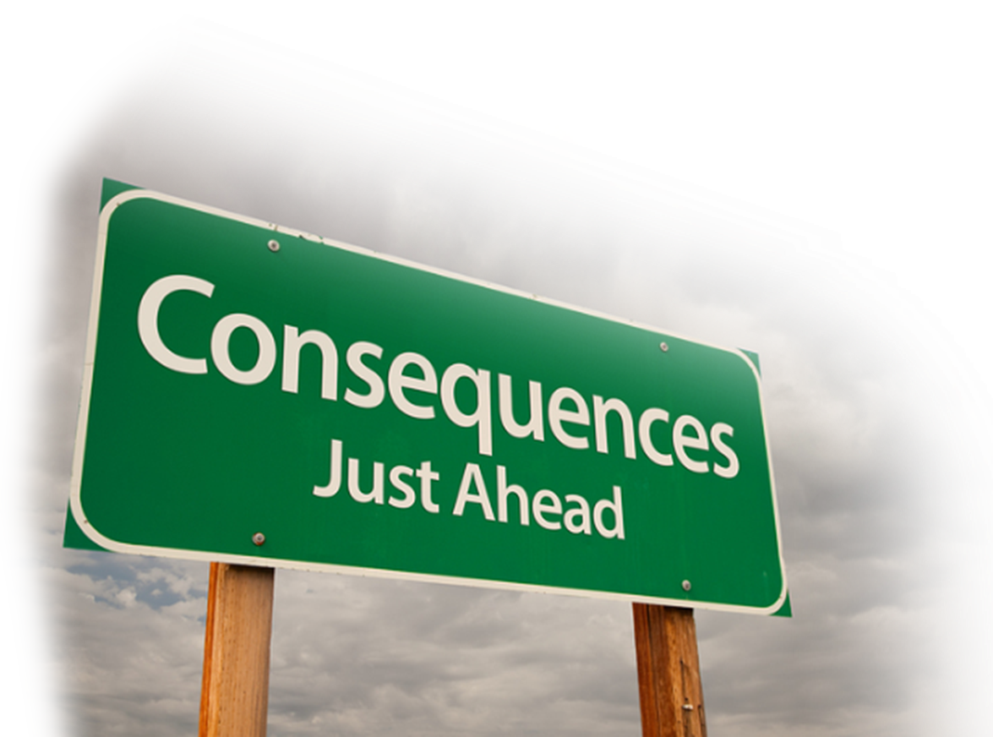
Let’s sum it up ...
Freedom is so great ... Don’t go back to legalism:
For FREEDOM sake
For VALUE sake
For WINNING sake
For CONSEQUNCES sake

Slide 32
Let’s sum it up ...
Freedom is so great ... Don’t go back to legalism:
For FREEDOM sake
For VALUE sake
For WINNING sake
For CONSEQUNCES sake
For the CROSS sake

Slide 33
Let’s sum it up ...
Freedom is so great ... Don’t go back to legalism:
For FREEDOM sake
For VALUE sake
For WINNING sake
For CONSEQUNCES sake
For the CROSS sake

Slide 34
Let’s sum it up ...
Freedom is so great ... Don’t go back to legalism:
For FREEDOM sake
For VALUE sake
For WINNING sake
For CONSEQUNCES sake
For the CROSS sake
The POINT:
You can’t unlock the Christian life by law keeping—it’s already unlocked by the grace of Christ.
Notes:
You can’t unlock a door that is already unlocked. Like Houdini who just leaned on the door and was set free, you appropriate the Grace of God by leaning on the door. Jesus is the door. (I am the door of the sheep. (Joh 10:7 KJV)) He is the way. (John 14:6)

Slide 35
Let’s Pray!

