Slide 1
Joy!
Notes:
Background picture of gift = LICENSED AND NOT FOR REUSE ELSEWHERE = To reuse elsewhere get a license from http://www.bigstockphoto.com/download/bid-2252323/
Jesus is the Truth (John 14:6) When you wander away from the Lord you lose your joy! Even David learned this in the OT. After his sin with Bathsheba he wrote, “Restore the joy of my salvation.”
Copyright © 2000-2021. All rights reserved. Bible Point is a registered trademark of Dennis Henderson. All other trademarks acknowledged.
Bible Point contains graphics from Bible Point artists. These illustrations belong to Bible Point and the respective artists. You may use the designs and illustrations for graphical illustration of lessons free and without special permission, provided they are not used in any way that maligns the Christian faith. Furthermore, republication or production of any illustration by any other graphic service whether it be in book, in a machine-readable form, or in any other design resource is strictly prohibited. Furthermore, they cannot be duplicated or resold as any other form of publishing, clip art, or graphic resource.
So What does it mean? (A simple translations of the legal jargon)
So, if you don’t own the presentation(s), graphic(s), and text(s) how can you legally use them? The purchase of the license allows you to use all the images in the product. However, the actual ownership and copyright of the presentation(s), graphic(s), and text(s) remain the property of Bible Point and its licensors. If you had plans on using this product in your “for sale” work—think again!
License Agreement
Article 1: License Grant
All the graphics and text in Bible Point presentations (excluding quotes from the Bible and stated sources) are the intellectual and real property of Bible Point and its licensors, and is protected by law, including United States copyright laws and international treaties. Bible Point grants to you a license:
1. To use the presentation in a single church, single school, or single office of a Christian organization.
2. To make a single archival back-up copy of the program.
3. To modify the presentation(s) and merge with other presentations in a single church, school, or Christian organization.
4. To transfer to another party if that party agrees to accept the terms and conditions of this agreement, and you do not retain any copies of the presentation, whether printed, machine readable, modified, or merged form.
Article 2: Terms
This license is effective until terminated. You may terminate the license at any time by destroying the presentation(s), graphic(s), or text(s) together with all copies, modifications and merged portions in any form. Bible Point may terminate your license if you fail to comply with this Agreement. You agree, upon such termination, for any reason, to destroy the presentation(s), graphics, and text(s) with all copies, modifications, and merged portions in any form.
Article 3: Disclaimers
1. Bible Point presentations, graphics, and texts are licensed to you As Is. You, the consumer, bear the entire risk relating to the quality and performance of the presentation(s), graphic(s), or text(s). In no event will Bible Point be liable for damages resulting from any defect.
2. Thirty-day limited warrantee on disks. Bible Point warrants the disks to be free of defects in material and workmanship under normal use for 30 days after purchase. During the 30-day period you may return a defective presentation, graphic, or text with proof of purchase and it will be replaced without charge, unless the presentation is damaged by misuse.
Article 4: General
1. You may not sub-license, assign, or transfer the license of the presentation(s), graphic(s), or text(s) except as provided by this Agreement.
2. This Agreement will be governed by the laws of the State of Michigan.
So What does it mean? (A simple translations of the legal jargon)
May I let someone borrow or copy my licensed Bible Point presentation (even after I modified it)? As long as it is within your local church, or single school, or the immediate office of a Christian organization you may. Otherwise, please refer the person interested in borrowing to: http://www.biblepoint.com or E-mail: dh@biblepoint.com with any related questions.
---------------------------------------------------------------------------------------------------------------------------
Scripture taken from the HOLY BIBLE, NEW INTERNATIONAL VERSION®. NIV®. Copyright©1973, 1978, 1984 by International Bible Society. Used by permission of Zondervan. All rights reserved.

Slide 2
Grace Brings Joy ...

Slide 3
Joy in TRIALS 4:13-15
¹³ As you know, it was because of an illness that I first preached the gospel to you. ¹⁴ Even though my illness was a trial to you, you did not treat me with contempt or scorn. Instead, you welcomed me as if I were an angel of God, as if I were Christ Jesus himself. ¹⁵ What has happened to all your joy? I can testify that, if you could have done so, you would have torn out your eyes and given them to me.

Slide 4
Joy in TRIALS 4:13-15
¹³ As you know, it was because of an illness that I first preached the gospel to you. ¹⁴ Even though my illness was a trial to you, you did not treat me with contempt or scorn. Instead, you welcomed me as if I were an angel of God, as if I were Christ Jesus himself. ¹⁵ What has happened to all your joy? I can testify that, if you could have done so, you would have torn out your eyes and given them to me.

Slide 5
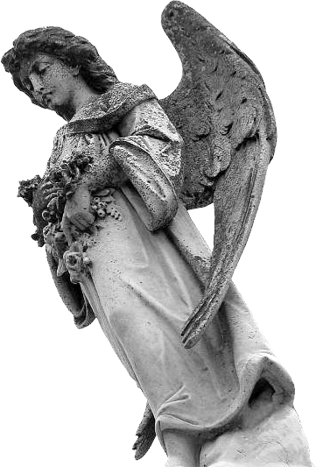
Joy in TRIALS 4:13-15
¹³ As you know, it was because of an illness that I first preached the gospel to you. ¹⁴ Even though my illness was a trial to you, you did not treat me with contempt or scorn. Instead, you welcomed me as if I were an angel of God, as if I were Christ Jesus himself. ¹⁵ What has happened to all your joy? I can testify that, if you could have done so, you would have torn out your eyes and given them to me.
Notes:
https://commons.wikimedia.org/

Slide 6
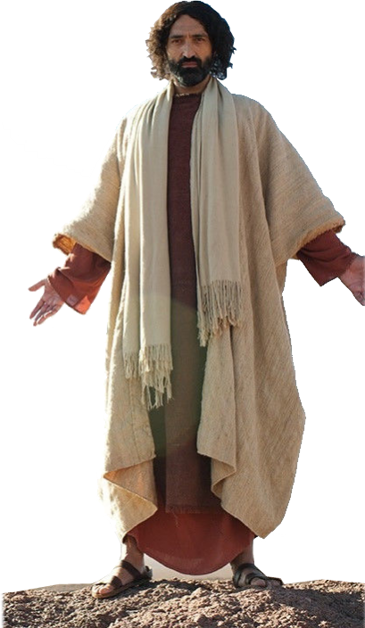
Joy in TRIALS 4:13-15
¹³ As you know, it was because of an illness that I first preached the gospel to you. ¹⁴ Even though my illness was a trial to you, you did not treat me with contempt or scorn. Instead, you welcomed me as if I were an angel of God, as if I were Christ Jesus himself. ¹⁵ What has happened to all your joy? I can testify that, if you could have done so, you would have torn out your eyes and given them to me.

Slide 7
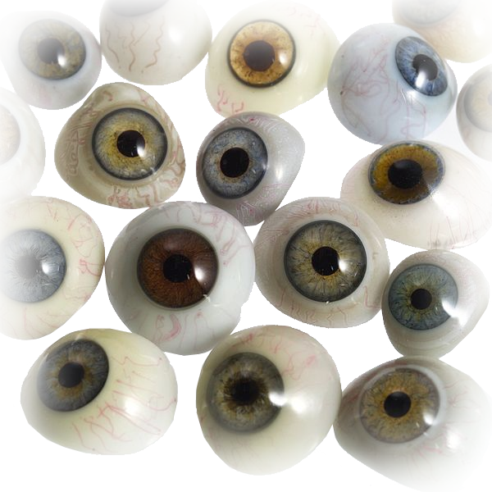
Joy in TRIALS 4:13-15
¹³ As you know, it was because of an illness that I first preached the gospel to you. ¹⁴ Even though my illness was a trial to you, you did not treat me with contempt or scorn. Instead, you welcomed me as if I were an angel of God, as if I were Christ Jesus himself. ¹⁵ What has happened to all your joy? I can testify that, if you could have done so, you would have torn out your eyes and given them to me.
Notes:
https://commons.wikimedia.org/wiki/File:A_selection_of_glass_eyes_from_an_opticians_glas_eye_case._Wellcome_L0036581.jpg

Slide 8
Joy in TRUTH 4:16-20
Notes:
Truth = FREE = https://pxhere.com/en/photo/1349206

Slide 9
Joy in TRUTH 4:16-20
¹⁶ Have I now become your enemy by telling you the truth?

Slide 10
Joy in TRUTH 4:16-20
¹⁶ Have I now become your enemy by telling you the truth?
So What Had Happened?

Slide 11
Joy in TRUTH 4:16-20
Zealous Judaizers--
¹⁷ Those people are zealous to win you over, but for no good. What they want is to alienate you from us, so that you may be zealous for them. ¹⁸ It is fine to be zealous, provided the purpose is good, and to be so always and not just when I am with you.
Notes:
Free = https://pixabay.com/en/disapprove-bad-down-rate-rated-149251/

Slide 12
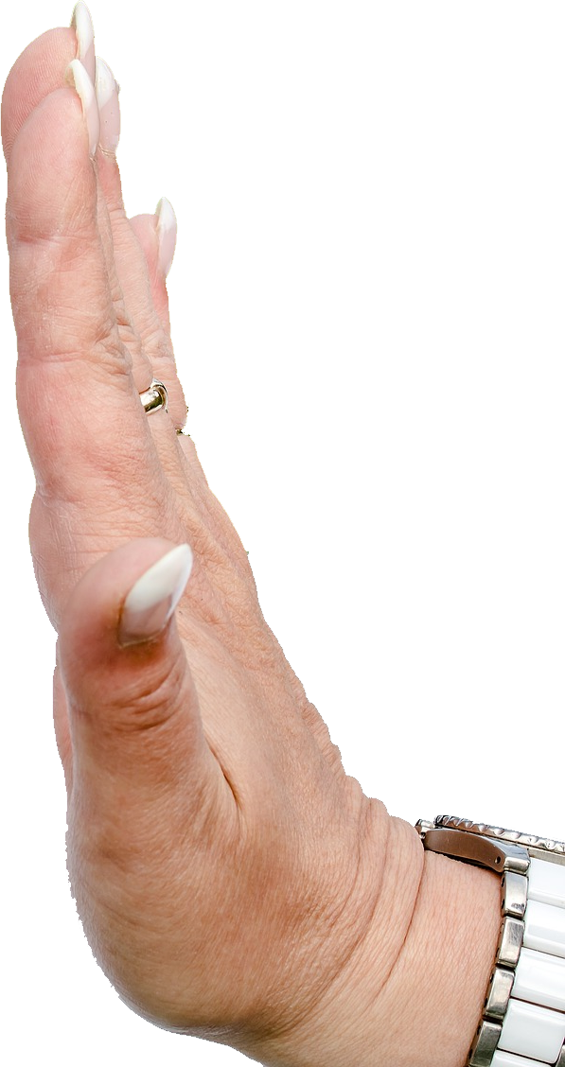
Joy in TRUTH 4:16-20
Alienation--
¹⁷ Those people are zealous to win you over, but for no good. What they want is to alienate you from us, so that you may be zealous for them. ¹⁸ It is fine to be zealous, provided the purpose is good, and to be so always and not just when I am with you.
Notes:
Rejection= FREE =https://pixabay.com/en/non-smoking-cigarette-box-cigarettes-2383236/

Slide 13
Joy in TRUTH 4:16-20
Birth Pangs--
¹⁹ My dear children, for whom I am again in the pains of childbirth until Christ is formed in you, ²⁰ how I wish I could be with you now and change my tone, because I am perplexed about you!
Notes:
Pregnant = FREE = https://pixabay.com/en/pregnant-maternity-pregnancy-woman-830685/

Slide 14
Joy in FREEDOM 4:21-31
Notes:
Free = FREE = https://pixabay.com/en/freedom-sky-hands-handcuffs-clouds-1886402/

Slide 15
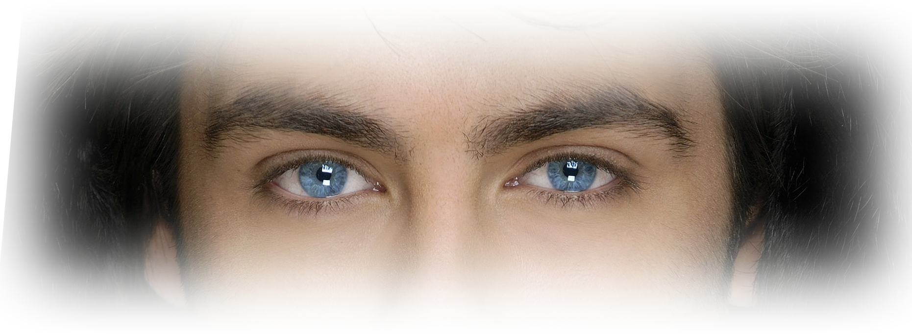
Joy in FREEDOM 4:21-31
Be Aware:
²¹ Tell me, you who want to be under the law, are you not aware of what the law says?
Notes:
Eyes = free = https://pixabay.com/en/man-singer-musician-portrait-67467/

Slide 16
Joy in FREEDOM 4:21-31
Be Aware:
²¹ Tell me, you who want to be under the law, are you not aware of what the law says? ²² For it is written that Abraham had two sons, one by the slave woman and the other by the free woman. ²³ His son by the slave woman was born in the ordinary way; but his son by the free woman was born as the result of a promise.

Slide 17
Historically Illustrated

Slide 18
75 – Abraham Called
¹ The LORD had said to Abram, "Leave your country, your people and your father's household and go to the land I will show you. ² "I will make you into a great nation and I will bless you; ...⁴ So Abram left, as the LORD had told him; Gen 12:1-4
Notes:
Abraham = FREE = from http://commons.wikimedia.org/wiki/File:Abraham_Friend_of_God.jpg

Slide 19
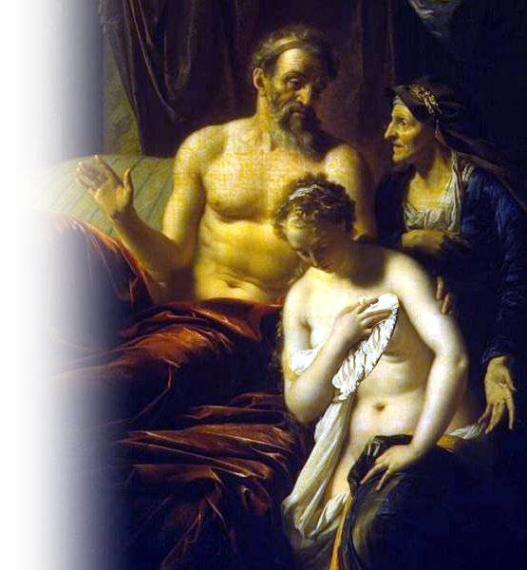
85 – Marries Hagar
¹ Now Sarai, Abram's wife, had borne him no children. But she had an Egyptian maidservant named Hagar; ² so she said to Abram, “... Go, sleep with my maidservant; perhaps I can build a family through her.“
Notes:
Abraham Sarai and Hagar = FREE = from http://commons.wikimedia.org/wiki/File:Adriaen_van_der_Werff_007.jpg

Slide 20
85 – Marries Hagar
Abram agreed to what Sarai said. ³ So after Abram had been living in Canaan ten years, Sarai his wife took her Egyptian maidservant Hagar and gave her to her husband to be his wife. Gen 16:1-3
Notes:
Abraham Sarai and Hagar = FREE = from http://commons.wikimedia.org/wiki/File:Adriaen_van_der_Werff_007.jpg

Slide 21
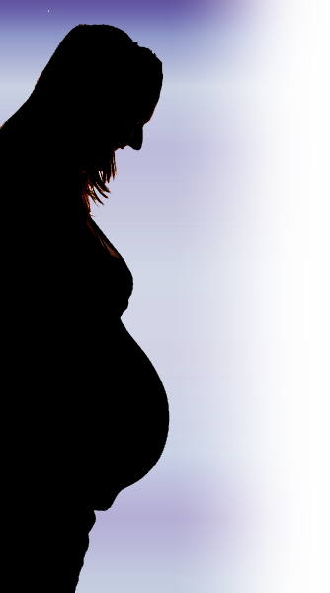
86 – Ishmael Born
⁴ He slept with Hagar, and she conceived. When she knew she was pregnant, she began to despise her mistress. ⁵ Then Sarai said to Abram, "You are responsible for the wrong I am suffering. I put my servant in your arms, and now that she knows she is pregnant, she despises me.... “¹⁵ So Hagar bore Abram a son, and Abram gave the name Ishmael to the son she had borne. ¹⁶ Abram was eighty-six years old when Hagar bore him Ishmael. Gen 16:4-16
Notes:
Pregnant woman = FREE = http://upload.wikimedia.org/wikipedia/commons/8/86/Silhouette_or_a_pregnant_woman_and_her_partner-14Aug2011.jpg

Slide 22
99 – Abraham Promised a Son
¹⁵ God also said to Abraham, "As for Sarai your wife, ...her name will be Sarah. ¹⁶ I will bless her and will surely give you a son by her. I will bless her so that she will be the mother of nations; kings of peoples will come from her.“

Slide 23
99 – Abraham Promised a Son
¹⁷ Abraham fell facedown; he laughed and said to himself, "Will a son be born to a man a hundred years old? Will Sarah bear a child at the age of ninety?“ Gen 17:15-17

Slide 24
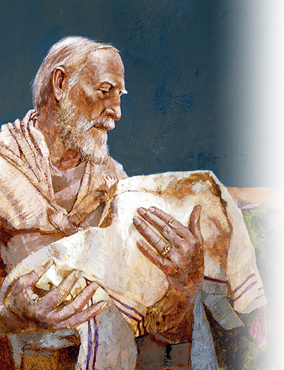
100 – Isaac Born
¹ Now the LORD was gracious to Sarah as he had said, ... ² Sarah became pregnant and bore a son to Abraham in his old age, at the very time God had promised him. Gen 21:1-2
Notes:
Abraham and Isaac = For PERSONAL AND NON-COMMERCIAL USE ONLY.

Slide 25
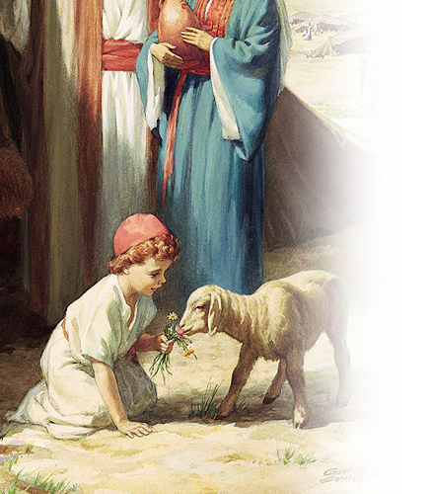
103 – Isaac Weaned
⁸ The child grew and was weaned, and on the day Isaac was weaned Abraham held a great feast. ⁹ But Sarah saw that the son whom Hagar the Egyptian had borne to Abraham was mocking, ¹⁰ and she said to Abraham, "Get rid of that slave woman and her son, for that slave woman's son will never share in the inheritance with my son Isaac." Gen 21:8-10

Slide 26
103 – Isaac Weaned
¹¹ The matter distressed Abraham greatly because it concerned his son.
¹² But God said to him, "Do not be so distressed about the boy and your maidservant. Listen to whatever Sarah tells you, because it is through Isaac that your offspring will be reckoned." Gen 21:11-12

Slide 27
Spiritually Illustrated
²⁴ These things may be taken figuratively, for the women represent two covenants.

Slide 28
Spiritually Illustrated
²⁴ These things may be taken figuratively, for the women represent two covenants.
Allegorically αλληγορεω

Slide 29
Spiritually Illustrated
²⁴ These things may be taken figuratively, for the women represent two covenants.
Allegorically αλληγορεω
αλλ another / αγορευω speak

Slide 30
Spiritually Illustrated
²⁴ These things may be taken figuratively, for the women represent two covenants. One covenant is from Mount Sinai and bears children who are to be slaves: This is Hagar. ²⁵ Now Hagar stands for Mount Sinai in Arabia and corresponds to the present city of Jerusalem, because she is in slavery with her children. ²⁶ But the Jerusalem that is above is free, and she is our mother.

Slide 31
Spiritually Illustrated
²⁷ For it is written: "Be glad, O barren woman, who bears no children; break forth and cry aloud, you who have no labor pains; because more are the children of the desolate woman than of her who has a husband.“ ²⁸ Now you, brothers, like Isaac, are children of promise. ²⁹ At that time the son born in the ordinary way persecuted the son born by the power of the Spirit. It is the same now.

Slide 32
Spiritually Illustrated
²⁴ ... for the women represent two covenants. Gal 4:24
Old Covenant
New Covenant

Slide 33
Spiritually Illustrated
²⁴ ... for the women represent two covenants. Gal 4:24
Old Covenant
Law
New Covenant
GRACE

Slide 34
Spiritually Illustrated
²⁴ ... for the women represent two covenants. Gal 4:24
Old Covenant
Law
Hagar: the slave
New Covenant
GRACE
Sarah: Freewoman

Slide 35
Spiritually Illustrated
²⁴ ... for the women represent two covenants. Gal 4:24
Old Covenant
Law
Hagar: the slave
Ishmael: fleshly
New Covenant
GRACE
Sarah: Freewoman
Isaac: miraculous

Slide 36
Spiritually Illustrated
²⁴ ... for the women represent two covenants. Gal 4:24
Old Covenant
Law
Hagar: the slave
Ishmael: fleshly
Earthly Jerusalem
New Covenant
GRACE
Sarah: Freewoman
Isaac: miraculous
Heavenly Jerusalem

Slide 37
Spiritually Illustrated
²⁴ ... for the women represent two covenants. Gal 4:24
Old Covenant
Law
Hagar: the slave
Ishmael: fleshly
Earthly Jerusalem IN BONDAGE
New Covenant
GRACE
Sarah: Freewoman
Isaac: miraculous
Heavenly Jerusalem IN FREEDOM

Slide 38
Spiritually Illustrated
Sarah & Isaac = GRACE
First Place

Slide 39
Spiritually Illustrated
Sarah & Isaac = GRACE
Hagar & Ishmael = LAW
First Place
Second Place

Slide 40
Spiritually Illustrated
Sarah & Isaac = GRACE
Hagar & Ishmael = LAW
First Place
Promised
Second Place
Notes:
Handshake = FREE = from https://pixabay.com/en/shaking-hands-handshake-hands-3098690/
Puppet = FREE = from http://www.rgbstock.com/photo/mBGiwTo/puppet

Slide 41
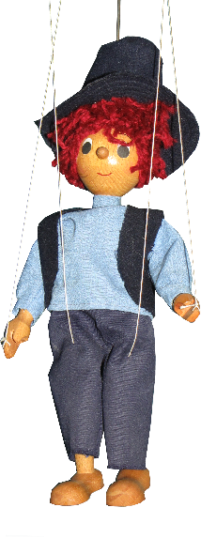
Spiritually Illustrated
Sarah & Isaac = GRACE
Hagar & Ishmael = LAW
First Place
Promised
Second Place
Manipulated
Notes:
Handshake = FREE = from https://pixabay.com/en/shaking-hands-handshake-hands-3098690/
Puppet = FREE = from http://www.rgbstock.com/photo/mBGiwTo/puppet

Slide 42
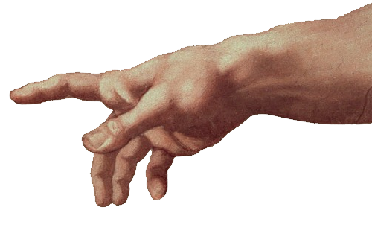
Spiritually Illustrated
Sarah & Isaac = GRACE
Hagar & Ishmael = LAW
First Place
Promised
Supernatural Power
Second Place
Manipulated

Slide 43
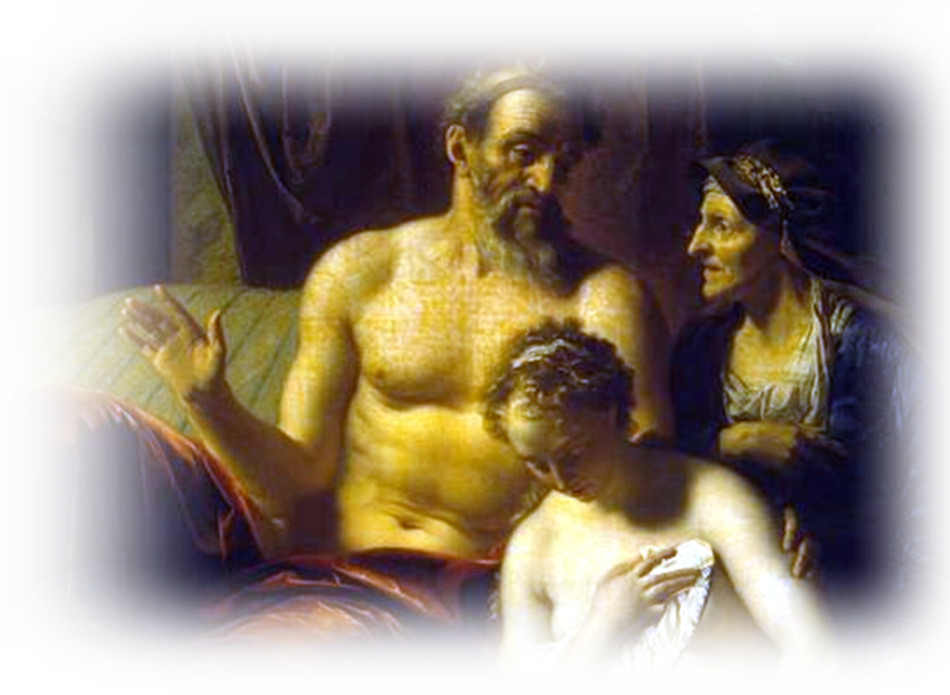
Spiritually Illustrated
Sarah & Isaac = GRACE
Hagar & Ishmael = LAW
First Place
Promised
Supernatural Power
Second Place
Manipulated
Natural Human Effort

Slide 44
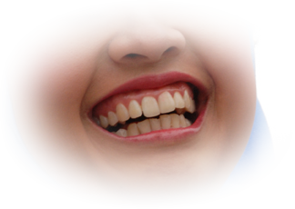
Spiritually Illustrated
Sarah & Isaac = GRACE
Hagar & Ishmael = LAW
First Place
Promised
Supernatural Power
Gift of Laughter
Second Place
Manipulated
Natural Human Effort
Notes:
Laughter = FREE = from http://commons.wikimedia.org/wiki/File:Laugh_Out_Loud.jpg
Shackle = FREE = from http://commons.wikimedia.org/wiki/File:Set_of_shackles,_late_18th_century_from_Tamale,_Ghana,_International_Slavery_Museum,_Liverpool_%281%29.JPG

Slide 45
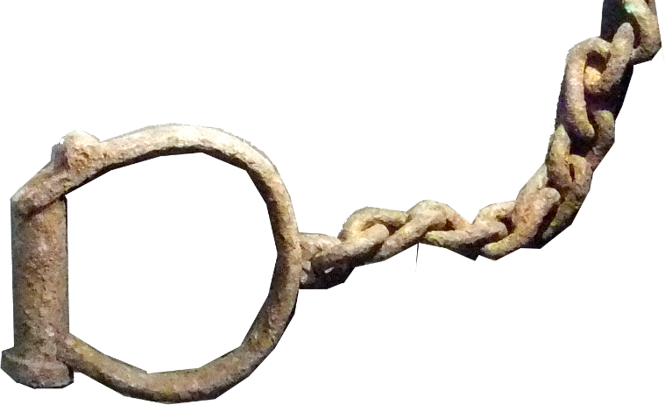
Spiritually Illustrated
Sarah & Isaac = GRACE
Hagar & Ishmael = LAW
First Place
Promised
Supernatural Power
Gift of Laughter
Second Place
Manipulated
Natural Human Effort
Life of Slavery
Notes:
Laughter = FREE = from http://commons.wikimedia.org/wiki/File:Laugh_Out_Loud.jpg
Shackle = FREE = from http://commons.wikimedia.org/wiki/File:Set_of_shackles,_late_18th_century_from_Tamale,_Ghana,_International_Slavery_Museum,_Liverpool_%281%29.JPG

Slide 46
Spiritually Illustrated
Sarah & Isaac = GRACE
Hagar & Ishmael = LAW
First Place
Promised
Supernatural Power
Gift of Laughter
Weaned & Growing
Second Place
Manipulated
Natural Human Effort
Life of Slavery
Notes:
Pacifier = FREE = from http://www.rgbstock.com/download/xymonau/dKTmot.jpg
Exit = FREE = from http://commons.wikimedia.org/wiki/File:Metal_exit_sign_with_green_text_and_permanent_directional_arrow.JPG

Slide 47
Spiritually Illustrated
Sarah & Isaac = GRACE
Hagar & Ishmael = LAW
First Place
Promised
Supernatural Power
Gift of Laughter
Weaned & Growing
Second Place
Manipulated
Natural Human Effort
Life of Slavery
Cast Out
Notes:
Pacifier = FREE = from http://www.rgbstock.com/download/xymonau/dKTmot.jpg
Exit = FREE = from http://commons.wikimedia.org/wiki/File:Metal_exit_sign_with_green_text_and_permanent_directional_arrow.JPG

Slide 48
Spiritually Illustrated
Sarah & Isaac = GRACE
Hagar & Ishmael = LAW
First Place
Promised
Supernatural Power
Gift of Laughter
Weaned & Growing
Persecuted
Second Place
Manipulated
Natural Human Effort
Life of Slavery
Cast Out
Notes:
Whipped = FREE = from http://commons.wikimedia.org/wiki/File:Carnival_002_4677.JPG

Slide 49
Spiritually Illustrated
Sarah & Isaac = GRACE
Hagar & Ishmael = LAW
First Place
Promised
Supernatural Power
Gift of Laughter
Weaned & Growing
Persecuted
Second Place
Manipulated
Natural Human Effort
Life of Slavery
Cast Out
Never Rejoined
Notes:
Whipped = FREE = from http://commons.wikimedia.org/wiki/File:Carnival_002_4677.JPG

Slide 50
Practically Illustrated
³⁰ But what does the Scripture say? "Get rid of the slave woman and her son, for the slave woman's son will never share in the inheritance with the free woman's son."
Notes:
Open Bible = FREE = from http://www.rgbstock.com/download/alexbruda/mEeoKBi.jpg

Slide 51
Practically Illustrated
³⁰ But what does the Scripture say? "Get rid of the slave woman and her son, for the slave woman's son will never share in the inheritance with the free woman's son."
³¹ Therefore, brothers, we are not children of the slave woman, but of the free woman. Galatians 4:30-31

Slide 52
We can try to change them
Notes:
U-Turn sign = FREE = from http://commons.wikimedia.org/wiki/File:MUTCD_R3-4.svg

Slide 53
We can try to change them
You cannot change God’s law or the old nature.
Notes:
U-Turn sign = FREE = from http://commons.wikimedia.org/wiki/File:MUTCD_R3-4.svg

Slide 54
We can try to compromise them
This did not work in Abraham’s home–it won’t work in yours!
Notes:
Merge sign = FREE = from http://pixabay.com/en/sign-signs-traffic-road-street-39400/

Slide 55
We can try to compromise them
This did not work in Abraham’s home–it won’t work in yours!
Do not invite Hagar and Ishmael back in.
Notes:
Merge sign = FREE = from http://pixabay.com/en/sign-signs-traffic-road-street-39400/

Slide 56
We can cast them out!
Now that Christ has come, law-keeping has to go.

Slide 57
We can cast them out!
Now that Christ has come, law-keeping has to go.
⁴ You who are trying to be justified by law have been alienated from Christ; you have fallen away from grace. Galatians 5:4

Slide 58
So Where’s the Joy?

Slide 59
So Where’s the Joy?
Answer: The Joy is living in God’s Grace

Slide 60
So Where’s the Joy?
Answer: The Joy is living in God’s Grace
Through the TRIALS

Slide 61
So Where’s the Joy?
Answer: The Joy is living in God’s Grace
Through the TRIALS
In the TRUTH

Slide 62
So Where’s the Joy?
Answer: The Joy is living in God’s Grace
Through the TRIALS
In the TRUTH
With FREEDOM in Christ!

Slide 63
Let’s Pray!

