Slide 1
Answer:
God’s FAMILY!
Notes:
Background picture of gift = LICENSED AND NOT FOR REUSE ELSEWHERE = To reuse elsewhere get a license from http://www.bigstockphoto.com/download/bid-2252323/
Copyright © 2000-2021. All rights reserved. Bible Point is a registered trademark of Dennis Henderson. All other trademarks acknowledged.
Bible Point contains graphics from Bible Point artists. These illustrations belong to Bible Point and the respective artists. You may use the designs and illustrations for graphical illustration of lessons free and without special permission, provided they are not used in any way that maligns the Christian faith. Furthermore, republication or production of any illustration by any other graphic service whether it be in book, in a machine-readable form, or in any other design resource is strictly prohibited. Furthermore, they cannot be duplicated or resold as any other form of publishing, clip art, or graphic resource.
So What does it mean? (A simple translations of the legal jargon)
So, if you don’t own the presentation(s), graphic(s), and text(s) how can you legally use them? The purchase of the license allows you to use all the images in the product. However, the actual ownership and copyright of the presentation(s), graphic(s), and text(s) remain the property of Bible Point and its licensors. If you had plans on using this product in your “for sale” work—think again!
License Agreement
Article 1: License Grant
All the graphics and text in Bible Point presentations (excluding quotes from the Bible and stated sources) are the intellectual and real property of Bible Point and its licensors, and is protected by law, including United States copyright laws and international treaties. Bible Point grants to you a license:
1. To use the presentation in a single church, single school, or single office of a Christian organization.
2. To make a single archival back-up copy of the program.
3. To modify the presentation(s) and merge with other presentations in a single church, school, or Christian organization.
4. To transfer to another party if that party agrees to accept the terms and conditions of this agreement, and you do not retain any copies of the presentation, whether printed, machine readable, modified, or merged form.
Article 2: Terms
This license is effective until terminated. You may terminate the license at any time by destroying the presentation(s), graphic(s), or text(s) together with all copies, modifications and merged portions in any form. Bible Point may terminate your license if you fail to comply with this Agreement. You agree, upon such termination, for any reason, to destroy the presentation(s), graphics, and text(s) with all copies, modifications, and merged portions in any form.
Article 3: Disclaimers
1. Bible Point presentations, graphics, and texts are licensed to you As Is. You, the consumer, bear the entire risk relating to the quality and performance of the presentation(s), graphic(s), or text(s). In no event will Bible Point be liable for damages resulting from any defect.
2. Thirty-day limited warrantee on disks. Bible Point warrants the disks to be free of defects in material and workmanship under normal use for 30 days after purchase. During the 30-day period you may return a defective presentation, graphic, or text with proof of purchase and it will be replaced without charge, unless the presentation is damaged by misuse.
Article 4: General
1. You may not sub-license, assign, or transfer the license of the presentation(s), graphic(s), or text(s) except as provided by this Agreement.
2. This Agreement will be governed by the laws of the State of Michigan.
So What does it mean? (A simple translations of the legal jargon)
May I let someone borrow or copy my licensed Bible Point presentation (even after I modified it)? As long as it is within your local church, or single school, or the immediate office of a Christian organization you may. Otherwise, please refer the person interested in borrowing to: http://www.biblepoint.com or E-mail: dh@biblepoint.com with any related questions.
---------------------------------------------------------------------------------------------------------------------------
Scripture taken from the HOLY BIBLE, NEW INTERNATIONAL VERSION®. NIV®. Copyright©1973, 1978, 1984 by International Bible Society. Used by permission of Zondervan. All rights reserved.

Slide 2
God’s Family

Slide 3
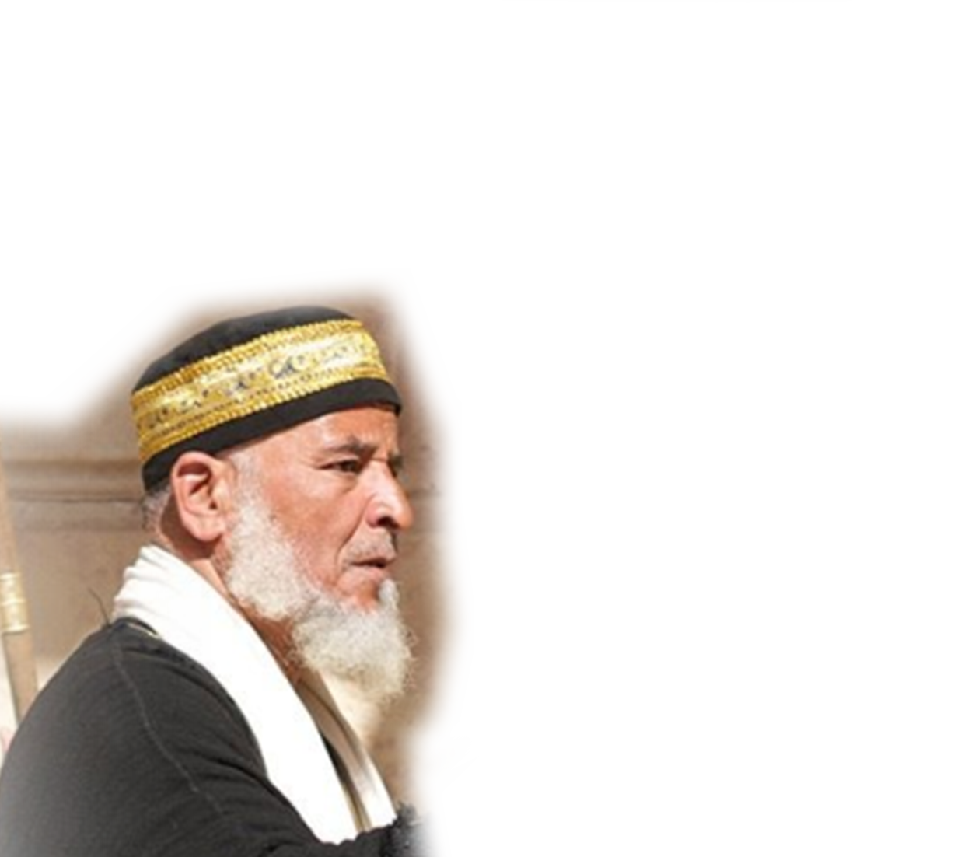
Jesus Told Us How to Become a Child of God.

Slide 4
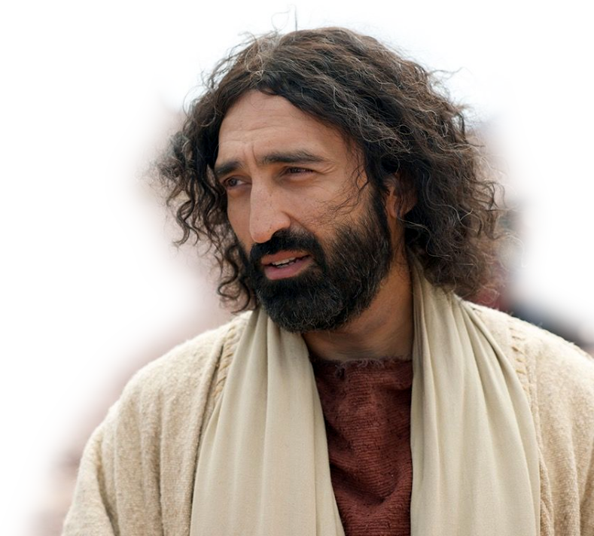
Jesus Told Us How to Become a Child of God.
³ In reply Jesus declared, "I tell you the truth, no one can see the kingdom of God unless he is born again. “

Slide 5
Jesus Told Us How to Become a Child of God.
⁴ "How can a man be born when he is old?" Nicodemus asked. "Surely he cannot enter a second time into his mother's womb to be born!“

Slide 6
Jesus Told Us How to Become a Child of God.
⁵ Jesus answered, "I tell you the truth, no one can enter the kingdom of God unless he is born of water and the Spirit.
⁶ Flesh gives birth to flesh, but the Spirit gives birth to spirit. ⁷ You should not be surprised at my saying, 'You must be born again.’

Slide 7
Jesus Told Us How to Become a Child of God.
John 1:¹¹ He came to that which was his own, but his own did not receive him. ¹² Yet to all who received him, to those who believed in his name, he gave the right to become children of God-- ¹³ children born not of natural descent, nor of human decision or a husband's will, but born of God.

Slide 8
If you have done that ...
You are a Child of God!

Slide 9
Paul Describes You as a Child of God Gal 3:29-4:12

Slide 10
1. You are an HEIR – 3:29
²⁹ If you belong to Christ, then you are Abraham's seed, and heirs according to the promise.
Notes:
Heir = FREE = http://thebluediamondgallery.com/h/heir.html
An heir is a person entitles to inherit property or a title. (here all that pertains to the promise covenant!)

Slide 11
2. You are the OWNER – 4:1
^{4:1} What I am saying is that as long as the heir is a child, he is no different from a slave, although he owns the whole estate.
Notes:
Biltmore estate = FREE = https://upload.wikimedia.org/wikipedia/commons/0/0c/Biltmore_Estate.jpg
⁸ By faith Abraham, when called to go to a place he would later receive as his inheritance, obeyed and went, even though he did not know where he was going.
⁹ By faith he made his home in the promised land like a stranger in a foreign country; he lived in tents, as did Isaac and Jacob, who were heirs with him of the same promise.
¹⁰ For he was looking forward to the city with foundations, whose architect and builder is God.
(Heb 11:8-10 NIV)
¹⁶ Instead, they were longing for a better country--a heavenly one. Therefore God is not ashamed to be called their God, for he has prepared a city for them. (Heb 11:16 NIV)
John 14:1-6

Slide 12
3. You were a MINOR 4:2
² He is subject to guardians and trustees until the time set by his father.
Notes:
FREE = https://commons.wikimedia.org/wiki/File:ParentChildIcon.svg

Slide 13
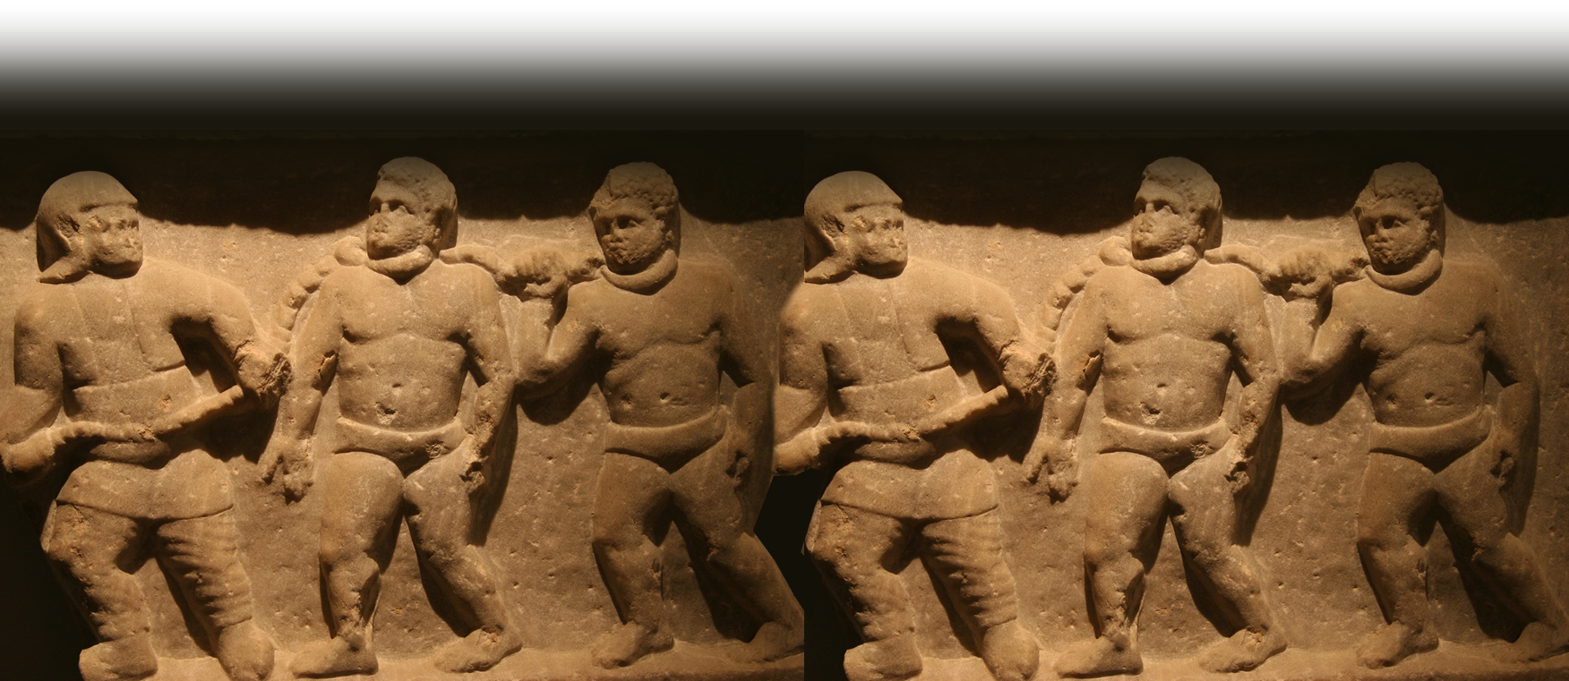
4. You were a SLAVE 4:3
³ So also, when we were children, we were in slavery under the basic principles of the world.
Notes:
Roman Slaves = FREE = https://www.flickr.com/photos/biker_jun/4338292346

Slide 14
5. You are REDEEMED 4:4,5
⁴ But when the time had fully come, God sent his Son, born of a woman, born under law, ⁵ to redeem those under law, that we might receive the full rights of sons.

Slide 15
6. You are ADOPTED 4:5
⁴ But when the time had fully come, God sent his Son, born of a woman, born under law, ⁵ to redeem those under law, that we might receive the full rights of sons.
Notes:
Adoption = FREE = http://creative-commons-images.com/handwriting/a/adoption.html

Slide 16
7. You are a FILLED 4:5
⁶ Because you are sons, God sent the Spirit of his Son into our hearts, the Spirit who calls out, "Abba, Father."

Slide 17
The Apostle Summarizes:
Who you are:
⁷ So you are no longer a slave, but a son; and since you are a son, God has made you also an heir.

Slide 18
The Apostle Summarizes:
What you were:
⁸ Formerly, when you did not know God, you were slaves to those who by nature are not gods.

Slide 19
The Apostle Summarizes:
What you are:
⁹ But now that you know God--or rather are known by God--

Slide 20
The Apostle Summarizes:
So How Is It ...
⁹ ... how is it that you are turning back to those weak and miserable principles? Do you wish to be enslaved by them all over again? ¹⁰ You are observing special days and months and seasons and years!

Slide 21
Final Plea ...
¹¹ I fear for you, that somehow I have wasted my efforts on you. ¹² I plead with you, brothers, become like me, for I became like you. You have done me no wrong.

Slide 22
Let’s Pray!

