Slide 1
Answer:
God’s PROMISE!
Notes:
Background picture of gift = LICENSED AND NOT FOR REUSE ELSEWHERE = To reuse elsewhere get a license from http://www.bigstockphoto.com/download/bid-2252323/
Copyright © 2000-2021. All rights reserved. Bible Point is a registered trademark of Dennis Henderson. All other trademarks acknowledged.
Bible Point contains graphics from Bible Point artists. These illustrations belong to Bible Point and the respective artists. You may use the designs and illustrations for graphical illustration of lessons free and without special permission, provided they are not used in any way that maligns the Christian faith. Furthermore, republication or production of any illustration by any other graphic service whether it be in book, in a machine-readable form, or in any other design resource is strictly prohibited. Furthermore, they cannot be duplicated or resold as any other form of publishing, clip art, or graphic resource.
So What does it mean? (A simple translations of the legal jargon)
So, if you don’t own the presentation(s), graphic(s), and text(s) how can you legally use them? The purchase of the license allows you to use all the images in the product. However, the actual ownership and copyright of the presentation(s), graphic(s), and text(s) remain the property of Bible Point and its licensors. If you had plans on using this product in your “for sale” work—think again!
License Agreement
Article 1: License Grant
All the graphics and text in Bible Point presentations (excluding quotes from the Bible and stated sources) are the intellectual and real property of Bible Point and its licensors, and is protected by law, including United States copyright laws and international treaties. Bible Point grants to you a license:
1. To use the presentation in a single church, single school, or single office of a Christian organization.
2. To make a single archival back-up copy of the program.
3. To modify the presentation(s) and merge with other presentations in a single church, school, or Christian organization.
4. To transfer to another party if that party agrees to accept the terms and conditions of this agreement, and you do not retain any copies of the presentation, whether printed, machine readable, modified, or merged form.
Article 2: Terms
This license is effective until terminated. You may terminate the license at any time by destroying the presentation(s), graphic(s), or text(s) together with all copies, modifications and merged portions in any form. Bible Point may terminate your license if you fail to comply with this Agreement. You agree, upon such termination, for any reason, to destroy the presentation(s), graphics, and text(s) with all copies, modifications, and merged portions in any form.
Article 3: Disclaimers
1. Bible Point presentations, graphics, and texts are licensed to you As Is. You, the consumer, bear the entire risk relating to the quality and performance of the presentation(s), graphic(s), or text(s). In no event will Bible Point be liable for damages resulting from any defect.
2. Thirty-day limited warrantee on disks. Bible Point warrants the disks to be free of defects in material and workmanship under normal use for 30 days after purchase. During the 30-day period you may return a defective presentation, graphic, or text with proof of purchase and it will be replaced without charge, unless the presentation is damaged by misuse.
Article 4: General
1. You may not sub-license, assign, or transfer the license of the presentation(s), graphic(s), or text(s) except as provided by this Agreement.
2. This Agreement will be governed by the laws of the State of Michigan.
So What does it mean? (A simple translations of the legal jargon)
May I let someone borrow or copy my licensed Bible Point presentation (even after I modified it)? As long as it is within your local church, or single school, or the immediate office of a Christian organization you may. Otherwise, please refer the person interested in borrowing to: http://www.biblepoint.com or E-mail: dh@biblepoint.com with any related questions.
---------------------------------------------------------------------------------------------------------------------------
Scripture taken from the HOLY BIBLE, NEW INTERNATIONAL VERSION®. NIV®. Copyright©1973, 1978, 1984 by International Bible Society. Used by permission of Zondervan. All rights reserved.

Slide 2
The Big Question:
“If Grace and Faith alone save, then why did God give the 10 Commandments (Law)?”
?

Slide 3
The Big Question:
“If Grace and Faith alone save, then why did God give the 10 Commandments (Law)?”
?
Paul answers that!

Slide 4
Grace is Superior to the Law!

Slide 5
Grace is Superior to the Law!
But WHY?

Slide 6
For the “Covenant” Sake 3:15-18
¹⁵ Brothers, let me take an example from everyday life. Just as no one can set aside or add to a human covenant that has been duly established, so it is in this case.

Slide 7
For the “Covenant” Sake 3:15-18
¹⁵ Brothers, let me take an example from everyday life. Just as no one can set aside or add to a human covenant that has been duly established, so it is in this case.

Slide 8
For the “Covenant” Sake 3:15-18
¹⁵ Brothers, let me take an example from everyday life. Just as no one can set aside or add to a human covenant that has been duly established, so it is in this case.

Slide 9
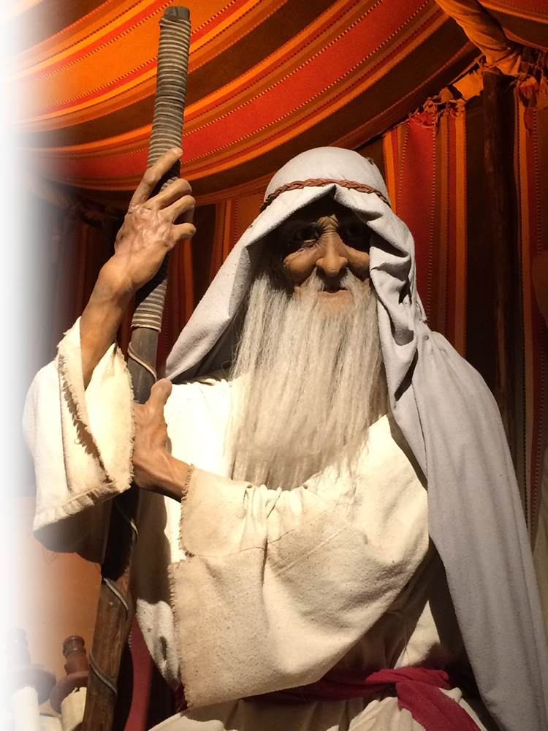
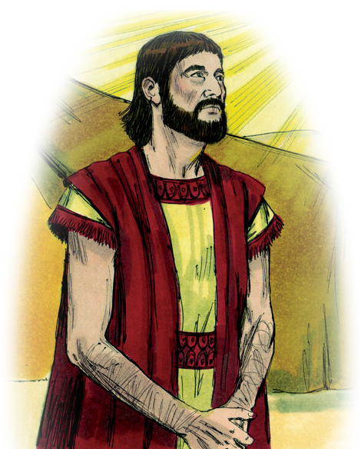
For the “Covenant” Sake 3:15-18
¹⁶ The promises were spoken to Abraham and to his seed. The Scripture does not say "and to seeds," meaning many people, but "and to your seed," meaning one person, who is Christ.
Notes:
And the LORD appeared unto Abram, and said, Unto thy seed will I give this land: and there builded he an altar unto the LORD, who appeared unto him. (Gen 12:7 KJV)
For all the land which thou seest, to thee will I give it, and to thy seed for ever. (Gen 13:15 KJV)
And I will establish my covenant between me and thee and thy seed after thee in their generations for an everlasting covenant, to be a God unto thee, and to thy seed after thee. (Gen 17:7 KJV)
The LORD God of heaven, which took me from my father's house, and from the land of my kindred, and which spake unto me, and that sware unto me, saying, Unto thy seed will I give this land; he shall send his angel before thee, and thou shalt take a wife unto my son from thence. (Gen 24:7 KJV)

Slide 10
For the “Covenant” Sake 3:15-18
¹⁶ The promises were spoken to Abraham and to his seed. The Scripture does not say "and to seeds," meaning many people, but "and to your seed," meaning one person, who is Christ.
Notes:
And the LORD appeared unto Abram, and said, Unto thy seed will I give this land: and there builded he an altar unto the LORD, who appeared unto him. (Gen 12:7 KJV)
For all the land which thou seest, to thee will I give it, and to thy seed for ever. (Gen 13:15 KJV)
And I will establish my covenant between me and thee and thy seed after thee in their generations for an everlasting covenant, to be a God unto thee, and to thy seed after thee. (Gen 17:7 KJV)
The LORD God of heaven, which took me from my father's house, and from the land of my kindred, and which spake unto me, and that sware unto me, saying, Unto thy seed will I give this land; he shall send his angel before thee, and thou shalt take a wife unto my son from thence. (Gen 24:7 KJV)

Slide 11
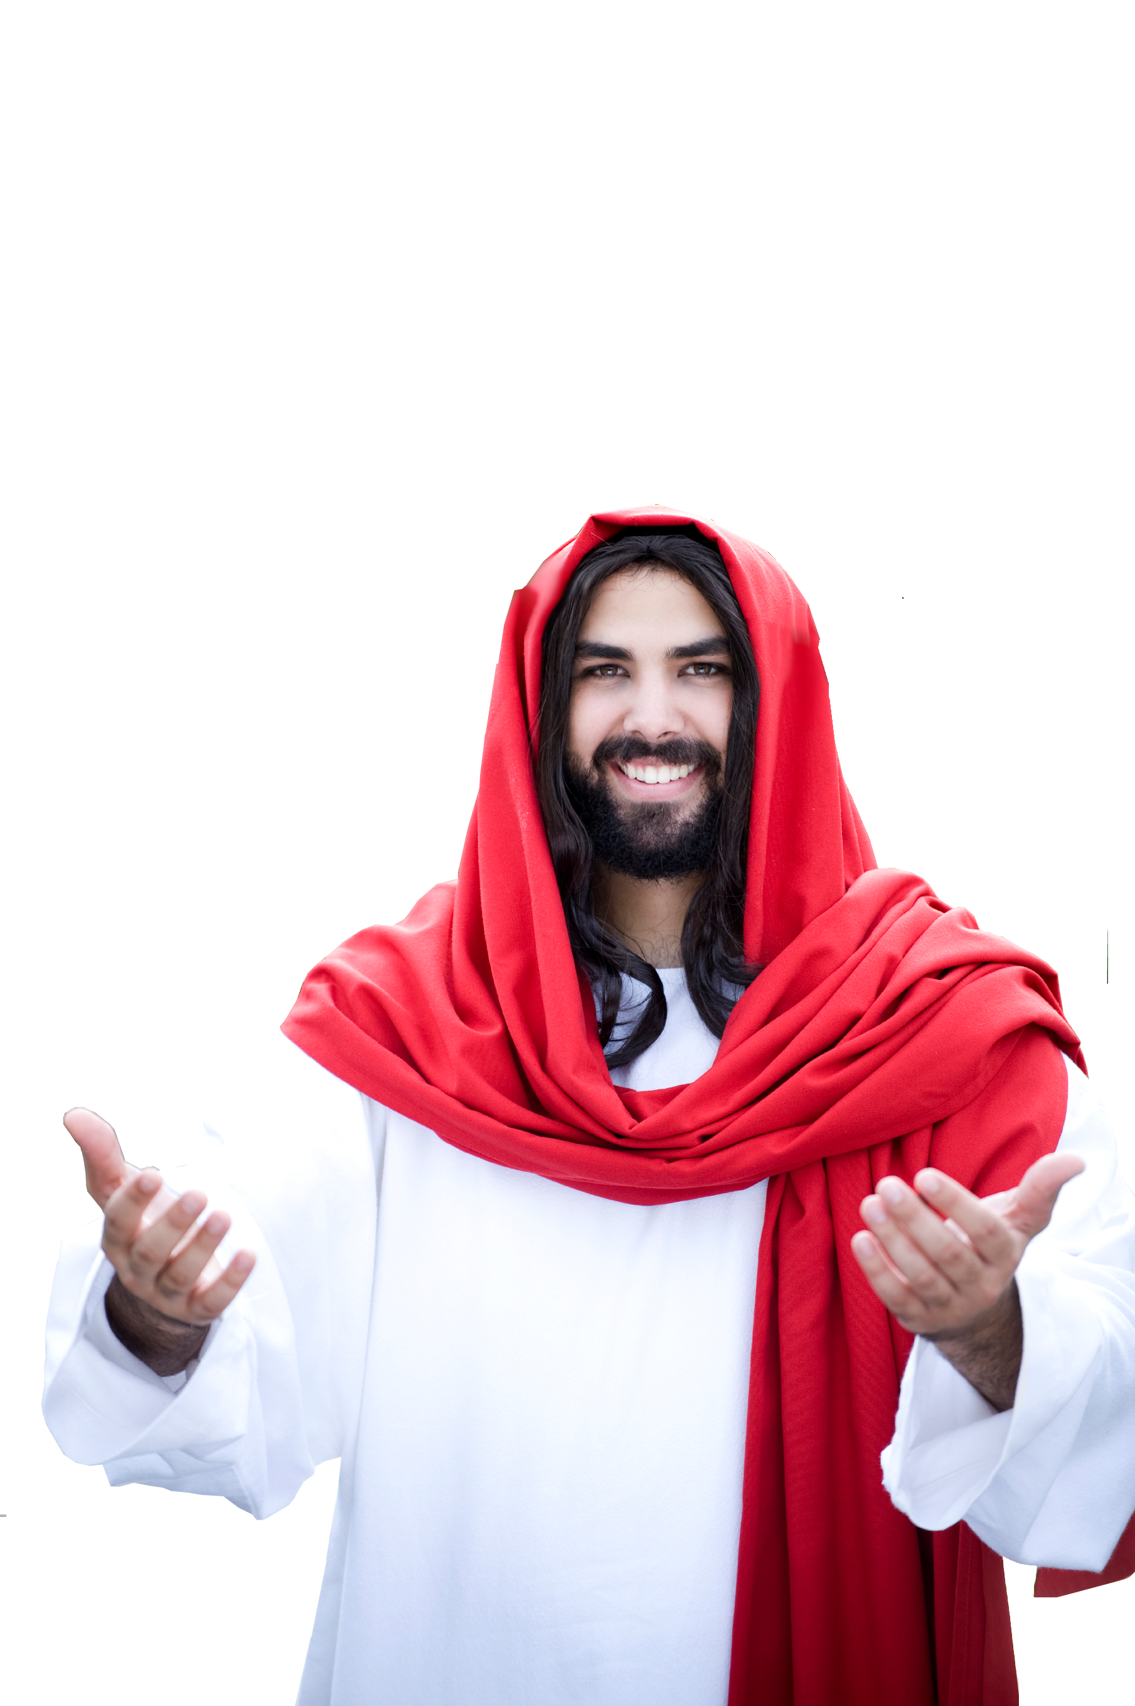
For the “Covenant” Sake 3:15-18
¹⁶ The promises were spoken to Abraham and to his seed. The Scripture does not say "and to seeds," meaning many people, but "and to your seed," meaning one person, who is Christ.

Slide 12
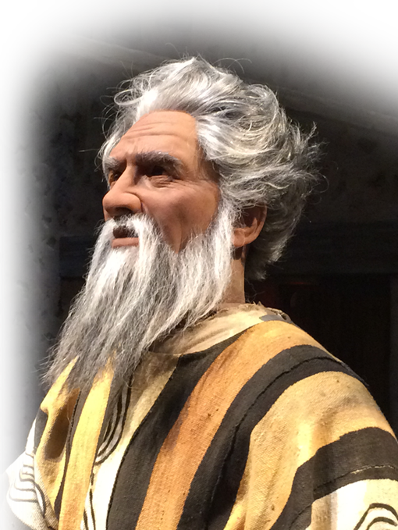
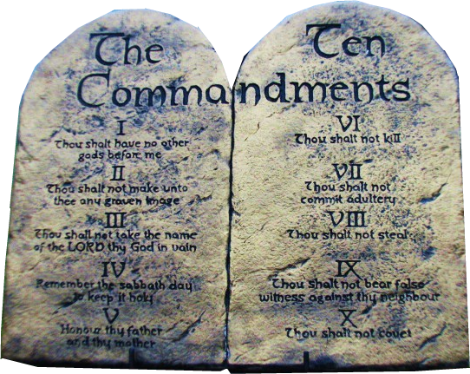
For the “Covenant” Sake 3:15-18
¹⁷ What I mean is this: The law, introduced 430 years later, does not set aside the covenant previously established by God and thus do away with the promise.
1440 BC
Notes:
Abraham – Jacob – Moses =FREE =from http://distantshoresmedia.org/resources/illustrations/sweet-publishing/genesis
Abraham lived sometime between 2100 and 1900 BC
Jacob

Slide 13
For the “Covenant” Sake 3:15-18
¹⁷ What I mean is this: The law, introduced 430 years later, does not set aside the covenant previously established by God and thus do away with the promise.
430 YEARS
1870 BC
1440 BC
Notes:
Abraham – Jacob – Moses =FREE =from http://distantshoresmedia.org/resources/illustrations/sweet-publishing/genesis
Abraham lived sometime between 2100 and 1900 BC
Jacob

Slide 14
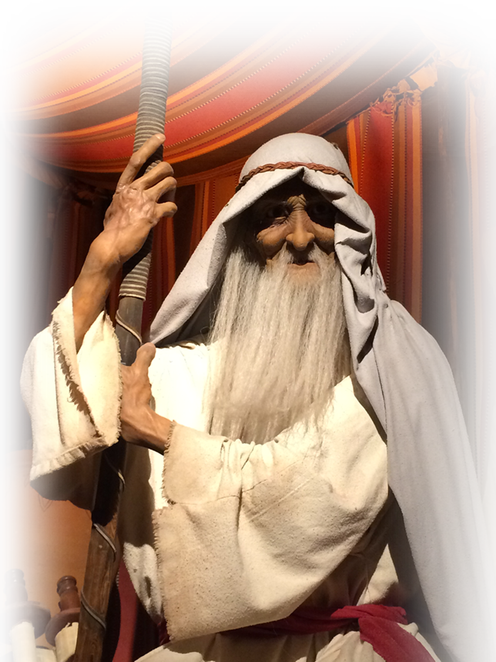
For the “Covenant” Sake 3:15-18
¹⁷ What I mean is this: The law, introduced 430 years later, does not set aside the covenant previously established by God and thus do away with the promise.
430 YEARS
2100-1900 BC
1870 BC
1440 BC
Notes:
Abraham – Jacob – Moses =FREE =from http://distantshoresmedia.org/resources/illustrations/sweet-publishing/genesis
Abraham lived sometime between 2100 and 1900 BC
The Promise Covenant was reconfirmed with son Isaac and grandson Jacob.

Slide 15
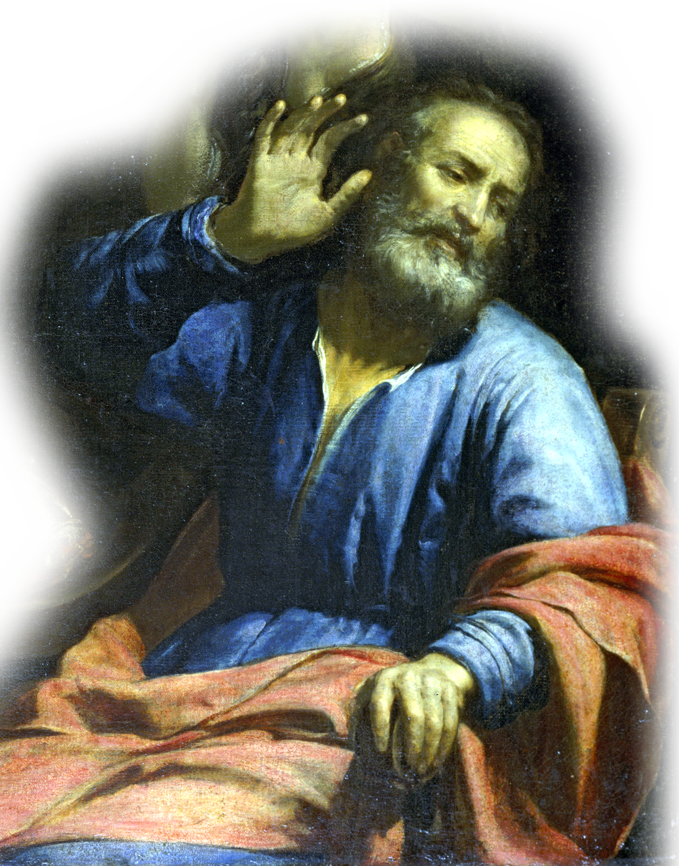
For the “Covenant” Sake 3:15-18
¹⁷ What I mean is this: The law, introduced 430 years later, does not set aside the covenant previously established by God and thus do away with the promise.
430 YEARS
2100-1900 BC
1870 BC
1440 BC
Notes:
Abraham – Jacob – Moses =FREE =from http://distantshoresmedia.org/resources/illustrations/sweet-publishing/genesis
Abraham lived sometime between 2100 and 1900 BC
The Promise Covenant was reconfirmed with son Isaac and grandson Jacob.
Genesis 46:1 So Israel set out with all that was his, and when he reached Beersheba, he offered sacrifices to the God of his father Isaac.
² And God spoke to Israel in a vision at night and said, "Jacob! Jacob!" "Here I am," he replied.
³ "I am God, the God of your father," he said. "Do not be afraid to go down to Egypt, for I will make you into a great nation there.
⁴ I will go down to Egypt with you, and I will surely bring you back again. And Joseph's own hand will close your eyes." (Gen 46:1-4 NIV)

Slide 16
For the “Covenant” Sake 3:15-18
¹⁷ What I mean is this: The law, introduced 430 years later, does not set aside the covenant previously established by God and thus do away with the promise.
The Point: The Promise came before the Law and the Law cannot alter it!
430 YEARS
2100-1900 BC
1870 BC
1440 BC
Notes:
Abraham – Jacob – Moses =FREE =from http://distantshoresmedia.org/resources/illustrations/sweet-publishing/genesis
Abraham lived sometime between 2100 and 1900 BC
Jacob

Slide 17
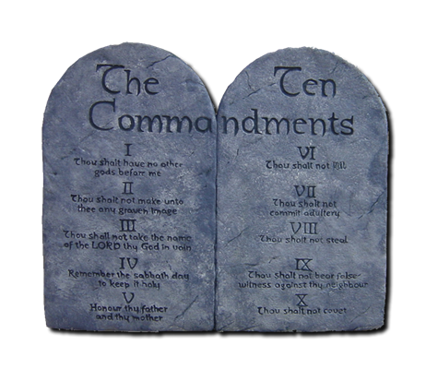
For the “Covenant” Sake 3:15-18
¹⁸ For if the inheritance depends on the law, then it no longer depends on a promise; but God in his grace gave it to Abraham through a promise.
LAW / WORKS

Slide 18
For the “Covenant” Sake 3:15-18
¹⁸ For if the inheritance depends on the law, then it no longer depends on a promise; but God in his grace gave it to Abraham through a promise.
PROMISE
LAW / WORKS

Slide 19
For the “Covenant” Sake 3:15-18
¹⁸ For if the inheritance depends on the law, then it no longer depends on a promise; but God in his grace gave it to Abraham through a promise.
PROMISE
Notes:
He ratified the “Covenant of Promise” with Abraham in Gen 15 in a unilateral, blood covenant.

Slide 20
Why is Grace Superior to the Law? For the “Covenant” Sake

Slide 21
Why is Grace Superior to the Law? For the “Covenant” Sake
AND ...

Slide 22
For the “Addition” Sake 3:19-20
?3
¹⁹ What, then, was the purpose of the law?
Notes:
If it does not negate or add to the Promise, then why did God give the law?

Slide 23
For the “Addition” Sake 3:19-20
+
¹⁹ What, then, was the purpose of the law? It was added because of transgressions ...
Notes:
If it does not negate or add to the Promise, then why did God give the law?

Slide 24
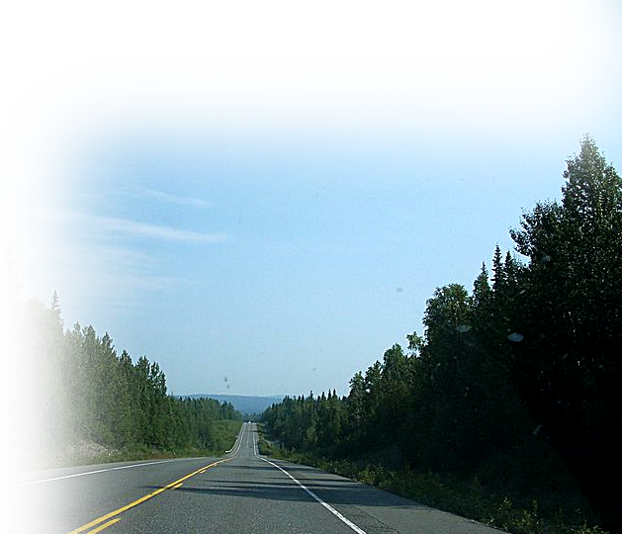
For the “Addition” Sake 3:19-20
¹⁹ What, then, was the purpose of the law? It was added because of transgressions ...
Notes:
Highway = FREE = http://commons.wikimedia.org/wiki/File:George_park_highway.jpg
If it does not negate or add to the Promise, then why did God give the law?

Slide 25
For the “Addition” Sake 3:19-20
¹⁹ What, then, was the purpose of the law? It was added because of transgressions ...
Notes:
Highway = FREE = http://commons.wikimedia.org/wiki/File:George_park_highway.jpg
If it does not negate or add to the Promise, then why did God give the law?

Slide 26
For the “Addition” Sake 3:19-20
¹⁹ What, then, was the purpose of the law? It was added because of transgressions until the Seed to whom the promise referred had come.

Slide 27
For the “Addition” Sake 3:19-20
¹⁹ What, then, was the purpose of the law? It was added because of transgressions until the Seed to whom the promise referred had come.

Slide 28
For the “Addition” Sake 3:19-20
.... The law was put into effect through angels by a mediator. ²⁰ A mediator, however, does not represent just one party; but God is one.
Notes:
Moses = FREE = from http://commons.wikimedia.org/wiki/File:Moses041.jpg
Angel = FREE = from http://upload.wikimedia.org/wikipedia/commons/8/80/Statue_at_Metairie_Cemetery.jpg

Slide 29
For the “Addition” Sake 3:19-20
.... The law was put into effect through angels by a mediator. ²⁰ A mediator, however, does not represent just one party; but God is one.
Notes:
Moses = FREE = from http://commons.wikimedia.org/wiki/File:Moses041.jpg
Angel = FREE = from http://upload.wikimedia.org/wikipedia/commons/8/80/Statue_at_Metairie_Cemetery.jpg

Slide 30
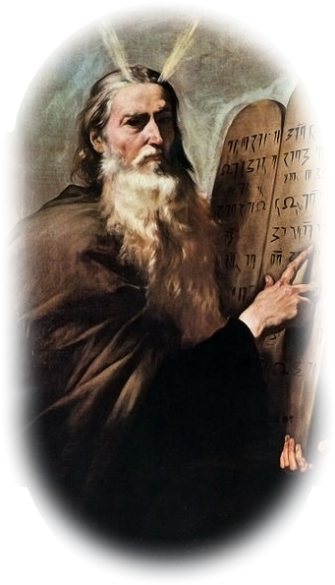
For the “Addition” Sake 3:19-20
.... The law was put into effect through angels by a mediator. ²⁰ A mediator, however, does not represent just one party; but God is one.
Notes:
Moses = FREE = from http://commons.wikimedia.org/wiki/File:Moses041.jpg
Angel = FREE = from http://upload.wikimedia.org/wikipedia/commons/8/80/Statue_at_Metairie_Cemetery.jpg

Slide 31
For the “Addition” Sake 3:19-20
.... The law was put into effect through angels by a mediator. ²⁰ A mediator, however, does not represent just one party; but God is one.
Notes:
Moses = FREE = from http://commons.wikimedia.org/wiki/File:Moses041.jpg
Angel = FREE = from http://upload.wikimedia.org/wikipedia/commons/8/80/Statue_at_Metairie_Cemetery.jpg

Slide 32
For the “Addition” Sake 3:19-20
.... The law was put into effect through angels by a mediator. ²⁰ A mediator, however, does not represent just one party; but God is one.
PROMISE BY GRACE
Notes:
Moses = FREE = from http://commons.wikimedia.org/wiki/File:Moses041.jpg
Angel = FREE = from http://upload.wikimedia.org/wikipedia/commons/8/80/Statue_at_Metairie_Cemetery.jpg

Slide 33
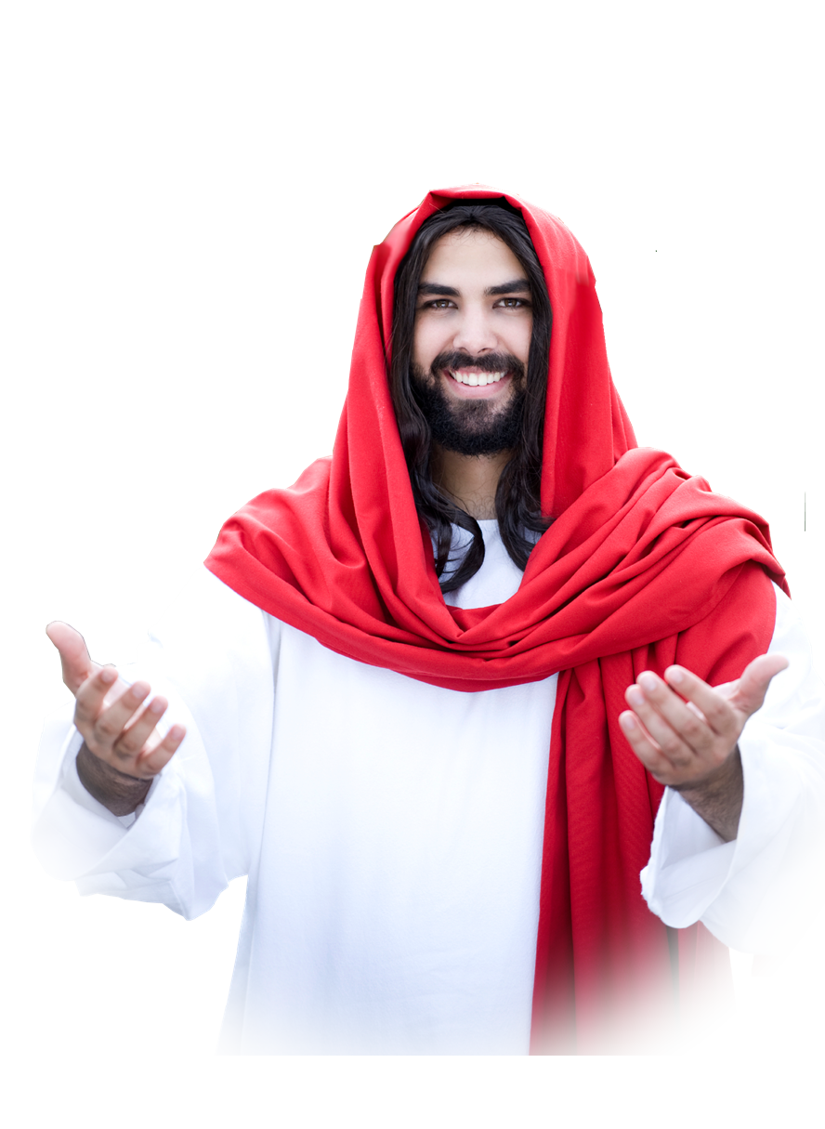
For the “Addition” Sake 3:19-20
.... The law was put into effect through angels by a mediator. ²⁰ A mediator, however, does not represent just one party; but God is one.
PROMISE BY GRACE
Notes:
Moses = FREE = from http://commons.wikimedia.org/wiki/File:Moses041.jpg
Angel = FREE = from http://upload.wikimedia.org/wikipedia/commons/8/80/Statue_at_Metairie_Cemetery.jpg

Slide 34
Why is Grace Superior to the Law? For the “Covenant” Sake For the “Addition” Sake
AND ...

Slide 35
For the “Hypothetical” sake 3:21
²¹ Is the law, therefore, opposed to the promises of God?

Slide 36
For the “Hypothetical” sake 3:21
²¹ Is the law, therefore, opposed to the promises of God?

Slide 37
For the “Hypothetical” sake 3:21
²¹ Is the law, therefore, opposed to the promises of God? Absolutely Not!
Is the law sin? Certainly not! Indeed I would not have known what sin was except through the law. For I would not have known what coveting really was if the law had not said, "Do not covet." Rom 7:7

Slide 38
For the “Hypothetical” sake 3:21
²¹ Is the law, therefore, opposed to the promises of God? Absolutely Not!
¹⁴ We know that the law is spiritual; but I am unspiritual, sold as a slave to sin. Rom 7:14

Slide 39
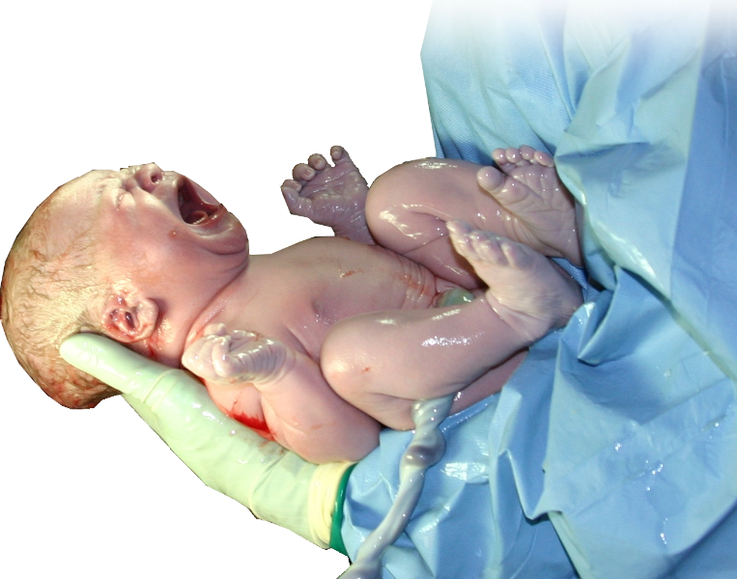
For the “Hypothetical” sake 3:21
²¹ ... For if a law had been given that could impart life, then righteousness would certainly have come by the law.
Notes:
2nd Class Condition = Determined as Unfulfilled. “If” = “If a law had been given and there was not such a law” etc.
Newborn baby = FREE = from http://upload.wikimedia.org/wikipedia/commons/3/38/HumanNewborn.JPG

Slide 40
For the “Hypothetical” sake 3:21
²¹ ... For if a law had been given that could impart life, then righteousness would certainly have come by the law.
Notes:
2nd Class Condition = Determined as Unfulfilled. “If” = “If a law had been given and there was not such a law” etc.
Newborn baby = FREE = from http://upload.wikimedia.org/wikipedia/commons/3/38/HumanNewborn.JPG

Slide 41
Why is Grace Superior to the Law? For the “Covenant” Sake For the “Addition” Sake For the “Hypothetical” Sake
AND ...

Slide 42
For the “Scriptures” Sake 3:22-25
²² But the Scripture declares that the whole world is a prisoner of sin, so that what was promised, being given through faith in Jesus Christ, might be given to those who believe.
Notes:
Globe = FREE = from http://commons.wikimedia.org/wiki/File:Earth_from_Space.jpg
behind bars = FREE = http://upload.wikimedia.org/wikipedia/commons/thumb/7/73/Cela.jpg/399px-Cela.jpg

Slide 43
For the “Scriptures” Sake 3:22-25
²² But the Scripture declares that the whole world is a prisoner of sin, so that what was promised, being given through faith in Jesus Christ, might be given to those who believe.
Notes:
Globe = FREE = from http://commons.wikimedia.org/wiki/File:Earth_from_Space.jpg
behind bars = FREE = http://upload.wikimedia.org/wikipedia/commons/thumb/7/73/Cela.jpg/399px-Cela.jpg

Slide 44
For the “Scriptures” Sake 3:22-25
²³ Before this faith came,
Notes:
Globe = FREE = from http://commons.wikimedia.org/wiki/File:Earth_from_Space.jpg
behind bars = FREE = http://upload.wikimedia.org/wikipedia/commons/thumb/7/73/Cela.jpg/399px-Cela.jpg

Slide 45
For the “Scriptures” Sake 3:22-25
²³ Before this faith came, we were held prisoners by the law, locked up until faith should be revealed.
Notes:
Globe = FREE = from http://commons.wikimedia.org/wiki/File:Earth_from_Space.jpg
behind bars = FREE = http://upload.wikimedia.org/wikipedia/commons/thumb/7/73/Cela.jpg/399px-Cela.jpg

Slide 46
For the “Scriptures” Sake 3:22-25
²³ Before this faith came, we were held prisoners by the law, locked up until faith should be revealed.
“Locked up” IN OUR TRANSGRESSION GUILT, SIN, &
UNDER THE CURSE
Notes:
Globe = FREE = from http://commons.wikimedia.org/wiki/File:Earth_from_Space.jpg
behind bars = FREE = http://upload.wikimedia.org/wikipedia/commons/thumb/7/73/Cela.jpg/399px-Cela.jpg

Slide 47
For the “Scriptures” Sake 3:22-25
²³ Before this faith came, we were held prisoners by the law, locked up until faith should be revealed. ²⁴ So the law was put in charge to lead us to Christ that we might be justified by faith.
Notes:
Globe = FREE = from http://commons.wikimedia.org/wiki/File:Earth_from_Space.jpg
behind bars = FREE = http://upload.wikimedia.org/wikipedia/commons/thumb/7/73/Cela.jpg/399px-Cela.jpg

Slide 48
For the “Scriptures” Sake 3:22-25
²³ Before this faith came, we were held prisoners by the law, locked up until faith should be revealed. ²⁴ So the law was put in charge to lead us to Christ that we might be justified by faith.
Notes:
Globe = FREE = from http://commons.wikimedia.org/wiki/File:Earth_from_Space.jpg
behind bars = FREE = http://upload.wikimedia.org/wikipedia/commons/thumb/7/73/Cela.jpg/399px-Cela.jpg

Slide 49
For the “Scriptures” Sake 3:22-25
²³ Before this faith came, we were held prisoners by the law, locked up until faith should be revealed. ²⁴ So the law was put in charge to lead us to Christ that we might be justified by faith.
Notes:
Globe = FREE = from http://commons.wikimedia.org/wiki/File:Earth_from_Space.jpg
behind bars = FREE = http://upload.wikimedia.org/wikipedia/commons/thumb/7/73/Cela.jpg/399px-Cela.jpg

Slide 50
For the “Scriptures” Sake 3:22-25
²³ Before this faith came, we were held prisoners by the law, locked up until faith should be revealed. ²⁴ So the law was put in charge to lead us to Christ that we might be justified by faith.
Notes:
Globe = FREE = from http://commons.wikimedia.org/wiki/File:Earth_from_Space.jpg
behind bars = FREE = http://upload.wikimedia.org/wikipedia/commons/thumb/7/73/Cela.jpg/399px-Cela.jpg

Slide 51
For the “Scriptures” Sake 3:22-25
²⁵ Now that faith has come, we are no longer under the supervision of the law.
Notes:
Globe = FREE = from http://commons.wikimedia.org/wiki/File:Earth_from_Space.jpg
behind bars = FREE = http://upload.wikimedia.org/wikipedia/commons/thumb/7/73/Cela.jpg/399px-Cela.jpg

Slide 52
For the “Scriptures” Sake 3:22-25
²⁵ Now that faith has come, we are no longer under the supervision of the law.
Notes:
Globe = FREE = from http://commons.wikimedia.org/wiki/File:Earth_from_Space.jpg
behind bars = FREE = http://upload.wikimedia.org/wikipedia/commons/thumb/7/73/Cela.jpg/399px-Cela.jpg

Slide 53
For the “Scriptures” Sake 3:22-25
²² But the Scripture declares that the whole world is a prisoner of sin, so that what was promised, being given through faith in Jesus Christ, might be given to those who believe.
Notes:
Globe = FREE = from http://commons.wikimedia.org/wiki/File:Earth_from_Space.jpg
behind bars = FREE = http://upload.wikimedia.org/wikipedia/commons/thumb/7/73/Cela.jpg/399px-Cela.jpg

Slide 54
Why is Grace Superior to the Law? For the “Covenant” Sake For the “Addition” Sake For the “Hypothetical” Sake For the “Scriptures” Sake
AND ...

Slide 55
For “Reality” Sake 3:26-29
Notes:
Globe = FREE = from http://commons.wikimedia.org/wiki/File:Earth_from_Space.jpg
behind bars = FREE = http://upload.wikimedia.org/wikipedia/commons/thumb/7/73/Cela.jpg/399px-Cela.jpg

Slide 56
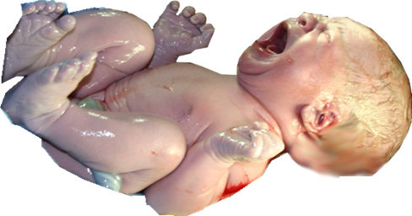
You are SONS! 3:26
²⁶ You are all sons of God through faith in Christ Jesus,
Notes:
Globe = FREE = from http://commons.wikimedia.org/wiki/File:Earth_from_Space.jpg
behind bars = FREE = http://upload.wikimedia.org/wikipedia/commons/thumb/7/73/Cela.jpg/399px-Cela.jpg

Slide 57
You are SONS! 3:26
²⁶ You are all sons of God through faith in Christ Jesus,
Notes:
Globe = FREE = from http://commons.wikimedia.org/wiki/File:Earth_from_Space.jpg
behind bars = FREE = http://upload.wikimedia.org/wikipedia/commons/thumb/7/73/Cela.jpg/399px-Cela.jpg

Slide 58
You are BAPTIZED! 3:27
²⁷ for all of you who were baptized into Christ have clothed yourselves with Christ.
Notes:
Globe = FREE = from http://commons.wikimedia.org/wiki/File:Earth_from_Space.jpg
behind bars = FREE = http://upload.wikimedia.org/wikipedia/commons/thumb/7/73/Cela.jpg/399px-Cela.jpg

Slide 59
You are BAPTIZED! 3:27
²⁷ for all of you who were baptized into Christ have clothed yourselves with Christ.
Notes:
Globe = FREE = from http://commons.wikimedia.org/wiki/File:Earth_from_Space.jpg
behind bars = FREE = http://upload.wikimedia.org/wikipedia/commons/thumb/7/73/Cela.jpg/399px-Cela.jpg

Slide 60
You are BAPTIZED! 3:27
²⁷ for all of you who were baptized into Christ have clothed yourselves with Christ.
Notes:
Globe = FREE = from http://commons.wikimedia.org/wiki/File:Earth_from_Space.jpg
behind bars = FREE = http://upload.wikimedia.org/wikipedia/commons/thumb/7/73/Cela.jpg/399px-Cela.jpg

Slide 61
You are BAPTIZED! 3:27
²⁷ for all of you who were baptized into Christ have clothed yourselves with Christ.
Notes:
Globe = FREE = from http://commons.wikimedia.org/wiki/File:Earth_from_Space.jpg
behind bars = FREE = http://upload.wikimedia.org/wikipedia/commons/thumb/7/73/Cela.jpg/399px-Cela.jpg

Slide 62
You are BAPTIZED! 3:27
²⁷ for all of you who were baptized into Christ have clothed yourselves with Christ.
Notes:
Globe = FREE = from http://commons.wikimedia.org/wiki/File:Earth_from_Space.jpg
behind bars = FREE = http://upload.wikimedia.org/wikipedia/commons/thumb/7/73/Cela.jpg/399px-Cela.jpg

Slide 63
You are BAPTIZED! 3:27
²⁷ for all of you who were baptized into Christ have clothed yourselves with Christ.
Notes:
Globe = FREE = from http://commons.wikimedia.org/wiki/File:Earth_from_Space.jpg
behind bars = FREE = http://upload.wikimedia.org/wikipedia/commons/thumb/7/73/Cela.jpg/399px-Cela.jpg

Slide 64
You are BAPTIZED! 3:27
²⁷ for all of you who were baptized into Christ have clothed yourselves with Christ.
Notes:
Globe = FREE = from http://commons.wikimedia.org/wiki/File:Earth_from_Space.jpg
behind bars = FREE = http://upload.wikimedia.org/wikipedia/commons/thumb/7/73/Cela.jpg/399px-Cela.jpg

Slide 65
You are ONE! 3:28
²⁸ There is neither Jew nor Greek, slave nor free, male nor female, for you are all one in Christ Jesus.
Notes:
Globe = FREE = from http://commons.wikimedia.org/wiki/File:Earth_from_Space.jpg
behind bars = FREE = http://upload.wikimedia.org/wikipedia/commons/thumb/7/73/Cela.jpg/399px-Cela.jpg

Slide 66
You are HEIRS 3:29
²⁹ If you belong to Christ, then you are Abraham's seed, and heirs according to the promise.

Slide 67
You are HEIRS 3:29
²⁹ If you belong to Christ, then you are Abraham's seed, and heirs according to the promise.

Slide 68
You are HEIRS 3:29
²⁹ If you belong to Christ, then you are Abraham's seed, and heirs according to the promise.

Slide 69
You are HEIRS 3:29
²⁹ If you belong to Christ, then you are Abraham's seed, and heirs according to the promise.
“heirs” OF SLAVATION – BEING MADE RIGHT WITH GOD

Slide 70
Let’s Sum It Up!

Slide 71
Let’s Sum It Up!
The LAW (rule keeping) never could save you.

Slide 72
Let’s Sum It Up!
The LAW (rule keeping) never could save you.
Why the LAW then?

Slide 73
Let’s Sum It Up!
The LAW (rule keeping) never could save you.
Why the LAW then? To show you that you need a Savior, Jesus!

Slide 74
Let’s Sum It Up!
The LAW (rule keeping) never could save you.
Why the LAW then? To show you that you need a Savior, Jesus!
It is the GRACE of God that brings FAITH in Jesus alone that saves you.

Slide 75
Let’s Sum It Up!
The LAW (rule keeping) never could save you.
Why the LAW then? To show you that you need a Savior, Jesus!
It is the GRACE of God that brings FAITH in Jesus alone that saves you.
You can receive that Grace today!

Slide 76
Let’s Pray!

