Slide 1
Notes:
Background picture of gift = LICENSED AND NOT FOR REUSE ELSEWHERE = To reuse elsewhere get a license from http://www.bigstockphoto.com/download/bid-2252323/
Copyright © 2000-2021. All rights reserved. Bible Point is a registered trademark of Dennis Henderson. All other trademarks acknowledged.
Bible Point contains graphics from Bible Point artists. These illustrations belong to Bible Point and the respective artists. You may use the designs and illustrations for graphical illustration of lessons free and without special permission, provided they are not used in any way that maligns the Christian faith. Furthermore, republication or production of any illustration by any other graphic service whether it be in book, in a machine-readable form, or in any other design resource is strictly prohibited. Furthermore, they cannot be duplicated or resold as any other form of publishing, clip art, or graphic resource.
So What does it mean? (A simple translations of the legal jargon)
So, if you don’t own the presentation(s), graphic(s), and text(s) how can you legally use them? The purchase of the license allows you to use all the images in the product. However, the actual ownership and copyright of the presentation(s), graphic(s), and text(s) remain the property of Bible Point and its licensors. If you had plans on using this product in your “for sale” work—think again!
License Agreement
Article 1: License Grant
All the graphics and text in Bible Point presentations (excluding quotes from the Bible and stated sources) are the intellectual and real property of Bible Point and its licensors, and is protected by law, including United States copyright laws and international treaties. Bible Point grants to you a license:
1. To use the presentation in a single church, single school, or single office of a Christian organization.
2. To make a single archival back-up copy of the program.
3. To modify the presentation(s) and merge with other presentations in a single church, school, or Christian organization.
4. To transfer to another party if that party agrees to accept the terms and conditions of this agreement, and you do not retain any copies of the presentation, whether printed, machine readable, modified, or merged form.
Article 2: Terms
This license is effective until terminated. You may terminate the license at any time by destroying the presentation(s), graphic(s), or text(s) together with all copies, modifications and merged portions in any form. Bible Point may terminate your license if you fail to comply with this Agreement. You agree, upon such termination, for any reason, to destroy the presentation(s), graphics, and text(s) with all copies, modifications, and merged portions in any form.
Article 3: Disclaimers
1. Bible Point presentations, graphics, and texts are licensed to you As Is. You, the consumer, bear the entire risk relating to the quality and performance of the presentation(s), graphic(s), or text(s). In no event will Bible Point be liable for damages resulting from any defect.
2. Thirty-day limited warrantee on disks. Bible Point warrants the disks to be free of defects in material and workmanship under normal use for 30 days after purchase. During the 30-day period you may return a defective presentation, graphic, or text with proof of purchase and it will be replaced without charge, unless the presentation is damaged by misuse.
Article 4: General
1. You may not sub-license, assign, or transfer the license of the presentation(s), graphic(s), or text(s) except as provided by this Agreement.
2. This Agreement will be governed by the laws of the State of Michigan.
So What does it mean? (A simple translations of the legal jargon)
May I let someone borrow or copy my licensed Bible Point presentation (even after I modified it)? As long as it is within your local church, or single school, or the immediate office of a Christian organization you may. Otherwise, please refer the person interested in borrowing to: http://www.biblepoint.com or E-mail: dh@biblepoint.com with any related questions.
---------------------------------------------------------------------------------------------------------------------------
Scripture taken from the HOLY BIBLE, NEW INTERNATIONAL VERSION®. NIV®. Copyright©1973, 1978, 1984 by International Bible Society. Used by permission of Zondervan. All rights reserved.

Slide 2
Answer:
Salvation!
Notes:
Background picture of gift = LICENSED AND NOT FOR REUSE ELSEWHERE = To reuse elsewhere get a license from http://www.bigstockphoto.com/download/bid-2252323/

Slide 3
Last time we learned that ...
It is by GRACE and through FAITH ALONE that we are made right with God!

Slide 4
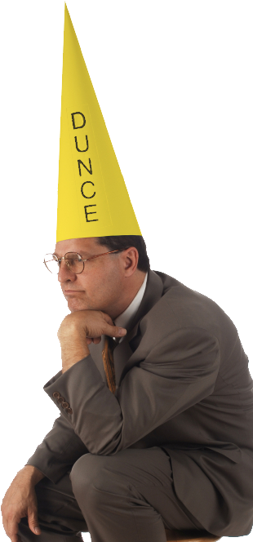
The Apostle Starts Accusing
You foolish Galatians! Gal 3:1
Notes:
Dunce = Licensed and NOT FOR REUSE ELSEWHERE = to use elsewhere get a license from istock photo.
Bewitched is copyrighted and is used here in compliance with fair use as described at http://en.wikipedia.org/wiki/File:Bewitched_color_title_card.jpg.
Paul accuses the Galatians of being foolish (literally = spiritually dull). Paul is saying, You spiritually dull Galatians!” He is not violating the words of Jesus in Mat 5:22 “But anyone who says, 'You fool!' will be in danger of the fire of hell,” because two different words are used for “fool”. The word “fool” used by Jesus means a “Godless person.”
God wants us to be sharp Christians—not dull ones.
After accusing them of being “spiritually dull,” He asks 6 penetrating questions. The first of which is “Who has bewitched you?”
The NLT captures to force of this, “who has cast a spell on you?” The idea of the question is, you are gone astray who led you down the wrong path. They must have done so with deceitfulness, for certainly no one in their right mind would have turned aside like you have.

Slide 5
The Apostle Starts Accusing
You foolish Galatians! Who has bewitched you?
Gal 3:1
Notes:
Dunce = Licensed and NOT FOR REUSE ELSEWHERE = to use elsewhere get a license from istock photo.
Bewitched is copyrighted and is used here in compliance with fair use as described at http://en.wikipedia.org/wiki/File:Bewitched_color_title_card.jpg.
Paul accuses the Galatians of being foolish (literally = spiritually dull). Paul is saying, You spiritually dull Galatians!” He is not violating the words of Jesus in Mat 5:22 “But anyone who says, 'You fool!' will be in danger of the fire of hell,” because two different words are used for “fool”. The word “fool” used by Jesus means a “Godless person.”
God wants us to be sharp Christians—not dull ones.
After accusing them of being “spiritually dull,” He asks 6 penetrating questions. The first of which is “Who has bewitched you?”
The NLT captures to force of this, “who has cast a spell on you?” The idea of the question is, you are gone astray who led you down the wrong path. They must have done so with deceitfulness, for certainly no one in their right mind would have turned aside like you have.

Slide 6
1-Don’t Be Fooled About ...
Notes:
People are still fooled today about the crucifixion– It really didn’t take place, or Jesus didn’t really die, it was just a good example, etc.

Slide 7
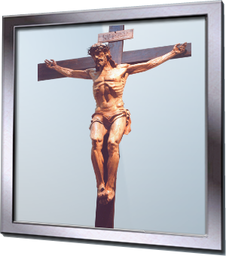
1-Don’t Be Fooled About ...
... the Crucifixion 3:1
Before your very eyes Jesus Christ was clearly portrayed as crucified. (Gal 3:1)
Notes:
People are still fooled today about the crucifixion– It really didn’t take place, or Jesus didn’t really die, it was just a good example, etc.

Slide 8
1-Don’t Be Fooled About ...
... the Spirit 3:2
² I would like to learn just one thing from you: Did you receive the Spirit by observing the law, or by believing what you heard?

Slide 9
1-Don’t Be Fooled About ...
... the Christian Life 3:3
³ Are you so foolish? After beginning with the Spirit, are you now trying to attain your goal by human effort?
Notes:
Neon Now = FREE = https://www.flickr.com/photos/genista/9536652

Slide 10
1-Don’t Be Fooled About ...
... the Purpose 3:4
⁴ Have you suffered so much for nothing--if it really was for nothing?
Notes:
Black hole = https://news.science360.gov/obj/pic-day/410e8fc8-53e6-4ccc-8106-cd57efcf9a69/lonely-black-hole-relic-shines-light-young-universe

Slide 11
1-Don’t Be Fooled About ...
... the Reason 3:5
⁵ Does God give you his Spirit and work miracles among you because you observe the law, or because you believe what you heard?
Notes:
Why = FREE = https://media.defense.gov/2017/Nov/13/2001842185/-1/-1/0/171026-F-RN211-001.JPG
We often attribute to God the wrong reason for which He does things...

Slide 12
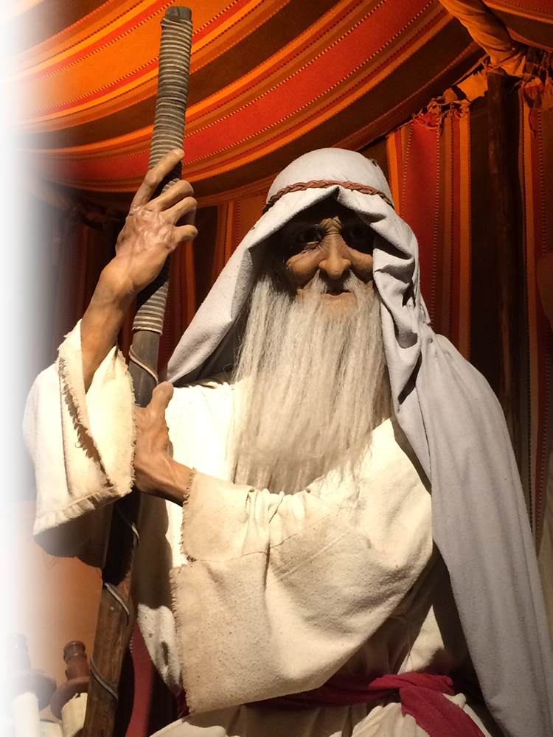
2-Instead Consider ...
Abraham
⁶ Consider Abraham
Notes:
Gen12:3

Slide 13
2-Instead Consider ...
Abraham’s Faith 3:6
⁶ Consider Abraham: "He believed God, and it was credited to him as righteousness."

Slide 14
2-Instead Consider ...
Abraham’s Faith 3:6
⁶ Consider Abraham: "He believed God, and it was credited to him as righteousness."

Slide 15
2-Instead Consider ...
Abraham’s Children 3:7
⁷ Understand, then, that those who believe are children of Abraham.

Slide 16
2-Instead Consider ...
Abraham’s Blessing 3:8-9
⁸ The Scripture foresaw that God would justify the Gentiles by faith, and announced the gospel in advance to Abraham: "All nations will be blessed through you." ⁹ So those who have faith are blessed along with Abraham, the man of faith.

Slide 17
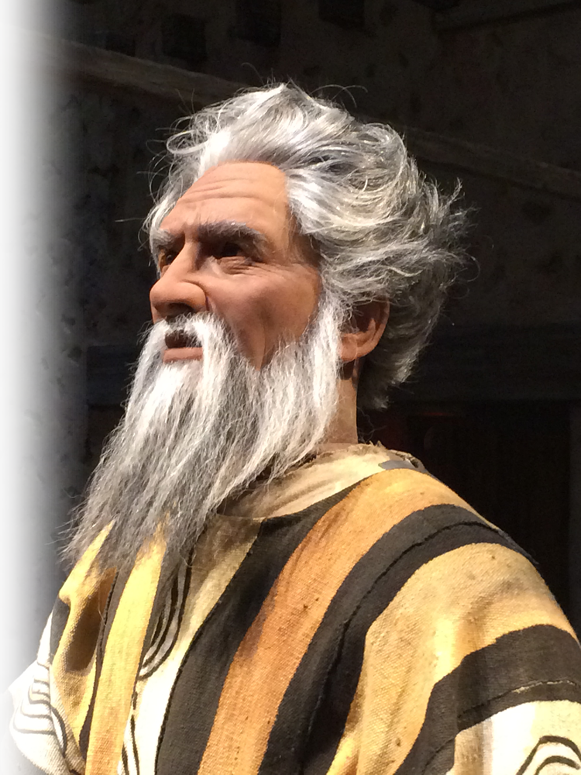
2-Instead Consider ...
Moses

Slide 18
2-Instead Consider ...
Moses’ Curse 3:10
¹⁰ All who rely on observing the law are under a curse, for it is written: "Cursed is everyone who does not continue to do everything written in the Book of the Law."
Notes:
Deut 27:26

Slide 19
2-Instead Consider ...
Habakkuk

Slide 20
2-Instead Consider ...
Habakkuk's Fact 3:10
¹¹ Clearly no one is justified before God by the law, because, "The righteous will live by faith."

Slide 21
3-So Recognize the Difference...

Slide 22
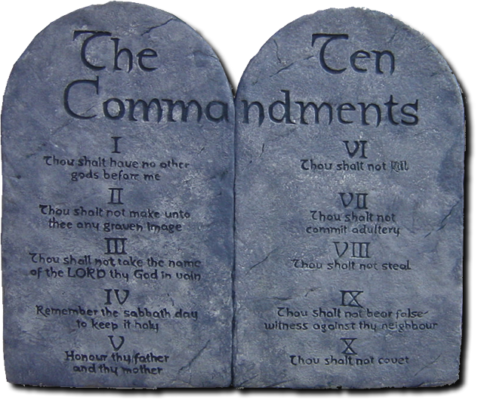
3-So Recognize the Difference...
Between Law and Faith 3:12
¹² The law is not based on faith;

Slide 23
3-So Recognize the Difference...
Between Doing and Believing 3:12
¹² The law is not based on faith; on the contrary, "The man who does these things will live by them."
DO!
BELIEVE

Slide 24
3-So Recognize the Difference...
Between Cursing and Redeeming
¹³ Christ redeemed us from the curse of the law by becoming a curse for us, for it is written: "Cursed is everyone who is hung on a tree."

Slide 25
3-So Recognize the Difference...
Between Cursing and Blessing
¹³ Christ redeemed us from the curse of the law by becoming a curse for us, for it is written: "Cursed is everyone who is hung on a tree." ¹⁴ He redeemed us in order that the blessing given to Abraham might come to the Gentiles through Christ Jesus, so that by faith we might receive the promise of the Spirit.

Slide 26
3-So Recognize the Difference...
Between Cursing and Promise
¹³ Christ redeemed us from the curse of the law by becoming a curse for us, for it is written: "Cursed is everyone who is hung on a tree." ¹⁴ He redeemed us in order that the blessing given to Abraham might come to the Gentiles through Christ Jesus, so that by faith we might receive the promise of the Spirit.

Slide 27
So what do we take away today?

Slide 28
So what do we take away today?
Don’t be fooled!

Slide 29
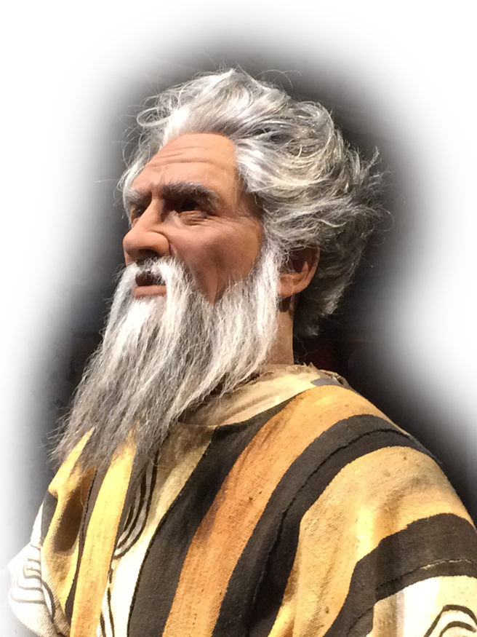
So what do we take away today?
Don’t be fooled!
Instead, consider those who have gone before us!

Slide 30
So what do we take away today?
Don’t be fooled!
Instead, consider those who have gone before us!
Rely on faith over law!

Slide 31
All summed up in ...
⁸ For it is by GRACE you have been SAVED, through FAITH--and this not from yourselves, it is the gift of God--⁹not by works, so that no one can boast.
--Ephesians 2:8-9

Slide 32
This Amazing Grace is offered today!

Slide 33
Let’s Pray!

