Slide 1
Notes:
Background picture of gift = LICENSED AND NOT FOR REUSE ELSEWHERE = To reuse elsewhere get a license from http://www.bigstockphoto.com/download/bid-2252323/
Copyright © 2000-2021. All rights reserved. Bible Point is a registered trademark of Dennis Henderson. All other trademarks acknowledged.
Bible Point contains graphics from Bible Point artists. These illustrations belong to Bible Point and the respective artists. You may use the designs and illustrations for graphical illustration of lessons free and without special permission, provided they are not used in any way that maligns the Christian faith. Furthermore, republication or production of any illustration by any other graphic service whether it be in book, in a machine-readable form, or in any other design resource is strictly prohibited. Furthermore, they cannot be duplicated or resold as any other form of publishing, clip art, or graphic resource.
So What does it mean? (A simple translations of the legal jargon)
So, if you don’t own the presentation(s), graphic(s), and text(s) how can you legally use them? The purchase of the license allows you to use all the images in the product. However, the actual ownership and copyright of the presentation(s), graphic(s), and text(s) remain the property of Bible Point and its licensors. If you had plans on using this product in your “for sale” work—think again!
License Agreement
Article 1: License Grant
All the graphics and text in Bible Point presentations (excluding quotes from the Bible and stated sources) are the intellectual and real property of Bible Point and its licensors, and is protected by law, including United States copyright laws and international treaties. Bible Point grants to you a license:
1. To use the presentation in a single church, single school, or single office of a Christian organization.
2. To make a single archival back-up copy of the program.
3. To modify the presentation(s) and merge with other presentations in a single church, school, or Christian organization.
4. To transfer to another party if that party agrees to accept the terms and conditions of this agreement, and you do not retain any copies of the presentation, whether printed, machine readable, modified, or merged form.
Article 2: Terms
This license is effective until terminated. You may terminate the license at any time by destroying the presentation(s), graphic(s), or text(s) together with all copies, modifications and merged portions in any form. Bible Point may terminate your license if you fail to comply with this Agreement. You agree, upon such termination, for any reason, to destroy the presentation(s), graphics, and text(s) with all copies, modifications, and merged portions in any form.
Article 3: Disclaimers
1. Bible Point presentations, graphics, and texts are licensed to you As Is. You, the consumer, bear the entire risk relating to the quality and performance of the presentation(s), graphic(s), or text(s). In no event will Bible Point be liable for damages resulting from any defect.
2. Thirty-day limited warrantee on disks. Bible Point warrants the disks to be free of defects in material and workmanship under normal use for 30 days after purchase. During the 30-day period you may return a defective presentation, graphic, or text with proof of purchase and it will be replaced without charge, unless the presentation is damaged by misuse.
Article 4: General
1. You may not sub-license, assign, or transfer the license of the presentation(s), graphic(s), or text(s) except as provided by this Agreement.
2. This Agreement will be governed by the laws of the State of Michigan.
So What does it mean? (A simple translations of the legal jargon)
May I let someone borrow or copy my licensed Bible Point presentation (even after I modified it)? As long as it is within your local church, or single school, or the immediate office of a Christian organization you may. Otherwise, please refer the person interested in borrowing to: http://www.biblepoint.com or E-mail: dh@biblepoint.com with any related questions.
---------------------------------------------------------------------------------------------------------------------------
Scripture taken from the HOLY BIBLE, NEW INTERNATIONAL VERSION®. NIV®. Copyright©1973, 1978, 1984 by International Bible Society. Used by permission of Zondervan. All rights reserved.

Slide 2
Answer:
FAITH!
Notes:
Background picture of gift = LICENSED AND NOT FOR REUSE ELSEWHERE = To reuse elsewhere get a license from http://www.bigstockphoto.com/download/bid-2252323/

Slide 3
Grace is Amazing Because...

Slide 4
Grace is Amazing Because...
It is by GRACE and through FAITH ALONE that we are made right with God!

Slide 5
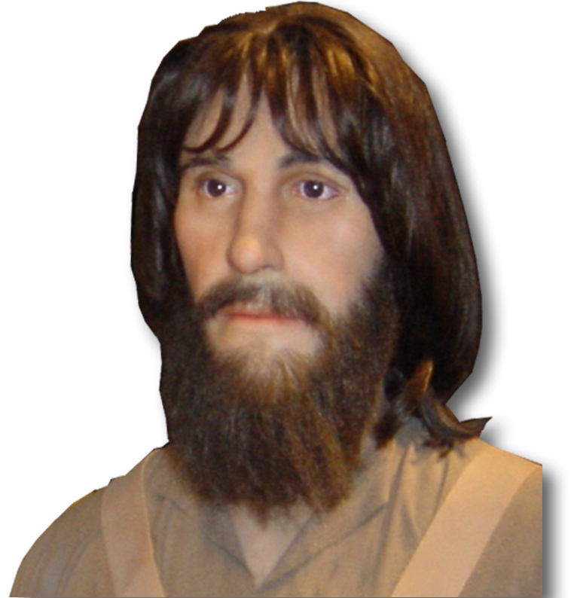
Here’s the Situation
Notes:
At some point Peter made a trip to Antioch, and when he did, he fit in with the Gentile believers just as God had told him to in Act 10.
He was not eating Kosher but perhaps ate ham sandwiches at the potluck with all the Gentile believers—but then a delegation of Jews came to Antioch. And Peter stopped fellowshipping with the Gentile believers and only hung with the Jewish ones.
Paul has a few things to say about that....

Slide 6
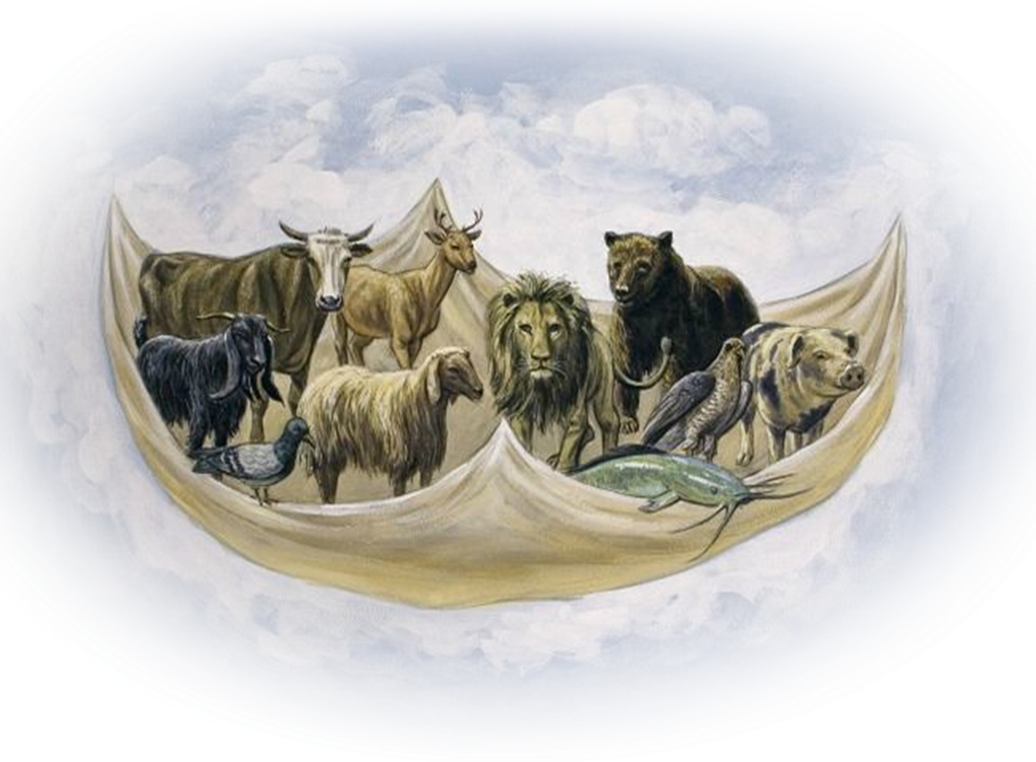
Here’s the Situation
Notes:
At some point Peter made a trip to Antioch, and when he did, he fit in with the Gentile believers just as God had told him to in Act 10.
He was not eating Kosher but perhaps ate ham sandwiches at the potluck with all the Gentile believers—but then a delegation of Jews came to Antioch. And Peter stopped fellowshipping with the Gentile believers and only hung with the Jewish ones.
Paul has a few things to say about that....

Slide 7
Here’s the Situation
Notes:
At some point Peter made a trip to Antioch, and when he did, he fit in with the Gentile believers just as God had told him to in Act 10.
He was not eating Kosher but perhaps ate ham sandwiches at the potluck with all the Gentile believers—but then a delegation of Jews came to Antioch. And Peter stopped fellowshipping with the Gentile believers and only hung with the Jewish ones.
Paul has a few things to say about that....

Slide 8
Here’s the Situation
Notes:
At some point Peter made a trip to Antioch, and when he did, he fit in with the Gentile believers just as God had told him to in Act 10.
He was not eating Kosher but perhaps ate ham sandwiches at the potluck with all the Gentile believers—but then a delegation of Jews came to Antioch. And Peter stopped fellowshipping with the Gentile believers and only hung with the Jewish ones.
Paul has a few things to say about that....

Slide 9
Here’s the Situation
Notes:
At some point Peter made a trip to Antioch, and when he did, he fit in with the Gentile believers just as God had told him to in Act 10.
He was not eating Kosher but perhaps ate ham sandwiches at the potluck with all the Gentile believers—but then a delegation of Jews came to Antioch. And Peter stopped fellowshipping with the Gentile believers and only hung with the Jewish ones.
Paul has a few things to say about that....

Slide 10
³⁴ Then Peter began to speak: "I now realize how true it is that God does not show favoritism ³⁵ but accepts men from every nation who fear him and do what is right. (Acts 10:34-35)
Notes:
At some point Peter made a trip to Antioch, and when he did, he fit in with the Gentile believers just as God had told him to in Act 10.
He was not eating Kosher but perhaps ate ham sandwiches at the potluck with all the Gentile believers—but then a delegation of Jews came to Antioch. And Peter stopped fellowshipping with the Gentile believers and only hung with the Jewish ones.
Paul has a few things to say about that....

Slide 11
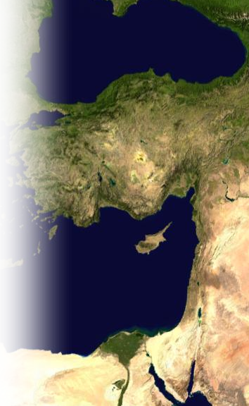
We Pick Up at 2:11
¹¹ When Peter came to Antioch,
Notes:
Wrong X = FREE = from http://pixabay.com/en/red-box-cross-square-wrong-39414/

Slide 12
1-The Opponents to Faith 2:11
¹¹ When Peter came to Antioch, I opposed him to his face, because he was clearly in the wrong.
Notes:
Wrong X = FREE = from http://pixabay.com/en/red-box-cross-square-wrong-39414/

Slide 13
1-The Opponents to Faith 2:11
¹¹ When Peter came to Antioch, I opposed him to his face, because he was clearly in the wrong.
Notes:
Wrong X = FREE = from http://pixabay.com/en/red-box-cross-square-wrong-39414/

Slide 14
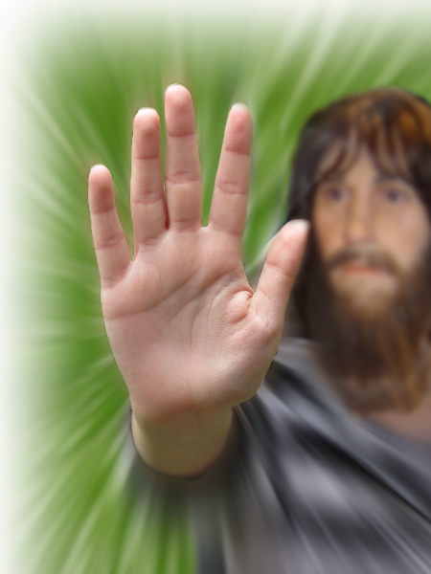
Prejudice opposes Faith 2:12
¹² Before certain men came from James, he used to eat with the Gentiles. But when they arrived, he began to draw back and separate himself from the Gentiles because he was afraid of those who belonged to the circumcision group.
Notes:
Hand = Modified = FREE = from http://www.sxc.hu/browse.phtml?f=download&id=1182571

Slide 15
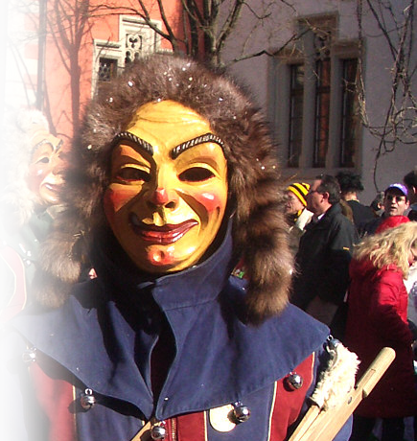
Hypocrisy opposes Faith 2:13
¹³ The other Jews joined him in his hypocrisy, so that by their hypocrisy even Barnabas was led astray.
Notes:
Mask = FREE = from https://upload.wikimedia.org/wikipedia/commons/b/b6/Ravensburg_Fasnet_Papierkrattler_2005.jpg

Slide 16
Diversion opposes Faith 2:14
¹⁴ When I saw that they were not acting in line with the truth of the gospel, I said to Peter in front of them all, "You are a Jew, yet you live like a Gentile and not like a Jew. How is it, then, that you force Gentiles to follow Jewish customs?
HYPOCRISY
GOSPEL TRUTH

Slide 17
2-The Importance of Faith

Slide 18
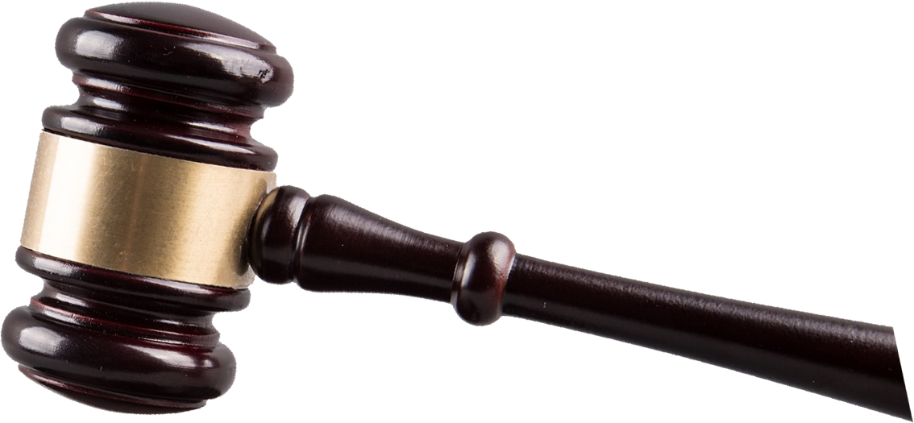
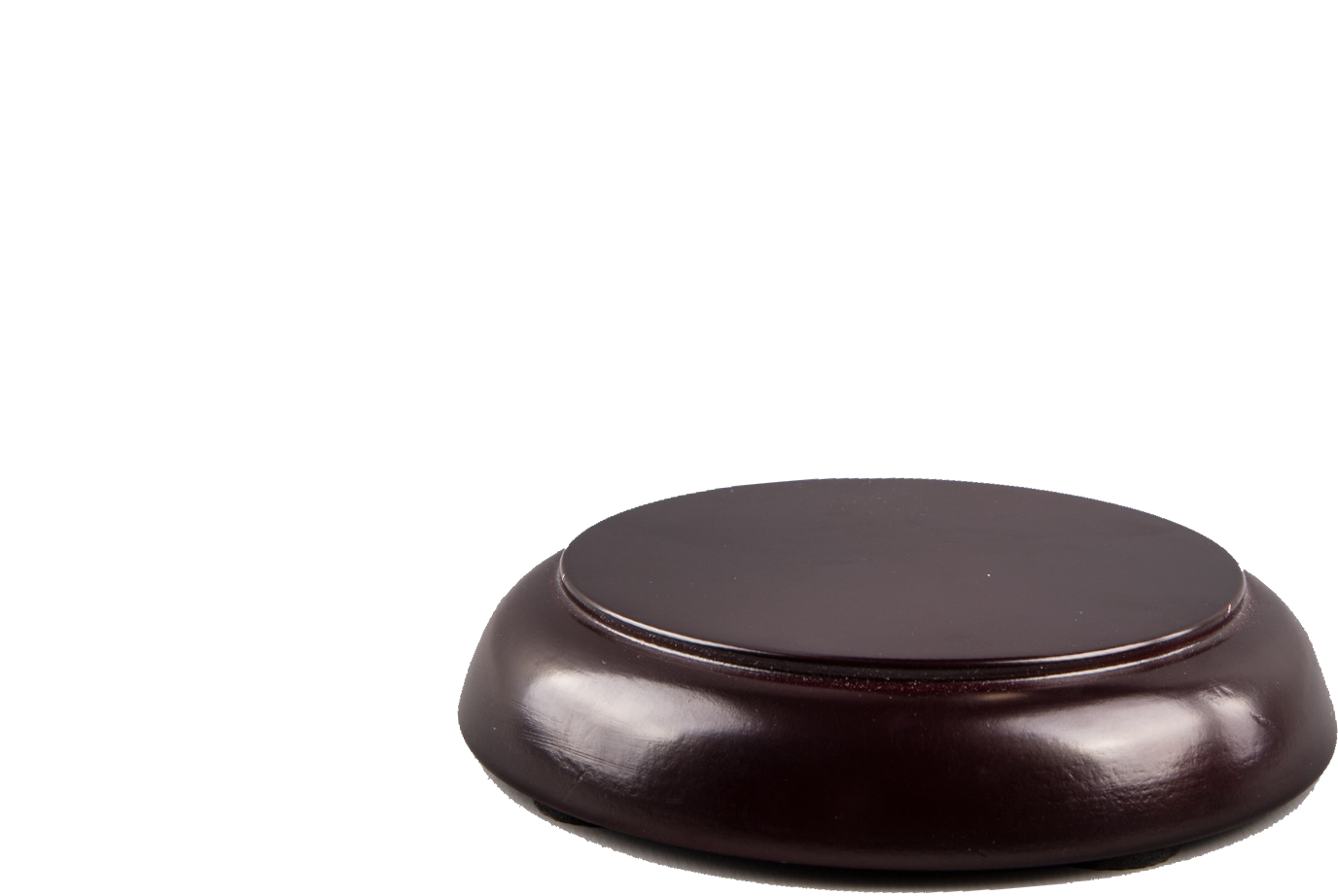
Importance of Faith for Justification
¹⁵ "We who are Jews by birth and not 'Gentile sinners‘ ¹⁶ know that a man is not justified by observing the law, but by faith in Jesus Christ. So we, too, have put our faith in Christ Jesus that we may be justified by faith in Christ and not by observing the law, because by observing the law no one will be justified.

Slide 19
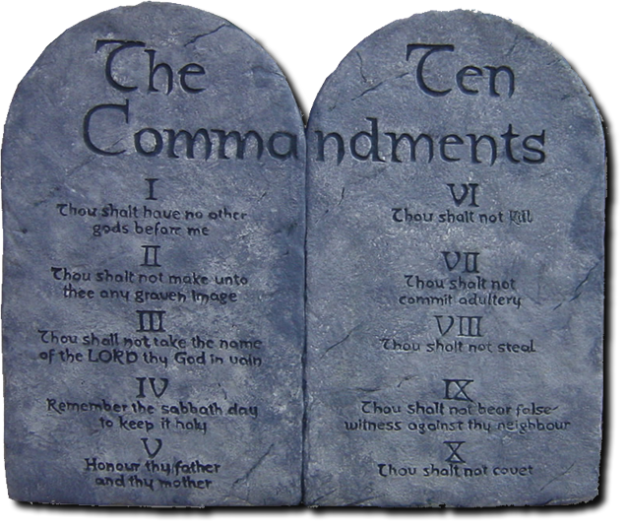
Importance of Faith over the Law
¹⁵ "We who are Jews by birth and not 'Gentile sinners‘ ¹⁶ know that a man is not justified by observing the law, but by faith in Jesus Christ. So we, too, have put our faith in Christ Jesus that we may be justified by faith in Christ and not by observing the law, because by observing the law no one will be justified.
Notes:
Three crosses = FREE = from http://www.sxc.hu/browse.phtml?f=download&id=1385159

Slide 20
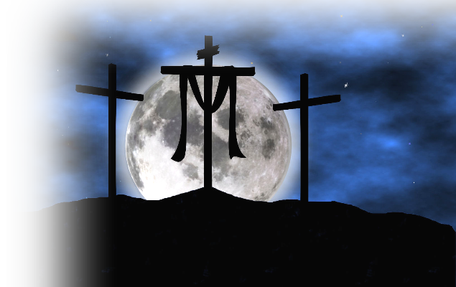
Importance of Faith in Jesus Christ
¹⁵ "We who are Jews by birth and not 'Gentile sinners‘ ¹⁶ know that a man is not justified by observing the law, but by faith in Jesus Christ. So we, too, have put our faith in Christ Jesus that we may be justified by faith in Christ and not by observing the law, because by observing the law no one will be justified.
Notes:
The faith is only as good as the object you place your faith in: for example, you can place your faith in an umbrella or a parachute as you jump out of an airplane that engines failed.
The umbrella will fail—I know, I tried. About 10 years old, climbed on the roof of the garage and jumped off the roof onto a bed mattress below with an umbrella the collapsed inside out upward. Your faith has to be placed IN the right object. Not the law, works, church, friends, government, butin Jesus Christ God’s Son.

Slide 21
Importance of Faith in Jesus Christ
¹⁵ "We who are Jews by birth and not 'Gentile sinners‘ ¹⁶ know that a man is not justified by observing the law, but by faith in Jesus Christ. So we, too, have put our faith in Christ Jesus that we may be justified by faith in Christ and not by observing the law, because by observing the law no one will be justified.
It is by GRACE and through FAITH ALONE that we are made right with God!

Slide 22
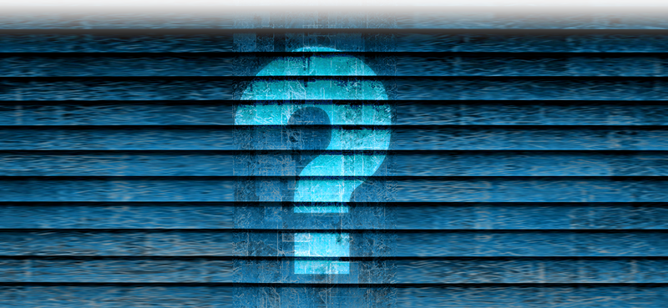
The Challenge to Faith 2:17-18
The Question:
¹⁷ "If, while we seek to be justified in Christ, it becomes evident that we ourselves are sinners, does that mean that Christ promotes sin?
Notes:
Question Mark = FREE = from http://www.rgbstock.com/download/melodi2/mjYFPPu.jpg

Slide 23
The Challenge to Faith 2:17-18
Put in more contemporary terms:
Doesn’t replacing “obedience to the law” with “faith alone” make you a lawbreaker since you are no longer keeping the law?
Notes:
Question Mark = FREE = from http://www.rgbstock.com/download/melodi2/mjYFPPu.jpg

Slide 24
The Challenge to Faith 2:17-18
The ANSWER:
¹⁷ .... Absolutely not! ¹⁸ If I rebuild what I destroyed, I prove that I am a lawbreaker.
Notes:
Metaphor appears to be the wall of partian between Jews and Gentiles. Peter had torn it down, because it was meaningless now in Christ. But if he begins rebuilding it, then he just proves that he was breaking the law when he was eating with Gentiles or when he reasserted it.
The whole point is that it cannot be law and grace at the same time. It cannot be works and grace at the same time.

Slide 25
4-The Explanation of FAITH 2:19-21

Slide 26
What Happened 2:19
¹⁹ For through the law I died to the law so that I might live for God.
I DIED

Slide 27
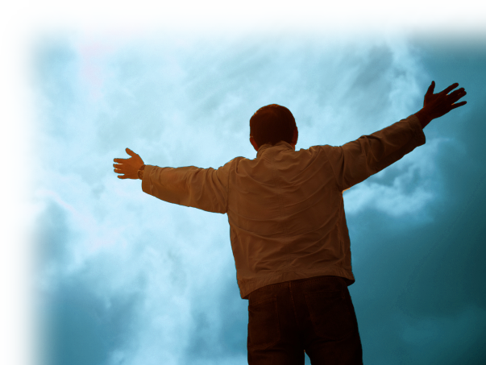
What Happened 2:19
¹⁹ For through the law I died to the law so that I might live for God.
I DIED
I LIVE

Slide 28
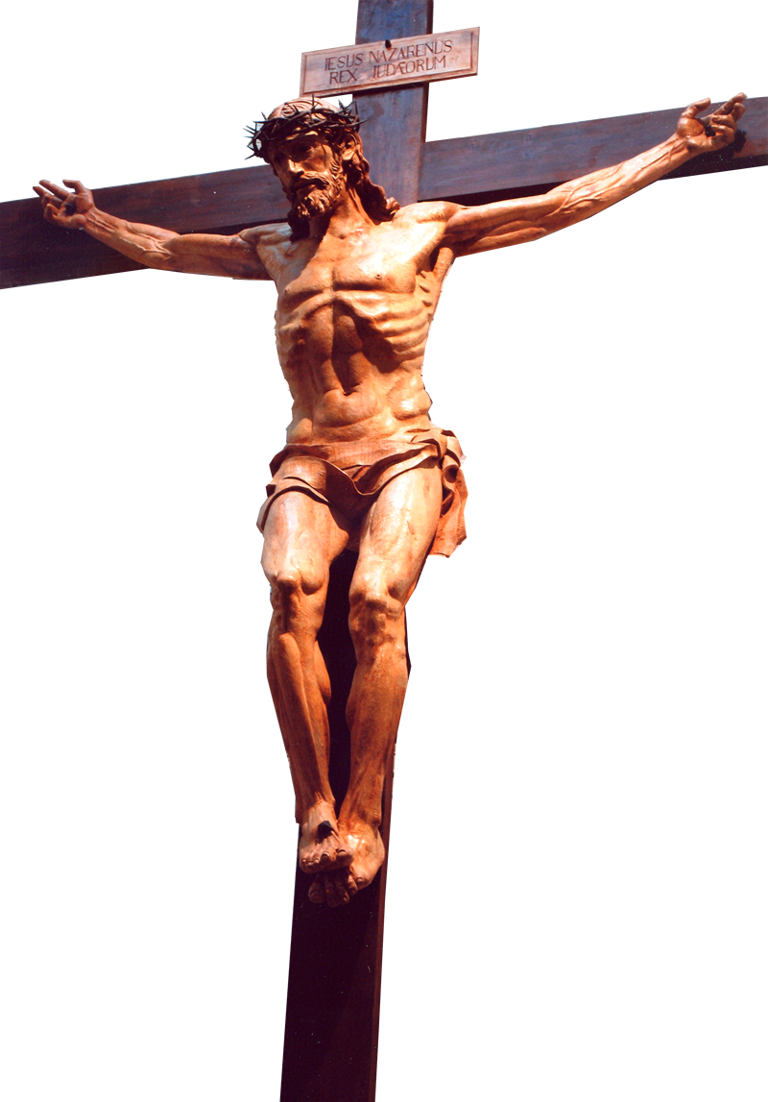
How it Happened 2:20
²⁰ I have been crucified with Christ and I no longer live,
I DIED

Slide 29
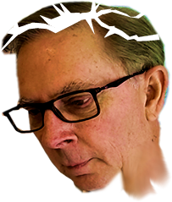
How it Happened 2:20
²⁰ I have been crucified with Christ and I no longer live,
I DIED

Slide 30
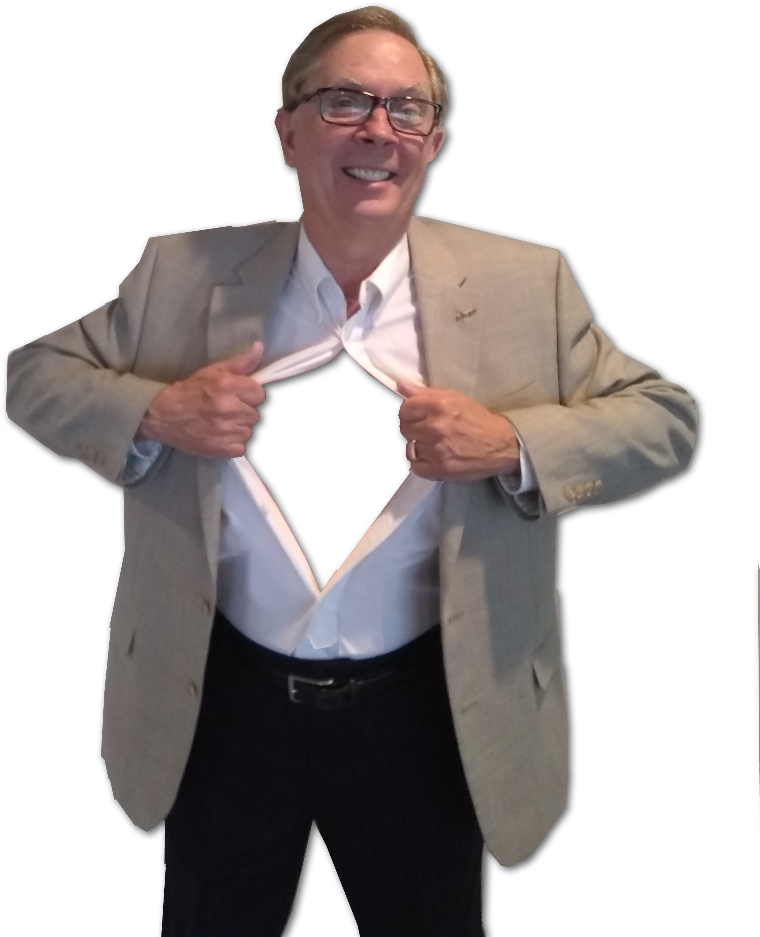
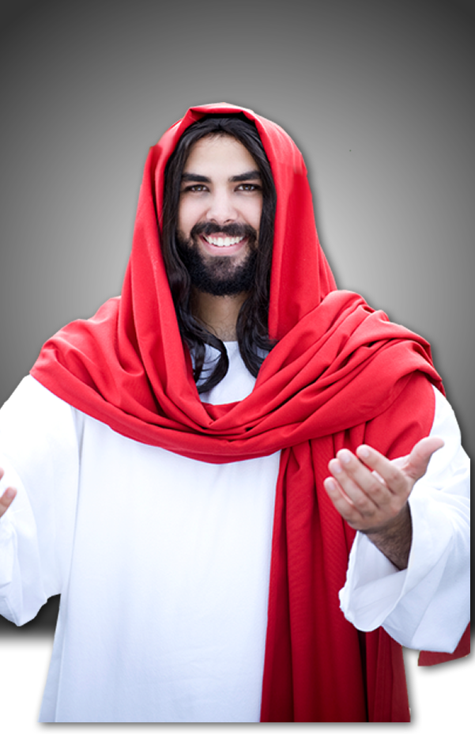
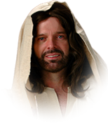
How it Happened 2:20
²⁰ I have been crucified with Christ and I no longer live, but Christ lives in me
I DIED
Notes:
Eph 3 ¹⁷ so that Christ may dwell in your hearts through faith. A (Eph 3:17 NIV)

Slide 31
What is Happening 2:20
²⁰ I have been crucified with Christ and I no longer live, but Christ lives in me. The life I live in the body,

Slide 32
What is Happening 2:20
²⁰ I have been crucified with Christ and I no longer live, but Christ lives in me. The life I live in the body, I live by faith in the Son of God, who loved me and gave himself for me.
FAITH

Slide 33
What should Happen 2:21
²¹ I do not set aside the grace of God, for if right-

Slide 34
What should Happen 2:21
²¹ I do not set aside the grace of God, for if right- eousness could be gained through the law,

Slide 35
What should Happen 2:21
²¹ I do not set aside the grace of God, for if right- eousness could be gained through the law, Christ died for nothing!”

Slide 36
What should Happen 2:21
²¹ I do not set aside the grace of God, for if right- eousness could be gained through the law, Christ died for nothing!”
INSTEAD

Slide 37
What should Happen 2:21
I firmly ESTABLISH the grace of God, for righteous-ness is gained through GRACE, Christ’s DEATH MEANS EVERYTHING!

Slide 38
What should Happen 2:21
I firmly ESTABLISH the grace of God, for righteous-ness is gained through GRACE, Christ’s DEATH MEANS EVERYTHING!

Slide 39
What should Happen 2:21
I firmly ESTABLISH the grace of God, for righteous-ness is gained through GRACE, Christ’s DEATH MEANS EVERYTHING!

Slide 40
All summed up in ...
⁸ For it is by grace you have been saved, through faith--and this not from yourselves, it is the gift of God--⁹not by works, so that no one can boast. --Ephesians 2:8-9

Slide 41
This Grace is offered today!

Slide 42
Let’s Pray!

