Slide 1
A study of Galatians
Notes:
Background picture of gift = LICENSED AND NOT FOR REUSE ELSEWHERE = To reuse elsewhere get a license from http://www.bigstockphoto.com/download/bid-2252323/
Copyright © 2000-2021. All rights reserved. Bible Point is a registered trademark of Dennis Henderson. All other trademarks acknowledged.
Bible Point contains graphics from Bible Point artists. These illustrations belong to Bible Point and the respective artists. You may use the designs and illustrations for graphical illustration of lessons free and without special permission, provided they are not used in any way that maligns the Christian faith. Furthermore, republication or production of any illustration by any other graphic service whether it be in book, in a machine-readable form, or in any other design resource is strictly prohibited. Furthermore, they cannot be duplicated or resold as any other form of publishing, clip art, or graphic resource.
So What does it mean? (A simple translations of the legal jargon)
So, if you don’t own the presentation(s), graphic(s), and text(s) how can you legally use them? The purchase of the license allows you to use all the images in the product. However, the actual ownership and copyright of the presentation(s), graphic(s), and text(s) remain the property of Bible Point and its licensors. If you had plans on using this product in your “for sale” work—think again!
License Agreement
Article 1: License Grant
All the graphics and text in Bible Point presentations (excluding quotes from the Bible and stated sources) are the intellectual and real property of Bible Point and its licensors, and is protected by law, including United States copyright laws and international treaties. Bible Point grants to you a license:
1. To use the presentation in a single church, single school, or single office of a Christian organization.
2. To make a single archival back-up copy of the program.
3. To modify the presentation(s) and merge with other presentations in a single church, school, or Christian organization.
4. To transfer to another party if that party agrees to accept the terms and conditions of this agreement, and you do not retain any copies of the presentation, whether printed, machine readable, modified, or merged form.
Article 2: Terms
This license is effective until terminated. You may terminate the license at any time by destroying the presentation(s), graphic(s), or text(s) together with all copies, modifications and merged portions in any form. Bible Point may terminate your license if you fail to comply with this Agreement. You agree, upon such termination, for any reason, to destroy the presentation(s), graphics, and text(s) with all copies, modifications, and merged portions in any form.
Article 3: Disclaimers
1. Bible Point presentations, graphics, and texts are licensed to you As Is. You, the consumer, bear the entire risk relating to the quality and performance of the presentation(s), graphic(s), or text(s). In no event will Bible Point be liable for damages resulting from any defect.
2. Thirty-day limited warrantee on disks. Bible Point warrants the disks to be free of defects in material and workmanship under normal use for 30 days after purchase. During the 30-day period you may return a defective presentation, graphic, or text with proof of purchase and it will be replaced without charge, unless the presentation is damaged by misuse.
Article 4: General
1. You may not sub-license, assign, or transfer the license of the presentation(s), graphic(s), or text(s) except as provided by this Agreement.
2. This Agreement will be governed by the laws of the State of Michigan.
So What does it mean? (A simple translations of the legal jargon)
May I let someone borrow or copy my licensed Bible Point presentation (even after I modified it)? As long as it is within your local church, or single school, or the immediate office of a Christian organization you may. Otherwise, please refer the person interested in borrowing to: http://www.biblepoint.com or E-mail: dh@biblepoint.com with any related questions.
---------------------------------------------------------------------------------------------------------------------------
Scripture taken from the HOLY BIBLE, NEW INTERNATIONAL VERSION®. NIV®. Copyright©1973, 1978, 1984 by International Bible Society. Used by permission of Zondervan. All rights reserved.

Slide 2
“Grace,” what is it?

Slide 3
“Grace,” what is it?
Undeserved favor! A gift!

Slide 4
“Grace,” what is it?
Undeserved favor! A gift!
God’s Riches At Christ’s Expense

Slide 5
Last time ... The Gospel of Grace
Notes:
Background picture of gift = LICENSED AND NOT FOR REUSE ELSEWHERE = To reuse elsewhere get a license from http://www.bigstockphoto.com/download/bid-2252323/

Slide 6
The Gospel of Grace ...
Is God-Revealed – not man-made

Slide 7
The Gospel of Grace ...
Is God-Revealed – not man-made
Is Life-Altering – not the same old, same old

Slide 8
The Gospel of Grace ...
Is God-Revealed – not man-made
Is Life-Altering – not the same old, same old

Slide 9
The Gospel of Grace ...
Is God-Revealed – not man-made
Is Life-Altering – not the same old, same old

Slide 10
The Gospel of Grace ...
Is God-Revealed – not man-made
Is Life-Altering – not the same old, same old
Is Self-Evident – not other validated

Slide 11
The Gospel of Grace ...
Is God-Revealed – not man-made
Is Life-Altering – not the same old, same old
Is Self-Evident – not other validated

Slide 12
The Gospel of Grace ...
Is God-Revealed – not man-made
Is Life-Altering – not the same old, same old
Is Self-Evident – not other validated

Slide 13
The Gospel of Grace ...
Is God-Revealed – not man-made
Is Life-Altering – not the same old, same old
Is Self-Evident – not other validated
Is Public-Knowledge – not a hidden-secret

Slide 14
The Gospel of Grace ...
Is God-Revealed – not man-made
Is Life-Altering – not the same old, same old
Is Self-Evident – not other validated
Is Public-Knowledge – not a hidden-secret
Is God-Glorifying – not self-exalting

Slide 15
The Gospel of Grace ...
Is God-Revealed – not man-made
Is Life-Altering – not the same old, same old
Is Self-Evident – not other validated
Is Public-Knowledge – not a hidden-secret
Is God-Glorifying – not self-exalting
This week...

Slide 16
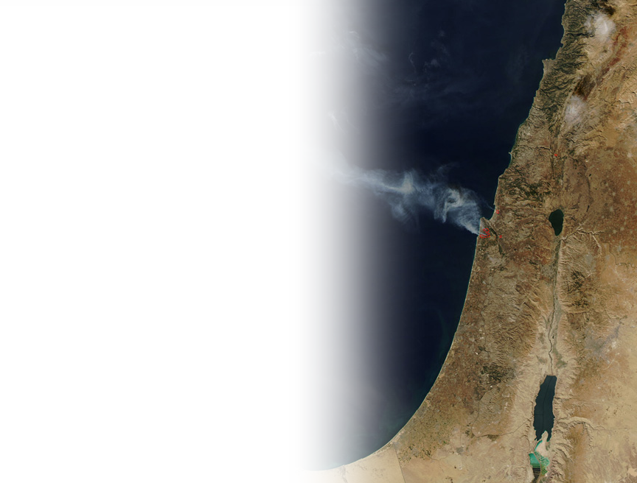
The Gospel of Grace 2:1-3
We pick up at ...
2:¹ Fourteen years later I went up again to Jerusalem, .... ² I went in response to a revelation and set before them the gospel that I preach among the Gentiles.
Notes:
In 1:18 three years after Paul conversion and call he went to Jerusalem for a 15 days and met with Peter and James ( the Lord’s half-brother) (this occurs after Acts 9) but before (Acts 11)
Now, in 2:1 it is 14 years later and Paul visited the Jerusalem for a second time Acts 11. On this trip Barnabas accompanies and so does Titus.
He had limited exposure to the apostles—the Jerusalem Christians were afraid of Paul.

Slide 17
The Gospel of Grace 2:1-3
² ... But I did this privately to those who seemed to be leaders, for fear that I was running or had run my race in vain.
Notes:
He is not questioning his own gospel message—he received that message directly from the Lord.
He is trying to determine if the others were undermining his message as the Judaizers were.
He met with them to see if they were all on the same page.

Slide 18
Answer:
What it Provides ...
Notes:
Background picture of gift = LICENSED AND NOT FOR REUSE ELSEWHERE = To reuse elsewhere get a license from http://www.bigstockphoto.com/download/bid-2252323/
Grace provides Family – What is family? Jesus once said,
( ³² A crowd was sitting around him and they said to him, "Look, your mother and your brothers are outside looking for you.“
³³ He answered them and said,)
"Who are my mother and my brothers?"
³⁴ And looking at those who were sitting around him in a circle, he said, "Here are my mother and my brothers!
³⁵ For whoever does the will of God is my brother and sister and mother.“ (Mar 3:32-1 NET)
Grace provides Ministry

Slide 19
1. GRACE Provides a Church Family 2:1-6

Slide 20
Fake Church Family 2:4-6
⁴ This matter arose because some false brothers had infiltrated our ranks
Notes:
Cut out people = FREE = from http://www.sxc.hu/browse.phtml?f=download&id=1215912

Slide 21
Fake Church Family 2:4-6
⁴ This matter arose because some false brothers had infiltrated our ranks
The expression “false brothers” implies that there are TRUE, REAL BROTHERS
Notes:
Cut out people = FREE = from http://www.sxc.hu/browse.phtml?f=download&id=1215912

Slide 22
Fake Church Family 2:4-6
⁴ This matter arose because some false brothers had infiltrated our ranks
Let’s talk about the FALSE BROTHERS first!
The expression “false brothers” implies that there are TRUE, REAL BROTHERS
Notes:
Cut out people = FREE = from http://www.sxc.hu/browse.phtml?f=download&id=1215912
Historically, they were Judaizes (legalist Jews—who claimed to be Christians but demand that Christians keep the law of Moses to complete there salvation)

Slide 23
Fake Church Family 2:4-6
⁴ This matter arose because some false brothers had infiltrated our ranks to spy on the freedom we have in Christ Jesus and to make us slaves.
Notes:
How can you tell a false brother from a real one? Not from outward appearance! Man looks on the outside – God sees the heart.
We have to have God eyes (which we don’t) so we only know them by their fruits.

Slide 24
Fake Church Family INFILTRATE
⁴ This matter arose because some false brothers had infiltrated our ranks to spy on the freedom we have in Christ Jesus and to make us slaves.

Slide 25
Fake Church Family SPY
⁴ This matter arose because some false brothers had infiltrated our ranks to spy on the freedom we have in Christ Jesus and to make us slaves.
Notes:
Spy = Licensed and NOT FOR REUSE elsewhere = to reuse elsewhere get a license from http://www.bigstockphoto.com/image-27016424/stock-photo-detective-investigate-with-magnifying-glass
Years ago a man infiltrated the ranks of a previous church to scam believer out of their money. He was selling investments, and then using the money to play the commodities market, not invest it as he said. He knew that the Bible taught it is wrong to sue a fellow believer so he “professed” to believe to not get sued.
Well, it back-fired on him. We followed the Biblical process of church discipline in Mat 18 = first, offended person approached the offender. Then the offended person took two witnesses and approached again. Then the offended, told the entire church and we did what Jesus taught, treated him as an unbeliever. Now, believer are permitted to sue unbelievers—and a group of offended people did. He served time.
The Judaizers were doing something more heinous. They were perverting the Gospel.

Slide 26
Fake Church Family ENSLAVE
⁴ This matter arose because some false brothers had infiltrated our ranks to spy on the freedom we have in Christ Jesus and to make us slaves.
Notes:
The OT law is now antiquated by the fulfillment in Christ -- We are not under the law
List of bizarre, antiquated driving laws ...
Americans are legalist –“there ought to be a law.” Some of the following are bizarre … lack common sense. (from http://www.dmv.org/fun-stuff/bizarre-driving-laws.php)
Arkansas It is illegal to blare a car horn where ice cold beverages or sandwiches are served after 9 p.m.
California in Glendale, California, it is illegal to jump from a car at 65 mph.
Hermosa Beach, California. It is illegal to spill your Margarita on any street.
Connecticut Hunting from cars in Connecticut is illegal, even during deer season.
Georgia Dublin, Georgia, it is illegal to drive through playgrounds.
Iowa In Mount Vernon, Iowa, it is illegal to throw your Red Ryder onto the highway.
Kansas In Derby, Kansas, it is considered a misdemeanor to screech your tires while driving. This abominable act can cost you 30 days in jail. In Topeka, Kansas, it is unlawful to transport dead poultry along Kansas Avenue. Lesson: look elsewhere for a KFC.
Minnesota In Minnetonka, Minnesota if you drive a truck that leaves mud, dirt or sticky substances on any road you will be considered a public nuisance that is harming the peace, safety and general welfare of the town.
Missouri University City, Missouri. It is illegal to honk the horn of someone else’s car.
Nevada Reno NV it is illegal to place a bench or chair in the middle of the road.
New York Sag Harbor, New York. Officials there have made it illegal to disrobe while in your car.
North Carolina Dunn, NC it is illegal to play in traffic, and it is illegal to drive through a cemetery if you’re not there to dig a grave or bury someone. Oregon If you drive on the side walk you must yield to pedestrians.
Rhode Island In Scituate, Rhode Island, it is illegal to drive with beer in your vehicle even if it is unopened.

Slide 27
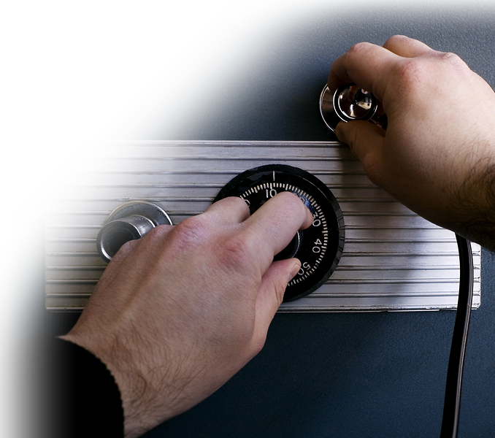
Fake Church Family TAKE
⁵ We did not give in to them for a moment, so that the truth of the gospel might remain with you.
Notes:
Crack Safe = Licensed and NOT FOR REUSE ELSEWHERE. To reuse elsewhere get a license from http://www.bigstockphoto.com/image-7045417/stock-photo-cracking-a-safe
We must guard the truth, defend the truth, protect the truth. If we don’t it will be taken away from us in the name of Political Corrtectness!
There is absolute truth.

Slide 28
Fake Church Family JUDGES on the external appearance
⁶ As for those who seemed to be important--whatever they were makes no difference to me; God does not judge by external appearance--those men added nothing to my message.
Notes:
Gavel = FREE = from http://www.sxc.hu/browse.phtml?f=download&id=1409593
Jam 2:1 My brothers, as believers in our glorious Lord Jesus Christ, don't show favoritism.
² Suppose a man comes into your meeting wearing a gold ring and fine clothes, and a poor man in shabby clothes also comes in.
³ If you show special attention to the man wearing fine clothes and say, "Here's a good seat for you," but say to the poor man, "You stand there" or "Sit on the floor by my feet,"
⁴ have you not discriminated among yourselves and become judges with evil thoughts?
⁵ Listen, my dear brothers: Has not God chosen those who are poor in the eyes of the world to be rich in faith and to inherit the kingdom he promised those who love him?
⁶ But you have insulted the poor. Is it not the rich who are exploiting you? Are they not the ones who are dragging you into court?
⁷ Are they not the ones who are slandering the noble name of him to whom you belong?
⁸ If you really keep the royal law found in Scripture, "Love your neighbor as yourself," you are doing right.
⁹ But if you show favoritism, you sin and are convicted by the law as lawbreakers.
¹⁰ For whoever keeps the whole law and yet stumbles at just one point is guilty of breaking all of it. (Jam 2:1-10 NIV)

Slide 29
Real Church Family 2:1-3
Notes:
A real brother encourages you.
See proverbs

Slide 30
Real Church Family 2:1-3
¹ Fourteen years later I went up again to Jerusalem, this time with Barnabas. I took Titus along also.
Notes:
A real brother encourages you.
See proverbs

Slide 31
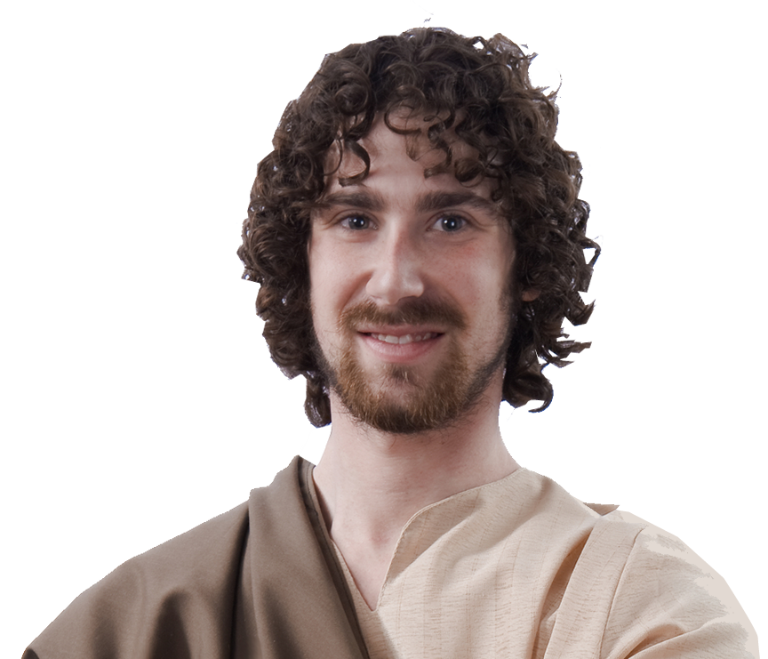
Real Church Family 2:1-3
¹ Fourteen years later I went up again to Jerusalem, this time with Barnabas. I took Titus along also.
Notes:
A real brother encourages you.
See proverbs

Slide 32
Barnabas: Encourage
¹ ... this time with Barnabas.

Slide 33
Barnabas: Encourage
Act 4:36 Joseph, a Levite from Cyprus, whom the apostles called Barnabas (which means Son of Encouragement),
Notes:
What is your nick name? What do people call (or think) when they see you?
Hard worker, good friend, happy go lucky, smiley, frugal, big mouth, quiet, , tightwad, son of encouragement!
When I first arrived at FBC Muskegon, a young man came to me and said, “I am your go to guy.” You know what, he was!

Slide 34
Barnabas: Encourage
Act 9:26 When he [i.e. Paul] came to Jerusalem, he tried to join the disciples, but they were all afraid of him, not believing that he really was a disciple. ²⁷ But Barnabas took him and brought him to the apostles.

Slide 35
Barnabas: Encourage
Act 15:37 Barnabas wanted to take John, also called Mark, with them, ³⁸ but Paul did not think it wise to take him, because he had deserted them .... ³⁹ They had such a sharp disagreement that they parted company.

Slide 36
Titus: Assist
¹ ... this time with Barnabas. I took Titus along also. ³ Yet not even Titus, who was with me, was compelled to be circumcised, even though he was a Greek.
Notes:
He was there but not mentioned at all in ACTs. He was considered a subordinate player in Luke’s recording the History of the church in Acts—but not subordinate to Paul or the argument of Galatians. Sometime we feel what we are doing is insignificant—but it is not.
When I went through the worst crisis of my life, the people I thought would be there for me, deserted me. The people that i never suspected cared for me, are the ones who came through for me. Never overlook the least of the brothers. In all likelihood when you really need someone, they will probably be the ones who come through for youl
Titus was a gentile who accompanied Paul. He was never circumcised. Nor even asked to be.
Paul’s point is that the Jerusalem church also understood that the gospel is GRACE plus nothing.
Not circumcision, not baptism, not communion, not membership, not tithing – nothing but the blood of Jesus.

Slide 37
The point is:
The Gospel of Grace provides us with a Spiritual Family that FREES us!
Notes:
Make a Life Lesson here:

Slide 38
2. GRACE Provides a Christian Ministry 2:7-10
Notes:
Ministry = service = one of the subdomains of this word is “period of employment”

Slide 39
A Distinct Ministry 2:7
⁷ On the contrary, they saw that I had been entrusted with the task of preaching the gospel to the Gentiles, just as Peter had been to the Jews. Gal 2:7
Notes:
Ministry is a “task” a job of preaching. The distinct task of going to the Gentiles.
We all have a ministry. Task to go somewhere. Maybe not as the “ordained minister” but at least as the “lay minister.”

Slide 40
A Distinct Ministry 2:7
⁷ On the contrary, they saw that I had been entrusted with the task of preaching the gospel to the Gentiles, just as Peter had been to the Jews. Gal 2:7
Notes:
Ministry is a “task” a job of preaching. The distinct task of going to the Gentiles.
We all have a ministry. Task to go somewhere. Maybe not as the “ordained minister” but at least as the “lay minister.”

Slide 41
You have a Distinct Ministry, too!

Slide 42
You have a Distinct Ministry, too!
Rom 13:4 For he is God's minister to you for good. But if you do evil, be afraid; for he does not bear the sword in vain; for he is God's minister, an avenger to execute wrath on him who practices evil. (NKJ)

Slide 43
You have a Distinct Ministry, too!
Rom 13:4 For he is God's minister to you for good. But if you do evil, be afraid; for he does not bear the sword in vain; for he is God's minister, an avenger to execute wrath on him who practices evil. (NKJ)
When you choose the career to which God has called you ...

Slide 44
You have a Distinct Ministry, too!
Rom 13:4 For he is God's minister to you for good. But if you do evil, be afraid; for he does not bear the sword in vain; for he is God's minister, an avenger to execute wrath on him who practices evil. (NKJ)
When you choose the career to which God has called you ...
It is no longer a job,
IT IS YOUR MINISTRY!

Slide 45
A Powerful Ministry 2:8
⁸ For God, who was at work in the ministry of Peter as an apostle to the Jews, was also at work in my ministry as an apostle to the Gentiles.
Notes:
Flags = FREE = from pixabay.com
God will be at work in your ministry, career, school, whatever it is that He has called you to.
The word “ministry” is literally the word “apostleship.” “ministry” = what God has called you to do. What God has empowered you to do.

Slide 46
A Grace Ministry 2:9
⁹ James, Peter and John, those reputed to be pillars, gave me and Barnabas the right hand of fellowship when they recognized the grace given to me. They agreed that we should go to the Gentiles, and they to the Jews.
Notes:
Law Enforcement Officers are God’s Servants/Ministers:
⁴ For he is God's servant to do you good. But if you do wrong, be afraid, for he does not bear the sword for nothing. He is God's servant, an agent of wrath to bring punishment on the wrongdoer. (Rom 13:4 NIV)
Everyone has received grace:
Common grace Saving grace Sufficient grace
Charismatic grace
You have a divine purpose here—you are not just drifting through time and space—You are here on a divine mission.
¹¹ For I know the plans I have for you," declares the LORD, "plans to prosper you and not to harm you, plans to give you hope and a future. (Jer 29:11 NIV)

Slide 47
A Practical Ministry 2:10
¹⁰ All they asked was that we should continue to remember the poor, the very thing I was eager to do.
Notes:
Swoosh = BiblePoint drawing
Bottom line—you have to discover what God has called you by His grace to do. Eph 2:8-10. Then you have to do it!
When the Lord, through His church calls upon you to serve, you need to respond ”Here am I, Lord.”

Slide 48
Life lessons from GRACE:

Slide 49
Life lessons from GRACE:
1—God’s Grace makes YOU family!

Slide 50
Life lessons from GRACE:
1—God’s Grace makes YOU family!
2—God’s Grace gives YOU a ministry!

Slide 51
Life lessons from GRACE:
1—God’s Grace makes YOU family!
2—God’s Grace gives YOU a ministry!
3—God’s Grace EMPOWERS your ministry!

Slide 52
Life lessons from GRACE:
1—God’s Grace makes YOU family!
2—God’s Grace gives YOU a ministry!
3—God’s Grace EMPOWERS your ministry!
4—God’ Grace SAVES—not works!

Slide 53
Life lessons from GRACE:
1—God’s Grace makes YOU family!
2—God’s Grace gives YOU a ministry!
3—God’s Grace EMPOWERS your ministry!
4—God’ Grace SAVES—not works!
Two Final Thoughts!

Slide 54
Life lessons from GRACE:
1—God’s Grace makes YOU family!
2—God’s Grace gives YOU a ministry!
3—God’s Grace EMPOWERS your ministry!
4—God’ Grace SAVES—not works!
Two Final Thoughts!
- You are in God’s Family only by GRACE

Slide 55
Life lessons from GRACE:
1—God’s Grace makes YOU family!
2—God’s Grace gives YOU a ministry!
3—God’s Grace EMPOWERS your ministry!
4—God’ Grace SAVES—not works!
Two Final Thoughts!
- You are in God’s Family only by GRACE
-You have a Ministry only by GRACE

Slide 56
Life lessons from GRACE:
1—God’s Grace makes YOU family!
2—God’s Grace give YOU a ministry!
3—God’s Grace EMPOWERS your ministry!
4—God’ Grace SAVES—not works!
Two Final Thoughts!
- You are in God’s Family only by GRACE
-You have a Ministry only by GRACE
NOW THAT’S AMAZING!

Slide 57
Let’s Pray!

