Slide 1
Our Focus Today:
The Gospel of Grace is...
Notes:
Background picture of gift = LICENSED AND NOT FOR REUSE ELSEWHERE = To reuse elsewhere get a license from http://www.bigstockphoto.com/download/bid-2252323/
Copyright © 2000-2021. All rights reserved. Bible Point is a registered trademark of Dennis Henderson. All other trademarks acknowledged.
Bible Point contains graphics from Bible Point artists. These illustrations belong to Bible Point and the respective artists. You may use the designs and illustrations for graphical illustration of lessons free and without special permission, provided they are not used in any way that maligns the Christian faith. Furthermore, republication or production of any illustration by any other graphic service whether it be in book, in a machine-readable form, or in any other design resource is strictly prohibited. Furthermore, they cannot be duplicated or resold as any other form of publishing, clip art, or graphic resource.
So What does it mean? (A simple translations of the legal jargon)
So, if you don’t own the presentation(s), graphic(s), and text(s) how can you legally use them? The purchase of the license allows you to use all the images in the product. However, the actual ownership and copyright of the presentation(s), graphic(s), and text(s) remain the property of Bible Point and its licensors. If you had plans on using this product in your “for sale” work—think again!
License Agreement
Article 1: License Grant
All the graphics and text in Bible Point presentations (excluding quotes from the Bible and stated sources) are the intellectual and real property of Bible Point and its licensors, and is protected by law, including United States copyright laws and international treaties. Bible Point grants to you a license:
1. To use the presentation in a single church, single school, or single office of a Christian organization.
2. To make a single archival back-up copy of the program.
3. To modify the presentation(s) and merge with other presentations in a single church, school, or Christian organization.
4. To transfer to another party if that party agrees to accept the terms and conditions of this agreement, and you do not retain any copies of the presentation, whether printed, machine readable, modified, or merged form.
Article 2: Terms
This license is effective until terminated. You may terminate the license at any time by destroying the presentation(s), graphic(s), or text(s) together with all copies, modifications and merged portions in any form. Bible Point may terminate your license if you fail to comply with this Agreement. You agree, upon such termination, for any reason, to destroy the presentation(s), graphics, and text(s) with all copies, modifications, and merged portions in any form.
Article 3: Disclaimers
1. Bible Point presentations, graphics, and texts are licensed to you As Is. You, the consumer, bear the entire risk relating to the quality and performance of the presentation(s), graphic(s), or text(s). In no event will Bible Point be liable for damages resulting from any defect.
2. Thirty-day limited warrantee on disks. Bible Point warrants the disks to be free of defects in material and workmanship under normal use for 30 days after purchase. During the 30-day period you may return a defective presentation, graphic, or text with proof of purchase and it will be replaced without charge, unless the presentation is damaged by misuse.
Article 4: General
1. You may not sub-license, assign, or transfer the license of the presentation(s), graphic(s), or text(s) except as provided by this Agreement.
2. This Agreement will be governed by the laws of the State of Michigan.
So What does it mean? (A simple translations of the legal jargon)
May I let someone borrow or copy my licensed Bible Point presentation (even after I modified it)? As long as it is within your local church, or single school, or the immediate office of a Christian organization you may. Otherwise, please refer the person interested in borrowing to: http://www.biblepoint.com or E-mail: dh@biblepoint.com with any related questions.
---------------------------------------------------------------------------------------------------------------------------
Scripture taken from the HOLY BIBLE, NEW INTERNATIONAL VERSION®. NIV®. Copyright©1973, 1978, 1984 by International Bible Society. Used by permission of Zondervan. All rights reserved.

Slide 2
1. GOD-REVEALED
.

Slide 3
1. GOD-REVEALED
NOT man-made.

Slide 4
1. GOD-REVEALED
NOT man-made.

Slide 5
1. GOD-REVEALED
NOT man-made.
¹¹ I want you to know, brothers, that the gospel I preached is not something that man made up. ¹² I did not receive it from any man, nor was I taught it; rather, I received it by revelation from Jesus Christ.
Notes:
People will say, “the Bible is just a book written by a bunch of religious fanatics”. I find it very interesting that most who say things like that have never read it.
A lady in a church I pastored in Philadelphia, bought a Bible at a secular bookstore because she had heard that it was the all time best selling book in the world. She started at Genesis 1:1 and by the end of the book of Romans she confessed Jesus is the Christ the Son of God.
This book has a divine author who used people like we use pens to write the Word of God and give us the gospel.

Slide 6
1. GOD-REVEALED
NOT man-made.
¹¹ I want you to know, brothers, that the gospel I preached is not something that man made up. ¹² I did not receive it from any man, nor was I taught it; rather, I received it by revelation from Jesus Christ.
Notes:
The Apostle Paul first received it on the Road to Damascus persecuting Christians. A heaven light struck him down and blinded him. In that light was Jesus, speaking ...
It was quite different for me—I was at a Christian camp.
Where were you when you received it? If you don’t know – then perhaps you have not receive the revelation of who Jesus is, or what the true gospel is. You can recieve Him and the gospel today.

Slide 7
2. LIFE-ALTERING
NOT the same-old, same old.

Slide 8
2. LIFE-ALTERING
NOT the same-old, same old.
¹³ For you have heard of my previous way of life

Slide 9
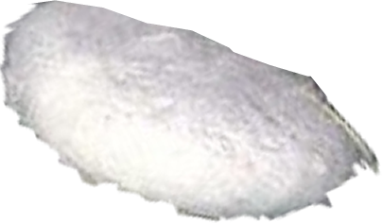
2. LIFE-ALTERING
NOT the same-old, same old.
¹³ For you have heard of my previous way of life

Slide 10
2. LIFE-ALTERING
NOT the same-old, same old.
¹³ For you have heard of my previous way of life

Slide 11
We all have a Past ...
¹³ For you have heard of my previous way of life in Judaism, how intensely I persecuted the church of God and tried to destroy it. ¹⁴ I was advancing in Judaism beyond many Jews of my own age and was extremely zealous for the traditions of my fathers.

Slide 12
We all have a Past ...
Atheism
¹³ For you have heard of my previous way of life in Judaism, how intensely I persecuted the church of God and tried to destroy it. ¹⁴ I was advancing in Judaism beyond many Jews of my own age and was extremely zealous for the traditions of my fathers.

Slide 13
We all have a Past ...
Atheism
Secularism
¹³ For you have heard of my previous way of life in Judaism, how intensely I persecuted the church of God and tried to destroy it. ¹⁴ I was advancing in Judaism beyond many Jews of my own age and was extremely zealous for the traditions of my fathers.

Slide 14
We all have a Past ...
Atheism
Secularism
Materialism
¹³ For you have heard of my previous way of life in Judaism, how intensely I persecuted the church of God and tried to destroy it. ¹⁴ I was advancing in Judaism beyond many Jews of my own age and was extremely zealous for the traditions of my fathers.

Slide 15
We all have a Past ...
Atheism
Secularism
Materialism
Bad Relationship
¹³ For you have heard of my previous way of life in Judaism, how intensely I persecuted the church of God and tried to destroy it. ¹⁴ I was advancing in Judaism beyond many Jews of my own age and was extremely zealous for the traditions of my fathers.

Slide 16
We all have a Past ...
Atheism
Secularism
Materialism
Bad Relationship
Bad Marriage
¹³ For you have heard of my previous way of life in Judaism, how intensely I persecuted the church of God and tried to destroy it. ¹⁴ I was advancing in Judaism beyond many Jews of my own age and was extremely zealous for the traditions of my fathers.

Slide 17
We all have a Past ...
Atheism
Secularism
Materialism
Bad Relationship
Bad Marriage
Immorality
¹³ For you have heard of my previous way of life in Judaism, how intensely I persecuted the church of God and tried to destroy it. ¹⁴ I was advancing in Judaism beyond many Jews of my own age and was extremely zealous for the traditions of my fathers.

Slide 18
We all have a Past ...
Atheism
Secularism
Materialism
Bad Relationship
Bad Marriage
Immorality
Gender Issues
¹³ For you have heard of my previous way of life in Judaism, how intensely I persecuted the church of God and tried to destroy it. ¹⁴ I was advancing in Judaism beyond many Jews of my own age and was extremely zealous for the traditions of my fathers.

Slide 19
We all have a Past ...
Addiction to:
¹³ For you have heard of my previous way of life in Judaism, how intensely I persecuted the church of God and tried to destroy it. ¹⁴ I was advancing in Judaism beyond many Jews of my own age and was extremely zealous for the traditions of my fathers.

Slide 20
We all have a Past ...
Addiction to: Tobacco
¹³ For you have heard of my previous way of life in Judaism, how intensely I persecuted the church of God and tried to destroy it. ¹⁴ I was advancing in Judaism beyond many Jews of my own age and was extremely zealous for the traditions of my fathers.

Slide 21
We all have a Past ...
Addiction to: Tobacco
Alcohol
¹³ For you have heard of my previous way of life in Judaism, how intensely I persecuted the church of God and tried to destroy it. ¹⁴ I was advancing in Judaism beyond many Jews of my own age and was extremely zealous for the traditions of my fathers.

Slide 22
We all have a Past ...
Addiction to: Tobacco
Alcohol
Drugs
¹³ For you have heard of my previous way of life in Judaism, how intensely I persecuted the church of God and tried to destroy it. ¹⁴ I was advancing in Judaism beyond many Jews of my own age and was extremely zealous for the traditions of my fathers.

Slide 23
We all have a Past ...
Addiction to: Tobacco
Alcohol
Drugs
Food
¹³ For you have heard of my previous way of life in Judaism, how intensely I persecuted the church of God and tried to destroy it. ¹⁴ I was advancing in Judaism beyond many Jews of my own age and was extremely zealous for the traditions of my fathers.

Slide 24
We all have a Past ...
Addiction to: Tobacco
Alcohol
Drugs
Food
Gambling
¹³ For you have heard of my previous way of life in Judaism, how intensely I persecuted the church of God and tried to destroy it. ¹⁴ I was advancing in Judaism beyond many Jews of my own age and was extremely zealous for the traditions of my fathers.

Slide 25
We all have a Past ...
Addiction to: Tobacco
Alcohol
Drugs
Food
Gambling
Porn
¹³ For you have heard of my previous way of life in Judaism, how intensely I persecuted the church of God and tried to destroy it. ¹⁴ I was advancing in Judaism beyond many Jews of my own age and was extremely zealous for the traditions of my fathers.

Slide 26
We all have a Past ...
You were ...
¹³ For you have heard of my previous way of life in Judaism, how intensely I persecuted the church of God and tried to destroy it. ¹⁴ I was advancing in Judaism beyond many Jews of my own age and was extremely zealous for the traditions of my fathers.

Slide 27
We all have a Past ...
You were ... Abused
¹³ For you have heard of my previous way of life in Judaism, how intensely I persecuted the church of God and tried to destroy it. ¹⁴ I was advancing in Judaism beyond many Jews of my own age and was extremely zealous for the traditions of my fathers.

Slide 28
We all have a Past ...
You were ... Abused
Raped
¹³ For you have heard of my previous way of life in Judaism, how intensely I persecuted the church of God and tried to destroy it. ¹⁴ I was advancing in Judaism beyond many Jews of my own age and was extremely zealous for the traditions of my fathers.

Slide 29
We all have a Past ...
You were ... Abused
Raped
Divorced
¹³ For you have heard of my previous way of life in Judaism, how intensely I persecuted the church of God and tried to destroy it. ¹⁴ I was advancing in Judaism beyond many Jews of my own age and was extremely zealous for the traditions of my fathers.

Slide 30
We all have a Past ...
You were ... Abused
Raped
Divorced
Cheater
¹³ For you have heard of my previous way of life in Judaism, how intensely I persecuted the church of God and tried to destroy it. ¹⁴ I was advancing in Judaism beyond many Jews of my own age and was extremely zealous for the traditions of my fathers.

Slide 31
We all have a Past ...
You were ... Abused
Raped
Divorced
Cheater Abortive
¹³ For you have heard of my previous way of life in Judaism, how intensely I persecuted the church of God and tried to destroy it. ¹⁴ I was advancing in Judaism beyond many Jews of my own age and was extremely zealous for the traditions of my fathers.

Slide 32
We all have a Past ...
You were ... Abused
Raped
Divorced
Cheater Abortive
Bad Career
¹³ For you have heard of my previous way of life in Judaism, how intensely I persecuted the church of God and tried to destroy it. ¹⁴ I was advancing in Judaism beyond many Jews of my own age and was extremely zealous for the traditions of my fathers.

Slide 33
We all have a Past ...
You were ... Criminal
¹³ For you have heard of my previous way of life in Judaism, how intensely I persecuted the church of God and tried to destroy it. ¹⁴ I was advancing in Judaism beyond many Jews of my own age and was extremely zealous for the traditions of my fathers.

Slide 34
We all have a Past ...
You were ... Criminal
Mean / Evil
¹³ For you have heard of my previous way of life in Judaism, how intensely I persecuted the church of God and tried to destroy it. ¹⁴ I was advancing in Judaism beyond many Jews of my own age and was extremely zealous for the traditions of my fathers.

Slide 35
We all have a Past ...
You were ... Criminal
Mean / Evil
Angry
¹³ For you have heard of my previous way of life in Judaism, how intensely I persecuted the church of God and tried to destroy it. ¹⁴ I was advancing in Judaism beyond many Jews of my own age and was extremely zealous for the traditions of my fathers.

Slide 36
We all have a Past ...
You were ... Criminal
Mean / Evil
Angry
Arrogant
¹³ For you have heard of my previous way of life in Judaism, how intensely I persecuted the church of God and tried to destroy it. ¹⁴ I was advancing in Judaism beyond many Jews of my own age and was extremely zealous for the traditions of my fathers.

Slide 37
We all have a Past ...
You were ... Criminal
Mean / Evil
Angry
Arrogant
Proud
¹³ For you have heard of my previous way of life in Judaism, how intensely I persecuted the church of God and tried to destroy it. ¹⁴ I was advancing in Judaism beyond many Jews of my own age and was extremely zealous for the traditions of my fathers.

Slide 38
We all have a Past ...
You were ... Criminal
Mean / Evil
Angry
Arrogant
Proud
Self-righteous
¹³ For you have heard of my previous way of life in Judaism, how intensely I persecuted the church of God and tried to destroy it. ¹⁴ I was advancing in Judaism beyond many Jews of my own age and was extremely zealous for the traditions of my fathers.
Notes:
1 Tim 1:16 But for that very reason I was shown mercy so that in me, the worst of sinners, Christ Jesus might display his unlimited patience as an example for those who would believe on him and receive eternal life. (1Ti 1:16 NIV)

Slide 39
We all have a Past ...
You were ... Criminal
Mean / Evil
Angry
Arrogant
Proud
Self-righteous
¹³ For you have heard of my previous way of life in Judaism, how intensely I persecuted the church of God and tried to destroy it. ¹⁴ I was advancing in Judaism beyond many Jews of my own age and was extremely zealous for the traditions of my fathers.
POINT:
We all have a PAST!

Slide 40
The Apostle had a PAST too!
¹³ For you have heard of my previous way of life in Judaism, how intensely I persecuted the church of God and tried to destroy it. ¹⁴ I was advancing in Judaism beyond many Jews of my own age ...

Slide 41
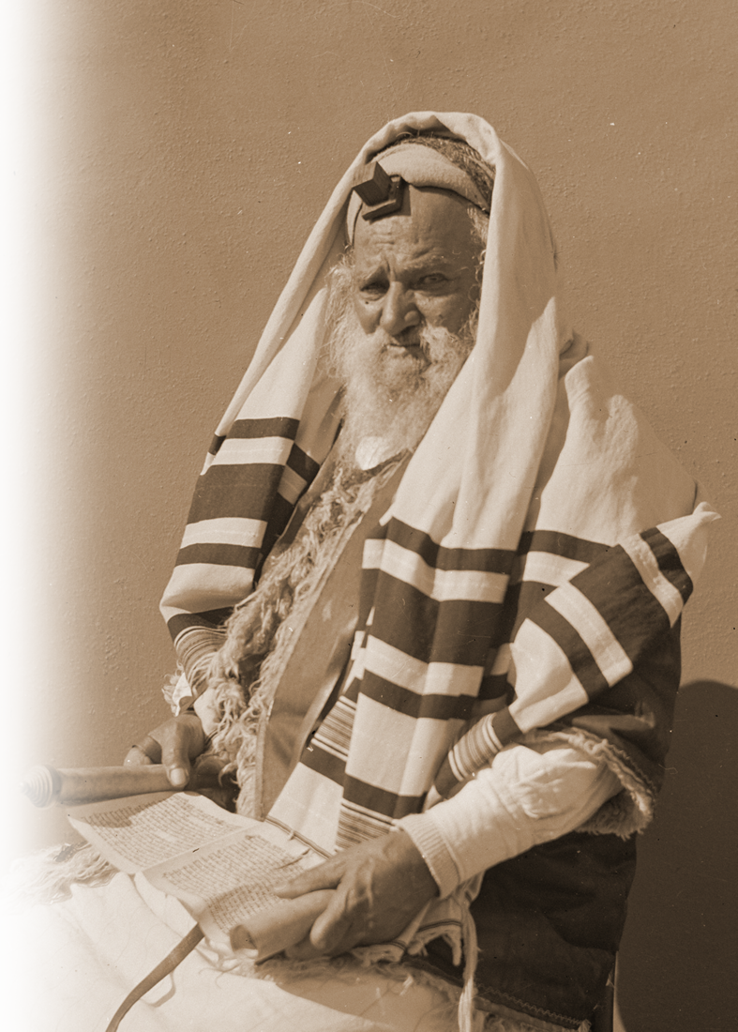
Even had an Excuse ...
¹³ For you have heard of my previous way of life in Judaism, how intensely I persecuted the church of God and tried to destroy it. ¹⁴ I was advancing in Judaism beyond many Jews of my own age and was extremely zealous for the traditions of my fathers.
,

Slide 42
BUT Grace Alters the Past ...
¹⁵ But when God, who set me apart from birth and called me by his grace,

Slide 43
BUT Grace Alters the Past ...
Called
¹⁵ But when God, who set me apart from birth and called me by his grace,
That changed EVERYTHING!

Slide 44
BUT Grace Alters the Past ...
Called
Redeemed
¹⁵ But when God, who set me apart from birth and called me by his grace,
That changed EVERYTHING!

Slide 45
BUT Grace Alters the Past ...
Called
Redeemed
Regenerated
¹⁵ But when God, who set me apart from birth and called me by his grace,
That changed EVERYTHING!

Slide 46
BUT Grace Alters the Past ...
Called
Redeemed
Regenerated
Justified
¹⁵ But when God, who set me apart from birth and called me by his grace,
That changed EVERYTHING!

Slide 47
BUT Grace Alters the Past ...
Called
Redeemed
Regenerated
Justified
Righteous
¹⁵ But when God, who set me apart from birth and called me by his grace,
That changed EVERYTHING!

Slide 48
BUT Grace Alters the Past ...
Called
Redeemed
Regenerated
Justified
Righteous
Forgiven
¹⁵ But when God, who set me apart from birth and called me by his grace,
That changed EVERYTHING!

Slide 49
BUT Grace Alters the Past ...
Called
Redeemed
Regenerated
Justified
Righteous
Forgiven
Pardoned
¹⁵ But when God, who set me apart from birth and called me by his grace,
That changed EVERYTHING!

Slide 50
BUT Grace Alters the Past ...
Holy
¹⁵ But when God, who set me apart from birth and called me by his grace,
That changed EVERYTHING!

Slide 51
BUT Grace Alters the Past ...
Holy
Cleansed
¹⁵ But when God, who set me apart from birth and called me by his grace,
That changed EVERYTHING!

Slide 52
BUT Grace Alters the Past ...
Holy
Cleansed
Adopted
¹⁵ But when God, who set me apart from birth and called me by his grace,
That changed EVERYTHING!

Slide 53
BUT Grace Alters the Past ...
Holy
Cleansed
Adopted
Assured
¹⁵ But when God, who set me apart from birth and called me by his grace,
That changed EVERYTHING!

Slide 54
BUT Grace Alters the Past ...
Holy
Cleansed
Adopted
Assured
Secure
¹⁵ But when God, who set me apart from birth and called me by his grace,
That changed EVERYTHING!

Slide 55
BUT Grace Alters the Past ...
Holy
Cleansed
Adopted
Assured
Secure
Will Be ...
Glorified
¹⁵ But when God, who set me apart from birth and called me by his grace,
That changed EVERYTHING!

Slide 56
BUT Grace Alters the Past ...
¹⁵ But when God, who set me apart from birth and called me by his grace,
BIRTH

Slide 57
BUT Grace Alters the Past ...
¹⁵ But when God, who set me apart from birth and called me by his grace,
CALLED
BIRTH

Slide 58
BUT Grace Alters the Past ...
CONVERS ION
¹⁵ But when God, who set me apart from birth and called me by his grace,
BIRTH

Slide 59
BUT Grace Alters the Past ...
CONVERS ION
¹⁵ But when God, who set me apart from birth and called me by his grace,
We have the past that we have so God could show us the GRACE that He has!
BIRTH

Slide 60
BUT Grace Alters the Past ...
^{1:4}... to rescue us from the present evil age...
CONVERS ION
¹⁵ But when God, who set me apart from birth and called me by his grace,
We have the past that we have so God could show us the GRACE that He has!
BIRTH

Slide 61
IT’S LIFE-ALTERING
AFTER EXPERIENCING HIS GRACE ... LIFE WILL NEVER BE THE SAME!

Slide 62
3. SELF-EVIDENT

Slide 63
3. SELF-EVIDENT
NOT needing human validation.

Slide 64
3. SELF-EVIDENT
NOT needing human validation.
¹⁶ ... I did not consult any man, ¹⁷ nor did I go up to Jerusalem to see those who were apostles before I was, but I went immediately into Arabia and later returned to Damascus.

Slide 65
3. SELF-EVIDENT
Two Divine witnesses:
1) the Word of God 2 Tim 3:16
NOT needing human validation.
¹⁶ ... I did not consult any man, ¹⁷ nor did I go up to Jerusalem to see those who were apostles before I was, but I went immediately into Arabia and later returned to Damascus.

Slide 66
3. SELF-EVIDENT
Two Divine witnesses:
1) the Word of God 2 Tim 3:16
2) the inner witness of the Spirit Rom 8:16
NOT needing human validation.
¹⁶ ... I did not consult any man, ¹⁷ nor did I go up to Jerusalem to see those who were apostles before I was, but I went immediately into Arabia and later returned to Damascus.

Slide 67
3. SELF-EVIDENT
NOT needing human validation.
¹⁸ Then after three years, I went up to Jerusalem to get acquainted with Peter and stayed with him fifteen days. ¹⁹ I saw none of the other apostles--only James, the Lord's brother. ²⁰ I assure you before God that what I am writing you is no lie.

Slide 68
3. SELF-EVIDENT
NOT needing human validation.
²¹ Later I went to Syria and Cilicia. ²² I was personally unknown to the churches of Judea that are in Christ.

Slide 69
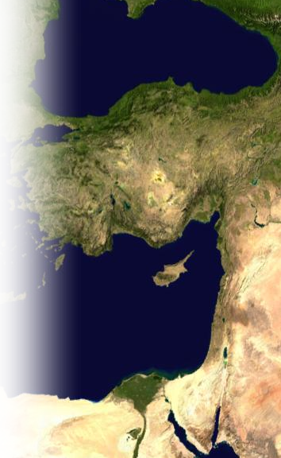
3. SELF-EVIDENT
NOT needing human validation.
²¹ Later I went to Syria and Cilicia. ²² I was personally unknown to the churches of Judea that are in Christ.

Slide 70
3. SELF-EVIDENT
NOT needing human validation.
²¹ Later I went to Syria and Cilicia. ²² I was personally unknown to the churches of Judea that are in Christ.

Slide 71
4. PUBLIC-KNOWLEDGE
Notes:
I was extremely zealous with my faith as a teenager. One day I was sharing my faith with a class mate while class was going on. The teacher, intending to publicly humiliate me, said, “Okay, Dennis, whatever it is that you have to say, just come up to the front of the class and tell everyone.” And of course it backfired on the teacher, because I did. I publicly share the good news of God’s grace with the entire class. Guess what? It wasn’t a secret after that. That I was a Christian became public knowledge.
You don’t have to be as extreme as that—you don’t have to publish it on facebook—but people who read your facebook should know that God’s Grace touched your life because you are not the same anyone—it should be “public knowledge.” That’s what grace does in a life.

Slide 72
4. PUBLIC-KNOWLEDGE
NOT a hidden secret.
Notes:
I was extremely zealous with my faith as a teenager. One day I was sharing my faith with a class mate while class was going on. The teacher, intending to publicly humiliate me, said, “Okay, Dennis, whatever it is that you have to say, just come up to the front of the class and tell everyone.” And of course it backfired on the teacher, because I did. I publicly share the good news of God’s grace with the entire class. Guess what? It wasn’t a secret after that. That I was a Christian became public knowledge.
You don’t have to be as extreme as that—you don’t have to publish it on facebook—but people who read your facebook should know that God’s Grace touched your life because you are not the same anyone—it should be “public knowledge.” That’s what grace does in a life.

Slide 73
4. PUBLIC-KNOWLEDGE
NOT a hidden secret.
²³ They only heard the report: "The man who formerly persecuted us is now preaching the faith he once tried to destroy."
Notes:
I was extremely zealous with my faith as a teenager. One day I was sharing my faith with a class mate while class was going on. The teacher, intending to publicly humiliate me, said, “Okay, Dennis, whatever it is that you have to say, just come up to the front of the class and tell everyone.” And of course it backfired on the teacher, because I did. I publicly share the good news of God’s grace with the entire class. Guess what? It wasn’t a secret after that. That I was a Christian became public knowledge.
You don’t have to be as extreme as that—you don’t have to publish it on facebook—but people who read your facebook should know that God’s Grace touched your life because you are not the same anyone—it should be “public knowledge.” That’s what grace does in a life.

Slide 74
5. GOD-GLORIFYING
Notes:
Map of Mediterranean = FREE = NASA map from http://www.hmml.org/centers/malta/mediterranean/Mediterranian_Sea_16.61811E_38.99124N.jpg

Slide 75
5. GOD-GLORIFYING
NOT self-exalting.
Notes:
Map of Mediterranean = FREE = NASA map from http://www.hmml.org/centers/malta/mediterranean/Mediterranian_Sea_16.61811E_38.99124N.jpg

Slide 76
5. GOD-GLORIFYING
NOT self-exalting.
²⁴ And they praised God because of me.
Notes:
Map of Mediterranean = FREE = NASA map from http://www.hmml.org/centers/malta/mediterranean/Mediterranian_Sea_16.61811E_38.99124N.jpg

Slide 77
A Few Summary Lessons:

Slide 78
A Few Summary Lessons:
1— God’s Grace has been revealed to you in Jesus!

Slide 79
A Few Summary Lessons:
1— God’s Grace has been revealed to you in Jesus!
2— God’s Grace is a radical, life-altering makeover!

Slide 80
A Few Summary Lessons:
1— God’s Grace has been revealed to you in Jesus!
2— God’s Grace is a radical, life-altering makeover!
3— God’s Gracious life-change is self-evident!

Slide 81
A Few Summary Lessons:
1— God’s Grace has been revealed to you in Jesus!
2— God’s Grace is a radical, life-altering makeover!
3— God’s Gracious life-change is self-evident!
4— God’s Gracious life-change is public knowledge!

Slide 82
A Few Summary Lessons:
1— God’s Grace has been revealed to you in Jesus!
2— God’s Grace is a radical, life-altering makeover!
3— God’s Gracious life-change is self-evident!
4— God’s Gracious life-change is public knowledge!
5— God’s Gracious life-change is God honoring!

Slide 83
A Few Summary Lessons:
1— God’s Grace has been revealed to you in Jesus!
2— God’s Grace is a radical, life-altering makeover!
3— God’s Gracious life-change is self-evident!
4— God’s Gracious life-change is public knowledge!
5— God’s Gracious life-change is God honoring!
God’s Amazing Grace changes people forever!

Slide 84
Let’s Pray!

