Slide 1
Snapshots from a Spiritual Journey
Notes:
This series uses the Revised Standard Version of the Bible.
Copyright © 2000-2021. All rights reserved. Bible Point is a registered trademark of Dennis Henderson. All other trademarks acknowledged.
Bible Point contains graphics from Bible Point artists. These illustrations belong to Bible Point and the respective artists. You may use the designs and illustrations for graphical illustration of lessons free and without special permission, provided they are not used in any way that maligns the Christian faith. Furthermore, republication or production of any illustration by any other graphic service whether it be in book, in a machine-readable form, or in any other design resource is strictly prohibited. Furthermore, they cannot be duplicated or resold as any other form of publishing, clip art, or graphic resource.
So What does it mean? (A simple translations of the legal jargon)
So, if you don’t own the presentation(s), graphic(s), and text(s) how can you legally use them? The purchase of the license allows you to use all the images in the product. However, the actual ownership and copyright of the presentation(s), graphic(s), and text(s) remain the property of Bible Point and its licensors. If you had plans on using this product in your “for sale” work—think again!
License Agreement
Article 1: License Grant
All the graphics and text in Bible Point presentations (excluding quotes from the Bible and stated sources) are the intellectual and real property of Bible Point and its licensors, and is protected by law, including United States copyright laws and international treaties. Bible Point grants to you a license:
1. To use the presentation in a single church, single school, or single office of a Christian organization.
2. To make a single archival back-up copy of the program.
3. To modify the presentation(s) and merge with other presentations in a single church, school, or Christian organization.
4. To transfer to another party if that party agrees to accept the terms and conditions of this agreement, and you do not retain any copies of the presentation, whether printed, machine readable, modified, or merged form.
Article 2: Terms
This license is effective until terminated. You may terminate the license at any time by destroying the presentation(s), graphic(s), or text(s) together with all copies, modifications and merged portions in any form. Bible Point may terminate your license if you fail to comply with this Agreement. You agree, upon such termination, for any reason, to destroy the presentation(s), graphics, and text(s) with all copies, modifications, and merged portions in any form.
Article 3: Disclaimers
1. Bible Point presentations, graphics, and texts are licensed to you As Is. You, the consumer, bear the entire risk relating to the quality and performance of the presentation(s), graphic(s), or text(s). In no event will Bible Point be liable for damages resulting from any defect.
2. Thirty-day limited warrantee on disks. Bible Point warrants the disks to be free of defects in material and workmanship under normal use for 30 days after purchase. During the 30-day period you may return a defective presentation, graphic, or text with proof of purchase and it will be replaced without charge, unless the presentation is damaged by misuse.
Article 4: General
1. You may not sub-license, assign, or transfer the license of the presentation(s), graphic(s), or text(s) except as provided by this Agreement.
2. This Agreement will be governed by the laws of the State of Michigan.
So What does it mean? (A simple translations of the legal jargon)
May I let someone borrow or copy my licensed Bible Point presentation (even after I modified it)? As long as it is within your local church, or single school, or the immediate office of a Christian organization you may. Otherwise, please refer the person interested in borrowing to: http://www.biblepoint.com or E-mail: dh@biblepoint.com with any related questions.

Slide 2
Just One More Night with the FROGS!

Slide 3
Chapters 7-12 = 10 Cycles

Slide 4
Chapters 7-12 = 10 Cycles
Moses to Pharaoh,
“Let my people go”

Slide 5
Chapters 7-12 = 10 Cycles
Moses to Pharaoh,
“Let my people go”
Moses Predicts a Plagues, if Refuses

Slide 6
Chapters 7-12 = 10 Cycles
Moses to Pharaoh,
“Let my people go”
Moses Predicts a Plagues, if Refuses
Pharaoh Refuses and Plagues Happens

Slide 7
Chapters 7-12 = 10 Cycles
Moses to Pharaoh,
“Let my people go”
Moses Predicts a Plagues, if Refuses
Pharaoh Refuses and Plagues Happens
Pharaoh: “Stop the Plague, I’ll let you go.“

Slide 8
Chapters 7-12 = 10 Cycles
Moses to Pharaoh,
“Let my people go”
Moses Predicts a Plagues, if Refuses
Pharaoh Refuses and Plagues Happens
Pharaoh: “Stop the Plague, I’ll let you go.“
Plague Ends

Slide 9
Chapters 7-12 = 10 Cycles
Moses to Pharaoh,
“Let my people go”
Moses Predicts a Plagues, if Refuses
Pharaoh Hardens Heart
Pharaoh Refuses and Plagues Happens
Pharaoh: “Stop the Plague, I’ll let you go.“
Plague Ends

Slide 10
Chapters 7-12 = 10 Cycles
Moses to Pharaoh,
“Let my people go”
Moses Predicts a Plagues, if Refuses
Pharaoh Hardens Heart
Pharaoh Refuses and Plagues Happens
Pharaoh: “Stop the Plague, I’ll let you go.“
Plague Ends

Slide 11
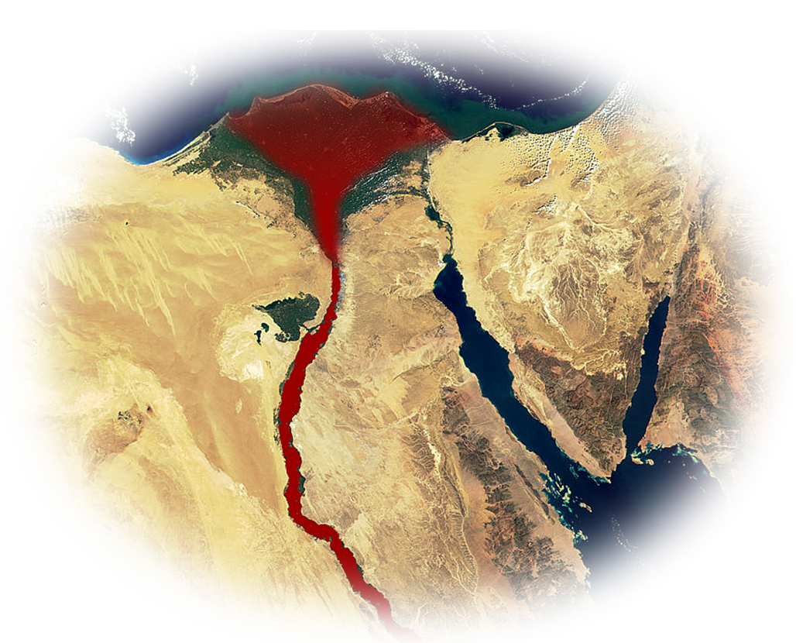
Chapters 7-12 = 10 PLAGUES
Moses to Pharaoh,
“Let my people go”
Moses Predicts a Plagues, if Refuses
Pharaoh Hardens Heart
Pharaoh Refuses and Plagues Happens
1. BLOOD
Pharaoh: “Stop the Plague, I’ll let you go.“
Plague Ends

Slide 12
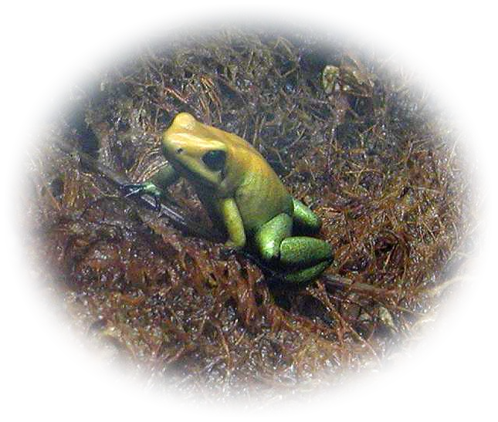
Chapters 7-12 = 10 PLAGUES
Moses to Pharaoh,
“Let my people go”
Moses Predicts a Plagues, if Refuses
Pharaoh Hardens Heart
Pharaoh Refuses and Plagues Happens
2. FROGS
Pharaoh: “Stop the Plague, I’ll let you go.“
Plague Ends

Slide 13
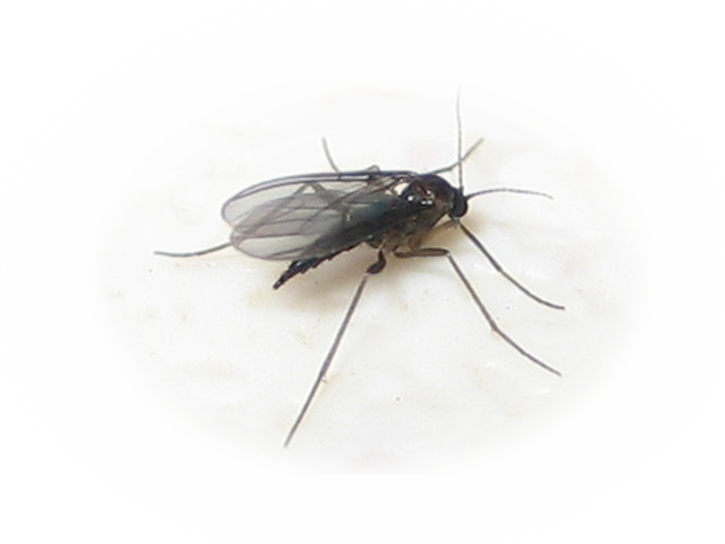
Chapters 7-12 = 10 PLAGUES
Moses to Pharaoh,
“Let my people go”
Moses Predicts a Plagues, if Refuses
Pharaoh Hardens Heart
Pharaoh Refuses and Plagues Happens
3. GNATS
Pharaoh: “Stop the Plague, I’ll let you go.“
Plague Ends
Notes:
Gnat = FREE = https://upload.wikimedia.org/wikipedia/commons/5/52/Female_black_fungus_gnat.jpg

Slide 14
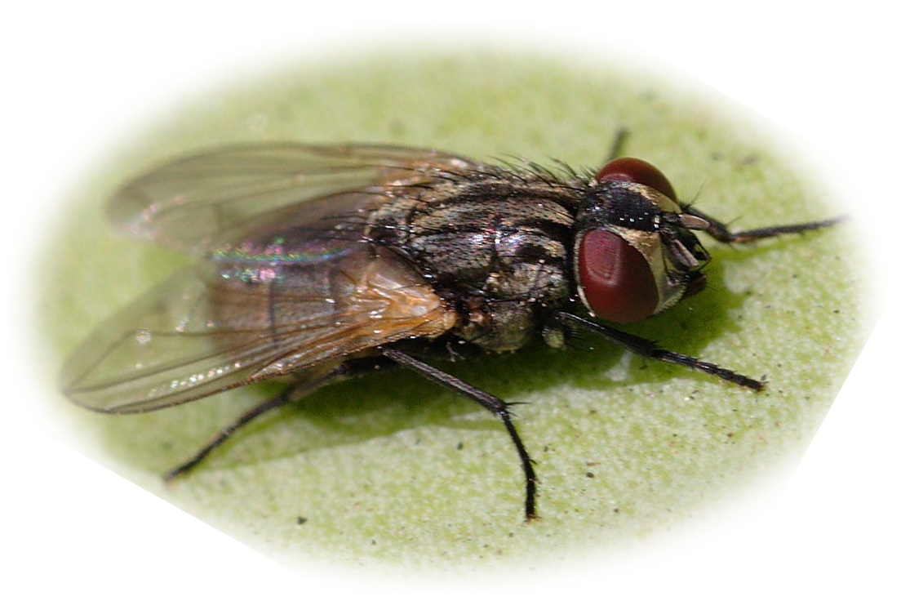
Chapters 7-12 = 10 PLAGUES
Moses to Pharaoh,
“Let my people go”
Moses Predicts a Plagues, if Refuses
Pharaoh Hardens Heart
Pharaoh Refuses and Plagues Happens
4. FLIES
Pharaoh: “Stop the Plague, I’ll let you go.“
Plague Ends

Slide 15
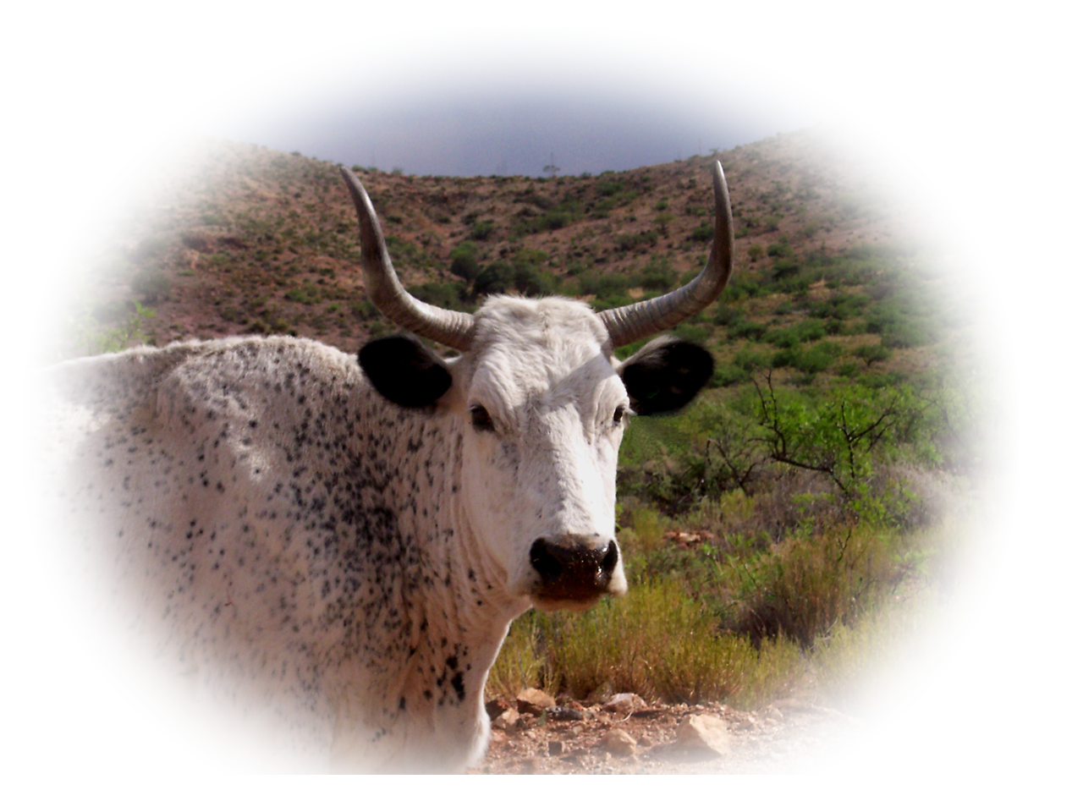
Chapters 7-12 = 10 PLAGUES
Moses to Pharaoh,
“Let my people go”
Moses Predicts a Plagues, if Refuses
Pharaoh Hardens Heart
Pharaoh Refuses and Plagues Happens
5. ANIMALS
Pharaoh: “Stop the Plague, I’ll let you go.“
Plague Ends

Slide 16
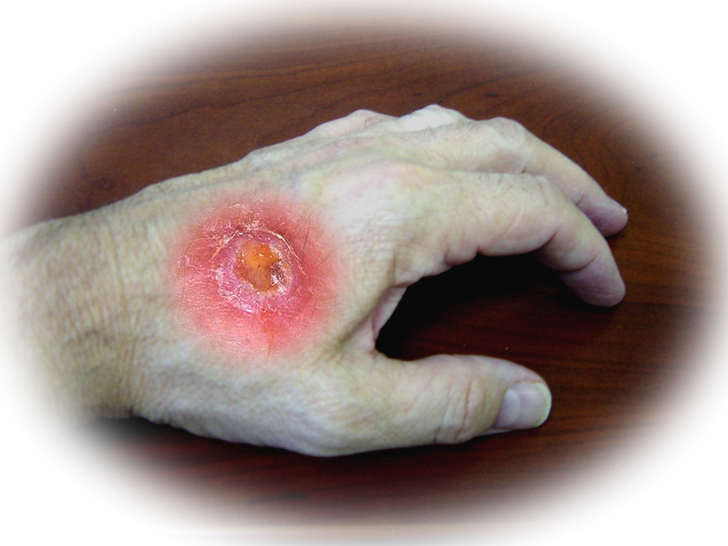
Chapters 7-12 = 10 PLAGUES
Moses to Pharaoh,
“Let my people go”
Moses Predicts a Plagues, if Refuses
Pharaoh Hardens Heart
Pharaoh Refuses and Plagues Happens
6. BOILS
Pharaoh: “Stop the Plague, I’ll let you go.“
Plague Ends

Slide 17
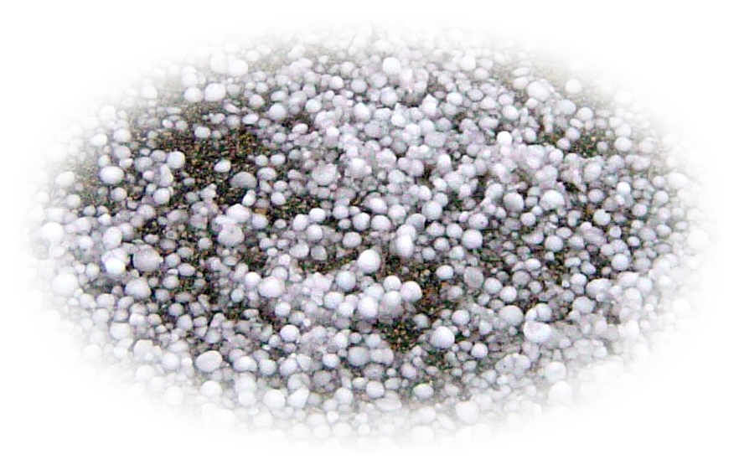
Chapters 7-12 = 10 PLAGUES
Moses to Pharaoh,
“Let my people go”
Moses Predicts a Plagues, if Refuses
Pharaoh Hardens Heart
Pharaoh Refuses and Plagues Happens
7. HAIL
Pharaoh: “Stop the Plague, I’ll let you go.“
Plague Ends

Slide 18
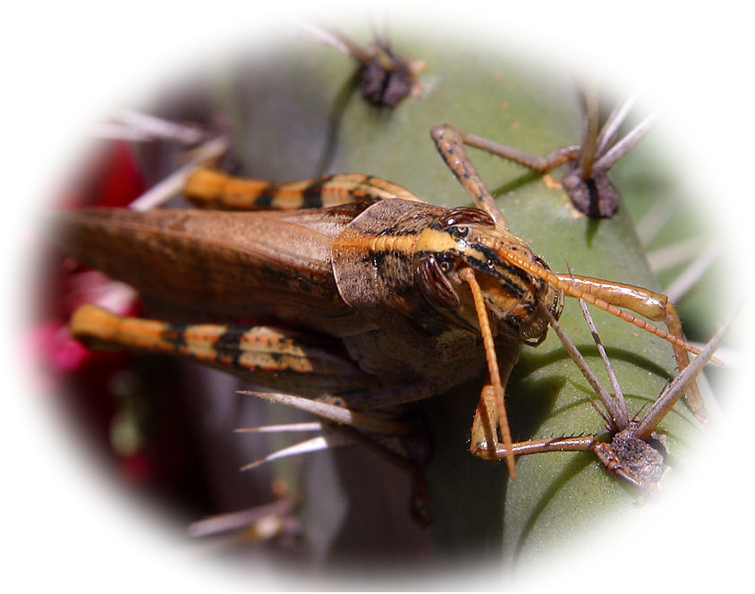
Chapters 7-12 = 10 PLAGUES
Moses to Pharaoh,
“Let my people go”
Moses Predicts a Plagues, if Refuses
Pharaoh Hardens Heart
Pharaoh Refuses and Plagues Happens
8. LOCUST
Pharaoh: “Stop the Plague, I’ll let you go.“
Plague Ends

Slide 19
Chapters 7-12 = 10 PLAGUES
Moses to Pharaoh,
“Let my people go”
Moses Predicts a Plagues, if Refuses
Pharaoh Hardens Heart
Pharaoh Refuses and Plagues Happens
9. DARKNESS
Pharaoh: “Stop the Plague, I’ll let you go.“
Plague Ends

Slide 20
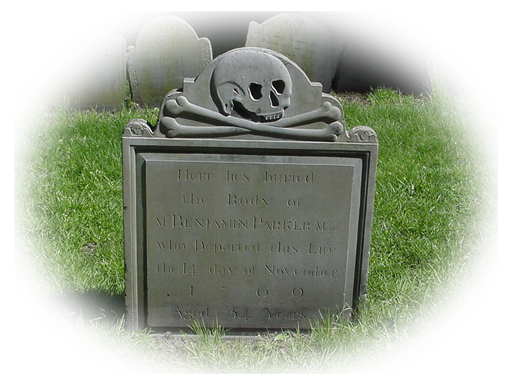
Chapters 7-12 = 10 PLAGUES
Moses to Pharaoh,
“Let my people go”
Moses Predicts a Plagues, if Refuses
Pharaoh Hardens Heart
Pharaoh Refuses and Plagues Happens
10. DEATH
Pharaoh: “Stop the Plague, I’ll let you go.“
Plague Ends

Slide 21
One Intrigues Me ...
FROGS ^{8:1-11}

Slide 22
Step 1: “Let My People Go”
Exodus 8:1 Then the LORD said to Moses,
"Go to Pharaoh and say to him,

Slide 23
Step 1: “Let My People Go”
Exodus 8:1 Then the LORD said to Moses,
"Go to Pharaoh and say to him,
'Thus says the LORD: Let my people go, so that they may worship me.'

Slide 24
Step 2: “Plague Predicted”
² 'If you refuse to let them go, I will plague your whole country with frogs. ³ The river shall swarm with frogs; they shall come up into your palace, into your bedchamber and your bed, and into the houses of your officials and of your people, and into your ovens and your kneading bowls....'"
⁴ The frogs shall come up on you and on your people and on all your officials.'"
⁵ And the LORD said to Moses, "Say to Aaron, 'Stretch out your hand with your staff over the rivers, the canals, and the pools, and make frogs come up on the land of Egypt.'"
⁶ So Aaron stretched out his hand over the waters of Egypt; and the frogs came up and covered the land of Egypt.
⁷ But the magicians did the same by their secret arts, and brought frogs up on the land of Egypt.
⁸ Then Pharaoh called Moses and Aaron, and said, "Pray to the LORD to take away the frogs from me and my people, and I will let the people go to sacrifice to the LORD."
⁹ Moses said to Pharaoh, "Kindly tell me when I am to pray for you and for your officials and for your people, that the frogs may be removed from you and your houses and be left only in the Nile."
¹⁰ And he said, "Tomorrow." Moses said, "As you say! So that you may know that there is no one like the LORD our God,
¹¹ the frogs shall leave you and your houses and your officials and your people; they shall be left only in the Nile."
¹² Then Moses and Aaron went out from Pharaoh; and Moses cried out to the LORD concerning the frogs that he had brought upon Pharaoh.
¹³ And the LORD did as Moses requested: the frogs died in the houses, the courtyards, and the fields.
¹⁴ And they gathered them together in heaps, and the land stank.
¹⁵ But when Pharaoh saw that there was a respite, he hardened his heart, and would not listen to them, just as the LORD had said. (Exo 8:1-15 NRS)

Slide 25
Step 3: “Refusal”
IMPLIED BY CONTEXT

Slide 26
Step 4: “The Plague”
⁵ And the LORD said to Moses, "Say to Aaron,
'Stretch out your hand with your staff over the rivers, the canals, and the pools, and make frogs come up on the land of Egypt.'"

Slide 27
Step 4: “The Plague”
⁶ So Aaron stretched out his hand over the waters of Egypt; and the frogs came up and covered the land of Egypt.

Slide 28
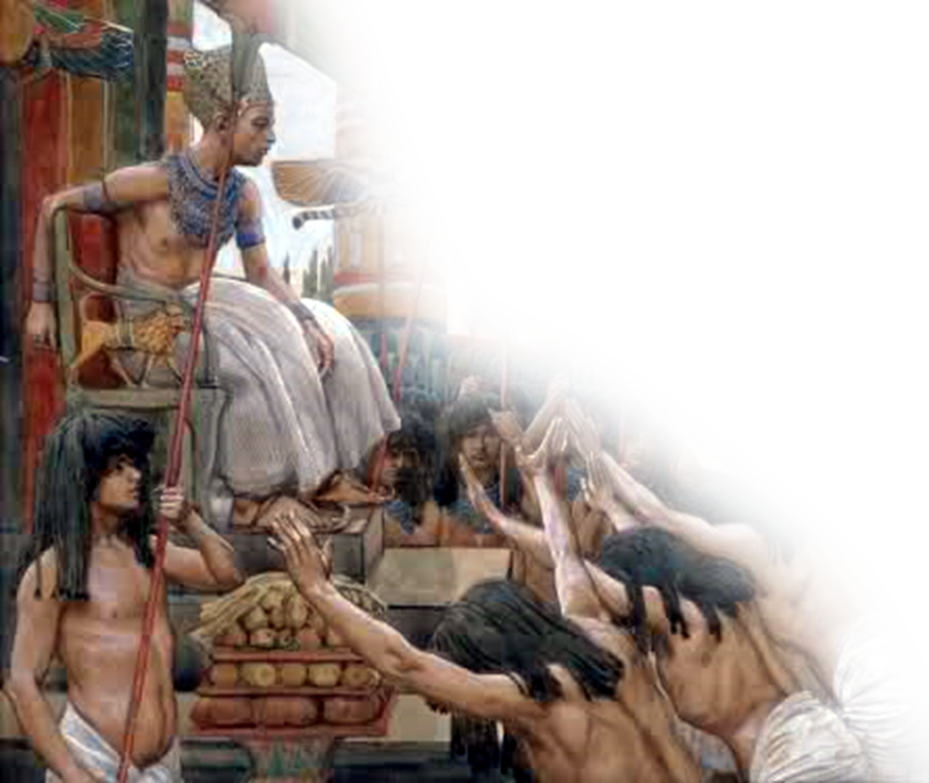
Step 4: “The Plague”
⁷ But the magicians did the same by their secret arts, and brought frogs up on the land of Egypt.
Notes:
Life really stinks when you spend unnecessary time with your frogs!

Slide 29
Step 4: “The Plague”
⁷ But the magicians did the same by their secret arts, and brought frogs up on the land of Egypt.
But the magician could not stop the frogs ... So ...
Notes:
Life really stinks when you spend unnecessary time with your frogs!

Slide 30
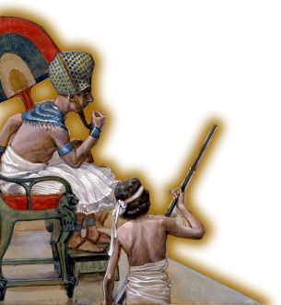
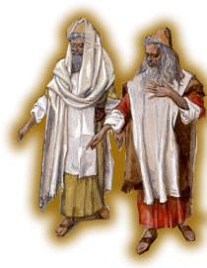
Step 5: “Stop! I’ll let you go!”
⁸ Then Pharaoh called Moses and Aaron, and said,
"Pray to the LORD to take away the frogs from me and my people, and I will let the people go to sacrifice to the LORD.“

Slide 31
What Intrigues Me
⁹ Moses said to Pharaoh,
"Kindly tell me when I am to pray for you and for your officials and for your people, that the frogs may be removed from you and your houses and be left only in the Nile."

Slide 32
One more night with the FROGS!
¹⁰ And he said, "Tomorrow."

Slide 33
One more night with the FROGS!
¹⁰ And he said, "Tomorrow."
You and I do this too!
Notes:
We do this too –
Hold off from doing what we know we should do--salvation, baptism, church membership, tithing,
We hang on to that which we should get rid of--our anger, depression, covetousness,
We promise ourselves to quit smoking, drinking, drugs or start a diet tomorrow.
We hang on to broken relationships, poor paying jobs, and terribly uncomfortable situations.
We stay one more night with our frogs!!! One more night becomes, “Just, one more night” and then again, “Just one more night.”
You know what the frogs are in your life—this intrigues me—we just want one more night with our frogs, too!!!

Slide 34
One more night with the FROGS!
Moses said,
"As you say! So that you may know that there is no one like the LORD our God, ¹¹ the frogs shall leave you and your houses and your officials and your people; they shall be left only in the Nile.“

Slide 35
Step 6: Plague Ends
¹² Then Moses and Aaron went out from Pharaoh; and Moses cried out to the LORD concerning the frogs that he had brought upon Pharaoh.
¹³ And the LORD did as Moses requested: the frogs died in the houses, the courtyards, and the fields.

Slide 36
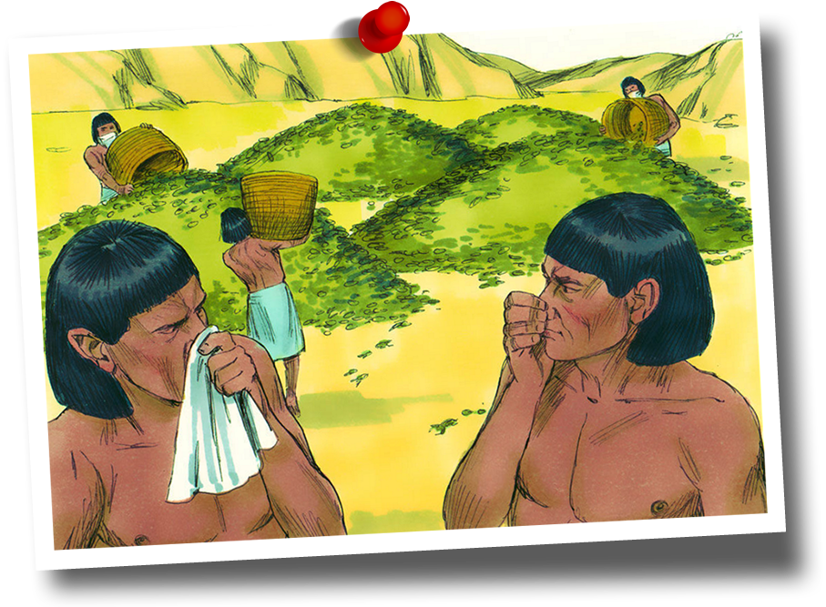
Step 6: Plague Ends
¹² Then Moses and Aaron went out from Pharaoh; and Moses cried out to the LORD concerning the frogs that he had brought upon Pharaoh.
¹³ And the LORD did as Moses requested: the frogs died in the houses, the courtyards, and the fields. ¹⁴ And they gathered them together in heaps, and the land stank.

Slide 37
Step 7: Hardened His Heart
¹⁵ But when Pharaoh saw that there was a respite, he hardened his heart, and would not listen to them, just as the LORD had said.

Slide 38
Pharaoh spent one more night with the frogs.
Pharaoh did so UNNECESSARILY!

Slide 39
Pharaoh spent one more night with the frogs UNNECESSARILY.
Why?

Slide 40
Pharaoh spent one more night with the frogs UNNECESSARILY.
Why?
Because of PROCRASTINATION

Slide 41
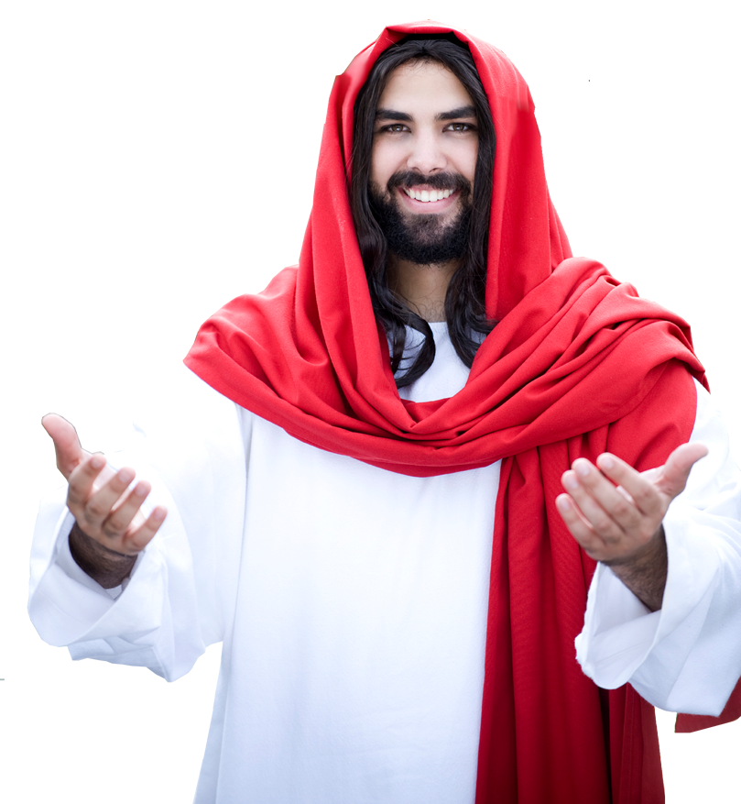
Delay, Procrastination
^{Luke 9:59} Jesus said, "Follow me." But he said, "Lord, first let me go and bury my father." ⁶⁰ But Jesus said to him, "Let the dead bury their own dead; but as for you, go and proclaim the kingdom of God." ⁶¹ Another said, "I will follow you, Lord; but let me first say farewell to those at my home." ⁶² Jesus said to him, "No one who puts a hand to the plow and looks back is fit for the kingdom of God."

Slide 42
Delay, Procrastination
^{Isaiah 55:6} Seek the LORD while he may be found, call upon him while he is near ....

Slide 43
Delay, Procrastination
^{Matthew 11:28} "Come to me, all you that are weary and are carrying heavy burdens, and I will give you rest.”

Slide 44
Final thought ...
Don’t delay ... Come to Him today!

Slide 45
Let’s Pray!

