Slide 1
Snapshots from a Spiritual Journey
Notes:
This series uses the Revised Standard Version of the Bible.
Copyright © 2000-2021. All rights reserved. Bible Point is a registered trademark of Dennis Henderson. All other trademarks acknowledged.
Bible Point contains graphics from Bible Point artists. These illustrations belong to Bible Point and the respective artists. You may use the designs and illustrations for graphical illustration of lessons free and without special permission, provided they are not used in any way that maligns the Christian faith. Furthermore, republication or production of any illustration by any other graphic service whether it be in book, in a machine-readable form, or in any other design resource is strictly prohibited. Furthermore, they cannot be duplicated or resold as any other form of publishing, clip art, or graphic resource.
So What does it mean? (A simple translations of the legal jargon)
So, if you don’t own the presentation(s), graphic(s), and text(s) how can you legally use them? The purchase of the license allows you to use all the images in the product. However, the actual ownership and copyright of the presentation(s), graphic(s), and text(s) remain the property of Bible Point and its licensors. If you had plans on using this product in your “for sale” work—think again!
License Agreement
Article 1: License Grant
All the graphics and text in Bible Point presentations (excluding quotes from the Bible and stated sources) are the intellectual and real property of Bible Point and its licensors, and is protected by law, including United States copyright laws and international treaties. Bible Point grants to you a license:
1. To use the presentation in a single church, single school, or single office of a Christian organization.
2. To make a single archival back-up copy of the program.
3. To modify the presentation(s) and merge with other presentations in a single church, school, or Christian organization.
4. To transfer to another party if that party agrees to accept the terms and conditions of this agreement, and you do not retain any copies of the presentation, whether printed, machine readable, modified, or merged form.
Article 2: Terms
This license is effective until terminated. You may terminate the license at any time by destroying the presentation(s), graphic(s), or text(s) together with all copies, modifications and merged portions in any form. Bible Point may terminate your license if you fail to comply with this Agreement. You agree, upon such termination, for any reason, to destroy the presentation(s), graphics, and text(s) with all copies, modifications, and merged portions in any form.
Article 3: Disclaimers
1. Bible Point presentations, graphics, and texts are licensed to you As Is. You, the consumer, bear the entire risk relating to the quality and performance of the presentation(s), graphic(s), or text(s). In no event will Bible Point be liable for damages resulting from any defect.
2. Thirty-day limited warrantee on disks. Bible Point warrants the disks to be free of defects in material and workmanship under normal use for 30 days after purchase. During the 30-day period you may return a defective presentation, graphic, or text with proof of purchase and it will be replaced without charge, unless the presentation is damaged by misuse.
Article 4: General
1. You may not sub-license, assign, or transfer the license of the presentation(s), graphic(s), or text(s) except as provided by this Agreement.
2. This Agreement will be governed by the laws of the State of Michigan.
So What does it mean? (A simple translations of the legal jargon)
May I let someone borrow or copy my licensed Bible Point presentation (even after I modified it)? As long as it is within your local church, or single school, or the immediate office of a Christian organization you may. Otherwise, please refer the person interested in borrowing to: http://www.biblepoint.com or E-mail: dh@biblepoint.com with any related questions.

Slide 2
Taking the Fear Out of the FUTURE
Notes:
Taking the Fear out of Life/Obedience/Leadership

Slide 3
Three of Our Biggest Fears
1- Fear of Failure
Notes:
Failur = FREE = http://www.rgbstock.com/photo/odxaFTq/going+down

Slide 4
Three of Our Biggest Fears
1- Fear of Failure
2- Fear of Rejection
Notes:
Rejection = FREE = http://www.rgbstock.com/photo/nF2j704/stop+it%21

Slide 5
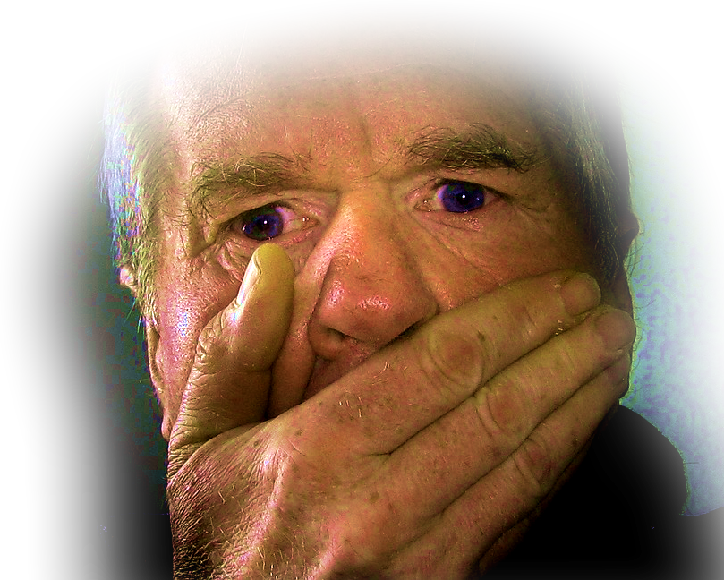
Three of Our Biggest Fears
1- Fear of Failure
2- Fear of Rejection
3- Fear of Speaking

Slide 6
1-Fear of FAILURE!

Slide 7
1-Fear of FAILURE!
It won’t work! I’ll be let down!
Why did you ever send me? Since I first came to Pharaoh to speak in your name, ... you have done nothing at all to deliver your people." (Exodus 5:22, 23)

Slide 8
Divine Reassurances
"Now you shall see what I will do to Pharaoh: Indeed, by a mighty hand he will let them go; by a mighty hand he will drive them out of his land." (Exodus 6:1)

Slide 9
Divine Reassurances
"I am the LORD” (6:2) ...
"I am the LORD” (6:6) ...
"I am the LORD” (6:8) ...
^{7:1} "Go and tell Pharaoh king of Egypt to let the Israelites go out of his land."

Slide 10
Ready ... but fear strikes again!
For two more intimidating reasons ...

Slide 11
2-Fear of REJECTION!
¹² But Moses spoke to the LORD,
"The Israelites have not listened to me ...

Slide 12
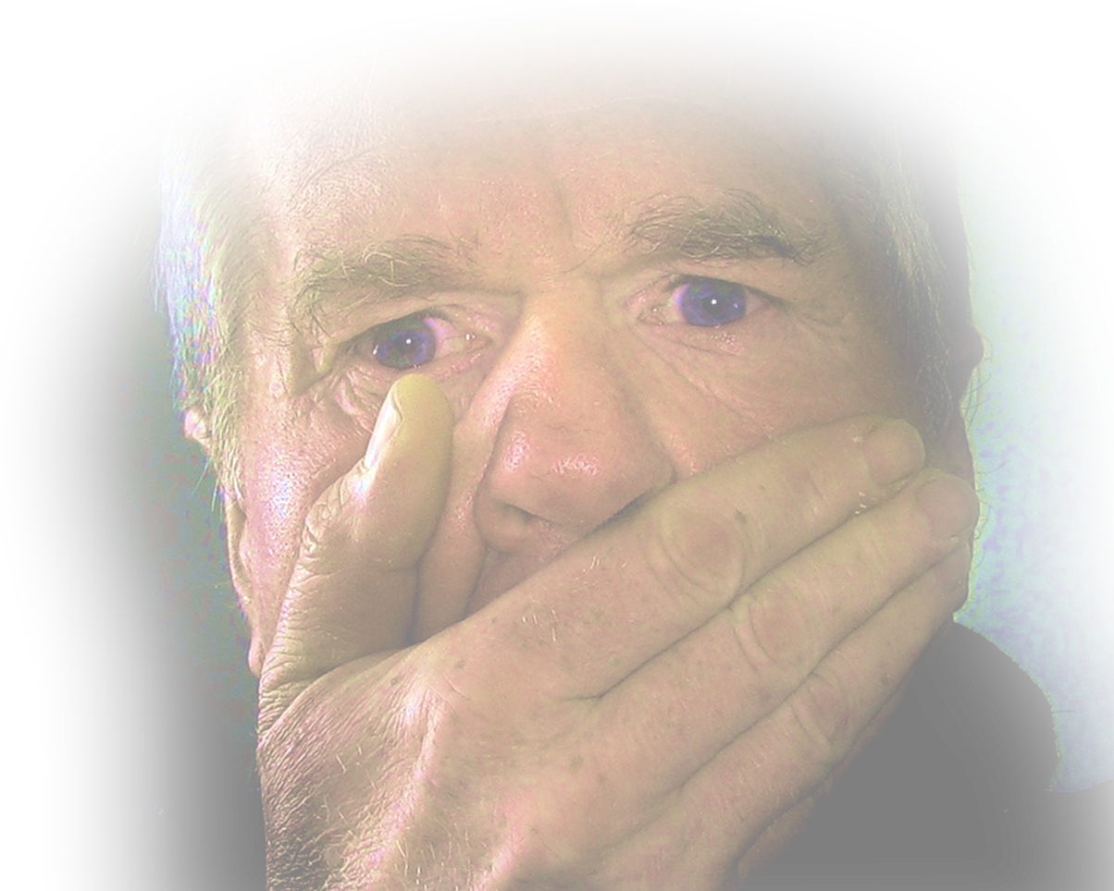
3-Fear of SPEAKING!
¹² But Moses spoke to the LORD,
“... how then shall Pharaoh listen to me, poor speaker that I am?”

Slide 13
The Divine Response

Slide 14
“I Want You to BE LOYAL”
That’s Why I ORDERED you
Thus the LORD spoke to Moses and Aaron, and gave them orders regarding the Israelites and Pharaoh king of Egypt, charging them to free the Israelites from the land of Egypt. (Exodus 6:13)

Slide 15
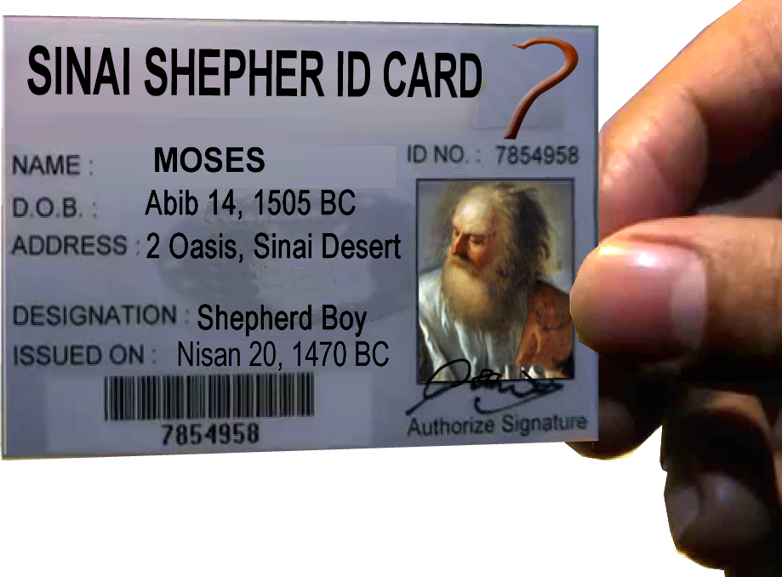
“I Want You to BE LOYAL”
That’s why I IDENTIFIED YOU!
These [genealogies] are the heads of the ancestral houses of the Levites by their families.
²⁶ It was this same Aaron and Moses to whom the LORD said, "Bring the Israelites out of the land of Egypt, company by company." (Exo 6:25-26)

Slide 16
“I Want You to BE LOYAL”
That’s why I COMMISSIONED you
²⁸ On the day when the LORD spoke to Moses in the land of Egypt, ²⁹ he said to him,
"I am the LORD; tell Pharaoh king of Egypt all that I am speaking to you.“ (6:28-29)
GO - TELL

Slide 17
“I Want You to BE LOYAL”
That’s why I HEARD you
³⁰ But Moses said in the LORD's presence,
"Since I am a poor speaker, why would Pharaoh listen to me?"
Self-Incrimination

Slide 18
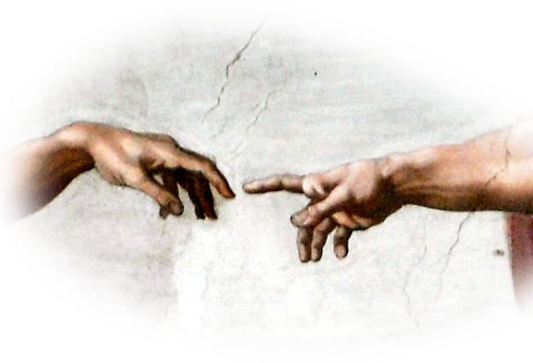
“I Want You to BE LOYAL”
That’s why I MADE you
^{Exo 7:1} The LORD said to Moses, "See, I have made you like God to Pharaoh, ...”
You’re adequate!
Notes:
Hand of God = FREE = https://upload.wikimedia.org/wikipedia/commons/7/73/God2-Sistine_Chapel.png
You are like God when you speak the Word of God.

Slide 19
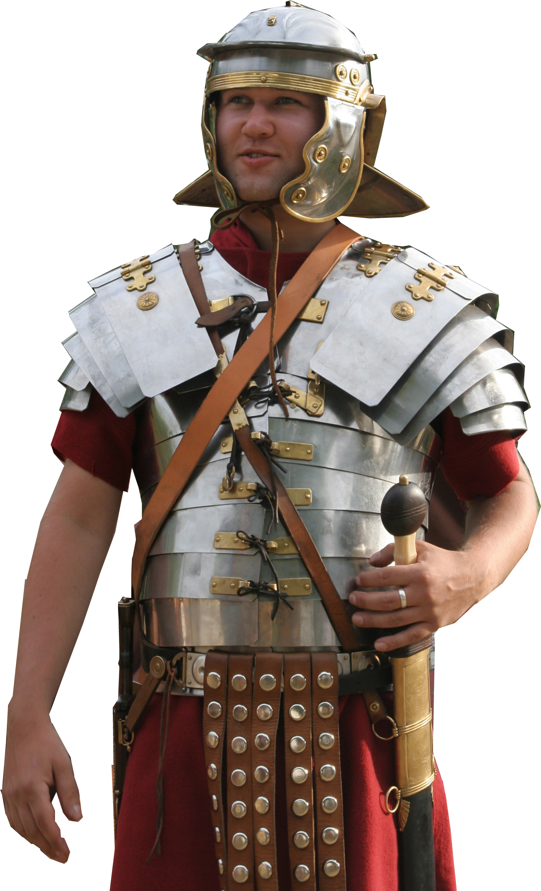
“I Want You to BE LOYAL”
That’s why I EQUIPPED you
^{Exo 7:1} The LORD said to Moses,
"See, I have made you like God to Pharaoh, and your brother Aaron shall be your prophet.”
You’re Equipped!
Notes:
Armor = FREE = https://upload.wikimedia.org/wikipedia/commons/a/a6/Roman_soldier_in_lorica_segmentata_1-cropped.jpg

Slide 20
“I Want You to BE LOYAL”
That’s why I COMMANDED you
¹ The LORD said to Moses, ...
² “You shall speak all that I command you, and your brother Aaron shall tell Pharaoh to let the Israelites go out of his land.
Notes:
You are like God when you speak the Word of God.

Slide 21
“I Want You to BE LOYAL”
That’s why I INTERVENE for you
¹ The LORD said to Moses, ...
³ But I will harden Pharaoh's heart, and I will multiply my signs and wonders in the land of Egypt
For the Toughest
Notes:
You are like God when you speak the Word of God.

Slide 22
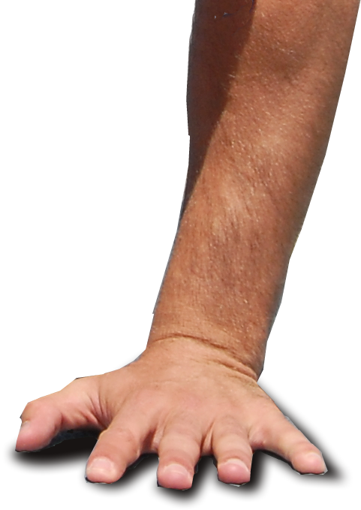
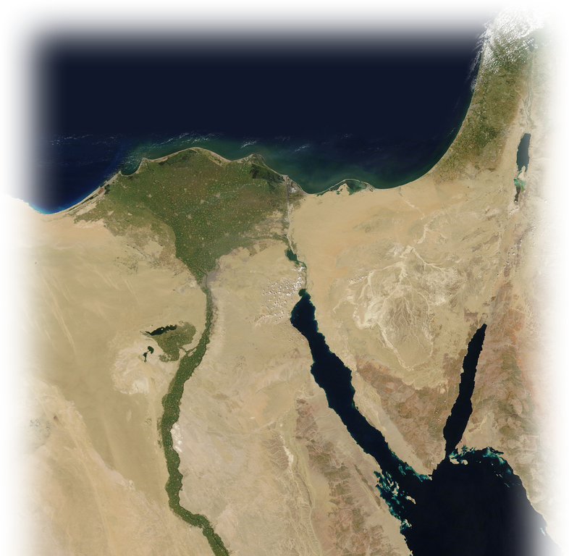
“I Want You to BE LOYAL”
That’s why I BACK you
¹ The LORD said to Moses, ...
⁴ When Pharaoh does not listen to you, I will lay my hand upon Egypt and bring my people the Israelites, company by company, out of the land of Egypt by great acts of judgment.
Notes:
Egypt Map = FREE = https://www.flickr.com/photos/gsfc/5635018418
Hand = FREE = https://upload.wikimedia.org/wikipedia/commons/a/ae/Airman_doing_pushup.JPG

Slide 23
“I Want You to BE LOYAL”
That’s why I VINDICATE you
¹ The LORD said to Moses, ... ⁵ The Egyptians shall know that I am the LORD, when I stretch out my hand against Egypt and bring the Israelites out from among them.“ (7:1-5)
Notes:
You are like God when you speak the Word of God.

Slide 24
HERE’S THE POINT:
God want us to BE LOYAL
in the face of fear!

Slide 25
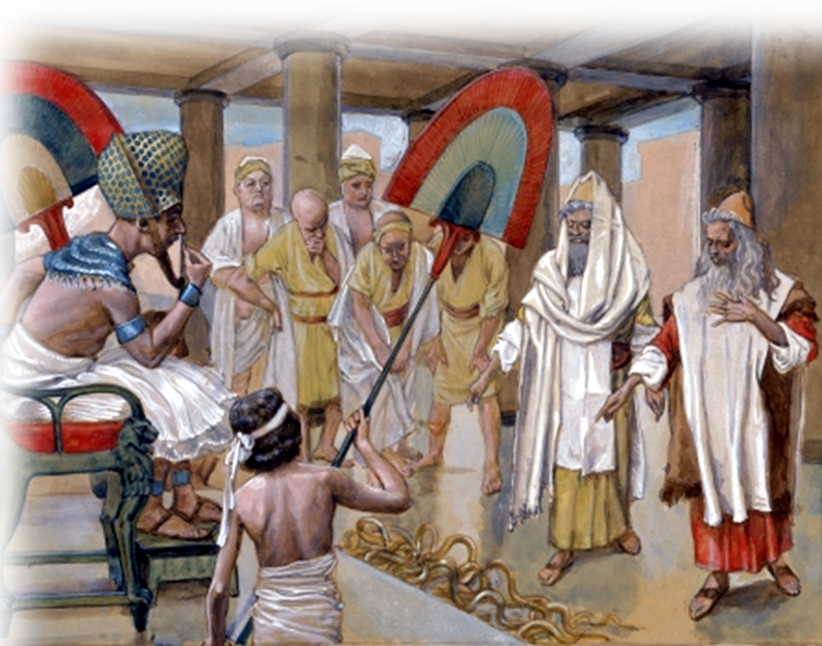
They did it!
⁶ Moses and Aaron did so; they did just as the LORD commanded them.
⁷ Moses was eighty years old and Aaron eighty-three when they spoke to Pharaoh.
Notes:
Moses and Aaron = FREE = https://upload.wikimedia.org/wikipedia/commons/5/51/Tissot_The_Rod_of_Aaron_Devours_the_Other_Rods.jpg

Slide 26
Here’s the Point:
If Moses and Aaron could do it ...
We can do it too!

Slide 27
Take this with you!
Don’t Fear FAILURE –

Slide 28
Take this with you!
Don’t Fear FAILURE – “I’ll multiply my signs and wonders”

Slide 29
Take this with you!
Don’t Fear FAILURE – “I’ll multiply my signs and wonders”
Don’t Fear REJECTION –

Slide 30
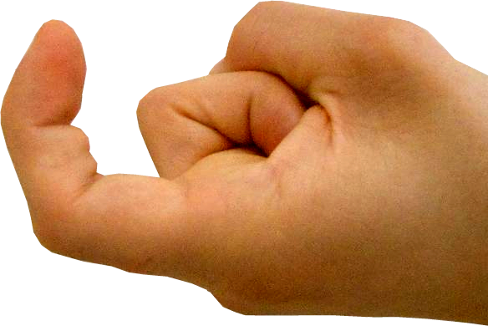
Take this with you!
Don’t Fear FAILURE – “I’ll multiply my signs and wonders”
Don’t Fear REJECTION – “I will bring my people out of Egypt”

Slide 31
Take this with you!
Don’t Fear FAILURE – “I’ll multiply my signs and wonders”
Don’t Fear REJECTION – “I will bring my people out of Egypt”
Don’t Fear SPEAKING –

Slide 32
Take this with you!
Don’t Fear FAILURE – “I’ll multiply my signs and wonders”
Don’t Fear REJECTION – “I will bring my people out of Egypt”
Don’t Fear SPEAKING – “I will put my words in the mouth”
Notes:
Man Speaking = Licensed from + http://www.bigstockphoto.com/image-99716420/stock-photo-shouting-hispanic-male-cupping-hands-mouth-h

Slide 33
Just be LOYAL!
Whether you eat or drink, or whatever you do, do everything for the glory of God. (1Cor 10:31)

Slide 34
Let’s Pray

