Slide 1
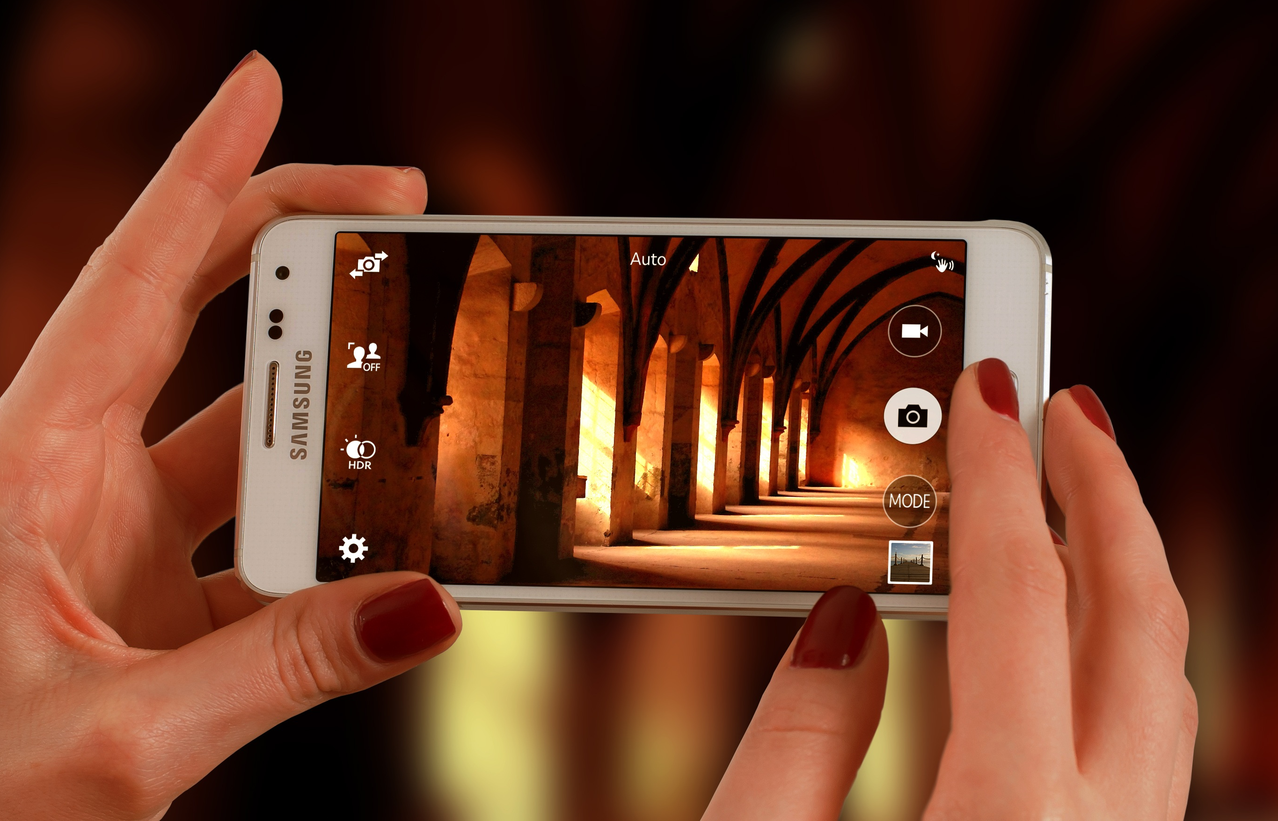
Snapshots from a Spiritual Journey
Notes:
This series uses the Revised Standard Version of the Bible.
Copyright © 2000-2021. All rights reserved. Bible Point is a registered trademark of Dennis Henderson. All other trademarks acknowledged.
Bible Point contains graphics from Bible Point artists. These illustrations belong to Bible Point and the respective artists. You may use the designs and illustrations for graphical illustration of lessons free and without special permission, provided they are not used in any way that maligns the Christian faith. Furthermore, republication or production of any illustration by any other graphic service whether it be in book, in a machine-readable form, or in any other design resource is strictly prohibited. Furthermore, they cannot be duplicated or resold as any other form of publishing, clip art, or graphic resource.
So What does it mean? (A simple translations of the legal jargon)
So, if you don’t own the presentation(s), graphic(s), and text(s) how can you legally use them? The purchase of the license allows you to use all the images in the product. However, the actual ownership and copyright of the presentation(s), graphic(s), and text(s) remain the property of Bible Point and its licensors. If you had plans on using this product in your “for sale” work—think again!
License Agreement
Article 1: License Grant
All the graphics and text in Bible Point presentations (excluding quotes from the Bible and stated sources) are the intellectual and real property of Bible Point and its licensors, and is protected by law, including United States copyright laws and international treaties. Bible Point grants to you a license:
1. To use the presentation in a single church, single school, or single office of a Christian organization.
2. To make a single archival back-up copy of the program.
3. To modify the presentation(s) and merge with other presentations in a single church, school, or Christian organization.
4. To transfer to another party if that party agrees to accept the terms and conditions of this agreement, and you do not retain any copies of the presentation, whether printed, machine readable, modified, or merged form.
Article 2: Terms
This license is effective until terminated. You may terminate the license at any time by destroying the presentation(s), graphic(s), or text(s) together with all copies, modifications and merged portions in any form. Bible Point may terminate your license if you fail to comply with this Agreement. You agree, upon such termination, for any reason, to destroy the presentation(s), graphics, and text(s) with all copies, modifications, and merged portions in any form.
Article 3: Disclaimers
1. Bible Point presentations, graphics, and texts are licensed to you As Is. You, the consumer, bear the entire risk relating to the quality and performance of the presentation(s), graphic(s), or text(s). In no event will Bible Point be liable for damages resulting from any defect.
2. Thirty-day limited warrantee on disks. Bible Point warrants the disks to be free of defects in material and workmanship under normal use for 30 days after purchase. During the 30-day period you may return a defective presentation, graphic, or text with proof of purchase and it will be replaced without charge, unless the presentation is damaged by misuse.
Article 4: General
1. You may not sub-license, assign, or transfer the license of the presentation(s), graphic(s), or text(s) except as provided by this Agreement.
2. This Agreement will be governed by the laws of the State of Michigan.
So What does it mean? (A simple translations of the legal jargon)
May I let someone borrow or copy my licensed Bible Point presentation (even after I modified it)? As long as it is within your local church, or single school, or the immediate office of a Christian organization you may. Otherwise, please refer the person interested in borrowing to: http://www.biblepoint.com or E-mail: dh@biblepoint.com with any related questions.

Slide 2
Something Unusual Happened Today!

Slide 3
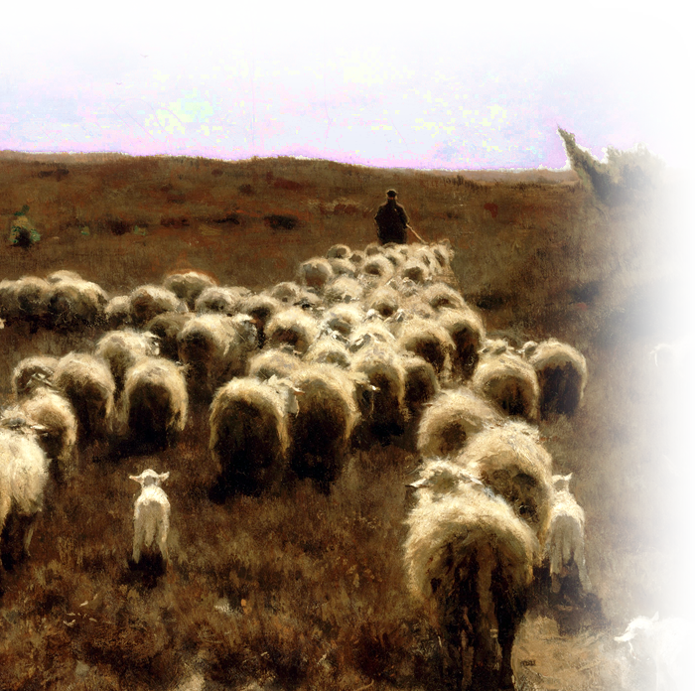
An Ordinary Routine Day
^{Ex 3:1} Moses was keeping the flock of his father-in-law Jethro, the priest of Midian; he led his flock beyond the wilderness, and came to Horeb, the mountain of God.
Notes:
Sheep = https://upload.wikimedia.org/wikipedia/commons/f/f0/Anton_Mauve_-_The_Return_of_the_Flock%2C_Laren_-_Google_Art_Project.jpg

Slide 4
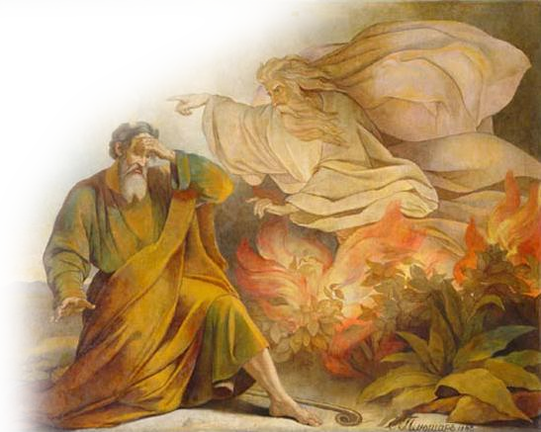
An Extraordinary Bush
² There the angel of the LORD appeared to him in a flame of fire out of a bush; he looked, and the bush was blazing, yet it was not consumed.
Notes:
Burning Bush = FREE = https://https://commons.wikimedia.org/wiki/File:Moses_Pluchart.jpg

Slide 5
An Extraordinary Bush
³ Then Moses said,
"I must turn aside and look at this great sight, and see why the bush is not burned up."
Notes:
Burning Bush = FREE = https://commons.wikimedia.org/wiki/File:Moses_Pluchart.jpg

Slide 6
A Divine Call
⁴ When the LORD saw that he had turned aside to see, God called to him out of the bush, "Moses, Moses!" And he said, "Here I am."
Notes:
Burning Bush = FREE = https://commons.wikimedia.org/wiki/File:Moses_Pluchart.jpg

Slide 7
A Divine Call
⁵ Then he said, "Come no closer! Remove the sandals from your feet, for the place on which you are standing is holy ground."
Notes:
Burning Bush = FREE = https://commons.wikimedia.org/wiki/File:Moses_Pluchart.jpg

Slide 8
A Divine Revelation
⁶ He said further, "I am the God of your father, the God of Abraham, the God of Isaac, and the God of Jacob." And Moses hid his face, for he was afraid to look at God.
Notes:
Burning Bush = FREE = https://commons.wikimedia.org/wiki/File:Moses_Pluchart.jpg

Slide 9
A Divine Revelation
⁷ Then the LORD said, "I have observed the misery of my people who are in Egypt; I have heard their cry ... ⁸ and I have come down to deliver them from the Egyptians,
Notes:
Burning Bush = FREE = https://commons.wikimedia.org/wiki/File:Moses_Pluchart.jpg

Slide 10
A Divine Commission
¹⁰ So come, I will send you to Pharaoh to bring my people, the Israelites, out of Egypt."
Notes:
Burning Bush = FREE = https://commons.wikimedia.org/wiki/File:Moses_Pluchart.jpg

Slide 11
Something Unusual Was Said Today!

Slide 12
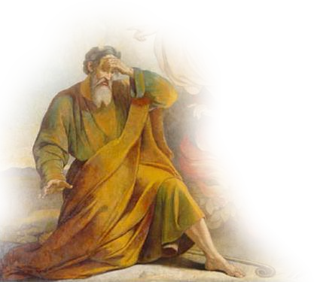
1st Stall: Who am I?
¹¹ But Moses said to God, "Who am I that I should go to Pharaoh, and bring the Israelites out of Egypt?"
Notes:
“I’m too old—I’m 80 years old –I’ve been tending sheep for 40 years—I can’t change. Who am I to try to change this late in life?

Slide 13
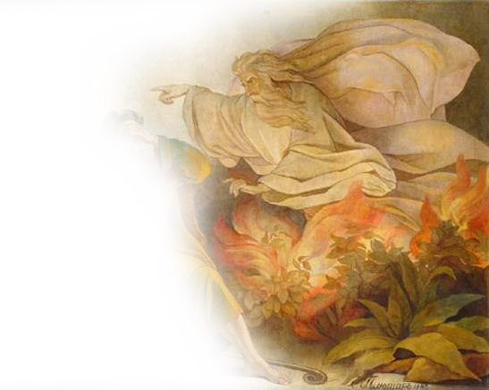
1st Response: Never Mind
¹² And God said, "I will be with you; and this shall be the sign for you that it is I who sent you: when you have brought the people out of Egypt, you shall worship God on this mountain."

Slide 14
2nd Stall: Who are You Really?
¹³ But Moses said to God,
"If I come to the Israelites and say to them, 'The God of your ancestors has sent me to you,' and they ask me, 'What is his name?' what shall I say to them?"
Notes:
I’m no theologian! I don’t even know your name!
We are all afraid of the hypothetical ‘What if ...”

Slide 15
2nd Response: YHWH!
¹⁴ God said to Moses,
"I AM WHO I AM." He said further, "Thus you shall say to the Israelites, 'I AM has sent me to you.'“ ... 'The LORD, the God of your ancestors, ... This is my name forever, and this my title for all generations.

Slide 16
3rd Stall: Who will Believe Me?
¹ Then Moses answered,
"But suppose they do not believe me or listen to me, but say, 'The LORD did not appear to you.'"

Slide 17
3rd Response: Just Watch
² The LORD said to him,
"What is that in your hand?“

Slide 18
3rd Response: Just Watch
² The LORD said to him,
"What is that in your hand?“
He said, "A staff.“

Slide 19
3rd Response: Just Watch
² The LORD said to him,
"What is that in your hand?“
He said, "A staff.“
³ Then the LORD said ...
"Throw it on the ground."

Slide 20
3rd Response: Just Watch
So he threw the staff on the ground, and it became a snake... ⁴ Then the LORD said ... "Reach out your hand, and seize it by the tail“
-- so he reached out his hand and grasped it, and it became a staff in his hand--

Slide 21
3rd Response: Just Watch
⁶ Again, the LORD said to him, "Put your hand inside your cloak." He put his hand into his cloak; and when he took it out, his hand was leprous, as white as snow.

Slide 22
3rd Response: Just Watch
"Put your hand back into your cloak"–
so he put his hand back into his cloak, and when he took it out, it was restored like the rest of his body-- ⁸ "If they will not believe you or heed the first sign, they may believe the second sign.

Slide 23
4th Stall: I Can’t
¹⁰ But Moses said ... "O my Lord, I have never been eloquent, neither in the past nor even now that you have spoken to your servant; but I am slow of speech and slow of tongue."

Slide 24
4th Response: I will help you
¹¹ The LORD said to him,
"Who gives speech to mortals? Who makes them mute or deaf, seeing or blind? Is it not I, the LORD? ¹² Now go, and I will be with your mouth and teach you what you are to speak."

Slide 25
5th Stall: I don’t want to!
¹³ But he said,
"O my Lord, please send someone else."

Slide 26
5th Response: God was angered!
¹⁴ Then the anger of the LORD was kindled against Moses and he said, "What of your brother Aaron, the Levite? I know that he can speak fluently .... ¹⁵ You shall speak to him ... ¹⁶ He indeed shall speak for you to the people....

Slide 27
The Results:
¹⁸ Moses went back to his father-in-law Jethro and said to him, "Please let me go back to my kindred in Egypt and see whether they are still living.“
And Jethro said to Moses, "Go in peace."

Slide 28
Something Unusual Happened That Day...

Slide 29
Something Unusual Happened That Day...
God showed up and spoke to Moses!

Slide 30
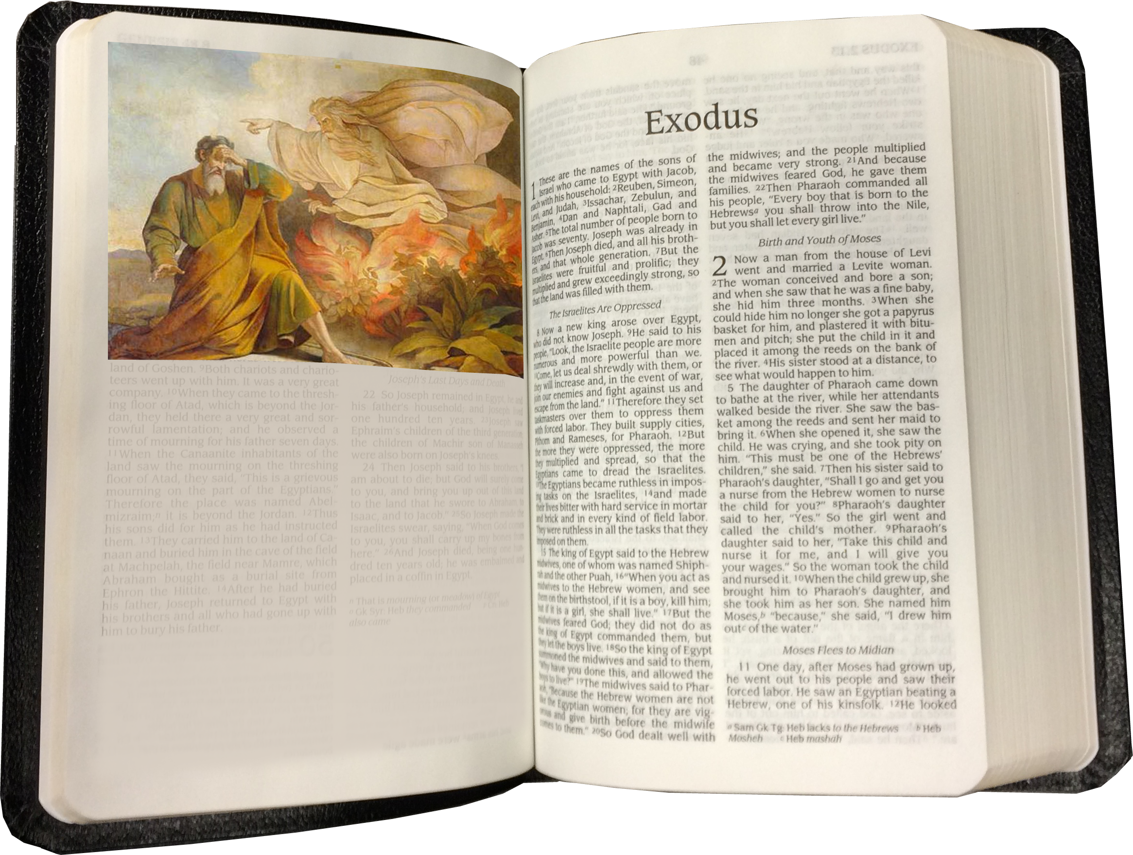
God spoke to me today ...

Slide 31
God spoke to me today ...
and this is what I heard Him say:

Slide 32
God said to me ...
“You have not done anything so bad that I cannot still use you.”
Notes:
It’s not about you--It’s about Me--I AM.

Slide 33
God said to me ...
“You have not done anything so bad that I cannot still use you.”
“You can get to know Who I AM!”
Notes:
It’s not about you--It’s about Me--I AM.

Slide 34
God said to me ...
“You have not done anything so bad that I cannot still use you.”
“You can get to know Who I AM!”
“Just watch what I will do.”
Notes:
It’s not about you--It’s about Me--I AM.

Slide 35
God said to me ...
“You have not done anything so bad that I cannot still use you.”
“You can get to know Who I AM!”
“Just watch what I will do.”
“It’s not about you—It’s about Me!”
Notes:
It’s not about you--It’s about Me--I AM.

Slide 36
God said to me ...
“You have not done anything so bad that I cannot still use you.”
“You can get to know Who I AM!”
“Just watch what I will do.”
“It’s not about you—It’s about Me!”
“Just ‘Do it!’”
Notes:
It’s not about you--It’s about Me--I AM.

Slide 37
Let’s Pray!

