Slide 1
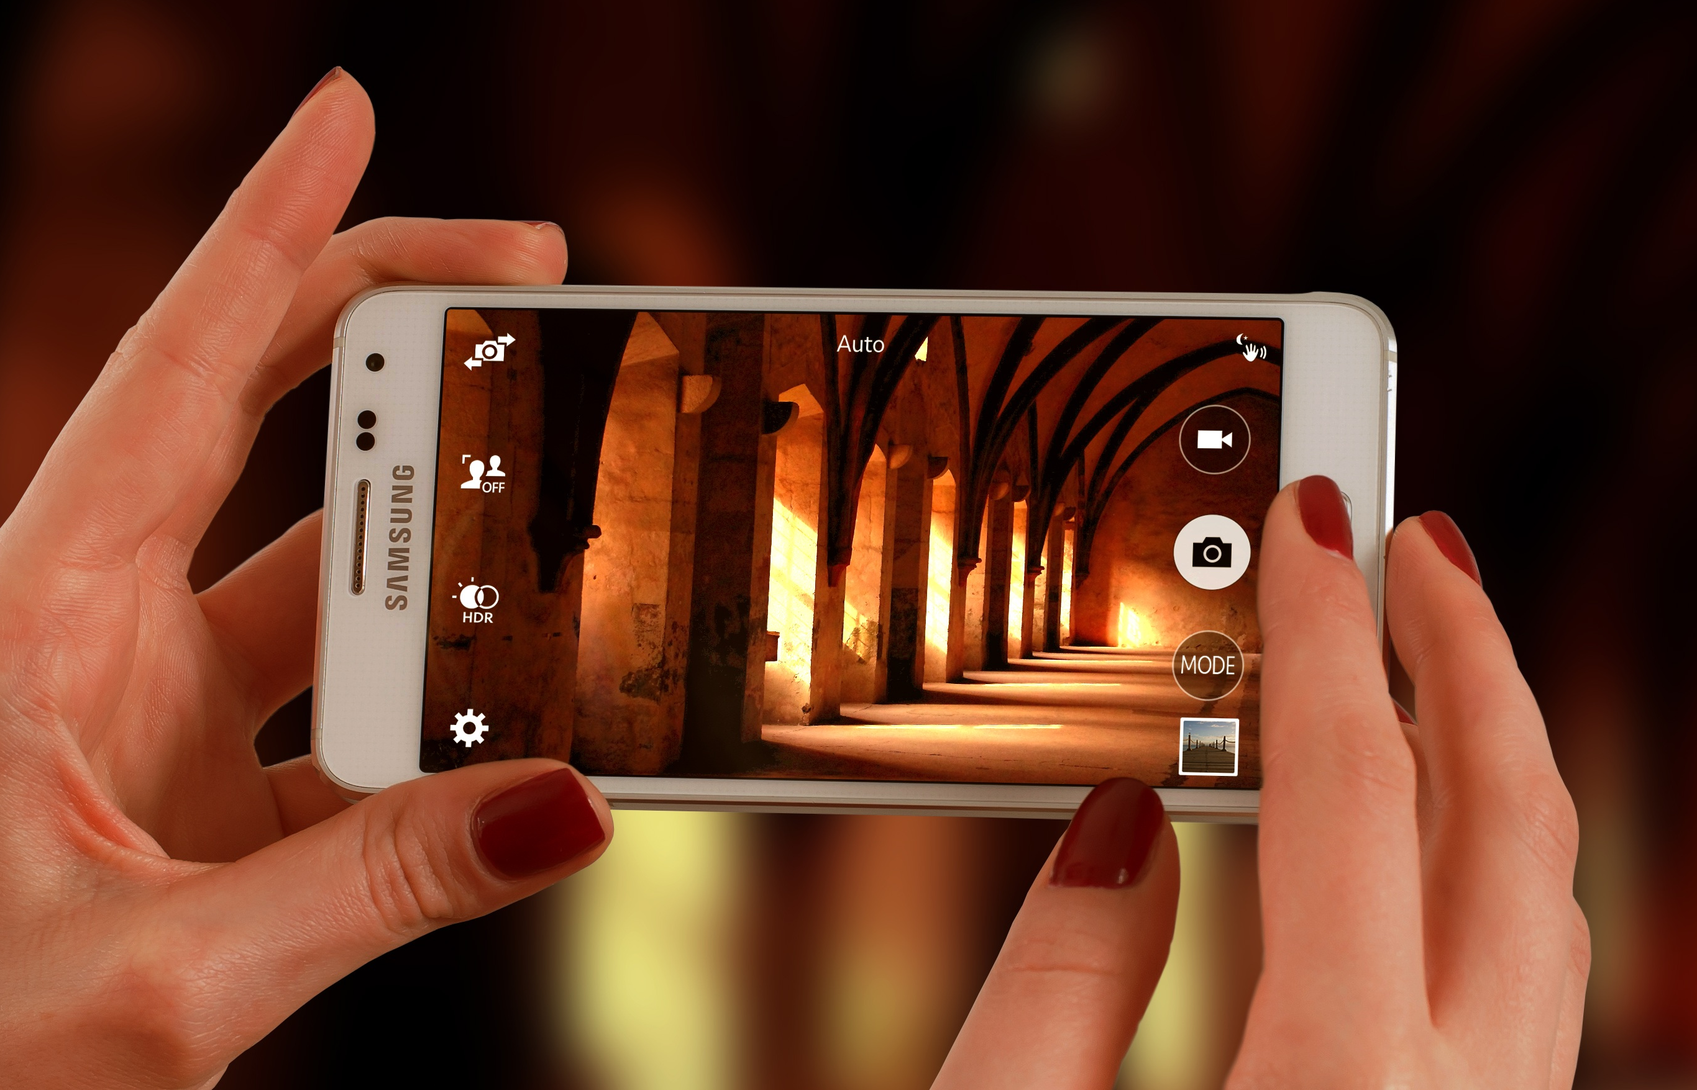
Snapshots from a Spiritual Journey
Notes:
This series uses the Revised Standard Version of the Bible.
Copyright © 2000-2021. All rights reserved. Bible Point is a registered trademark of Dennis Henderson. All other trademarks acknowledged.
Bible Point contains graphics from Bible Point artists. These illustrations belong to Bible Point and the respective artists. You may use the designs and illustrations for graphical illustration of lessons free and without special permission, provided they are not used in any way that maligns the Christian faith. Furthermore, republication or production of any illustration by any other graphic service whether it be in book, in a machine-readable form, or in any other design resource is strictly prohibited. Furthermore, they cannot be duplicated or resold as any other form of publishing, clip art, or graphic resource.
So What does it mean? (A simple translations of the legal jargon)
So, if you don’t own the presentation(s), graphic(s), and text(s) how can you legally use them? The purchase of the license allows you to use all the images in the product. However, the actual ownership and copyright of the presentation(s), graphic(s), and text(s) remain the property of Bible Point and its licensors. If you had plans on using this product in your “for sale” work—think again!
License Agreement
Article 1: License Grant
All the graphics and text in Bible Point presentations (excluding quotes from the Bible and stated sources) are the intellectual and real property of Bible Point and its licensors, and is protected by law, including United States copyright laws and international treaties. Bible Point grants to you a license:
1. To use the presentation in a single church, single school, or single office of a Christian organization.
2. To make a single archival back-up copy of the program.
3. To modify the presentation(s) and merge with other presentations in a single church, school, or Christian organization.
4. To transfer to another party if that party agrees to accept the terms and conditions of this agreement, and you do not retain any copies of the presentation, whether printed, machine readable, modified, or merged form.
Article 2: Terms
This license is effective until terminated. You may terminate the license at any time by destroying the presentation(s), graphic(s), or text(s) together with all copies, modifications and merged portions in any form. Bible Point may terminate your license if you fail to comply with this Agreement. You agree, upon such termination, for any reason, to destroy the presentation(s), graphics, and text(s) with all copies, modifications, and merged portions in any form.
Article 3: Disclaimers
1. Bible Point presentations, graphics, and texts are licensed to you As Is. You, the consumer, bear the entire risk relating to the quality and performance of the presentation(s), graphic(s), or text(s). In no event will Bible Point be liable for damages resulting from any defect.
2. Thirty-day limited warrantee on disks. Bible Point warrants the disks to be free of defects in material and workmanship under normal use for 30 days after purchase. During the 30-day period you may return a defective presentation, graphic, or text with proof of purchase and it will be replaced without charge, unless the presentation is damaged by misuse.
Article 4: General
1. You may not sub-license, assign, or transfer the license of the presentation(s), graphic(s), or text(s) except as provided by this Agreement.
2. This Agreement will be governed by the laws of the State of Michigan.
So What does it mean? (A simple translations of the legal jargon)
May I let someone borrow or copy my licensed Bible Point presentation (even after I modified it)? As long as it is within your local church, or single school, or the immediate office of a Christian organization you may. Otherwise, please refer the person interested in borrowing to: http://www.biblepoint.com or E-mail: dh@biblepoint.com with any related questions.

Slide 2
“God Dwelling is within US!”

Slide 3
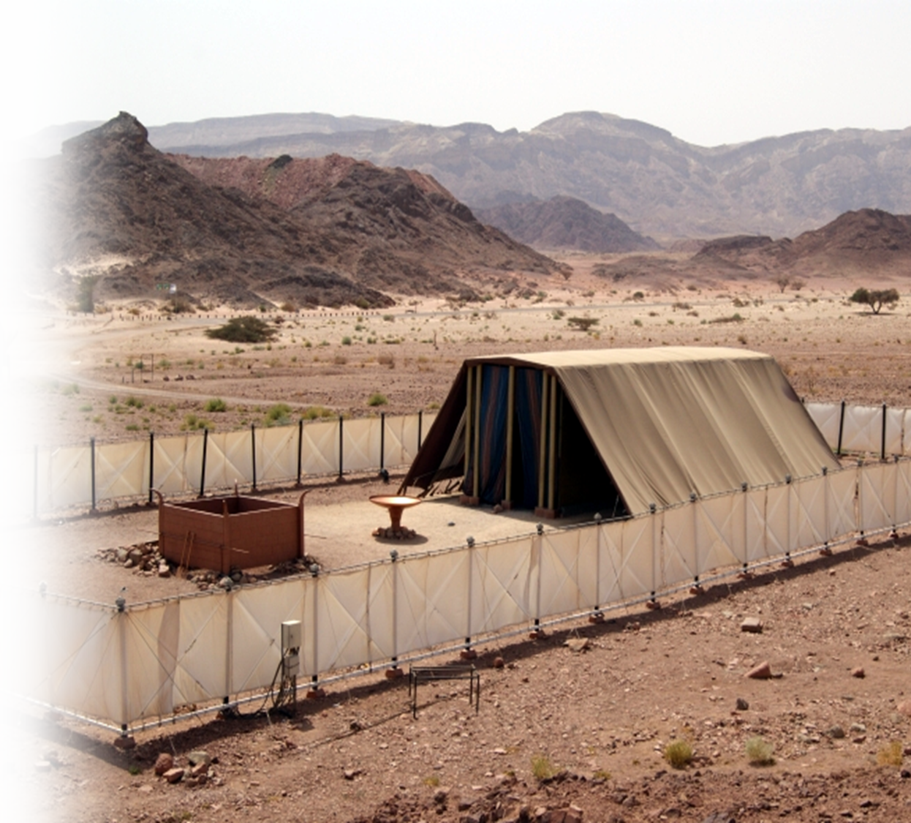
The Tabernacle
⁸ Make me a sanctuary, so that I may dwell among them. ⁹ In accordance with all that I show you concerning the pattern of the tabernacle and of all its furniture, so you shall make it. (Exo 25:8-9)
Notes:
Tabernacle = FREE = https://en.wikipedia.org/wiki/Tabernacle#/media/File:Stiftshuette_Modell_Timnapark.jpg

Slide 4
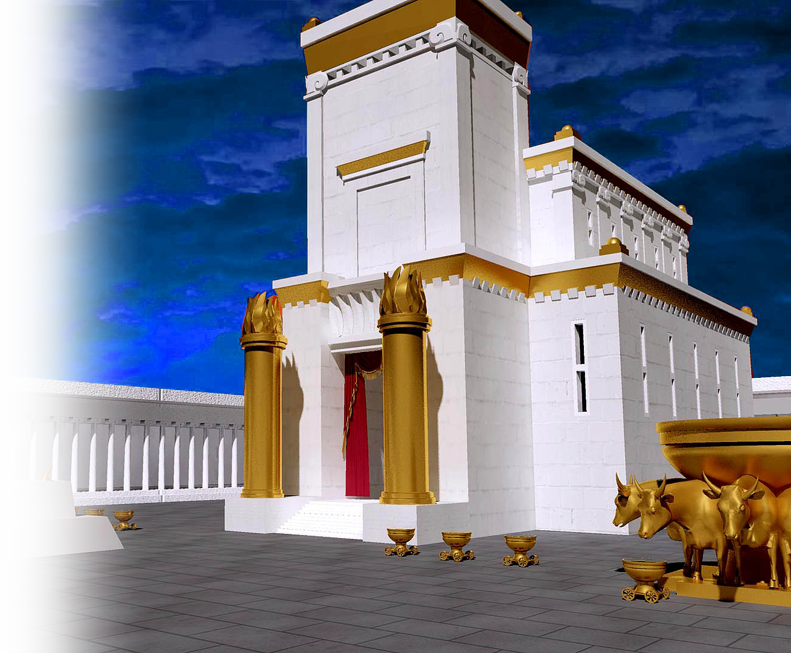
Solomon’s Temple
⁸ Make me a sanctuary, so that I may dwell among them. ⁹ In accordance with all that I show you concerning the pattern of the tabernacle and of all its furniture, so you shall make it. (Exo 25:8-9)
Notes:
Solomon’s Temple: the Frist Temple = FREE = https://upload.wikimedia.org/wikipedia/commons/7/72/Jerusalem_temple3.jpg

Slide 5
Solomon’s Temple
⁸ Make me a sanctuary, so that I may dwell among them. ⁹ In accordance with all that I show you concerning the pattern of the tabernacle and of all its furniture, so you shall make it. (Exo 25:8-9)
Notes:
Solomon’s Temple: the Frist Temple = FREE = https://upload.wikimedia.org/wikipedia/commons/7/72/Jerusalem_temple3.jpg

Slide 6
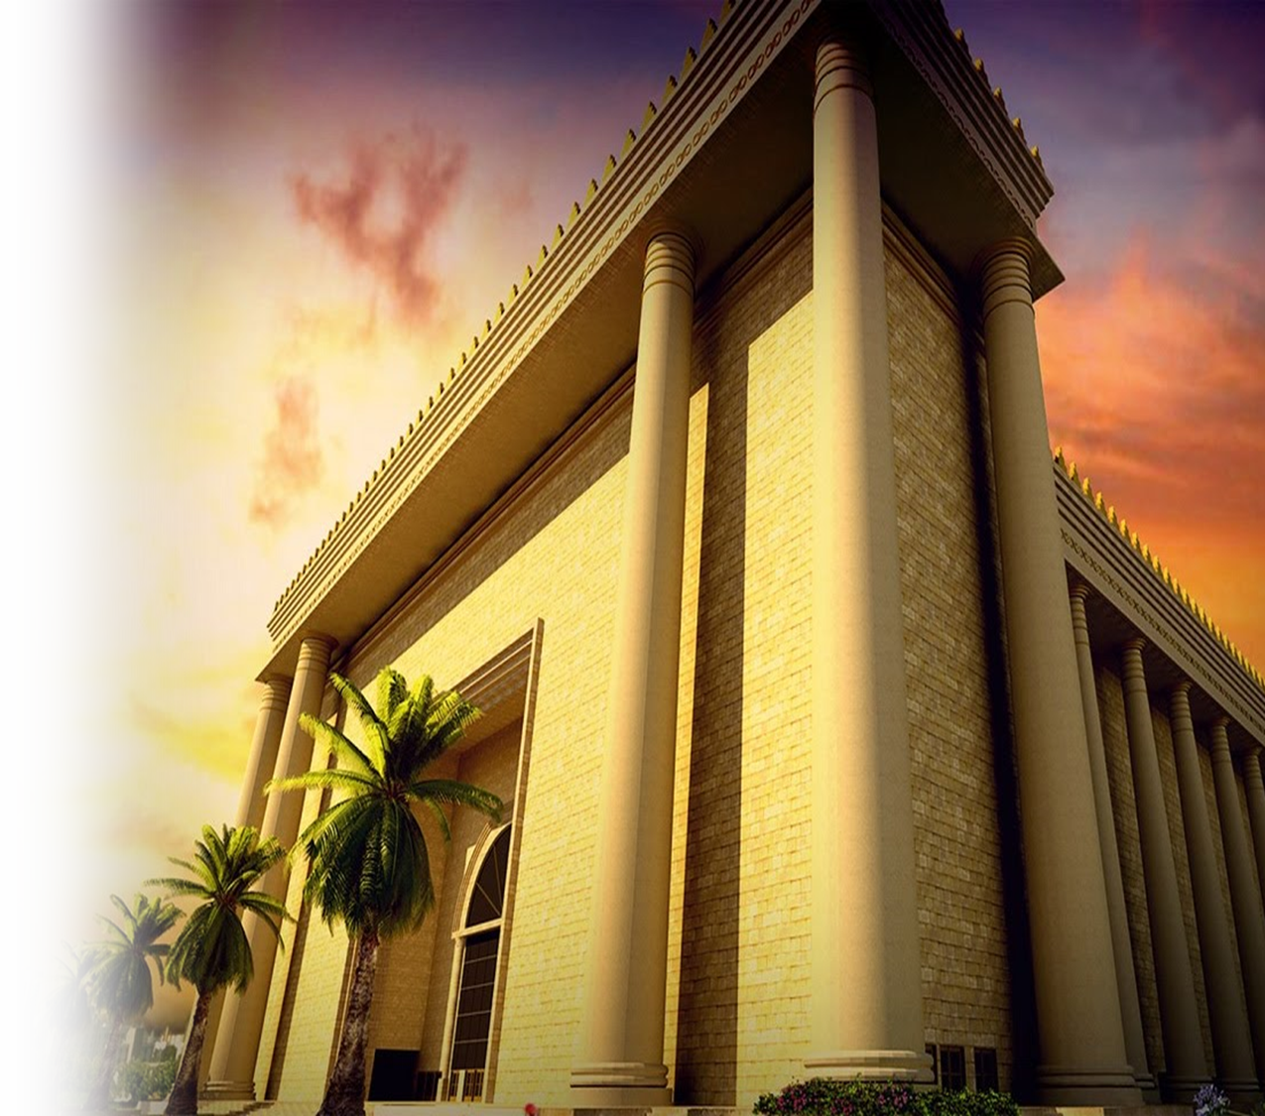
Zerubbabel’s Temple
¹⁴ So the elders of the Jews built and prospered, through the prophesying of the prophet Haggai and Zechariah son of Iddo. They finished their building by command of the God of Israel and by decree of Cyrus, Darius, and King Artaxerxes of Persia. (Ezra 6:14)
Notes:
Zerubbabel’s Temple: the Second Temple = FREE = https://www.youtube.com/watch?v=YhlM5LLH3SQ

Slide 7
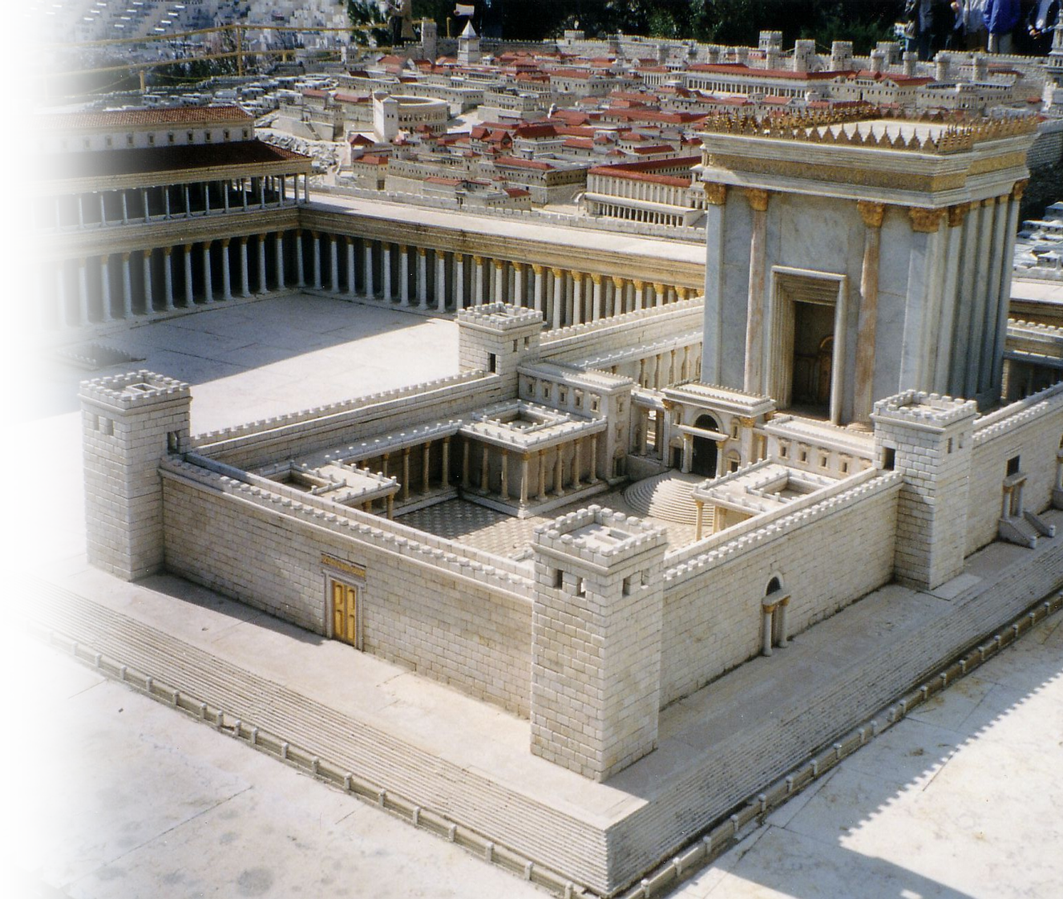
Herod’s Temple
²⁰ The Jews then said, "This temple has been under construction for forty-six years, and will you raise it up in three days?“ (John 2:20)
Notes:
Herod’sTemple = FREE =https://upload.wikimedia.org/wikipedia/commons/e/e8/Jerus-n4i.jpg

Slide 8
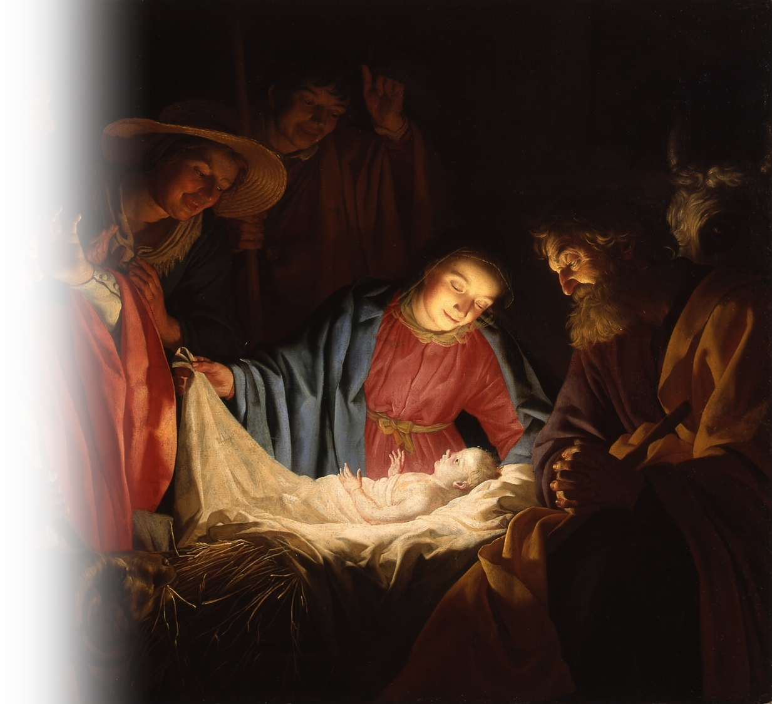
Jesus’ Body Tabernacle
¹⁴ And the Word became flesh and lived [i.e. tabernacle] among us, and we have seen his glory, the glory as of a father's only son, full of grace and truth. (John 1:14)
Notes:
Jesus’ Temple = FREE = https://en.wikipedia.org/wiki/Nativity_of_Jesus#/media/File:Gerard_van_Honthorst_-_Adoration_of_the_Shepherds_(1622).jpg

Slide 9
Jesus’ Body Tabernacle
¹⁹ Jesus answered them, "Destroy this temple, and in three days I will raise it up.“ ²⁰ The Jews then said, "This temple has been under construction for forty-six years, and will you raise it up in three days?“ ²¹ But he was speaking of the temple of his body. (John 2:19-21)
Notes:
Jesus’ Temple = FREE = https://en.wikipedia.org/wiki/Nativity_of_Jesus#/media/File:Gerard_van_Honthorst_-_Adoration_of_the_Shepherds_(1622).jpg

Slide 10
Our Bodies Temple
¹⁶ Do you not know that you are God's temple and that God's Spirit dwells in you? ¹⁷ If anyone destroys God's temple, God will destroy that person. For God's temple is holy, and you are that temple. (1Cor 3:16-17)

Slide 11
Our Bodies Temple
¹⁹ Or do you not know that your body is a temple of the Holy Spirit within you, which you have from God, and that you are not your own? ²⁰ For you were bought with a price; therefore glorify God in your body. (1Cor 6:18-20)

Slide 12
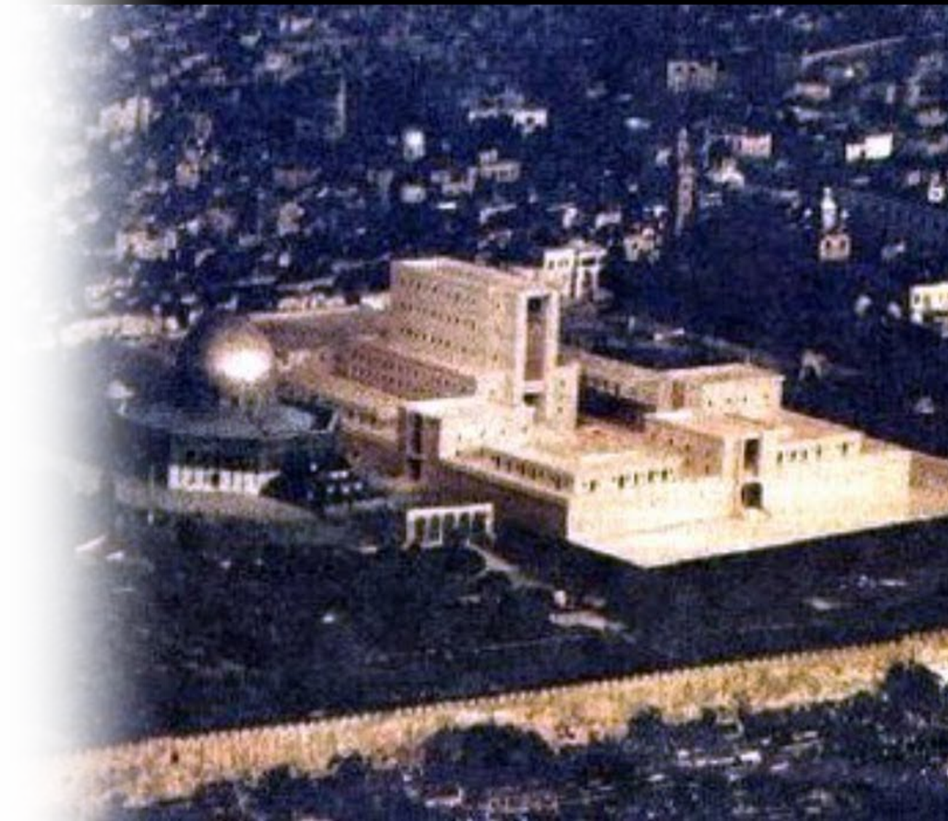
Tribulation Temple
"Come and measure the temple of God and the altar and those who worship there, ² but do not measure the court outside the temple; leave that out, for it is given over to the nations, and they will trample over the holy city for forty-two months. (Rev 11:1-2)
Notes:
Tribulation Temple = FREE = https://www.youtube.com/watch?v=1gHmmuSNlVo

Slide 13
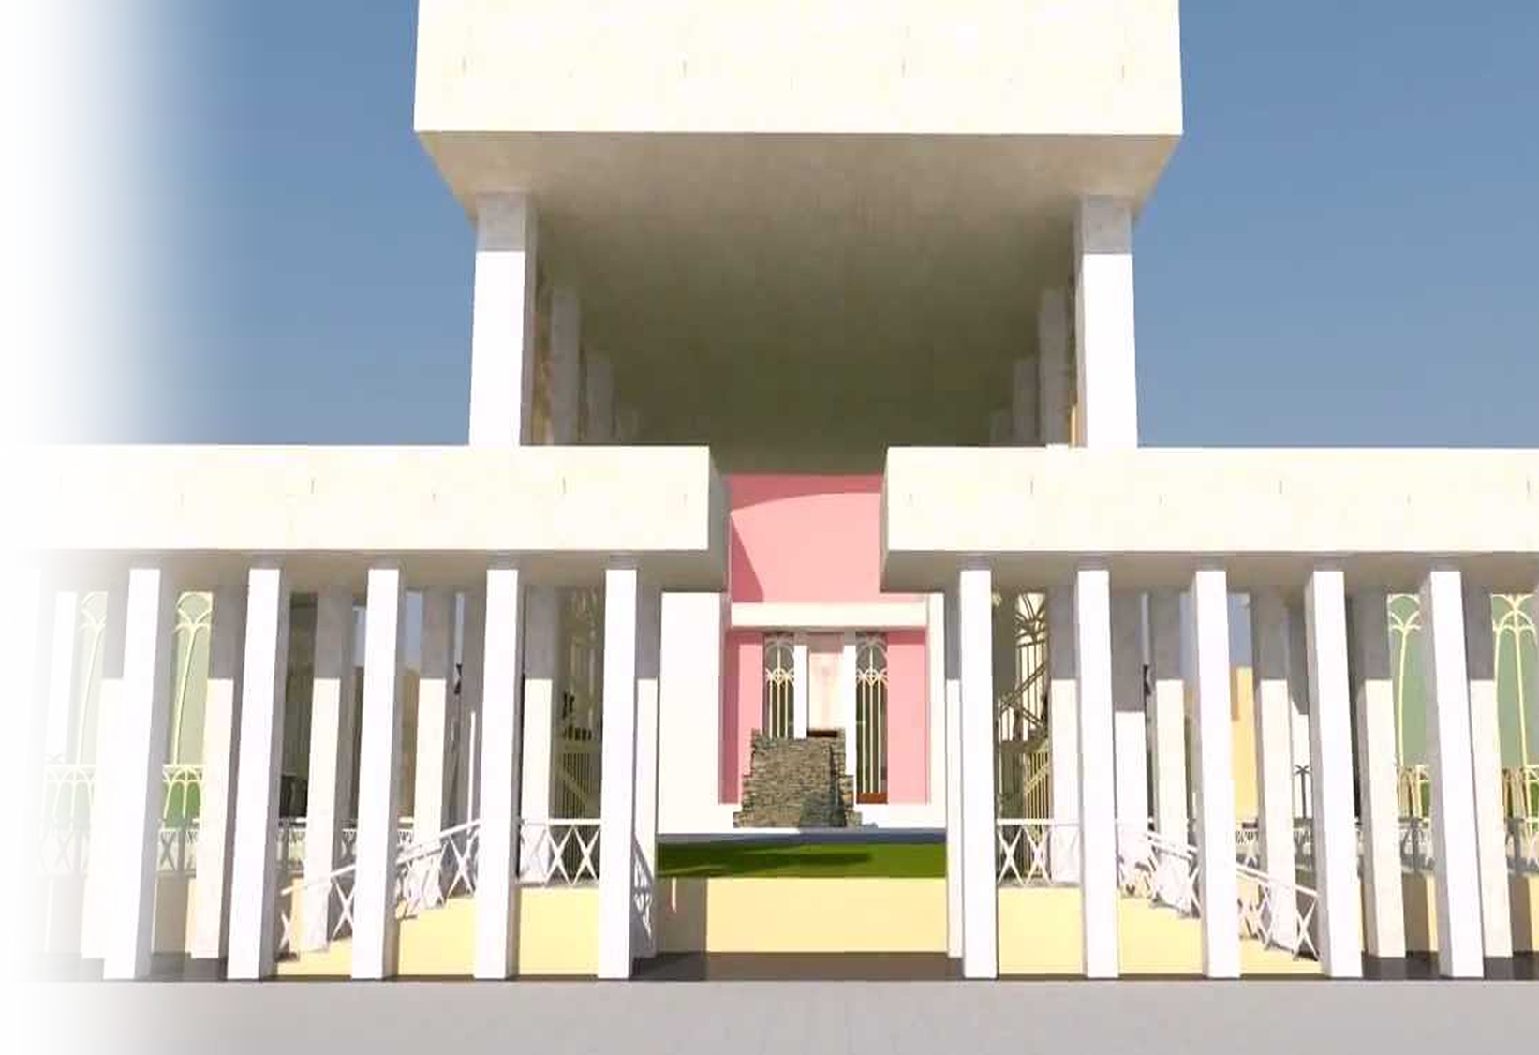
Millennial Temple
I looked, and lo! the glory of the LORD filled the temple of the LORD; and I fell upon my face. (Ezekiel 44:4)
Notes:
Millennial Temple – third Temple = FREE = from https://www.youtube.com/watch?v=nymuvDpQ-Fg

Slide 14
Millennial Temple
It is he who will build the temple of the LORD, and he will be clothed with majesty and will sit and rule on his throne. And he will be a priest on his throne. And there will be harmony between the two.' (Zec 6:13)
Notes:
Millennial Temple – third Temple = FREE = from https://www.youtube.com/watch?v=nymuvDpQ-Fg

Slide 15
Heavenly Temple
^{Rev 21:22} I saw no temple in the city, for its temple is the Lord God the Almighty and the Lamb.
Notes:
Heavenly Temple = FREE = BiblePoint
Background = FREE = https://pixabay.com/en/sunset-sky-red-heaven-85362/

