Slide 1
Snapshots from a Spiritual Journey
Notes:
This series uses the Revised Standard Version of the Bible.
Copyright © 2000-2021. All rights reserved. Bible Point is a registered trademark of Dennis Henderson. All other trademarks acknowledged.
Bible Point contains graphics from Bible Point artists. These illustrations belong to Bible Point and the respective artists. You may use the designs and illustrations for graphical illustration of lessons free and without special permission, provided they are not used in any way that maligns the Christian faith. Furthermore, republication or production of any illustration by any other graphic service whether it be in book, in a machine-readable form, or in any other design resource is strictly prohibited. Furthermore, they cannot be duplicated or resold as any other form of publishing, clip art, or graphic resource.
So What does it mean? (A simple translations of the legal jargon)
So, if you don’t own the presentation(s), graphic(s), and text(s) how can you legally use them? The purchase of the license allows you to use all the images in the product. However, the actual ownership and copyright of the presentation(s), graphic(s), and text(s) remain the property of Bible Point and its licensors. If you had plans on using this product in your “for sale” work—think again!
License Agreement
Article 1: License Grant
All the graphics and text in Bible Point presentations (excluding quotes from the Bible and stated sources) are the intellectual and real property of Bible Point and its licensors, and is protected by law, including United States copyright laws and international treaties. Bible Point grants to you a license:
1. To use the presentation in a single church, single school, or single office of a Christian organization.
2. To make a single archival back-up copy of the program.
3. To modify the presentation(s) and merge with other presentations in a single church, school, or Christian organization.
4. To transfer to another party if that party agrees to accept the terms and conditions of this agreement, and you do not retain any copies of the presentation, whether printed, machine readable, modified, or merged form.
Article 2: Terms
This license is effective until terminated. You may terminate the license at any time by destroying the presentation(s), graphic(s), or text(s) together with all copies, modifications and merged portions in any form. Bible Point may terminate your license if you fail to comply with this Agreement. You agree, upon such termination, for any reason, to destroy the presentation(s), graphics, and text(s) with all copies, modifications, and merged portions in any form.
Article 3: Disclaimers
1. Bible Point presentations, graphics, and texts are licensed to you As Is. You, the consumer, bear the entire risk relating to the quality and performance of the presentation(s), graphic(s), or text(s). In no event will Bible Point be liable for damages resulting from any defect.
2. Thirty-day limited warrantee on disks. Bible Point warrants the disks to be free of defects in material and workmanship under normal use for 30 days after purchase. During the 30-day period you may return a defective presentation, graphic, or text with proof of purchase and it will be replaced without charge, unless the presentation is damaged by misuse.
Article 4: General
1. You may not sub-license, assign, or transfer the license of the presentation(s), graphic(s), or text(s) except as provided by this Agreement.
2. This Agreement will be governed by the laws of the State of Michigan.
So What does it mean? (A simple translations of the legal jargon)
May I let someone borrow or copy my licensed Bible Point presentation (even after I modified it)? As long as it is within your local church, or single school, or the immediate office of a Christian organization you may. Otherwise, please refer the person interested in borrowing to: http://www.biblepoint.com or E-mail: dh@biblepoint.com with any related questions.

Slide 2
How to Eliminate Stress in Your Life

Slide 3
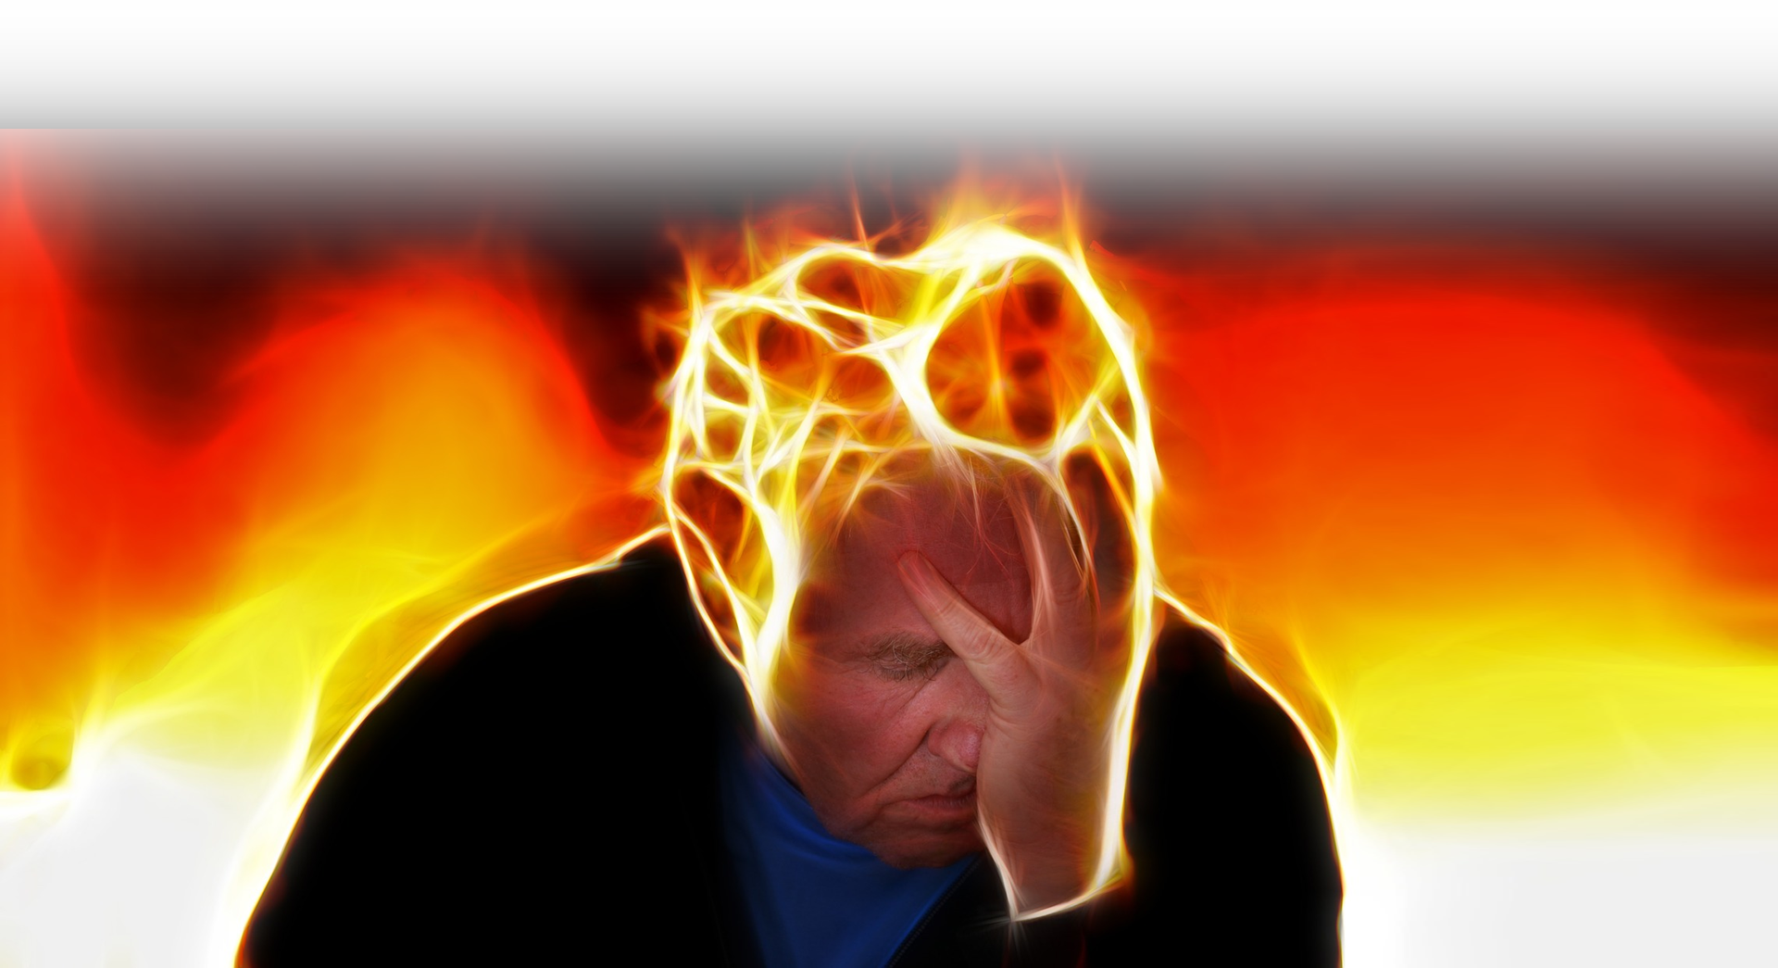
Identify the Source of Stress
Notes:
Stress = FREE = https://pixabay.com/en/photos/download/stress-864141_1920.jpg?attachment&modal

Slide 4
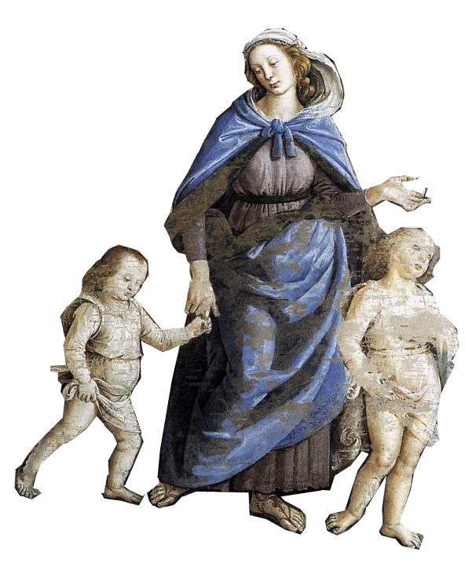
FAMILY can be a Source ^{18:2-7}
Notes:
Zipporah and kids = FREE = https://upload.wikimedia.org/wikipedia/commons/a/ac/Perugino%2C_Viaggio_di_Mos%C3%A8_in_Egitto_02.jpg

Slide 5
FAMILY can be a Source ^{18:2-7}
² After Moses had sent away his wife Zipporah, his father-in-law Jethro took her back, ³ along with her two sons. .... ⁵ Jethro ... came into the wilderness where Moses was encamped at the mountain of God, bringing Moses' sons and wife to him. .... ⁷ Moses went out to meet his father-in-law; he bowed
down and kissed him; each asked after the other's welfare....

Slide 6
SUCCESS can be a Source ^{18:1,8-10}
Notes:
Ladder = Licensed and not for reuse = http://www.bigstockphoto.com/image-4623640/stock-photo-success

Slide 7
SUCCESS can be a Source ^{18:1,8-10}
¹ Jethro, the priest of Midian, Moses' father-in-law, heard of all that God had done for Moses ...
Notes:
Ladder = Licensed and not for reuse = http://www.bigstockphoto.com/image-4623640/stock-photo-success

Slide 8
SUCCESS can be a Source ^{18:1,8-10}
⁷ ... they went into the tent.
⁸ Then Moses told his father-in-law all that the LORD had done to Pharaoh and to the Egyptians for Israel's sake, all the hardship that had beset them on the way, and how the LORD had delivered them.
Notes:
Ladder = Licensed and not for reuse = http://www.bigstockphoto.com/image-4623640/stock-photo-success
Past Success cna be a source of stress = The expectation of achieving the heights of the previous success can be very stressful.
Etc.

Slide 9
SUCCESS can be a Source ^{18:1,8-10}
⁹ Jethro rejoiced for all the good that the LORD had done to Israel, in delivering them from the Egyptians. ¹⁰ Jethro said, "Blessed be the LORD, who has delivered you from the Egyptians and from Pharaoh.
¹¹ Now I know that the LORD is greater than all gods, because he delivered the people from the Egyptians, when they dealt arrogantly with them."
¹² And Jethro, Moses' father-in-law, brought a burnt offering and sacrifices to God; and Aaron came with all the elders of Israel to eat bread with Moses' father-in-law in the presence of God.
(Exo 18:9-12 NRS)
Notes:
Ladder = Licensed and not for reuse = http://www.bigstockphoto.com/image-4623640/stock-photo-success
Past Success cna be a source of stress = The expectation of achieving the heights of the previous success can be very stressful.
Etc.

Slide 10
SUCCESS can be a Source ^{18:1,8-10}
¹¹ Now I know that the LORD is greater than all gods, ...
¹² And Jethro, Moses' father-in-law, brought a burnt offering and sacrifices to God ....
Notes:
Ladder = Licensed and not for reuse = http://www.bigstockphoto.com/image-4623640/stock-photo-success
Past Success can be a source of stress = The expectation of achieving the heights of the previous success can be very stressful.
Etc.

Slide 11
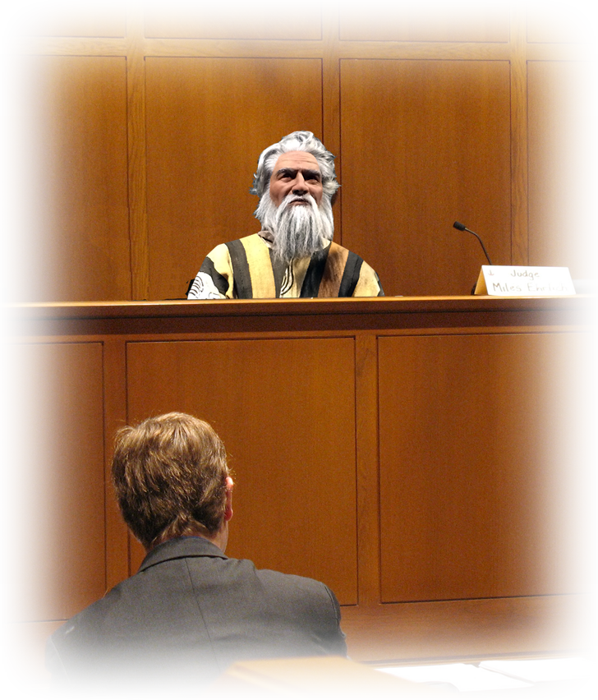
WORK can be a Source ^{18:13-14}
Notes:
Courtroom = FREE = https://en.wikipedia.org/wiki/Judge
Judge = BiblePoint

Slide 12
WORK can be a Source ^{18:13-14}
¹³ The next day Moses sat as judge for the people, while the people stood around him from morning until evening. ¹⁴ When Moses' father-in-law saw all that he was doing for the people, he said, "What is this that you are doing for the people? Why do you sit alone, while all the people stand around you from morning until evening?"
Notes:
Courtroom = FREE = https://en.wikipedia.org/wiki/Judge
Judge = BiblePoint

Slide 13
SELF can be a Source ^{18:15-16}

Slide 14
SELF can be a Source ^{18:15-16}
¹⁵ Moses said to his father-in-law, "Because the people come to me to inquire of God.
¹⁶ When they have a dispute, they come to me and I decide between one person and another, and I make known to them the statutes and instructions of God."

Slide 15
CRITICISM can be a Source ^{18:17-18}
Notes:
Failure = FREE = http://www.rgbstock.com/photo/odxaFTq/going+down

Slide 16
CRITICISM can be a Source ^{18:17-18}
¹⁷ Moses' father-in-law said to him,
"What you are doing is not good. ¹⁸ You will surely wear yourself out, both you and these people with you. For the task is too heavy for you; you cannot do it alone.”
Notes:
Failure = FREE = http://www.rgbstock.com/photo/odxaFTq/going+down

Slide 17
Discover the SOLUTION to Stress

Slide 18
COUNSEL can be a Solution ^{18:19}
¹⁹ Now listen to me. I will give you counsel, and God be with you!
Notes:
Counseling = FREE = https://en.wikipedia.org/wiki/Crisis_hotline#/media/File:Suicidemessageggb01252006.JPG

Slide 19
DELEGATION can be a Solution ^{18:19}
¹⁹ ... You should represent the people before God, and you should bring their cases before God;
Notes:
Handoff = FREE = https://upload.wikimedia.org/wikipedia/commons/8/80/U.S._Navy_Junior_Reserve_Officer_Training_Course_%28NJROTC%29_cadets_hand_off_batons_during_a_8x220-yard_relay_race_on_Naval_Air_Station_Pensacola%2C_Fla.%2C_April_17%2C_2009%2C_during_the_2009_NJROTC_National_Academic_090417-N-IK959-321.jpg

Slide 20
DELEGATION involves ...
Training people 18:20
²⁰ teach them the statutes and instructions and make known to them the way they are to go and the things they are to do.
Notes:
Training = FREE = https://pixabay.com/en/training-corporate-lecture-998351/

Slide 21
DELEGATION involves ...
Training people 18:20
Enabling people 18:21
²¹ You should also look for able men among all the people,
Notes:
Muscle = FREE = https://upload.wikimedia.org/wikipedia/commons/4/41/Arm_flex_supinate.jpg

Slide 22
DELEGATION involves ...
Training people 18:20
Enabling people 18:21
Qualifying people - 18:21
²¹ ... men who fear God,
Notes:
Approved = FREE = https://pixabay.com/en/approved-stamp-approval-quality-29149/

Slide 23
DELEGATION involves ...
Training people 18:20
Enabling people 18:21
Qualifying people - 18:21
Entrusting people - 18:21
are trustworthy,

Slide 24
DELEGATION involves ...
Training people 18:20
Enabling people 18:21
Qualifying people - 18:21
Entrusting people - 18:21
Ethical people - 18:21
and hate dishonest gain;
Notes:
Honesty = FREE = https://pixabay.com/en/businessmen-honest-honesty-sincere-1050343/

Slide 25
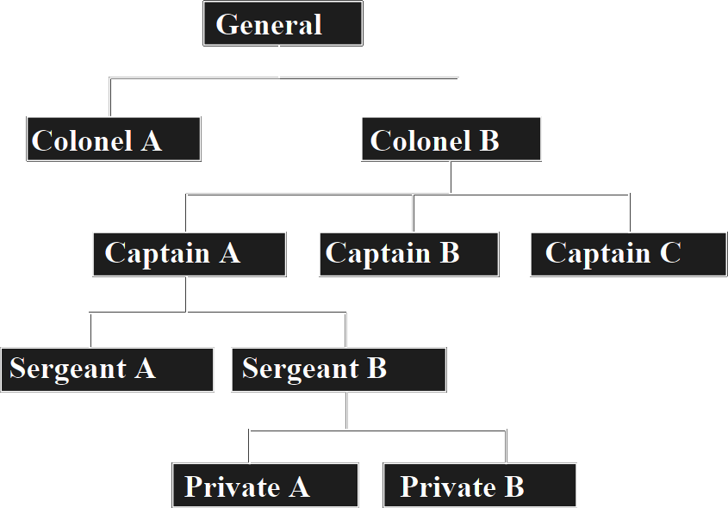
DELEGATION involves ...
Training people 18:20
Enabling people 18:21
Qualifying people - 18:21
Entrusting people - 18:21
Ethical people - 18:21
Organizing people 18:21
set such men over them as officers over thousands, hundreds, fifties and tens.
Notes:
Org chart = https://upload.wikimedia.org/wikipedia/commons/2/2e/Organizational_chart.svg

Slide 26
DELEGATION involves ...
²² Let them sit as judges for the people at all times; let them bring every important case to you, but decide every minor case themselves. So it will be easier for you, and they will bear the burden with you.
Training people 18:20
Enabling people 18:21
Qualifying people - 18:21
Entrusting people - 18:21
Ethical people - 18:21
Organizing people 18:21
Discerning people 18:22

Slide 27
Experience the End of Stress

Slide 28
Experience the End of Stress^{18:24-25}
²³ If you do this, and God so commands you, then you will be able to endure, and all these people will go to their home in peace."
JUST DO IT

Slide 29
Experience the End of Stress^{18:24-25}
²³ If you do this, and God so commands you, then you will be able to endure, and all these people will go to their home in peace."
JUST DO IT

Slide 30
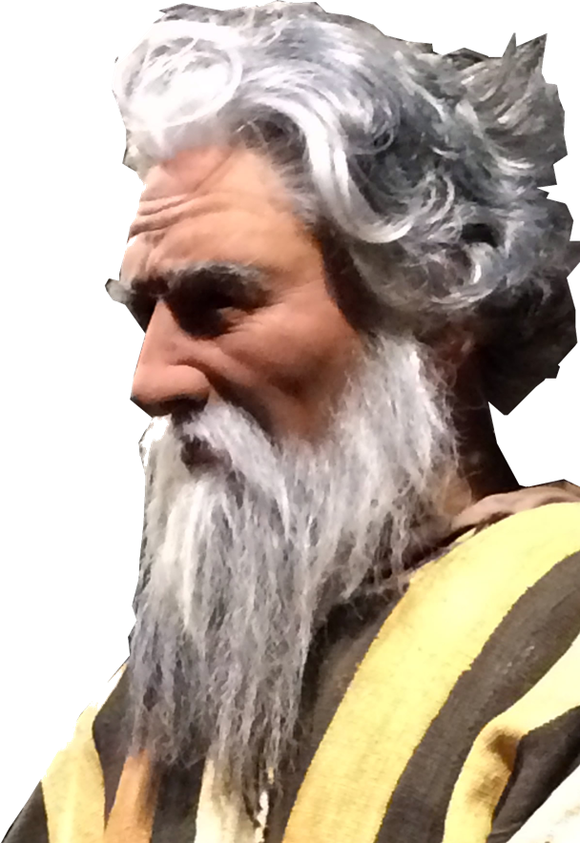
Experience the End of Stress^{18:24-25}
²⁴ So Moses ... [DID JUST THAT ... HE:]

Slide 31
Experience the End of Stress^{18:24-25}
²⁴ So Moses ... [DID JUST THAT ... HE:]
listened to his father-in-law and did all that he had said. ²⁵ Moses

Slide 32
Experience the End of Stress^{18:24-25}
²⁴ So Moses ... [DID JUST THAT ... HE:]
listened to his father-in-law and did all that he had said. ²⁵ Moses
chose able men from all Israel and

Slide 33
Experience the End of Stress^{18:24-25}
²⁴ So Moses ... [DID JUST THAT ... HE:]
listened to his father-in-law and did all that he had said. ²⁵ Moses
chose able men from all Israel and
appointed them as heads over the people, as officers over thousands, hundreds, fifties, and tens.

Slide 34
ELIMINTION of Stress ^{18:24-25}
²⁶ And they ...
judged the people at all times; hard cases they brought to Moses, but any minor case they decided themselves.
²⁷ Then Moses let his father-in-law depart, and he went off to his own country.

Slide 35
Take this away with you ...

Slide 36
Take this away with you ...
Identify your stress’ cause

Slide 37
Take this away with you ...
Identify your stress’ cause
Find a solution through:
– Counseling
– Delegation
– Implementation

Slide 38
Take this away with you ...
Identify your stress’ cause
Find a solution through:
– Counseling
– Delegation
– Implementation
End the stress: JUST DO IT!

Slide 39
Let’s Pray!

