Slide 1
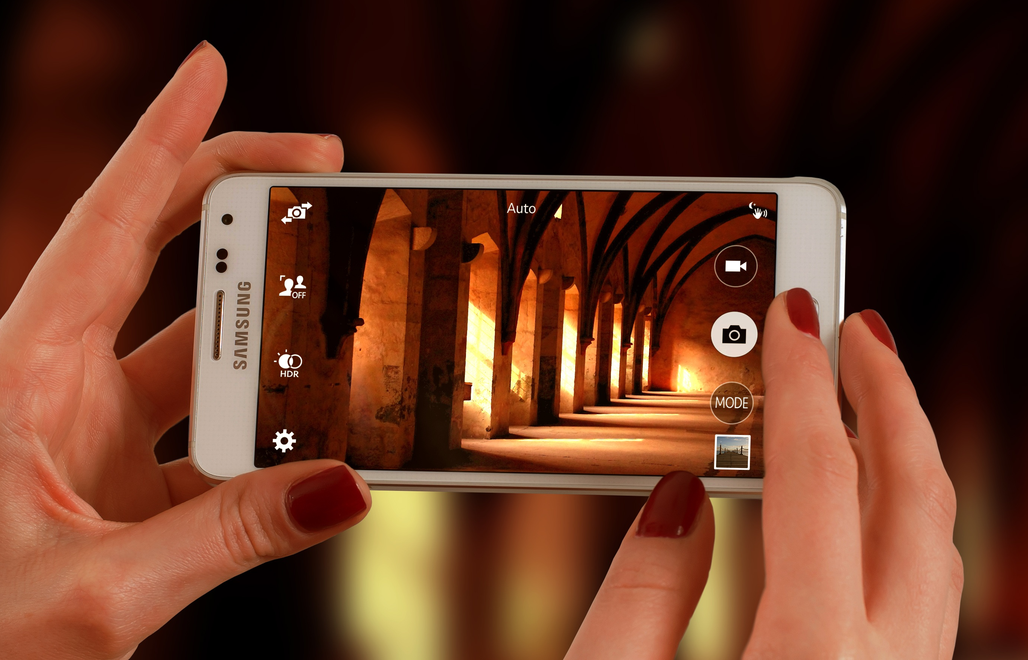
Snapshots from a Spiritual Journey
Notes:
This series uses the Revised Standard Version of the Bible.
Copyright © 2000-2021. All rights reserved. Bible Point is a registered trademark of Dennis Henderson. All other trademarks acknowledged.
Bible Point contains graphics from Bible Point artists. These illustrations belong to Bible Point and the respective artists. You may use the designs and illustrations for graphical illustration of lessons free and without special permission, provided they are not used in any way that maligns the Christian faith. Furthermore, republication or production of any illustration by any other graphic service whether it be in book, in a machine-readable form, or in any other design resource is strictly prohibited. Furthermore, they cannot be duplicated or resold as any other form of publishing, clip art, or graphic resource.
So What does it mean? (A simple translations of the legal jargon)
So, if you don’t own the presentation(s), graphic(s), and text(s) how can you legally use them? The purchase of the license allows you to use all the images in the product. However, the actual ownership and copyright of the presentation(s), graphic(s), and text(s) remain the property of Bible Point and its licensors. If you had plans on using this product in your “for sale” work—think again!
License Agreement
Article 1: License Grant
All the graphics and text in Bible Point presentations (excluding quotes from the Bible and stated sources) are the intellectual and real property of Bible Point and its licensors, and is protected by law, including United States copyright laws and international treaties. Bible Point grants to you a license:
1. To use the presentation in a single church, single school, or single office of a Christian organization.
2. To make a single archival back-up copy of the program.
3. To modify the presentation(s) and merge with other presentations in a single church, school, or Christian organization.
4. To transfer to another party if that party agrees to accept the terms and conditions of this agreement, and you do not retain any copies of the presentation, whether printed, machine readable, modified, or merged form.
Article 2: Terms
This license is effective until terminated. You may terminate the license at any time by destroying the presentation(s), graphic(s), or text(s) together with all copies, modifications and merged portions in any form. Bible Point may terminate your license if you fail to comply with this Agreement. You agree, upon such termination, for any reason, to destroy the presentation(s), graphics, and text(s) with all copies, modifications, and merged portions in any form.
Article 3: Disclaimers
1. Bible Point presentations, graphics, and texts are licensed to you As Is. You, the consumer, bear the entire risk relating to the quality and performance of the presentation(s), graphic(s), or text(s). In no event will Bible Point be liable for damages resulting from any defect.
2. Thirty-day limited warrantee on disks. Bible Point warrants the disks to be free of defects in material and workmanship under normal use for 30 days after purchase. During the 30-day period you may return a defective presentation, graphic, or text with proof of purchase and it will be replaced without charge, unless the presentation is damaged by misuse.
Article 4: General
1. You may not sub-license, assign, or transfer the license of the presentation(s), graphic(s), or text(s) except as provided by this Agreement.
2. This Agreement will be governed by the laws of the State of Michigan.
So What does it mean? (A simple translations of the legal jargon)
May I let someone borrow or copy my licensed Bible Point presentation (even after I modified it)? As long as it is within your local church, or single school, or the immediate office of a Christian organization you may. Otherwise, please refer the person interested in borrowing to: http://www.biblepoint.com or E-mail: dh@biblepoint.com with any related questions.

Slide 2
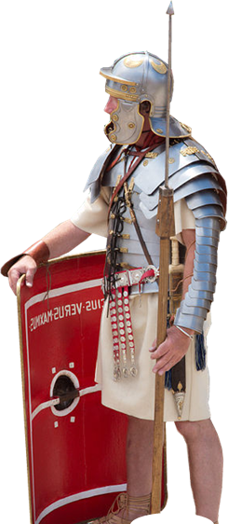
The Art of Spiritual Warfare!

Slide 3
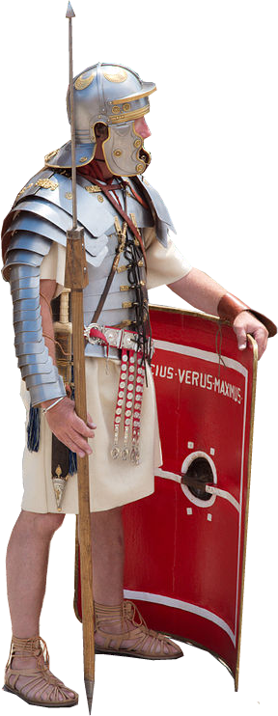
We’re talking “Spiritual Warfare”
⁴ for the weapons of our warfare are not merely human, but they have divine power to destroy strongholds. (2 Corinthians 10:4)
Notes:
Roman = FREE = https://commons.wikimedia.org/wiki/File:Roman_legionaire_with_manica_01.jpg

Slide 4
Principles of Spiritual Warfare

Slide 5
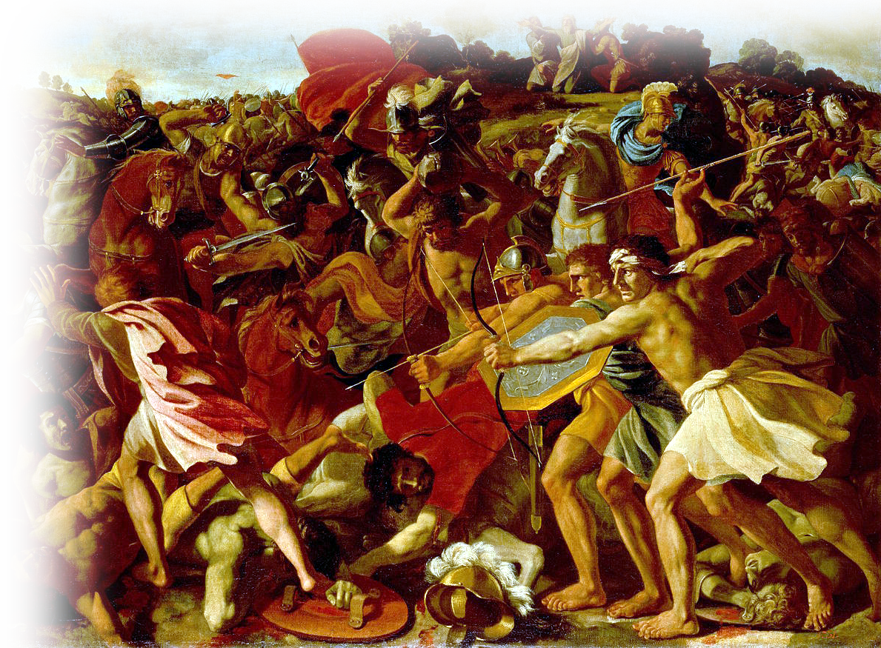
Don’t pick a fight...It will pick You! 17:8
^{17:8} Then Amalek came and fought with Israel at Rephidim.
Notes:
War = FREE = https://en.wikipedia.org/wiki/Judaism_and_warfare#/media/File:Poussin,_Nicolas_-_The_Victory_of_Joshua_over_the_Amalekites.jpg
The Amalekites were descendants of Amlek, the grandson of Esau (Edom Gen 36:16)
Esau’s brother was Jacob. Jacob stole the birth right and the blessing from Esau. A conflict ensued.
So you might say this is a family Feud – Now a national conflict!.

Slide 6
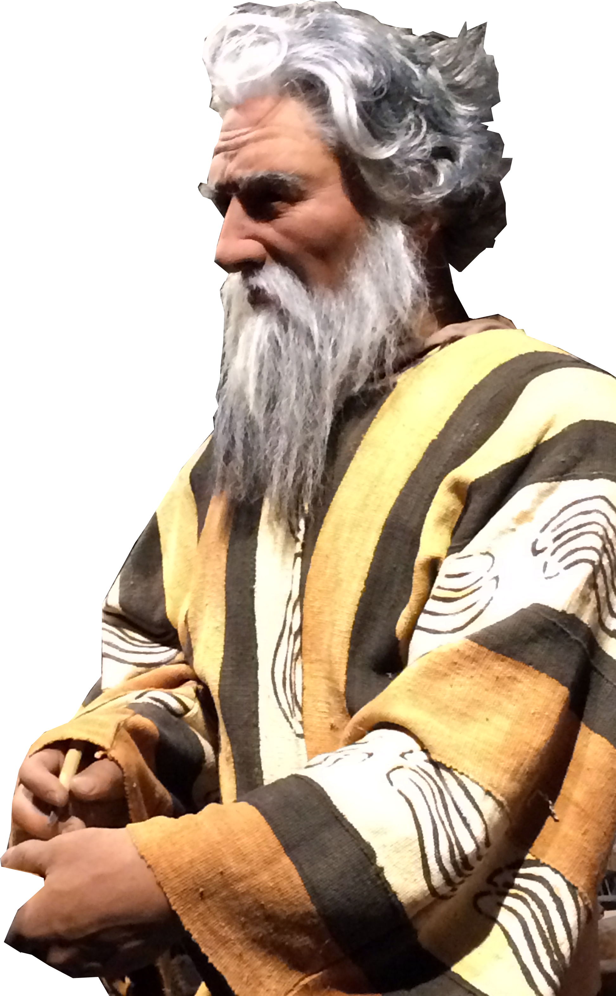
When it does ... Have a plan! 17:9
⁹ Moses said to Joshua, "Choose some men for us and go out, fight with Amalek. Tomorrow I will stand on the top of the hill with the staff of God in my hand."
Notes:
Always be prepared to give an answer to everyone who asks you to give the reason for the hope that you have. But do this with gentleness and respect,
¹⁶ keeping a clear conscience, so that those who speak maliciously against your good behavior in Christ may be ashamed of their slander.
¹⁷ It is better, if it is God's will, to suffer for doing good than for doing evil. (1Pe 3:15-17 NIV)
There is a doctrine of a “Just War.” it is most often a defensive battle.
Choose -- valiant warriors
Fight -- defend us
Support – this is the first “Support Group”

Slide 7
Have a plan...Then work it! 17:10-12
¹⁰ So Joshua did as Moses told him, and fought with Amalek, while Moses, Aaron, and Hur went up to the top of the hill.
Notes:
³ For though we live in the world, we do not wage war as the world does.
⁴ The weapons we fight with are not the weapons of the world. On the contrary, they have divine power to demolish strongholds.
⁵ We demolish arguments and every pretension that sets itself up against the knowledge of God, and we take captive every thought to make it obedient to Christ.
⁶ And we will be ready to punish every act of disobedience, once your obedience is complete.
(2Co 10:3-6 NIV)
Please note—Israel did not attack—Amalek attacked. Israel defended.

Slide 8
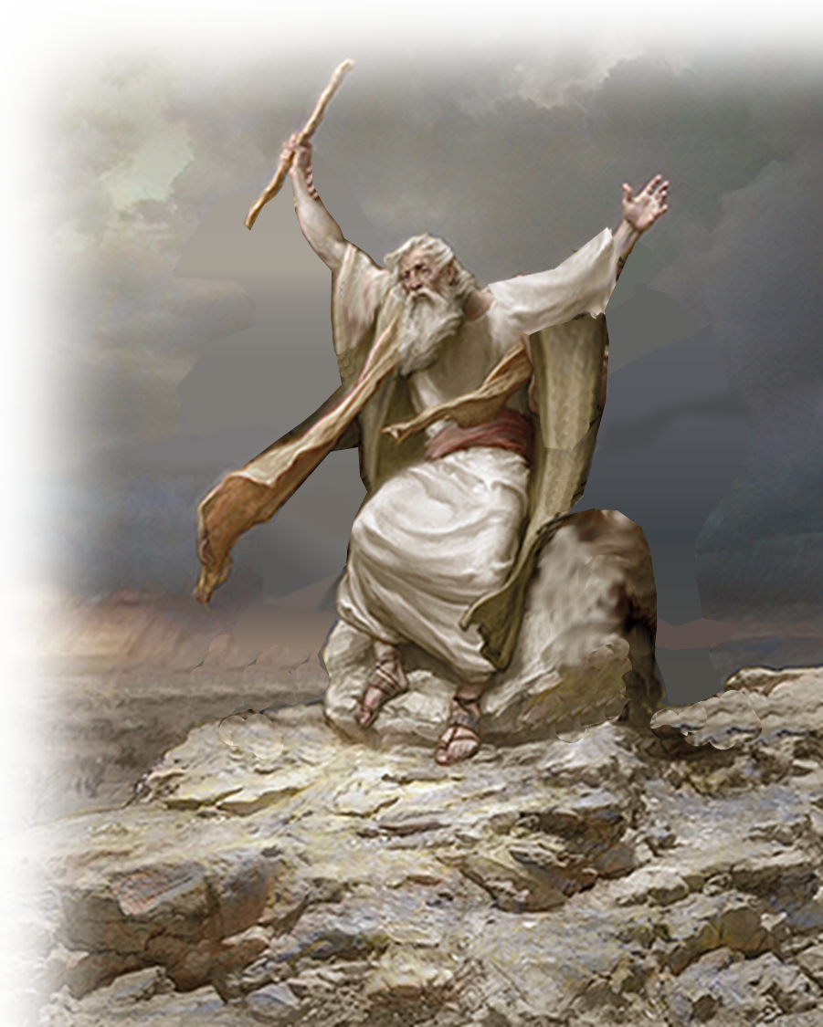
Have a plan...Then work it! 17:10-12
Find What Works For You! .
¹¹ Whenever Moses held up his hand, Israel prevailed;
Notes:
Moses heavy arms = FREE = from https://www.lds.org/media-library/images/one-before-god-moses-aaron-796906?lang=eng

Slide 9
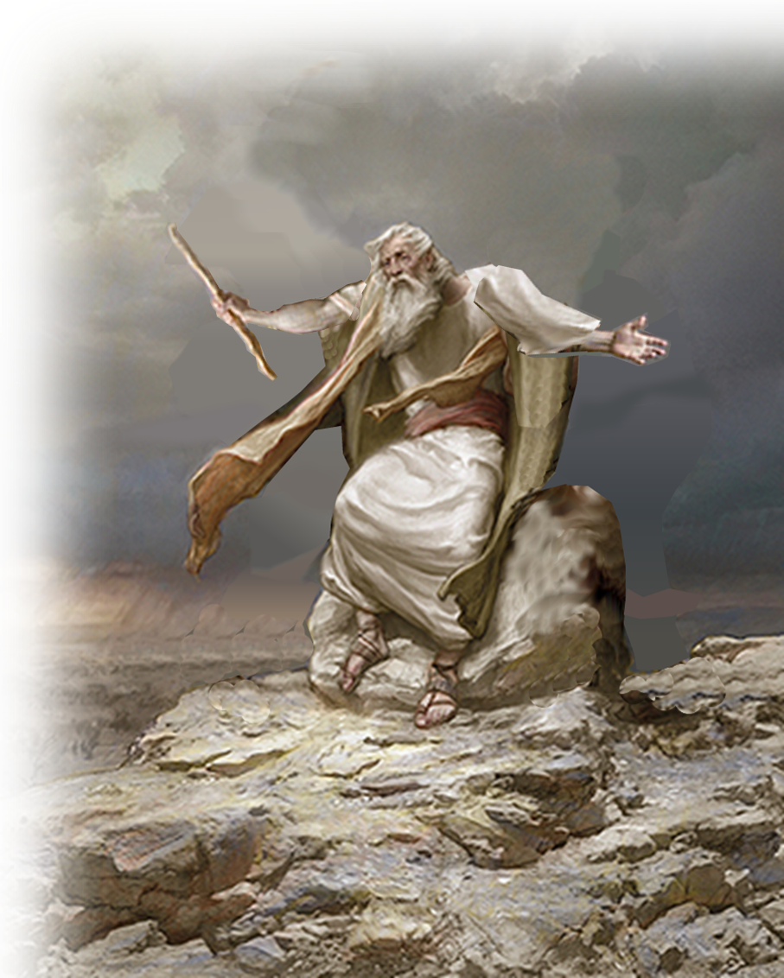
Have a plan...Then work it! 17:10-12
Find What Works For You! .
¹¹ Whenever Moses held up his hand, Israel prevailed; and whenever he lowered his hand, Amalek prevailed.
Notes:
Moses heavy arms = FREE = from https://www.lds.org/media-library/images/one-before-god-moses-aaron-796906?lang=eng

Slide 10
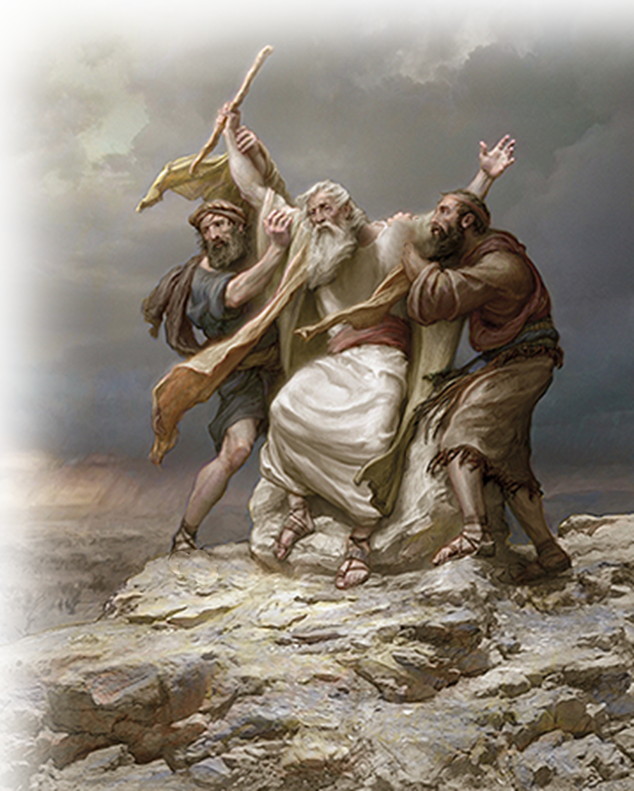
Have a plan...Then work it! 17:10-12
Do What it Takes!
¹² But Moses' hands grew weary; so they took a stone and put it under him, and he sat on it. Aaron and Hur held up his hands, one on one side, and the other on the other side; so his hands were steady until the sun set.
Notes:
Moses heavy arms = FREE = from https://www.lds.org/media-library/images/one-before-god-moses-aaron-796906?lang=eng
Sometimes in spiritual battle you need help—Prayer help!

Slide 11
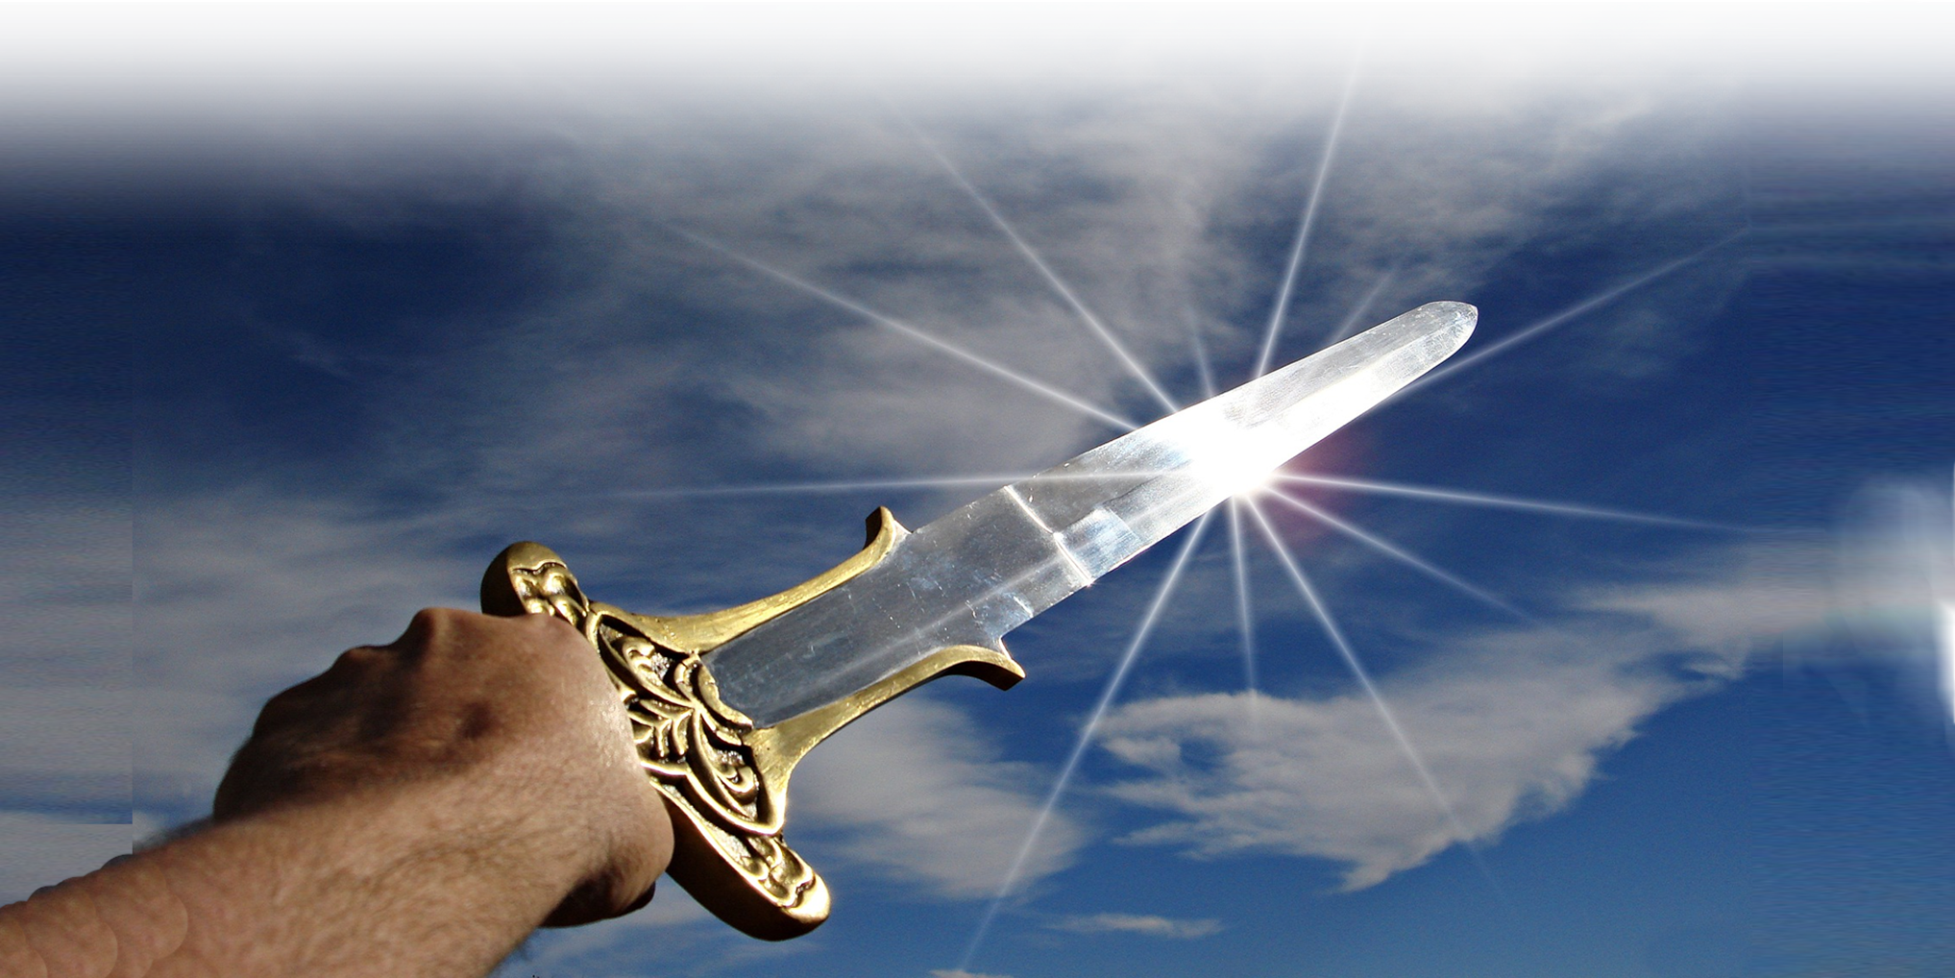
Experience Victory—Not Defeat 17:13
¹³ And Joshua defeated Amalek and his people with the sword.
Notes:
Sword = FREE = https://pixabay.com/en/sword-victory-triumph-weapon-war-790815/

Slide 12
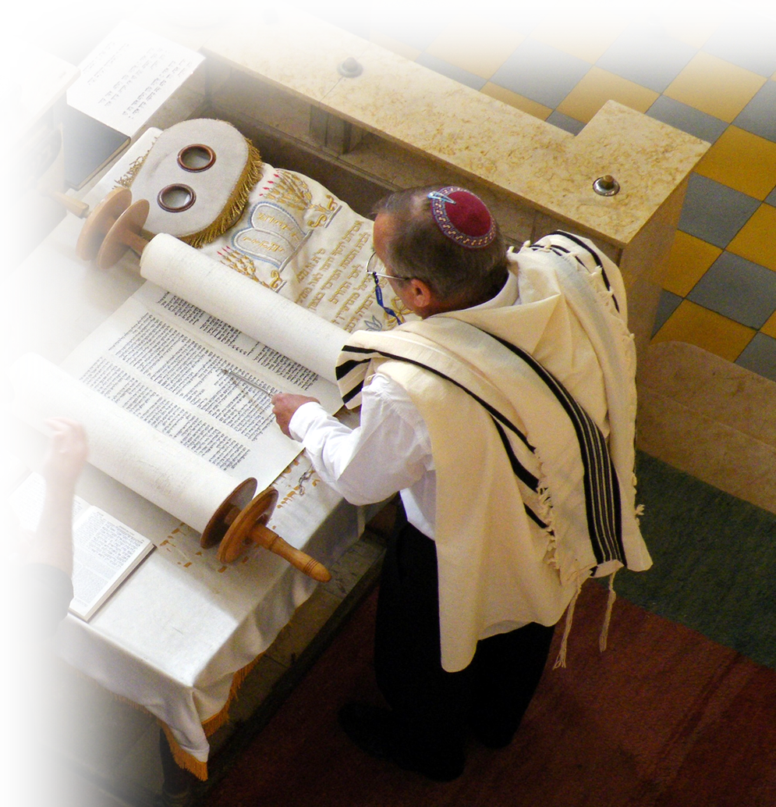
Remember—Write It Down 17:14
¹⁴ Then the LORD said to Moses,
"Write this as a reminder in a book and recite it in the hearing of Joshua: I will utterly blot out the remembrance of Amalek from under heaven."
Notes:
Scroll = FREE = https://en.wikipedia.org/wiki/Torah#/media/File:ReadingOfTheTorah.jpg
It is clear that he was to write down for Joshua what Joshua did not know. What Joshua knew was that he won the battle—what was written down is that he never could have without the staff/power of God.

Slide 13
Remember—Write It Down 17:14
¹⁴ Then the LORD said to Moses,
"Write this as a reminder in a book and recite it in the hearing of Joshua: I will utterly blot out the remembrance of Amalek from under heaven."
Notes:
Scroll = FREE = https://en.wikipedia.org/wiki/Torah#/media/File:ReadingOfTheTorah.jpg
There is a promise here. Although Joshua won a battle a war would rage on. The promise is that Israel wins!

Slide 14
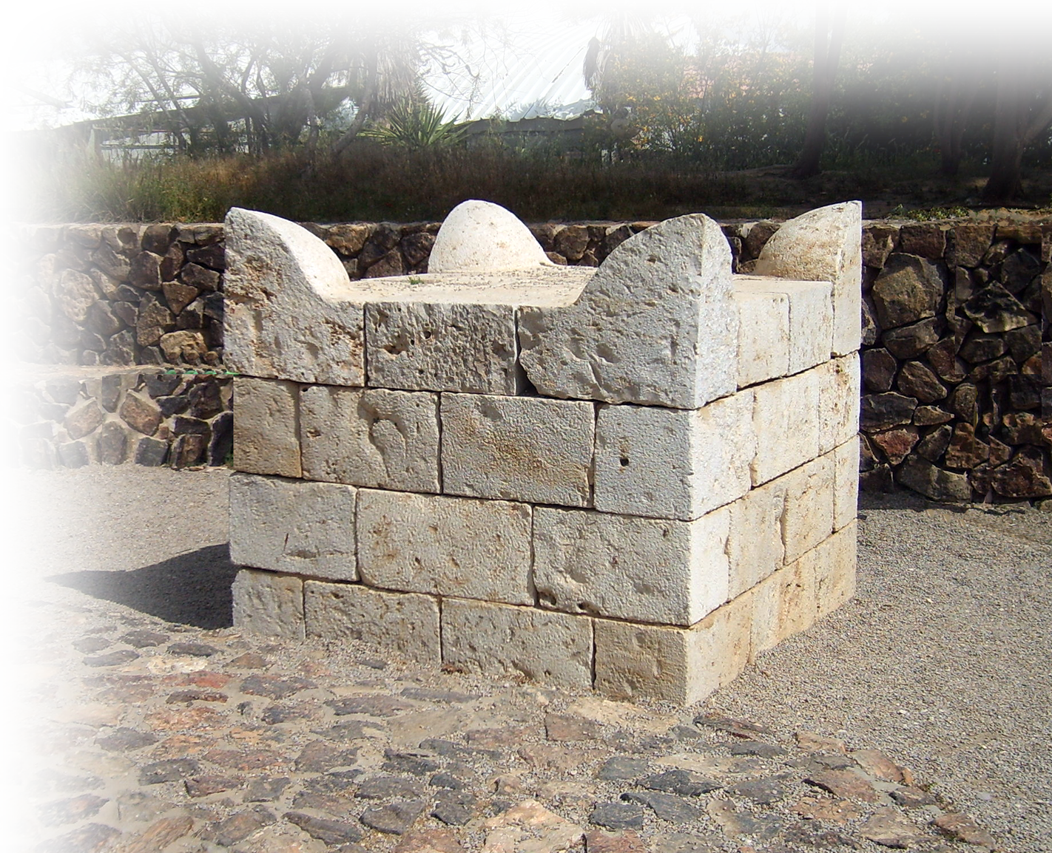
Set Up an Altar—An Altar of Prayer 17:15-16
¹⁵ And Moses built an altar and called it, The LORD is my banner. ¹⁶ He said,
"A hand upon the banner of the LORD. The LORD will have war with Amalek from generation to generation."
Notes:
Altar = FREE = https://en.wikipedia.org/wiki/Altar#/media/File:Tel_Be%27er_Sheva_Altar_2007041.JPG
See NET Bible = ¹⁵ Moses built an altar, and he called it "The LORD is my Banner,"
¹⁶ for he said, "For a hand was lifted up to the throne of the LORD– that the LORD will have war with Amalek from generation to generation."
(Exo 17:15-16 NET)
⁴⁴ tn The line here is very difficult. The Hebrew text has עַל־כֵּס יָהּ כִּי־יָד (ki yad 'al kes yah, "for a hand on the throne of Yah"). If the word is "throne" (and it is not usually spelled like this), then it would mean Moses' hand was extended to the throne of God, showing either intercession or source of power. It could not be turned to mean that the hand of Yah was taking an oath to destroy the Amalekites. The LXX took the same letters, but apparently saw the last four (כסיה) as a verbal form; it reads "with a secret hand." Most scholars have simply assumed that the text is wrong, and כֵּס should be emended to נֵס (nes) to fit the name, for this is the pattern of naming in the OT with popular etymologies – some motif of the name must be found in the sentiment. This would then read, "My hand on the banner of Yah." It would be an expression signifying that the banner, the staff of God, should ever be ready at hand when the Israelites fight the Amalekites again.

Slide 15
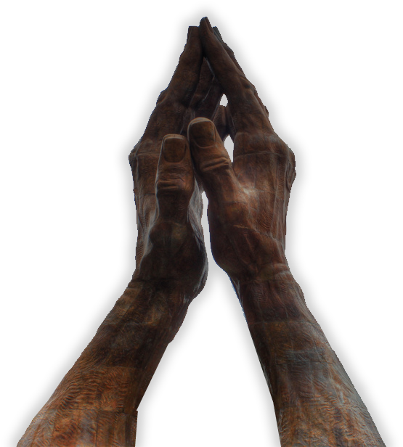
Set Up an Altar—An Altar of Prayer 17:15-16
¹⁵ Moses built an altar and called it The LORD is my Banner. ¹⁶ He said, "For hands were lifted up to the throne of the LORD. The LORD will be at war against the Amalekites from generation to generation." (NIV)
Notes:
Altar = FREE = https://en.wikipedia.org/wiki/Altar#/media/File:Tel_Be%27er_Sheva_Altar_2007041.JPG
See NET Bible = ¹⁵ Moses built an altar, and he called it "The LORD is my Banner,"
¹⁶ for he said, "For a hand was lifted up to the throne of the LORD– that the LORD will have war with Amalek from generation to generation."
(Exo 17:15-16 NET)
⁴⁴ tn The line here is very difficult. The Hebrew text has עַל־כֵּס יָהּ כִּי־יָד (ki yad 'al kes yah, "for a hand on the throne of Yah"). If the word is "throne" (and it is not usually spelled like this), then it would mean Moses' hand was extended to the throne of God, showing either intercession or source of power. It could not be turned to mean that the hand of Yah was taking an oath to destroy the Amalekites. The LXX took the same letters, but apparently saw the last four (כסיה) as a verbal form; it reads "with a secret hand." Most scholars have simply assumed that the text is wrong, and כֵּס should be emended to נֵס (nes) to fit the name, for this is the pattern of naming in the OT with popular etymologies – some motif of the name must be found in the sentiment. This would then read, "My hand on the banner of Yah." It would be an expression signifying that the banner, the staff of God, should ever be ready at hand when the Israelites fight the Amalekites again.

Slide 16
Set Up an Altar—An Altar of Prayer 17:15-16
¹⁵ Moses built an altar and called it The LORD is my Banner. ¹⁶ He said, "For hands were lifted up to the throne of the LORD. The LORD will be at war against the Amalekites from generation to generation." (NIV)
WHY?
Notes:
Altar = FREE = https://en.wikipedia.org/wiki/Altar#/media/File:Tel_Be%27er_Sheva_Altar_2007041.JPG

Slide 17
Set Up an Altar—An Altar of Prayer 17:15-16
^{Deut 25:17} Remember what the Amalekites did to you along the way when you came out of Egypt. ¹⁸ When you were weary and worn out, they met you on your journey and cut off all who were lagging behind; they had no fear of God.
BECAUSE...
Notes:
Altar = FREE = https://en.wikipedia.org/wiki/Altar#/media/File:Tel_Be%27er_Sheva_Altar_2007041.JPG

Slide 18
Set Up an Altar—An Altar of Prayer 17:15-16
^{Deut 25:17} Remember what the Amalekites did to you along the way when you came out of Egypt. ¹⁸ When you were weary and worn out, they met you on your journey and cut off all who were lagging behind; they had no fear of God.
"Amalek was first among the nations, but he will come to ruin at last." (Num 24:20 NIV)
BECAUSE...
Notes:
Altar = FREE = https://en.wikipedia.org/wiki/Altar#/media/File:Tel_Be%27er_Sheva_Altar_2007041.JPG

Slide 19
Set Up an Altar—An Altar of Prayer 17:15-16
^{Deut 25:17} Remember what the Amalekites did to you along the way when you came out of Egypt. ¹⁸ When you were weary and worn out, they met you on your journey and cut off all who were lagging behind; they had no fear of God.
BECAUSE...
Notes:
Altar = FREE = https://en.wikipedia.org/wiki/Altar#/media/File:Tel_Be%27er_Sheva_Altar_2007041.JPG

Slide 20
Set Up an Altar—An Altar of Prayer 17:15-16
^{Deut 25:19} When the LORD your God gives you rest from all the enemies around you in the land he is giving you to possess as an inheritance, you shall blot out the memory of Amalek from under heaven. Do not forget!
(Deu 25:17-1 NIV)
So...
Notes:
Altar = FREE = https://en.wikipedia.org/wiki/Altar#/media/File:Tel_Be%27er_Sheva_Altar_2007041.JPG

Slide 21
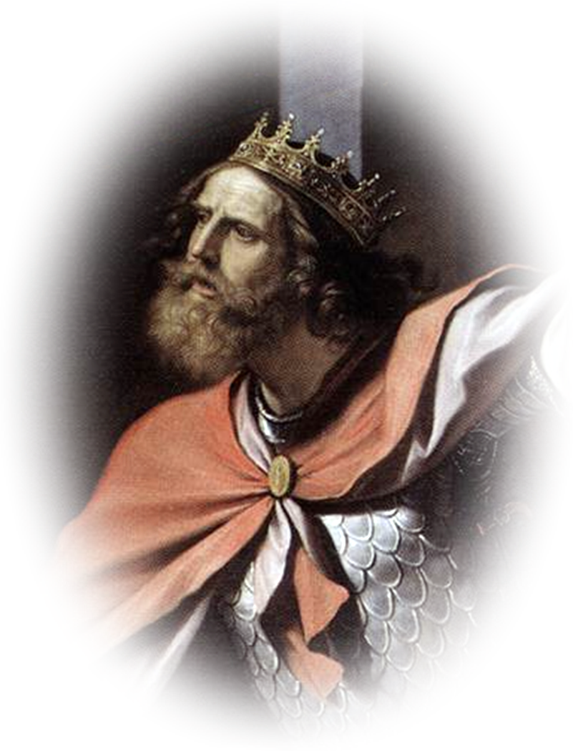
Set Up an Altar—An Altar of Prayer 17:15-16
² Thus says the LORD of hosts, 'I will punish the Amalekites for what they did in opposing the Israelites when they came up out of Egypt. ³ Now go and attack Amalek, and utterly destroy all that they have; do not spare them,....' (1Sam 15:2-3)
400 years later...
Notes:
Altar = FREE = https://en.wikipedia.org/wiki/Altar#/media/File:Tel_Be%27er_Sheva_Altar_2007041.JPG
Saul = https://upload.wikimedia.org/wikipedia/commons/b/b3/Guercino_Saul_Davide.jpg

Slide 22
Set Up an Altar—An Altar of Prayer 17:15-16
⁷ Saul defeated the Amalekites, ... ⁸ He took King Agag of the Amalekites alive, but utterly destroyed all the people with the edge of the sword. ⁹ Saul and the people spared Agag, and the best of the sheep ... and all that was valuable, and would not utterly destroy them ....
Spared
Notes:
Altar = FREE = https://en.wikipedia.org/wiki/Altar#/media/File:Tel_Be%27er_Sheva_Altar_2007041.JPG
Need to fill-in the story of Saul’s compromise in sparing Agag the Amalekite.

Slide 23
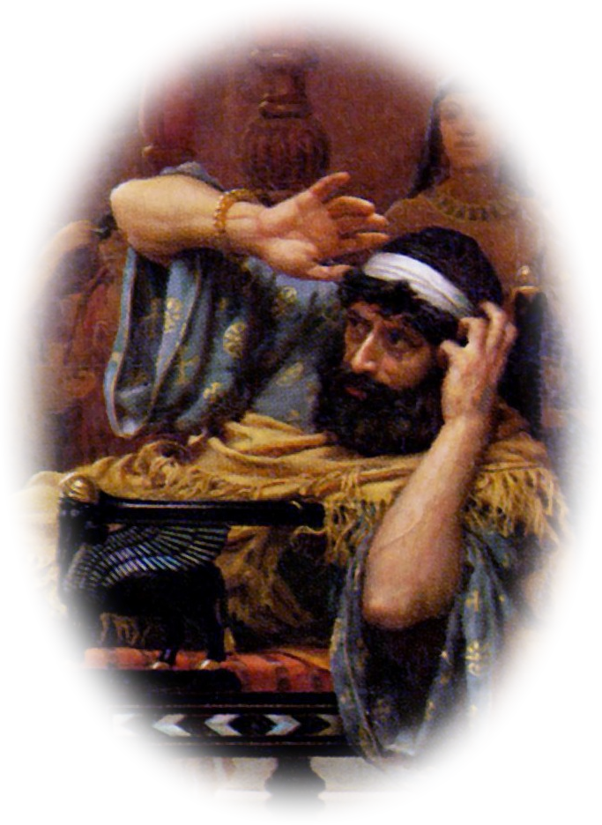
Set Up an Altar—An Altar of Prayer 17:15-16
^{Esther} ^{3:1} After these things King Ahasuerus promoted Haman the Agagite, ... [said] ⁸ There is a certain people ... in ... your kingdom; ... they do not keep the king's laws, .... ⁹ If it pleases the king, let a decree be issued for their destruction, and I will pay....
Fast Forward
500 years
Notes:
Altar = FREE = https://en.wikipedia.org/wiki/Altar#/media/File:Tel_Be%27er_Sheva_Altar_2007041.JPG
Haman = https://upload.wikimedia.org/wikipedia/commons/0/03/Esther_Denouncing_Haman.jpg
Need to fill-in the story of Haman opposition to the people of God in the Book of Esther.
A man named Haman, who was prime minister of Persia under King Xeres (Esther 3:1), was willing to pay the king 10,000 talents of silver (roughly $153 million U.S. in today's money) to cover the expenses of exterminating all Jews in the land (see our study on the Book of Esther). (http://www.biblestudy.org/bible-study-by-topic/silver-in-the-bible.html)

Slide 24
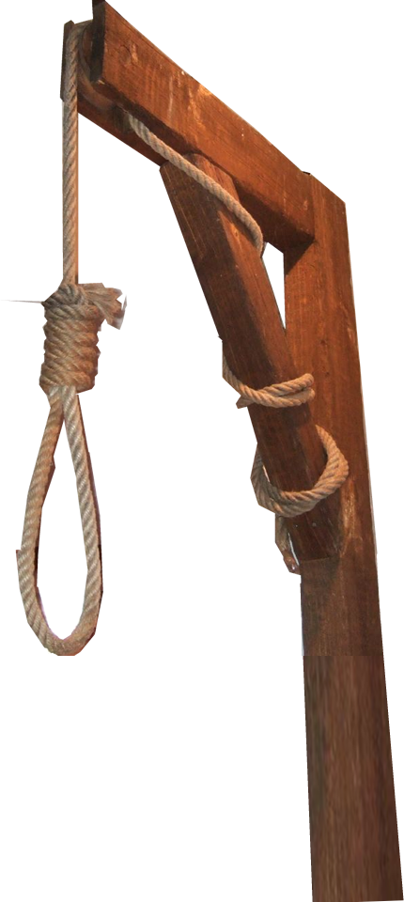
Set Up an Altar—An Altar of Prayer 17:15-16
^{7:10} So they hanged Haman on the gallows that he had prepared for Mordecai.
^{9:5} So the Jews struck down all their enemies with the sword, ...
VICTORY
Notes:
Altar = FREE = https://en.wikipedia.org/wiki/Altar#/media/File:Tel_Be%27er_Sheva_Altar_2007041.JPG
Noose = https://www.flickr.com/photos/bensutherland/130730734

Slide 25
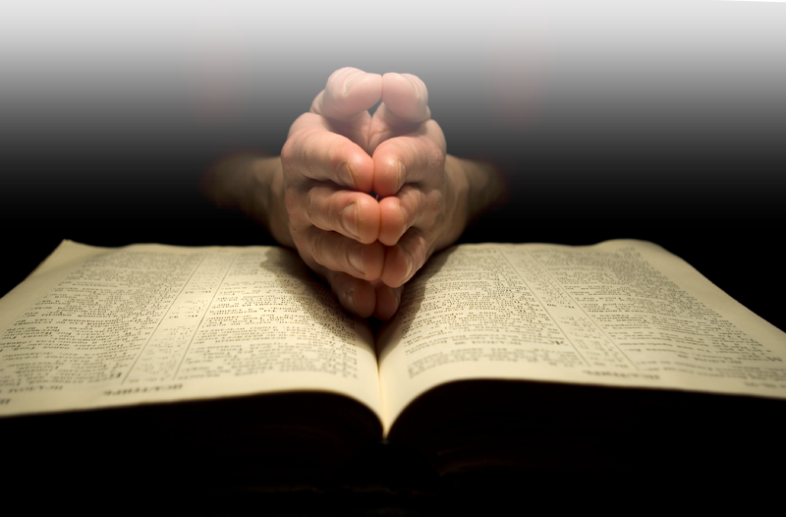
Here’s the Point:
⁴ For whatever was written in former days was written for our instruction, so that by steadfastness and by the encouragement of the scriptures we might have hope. (Romans 15:4)
Notes:
I had a battle fierce today ...

Slide 26
Here’s the Point:
^{Eph 6:13} Therefore take up the whole armor of God, so that you may be able to withstand on that evil day, and having done everything, to stand firm.

Slide 27
Here’s the Point:
¹⁸ Pray in the Spirit at all times in every prayer and supplication.
Notes:
Here’s the point: We must engage in battle as Joshua did, and pray as Moses did. When we do the victory is ours!
I had a battle fierce today ...
“The Battleground of Prayer”
“I had a battle fierce today
Within my place pf prayer;
I went to meet and talk with God,
But I found Satan there.
He whispered, ‘You can’t really pray,
You lost out long ago;
You may say words while on your knees,
But you can’t pray, you know.’
So then I pulled my helmet down,
Way down upon my ears,
And found it helped to still his voice,
And helped allay my fears.
I checked my other armour o’er,
My feet in peace were shod;
My loins with truth were girded round;
My sword, the Word of God.
My righteous breastplate still was on,
My heart’s love to protect.
My shield of faith was still intact – –
His fiery darts bounced back.
I called on God in Jesus name,
I pled the precious blood – –
While Satan sneaked away in shame,
I met and talked with God.
Though Satan hurls his fiery darts,
And seeks to hinder me,
With armour bright, on praying ground,
I’ll win the victory!”
– – Author Unknown

Slide 28
Let’s Pray!

