Slide 1
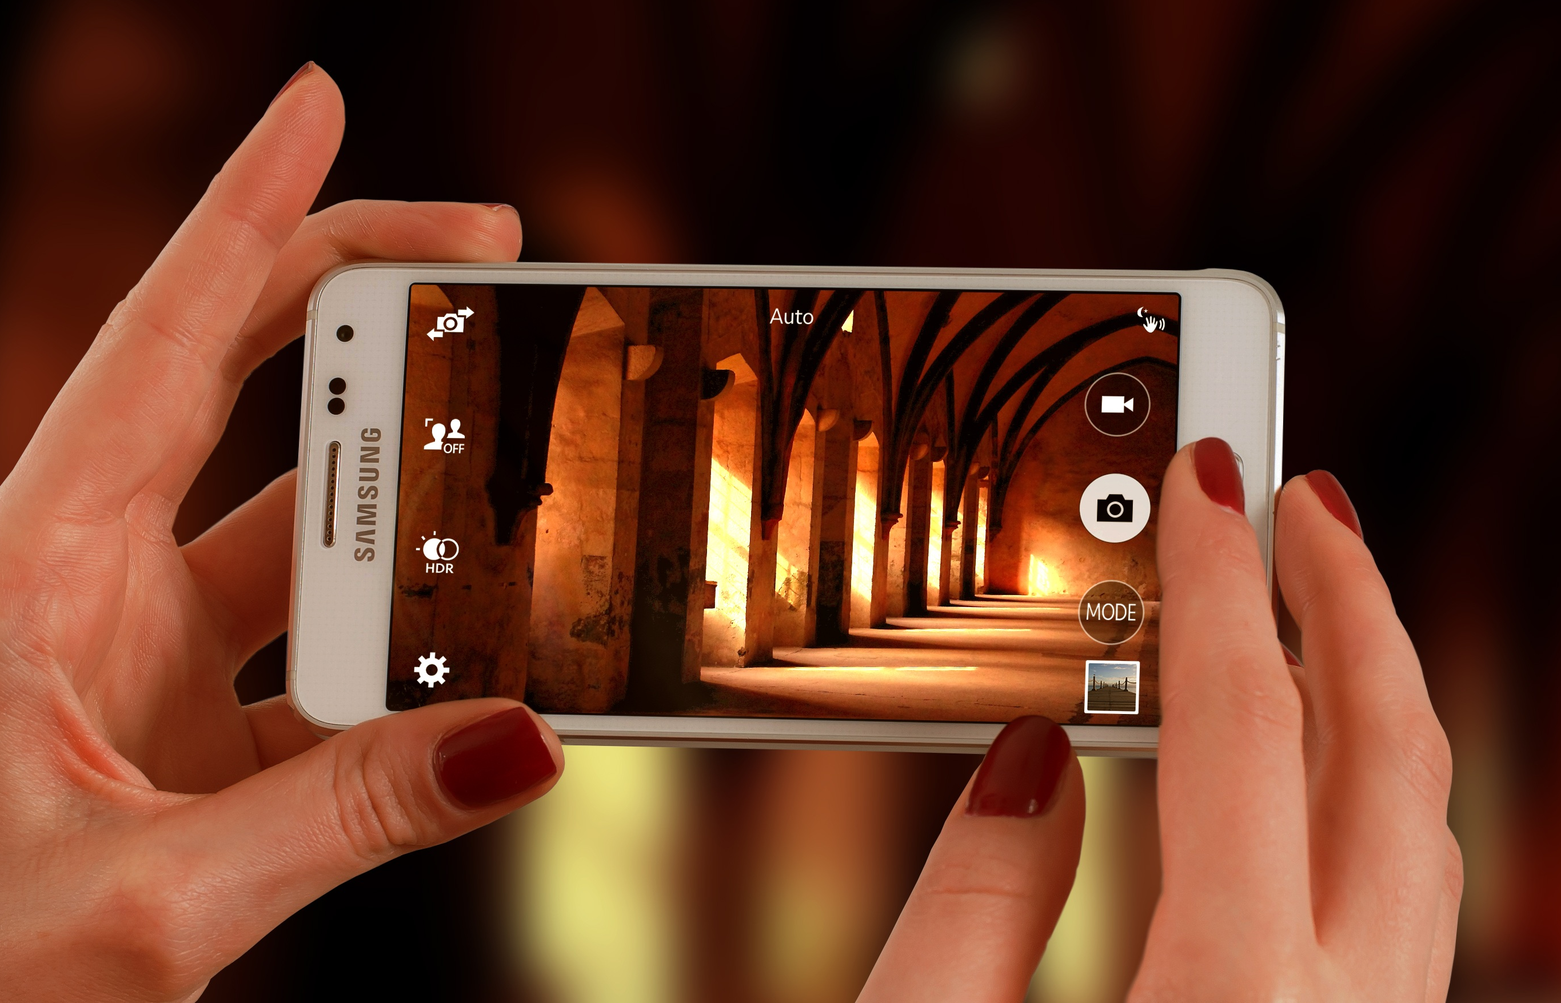
Snapshots from a Spiritual Journey
Notes:
This series uses the Revised Standard Version of the Bible.
Copyright © 2000-2021. All rights reserved. Bible Point is a registered trademark of Dennis Henderson. All other trademarks acknowledged.
Bible Point contains graphics from Bible Point artists. These illustrations belong to Bible Point and the respective artists. You may use the designs and illustrations for graphical illustration of lessons free and without special permission, provided they are not used in any way that maligns the Christian faith. Furthermore, republication or production of any illustration by any other graphic service whether it be in book, in a machine-readable form, or in any other design resource is strictly prohibited. Furthermore, they cannot be duplicated or resold as any other form of publishing, clip art, or graphic resource.
So What does it mean? (A simple translations of the legal jargon)
So, if you don’t own the presentation(s), graphic(s), and text(s) how can you legally use them? The purchase of the license allows you to use all the images in the product. However, the actual ownership and copyright of the presentation(s), graphic(s), and text(s) remain the property of Bible Point and its licensors. If you had plans on using this product in your “for sale” work—think again!
License Agreement
Article 1: License Grant
All the graphics and text in Bible Point presentations (excluding quotes from the Bible and stated sources) are the intellectual and real property of Bible Point and its licensors, and is protected by law, including United States copyright laws and international treaties. Bible Point grants to you a license:
1. To use the presentation in a single church, single school, or single office of a Christian organization.
2. To make a single archival back-up copy of the program.
3. To modify the presentation(s) and merge with other presentations in a single church, school, or Christian organization.
4. To transfer to another party if that party agrees to accept the terms and conditions of this agreement, and you do not retain any copies of the presentation, whether printed, machine readable, modified, or merged form.
Article 2: Terms
This license is effective until terminated. You may terminate the license at any time by destroying the presentation(s), graphic(s), or text(s) together with all copies, modifications and merged portions in any form. Bible Point may terminate your license if you fail to comply with this Agreement. You agree, upon such termination, for any reason, to destroy the presentation(s), graphics, and text(s) with all copies, modifications, and merged portions in any form.
Article 3: Disclaimers
1. Bible Point presentations, graphics, and texts are licensed to you As Is. You, the consumer, bear the entire risk relating to the quality and performance of the presentation(s), graphic(s), or text(s). In no event will Bible Point be liable for damages resulting from any defect.
2. Thirty-day limited warrantee on disks. Bible Point warrants the disks to be free of defects in material and workmanship under normal use for 30 days after purchase. During the 30-day period you may return a defective presentation, graphic, or text with proof of purchase and it will be replaced without charge, unless the presentation is damaged by misuse.
Article 4: General
1. You may not sub-license, assign, or transfer the license of the presentation(s), graphic(s), or text(s) except as provided by this Agreement.
2. This Agreement will be governed by the laws of the State of Michigan.
So What does it mean? (A simple translations of the legal jargon)
May I let someone borrow or copy my licensed Bible Point presentation (even after I modified it)? As long as it is within your local church, or single school, or the immediate office of a Christian organization you may. Otherwise, please refer the person interested in borrowing to: http://www.biblepoint.com or E-mail: dh@biblepoint.com with any related questions.

Slide 2
Lessons from the School of Life
Notes:
Life is a school room with a lot of teaching going on. This was true for the Hebrews.
Ten lessons to Pharaoh. Parting of the Red Sea lesson for Israel.
Now it is time to test the class ...

Slide 3
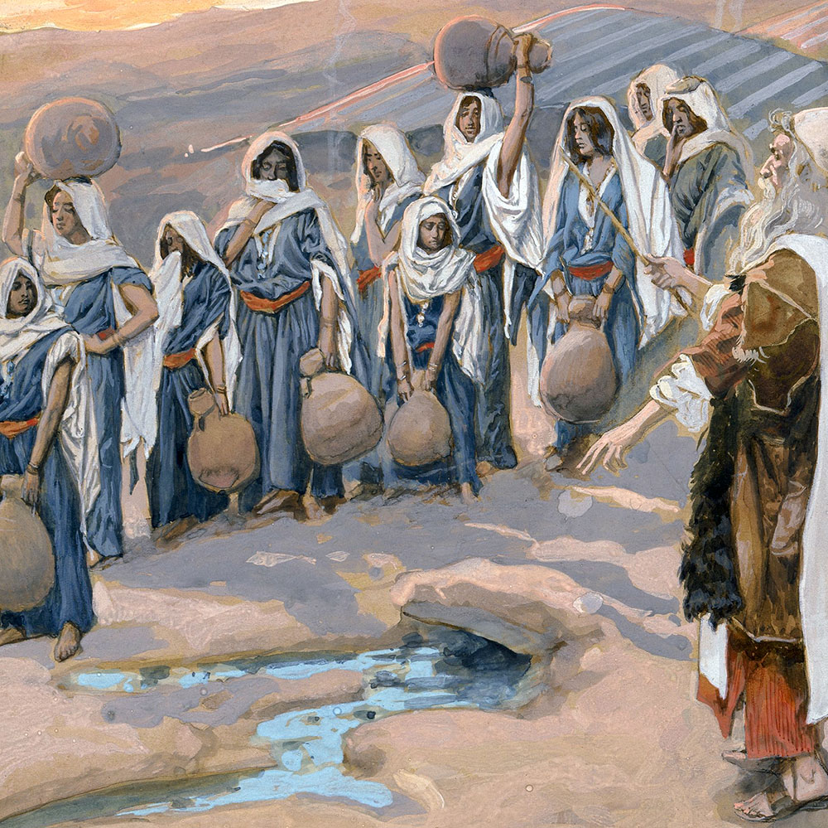
Three Stories
Bitter Water

Slide 4
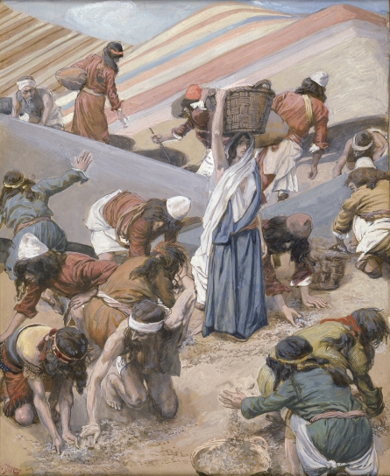
Three Stories
Bitter Water 2) No Food

Slide 5
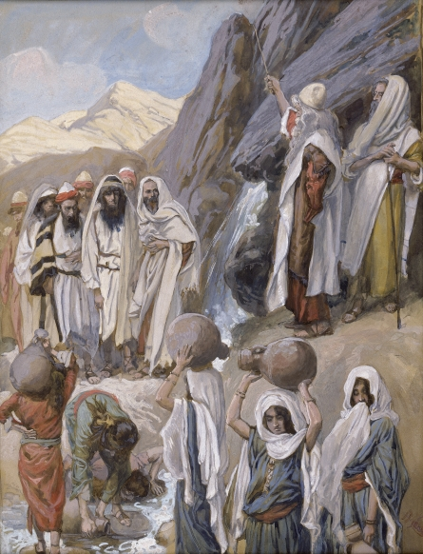
Three Stories
Bitter Water 2) No Food 3) No Water

Slide 6
Unified by two concepts:
Notes:
Besides the fact that they each deals with “the bare necessities of life, food and water,” the stories are unified by two important concepts:
Testing – Tests are given after the lesson to see what you have learned. God has given many lessons in the plagues, Passover, exodus. So the test is to see what they have learned.
Dissatisfaction – not everyone likes a test—especially those who are not prepared. They “complain.”

Slide 7
Unified by two concepts:
“TEST”
“DISSATIFACTION”

Slide 8
Unified by two concepts:
“TEST”
“... there [the LORD] put them to the test.” (15:25)
“DISSATIFACTION”
“And the people complained against Moses” (15:24)

Slide 9
Unified by two concepts:
“TEST”
“... there [the LORD] put them to the test.” (15:25)
“In that way I will test them ...” (16:4)
“DISSATIFACTION”
“And the people complained against Moses” (15:24)
“The whole congregation of complained” (16:2)

Slide 10
Unified by two concepts:
“TEST”
“... there [the LORD] put them to the test.” (15:25)
“In that way I will test them ...” (16:4)
“the Israelites ... tested the LORD (17:7)
“DISSATIFACTION”
“And the people complained against Moses” (15:24)
“The whole congregation of complained” (16:2)
The people quarreled with Moses (17:2)

Slide 11
Three lessons

Slide 12
1) Life can be BITTER 15:22-27
Notes:
When “Bitterness” is used to describe “life” it means life is “hard to bear; grievous; distressful.”

Slide 13
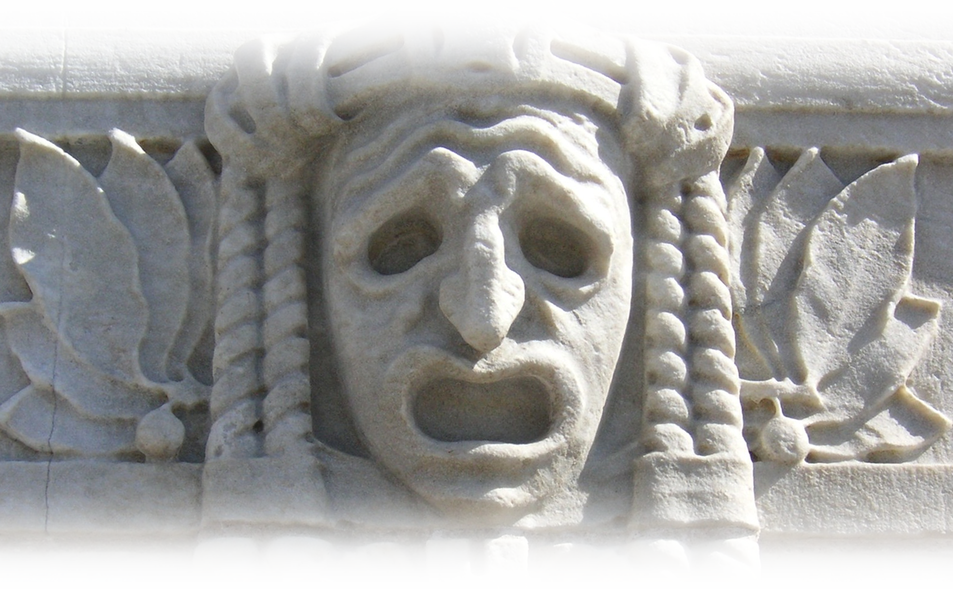
1) Life can be BITTER 15:22-27
That is, life can be “hard to bear, grievous, distressful.”
Notes:
When “Bitterness” is used to describe “life” it means life is “hard to bear; grievous; distressful.”

Slide 14
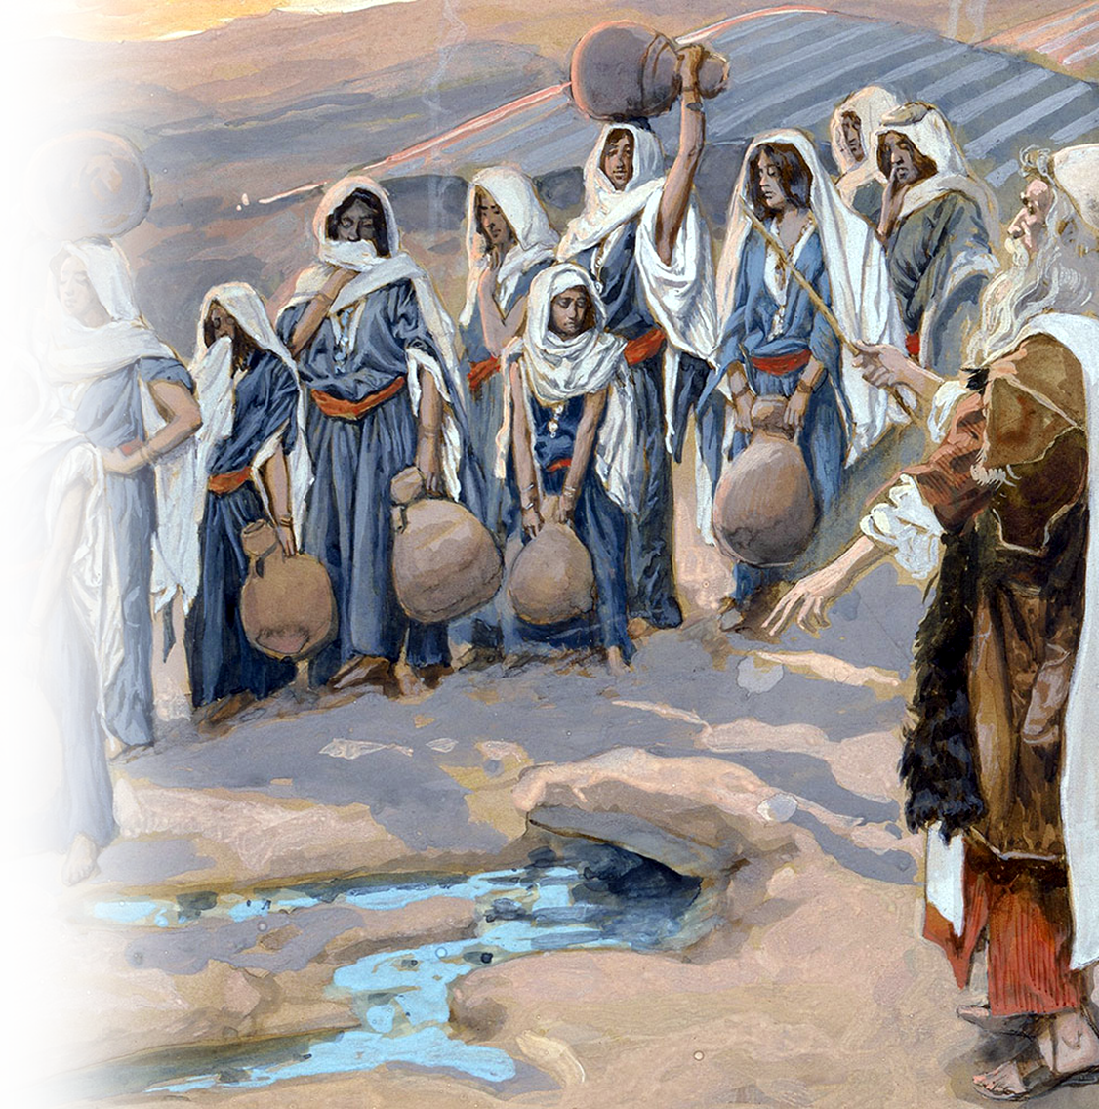
1) Life can be BITTER 15:22-27
^{15:23} When they came to Marah, they could not drink the water of Marah because it was bitter. That is why it was called Marah. ²⁴ And the people complained against Moses, saying, "What shall we drink?"
Notes:
Compare “bitter” to Naomi calling herself bitter in the book of Ruth.

Slide 15
1) Life can be BITTER 15:22-27
²⁵ He cried out to the LORD; and the LORD showed him a piece of wood; he threw it into the water, and the water became sweet. There the LORD made for them a statute and an ordinance and there he put them to the test.

Slide 16
1) Life can be BITTER 15:22-27
²⁵ He cried out to the LORD; and the LORD showed him a piece of wood; he threw it into the water, and the water became sweet. There the LORD made for them a statute and an ordinance and there he put them to the test.

Slide 17
1) Life can be BITTER 15:22-27
²⁵ He cried out to the LORD; and the LORD showed him a piece of wood; he threw it into the water, and the water became sweet. There the LORD made for them a statute and an ordinance and there he put them to the test.

Slide 18
1) Life can be BITTER 15:22-27
²⁵ He cried out to the LORD; and the LORD showed him a piece of wood; he threw it into the water, and the water became sweet. There the LORD made for them a statute and an ordinance and there he put them to the test.

Slide 19
1) Life can be BITTER 15:22-27
²⁵ He cried out to the LORD; and the LORD showed him a piece of wood; he threw it into the water, and the water became sweet. There the LORD made for them a statute and an ordinance and there he put them to the test.
What statute and what ordinance?

Slide 20
1) Life can be BITTER 15:22-27
²⁶ He said, "If you will listen carefully to the voice of the LORD your God, and do what is right in his sight, and give heed to his commandments and keep all his statutes,

Slide 21
1) Life can be BITTER 15:22-27
²⁶ ... [then] I will not bring upon you any of the diseases that I brought upon the Egyptians; for I am the LORD who heals you."
Notes:
The diseases = what resulted from the plagues ....

Slide 22
1) Life can be BITTER 15:22-27
²⁶ ... [then] I will not bring upon you any of the diseases that I brought upon the Egyptians; for I am the LORD who heals you."
Notes:
Shocker here: It does not say heals the water, but rather, heals YOU!

Slide 23
1) Life can be BITTER 15:22-27
When it is, “Cry out to the LORD” (Exo 15:25)

Slide 24
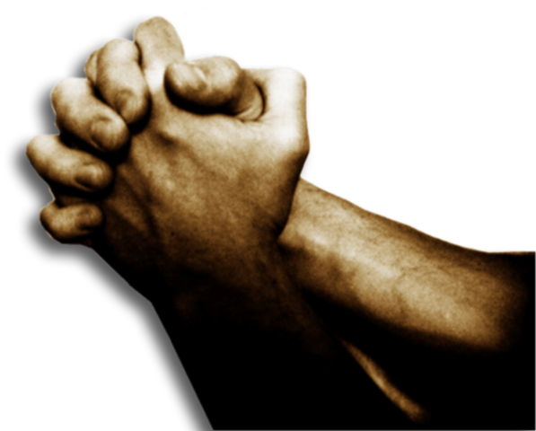
1) Life can be BITTER 15:22-27
When it is, “Cry out to the LORD” (Exo 15:25)

Slide 25
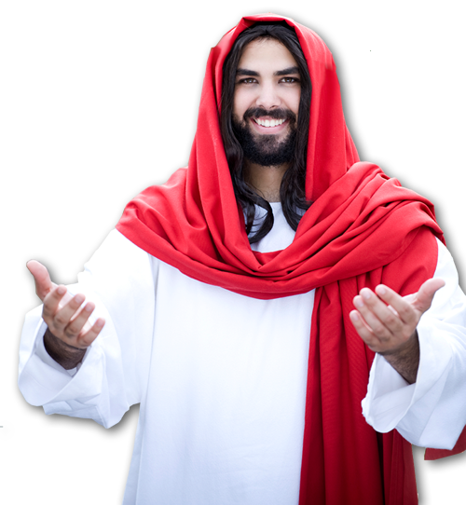
1) Life can be BITTER 15:22-27
Ask and you will receive,
so that your joy may be
complete. –Jesus
(John 16:24)
When it is, “Cry out to the LORD” (Exo 15:25)

Slide 26
2) Life can be EMPTY 16:1-36

Slide 27
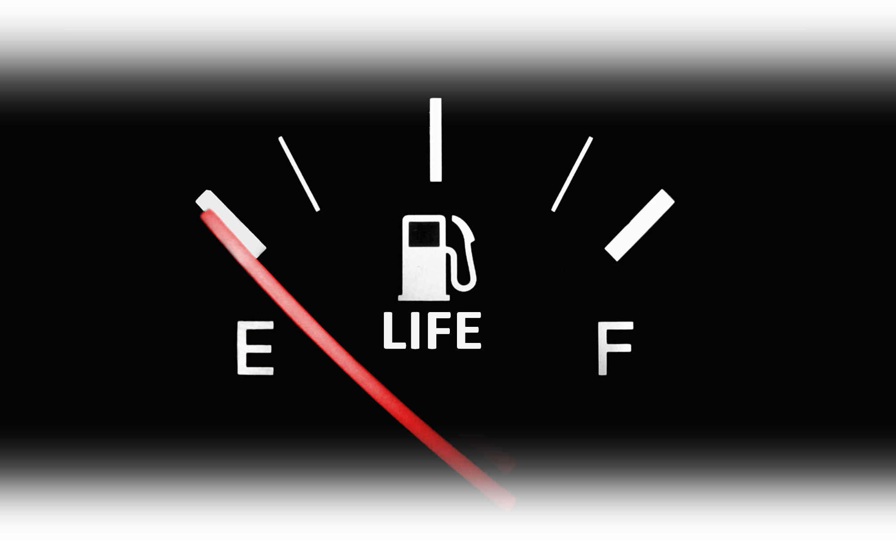
2) Life can be EMPTY 16:1-36
That is, “nothing to keep you going.”
Notes:
Empty = FREE = http://www.publicdomainpictures.net/view-image.php?image=8422
Job had lost everything ... His wife says, Job 2:9 Then his wife said to him, "Do you still persist in your integrity? Curse God, and die." (Job 2:9 NRS)
Life can seem so empty, meaningless, purposeless, that you just want to die!

Slide 28
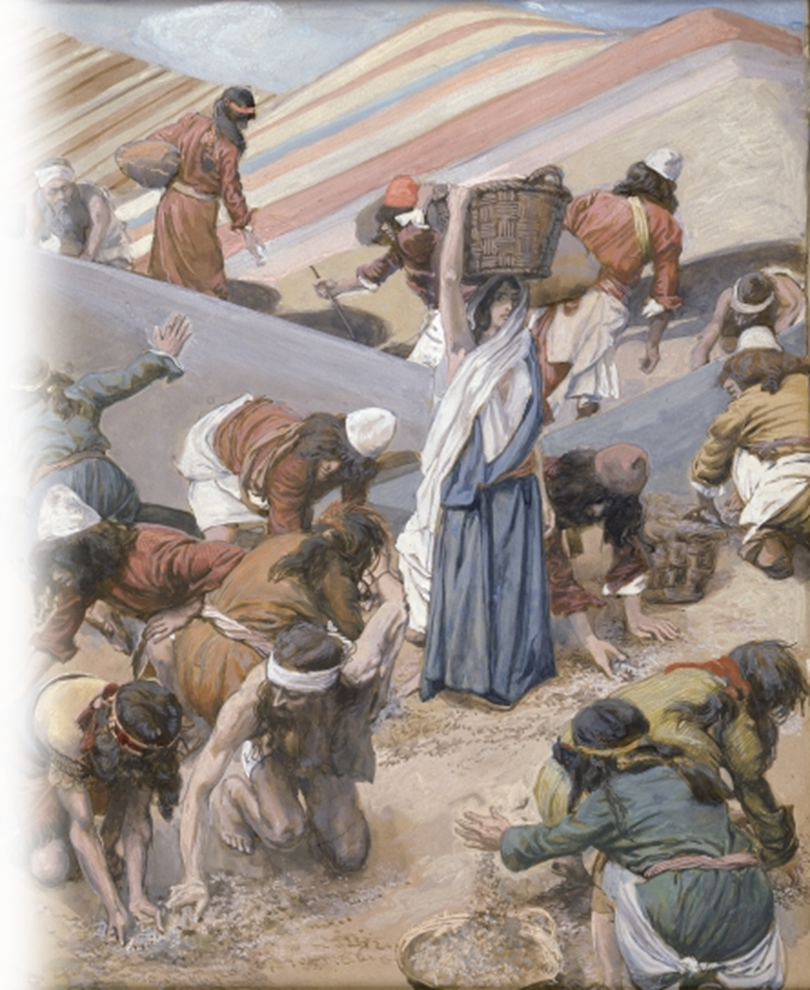
2) Life can be EMPTY 16:1-36
^{16:2} The whole congregation of the Israelites complained against Moses and Aaron ..., "If only we had died by the hand of the LORD in the land of Egypt, when we sat by the fleshpots and ate our fill of bread; for you have brought us out into this wilderness to kill this whole assembly with hunger."

Slide 29
2) Life can be EMPTY 16:1-36
^{16:2} The whole congregation of the Israelites complained against Moses and Aaron ..., "If only we had died by the hand of the LORD in the land of Egypt, when we sat by the fleshpots and ate our fill of bread; for you have brought us out into this wilderness to kill this whole assembly with hunger."

Slide 30
2) Life can be EMPTY 16:1-36
^{16:2} The whole congregation of the Israelites complained against Moses and Aaron ..., "If only we had died by the hand of the LORD in the land of Egypt, when we sat by the fleshpots and ate our fill of bread; for you have brought us out into this wilderness to kill this whole assembly with hunger."

Slide 31
2) Life can be EMPTY 16:1-36
^{16:2} The whole congregation of the Israelites complained against Moses and Aaron ..., ³ "If only we had died by the hand of the LORD in the land of Egypt, when we sat by the fleshpots and ate our fill of bread; for you have brought us out into this wilderness to kill this whole assembly with hunger."

Slide 32
2) Life can be EMPTY 16:1-36
⁴ Then the LORD said to Moses, "I am going to rain bread from heaven for you, and each day the people shall go out and gather enough for that day. In that way I will test them, whether they will follow my instruction or not.”

Slide 33
2) Life can be EMPTY 16:1-36
⁴ Then the LORD said to Moses, "I am going to rain bread from heaven for you, and each day the people shall go out and gather enough for that day. In that way I will test them, whether they will follow my instruction or not.”

Slide 34
2) Life can be EMPTY 16:1-36
⁸ Your complaining is not against us but against the LORD ....

Slide 35
2) Life can be EMPTY 16:1-36
⁸ Your complaining is not against us but against the LORD ....
⁹ Then Moses said to Aaron, "Say to the whole congregation of the Israelites, 'Draw near to the LORD, for he has heard your complaining.'"

Slide 36
2) Life can be EMPTY 16:1-36
¹² "I have heard the complaining of the Israelites; say to them, 'At twilight you shall eat meat, and in the morning you shall have your fill of bread; then you shall know that I am the LORD your God.'"

Slide 37
2) Life can be EMPTY 16:1-36
¹² "I have heard the complaining of the Israelites; say to them, 'At twilight you shall eat meat, and in the morning you shall have your fill of bread; then you shall know that I am the LORD your God.'"

Slide 38
2) Life can be EMPTY 16:1-36
¹² "I have heard the complaining of the Israelites; say to them, 'At twilight you shall eat meat, and in the morning you shall have your fill of bread; then you shall know that I am the LORD your God.'"

Slide 39
2) Life can be EMPTY 16:1-36
¹³ In the evening quails came up and covered the camp; and in the morning there was a layer of dew ... ¹⁴ When the layer of dew lifted, there ... was a fine flaky substance, as fine as frost on the ground.

Slide 40
2) Life can be EMPTY 16:1-36
¹³ In the evening quails came up and covered the camp; and in the morning there was a layer of dew ... ¹⁴ When the layer of dew lifted, there ... was a fine flaky substance, as fine as frost on the ground.

Slide 41
2) Life can be EMPTY 16:1-36
¹⁵ ... they said to one another, "What is it?" For they did not know what it was.
Moses said to them, "It is the bread that the LORD has given you to eat.

Slide 42
2) Life can be EMPTY 16:1-36
¹⁵ ... they said to one another, "What is it?" For they did not know what it was.
Moses said to them, "It is the bread that the LORD has given you to eat.”

Slide 43
2) Life can be EMPTY 16:1-36

Slide 44
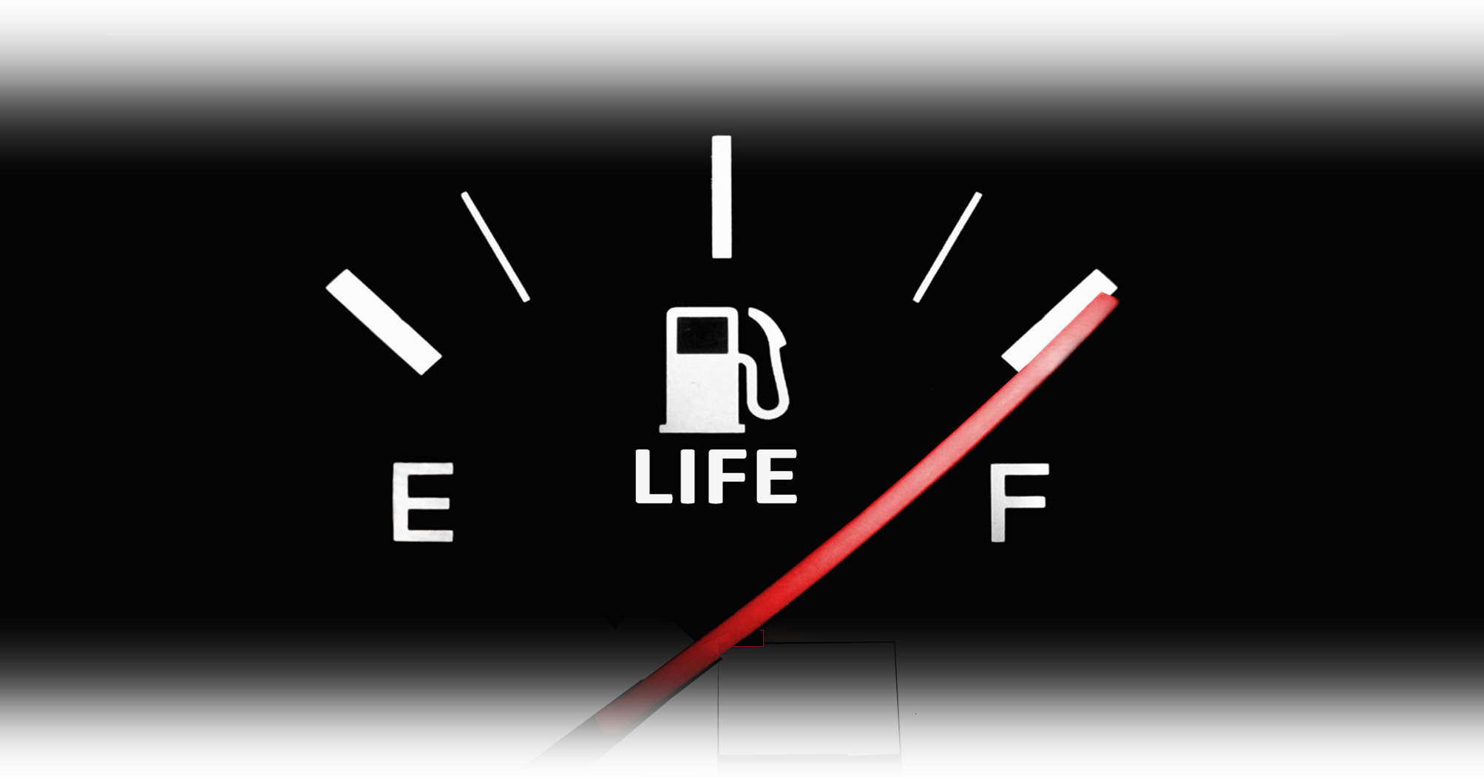
2) Life can be EMPTY 16:1-36
When it is, “Draw near to the LORD” (Exo 16:9)

Slide 45
2) Life can be EMPTY 16:1-36
Jesus said to them,
"I am the bread of life.
Whoever comes to me
will never be hungry....”
(John 6:35)
When it is, “Draw near to the LORD” (Exo 16:9)

Slide 46
2) Life can be EMPTY 16:1-36
“I have come that they
may have life, and
have it to the full.” --Jesus
^{(John 10:10 NIV)}
When it is, “Draw near to the LORD” (Exo 16:9)

Slide 47
3) Life can be THREATENING 17:1-7
Notes:
Dry ground = free =https://pixabay.com/en/ground-cracked-dry-desert-nature-753070/

Slide 48
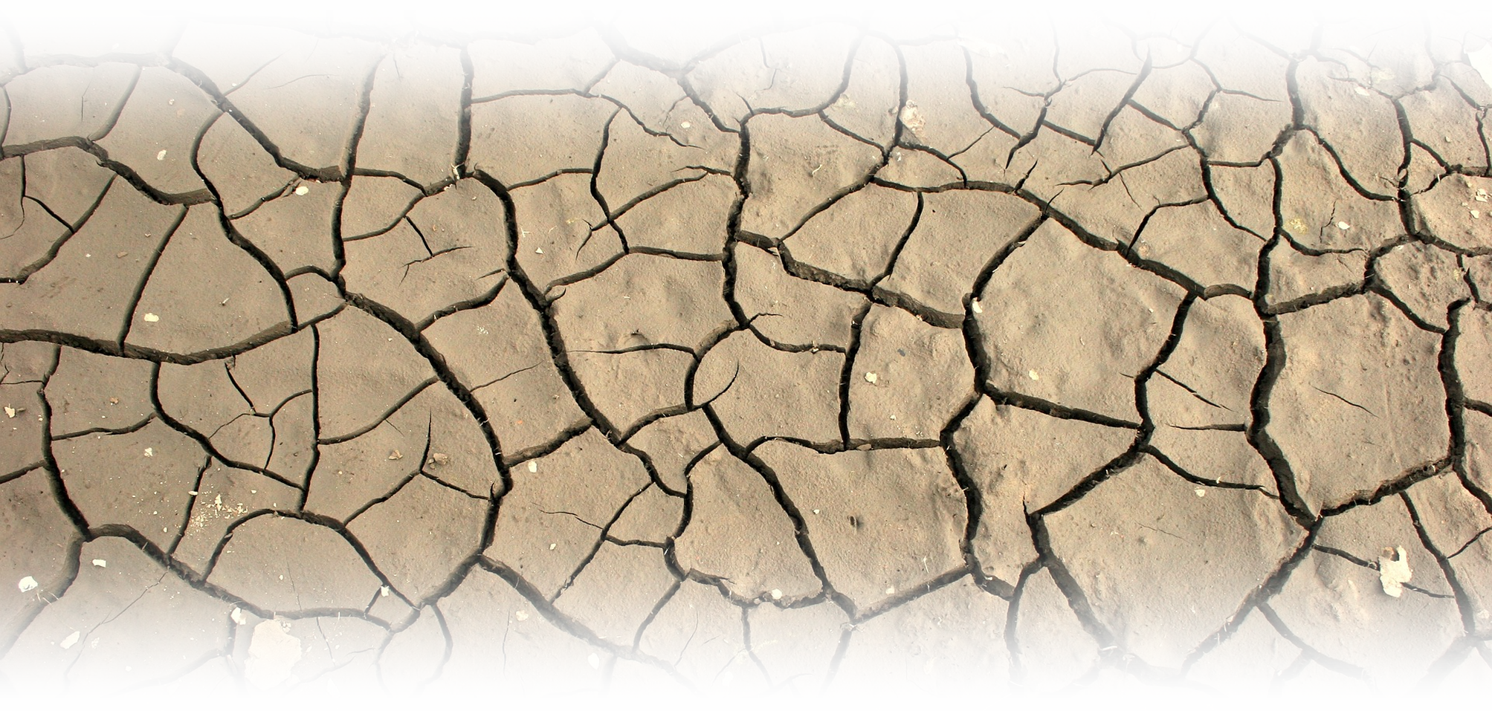
3) Life can be THREATENING 17:1-7
That is, “circumstances can be life threatening”

Slide 49
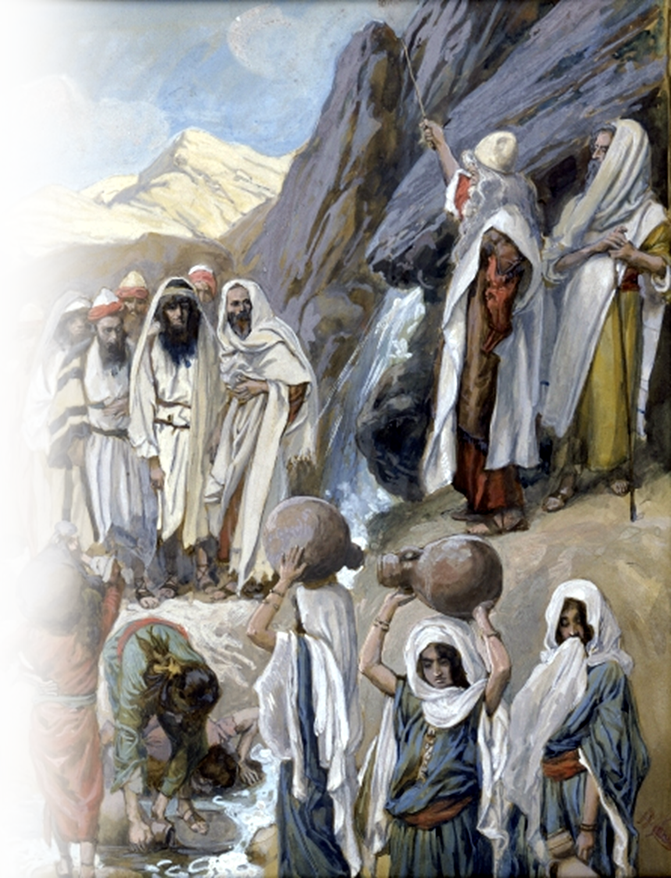
3) Life can be THREATENING
^{17:1} ... the Israelites ... camped at Rephidim, but there was no water for the people to drink. ² The people quarreled with Moses, and said, "Give us water to drink." Moses said to them, "Why do you quarrel with me? Why do you test the LORD?"

Slide 50
3) Life can be THREATENING
^{17:1} ... the Israelites ... camped at Rephidim, but there was no water for the people to drink. ² The people quarreled with Moses, and said, "Give us water to drink." Moses said to them, "Why do you quarrel with me? Why do you test the LORD?"

Slide 51
3) Life can be THREATENING
^{17:1} ... the Israelites ... camped at Rephidim, but there was no water for the people to drink. ² The people quarreled with Moses, and said, "Give us water to drink." Moses said to them, "Why do you quarrel with me? Why do you test the LORD?"

Slide 52
3) Life can be THREATENING
³ ... and the people complained against Moses and said, "Why did you bring us out of Egypt, to kill us and our children and livestock with thirst?"

Slide 53
3) Life can be THREATENING
⁴ So Moses cried out to the LORD, "What shall I do with this people? They are almost ready to stone me.“

Slide 54
3) Life can be THREATENING
⁵ The LORD said to Moses, "Go ... and ... ⁶ I will be standing there in front of you on the rock at Horeb. Strike the rock, and water will come out of it, so that the people may drink."

Slide 55
3) Life can be THREATENING
⁵ The LORD said to Moses, "Go ... and ... ⁶ I will be standing there in front of you on the rock at Horeb. Strike the rock, and water will come out of it, so that the people may drink."

Slide 56
3) Life can be THREATENING
⁵ The LORD said to Moses, "Go ... and ... ⁶ I will be standing there in front of you on the rock at Horeb. Strike the rock, and water will come out of it, so that the people may drink." Moses did so, in the sight of the elders of Israel.

Slide 57
3) Life can be THREATENING 17:1-7

Slide 58
3) Life can be THREATENING 17:1-7
When it is, realize ‘I will stand there before you”

Slide 59
3) Life can be THREATENING 17:1-7
[They] all drank the same spiritual drink. For they drank from the spiritual rock that followed them, and the rock was Christ. (1Cor 10:4)
When it is, realize ‘I will stand there before you”

Slide 60
3) Life can be THREATENING 17:1-7
“The water that I will give
will become in them a
spring of water gushing
up to eternal life.“ --Jesus
(John 4:14)
When it is, realize ‘I will stand there before you”

Slide 61
The place was named:
⁷ He called the place Massah and Meribah, because the Israelites quarreled and tested the LORD, saying,
"Is the LORD among us or not?" (17:7)
Notes:
Massah = Test
Meribah = Quarreling

Slide 62
The place was named:
⁷ He called the place Massah and Meribah, because the Israelites quarreled and tested the LORD, saying,
"Is the LORD among us or not?" (17:7)
Where is God when you need Him?
Notes:
Massah = Test
Meribah = Quarreling

Slide 63
The Answer:
... the LORD your God who goes with you; he will not fail you or forsake you." (Deuteronomy 31:6)

Slide 64
The Answer:
... the LORD your God who goes with you; he will not fail you or forsake you." (Deuteronomy 31:6)
... He will be with you; he will not fail you or forsake you. (Deuteronomy 31:8)

Slide 65
The Answer:
... the LORD your God who goes with you; he will not fail you or forsake you." (Deuteronomy 31:6)
... He will be with you; he will not fail you or forsake you. (Deuteronomy 31:8)
"I will never leave you or forsake you." (Hebrews 13:5)

Slide 66
Get the picture?
“And be sure of this: I am with you always, even to the end of the age." (Matthew 28:20)

Slide 67
Here’s the point:
Even when life seems BITTER, EMPTY, & THREATENING ...
. I am with you always, even to the end of the age." (Matthew 28:20)

Slide 68
Let’s Pray!

