Slide 1
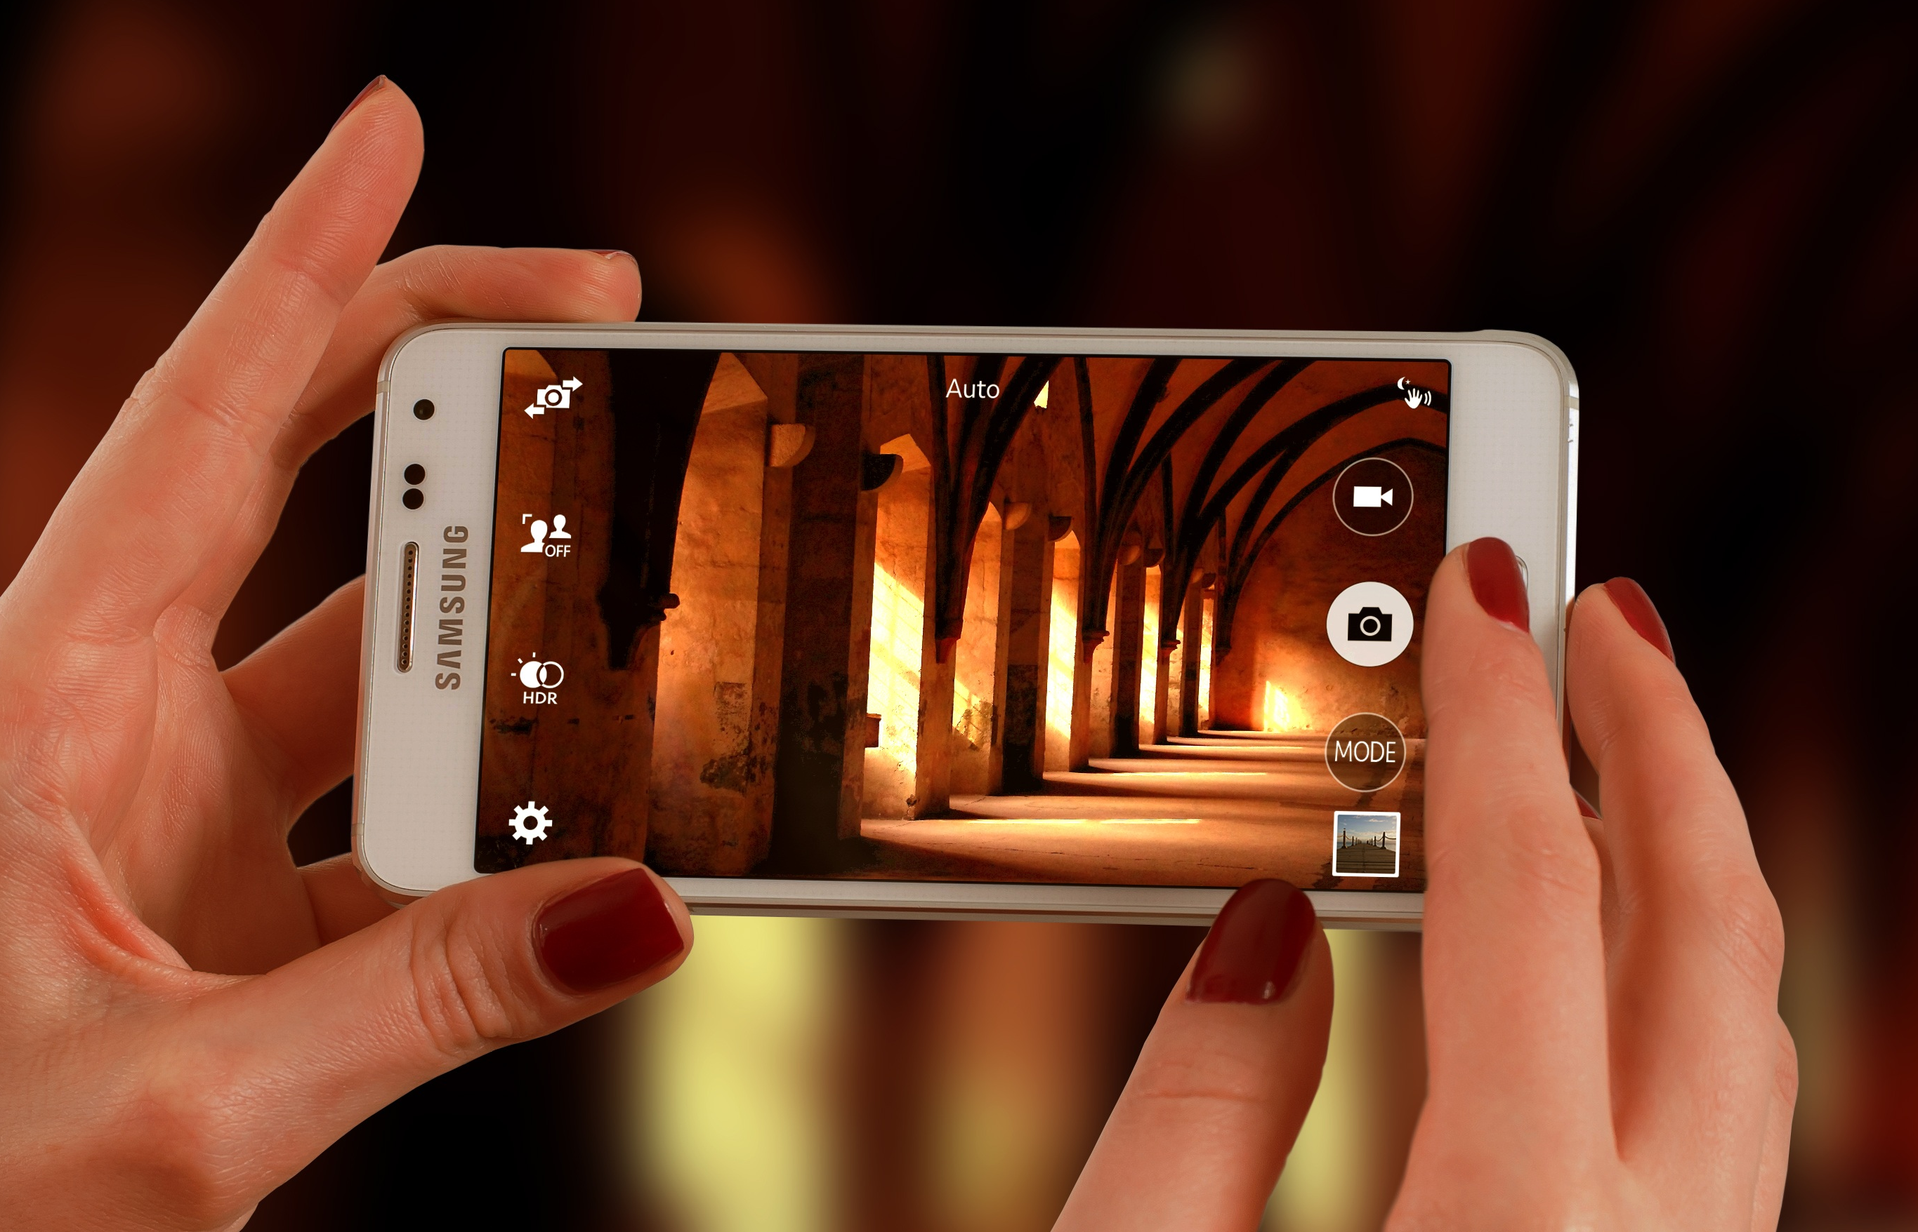
Snapshots from a Spiritual Journey
Notes:
This series uses the Revised Standard Version of the Bible.
Copyright © 2000-2021. All rights reserved. Bible Point is a registered trademark of Dennis Henderson. All other trademarks acknowledged.
Bible Point contains graphics from Bible Point artists. These illustrations belong to Bible Point and the respective artists. You may use the designs and illustrations for graphical illustration of lessons free and without special permission, provided they are not used in any way that maligns the Christian faith. Furthermore, republication or production of any illustration by any other graphic service whether it be in book, in a machine-readable form, or in any other design resource is strictly prohibited. Furthermore, they cannot be duplicated or resold as any other form of publishing, clip art, or graphic resource.
So What does it mean? (A simple translations of the legal jargon)
So, if you don’t own the presentation(s), graphic(s), and text(s) how can you legally use them? The purchase of the license allows you to use all the images in the product. However, the actual ownership and copyright of the presentation(s), graphic(s), and text(s) remain the property of Bible Point and its licensors. If you had plans on using this product in your “for sale” work—think again!
License Agreement
Article 1: License Grant
All the graphics and text in Bible Point presentations (excluding quotes from the Bible and stated sources) are the intellectual and real property of Bible Point and its licensors, and is protected by law, including United States copyright laws and international treaties. Bible Point grants to you a license:
1. To use the presentation in a single church, single school, or single office of a Christian organization.
2. To make a single archival back-up copy of the program.
3. To modify the presentation(s) and merge with other presentations in a single church, school, or Christian organization.
4. To transfer to another party if that party agrees to accept the terms and conditions of this agreement, and you do not retain any copies of the presentation, whether printed, machine readable, modified, or merged form.
Article 2: Terms
This license is effective until terminated. You may terminate the license at any time by destroying the presentation(s), graphic(s), or text(s) together with all copies, modifications and merged portions in any form. Bible Point may terminate your license if you fail to comply with this Agreement. You agree, upon such termination, for any reason, to destroy the presentation(s), graphics, and text(s) with all copies, modifications, and merged portions in any form.
Article 3: Disclaimers
1. Bible Point presentations, graphics, and texts are licensed to you As Is. You, the consumer, bear the entire risk relating to the quality and performance of the presentation(s), graphic(s), or text(s). In no event will Bible Point be liable for damages resulting from any defect.
2. Thirty-day limited warrantee on disks. Bible Point warrants the disks to be free of defects in material and workmanship under normal use for 30 days after purchase. During the 30-day period you may return a defective presentation, graphic, or text with proof of purchase and it will be replaced without charge, unless the presentation is damaged by misuse.
Article 4: General
1. You may not sub-license, assign, or transfer the license of the presentation(s), graphic(s), or text(s) except as provided by this Agreement.
2. This Agreement will be governed by the laws of the State of Michigan.
So What does it mean? (A simple translations of the legal jargon)
May I let someone borrow or copy my licensed Bible Point presentation (even after I modified it)? As long as it is within your local church, or single school, or the immediate office of a Christian organization you may. Otherwise, please refer the person interested in borrowing to: http://www.biblepoint.com or E-mail: dh@biblepoint.com with any related questions.

Slide 2
You Don’t Get to Pick Your FAMILY

Slide 3
You Don’t Get to Pick Your FAMILY
In Fact ...

Slide 4
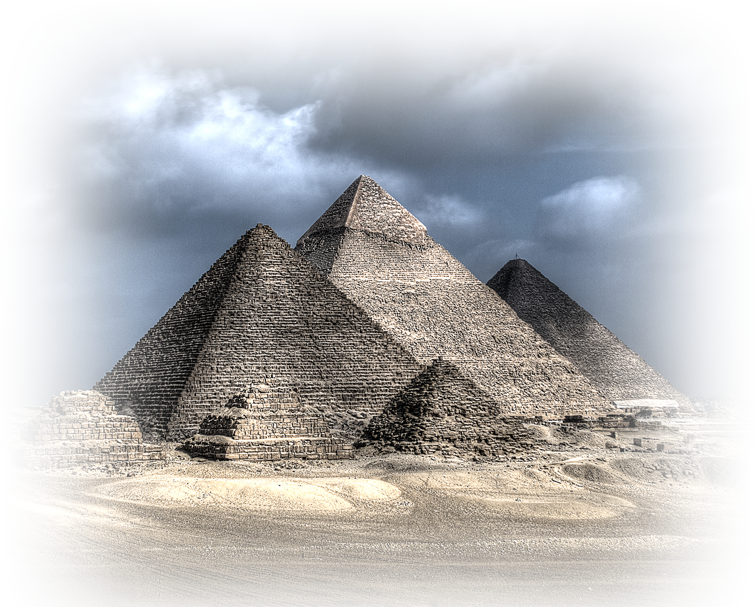
You don’t get to pick your PLACE OF BIRTH
¹ These are the names of the sons of Israel who came to Egypt with Jacob, ... ⁵ The total number of people born to Jacob was seventy. Joseph was already in Egypt. ⁶ Then Joseph died, and all his brothers, and that whole generation.
Notes:
Pyramids = FREE = https://en.wikipedia.org/wiki/Egypt#/media/File:Giza_Necropolis.jpg

Slide 5
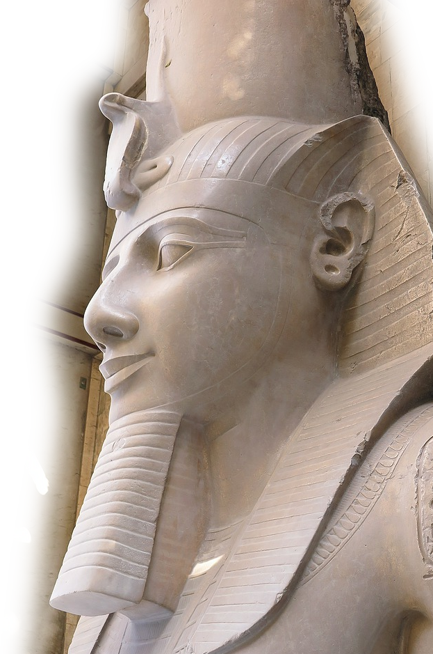
You don’t get to pick your CIRCUMSTANCES
⁸ Now a new king arose over Egypt, who did not know Joseph. ⁹ He said to his people, "Look, the Israelite people are more numerous and more powerful than we. ¹⁰ Come, let us deal shrewdly with them, ...
¹⁴ and made their lives bitter ....
Notes:
Ramses = FREE = https://pixabay.com/en/memphis-egypt-ramses-ii-pharaoh-582002/

Slide 6
You don’t get to pick your CIRCUMSTANCES
¹⁵ The king of Egypt said to the Hebrew midwives, ... "When you ... see them on the birthstool, if it is a boy, kill him; but if it is a girl, she shall live." ²² Then Pharaoh commanded all his people, "Every boy that is born to the Hebrews you shall throw into the Nile, but you shall let every girl live."

Slide 7
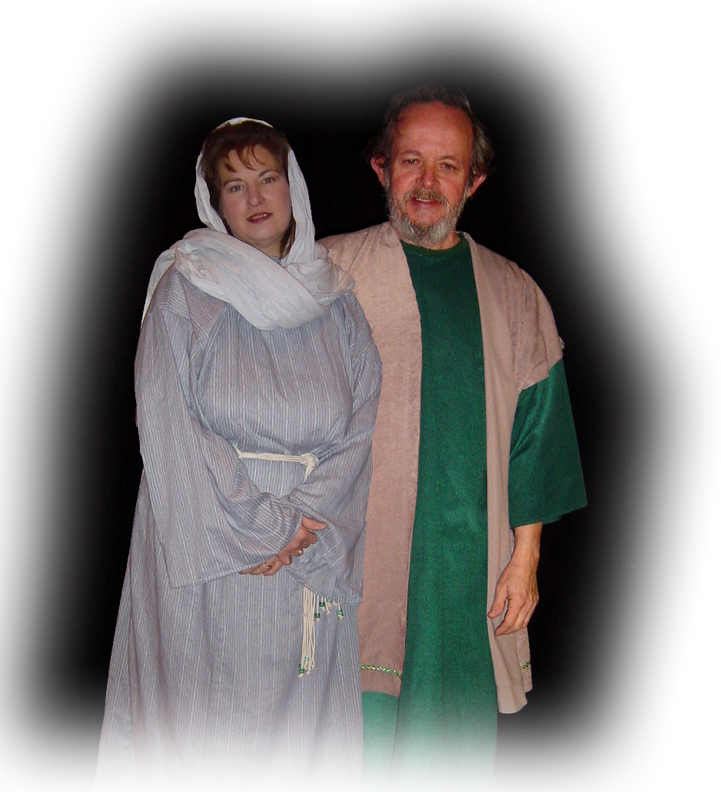
You don’t get to pick your PARENTS
¹ Now a man from the house of Levi went and married a Levite woman. ² The woman conceived and bore a son; and when she saw that he was a fine baby, she hid him three months.
²⁰ Amram married Jochebed his father's sister and she bore him Aaron and Moses,
Notes:
Couple = FREE = BiblePoint photos
They were godly parents:
²³ By faith Moses was hidden by his parents for three months after his birth, because they saw that the child was beautiful; and they were not afraid of the king's edict. (Heb 11:23 NRS)

Slide 8
You don’t get to pick your PARENTS
¹ Now a man from the house of Levi went and married a Levite woman. ² The woman conceived and bore a son; and when she saw that he was a fine baby, she hid him three months.
Notes:
Couple = FREE = BiblePoint photos
They were godly parents:
²³ By faith Moses was hidden by his parents for three months after his birth, because they saw that the child was beautiful; and they were not afraid of the king's edict. (Heb 11:23 NRS)

Slide 9
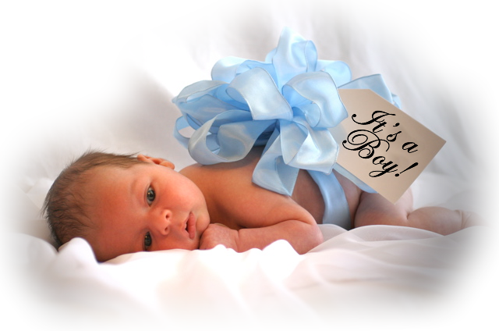
You don’t get to pick your GENDER
^{2:1} Now a man from the house of Levi went and married a Levite woman. ² The woman conceived and bore a son;
Notes:
Baby boy = FREE = https://commons.wikimedia.org/wiki/File:Baby_boy,_one_month_old.jpg
Watch out for those who distort the truth. God determines your gender. We live in confusing times in the world. They call men women, women men. How do you know what you are? Your DNA tells you—you don’t choose it—God assigns it.
Listen to what God says,
²⁰ Woe to those who call evil good and good evil, who put darkness for light and light for darkness, who put bitter for sweet and sweet for bitter. (Isa 5:20 NIV)
²⁵ Therefore the LORD's anger burns against his people; his hand is raised and he strikes them down. (Isa 5:25 NIV)

Slide 10
You don’t get to pick your GENDER
Woe to those who call evil good and good evil, who put darkness for light and light for darkness, who put bitter for sweet and sweet for bitter. (Isaiah 5:20 NIV)
Notes:
Baby boy = FREE = https://commons.wikimedia.org/wiki/File:Baby_boy,_one_month_old.jpg
Watch out for those who distort the truth. God determines your gender. We live in confusing times in the world. They call men women, women men. How do you know what you are? Your DNA tells you—you don’t choose it—God assigns it.
Listen to what God says,
²⁰ Woe to those who call evil good and good evil, who put darkness for light and light for darkness, who put bitter for sweet and sweet for bitter. (Isa 5:20 NIV)
²⁵ Therefore the LORD's anger burns against his people; his hand is raised and he strikes them down. (Isa 5:25 NIV)

Slide 11
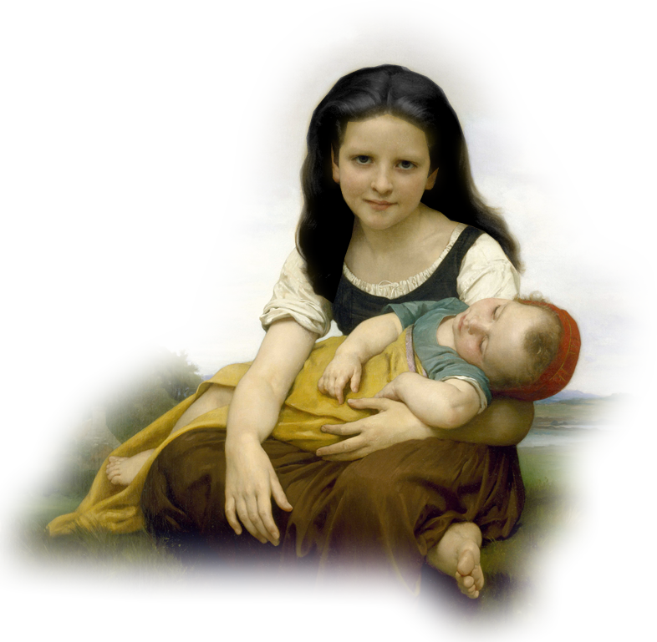
You don’t get to pick your SIBLINGS
³ When she could hide him no longer she got a papyrus basket for him, and plastered it with bitumen and pitch; she put the child in it and placed it among the reeds on the bank of the river.
⁴ His sister stood at a distance, to see what would happen to him.
Notes:
Big sister & Moses = FREE = from https://en.wikipedia.org/wiki/The_Elder_Sister#/media/File:William_Bouguereau_-_The_Elder_Sister_-_Google_Art_Project.jpg
You don’t even get to pick your birth order. Firstborn, middle child, baby.

Slide 12
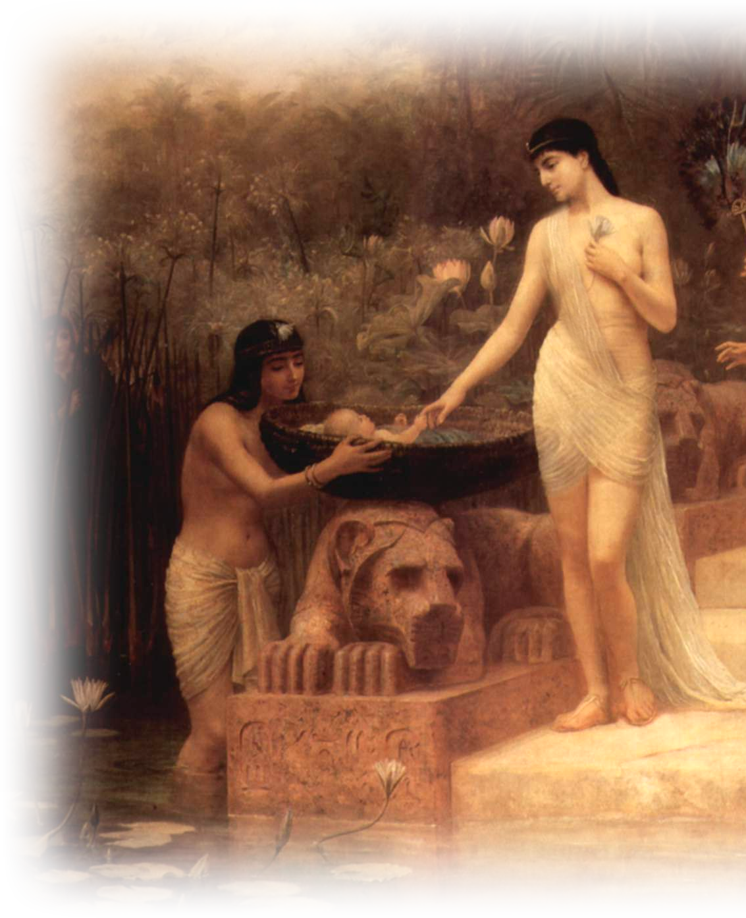
You don’t get to pick your ADOPTION
⁵ The daughter of Pharaoh came down to bathe at the river.... She saw the basket among the reeds and sent her maid to bring it.
⁶ When she opened it, she saw the child. He was crying, and she took pity on him, "This must be one of the Hebrews' children," she said.
Notes:
Pharaoh Daughter = FREE = https://en.wikipedia.org/wiki/Shemot_(parsha)#/media/File:Edwin_Long_002.jpg

Slide 13
You don’t get to pick your ADOPTION
⁷ Then his sister said to Pharaoh's daughter, "Shall I go and get you a nurse from the Hebrew women to nurse the child for you?"
⁸ Pharaoh's daughter said to her, "Yes." So the girl went and called the child's mother.

Slide 14
You don’t get to pick your ADOPTION
⁹ Pharaoh's daughter said to her, "Take this child and nurse it for me, and I will give you your wages." So the woman took the child and nursed it.
¹⁰ When the child grew up, she brought him to Pharaoh's daughter, and she took him as her son.

Slide 15
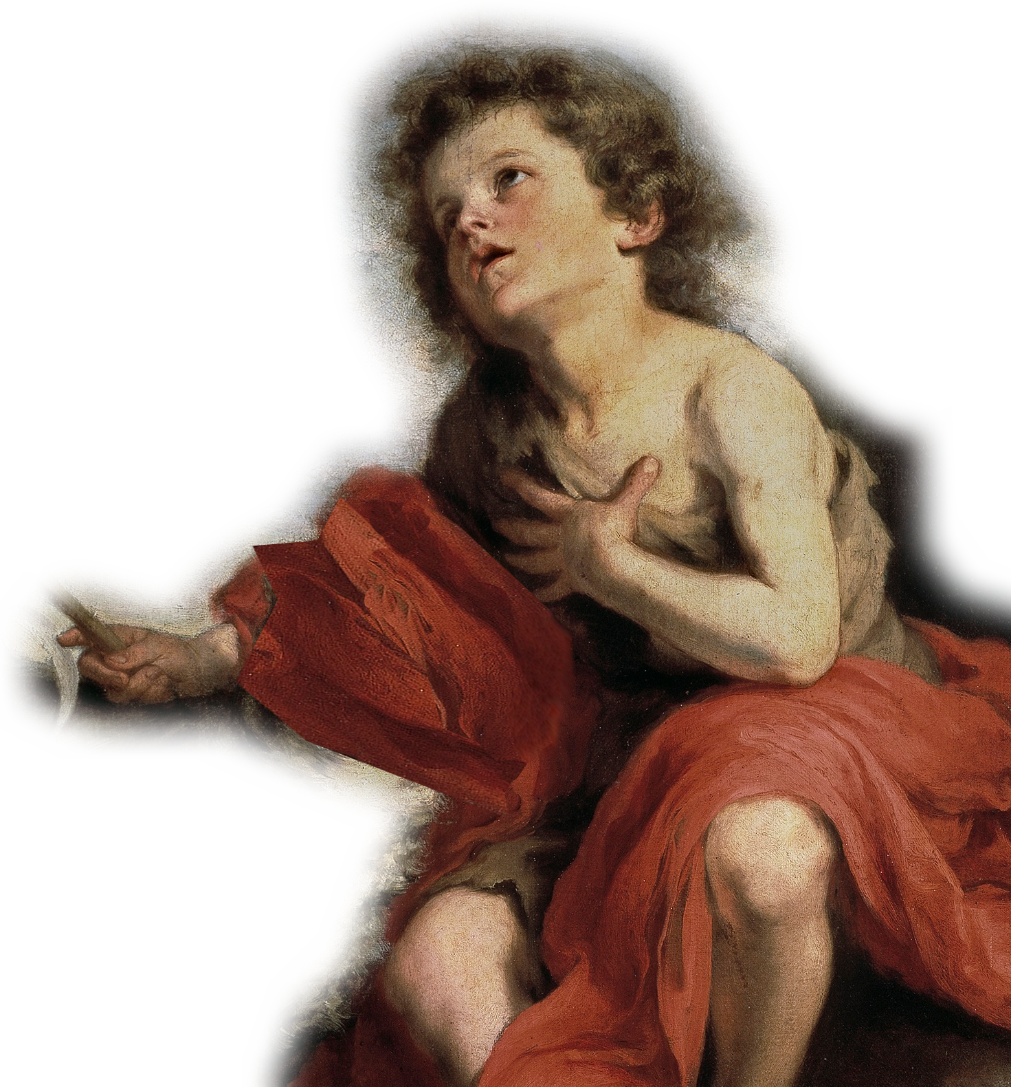
You don’t get to pick your CHILDHOOD
⁹ Pharaoh's daughter said to her, "Take this child and nurse it for me, and I will give you your wages." So the woman took the child and nursed it.
¹⁰ When the child grew up, she brought him to Pharaoh's daughter, and she took him as her son.
Notes:
Children don’t get to drive to church—it’s the parents that bring them. My parents, etc.

Slide 16
You don’t get to pick your NAME
¹⁰ When the child grew up, she brought him to Pharaoh's daughter, and she took him as her son. She named him Moses, "because," she said, "I drew him out of the water."
Notes:
The Egyptian hieroglyphic ms can be the noun "child" or the perfective verb "be born." This was often connected with divine elements for names: Ptah-mose, "Ptah is born." Also the name Rameses (R'-m-sw) means "[the god] Re' is he who has born him."
"You called him 'born one’ in your [Egyptian] language and after your custom, but in our [Hebrew] language that name means 'drawing out' – which is what was to become of him. You drew him out of the water, but he would draw us out of Egypt through the water." So the circumstances of the story show Moses to be a man of destiny, and this naming episode summarizes how divine providence was at work in Israel. To the Israelites the name forever commemorated the portent of this event in the early life of the great deliverer (see Isa 63:11).
Could she have said something like, “I birthed him out of the Nile/water” which came over into Hebrew as “I drew him out of the water’. ????
Story of Philippines praying for: Appo Juus = Apple Juice = but really in Ilocano it meant “Lord God”
The pastor told me his wife’s name was “Irene” but all I ever heard him call her was” Mahal.” etc.
My name is “Dennis” from Greek goddess “Dionesius.” = goddess of drunkenness revelry and debauchery.
I didn’t get to pick my name.

Slide 17
Here’s the point!
Don’t Get to PICK ...
BIRTHDAY
GENDER
FAMILY
CIRCUMSTANCES
ADOPTION

Slide 18
Here’s the point!
Don’t Get to PICK ...
BIRTHDAY
GENDER
FAMILY
CIRCUMSTANCES
ADOPTION
HOWEVER, You DO get to pick your ...

Slide 19
HOWEVER, You DO get to pick your ... LOYALTIES
¹¹ One day, after Moses had grown up, he went out to his people and saw their forced labor. He saw an Egyptian beating a Hebrew, one of his kinsfolk.
Notes:
Star of David = FREE = https://www.flickr.com/photos/zeevveez/6388408153
⁴⁶ While he was still speaking to the crowds, his mother and his brothers were standing outside, wanting to speak to him.
⁴⁷ Someone told him, "Look, your mother and your brothers are standing outside, wanting to speak to you."
⁴⁸ But to the one who had told him this, Jesus replied, "Who is my mother, and who are my brothers?"
⁴⁹ And pointing to his disciples, he said, "Here are my mother and my brothers!
⁵⁰ For whoever does the will of my Father in heaven is my brother and sister and mother."
(Mat 12:46-1 NRS)

Slide 20
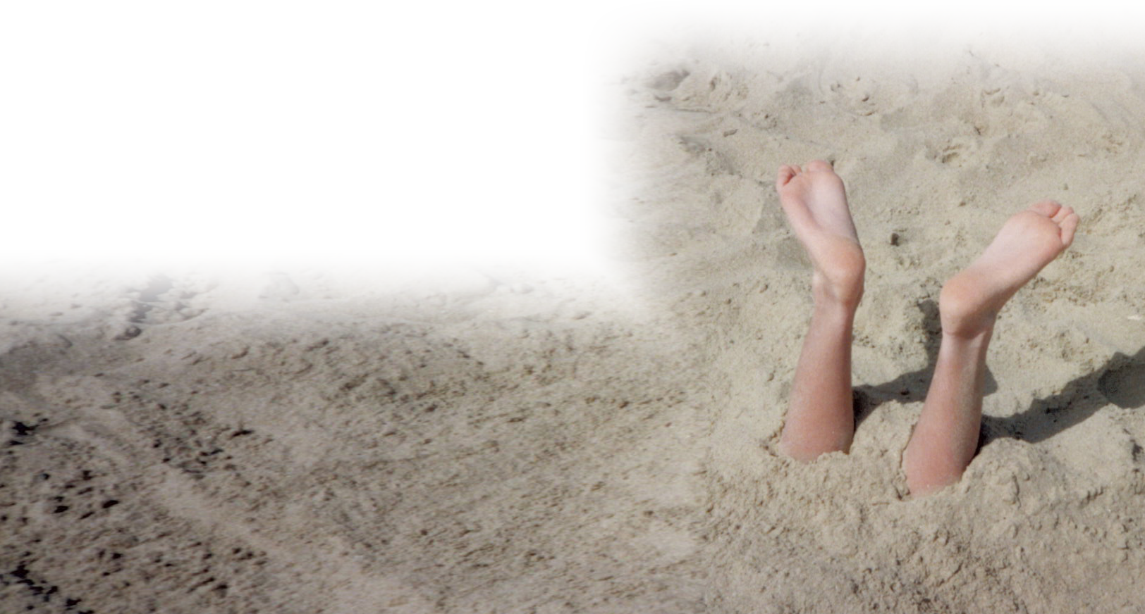
HOWEVER, You DO get to pick your ... ACTIONS
¹² He looked this way and that, and seeing no one he killed the Egyptian and hid him in the sand.
Notes:
Feet sticking out of sand = FREE = https://www.flickr.com/photos/hodgers/2233177410

Slide 21
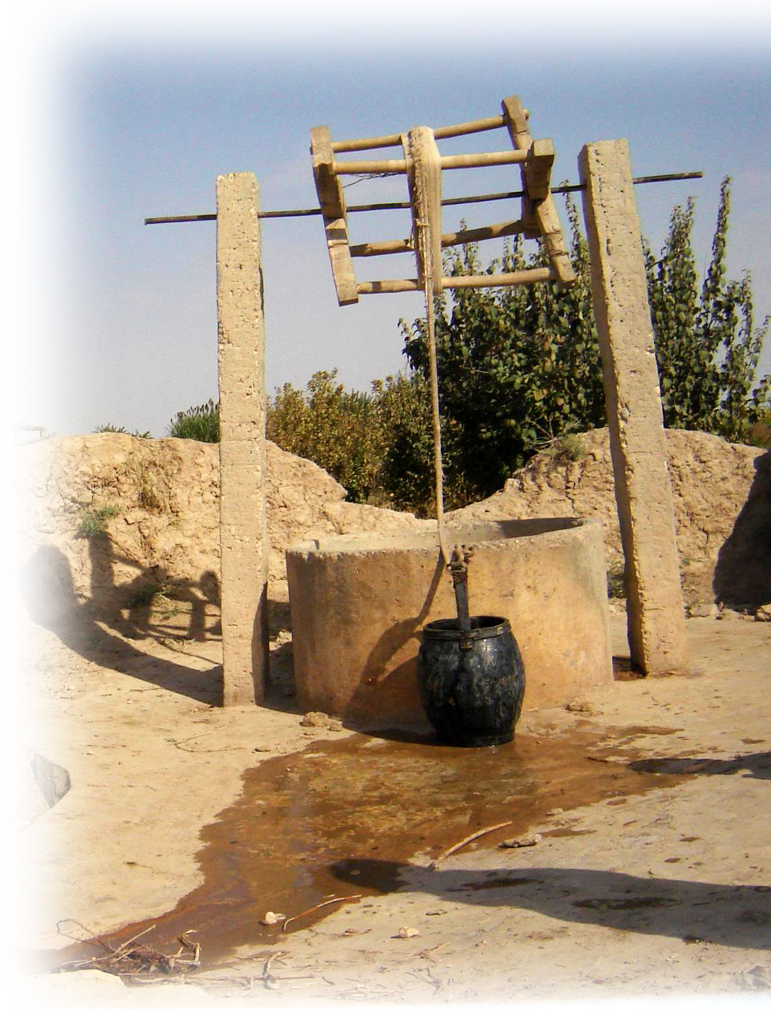
HOWEVER, You DO get to pick your ... REACTIONS
¹⁵ When Pharaoh heard of it, he sought to kill Moses. But Moses fled from Pharaoh. He settled in the land of Midian, and sat down by a well.
Notes:
Well = FREE = https://en.wikipedia.org/wiki/Water_well#/media/File:Faryab-_village_dug_well.JPG
²⁴ By faith Moses, when he was grown up, refused to be called a son of Pharaoh's daughter,
²⁵ choosing rather to share ill-treatment with the people of God than to enjoy the fleeting pleasures of sin.
²⁶ He considered abuse suffered for the Christ to be greater wealth than the treasures of Egypt, for he was looking ahead to the reward. (Heb 11:24-26 NRS)

Slide 22
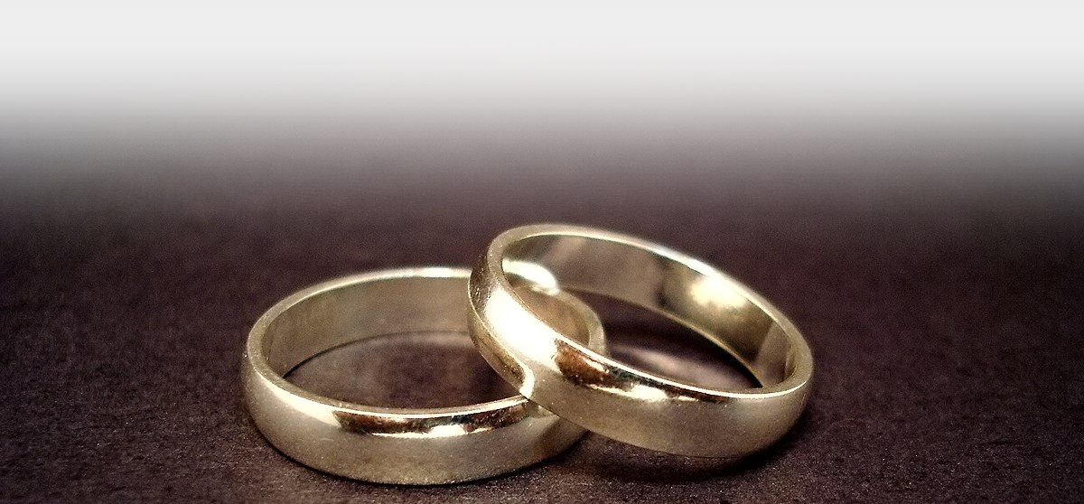
HOWEVER, You DO get to pick your ... SPOUSE
²¹ Moses agreed to stay with the man, and he gave Moses his daughter Zipporah in marriage
Notes:
Rings = free = https://commons.wikimedia.org/wiki/File:Wedding_rings.jpg

Slide 23
HOWEVER, You DO get to pick your ... FAITH
²³ After ... the king of Egypt died. The Israelites groaned under their slavery, and cried out ... to God. ²⁴ God heard their groaning, and God remembered his covenant with Abraham, Isaac, and Jacob. ²⁵ God looked upon the Israelites, and God took notice of them.
(Exo 2:23-1 NRS)

Slide 24
What have we learned?

Slide 25
What have we learned?
Don’t Get to PICK ...
BIRTHDAY
GENDER
FAMILY
CIRCUMSTANCES
ADOPTION

Slide 26
What have we learned?
Don’t Get to PICK ...
BIRTHDAY
GENDER
FAMILY
CIRCUMSTANCES
ADOPTION
Do Get to PICK ...
LOYALTIES
ACTIONS
REACTIONS
SPOUSE
FAITH

Slide 27
What have we learned?
Don’t Get to PICK ...
BIRTHDAY
GENDER
FAMILY
CIRCUMSTANCES
ADOPTION
Do Get to PICK ...
LOYALTIES
ACTIONS
REACTIONS
SPOUSE
FAITH
Point: You need to know the difference

Slide 28
The Serenity Prayer
God, grant me the serenity to accept the things I cannot change,
courage to change the things I can,
and wisdom to know the difference.
Amen!
Notes:
Praying hands = FREE = https://www.flickr.com/photos/angel_ina/4172014067
Serenity Prayer =
authored by the American theologian Reinhold Niebuhr (1892–1971)

Slide 29
Summed Up
²⁴ By faith Moses, when he was grown up, refused to be called a son of Pharaoh's daughter,
²⁵ choosing rather to share ill-treatment with the people of God than to enjoy the fleeting pleasures of sin.
(Hebrews 11:24-25)
Notes:
My paraphrase = “Choosing to share ill-treatment with God’s people than POLITICAL CORRECTNESS of our generation!

Slide 30
Summed Up
²⁴ By faith Moses, when he was grown up, refused to be called a son of Pharaoh's daughter,
²⁵ choosing rather to share ill-treatment with the people of God than to enjoy the fleeting pleasures of sin.
(Hebrews 11:24-25)
So CHOOSE WISELY!
Notes:
My paraphrase = “Choosing to share ill-treatment with God’s people than POLITICAL CORRECTNESS of our generation!

Slide 31
Let’s Pray

