Slide 1
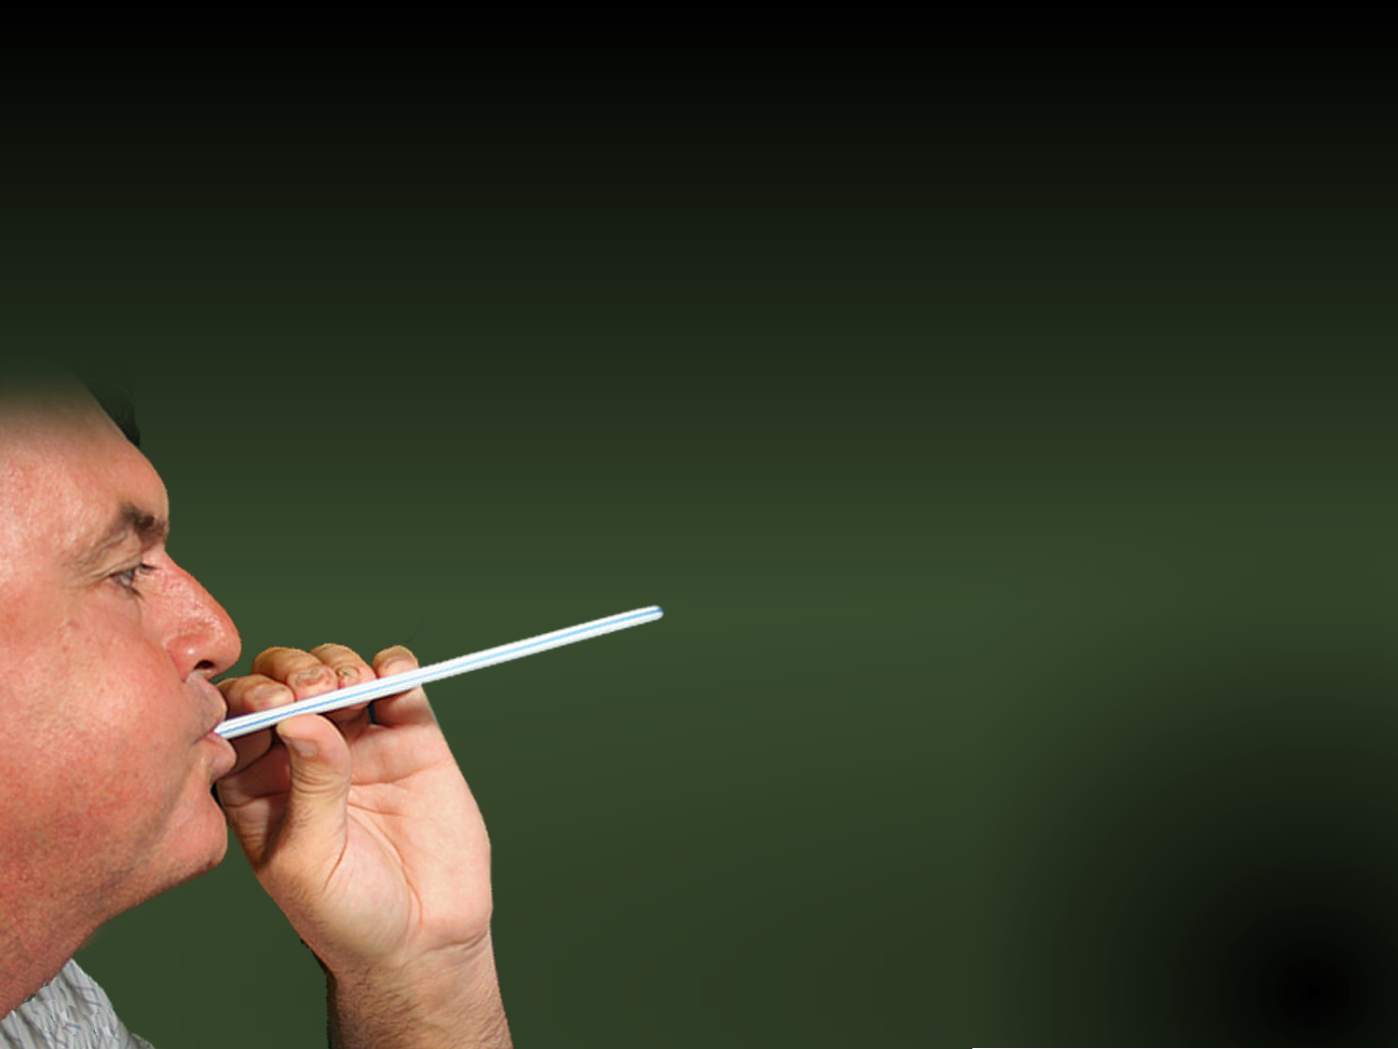
Holding Off the
Forces of Evil with a
P-SHOOTER
Ephesians 6:10-24
Notes:
P-Shooter Background = LICENSED and NOT FOR REUSE elsewhere. To reuse elsewhere get a licenses from http://www.bigstockphoto.com/image-1515436/stock-photo-breath-test-machine-
Copyright © 2006−2020. All rights reserved. Bible Point is a registered trademark of Dennis Henderson. All other trademarks acknowledged.
Bible Point contains graphics from Bible Point artists. These illustrations belong to Bible Point and the respective artists. You may use the designs and illustrations for graphical illustration of lessons free and without special permission, provided they are not used in any way that maligns the Christian faith. Furthermore, republication or production of any illustration by any other graphic service whether it be in book, in a machine-readable form, or in any other design resource is strictly prohibited. Furthermore, they cannot be duplicated or resold as any other form of publishing, clip art, or graphic resource.
So What does it mean? (A simple translations of the legal jargon)
So, if you don’t own the presentation(s), graphic(s), and text(s) how can you legally use them? The purchase of the license allows you to use all the images in the product. However, the actual ownership and copyright of the presentation(s), graphic(s), and text(s) remain the property of Bible Point and its licensors. If you had plans on using this product in your “for sale” work—think again!
License Agreement
Article 1: License Grant
All the graphics and text in Bible Point presentations (excluding quotes from the Bible and stated sources) are the intellectual and real property of Bible Point and its licensors, and is protected by law, including United States copyright laws and international treaties. Bible Point grants to you a license:
1. To use the presentation in a single church, single school, or single office of a Christian organization.
2. To make a single archival back-up copy of the program.
3. To modify the presentation(s) and merge with other presentations in a single church, school, or Christian organization.
4. To transfer to another party if that party agrees to accept the terms and conditions of this agreement, and you do not retain any copies of the presentation, whether printed, machine readable, modified, or merged form.
Article 2: Terms
This license is effective until terminated. You may terminate the license at any time by destroying the presentation(s), graphic(s), or text(s) together with all copies, modifications and merged portions in any form. Bible Point may terminate your license if you fail to comply with this Agreement. You agree, upon such termination, for any reason, to destroy the presentation(s), graphics, and text(s) with all copies, modifications, and merged portions in any form.
Article 3: Disclaimers
1. Bible Point presentations, graphics, and texts are licensed to you As Is. You, the consumer, bear the entire risk relating to the quality and performance of the presentation(s), graphic(s), or text(s). In no event will Bible Point be liable for damages resulting from any defect.
2. Thirty-day limited warrantee on disks. Bible Point warrants the disks to be free of defects in material and workmanship under normal use for 30 days after purchase. During the 30-day period you may return a defective presentation, graphic, or text with proof of purchase and it will be replaced without charge, unless the presentation is damaged by misuse.
Article 4: General
1. You may not sub-license, assign, or transfer the license of the presentation(s), graphic(s), or text(s) except as provided by this Agreement.
2. This Agreement will be governed by the laws of the State of Michigan.
So What does it mean? (A simple translations of the legal jargon)
May I let someone borrow or copy my licensed Bible Point presentation (even after I modified it)? As long as it is within your local church, or single school, or the immediate office of a Christian organization you may. Otherwise, please refer the person interested in borrowing to: http://www.biblepoint.com or E-mail: dennis@drdh.net with any related questions.

Slide 2
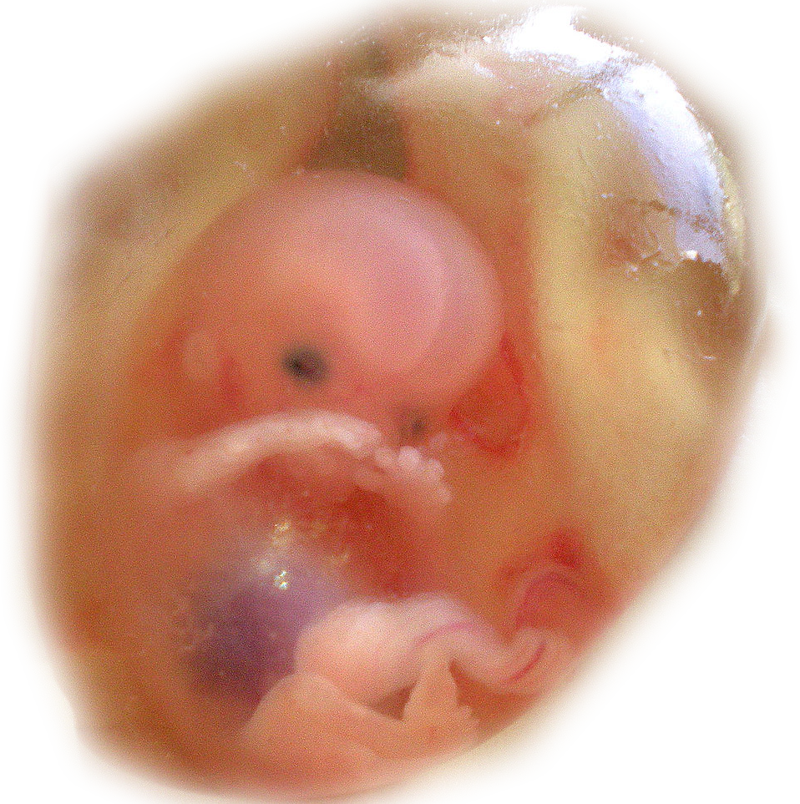

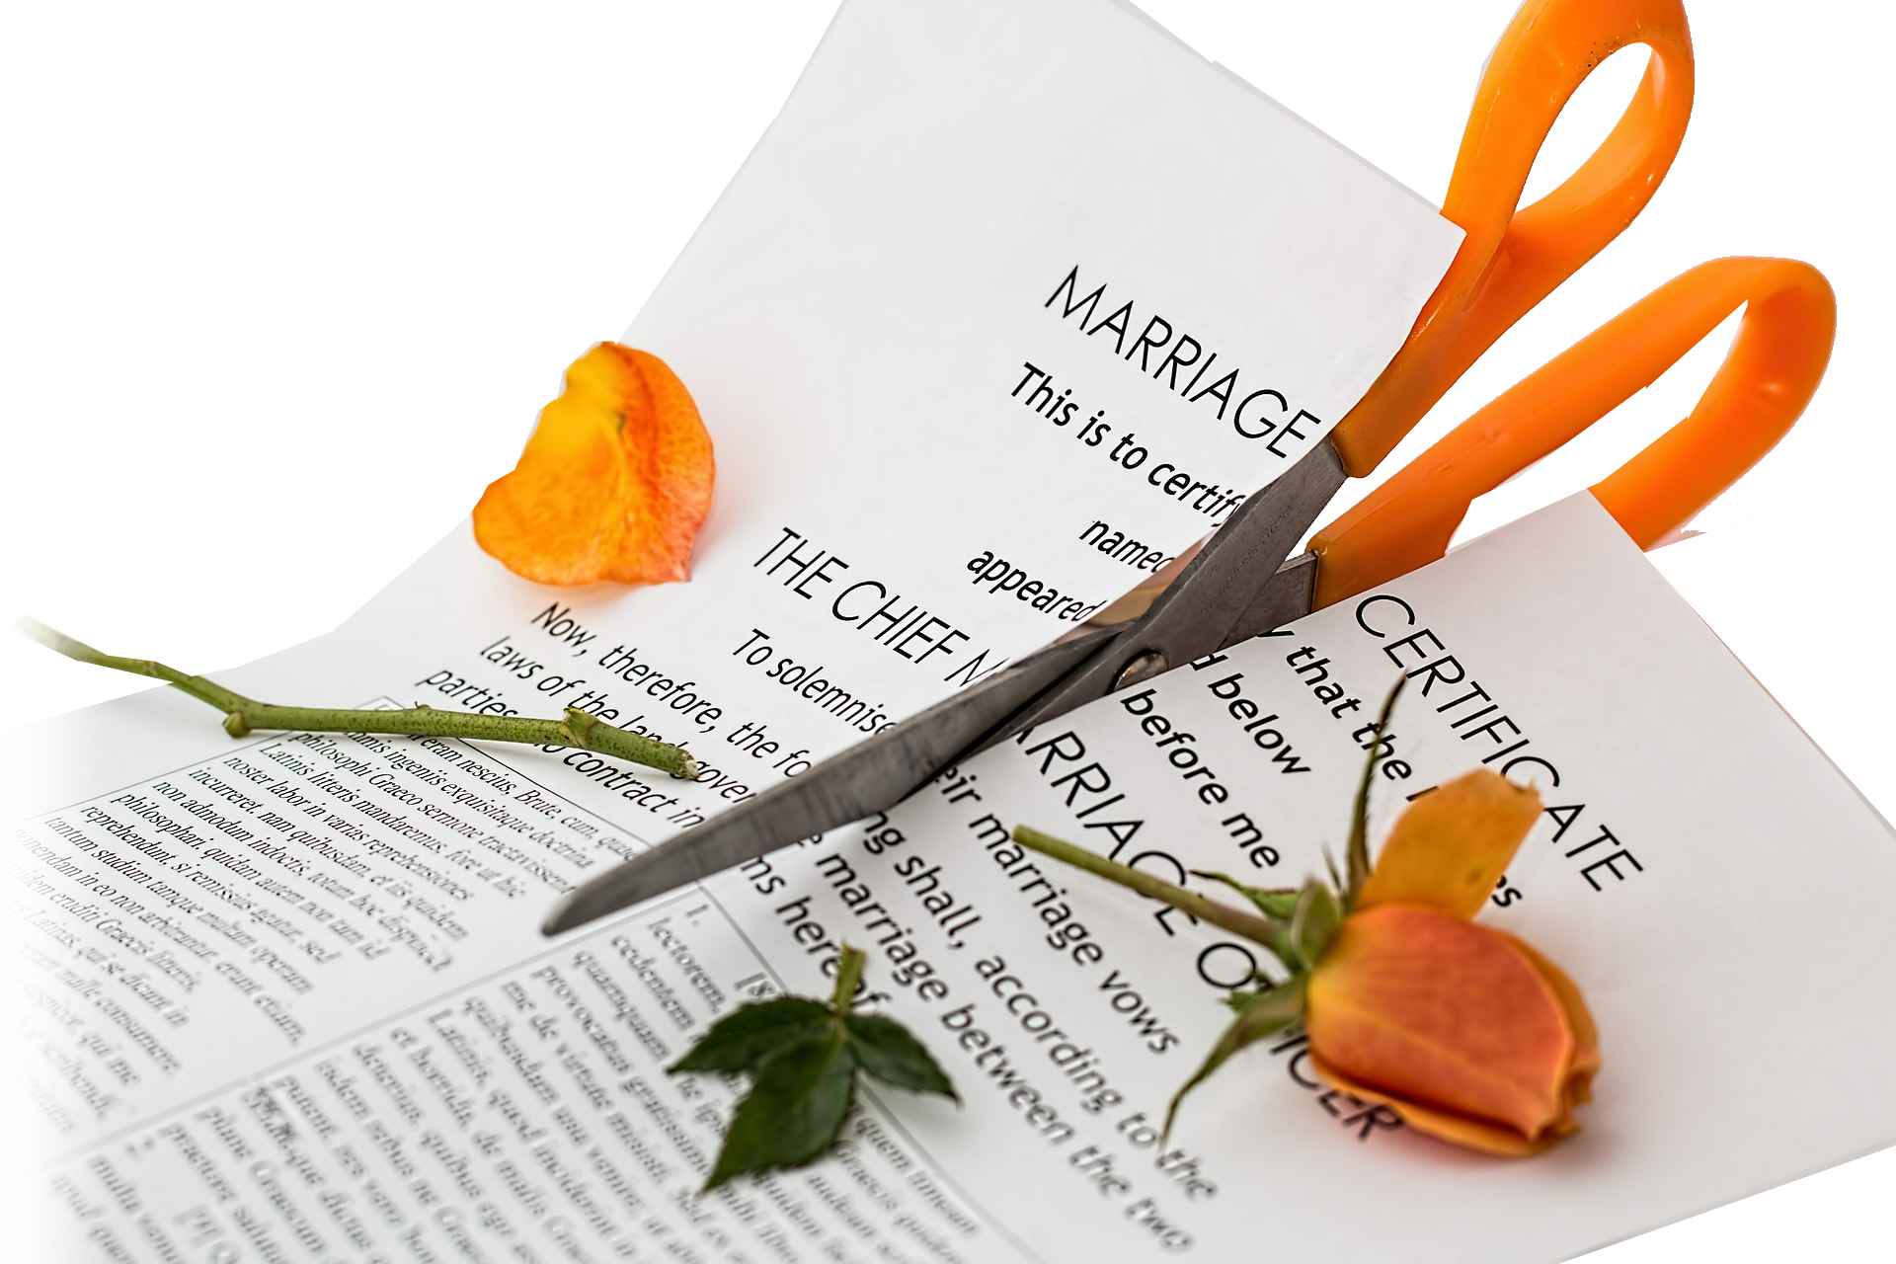
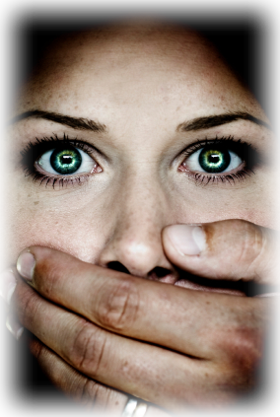
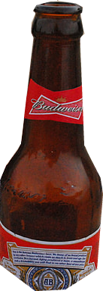

There is a Spiritual War going on
Notes:
https://pixabay.com/photos/divorce-separation-marriage-breakup-619195/

Slide 3
People are hurting
Wounded in a spiritual war
Bleeding from wounds of:
Infidelity - Separation - Divorce
Abuse - Addictions - Gender Confusion
Many wounded by yielding to temptation
But Jesus gives us the VICTORY
Notes:
P-Shooter Background = LICENSED and NOT FOR REUSE elsewhere. To reuse elsewhere get a licenses from http://www.bigstockphoto.com/image-1515436/stock-photo-breath-test-machine-

Slide 4
Still there are some things we must know
¹⁰ Finally, be strong in the Lord and in his mighty power.

Slide 5
We must…Know Our Enemy

Slide 6
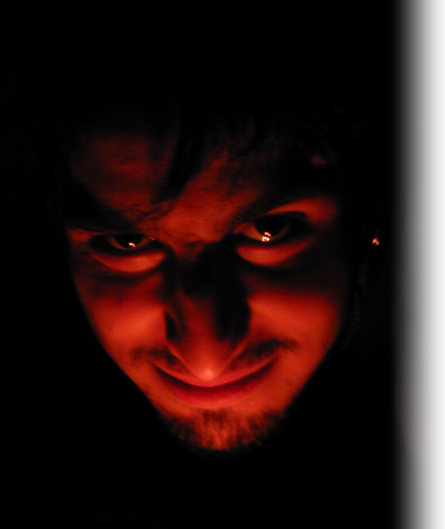
The Enemy’s Leader
¹¹ Put on the full armor of God so that you can take your stand against the devil's schemes.
Notes:
Devil = FREE = from http://www.sxc.hu/photo/229100

Slide 7
The Enemy’s Attacks ...
¹² For our struggle is not against flesh and blood, but against the rulers, against the authorities, against the powers of this dark world and against the spiritual forces of evil in the heavenly realms.
Notes:
Devil = FREE = from http://www.sxc.hu/photo/229100

Slide 8
It’s Invisible, but Real!
¹² For our struggle is not against flesh and blood, but against the rulers, against the authorities, against the powers of this dark world and against the spiritual forces of evil in the heavenly realms.
Notes:
Devil = FREE = from http://www.sxc.hu/photo/229100

Slide 9
It’s Organized!
¹² For our struggle is not against flesh and blood, but against the rulers, against the authorities, against the powers of this dark world and against the spiritual forces of evil in the heavenly realms.
Notes:
Devil = FREE = from http://www.sxc.hu/photo/229100

Slide 10
It’s Powerful!
¹² For our struggle is not against flesh and blood, but against the rulers, against the authorities, against the powers of this dark world and against the spiritual forces of evil in the heavenly realms.
Notes:
Devil = FREE = from http://www.sxc.hu/photo/229100

Slide 11
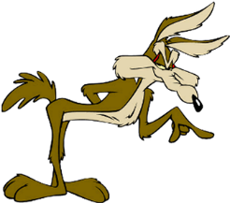
It’s Scheming!
“Wiles
of the devil”
¹¹ Put on the full armor of God so that you can take your stand against the devil's schemes.
“For we are not unaware of his schemes.” 2 Cor 2:11
Notes:
Devil = FREE = from http://www.sxc.hu/photo/229100

Slide 12
Scheming assault on Us
He lies
He casts doubt
He tempts
He murders
He entices
He beguiles
He slanders
He accuses
¹¹ Put on the full armor of God so that you can take your stand against the devil's schemes.
“For we are not unaware of his schemes.” 2 Cor 2:11
Notes:
Wile E Coyote = FREE = from http://www.flickr.com/photos/jdhancock/4313310098/sizes/o/in/photostream/
Devil = FREE = from http://www.sxc.hu/photo/229100

Slide 13
The point:
We must know our enemy!

Slide 14
We must … Know Our Selves

Slide 15
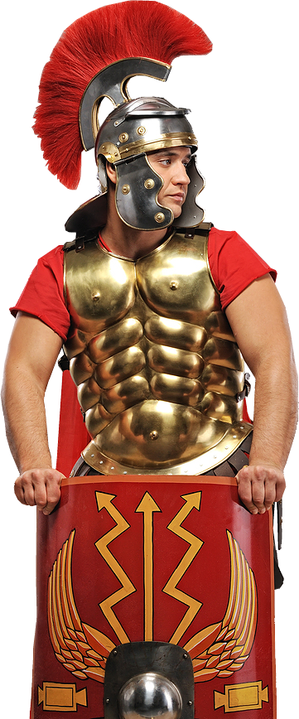
Our Responsibility … To Stand!
¹¹ Put on the full armor of God so that you can take your stand against the devil's schemes. ….
Notes:
Roman Soldier = LICENSED and NOT FOR REUSE elsewhere. To reuse elsewhere get a license from http://www.bigstockphoto.com/image-10896698/stock-photo-nice-portrait-of-a-legionary-soldier-in-armou

Slide 16
Our Responsibility … To Stand!
¹¹ Put on the full armor of God so that you can take your stand against the devil's schemes. …. ¹³ … so that when the day of evil comes, you may be able to stand your ground, and after you have done everything, to stand. ¹⁴ Stand …
To STAND
Notes:
Roman Soldier = LICENSED and NOT FOR REUSE elsewhere. To reuse elsewhere get a license from http://www.bigstockphoto.com/image-10896698/stock-photo-nice-portrait-of-a-legionary-soldier-in-armou

Slide 17
Our Responsibility… To Armor Up!
¹¹ Put on the full armor of God so that you can take your stand against the devil's schemes. …. ¹³ Therefore put on the full armor of God…
Armor Up ... Why?
Notes:
Roman Soldier = LICENSED and NOT FOR REUSE elsewhere. To reuse elsewhere get a license from http://www.bigstockphoto.com/image-10896698/stock-photo-nice-portrait-of-a-legionary-soldier-in-armou

Slide 18
Our Vulnerability …

Slide 19
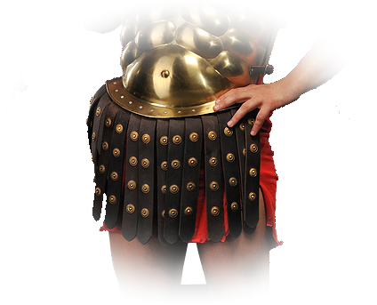
Our Belly is Vulnerable …
¹⁴ Stand firm then, with the belt of truth buckled around your waist,
Notes:
Roman Soldier = LICENSED and NOT FOR REUSE elsewhere. To reuse elsewhere get a license from http://www.bigstockphoto.com/image-10841738/stock-photo-roman-legionary-soldie

Slide 20
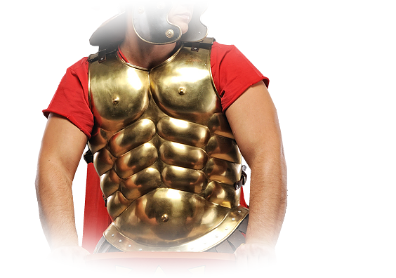
Our Heart is Vulnerable …
¹⁴ Stand firm then, with the belt of truth buckled around your waist, with the breast-plate of righteousness in place,
Notes:
Roman Soldier = LICENSED and NOT FOR REUSE elsewhere. To reuse elsewhere get a license from http://www.bigstockphoto.com/image-10896698/stock-photo-nice-portrait-of-a-legionary-soldier-in-armou

Slide 21
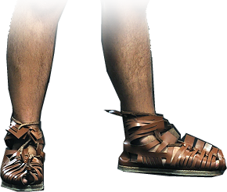
Our Feet are Vulnerable...
¹⁵ and with your feet fitted with the readiness that comes from the gospel of peace.
Notes:
Roman soldier = LICENSED and NOT FOR REUSE elsewhere. To reuse elsewhere get a license from http://www.bigstockphoto.com/image-10841738/stock-photo-roman-legionary-soldie

Slide 22
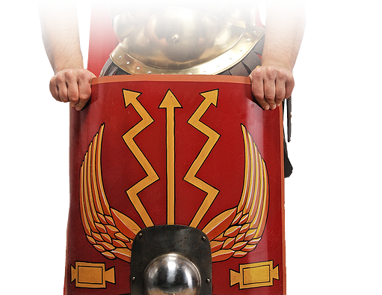
Our Bodies are Vulnerable…
¹⁶ In addition to all this, take up the shield of faith,
Notes:
Roman soldier = LICENSED and NOT FOR REUSE elsewhere. To reuse elsewhere get a license from http://www.bigstockphoto.com/image-10841738/stock-photo-roman-legionary-soldie

Slide 23
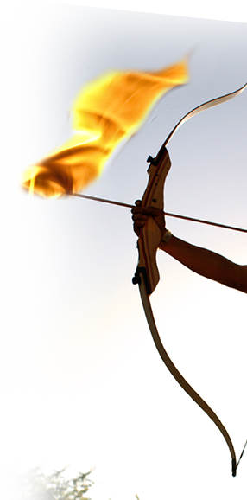
Our Bodies are Vulnerable…
with which you can extinguish all
the flaming
arrows of the
evil one.
Notes:
Roman soldier = LICENSED and NOT FOR REUSE elsewhere. To reuse elsewhere get a license from http://www.bigstockphoto.com/image-10841738/stock-photo-roman-legionary-soldie
Fire Arrow – Modified = FREE = from http://www.sxc.hu/browse.phtml?f=download&id=595948

Slide 24
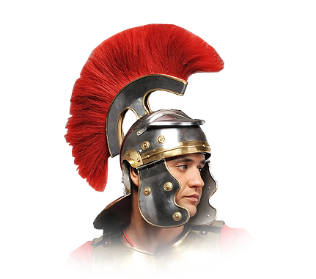
Our Head is Vulnerable…
¹⁷ Take the helmet of salvation and the sword of the Spirit, which is the word of God.
Notes:
Roman Soldier = LICENSED and NOT FOR REUSE elsewhere. To reuse elsewhere get a license from http://www.bigstockphoto.com/image-10896698/stock-photo-nice-portrait-of-a-legionary-soldier-in-armou

Slide 25
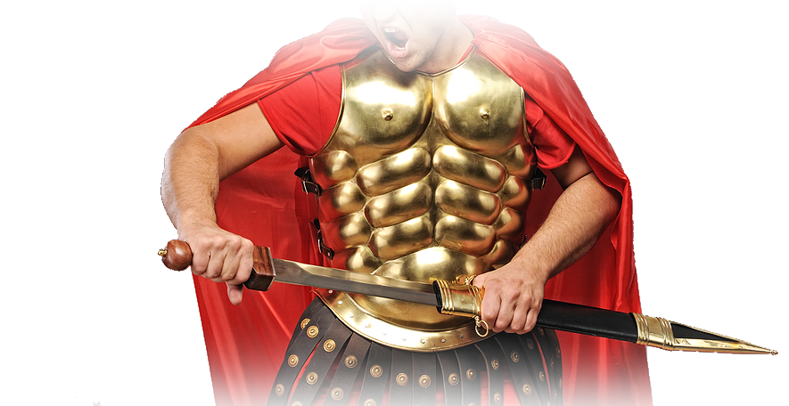
Our Hands are Vulnerable…
¹⁷ Take the helmet of salvation and the sword of the Spirit, which is the word of God.
Notes:
Roman Soldier = LICENSED and NOT FOR REUSE elsewhere. To reuse elsewhere get a license from http://www.bigstockphoto.com/image-10896713/stock-photo-handsome-legionary-soldier-ready-for-a-wa

Slide 26
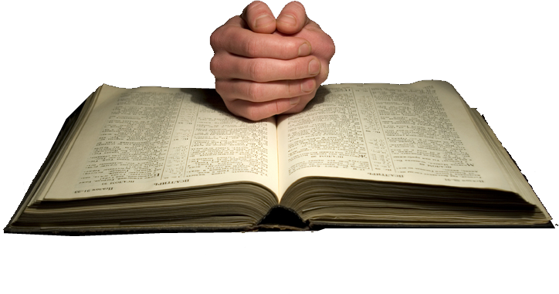
Our Hands are Vulnerable…
¹⁷ Take the helmet of salvation and the sword of the Spirit, which is the word of God.
Notes:
Roman Soldier = LICENSED and NOT FOR REUSE elsewhere. To reuse elsewhere get a license from http://www.bigstockphoto.com/image-10896713/stock-photo-handsome-legionary-soldier-ready-for-a-wa

Slide 27
We must … Know Our Selves

Slide 28
We Must … Know Our God
The Word tells us of Him …
Notes:
Bible = LICENSED and NOT FOR REUSE elsewhere. To reuse elsewhere get a license from http://www.dreamstime.com/item.php?imageid=4229424

Slide 29
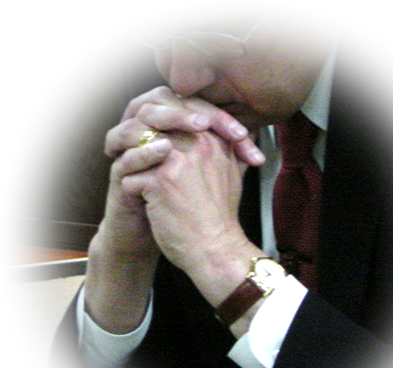
We Must … Know Our God
The Word tells us of Him …
But it is through P-RAYER that we come to know HIM!
Notes:
Man Praying = FREE = from BiblePoint photos.

Slide 30
How Should We P-RAY

Slide 31
Pray in the Spirit
¹⁸ And pray in the Spirit on all occasions with all kinds of prayers and requests. With this in mind, be alert and always keep on praying for all the saints.
¹⁹ Pray also for me,
Notes:
Man Praying = FREE = from BiblePoint photos.
Dear Pastor Dennis,
Reference to our today discussion, I promised you to share my a brief story bout what was happening during our US Oil & Gas Company - Annual General Meeting-(AGM) in November/20/2018 in Dublin.
I’d like to call it “the miracle of Dublin”. It's a testimony of a belief that just recently started to overtake my vision in faith and the power of the unseen, and now that I experienced it, I would like to share it with the world. Our faith in the unseen is perhaps the most important part of our very existence of living.
On the month of November 20 in 2018, we had a very important presentations that occupied all our time and effort, several months prior to the meeting as board members.
A little background about me, I worked all my life in oil and gave everything I had from my youth till my old age to my work. This meeting was one of the most important meeting that took place since we decided to have investors invest in our ideas and work ethics, and we have been struggling to show up due to our physical condition, basically it was overdue and it was delayed several times prior to this event.
Fast forward to the meeting, 4 pm after we were on stage convincing over 200 shareholders to believe in us something strange happened. In the midst of discussion, a voice comes from the crowd echoing to the front of the room, taking all the attention to the back. A man was losing his life, taking his last breath and surrounded by people that had no power to help. Everyone called it a heart-attack (or stroke) and an Ambulance was on its way.
I saw this helpless man, and for the first time in my life felt like I can run to the back of the room with my rheumatoid arthritis and feel no pain, a voice told me to put my hand on his heart, when I got there I saw a man lying on his right-side without a breath, completely silent as if death has come to him suddenly. the same voice returned and told me to pray, so I kneeled and put my hand on his heart, not noticing my gestures I spoke loudly and said “I have nothing to give you but Jesus and I said, “in Christ’s name you are healed” within a blink of an eye the man took a deep breath and opened both of his eyes looking straight at me!
It was my first time experiencing this kind of faith and miracle, the man was then looked after for 30 minutes and chose to sit thru the rest of the meeting. He also refused to go with the ambulance and walked out with his 2 feet and in great health after the meeting was over.
I am telling this story because I have no previous experience with any of this. I just hear the voice and felt the power and obeyed. If anyone knows me, they know I am a conservative silent man, to pray loudly in front of over 200 people was not something I would ever do. The fact that the lord used me and immediately raised the man from the dead was an incredible miracle.
I believe that everything happens for a reason and now I strongly believe that faith is all we have that connects us to a bigger, powerful and beautiful realm. I know that my Lord Jesus Christ, is alive and he is standing at the door of your hearts knocking, please answer without delay.
Thankful to have known my saver and Lord Jesus Christ.
Merry Christmas & Happy New Year.
With my Best Wishes
Karim Tom Akrawi (PHD)
248-7590333

Slide 32
Pray Always
¹⁸ And pray in the Spirit on all occasions with all kinds of prayers and requests. With this in mind, be alert and always keep on praying for all the saints.
¹⁹ Pray also for me,
Notes:
Man Praying = FREE = from BiblePoint photos.

Slide 33
Pray Differently
¹⁸ And pray in the Spirit on all occasions with all kinds of prayers and requests. With this in mind, be alert and always keep on praying for all the saints.
¹⁹ Pray also for me,
Notes:
Man Praying = FREE = from BiblePoint photos.

Slide 34
Pray Alertly
¹⁸ And pray in the Spirit on all occasions with all kinds of prayers and requests. With this in mind, be alert and always keep on praying for all the saints.
¹⁹ Pray also for me,
Notes:
Man Praying = FREE = from BiblePoint photos.

Slide 35
Pray Persistently
¹⁸ And pray in the Spirit on all occasions with all kinds of prayers and requests. With this in mind, be alert and always keep on praying for all the saints.
¹⁹ Pray also for me,
Notes:
Man Praying = FREE = from BiblePoint photos.

Slide 36
Pray for People
¹⁸ And pray in the Spirit on all occasions with all kinds of prayers and requests. With this in mind, be alert and always keep on praying for all the saints.
¹⁹ Pray also for me,
Notes:
Man Praying = FREE = from BiblePoint photos.

Slide 37
Pray for Courage
¹⁹ Pray also for me, that whenever I open my mouth, words may be given me so that I will fearlessly make known the mystery of the gospel, ²⁰ for which I am an ambassador in chains. Pray that
I may declare it fearlessly, as I should.
Notes:
Man Praying = FREE = from BiblePoint photos.

Slide 38
Pray for Courage
¹⁹ Pray also for me, that whenever I open my mouth, words may be given me so that I will fearlessly make known the mystery of the gospel, ²⁰ for which I am an ambassador in chains. Pray that
I may declare it fearlessly, as I should.
Notes:
Man Praying = FREE = from BiblePoint photos.

Slide 39
Pray for Yourself!
¹⁹ Pray also for me, that whenever I open my mouth, words may be given me so that I will fearlessly make known the mystery of the gospel, ²⁰ for which I am an ambassador in chains. Pray that I may declare it fearlessly, as I should.
Notes:
Man Praying = FREE = from BiblePoint photos.

Slide 40
The Point is:
We win and lose most spiritual fights on the battlefield
of prayer.
Notes:
Man Praying = FREE = from BiblePoint photos.

Slide 41
Paul Concludes 6:21-24
²¹ Tychicus, the dear brother and faithful servant in the Lord, will tell you everything, so that you also may know how I am and what I am doing. ²² I am sending him to you for this very purpose, that you may know how we are, and that he may encourage you.

Slide 42
Paul Concludes 6:21-24
²³ Peace to the brothers, and love with faith from God the Father and the Lord Jesus Christ. ²⁴ Grace to all who love our Lord Jesus Christ with an undying love.

Slide 43
My final thoughts:
We are all in a spiritual conflict...
We must take up the armor and stand...
We only have one offensive weapon...
We must use it with a P-Shooter...
When we do …

Slide 44
We hold off the forces of evil with a P-SHOOTER

Slide 45
Let’s Pray

