Slide 1

You Can Make This a Better World!
Ephesians
6:1-9
Notes:
Background image of earth = FREE = from http://commons.wikimedia.org/wiki/File:Nasa_blue_marble.jpg
Copyright © 2006−2020. All rights reserved. Bible Point is a registered trademark of Dennis Henderson. All other trademarks acknowledged.
Bible Point contains graphics from Bible Point artists. These illustrations belong to Bible Point and the respective artists. You may use the designs and illustrations for graphical illustration of lessons free and without special permission, provided they are not used in any way that maligns the Christian faith. Furthermore, republication or production of any illustration by any other graphic service whether it be in book, in a machine-readable form, or in any other design resource is strictly prohibited. Furthermore, they cannot be duplicated or resold as any other form of publishing, clip art, or graphic resource.
So What does it mean? (A simple translations of the legal jargon)
So, if you don’t own the presentation(s), graphic(s), and text(s) how can you legally use them? The purchase of the license allows you to use all the images in the product. However, the actual ownership and copyright of the presentation(s), graphic(s), and text(s) remain the property of Bible Point and its licensors. If you had plans on using this product in your “for sale” work—think again!
License Agreement
Article 1: License Grant
All the graphics and text in Bible Point presentations (excluding quotes from the Bible and stated sources) are the intellectual and real property of Bible Point and its licensors, and is protected by law, including United States copyright laws and international treaties. Bible Point grants to you a license:
1. To use the presentation in a single church, single school, or single office of a Christian organization.
2. To make a single archival back-up copy of the program.
3. To modify the presentation(s) and merge with other presentations in a single church, school, or Christian organization.
4. To transfer to another party if that party agrees to accept the terms and conditions of this agreement, and you do not retain any copies of the presentation, whether printed, machine readable, modified, or merged form.
Article 2: Terms
This license is effective until terminated. You may terminate the license at any time by destroying the presentation(s), graphic(s), or text(s) together with all copies, modifications and merged portions in any form. Bible Point may terminate your license if you fail to comply with this Agreement. You agree, upon such termination, for any reason, to destroy the presentation(s), graphics, and text(s) with all copies, modifications, and merged portions in any form.
Article 3: Disclaimers
1. Bible Point presentations, graphics, and texts are licensed to you As Is. You, the consumer, bear the entire risk relating to the quality and performance of the presentation(s), graphic(s), or text(s). In no event will Bible Point be liable for damages resulting from any defect.
2. Thirty-day limited warrantee on disks. Bible Point warrants the disks to be free of defects in material and workmanship under normal use for 30 days after purchase. During the 30-day period you may return a defective presentation, graphic, or text with proof of purchase and it will be replaced without charge, unless the presentation is damaged by misuse.
Article 4: General
1. You may not sub-license, assign, or transfer the license of the presentation(s), graphic(s), or text(s) except as provided by this Agreement.
2. This Agreement will be governed by the laws of the State of Michigan.
So What does it mean? (A simple translations of the legal jargon)
May I let someone borrow or copy my licensed Bible Point presentation (even after I modified it)? As long as it is within your local church, or single school, or the immediate office of a Christian organization you may. Otherwise, please refer the person interested in borrowing to: http://www.biblepoint.com or E-mail: dennis@drdh.net with any related questions.

Slide 2
Our World is in Trouble

Slide 3
Divorce
“...in the U.S., we have about 2.4 million marriages a year and 1.2 million divorces a year. Hence, 50 percent of married couples divorce.”
Notes:
50% Divorce rate is based on US Divorce Statistics ...
“...in the U.S., we have about 2.4 million marriages a year and 1.2 million divorces a year. Hence, 50 percent of married couples divorce," says Scott M. Stanley of the University of Denver.
From -- http://www.divorcesource.com/ds/main/u-s-divorce-rates-and-statistics-1037.shtml
in 2006, the U.S. Census Bureau found that 60 percent of second marriages and 73 percent of third marriages end in divorce.

Slide 4
Divorce
... in 2006, the U.S. Census Bureau found that 60 percent of second marriages and 73 percent of third marriages end in divorce.
Notes:
50% Divorce rate is based on US Divorce Statistics ...
“...in the U.S., we have about 2.4 million marriages a year and 1.2 million divorces a year. Hence, 50 percent of married couples divorce," says Scott M. Stanley of the University of Denver.
From -- http://www.divorcesource.com/ds/main/u-s-divorce-rates-and-statistics-1037.shtml
in 2006, the U.S. Census Bureau found that 60 percent of second marriages and 73 percent of third marriages end in divorce.

Slide 5
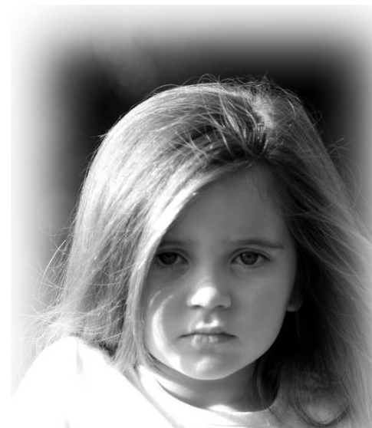
Child Abuse
- Approximately 5 children die every day because of child abuse. ¹
Notes:
http://www.childhelp.org/resources/learning-center/statistics
Little girl = FREE = with attributing that the image does not endorse the lesson from http://commons.wikimedia.org/wiki/File:My_child.jpg
¹ National Children's Alliance. "National Statistics on Child Abuse." Accessed February 19, 2014, http://www.nationalchildrensalliance.org/NCANationalStatistics.

Slide 6
Child Abuse
- 3.6 million cases of child abuse are reported every year in the U.S. ²
Notes:
http://www.childhelp.org/resources/learning-center/statistics
Little girl = FREE = with attributing that the image does not endorse the lesson from http://commons.wikimedia.org/wiki/File:My_child.jpg
² Safe Horizon. "Child Abuse: Statistics & Facts." Accessed February 19, 2014, http://www.safehorizon.org/index/what-we-do-2/child-abuse--incest-55/child-abuse-statistics--facts-304.html.
³ Safe Horizon. "Child Abuse: Statistics & Facts." Accessed February 19, 2014, http://www.safehorizon.org/index/what-we-do-2/child-abuse--incest-55/child-abuse-statistics--facts-304.html.
⁴ Silverman, Amy B., Helen Z. Reinherz, and Rose M. Giaconia. "The Long-term Sequelae Of Child And Adolescent Abuse: A Longitudinal Community Study." Child Abuse & Neglect 20, no. 8 (1996): 709-723.

Slide 7
Child Abuse
- Abused and neglected children
are 11 times more likely to
engage in criminal behavior
as an adult. ³
Notes:
http://www.childhelp.org/resources/learning-center/statistics
Little girl = FREE = with attributing that the image does not endorse the lesson from http://commons.wikimedia.org/wiki/File:My_child.jpg
² Safe Horizon. "Child Abuse: Statistics & Facts." Accessed February 19, 2014, http://www.safehorizon.org/index/what-we-do-2/child-abuse--incest-55/child-abuse-statistics--facts-304.html.
³ Safe Horizon. "Child Abuse: Statistics & Facts." Accessed February 19, 2014, http://www.safehorizon.org/index/what-we-do-2/child-abuse--incest-55/child-abuse-statistics--facts-304.html.
⁴ Silverman, Amy B., Helen Z. Reinherz, and Rose M. Giaconia. "The Long-term Sequelae Of Child And Adolescent Abuse: A Longitudinal Community Study." Child Abuse & Neglect 20, no. 8 (1996): 709-723.

Slide 8
Child Abuse
- About 80% of 21-year-olds who were abused as children met criteria
for at least one psychological
disorder. ⁴
Notes:
http://www.childhelp.org/resources/learning-center/statistics
Little girl = FREE = with attributing that the image does not endorse the lesson from http://commons.wikimedia.org/wiki/File:My_child.jpg
² Safe Horizon. "Child Abuse: Statistics & Facts." Accessed February 19, 2014, http://www.safehorizon.org/index/what-we-do-2/child-abuse--incest-55/child-abuse-statistics--facts-304.html.
³ Safe Horizon. "Child Abuse: Statistics & Facts." Accessed February 19, 2014, http://www.safehorizon.org/index/what-we-do-2/child-abuse--incest-55/child-abuse-statistics--facts-304.html.
⁴ Silverman, Amy B., Helen Z. Reinherz, and Rose M. Giaconia. "The Long-term Sequelae Of Child And Adolescent Abuse: A Longitudinal Community Study." Child Abuse & Neglect 20, no. 8 (1996): 709-723.

Slide 9
Child Abuse
-Ninety percent of child sexual abuse victims know the perpetrator in
some way; ⁵
- 68% are abused by
family members. ⁵
Notes:
http://www.childhelp.org/resources/learning-center/statistics
Little girl = FREE = with attributing that the image does not endorse the lesson from http://commons.wikimedia.org/wiki/File:My_child.jpg
⁵ U.S. Department of Justice. "Sexual Assault of Young Children as Reported to Law Enforcement: Victim, Incident, and Offender Characteristics." Bureau of Justice Statics. Accessed February 21, 2014, http://www.bjs.gov/content/pub/pdf/saycrle.pdf.

Slide 10
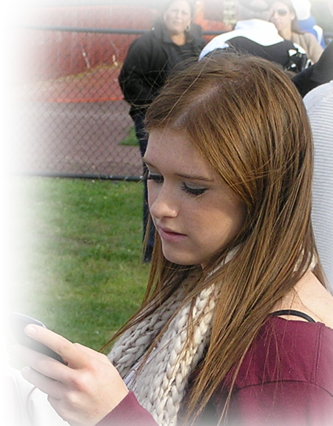
Teen
In 2013, nearly half (46.8%) of
all high school students
reported ever having sexual
intercourse. ^{6 CDC}
Notes:
Teen girl = FREE = Public domain from http://commons.wikimedia.org/wiki/File:American_teenager_with_cellphone_2011.jpg
6 CDC. Youth risk behavior surveillance—United States, 2011. MMWR 2012;61(SS-4).
7 Abma JC et al., Teenagers in the United States: sexual activity, contraceptive use, and childbearing, National Survey of Family Growth 2006–2008, Vital and Health Statistics, 2010, Series 23, No. 30.
8 Martinez G et al., Teenagers in the United States: sexual activity, contraceptive use, and childbearing, 2006–2010 National Survey of Family Growth, Vital and Health Statistics, 2011, Series 23, No. 31.

Slide 11
Teen
- By their 19th birthday, 7 out
of 10 teens have engaged
in sexual intercourse. ⁷
Notes:
Teen girl = FREE = Public domain from http://commons.wikimedia.org/wiki/File:American_teenager_with_cellphone_2011.jpg
6 CDC. Youth risk behavior surveillance—United States, 2011. MMWR 2012;61(SS-4).
7 Abma JC et al., Teenagers in the United States: sexual activity, contraceptive use, and childbearing, National Survey of Family Growth 2006–2008, Vital and Health Statistics, 2010, Series 23, No. 30.
8 Martinez G et al., Teenagers in the United States: sexual activity, contraceptive use, and childbearing, 2006–2010 National Survey of Family Growth, Vital and Health Statistics, 2011, Series 23, No. 31.

Slide 12

Young Adults
Death: 1,825 college students between the ages of 18 and 24 die each year from alcohol-related unintentional injuries.
Notes:
http://www.soundvision.com/Info/teens/stat.asp
Young man with drink = FREE = from http://www.sxc.hu/photo/1348191
Stats from : ww.niaaa.nih.gov/alcohol-health/special-populations-co-occurring-disorders/college-drinking

Slide 13
Young Adults
Assault: More than 690,000 students between the ages of 18 and 24 are assaulted by another student who has been drinking.
Notes:
http://www.soundvision.com/Info/teens/stat.asp
Young man with drink = FREE = from http://www.sxc.hu/photo/1348191
Stats from : ww.niaaa.nih.gov/alcohol-health/special-populations-co-occurring-disorders/college-drinking

Slide 14
Young Adults
Sexual Abuse: More than 97,000 students between the ages of 18 and 24 are victims of alcohol-related sexual assault or date rape.
Notes:
http://www.soundvision.com/Info/teens/stat.asp
Young man with drink = FREE = from http://www.sxc.hu/photo/1348191
Stats from : ww.niaaa.nih.gov/alcohol-health/special-populations-co-occurring-disorders/college-drinking

Slide 15
Young Adults
Injury: 599,000 students between the ages of 18 and 24 receive unintentional injuries while under the influence of alcohol.
Notes:
http://www.soundvision.com/Info/teens/stat.asp
Young man with drink = FREE = from http://www.sxc.hu/photo/1348191
Stats from : ww.niaaa.nih.gov/alcohol-health/special-populations-co-occurring-disorders/college-drinking

Slide 16
Young Adults
- One in four college students has
a STD.
As much as 60% of women ...
reported that they are in
committed relationships while
only 38% of men reported
the same.
Notes:
http://www.soundvision.com/Info/teens/stat.asp
Young man with drink = FREE = from http://www.sxc.hu/photo/1348191
STDs stats from http://www.nursingschools.net/blog/2010/05/10-truly-shocking-stats-on-stds-and-college-students/

Slide 17

Abusive Parents
- About 30% of abused
and neglected children
will later abuse their
own children, continuing
the horrible cycle of abuse.
Notes:
Abused woman = LICENSED and NOT FOR REUSE. To reuse elsewhere, get a license from http://www.istockphoto.com/stock-photo-2090996-abuse.php
Abuse fact = from http://www.childabuse.org/facts

Slide 18
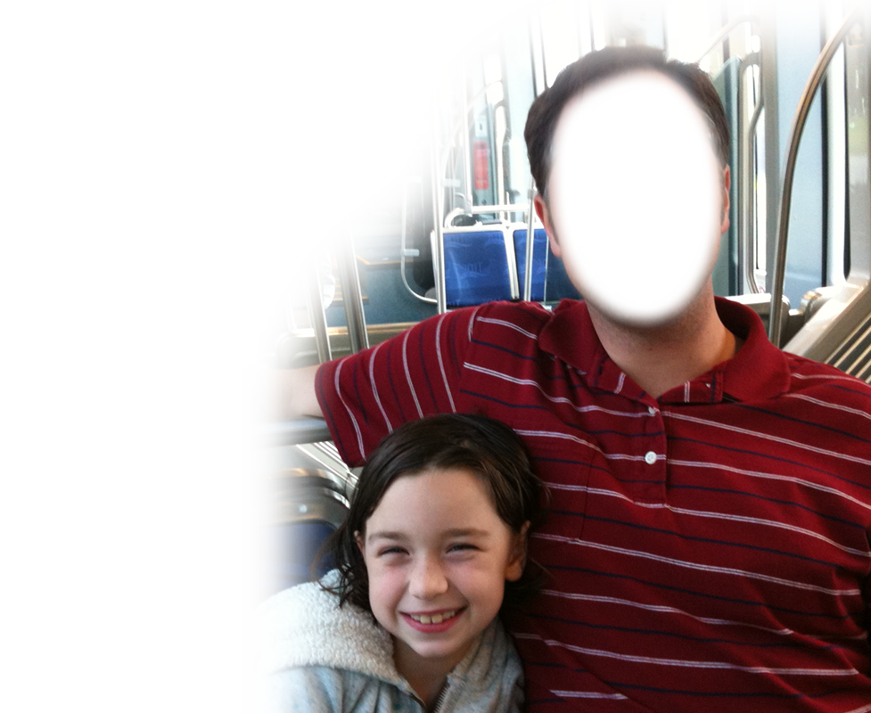
Daughters with Absent Fathers
• Seven Times More Likely to Become Pregnant as a Teen
(Child Development Journal)
Ten Times More Likely to Face
Abuse and Six Times Neglect
(Child's Bureau)
Notes:
http://www.amchp.org/Events/Documents/Father%20Factor%20in%20Children's%20Health%20Outline.pdf
Man and Daughter = FREE = from http://commons.wikimedia.org/wiki/File:Father_and_Daughter_ride_The_Tide_Light_Rail_in_Norfolk,_VA.jpg

Slide 19
Daughters with Absent Fathers
More Likely to Commit Crime
(Journal of Youth and Adolescence)
More Likely to Abuse Drugs and Alcohol.
(Social Science Research)
Notes:
http://www.amchp.org/Events/Documents/Father%20Factor%20in%20Children's%20Health%20Outline.pdf
Man and Daughter = FREE = from http://commons.wikimedia.org/wiki/File:Father_and_Daughter_ride_The_Tide_Light_Rail_in_Norfolk,_VA.jpg

Slide 20
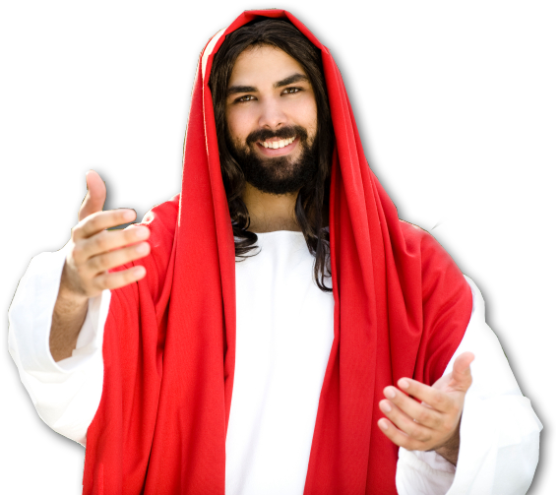
That’s not the way it should be.
Your world can be much
BETTER.
With Christ You Can
Change the World!
Notes:
Jesus = LICENSED and NOT FOR REUSE. To reuse elsewhere, get a license from http://www.istockphoto.com/stock-photo-7302839-waiting-for-you.php

Slide 21
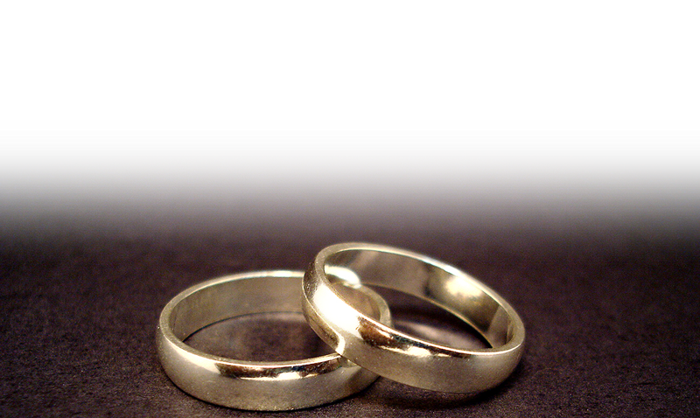
By Having a Better Marriage
But those who marry will face many troubles in this life, and I want to spare you this. 1Cor 7:28
Notes:
Rings = FREE = from http://commons.wikimedia.org/wiki/File:Wedding_rings.jpg

Slide 22
By Having a Better Marriage
³³ However, each one of you also must love his wife as he loves himself, and the wife must respect her husband.
Notes:
Rings = FREE = from http://commons.wikimedia.org/wiki/File:Wedding_rings.jpg

Slide 23
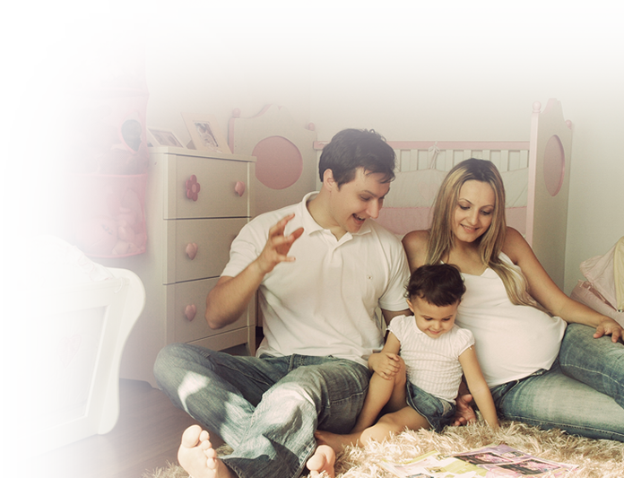
By Having Better Kids
6:¹ Children, obey your parents in the Lord, for this is right.
Notes:
Family = FREE = from http://www.sxc.hu/photo/1156583

Slide 24
By Having Better Kids
6:¹ Children, obey your parents in the Lord, for this is right.
NOT
Parents, obey your children, for this will keep them happy and bring peace in the home.
Notes:
Family = FREE = from http://www.sxc.hu/photo/1156583

Slide 25
By Having Better Kids
6:¹ Children, obey your parents in the Lord, for this is right.
This is a command!
This means there must be boundaries—and parents must set them!
Notes:
Family = FREE = from http://www.sxc.hu/photo/1156583

Slide 26
By Having Better Kids
6:¹ Children, obey your parents in the Lord, for this is right.
²⁰ Children, obey your parents in everything, Col 3:20
Notes:
Family = FREE = from http://www.sxc.hu/photo/1156583

Slide 27
By Having Better Kids
6:¹ Children, obey your parents in the Lord, for this is right.
²⁰ Children, obey your parents in everything, for this pleases the Lord. Col 3:20
Notes:
Family = FREE = from http://www.sxc.hu/photo/1156583

Slide 28

By Being a Better Kid YOURSELF
² "Honor your father and mother"--which is the first commandment
with a promise-- ³ "that it
may go well with you
and that you may enjoy
long life on the earth."
Notes:
Finger pointing = FREE= from BiblePoint

Slide 29
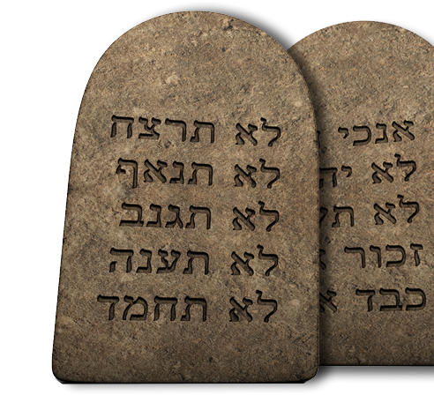
By Being a Better Kid YOURSELF
² "Honor your father and mother"—
which is the first commandment
with a promise-- ³ "that it
may go well with you
and that you may enjoy
long life on the earth."
Notes:
Finger pointing = FREE= from BiblePoint

Slide 30
By Being a Better Kid YOURSELF
² "Honor your father and mother"—
which is the first commandment
with a promise-- ³ "that it
may go well with you
and that you may enjoy
long life on the earth."
Notes:
Finger pointing = FREE= from BiblePoint

Slide 31
So How Do You Honor …
a parent that abused you?
Very carefully:
You confront them on their behavior
So they can admit the wrong and ask for forgiveness.
Then you must forgive them and honor them for repentance.

Slide 32
By Being a Better Parent

Slide 33

By Being a Better Parent
⁴ Fathers, do not exasperate your children;

Slide 34
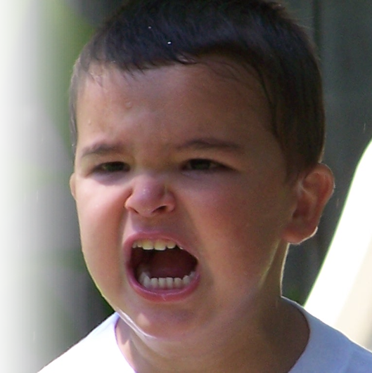
By Being a Better Parent
4 Fathers, do not provoke your children to anger by the way you treat them. (Eph 6:4 NLT)

Slide 35

By Being a Better Parent
4 Fathers, do not provoke your children to anger by the way you treat them. (Eph 6:4 NLT)
Rather, bring them up with the discipline and instruction that comes from the Lord. (Eph 6:4 NLT)

Slide 36
By Being a Better Parent
4 Fathers, do not provoke your children to anger by the way you treat them. (Eph 6:4 NLT)
Rather, bring them up with the discipline and instruction that comes from the Lord. (Eph 6:4 NLT)

Slide 37
By Being a Better Parent
4 Fathers, do not provoke your children to anger by the way you treat them. (Eph 6:4 NLT)
Rather, bring them up with the discipline and instruction that comes from the Lord. (Eph 6:4 NLT)

Slide 38
Don’t Discourage – Encourage!
Fathers, do not embitter your children, or they will become discouraged. Col 3:21

Slide 39
Don’t Discourage – Encourage!
Fathers, do not embitter your children, or they will become discouraged. Col 3:21
[Encouraging them]

Slide 40
How to discourage!
Blame without praise
Be inconsistent or unfair in discipline
Show favoritism
Make promises that you do not keep
Belittle what is important to the child

Slide 41
How to encourage!
Blame without praise
Be inconsistent or unfair in discipline
Show favoritism –Treat children equal
Make promises that you do not keeper
Belittle what is important to the child

Slide 42
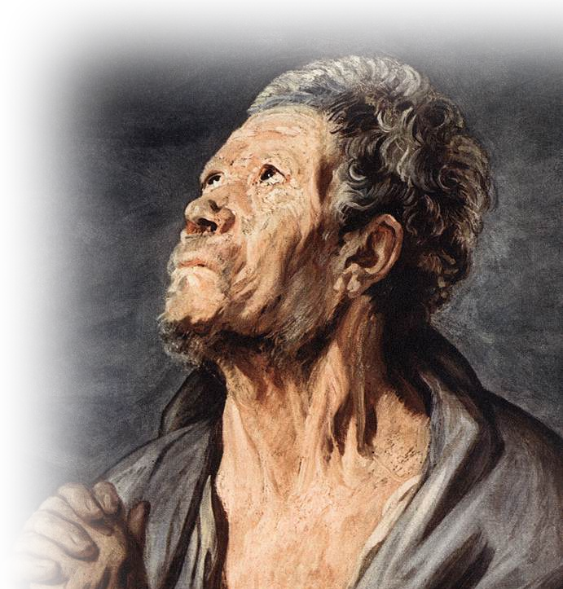
The outcome can be awesome
Like Jonadab
We have obeyed everything our forefather Jonadab son of Recab commanded us.
Jeremiah 35:8
Notes:
Painting of Apostle = FREE =from http://commons.wikimedia.org/wiki/File:Jordaens_Apostle.jpg

Slide 43
By Being a Better Employee

Slide 44
By Being a Better Employee
⁵ Slaves, obey your earthly masters with respect and fear, and with sincerity of heart, just as you would obey Christ. ⁶ Obey
NOW
HIRING
6 Million Slaves in the Roman Empire

Slide 45
By Being a Better Employee
⁵ Slaves, obey your earthly masters with respect and fear, and with sincerity of heart, just as you would obey Christ. ⁶ Obey
NOW
HIRING
Do what you’re told

Slide 46
By Being a Better Employee
⁵ Slaves, obey your earthly masters with respect and fear, and with sincerity of heart, just as you would obey Christ.
¹⁸ Slaves, submit yourselves to your masters with all respect, not only to those who are good and considerate, but also to those who are harsh. 1 Pet 2:18
NOW
HIRING
“Fear and trembling” and with “simplicity”

Slide 47

By Being a Better Employee
⁵ Slaves, obey your earthly masters with respect and fear, and with sincerity of heart, just as you would obey Christ.
NOW
HIRING
Notes:
Jesus = LICENSED and NOT FOR REUSE. To reuse elsewhere, get a license from http://www.istockphoto.com/stock-photo-7302839-waiting-for-you.php

Slide 48
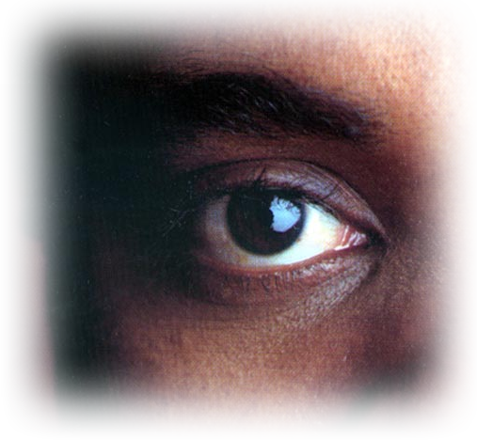
By Being a Better Employee
⁶ Obey them not only to win their favor when their eye is on you, but like slaves of Christ, doing the will of God from your heart.
Notes:
Eye = FREE = from GreekPhilospher

Slide 49
By Being a Better Employee
⁶ Obey them not
only to win their
favor when their
eye is on you, but
like slaves of Christ, doing the will of God from your heart.
Notes:
Eye = FREE = from GreekPhilospher

Slide 50

By Being a Better Employee
⁷ Serve wholeheartedly, as if you were serving the Lord, not men,
Notes:
Jesus = LICENSED and NOT FOR REUSE. To reuse elsewhere, get a license from http://www.istockphoto.com/stock-photo-7302839-waiting-for-you.php
Heart = LICNESED and NOT FOR REUSE. To reuse elsewhere, get a license from Dreamtime 12965431

Slide 51

By Being a Better Employee
⁸ because you know that the Lord will reward everyone for whatever good he does, whether he is slave or free.
Notes:
Jesus = LICENSED and NOT FOR REUSE. To reuse elsewhere, get a license from http://www.istockphoto.com/stock-photo-7302839-waiting-for-you.php
Crown = LICENSED and NOT FOR REUSE. To reuse elsewhere, get a license from http://www.istockphoto.com/stock-photo-9303908-crown.php

Slide 52
By Being a Better Employer

Slide 53
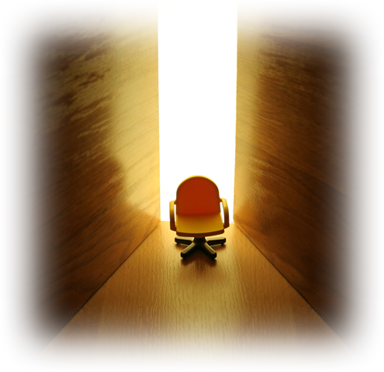
By Being a Better Employer
⁹ And masters, treat your slaves in the same way. Do not threaten them, since you know that he who is both their Master and yours is in heaven, and there is no favoritism with him.
Notes:
Boss chair = FREE = from http://www.sxc.hu/photo/256766

Slide 54
By Being a Better Employer
⁹ And masters, treat your slaves in the same way. Do not threaten them, since
you know that he who is
both their Master and yours is in heaven, and there is
no favoritism with him.
“Fear and trembling”
and with “simplicity”
Notes:
Boss chair = FREE = from http://www.sxc.hu/photo/256766

Slide 55
By Being a Better Employer
⁹ And masters, treat your slaves in the same way. Do not threaten them, since you know that he who is both their Master and yours is in heaven, and there is no favoritism with him.
“…OR
ELSE.”
Notes:
Boss chair = FREE = from http://www.sxc.hu/photo/256766

Slide 56



By Being a Better Employer
⁹ And masters, treat your slaves in the same way. Do not threaten them, since
you know that he who is both their Master and yours is in heaven, and there is
no favoritism with him.
T
H
E
I
R
Y
O
U
R
Notes:
Boss chair = FREE = from http://www.sxc.hu/photo/256766

Slide 57
By Being a Better Employer
⁹ And masters, treat your slaves in the same way. Do not threaten them, since you know that he who is both their Master and yours is in heaven, and there is no favoritism with him.
T
H
E
I
R
Y
O
U
R
Notes:
Boss chair = FREE = from http://www.sxc.hu/photo/256766

Slide 58
The Point is “With Christ”
You can have a better marriage
You can have better kids
You can be a better son or daughter
You can be a better parent
You can be a better employee
You can be a better employer

Slide 59
To fix our troubled world …
We need Christ in our lives.
We need to walk the talk
and live out our faith.
He is the “Savior of the World.”
John 4:42

Slide 60
He can Save Your …
Marriage
Kids
Parents
Jobs
Companies
“When we surrender all”
“Obey”
“Submit”

Slide 61
LET’S PRAY

