Slide 1

Love and Respect
Ephesians 5:22-33
Notes:
Background Heart in Sand = LICENSED and NOT FOR REUSE. To reuse elsewhere, get a license from http://www.dreamstime.com/heart-on-a-beach-image7185538
Copyright © 2006−2020. All rights reserved. Bible Point is a registered trademark of Dennis Henderson. All other trademarks acknowledged.
Bible Point contains graphics from Bible Point artists. These illustrations belong to Bible Point and the respective artists. You may use the designs and illustrations for graphical illustration of lessons free and without special permission, provided they are not used in any way that maligns the Christian faith. Furthermore, republication or production of any illustration by any other graphic service whether it be in book, in a machine-readable form, or in any other design resource is strictly prohibited. Furthermore, they cannot be duplicated or resold as any other form of publishing, clip art, or graphic resource.
So What does it mean? (A simple translations of the legal jargon)
So, if you don’t own the presentation(s), graphic(s), and text(s) how can you legally use them? The purchase of the license allows you to use all the images in the product. However, the actual ownership and copyright of the presentation(s), graphic(s), and text(s) remain the property of Bible Point and its licensors. If you had plans on using this product in your “for sale” work—think again!
License Agreement
Article 1: License Grant
All the graphics and text in Bible Point presentations (excluding quotes from the Bible and stated sources) are the intellectual and real property of Bible Point and its licensors, and is protected by law, including United States copyright laws and international treaties. Bible Point grants to you a license:
1. To use the presentation in a single church, single school, or single office of a Christian organization.
2. To make a single archival back-up copy of the program.
3. To modify the presentation(s) and merge with other presentations in a single church, school, or Christian organization.
4. To transfer to another party if that party agrees to accept the terms and conditions of this agreement, and you do not retain any copies of the presentation, whether printed, machine readable, modified, or merged form.
Article 2: Terms
This license is effective until terminated. You may terminate the license at any time by destroying the presentation(s), graphic(s), or text(s) together with all copies, modifications and merged portions in any form. Bible Point may terminate your license if you fail to comply with this Agreement. You agree, upon such termination, for any reason, to destroy the presentation(s), graphics, and text(s) with all copies, modifications, and merged portions in any form.
Article 3: Disclaimers
1. Bible Point presentations, graphics, and texts are licensed to you As Is. You, the consumer, bear the entire risk relating to the quality and performance of the presentation(s), graphic(s), or text(s). In no event will Bible Point be liable for damages resulting from any defect.
2. Thirty-day limited warrantee on disks. Bible Point warrants the disks to be free of defects in material and workmanship under normal use for 30 days after purchase. During the 30-day period you may return a defective presentation, graphic, or text with proof of purchase and it will be replaced without charge, unless the presentation is damaged by misuse.
Article 4: General
1. You may not sub-license, assign, or transfer the license of the presentation(s), graphic(s), or text(s) except as provided by this Agreement.
2. This Agreement will be governed by the laws of the State of Michigan.
So What does it mean? (A simple translations of the legal jargon)
May I let someone borrow or copy my licensed Bible Point presentation (even after I modified it)? As long as it is within your local church, or single school, or the immediate office of a Christian organization you may. Otherwise, please refer the person interested in borrowing to: http://www.biblepoint.com or E-mail: dennis@drdh.net with any related questions.

Slide 2
Christian Marriage has always been Countercultural
²¹ Submit to one another out of reverence for Christ.

Slide 3
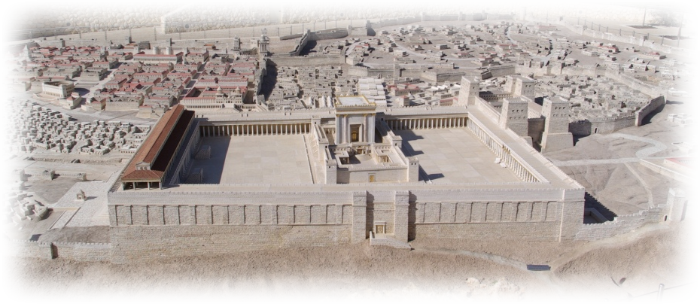
Countercultural to the Jews
²¹ Submit to one another out of reverence for Christ.
Notes:
Jerusalem Model = FREE = with credit to http://www.flickr.com/photos/emeryjl/508067090/
Barclay, Ephesians, P199

Slide 4
Countercultural to the Jews
Jewish man every morning gave thanks that God had not made him
“a Gentile, a slave, or a woman.”
Divorce was rampant:
1—Shammai – only adultery
2—Hillel – finds no pleasure
²¹ Submit to one another out of reverence for Christ.
Notes:
Jerusalem Model = FREE = with credit to http://www.flickr.com/photos/emeryjl/508067090/
Barclay, Ephesians, P199

Slide 5

Countercultural to the Greeks
²¹ Submit to one another out of reverence for Christ.
Notes:
Greek Parthenon = FREE = from http://paulbates.com/parthenon-nashville-tn-centennial-park-pictures-photos/
Barclay, Ephesians, p201

Slide 6
Countercultural to the Greeks
Prostitution was essential part of Greek life.
We have courtesans for the sake of pleasure; we have concubines for the sake of daily cohabitation; we have wives for the purpose of having children.
²¹ Submit to one another out of reverence for Christ.
Notes:
Greek Parthenon = FREE = from http://paulbates.com/parthenon-nashville-tn-centennial-park-pictures-photos/
Barclay, Ephesians, p201

Slide 7
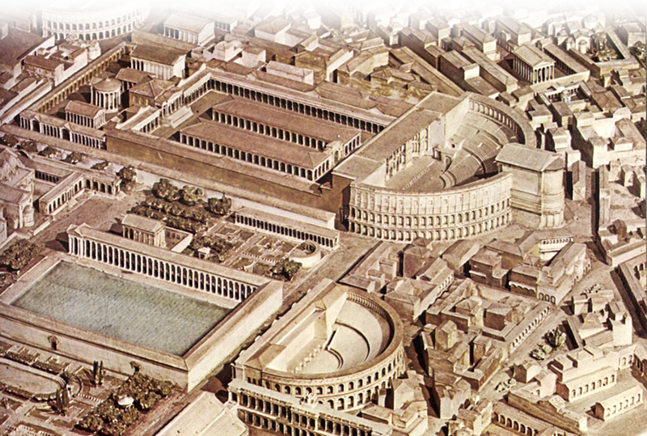
Countercultural to the Romans
²¹ Submit to one another out of reverence for Christ.
Notes:
Rome = FREE = Public Domain = http://commons.wikimedia.org/wiki/File:Campus_Martius.jpg

Slide 8
Countercultural to the Romans
In Rome, in Paul’s day, the matter was still worse. Seneca writes that women were married to be divorced and divorced to be married.
Jerome mentioned in Rome a woman was married to her 23rd husband (his 21st wife)
²¹ Submit to one another out of reverence for Christ.
Notes:
Rome = FREE = Public Domain = http://commons.wikimedia.org/wiki/File:Campus_Martius.jpg

Slide 9

Countercultural to USA
²¹ Submit to one another out of reverence for Christ.
Notes:
Hollywood sign = FREE = from http://commons.wikimedia.org/wiki/File:Hollywood_Sign_PB050006.jpg

Slide 10
Countercultural to USA
The divorce rate in America
50% percent of first marriages,
67% of second and
74% of third marriages end in divorce, (according to the Institute of Professional Psychology)
²¹ Submit to one another out of reverence for Christ.
Notes:
Hollywood sign = FREE = from http://commons.wikimedia.org/wiki/File:Hollywood_Sign_PB050006.jpg

Slide 11
Paul goes Countercultural
Love and Respect
³³ However, each one of you also must love his wife as he loves himself, and the wife must respect her husband.

Slide 12

Individually Countercultural
³³ However, each one of you also must love his wife as he loves himself, and the wife must respect her husband.
Notes:
Finger Pointing = FREE = from BiblePoint photos.

Slide 13
Unconditionally Countercultural
IF
³³ However, each one of you also must love his wife as he loves himself, and the wife must respect her husband.

Slide 14
What every Woman wants!
LOVE

Slide 15
What every Man wants!
R-E-S-P-E-C-T

Slide 16
“Respect is man’s deepest value.”
When men were asked “If forced to chose to live with only one of the following, which would it be?”
A) left alone and unloved
B) feel inadequate and disrespected
74 % chose “A”
Notes:
Eggriches, Love and Respect, p.

Slide 17


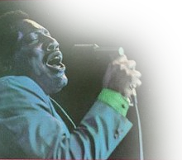
What every Man wants!
R-E-S-P-E-C-T
Notes:
Aretha Franklin = FREE = with credit to http://www.flickr.com/photos/petertea/4336555429/sizes/o/in/photostream/
Otis Redding = FREE = with citation to http://www.flickr.com/photos/markcph/3296770817/sizes/o/in/photostream/

Slide 18
Christian Marriage is about RESPECT!

Slide 19
Submissive RESPECT
PLACE
²² Wives, submit to your husbands as to the Lord.
UNDER

Slide 20
Christlike RESPECT!
λογοs
¹ In the beginning was the Word, and the Word was with God, and the Word was God…. ¹⁴ The Word became flesh and made his dwelling among us. John 1:1-14

Slide 21
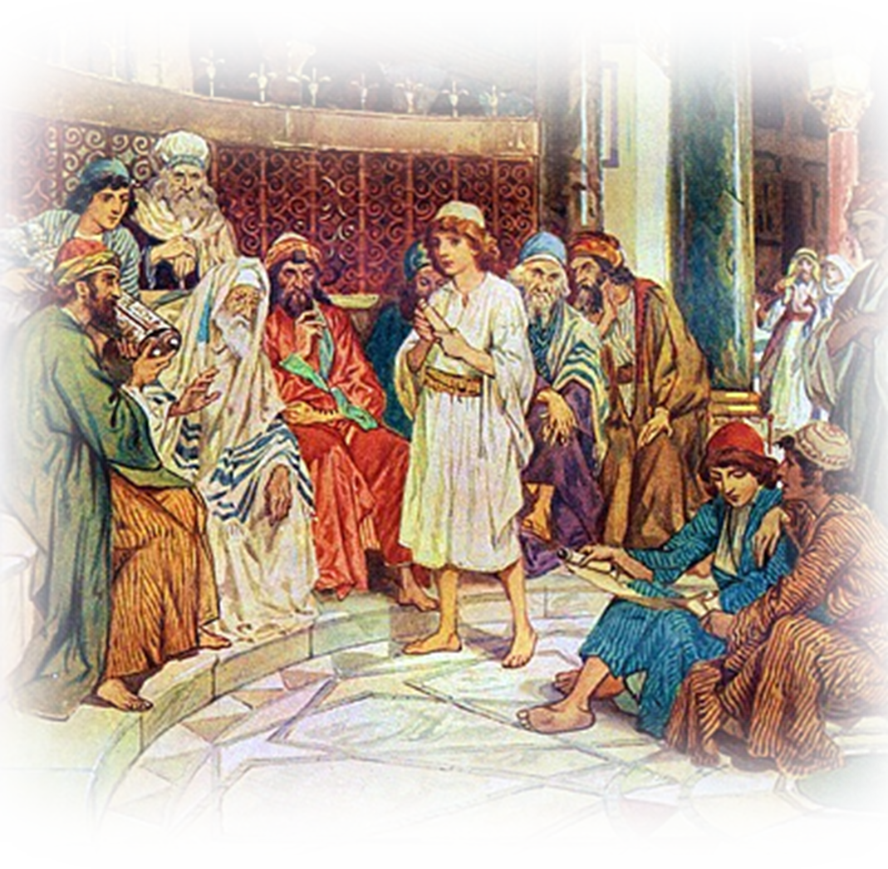
Christlike RESPECT!
Notes:
Jesus 12 years old in temple = FREE = from http://commons.wikimedia.org/wiki/File:William_Hole_Jesus_Amidst_The_Doctors_In_The_Temple_400.jpg

Slide 22
Christlike RESPECT!
Then He went down with them and came to Nazareth, and was subject to them, but His mother kept all these things in her heart. Luke 2:51 NKJ
Notes:
Jesus 12 years old in temple = FREE = from http://commons.wikimedia.org/wiki/File:William_Hole_Jesus_Amidst_The_Doctors_In_The_Temple_400.jpg

Slide 23
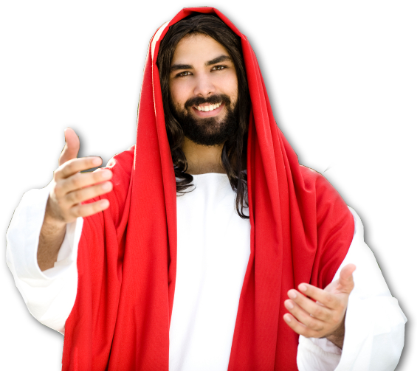
Christlike RESPECT!
²² Wives, submit to your husbands as to the Lord.
Notes:
Jesus = LICENSED and NOT FOR REUSE. To reuse elsewhere, get a license from http://www.istockphoto.com/stock-photo-7302839-waiting-for-you.php

Slide 24
Why Respect?
²³ For the husband is the head of the wife as Christ is the head of the church, his body, of which he is the Savior.
BECAUSE

Slide 25
Why Respect?
HUSBAND
HEAD
²³ For the husband is the head of the wife as Christ is the head of the church, his body, of which he is the Savior.
WIFE

Slide 26

Why Respect?
²³ For the husband is the head of the wife as Christ is the head of the church, his body, of which he is the Savior.
Notes:
Jesus = LICENSED and NOT FOR REUSE. To reuse elsewhere, get a license from http://www.istockphoto.com/stock-photo-7302839-waiting-for-you.php
Church building = FREE =from BiblePoint photos.

Slide 27
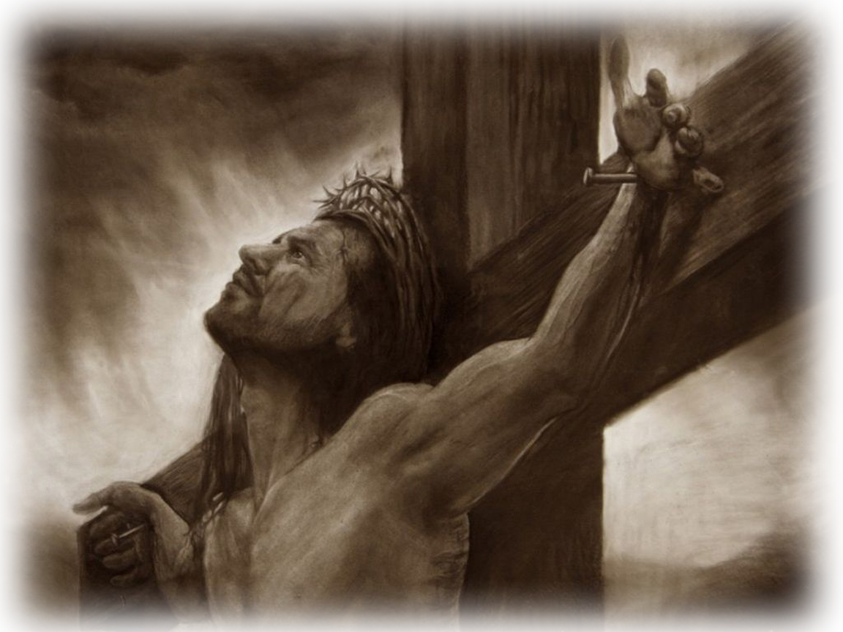
Why Respect?
²³ For the husband is the head of the wife as Christ is the head of the church, his body, of which he is the Savior.
Notes:
Crucified Christ = LICENSED and NOT FOR REUSE. To reuse elsewhere get a license from http://www.bigstockphoto.com/image-1624763/stock-photo-art-jesus-portcross-sepi

Slide 28
Why Respect?
²⁴ Now as the church submits to Christ, so also wives should submit to their husbands in everything.
Notes:
Jesus = LICENSED and NOT FOR REUSE. To reuse elsewhere, get a license from http://www.istockphoto.com/stock-photo-7302839-waiting-for-you.php
Church building = FREE =from BiblePoint photos.

Slide 29
Why Respect?
²⁴ Now as the church submits to Christ, so also wives should submit to their husbands in everything.
HUSBAND
WIFE

Slide 30
Why Respect?
Wives, submit to your husbands, as is fitting in the Lord. Col 3:18
²⁴ Now as the church submits to Christ, so also wives should submit to their husbands in everything.
Domestic
Disobedience

Slide 31
Christian Marriage has always been about LOVE

Slide 32
What every Woman wants!
L-O-V-E

Slide 33
Husbands Love Your Wives with ...

Slide 34
Obedient Love
²⁵ Husbands, love your wives, just as Christ loved the church and gave himself up for her
WIFE
L
O
V
E
HUSBAND

Slide 35
Unconditional Love
²⁵ Husbands, love your wives, just as Christ loved the church and gave himself up for her
WIFE
L
O
V
E
HUSBAND

Slide 36
Comparable Love
²⁵ Husbands, love your wives, just as Christ loved the church and gave himself up for her
Notes:
Crucified Christ = LICENSED and NOT FOR REUSE. To reuse elsewhere get a license from http://www.bigstockphoto.com/image-1624763/stock-photo-art-jesus-portcross-sepi

Slide 37
Unfathomable Love
²⁵ Husbands, love your wives, just as Christ loved the church and gave himself up for her
Notes:
Crucified Christ = LICENSED and NOT FOR REUSE. To reuse elsewhere get a license from http://www.bigstockphoto.com/image-1624763/stock-photo-art-jesus-portcross-sepi
Church building = FREE =from BiblePoint photos.

Slide 38
Demonstrable Love
²⁵ Husbands, love your wives, just as Christ loved the church and gave himself up for her
Notes:
Crucified Christ = LICENSED and NOT FOR REUSE. To reuse elsewhere get a license from http://www.bigstockphoto.com/image-1624763/stock-photo-art-jesus-portcross-sepi
Church building = FREE =from BiblePoint photos.

Slide 39
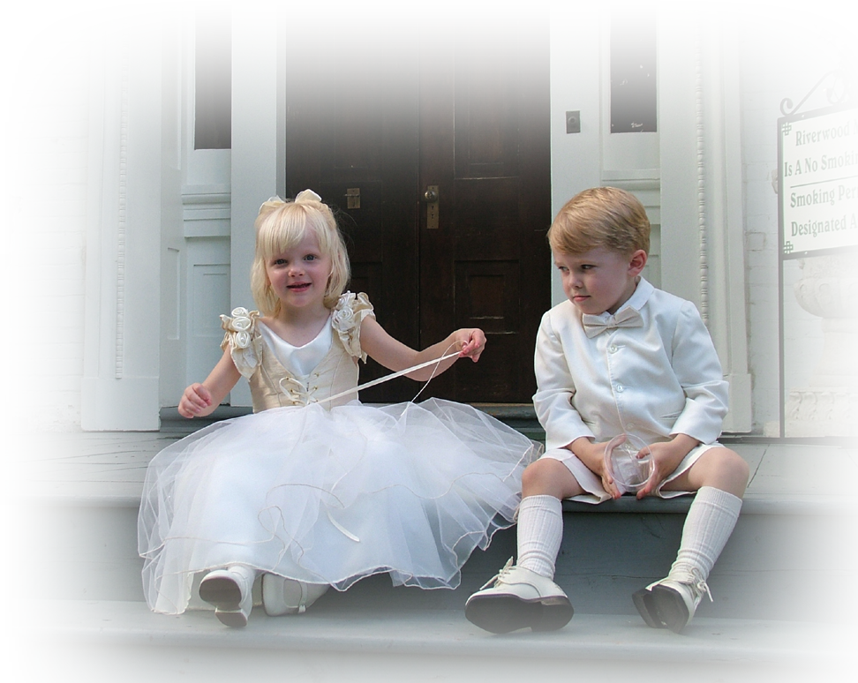
Purposeful Love
²⁶ to make her holy, cleansing her by the washing with water through the word,
Notes:
Children = FREE = from http://www.sxc.hu/browse.phtml?f=download&id=416472

Slide 40

Practical Love
²⁶ to make her holy, cleansing her by the washing with water through the word,
Notes:
Torah = FREE = from http://upload.wikimedia.org/wikipedia/commons/8/8b/WLA_jewishmuseum_Greek_Torah_Scroll_from_Ionnina.jpg

Slide 41
Reciprocal Love
²⁷ and to present her to himself as a radiant church, without stain or wrinkle or any other blemish, but holy and blameless.

Slide 42

Radiant Love
²⁷ and to present her to himself as a radiant church, without stain or wrinkle or any other blemish, but holy and blameless.
Notes:
Church building = FREE =from BiblePoint photos.

Slide 43
Radiant Love
²⁷ and to present her to himself as a radiant church, without stain or wrinkle or any other blemish, but holy and blameless.
Notes:
Church building = FREE =from BiblePoint photos.

Slide 44
Holy Love
²⁷ and to present her to himself as a radiant church, without stain or wrinkle or any other blemish, but holy and blameless.
Notes:
Church building = FREE =from BiblePoint photos.

Slide 45
Obligatory Love
²⁸ In this same way, husbands ought to love their wives as their own bodies. He who loves his wife loves himself.
OWE

Slide 46
Rewarded Love
²⁸ In this same way, husbands ought to love their wives as their own bodies. He who loves his wife loves himself.
WIFE
L
O
V
E
L
O
V
E
HUSBAND

Slide 47
Reasonable Love
²⁹ After all, no one ever hated his own body, but he feeds and cares for it, just as Christ does the church--
The Bottom Line = Love, feed, and care for self

Slide 48

Reasonable Love
³⁰ for we are members of his body.
The Bottom Line = We’re One
Notes:
Flag man = FREE = from BiblePoint photos

Slide 49
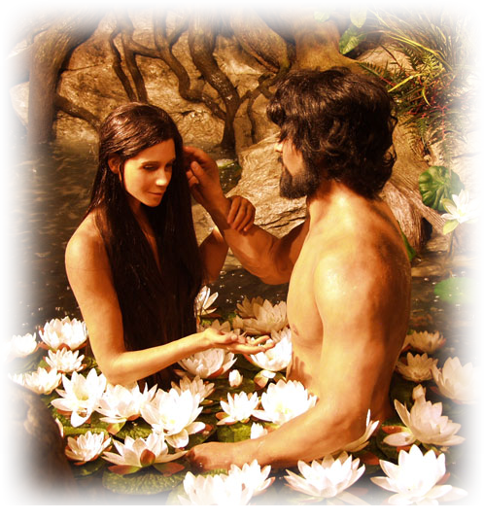
Biblical Love
³¹ "For this reason a man will leave his father and mother and be united to his wife, and the two will become one flesh.”
GEN 2:24-25
Notes:
Adam and Eve = FREE = From BiblePoint photos

Slide 50
Theological Love
³² This is a profound mystery--but I am talking about Christ and the church.
“mystery” =
an open sacred secret that was once concealed but is now revealed!

Slide 51
Theological Love
³² This is a profound mystery--but I am talking about Christ and the church.

Slide 52
Theological Love
³² This is a profound mystery--but I am talking about Christ and the church.

Slide 53
Countercultural Love
³³ However, each one of you also must love his wife as he loves himself, and the wife must respect her husband.
Notes:
Finger pointing = FREE = from BiblePoint photos.

Slide 54
So where do I go from here?
Marriage is NOT for everyone!
1 Corinthians 7

Slide 55
So where do I go from here?
⁸ Now to the unmarried and the widows I say: It is good for them to stay unmarried,
as I am. 1 Cor. 7:8

Slide 56
So where do I go from here?
⁸ Now to the unmarried and the widows I say: It is good for them to stay unmarried,
as I am. 1 Cor. 7:8
But those who marry will face many troubles in this life, and I want to spare you this.
1 Cor 7:28
Either way,
You need Christ
in your life!

Slide 57
God’s Unbeatable Combination:
Husband who LOVES his wife,
is easy to RESPECT!
Wife who REPECTS her husband,
is easy to LOVE!

Slide 58
So,
Husbands, love your wives.
Wives, respect your husbands.

Slide 59
Let’s PRAY!

