Slide 1

Notes:
Background = LICENSED and NOT FOR REUSE. To reuse elsewhere get a license from http://www.dreamstime.com/the-time-is-now-clock-image9616856
Copyright © 2006−2020. All rights reserved. Bible Point is a registered trademark of Dennis Henderson. All other trademarks acknowledged.
Bible Point contains graphics from Bible Point artists. These illustrations belong to Bible Point and the respective artists. You may use the designs and illustrations for graphical illustration of lessons free and without special permission, provided they are not used in any way that maligns the Christian faith. Furthermore, republication or production of any illustration by any other graphic service whether it be in book, in a machine-readable form, or in any other design resource is strictly prohibited. Furthermore, they cannot be duplicated or resold as any other form of publishing, clip art, or graphic resource.
So What does it mean? (A simple translations of the legal jargon)
So, if you don’t own the presentation(s), graphic(s), and text(s) how can you legally use them? The purchase of the license allows you to use all the images in the product. However, the actual ownership and copyright of the presentation(s), graphic(s), and text(s) remain the property of Bible Point and its licensors. If you had plans on using this product in your “for sale” work—think again!
License Agreement
Article 1: License Grant
All the graphics and text in Bible Point presentations (excluding quotes from the Bible and stated sources) are the intellectual and real property of Bible Point and its licensors, and is protected by law, including United States copyright laws and international treaties. Bible Point grants to you a license:
1. To use the presentation in a single church, single school, or single office of a Christian organization.
2. To make a single archival back-up copy of the program.
3. To modify the presentation(s) and merge with other presentations in a single church, school, or Christian organization.
4. To transfer to another party if that party agrees to accept the terms and conditions of this agreement, and you do not retain any copies of the presentation, whether printed, machine readable, modified, or merged form.
Article 2: Terms
This license is effective until terminated. You may terminate the license at any time by destroying the presentation(s), graphic(s), or text(s) together with all copies, modifications and merged portions in any form. Bible Point may terminate your license if you fail to comply with this Agreement. You agree, upon such termination, for any reason, to destroy the presentation(s), graphics, and text(s) with all copies, modifications, and merged portions in any form.
Article 3: Disclaimers
1. Bible Point presentations, graphics, and texts are licensed to you As Is. You, the consumer, bear the entire risk relating to the quality and performance of the presentation(s), graphic(s), or text(s). In no event will Bible Point be liable for damages resulting from any defect.
2. Thirty-day limited warrantee on disks. Bible Point warrants the disks to be free of defects in material and workmanship under normal use for 30 days after purchase. During the 30-day period you may return a defective presentation, graphic, or text with proof of purchase and it will be replaced without charge, unless the presentation is damaged by misuse.
Article 4: General
1. You may not sub-license, assign, or transfer the license of the presentation(s), graphic(s), or text(s) except as provided by this Agreement.
2. This Agreement will be governed by the laws of the State of Michigan.
So What does it mean? (A simple translations of the legal jargon)
May I let someone borrow or copy my licensed Bible Point presentation (even after I modified it)? As long as it is within your local church, or single school, or the immediate office of a Christian organization you may. Otherwise, please refer the person interested in borrowing to: http://www.biblepoint.com or E-mail: dennis@drdh.net with any related questions.

Slide 2


Slide 3
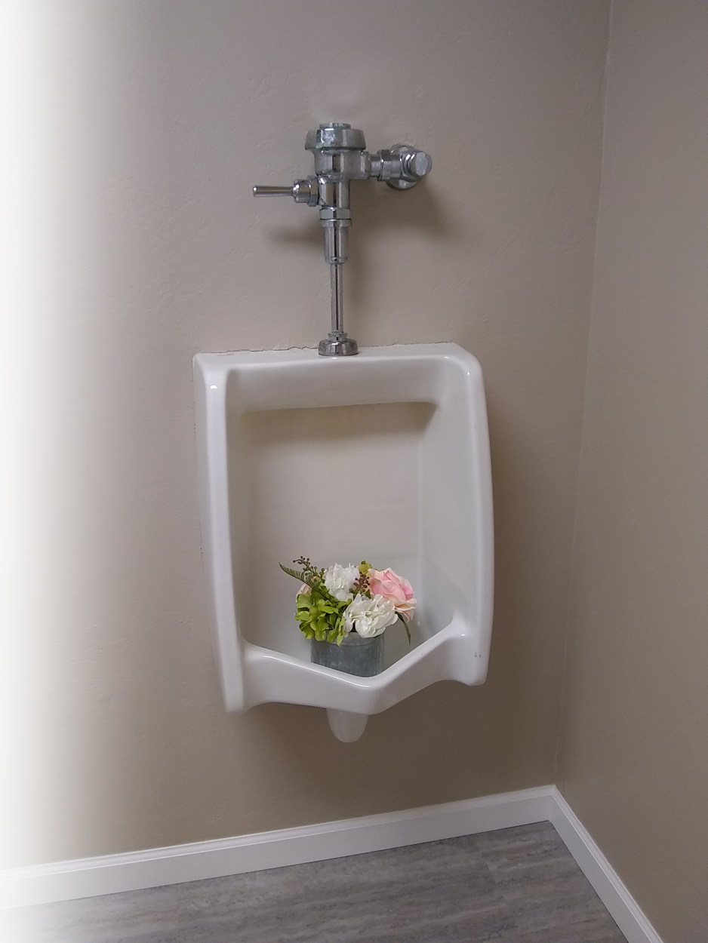

Slide 4
Notes:
Background = LICENSED and NOT FOR REUSE. To reuse elsewhere get a license from http://www.dreamstime.com/the-time-is-now-clock-image9616856

Slide 5
What’s Your Outlook on Life?

Slide 6
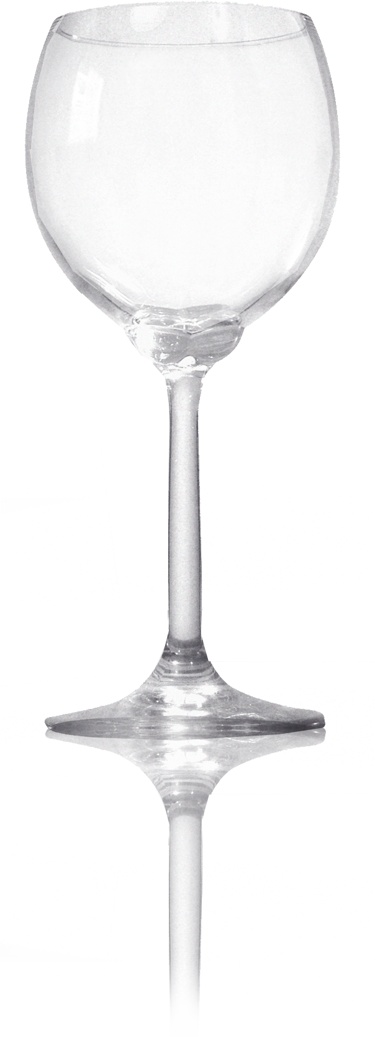

How do you see the glass?
Notes:
Wine glass = FREE = from http://www.sxc.hu/photo/863359

Slide 7

Pessimistic
Notes:
Wine glass = FREE = from http://www.sxc.hu/photo/863359
Hand = FREE = from BiblePoint art.

Slide 8

Optimistic
Notes:
Wine glass = FREE = from http://www.sxc.hu/photo/863359
Hand = FREE = from BiblePoint art.

Slide 9

Opportunistic
Notes:
Wine glass = FREE = from http://www.sxc.hu/photo/863359
Hand = FREE = from BiblePoint art.

Slide 10
Be Opportunistic
At Home
On the Job
At School
With Friends
At Church
¹⁵ Be very careful, then, how you live--not as unwise but as wise, ¹⁶ making the most of every opportunity, because the days are evil.
HOW?
Notes:
Wine glass = FREE = from http://www.sxc.hu/photo/863359
Hand = FREE = from BiblePoint art.

Slide 11
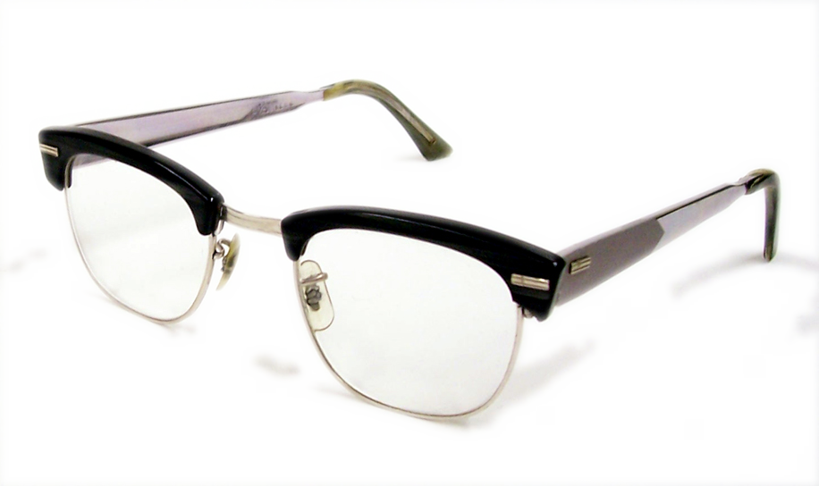
Live Carefully…
¹⁵ Be very careful, then, how you live--not as unwise but as wise, ¹⁶ making the most of every opportunity, because the days are evil.
“See then that ye walk circumspectly “ KJV
Notes:
Eye glasses = FREE = from http://www.sxc.hu/browse.phtml?f=view&id=696003

Slide 12
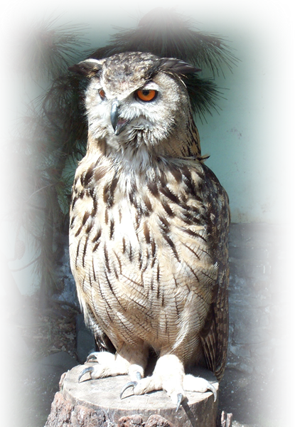
Live Wisely…
¹⁵ Be very careful, then, how you live--not as unwise but as wise, ¹⁶ making the most of every opportunity, because the days are evil.
Notes:
Owl = FREE = from http://www.sxc.hu/photo/35023

Slide 13
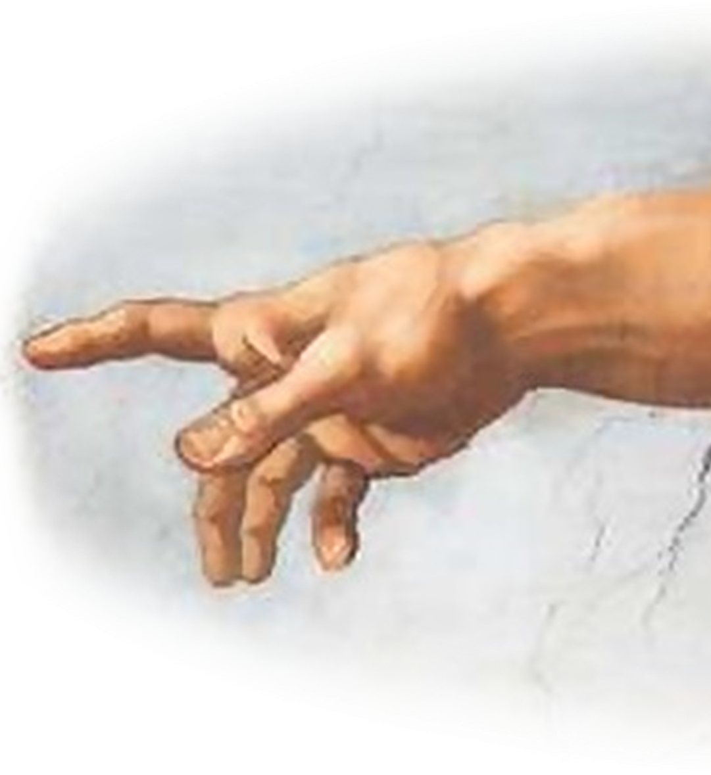
Live Creatively…
¹⁵ Be very careful, then, how you live--not as unwise but as wise, ¹⁶ making the most of every opportunity, because the days are evil.
Notes:
Hand of God = FREE = from http://commons.wikimedia.org/wiki/File:Creation_of_Adam.jpg

Slide 14

Why?
¹⁵ Be very careful, then, how you live--not as unwise but as wise, ¹⁶ making the most of every opportunity, because the days are evil.
Notes:
Devil = FREE = from sxc.hu photo: 678483_13468499

Slide 15
So Be Opportunistic
and
Be Understanding
¹⁷ Therefore do not be foolish, but understand what the Lord's will is.

Slide 16

Like the men of Issachar
³² men of Issachar, who understood the times and knew what Israel should do…
--1Chronicles 12:32
Notes:
Man before a maze = LICENSED and NOT FOR REUSE. To reuse elsewhere, get a license from http://www.bigstockphoto.com/image-12116480/stock-photo-man-before-labyrint

Slide 17
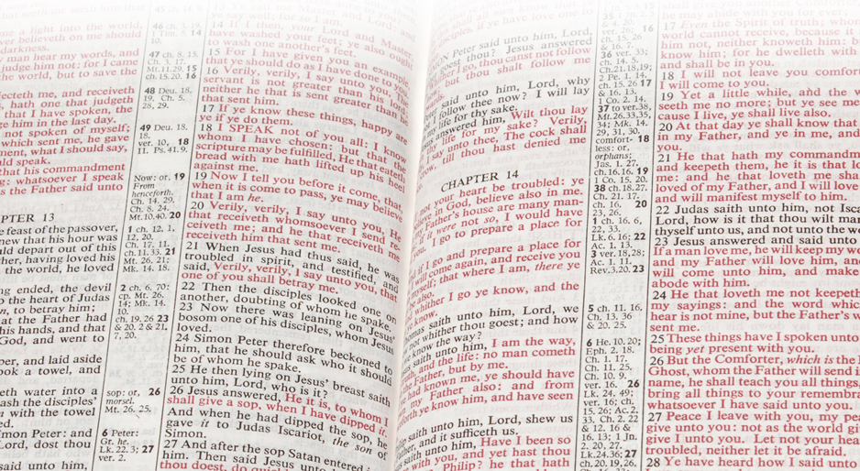
Be Understanding: Of God’s Will
¹⁷ Therefore do not be foolish, but understand what the Lord's will is.
This calls for
God’s Word!
Notes:
Bible = FREE = from BiblePoint photos.

Slide 18
Be Understanding: Not Foolish
¹⁷ Therefore do not be foolish, but understand what the Lord's will is.
This calls for
God’s Word!
Notes:
Bible = FREE = from BiblePoint photos.

Slide 19
Be Opportunistic
and
Be Understanding
and
Be Spiritual

Slide 20


Be Spiritual
To be Spiritual you must learn to …

Slide 21
Be Spiritual
To be Spiritual you must learn to …
22 You were taught, with regard to your former way of life, to put off your old self, which is being corrupted by its deceitful desires;
24 and to put on the new self, created to be like God in true righteousness and holiness.
23 to be made new
in the attitude of
your minds;

Slide 22

Be SOBER!
To be Spiritual you must learn to …
MI legal standard for drunkenness is .10 alcohol in the blood, while .08 is considered impaired. (MO of HSP)
¹⁸ Do not get drunk on wine, which leads to debauchery.
Notes:
Wine pouring = FREE = from http://commons.wikimedia.org/wiki/File:Waiter_pouring_Zardetto_sparkling_Prosecco.jpg

Slide 23
Be SOBER!
To be Spiritual you must learn to …
Even MI considers it wrong (a sin) to consume more than three drinks in an hour if you are under 150 lbs. (or just one strong drink)!
¹⁸ Do not get drunk on wine, which leads to debauchery.
Notes:
Wine pouring = FREE = from http://commons.wikimedia.org/wiki/File:Waiter_pouring_Zardetto_sparkling_Prosecco.jpg

Slide 24
How does intoxication affect you:
Physical life?
Work life?
Emotional life?
Married life?
Family life?
Social life?
Rational life?
Spiritual life?
The point is: When you surrender to alcohol it takes control of every compartment of your life.

Slide 25
Be SOBER!
To be Spiritual you must learn to …
¹⁸ Do not get drunk on wine, which leads to debauchery.
Notes:
Wine pouring = FREE = from http://commons.wikimedia.org/wiki/File:Waiter_pouring_Zardetto_sparkling_Prosecco.jpg

Slide 26

Be FILLED!
To be Spiritual you must learn to …
¹⁸ Do not get drunk on wine, which leads to debauchery.
Instead, be filled with the Spirit.
Keep on being filled
Notes:
No Vacancy sign = FREE = from http://www.sxc.hu/photo/470657
Dove = LICENSED and NOT FOR REUSE. To reuse elsewhere get a license from http://www.istockphoto.com/stock-photo-9179621-pigoen-flying.php

Slide 27




Be FILLED!
To be Spiritual you must learn to …
¹⁸ Do not get drunk on wine, which leads to debauchery.
Instead, be filled with the Spirit.
Keep on being filled
Notes:
No Vacancy sign = FREE = from http://www.sxc.hu/photo/470657
Dove = LICENSED and NOT FOR REUSE. To reuse elsewhere get a license from http://www.istockphoto.com/stock-photo-9179621-pigoen-flying.php

Slide 28
Be FILLED!
To be Spiritual you must learn to …
Now if any man have not the Spirit of Christ, he is none of his. (Rom 8:9 KJV)
¹⁸ Do not get drunk on wine, which leads to debauchery.
Instead, be filled with the Spirit.
Keep on being filled
Notes:
No Vacancy sign = FREE = from http://www.sxc.hu/photo/470657
Dove = LICENSED and NOT FOR REUSE. To reuse elsewhere get a license from http://www.istockphoto.com/stock-photo-9179621-pigoen-flying.php

Slide 29

Spirit intoxication affects the:
Physical life—Body is temple 1 Cor 6:19
Work life—Do as to the Lord Col 3:23
Emotional life—Joy of Spirit Acts 13:52
Married life—Agape love Ro. 5:5
Family life—Care for his own 1 Tim 5:8
Social life—For God’s glory 1 Cor 10:31
Rational life—Mind of Christ 1 Cor.2:16
Spiritual life—Spiritual man 1 Cor 2:15
Notes:
Keys = FREE = from http://www.sxc.hu/photo/1067598

Slide 30
How do you get spiritual?
What do you replace with?
¹⁸ Do not get drunk on wine, which leads to debauchery.
Instead, be filled with the Spirit.
Notes:
Dove = LICENSED and NOT FOR REUSE. To reuse elsewhere get a license from http://www.istockphoto.com/stock-photo-9179621-pigoen-flying.php

Slide 31
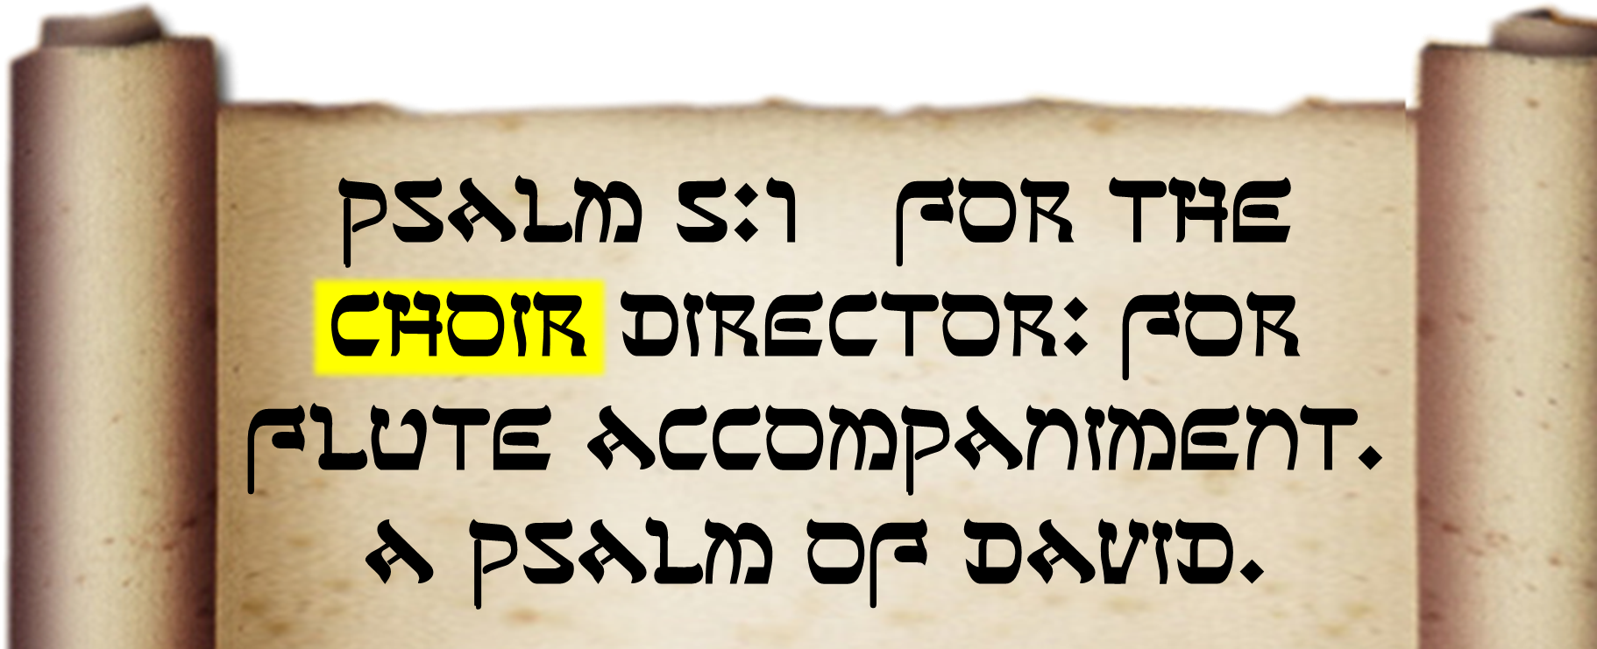
Be MUSICAL!
¹⁹ Speak to one another with psalms,
Notes:
Scroll = FREE = from http://www.sxc.hu/photo/1328513

Slide 32

Be MUSICAL!
¹⁹ Speak to one another with psalms, hymns
Notes:
Hymnal = FREE = from BiblePoint photos

Slide 33

Be MUSICAL!
¹⁹ Speak to one another with psalms, hymns and spiritual songs.
PRAISE MUSIC
Notes:
Woman praising = LICENSED and NOT FOR REUSE. To reuse elsewhere get a license from http://www.istockphoto.com/stock-photo-7181017-african-american-woman-praising.php

Slide 34

Be MUSICAL!
¹⁹ Speak to one another with psalms, hymns and spiritual songs.
RAP MUSIC
Notes:
Woman with boom box = LICENSED and NOT FOR REUSE. To reuse elsewhere, get a license from http://www.bigstockphoto.com/image-7303854/stock-photo-pretty-girl-in-purple-on-green-background-with-big-radi

Slide 35

Be MUSICAL!
¹⁹ Speak to one another with psalms, hymns and spiritual songs. Sing
Notes:
Man singing = FREE = from http://www.sxc.hu/browse.phtml?f=download&id=59150

Slide 36

Be MUSICAL!
¹⁹ Speak to one another with psalms, hymns and spiritual songs. Sing and make music in your heart to the Lord,
HUMMING
Notes:
Heart = FREE = from dreamstimefree_12965431

Slide 37

Be Passionate - Emotional
¹⁹ Speak to one another with psalms, hymns and spiritual songs. Sing and make music in your heart to the Lord,
Notes:
Jesus = LICENSED and NOT FOR REUSE. To reuse elsewhere get a license from http://www.dreamstime.com/jesus-the-bread-of-life-image1872806

Slide 38

Be Thankful
²⁰ always giving thanks to God
the Father for everything,
in the name of our Lord
Jesus Christ.
Notes:
Praise Hands = FREE = from http://www.sxc.hu/photo/245834

Slide 39
Be Thankful
²⁰ always giving thanks to God
the Father for everything,
in the name of our Lord
Jesus Christ.
Notes:
Praise Hands = FREE = from http://www.sxc.hu/photo/245834

Slide 40
Be Christian
²⁰ always giving thanks to God
the Father for everything,
in the name of our Lord
Jesus Christ.
Notes:
Praise Hands = FREE = from http://www.sxc.hu/photo/245834

Slide 41
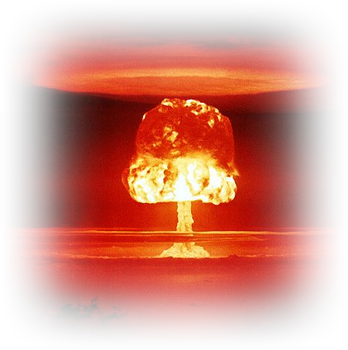
Be Submissive
²¹ Submit to one another out of reverence for Christ.
No Worship
Wars!
Notes:
Atomic explosion = FREE = from http://commons.wikimedia.org/wiki/File:Castle_Romeo.jpg

Slide 42
For Christ’s Sake!
²¹ Submit to one another out of reverence for Christ.
Notes:
Jesus = LICENSED and NOT FOR REUSE. To reuse elsewhere get a license from http://www.dreamstime.com/jesus-the-bread-of-life-image1872806

Slide 43
The time is now to be …

Slide 44
Opportunistic
Notes:
Wine glass = FREE = from http://www.sxc.hu/photo/863359

Slide 45
NOT Pessimistic
Notes:
Wine glass = FREE = from http://www.sxc.hu/photo/863359
Hand = FREE = from BiblePoint art.

Slide 46
NOT JUST Optimistic
Notes:
Wine glass = FREE = from http://www.sxc.hu/photo/863359
Hand = FREE = from BiblePoint art.

Slide 47
But TRULY Opportunistic
Notes:
Wine glass = FREE = from http://www.sxc.hu/photo/863359
Hand = FREE = from BiblePoint art.

Slide 48
Yes, The time is now to be…

Slide 49
Spiritual
Surrendering all your life to God
Worshiping God in a variety of ways
And accepting the ways others worship.
Notes:
Keys = FREE = from http://www.sxc.hu/photo/1067598

Slide 50
Let’s Pray

