Slide 1

Ephesians 5:1-14
Notes:
COPYCAT Christians = background = FREE = from BiblePoint art.
Copyright © 2006−2020. All rights reserved. Bible Point is a registered trademark of Dennis Henderson. All other trademarks acknowledged.
Bible Point contains graphics from Bible Point artists. These illustrations belong to Bible Point and the respective artists. You may use the designs and illustrations for graphical illustration of lessons free and without special permission, provided they are not used in any way that maligns the Christian faith. Furthermore, republication or production of any illustration by any other graphic service whether it be in book, in a machine-readable form, or in any other design resource is strictly prohibited. Furthermore, they cannot be duplicated or resold as any other form of publishing, clip art, or graphic resource.
So What does it mean? (A simple translations of the legal jargon)
So, if you don’t own the presentation(s), graphic(s), and text(s) how can you legally use them? The purchase of the license allows you to use all the images in the product. However, the actual ownership and copyright of the presentation(s), graphic(s), and text(s) remain the property of Bible Point and its licensors. If you had plans on using this product in your “for sale” work—think again!
License Agreement
Article 1: License Grant
All the graphics and text in Bible Point presentations (excluding quotes from the Bible and stated sources) are the intellectual and real property of Bible Point and its licensors, and is protected by law, including United States copyright laws and international treaties. Bible Point grants to you a license:
1. To use the presentation in a single church, single school, or single office of a Christian organization.
2. To make a single archival back-up copy of the program.
3. To modify the presentation(s) and merge with other presentations in a single church, school, or Christian organization.
4. To transfer to another party if that party agrees to accept the terms and conditions of this agreement, and you do not retain any copies of the presentation, whether printed, machine readable, modified, or merged form.
Article 2: Terms
This license is effective until terminated. You may terminate the license at any time by destroying the presentation(s), graphic(s), or text(s) together with all copies, modifications and merged portions in any form. Bible Point may terminate your license if you fail to comply with this Agreement. You agree, upon such termination, for any reason, to destroy the presentation(s), graphics, and text(s) with all copies, modifications, and merged portions in any form.
Article 3: Disclaimers
1. Bible Point presentations, graphics, and texts are licensed to you As Is. You, the consumer, bear the entire risk relating to the quality and performance of the presentation(s), graphic(s), or text(s). In no event will Bible Point be liable for damages resulting from any defect.
2. Thirty-day limited warrantee on disks. Bible Point warrants the disks to be free of defects in material and workmanship under normal use for 30 days after purchase. During the 30-day period you may return a defective presentation, graphic, or text with proof of purchase and it will be replaced without charge, unless the presentation is damaged by misuse.
Article 4: General
1. You may not sub-license, assign, or transfer the license of the presentation(s), graphic(s), or text(s) except as provided by this Agreement.
2. This Agreement will be governed by the laws of the State of Michigan.
So What does it mean? (A simple translations of the legal jargon)
May I let someone borrow or copy my licensed Bible Point presentation (even after I modified it)? As long as it is within your local church, or single school, or the immediate office of a Christian organization you may. Otherwise, please refer the person interested in borrowing to: http://www.biblepoint.com or E-mail: dennis@drdh.net with any related questions.

Slide 2
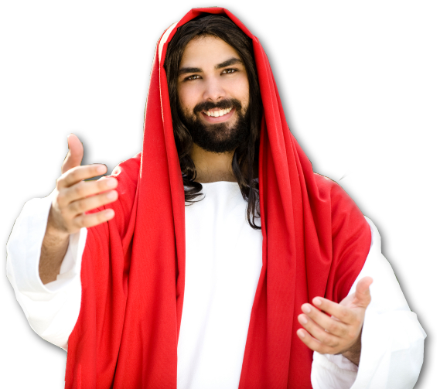
Who to Copycat: The Lord
Ephesians 5:1
Be imitators of God, therefore, as dearly loved children
Notes:
Jesus = LICENSED and NOT FOR REUSE. To reuse elsewhere get a license from http://www.dreamstime.com/jesus-the-bread-of-life-image1872806

Slide 3
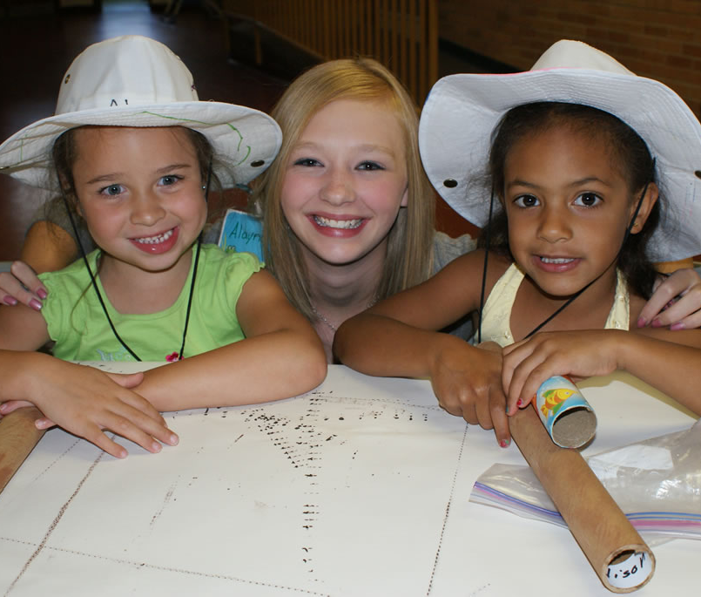
Who to Copycat: The Lord
Ephesians 5:1
Be imitators of God, therefore, as dearly loved children
Notes:
Children = FREE = from BiblePoint photos.

Slide 4

Who to Copycat: The Lord
² and live a life of love, just as Christ loved us and gave himself up for us as a fragrant offering and sacrifice to God.
Notes:
Heart = LICENSED and NOT FOR REUSE. To reuse get a license from http://www.istockphoto.com/stock-photo-2770344-valentines-heart-on-white-satin-background.php

Slide 5
What to Copycat
Notes:
Jesus on cross = FREE = from BiblePoint photos.

Slide 6
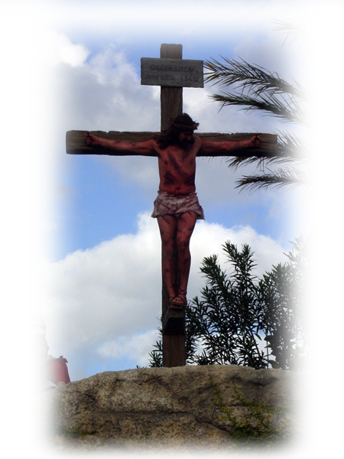
l Copycat Christ’s Love
² and live a life of love, just as Christ loved us and gave himself up for us as a fragrant offering and sacrifice to God.
Notes:
Jesus on cross = FREE = from BiblePoint photos.

Slide 7
l Copycat Christ’s Love
² and live a life of love, just as Christ loved us and gave himself up for us as a fragrant offering and sacrifice to God.
Notes:
Jesus on cross = FREE = from BiblePoint photos.
Altar = FREE = from http://commons.wikimedia.org/wiki/File:SaddleLele.JPG

Slide 8
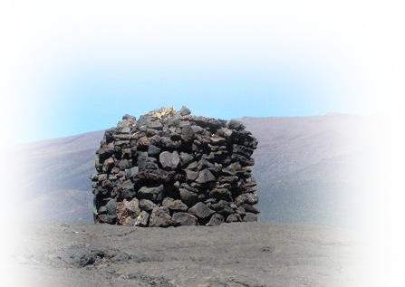
l Copycat Christ’s Love
² and live a life of love, just as Christ loved us and gave himself up for us as a fragrant offering and sacrifice to God.
Notes:
Jesus on cross = FREE = from BiblePoint photos.
Altar = FREE = from http://commons.wikimedia.org/wiki/File:SaddleLele.JPG

Slide 9
Why do you Copycat?
Because you Love Jesus!!!!

Slide 10
Those who love Jesus, will …

Slide 11


Those who love Jesus, will …
22 You were taught, with regard to your former way of life, to put off your old self, which is being corrupted by its deceitful desires;
24 and to put on the new self, created to be like God in true righteousness and holiness.

Slide 12
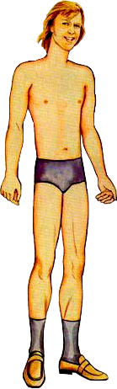


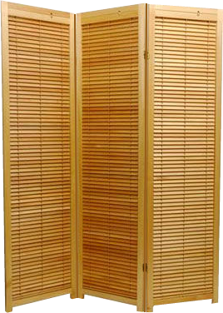
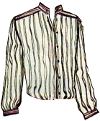
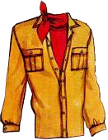
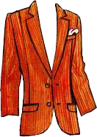


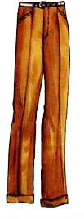



Slide 15
Don’t Just Change—Exchange!
22 You were taught, with regard to your former way of life, to put off your old self, which is being corrupted by its deceitful desires;
24 and to put on the new self, created to be like God in true righteousness and holiness.
23 to be made new
in the attitude of
your minds;

Slide 16

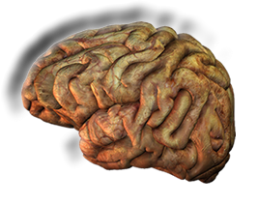
Get a New Attitude
(Mind Set)
For as he thinks in his heart, so is he.
-Prov 23:7 (NKJV)
Renew your mind! Romans 12:2
Notes:
Brain = LICENSED and NOT FOR REUSE. To reuse elsewhere get a License from http://www.dreamstime.com/royalty-free-stock-photos-diseased-human-brain-image13076568

Slide 17
Copycat l Christ’s Love—Not the world’s

Slide 18

³ But among you there must not be even a hint of sexual immorality, or of any kind of impurity, or of greed,
πορνεια
porneia
Notes:
XXX sign = FREE = from http://commons.wikimedia.org/wiki/File:XXX_Root_Beer_Original_Sign_2079px.jpg

Slide 19
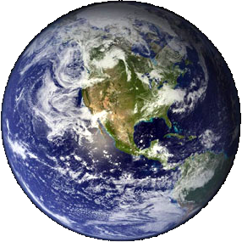
³ But among you there must not be even a hint of sexual immorality, or of any kind of impurity, or of greed,
Living together
before marriage!
Living together
before marriage!
“characteristic
of secular existence”
--Wood
Notes:
Western hemisphere = FREE = from http://commons.wikimedia.org/wiki/File:Earth_Western_Hemisphere.jpg
Skevington Wood Ephesians in The Expositor’s Bible Commentary vol 11 page 68.

Slide 20
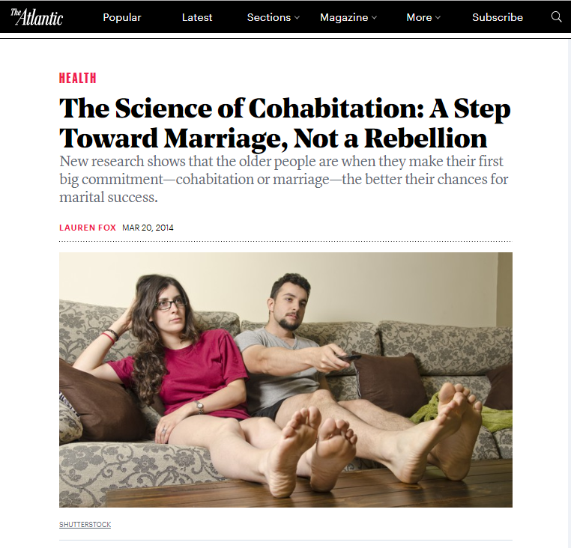
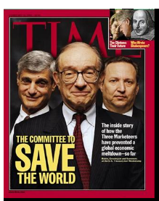
³ But among you there must not be even a hint of sexual immorality, or of any kind of impurity, or of greed,
33%
Notes:
Time magazine cover 1999.
The following is from https://www.theatlantic.com/health/archive/2014/03/the-science-of-cohabitation-a-step-toward-marriage-not-a-rebellion/284512/
Since the 1970’s, study after study found that living together before marriage could undercut a couple’s future happiness and ultimately lead to divorce. On average, researchers concluded that couples who lived together before they tied the knot saw a 33 percent higher rate of divorce than those who waited to live together until after they were married.
[So if you are already in the 60% bracket of divorce rate (age 18) and add 33% to it, you are 99% likely to end in divorce. Likewise, if you are in the 30% divorce rate bracket (age 23), you are 66% more likely to divorce.] bracketed are my comments based on the article
Re; cohabitation “2007 USA Today/Gallup poll found that just 27 percent of Americans disapproved of it. ” So 73% are ok with it. Unfortunately God is not.

Slide 21

³ But among you there must not be even a hint of sexual immorality, or of any kind of impurity, or of greed,
“a lust for more”--Wood
Notes:
Skevington Wood Ephesians in The Expositor’s Bible Commentary vol 11 page 68.
Temptation woman = LICENSED and NOT FOR REUSE. To reuse elsewhere get a license from http://www.dreamstime.com/beautiful-woman-holding-apple-image6542401

Slide 22

³ But among you there must not be even a hint of sexual immorality, or of any kind of impurity, or of greed,

Slide 23
l Copycat God’s Holiness
³ But among you there must not be even a hint of sexual immorality, or of any kind of impurity, or of greed,
because these are improper for God's holy people.

Slide 24

Point:
Don’t let Hollywood
put you in its mold!
Notes:
Hollywood Sign = FREE = from http://commons.wikimedia.org/wiki/File:Hollywood_Sign_PB050006.jpg

Slide 25

Point:
Don’t let Hollywood
put you in its mold!
Instead, let God put you in His mold!
How do you Copycat God’s HOLINESS?
Notes:
Praise = FREE = from http://www.sxc.hu/browse.phtml?f=download&id=700879

Slide 26
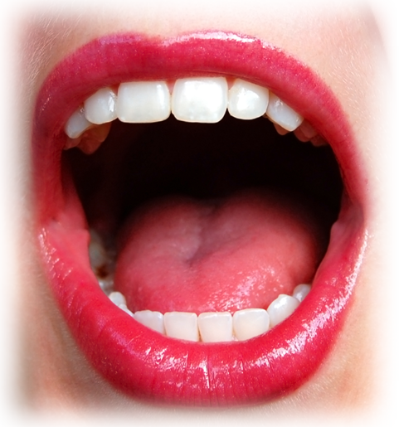
l Not Worldliness
⁴ Nor should there be obscenity, foolish talk or coarse joking, which are out
of place,
*!#]*
Notes:
Mouth = FREE = from www.sxc.hu/photo/837375

Slide 27
l Not Worldliness
⁴ Nor should there be obscenity, foolish talk or coarse joking, which are out
of place,
but rather thanksgiving.
Thanks
Notes:
Mouth = FREE = from www.sxc.hu/photo/837375

Slide 28
Why Copycat Holiness?
⁵ For of this you can be sure:

Slide 29
l For the Kingdom Sake
⁵ For of this you can be sure: No immoral, impure or greedy person--such a man is an idolater--has any inheritance in the kingdom of Christ and of God.

Slide 30
l For the Kingdom Sake
⁵ For of this you can be sure: No immoral, impure or greedy person--such a man is an idolater--has any inheritance in the kingdom of Christ and of God.
Notes:
XXX sign = FREE = from http://commons.wikimedia.org/wiki/File:XXX_Root_Beer_Original_Sign_2079px.jpg

Slide 31
l For the Kingdom Sake
⁵ For of this you can be sure: No immoral, impure or greedy person--such a man is an idolater--has any inheritance in the kingdom of Christ and of God.
Notes:
XXX sign = FREE = from http://commons.wikimedia.org/wiki/File:XXX_Root_Beer_Original_Sign_2079px.jpg

Slide 32
l For the Kingdom Sake
⁵ For of this you can be sure: No immoral, impure or greedy person--such a man is an idolater--has any inheritance in the kingdom of Christ and of God.
Notes:
XXX sign = FREE = from http://commons.wikimedia.org/wiki/File:XXX_Root_Beer_Original_Sign_2079px.jpg
Temptation woman = LICENSED and NOT FOR REUSE. To reuse elsewhere get a license from http://www.dreamstime.com/beautiful-woman-holding-apple-image6542401

Slide 33

l For the Kingdom Sake
⁵ For of this you can be sure: No immoral, impure or greedy person--such a man is an idolater--has any inheritance in the kingdom of Christ and of God.
Notes:
Oscar = FREE = from http://commons.wikimedia.org/wiki/File:Oscar_6.jpg

Slide 34
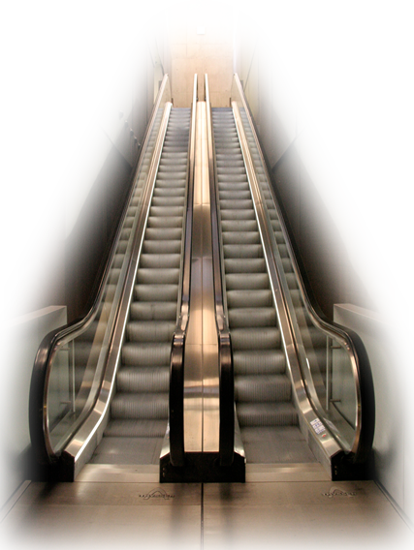
l For the Kingdom Sake
⁵ For of this you can be sure: No immoral, impure or greedy person--such a man is an idolater--has any inheritance in the kingdom of Christ and of God.
Notes:
Escalator = FREE =from http://www.sxc.hu/browse.phtml?f=download&id=721743

Slide 35
l For the Kingdom Sake
⁵ For of this you can be sure: No immoral, impure or greedy person--such a man is an idolater--has any inheritance in the kingdom of Christ and of God.
because these are improper for God's holy people. --Eph 5:3

Slide 36
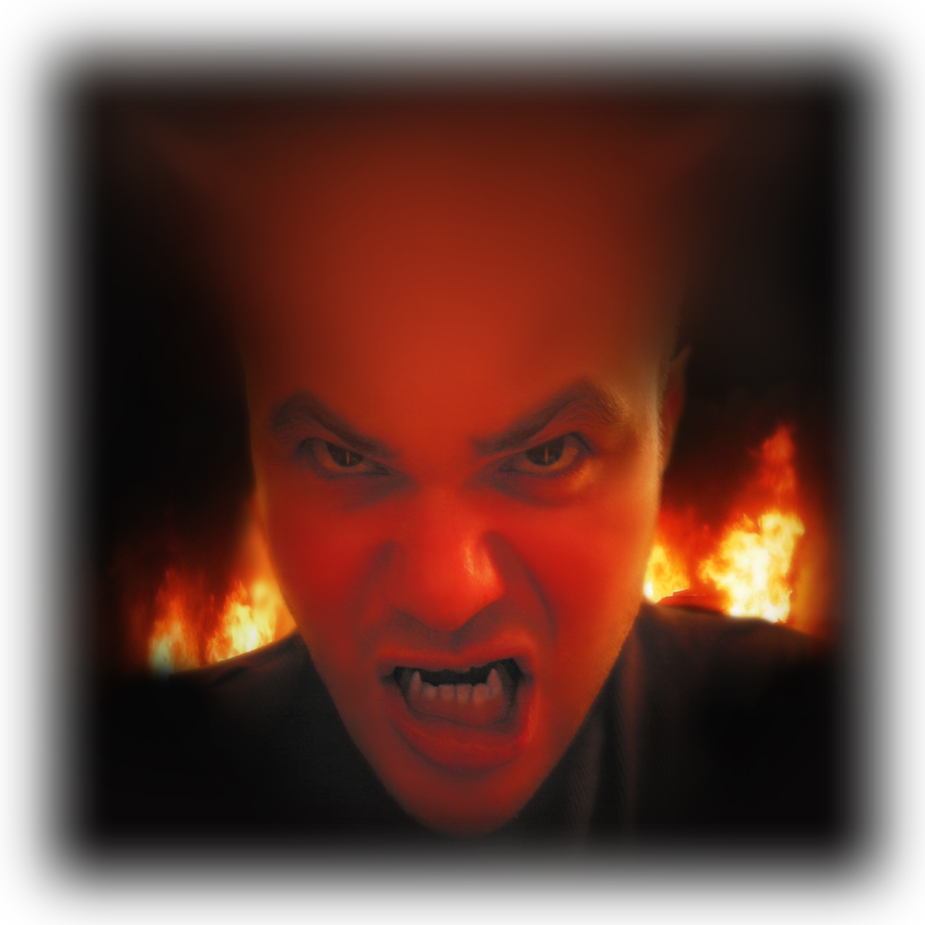
l For Obedience Sake
⁶ Let no one deceive you with empty words, for because of such things God's wrath comes on those who are disobedient.
Notes:
Devil = FREE = from http://www.sxc.hu/photo/229100

Slide 37
l For Obedience Sake
⁶ Let no one deceive you with empty words, for because of such things God's wrath comes on those who are disobedient.
Notes:
Devil = FREE = from http://www.sxc.hu/photo/229100

Slide 38
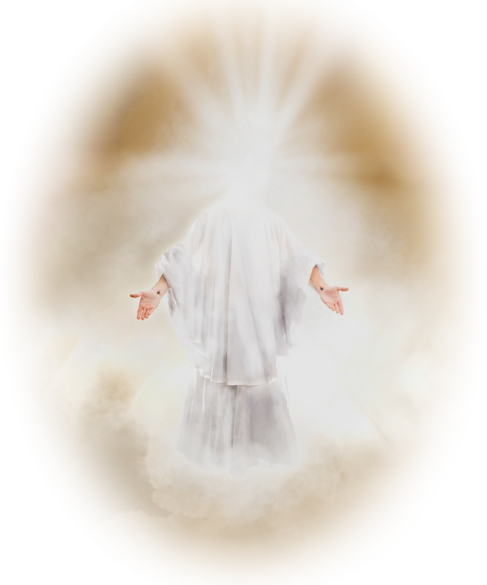
l For Obedience Sake
⁶ Let no one deceive you with empty words, for because of such things God's wrath comes on those who are disobedient.
Make every effort … to be holy; without holiness no one will see the Lord. --Hebrews 12:14
Notes:
Jesus in glory = LICENSED and NOT FOR REUSE. To reuse elsewhere get a license from http://www.istockphoto.com/stock-photo-7117793-second-coming.php

Slide 39

l For Obedience Sake
“Joint-sharers”
--Bruce
“Don’t get mixed-up with them”
--Wood
⁷ Therefore do not be partners with them.
Notes:
Handshake = LICENSED and NOT FOR REUSE. To reuse elsewhere get a license from http://www.istockphoto.com/stock-photo-2645441-man-and-woman-shaking-hands.php

Slide 40
l For the LIGHT’S Sake
⁸ For you were once darkness, but now you are light in the Lord.
Notes:
Handshake = LICENSED and NOT FOR REUSE. To reuse elsewhere get a license from http://www.istockphoto.com/stock-photo-2645441-man-and-woman-shaking-hands.php

Slide 41
l For the LIGHT’S Sake
⁸ For you were once darkness, but now you are light in the Lord.
Not just “in the dark”—but rather, you embodied darkness!
Notes:
Handshake = LICENSED and NOT FOR REUSE. To reuse elsewhere get a license from http://www.istockphoto.com/stock-photo-2645441-man-and-woman-shaking-hands.php

Slide 42
l For the LIGHT’S Sake
⁸ For you were once darkness, but now you are light in the Lord.

Slide 43
l For the LIGHT’S Sake
⁸ For you were once darkness, but now you are light in the Lord.
Live as children of light ⁹ (for the fruit of the light consists in all goodness, right-eousness and truth) ¹⁰ and find out what pleases the Lord.

Slide 44


l For the LIGHT’S Sake
MORAL EXELLENCE
⁷ Therefore do not be partners with them. ⁸ For you were once darkness, but now you are light in the Lord.
Live as children of light ⁹ (for the fruit of the light consists in all goodness, right-eousness and truth) ¹⁰ and find out what pleases the Lord.
Notes:
Paper and clip = FREE = from http://www.sxc.hu/browse.phtml?f=download&id=1307259

Slide 45

l For the LIGHT’S Sake
DO RIGHT
⁷ Therefore do not be partners with them. ⁸ For you were once darkness, but now you are light in the Lord.
Live as children of light ⁹ (for the fruit of the light consists in all goodness, right-eousness and truth) ¹⁰ and find out what pleases the Lord.
Notes:
Gavel = FREE = from http://www.sxc.hu/browse.phtml?f=view&id=952313

Slide 46
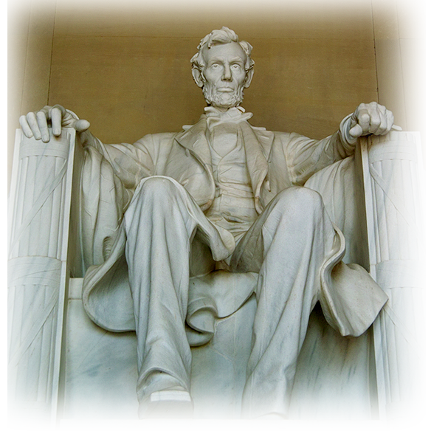
l For the LIGHT’S Sake
BE GENUINELY HONEST
Live as children of light ⁹ (for the fruit of the light consists in all goodness, right-eousness and truth) ¹⁰ and find out what pleases the Lord.
Notes:
Lincoln Memorial = FREE = from http://www.sxc.hu/photo/1002302

Slide 47
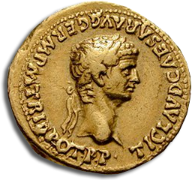
l For the LIGHT’S Sake
PLEASE GOD
⁷ Therefore do not be partners with them. ⁸ For you were once darkness, but now you are light in the Lord.
Live as children of light ⁹ (for the fruit of the light consists in all goodness, right-eousness and truth) ¹⁰ and find out what pleases the Lord.
What God Approves!
Notes:
Roman coin =FREE =from http://commons.wikimedia.org/wiki/File:Monetazione_Giulio-Claudii.jpg

Slide 48
How to Copycat
Notes:
Magnifying glass = FREE = from http://www.sxc.hu/photo/1080177

Slide 49
l Don’t Hide in Darkness
¹² For it is shameful even to mention what the disobedient do in secret.
¹¹ Have nothing to do with the fruitless deeds of darkness,
WHY?
Notes:
Magnifying glass = FREE = from http://www.sxc.hu/photo/1080177

Slide 50

l Turn on the Light
¹¹ Have nothing to do with the fruitless deeds of darkness,
but rather expose them.
Notes:
Magnifying glass = FREE = from http://www.sxc.hu/photo/1080177

Slide 51
WHY?
¹² For it is shameful even to mention what the disobedient do in secret.
¹³ But everything exposed by the light becomes visible ¹⁴ for it is light that makes everything visible.
Notes:
Magnifying glass = FREE = from http://www.sxc.hu/photo/1080177

Slide 52

l Wake Up!
This is why it is said: "Wake up, O sleeper, rise from the dead, and Christ will shine on you.”
Notes:
Clock = FREE = from Dreamstime_free2978470

Slide 53
l Wake Up!
This is why it is said: "Wake up, O sleeper, rise from the dead, and Christ will shine on you.”
You can make
life-change stick—
Just put off the old and put on the new!
Notes:
Clock = FREE = from Dreamstime_free2978470

Slide 54
Let’s become one!

Slide 55
Let’s Pray.

