Slide 1

Making Change Stick
Ephesians
4: 17-32
Notes:
Background = FREE = from BiblePoint art
Copyright © 2006−2020. All rights reserved. Bible Point is a registered trademark of Dennis Henderson. All other trademarks acknowledged.
Bible Point contains graphics from Bible Point artists. These illustrations belong to Bible Point and the respective artists. You may use the designs and illustrations for graphical illustration of lessons free and without special permission, provided they are not used in any way that maligns the Christian faith. Furthermore, republication or production of any illustration by any other graphic service whether it be in book, in a machine-readable form, or in any other design resource is strictly prohibited. Furthermore, they cannot be duplicated or resold as any other form of publishing, clip art, or graphic resource.
So What does it mean? (A simple translations of the legal jargon)
So, if you don’t own the presentation(s), graphic(s), and text(s) how can you legally use them? The purchase of the license allows you to use all the images in the product. However, the actual ownership and copyright of the presentation(s), graphic(s), and text(s) remain the property of Bible Point and its licensors. If you had plans on using this product in your “for sale” work—think again!
License Agreement
Article 1: License Grant
All the graphics and text in Bible Point presentations (excluding quotes from the Bible and stated sources) are the intellectual and real property of Bible Point and its licensors, and is protected by law, including United States copyright laws and international treaties. Bible Point grants to you a license:
1. To use the presentation in a single church, single school, or single office of a Christian organization.
2. To make a single archival back-up copy of the program.
3. To modify the presentation(s) and merge with other presentations in a single church, school, or Christian organization.
4. To transfer to another party if that party agrees to accept the terms and conditions of this agreement, and you do not retain any copies of the presentation, whether printed, machine readable, modified, or merged form.
Article 2: Terms
This license is effective until terminated. You may terminate the license at any time by destroying the presentation(s), graphic(s), or text(s) together with all copies, modifications and merged portions in any form. Bible Point may terminate your license if you fail to comply with this Agreement. You agree, upon such termination, for any reason, to destroy the presentation(s), graphics, and text(s) with all copies, modifications, and merged portions in any form.
Article 3: Disclaimers
1. Bible Point presentations, graphics, and texts are licensed to you As Is. You, the consumer, bear the entire risk relating to the quality and performance of the presentation(s), graphic(s), or text(s). In no event will Bible Point be liable for damages resulting from any defect.
2. Thirty-day limited warrantee on disks. Bible Point warrants the disks to be free of defects in material and workmanship under normal use for 30 days after purchase. During the 30-day period you may return a defective presentation, graphic, or text with proof of purchase and it will be replaced without charge, unless the presentation is damaged by misuse.
Article 4: General
1. You may not sub-license, assign, or transfer the license of the presentation(s), graphic(s), or text(s) except as provided by this Agreement.
2. This Agreement will be governed by the laws of the State of Michigan.
So What does it mean? (A simple translations of the legal jargon)
May I let someone borrow or copy my licensed Bible Point presentation (even after I modified it)? As long as it is within your local church, or single school, or the immediate office of a Christian organization you may. Otherwise, please refer the person interested in borrowing to: http://www.biblepoint.com or E-mail: dennis@drdh.net with any related questions.

Slide 2
Identify what needs changing.
¹⁷ So I tell you this,
and insist on it in
the Lord, that you
must no longer live
as the Gentiles do,

Slide 3

Identify what needs changing.
¹⁷ So I tell you this,
and insist on it in
the Lord, that you
must no longer live
as the Gentiles do,
Notes:
Multination flags = FREE = from http://commons.wikimedia.org/wiki/File:Expo_2010_flags_1.JPG

Slide 4

Identify what needs changing.
in the futility of their thinking.
Notes:
Empty Head modified = FREE = from http://upload.wikimedia.org/wikipedia/commons/f/f2/Adolph_Alexander_Weinman_by_Anthony_de_Francisci.gif

Slide 5
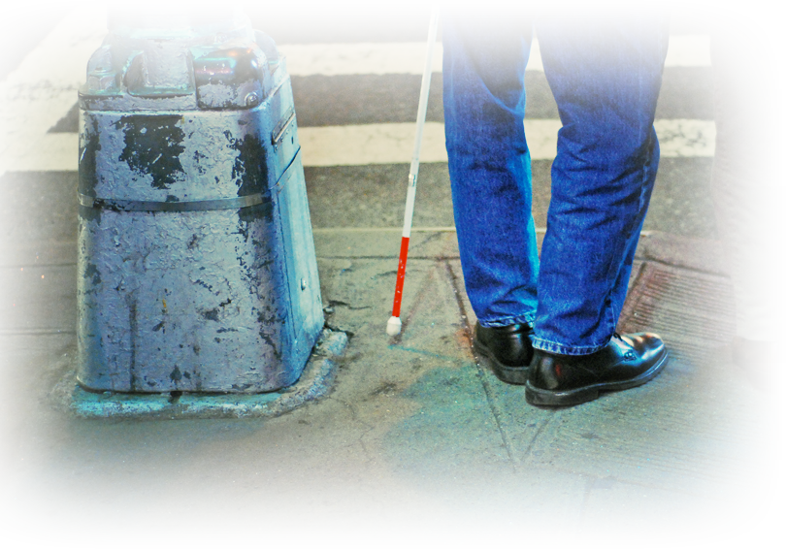
Identify what needs changing.
¹⁸ They are
darkened in their
understanding
Notes:
Blind man cane = FREE with credit to http://www.flickr.com/photos/moriza/479559318/sizes/o/in/photostream/

Slide 6


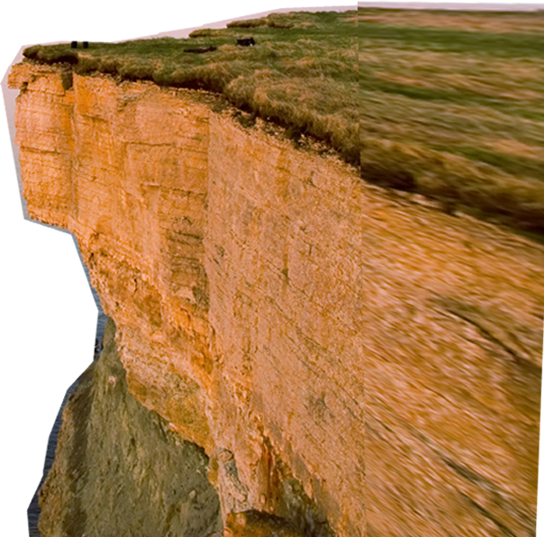
Identify what needs changing.
and separated from the life of God
Notes:
Cliffs = LICENSED and NOT FOR REUSE = Get a license from http://www.istockphoto.com/stock-photo-1645375-freedom-1.php

Slide 7

Identify what needs changing.
because of the ignorance that is in them.
Notes:
Dunce = LICENSED and NOT FOR REUSE. To reuse elsewhere get a license from www.bigstockphoto.com/image-851464/stock-photo-the-dunce

Slide 8

Identify what needs changing.
due to the hardening of their hearts.
Notes:
Heart of stone = FREE = from BiblePoint art

Slide 9

Identify what needs changing.
¹⁹ Having lost all sensitivity,
Notes:
Heart of stone = FREE = from BiblePoint art

Slide 10

Identify what needs changing.
they have given themselves over to sensuality so as to indulge in every kind of impurity, with a continual lust for more.
Notes:
XXX sign = FREE = from http://commons.wikimedia.org/wiki/File:XXX_Root_Beer_Original_Sign_2079px.jpg

Slide 11
Identify what needs changing.
they have given themselves over to sensuality so as to indulge in every kind of impurity, with a continual lust for more.
CONTINUALLY/HABITUALLY INDULGE
HABITS ARE HARD TO BREAK!

Slide 12

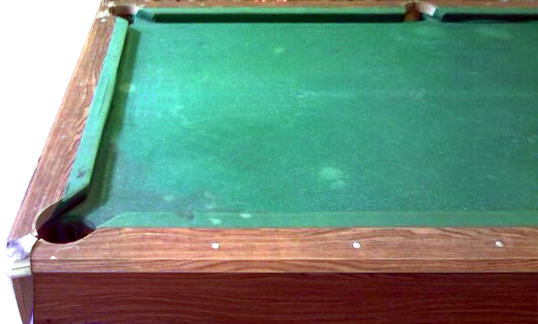


WHY? Because we get in a rut …

Slide 13


1962 For Galaxie

Slide 14


To Get Out of the Rut …

Slide 15

You Must Know Christ.
²⁰ You, however, did not come
to know Christ that way.
²¹ Surely you heard of him
and were taught in him in
accordance with the truth
that is in Jesus.
Notes:
Jesus = LICENSED and NOT FOR REUSE. To reuse elsewhere get a license from http://www.dreamstime.com/jesus-the-bread-of-life-image1872806

Slide 16
You Must Know Christ.
²⁰ You, however, did not come
to know Christ that way.
²¹ Surely you heard of him
and were taught in him in
accordance with the truth
that is in Jesus.
Notes:
Jesus = LICENSED and NOT FOR REUSE. To reuse elsewhere get a license from http://www.dreamstime.com/jesus-the-bread-of-life-image1872806

Slide 17
You Must Know Christ.
²⁰ You, however, did not come
to know Christ that way.
²¹ Surely you heard of him
and were taught in him in
accordance with the truth
that is in Jesus.
Notes:
Jesus = LICENSED and NOT FOR REUSE. To reuse elsewhere get a license from http://www.dreamstime.com/jesus-the-bread-of-life-image1872806

Slide 18
You Must Know Christ.
²⁰ You, however, did not come
to know Christ that way.
²¹ Surely you heard of him
and were taught in him in
accordance with the truth
that is in Jesus.

Slide 19
You Must Know Christ.
²⁰ You, however, did not come
to know Christ that way.
²¹ Surely you heard of him
and were taught in him in
accordance with the truth
that is in Jesus.
“I know Christ and I still struggle with life-change!”

Slide 20





Don’t Just Change—Exchange!
Notes:
Police Officer = LICENSED and NOT FOR REUSE. To reuse elsewhere get a license from http://www.dreamstime.com/police-officer-stop-image3351733

Slide 21
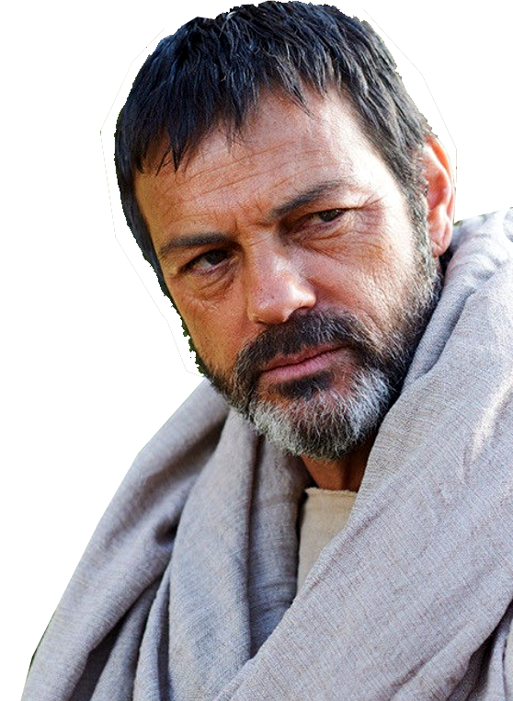
Don’t Just Change—Exchange!
22 You were taught, with regard to your former way
of life, to put off your old self, which is being corrupted by its deceitful desires;
Notes:
Paul = FREE = from Bible Point photos.

Slide 22
Don’t Just Change—Exchange!
22 You were taught, with regard to your former way of life, to put off your old self, which is being corrupted by its deceitful desires;
24 and to put on the new self, created to be like God in true righteousness and holiness.

Slide 23
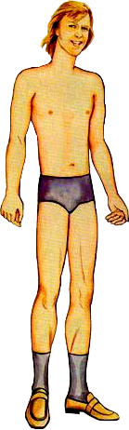



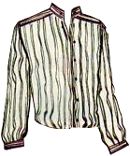
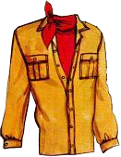



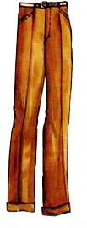



Slide 26
Don’t Just Change—Exchange!
22 You were taught, with regard to your former way of life, to put off your old self, which is being corrupted by its deceitful desires;
24 and to put on the new self, created to be like God in true righteousness and holiness.
23 to be made new
in the attitude of
your minds;

Slide 27
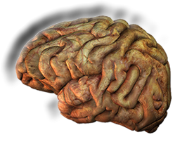
Get a New Attitude (Mind Set)
For as he thinks in his heart, so is he.
Prov. 23:7 (NKJV)
Renew your mind! Romans 12:2
Notes:
Brain = LICENSED and NOT FOR REUSE. To reuse elsewhere get a License from http://www.dreamstime.com/royalty-free-stock-photos-diseased-human-brain-image13076568

Slide 28
Get a New Attitude (Mind Set)
⁴ The weapons we fight with are not the weapons of the world. On the contrary, they have divine power to demolish strongholds. ⁵ We demolish arguments and every pretension that sets itself up against the knowledge of God, and we take captive every thought to make it obedient to Christ. 2 Corinthians 10:4-5

Slide 29
Live the Exchanged Life!

Slide 30

STOP LYING
²⁵ Therefore each of you must put off falsehood
LIES
Notes:
Mouth = FREE = from www.sxc.hu/photo/837375

Slide 31
START TRUTHING
²⁵ Therefore each of you must put off falsehood
and speak truthfully to his neighbor, for we are all members of one body.
TRUTH
Notes:
Mouth = FREE = from www.sxc.hu/photo/837375

Slide 32

STOP STUFFING
do not let the sun go down on your anger, ²⁷ and do not give the devil an opportunity.
(NAS)

Slide 33

START RELEASING
do not let the sun go down on your anger, ²⁷ and do not give the devil an opportunity.
(NAS)
²⁶ “Be angry, and yet do not sin; (NAS)
Notes:
Fist = FREE = from http://www.sxc.hu/browse.phtml?f=download&id=131307

Slide 34

STOP STEALING
²⁸ He who has been stealing must steal
no longer,
Notes:
Thief = LICENSED and NOT FOR REUSE. To reuse elsewhere get a license from http://www.dreamstime.com/wallet-thief-image8140984
"Will a man rob God? Yet you rob me. "But you ask, 'How do we rob you?' "In tithes and offerings. (Mal 3:8 NIV)

Slide 35

START SHARING!
²⁸ He who has been stealing must steal
no longer,
but must work, doing something useful with his own hands, that he may have something to share with those in need.

Slide 36
STOP CURSING
²⁹ Do not let any unwhole-some talk
come out of your mouths,
*!#]*
Notes:
Mouth = FREE = from www.sxc.hu/photo/837375

Slide 37
START PRAISING
²⁹ Do not let any unwhole-some talk
come out of your mouths,
but only what is helpful for build-ing others up according to their needs, that it may benefit those who listen.
Praise
Notes:
Mouth = FREE = from www.sxc.hu/photo/837375

Slide 38

STOP GREIVING
³⁰ And do not grieve the Holy Spirit of God,
Notes:
Dove = LICENSED and NOT FOR REUSE. To reuse elsewhere get a license from http://www.istockphoto.com/stock-photo-9179621-pigoen-flying.php

Slide 39

START SHOWING THE SEAL
³⁰ And do not grieve the Holy Spirit of God,
with whom you were sealed for the day of redemption.
Notes:
Scroll = LICENSED and NOT FOR REUSE. To reuse elsewhere get license from http://www.istockphoto.com/stock-photo-9551866-sealed-scroll-document.php

Slide 40

STOP HOSTILITY!
³¹ Get rid of all bitterness, rage and anger, brawl-ing and slander, along with every form of malice.
Notes:
Woman Yelling = FREE = from http://www.sxc.hu/photo/1192051

Slide 41


START KINDNESS!
³¹ Get rid of all bitterness, rage and anger, brawl-ing and slander, along with every form of malice.
³² Be kind and compassionate to one another, for-giving each other, just as in Christ God forgave you.
Notes:
Hand and rope =LICENSED and NOT FOR REUSE. To reuse elsewhere, get a license from http://www.bigstockphoto.com/image-1859756/stock-photo-hand-pulling-rop

Slide 42
A few thoughts to take home:
Identify what you need to change.
Really “Know” Christ.
Don’t just change –exchange!
Do so in practical ways—put off and put on.
Renew your mind.
Let’s Pray

