Slide 1
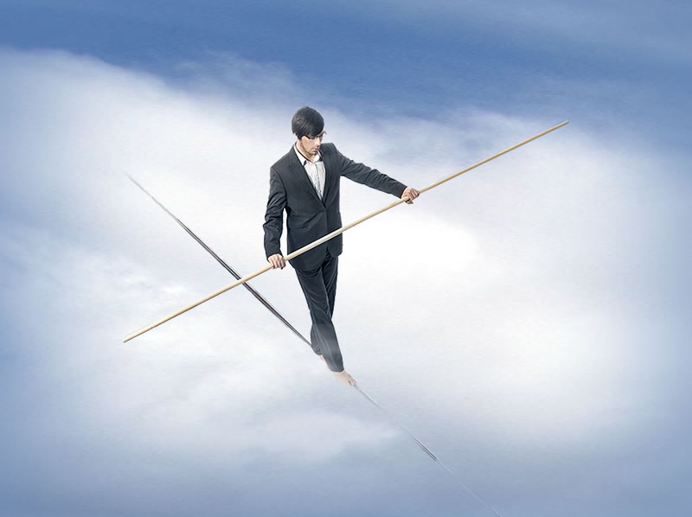
Ephesians 4:1-6
Notes:
Background Sky = FREE = from http://www.sxc.hu/browse.phtml?f=download&id=1344746
Tightrope woalker = LICENSED and NOT FOR REUSE. To reuse get a license from http://www.bigstockphoto.com/image-12124376/stock-photo-businessman-walking-a-tightrope
Copyright © 2006−2020. All rights reserved. Bible Point is a registered trademark of Dennis Henderson. All other trademarks acknowledged.
Bible Point contains graphics from Bible Point artists. These illustrations belong to Bible Point and the respective artists. You may use the designs and illustrations for graphical illustration of lessons free and without special permission, provided they are not used in any way that maligns the Christian faith. Furthermore, republication or production of any illustration by any other graphic service whether it be in book, in a machine-readable form, or in any other design resource is strictly prohibited. Furthermore, they cannot be duplicated or resold as any other form of publishing, clip art, or graphic resource.
So What does it mean? (A simple translations of the legal jargon)
So, if you don’t own the presentation(s), graphic(s), and text(s) how can you legally use them? The purchase of the license allows you to use all the images in the product. However, the actual ownership and copyright of the presentation(s), graphic(s), and text(s) remain the property of Bible Point and its licensors. If you had plans on using this product in your “for sale” work—think again!
License Agreement
Article 1: License Grant
All the graphics and text in Bible Point presentations (excluding quotes from the Bible and stated sources) are the intellectual and real property of Bible Point and its licensors, and is protected by law, including United States copyright laws and international treaties. Bible Point grants to you a license:
1. To use the presentation in a single church, single school, or single office of a Christian organization.
2. To make a single archival back-up copy of the program.
3. To modify the presentation(s) and merge with other presentations in a single church, school, or Christian organization.
4. To transfer to another party if that party agrees to accept the terms and conditions of this agreement, and you do not retain any copies of the presentation, whether printed, machine readable, modified, or merged form.
Article 2: Terms
This license is effective until terminated. You may terminate the license at any time by destroying the presentation(s), graphic(s), or text(s) together with all copies, modifications and merged portions in any form. Bible Point may terminate your license if you fail to comply with this Agreement. You agree, upon such termination, for any reason, to destroy the presentation(s), graphics, and text(s) with all copies, modifications, and merged portions in any form.
Article 3: Disclaimers
1. Bible Point presentations, graphics, and texts are licensed to you As Is. You, the consumer, bear the entire risk relating to the quality and performance of the presentation(s), graphic(s), or text(s). In no event will Bible Point be liable for damages resulting from any defect.
2. Thirty-day limited warrantee on disks. Bible Point warrants the disks to be free of defects in material and workmanship under normal use for 30 days after purchase. During the 30-day period you may return a defective presentation, graphic, or text with proof of purchase and it will be replaced without charge, unless the presentation is damaged by misuse.
Article 4: General
1. You may not sub-license, assign, or transfer the license of the presentation(s), graphic(s), or text(s) except as provided by this Agreement.
2. This Agreement will be governed by the laws of the State of Michigan.
So What does it mean? (A simple translations of the legal jargon)
May I let someone borrow or copy my licensed Bible Point presentation (even after I modified it)? As long as it is within your local church, or single school, or the immediate office of a Christian organization you may. Otherwise, please refer the person interested in borrowing to: http://www.biblepoint.com or E-mail: dennis@drdh.net with any related questions.

Slide 2
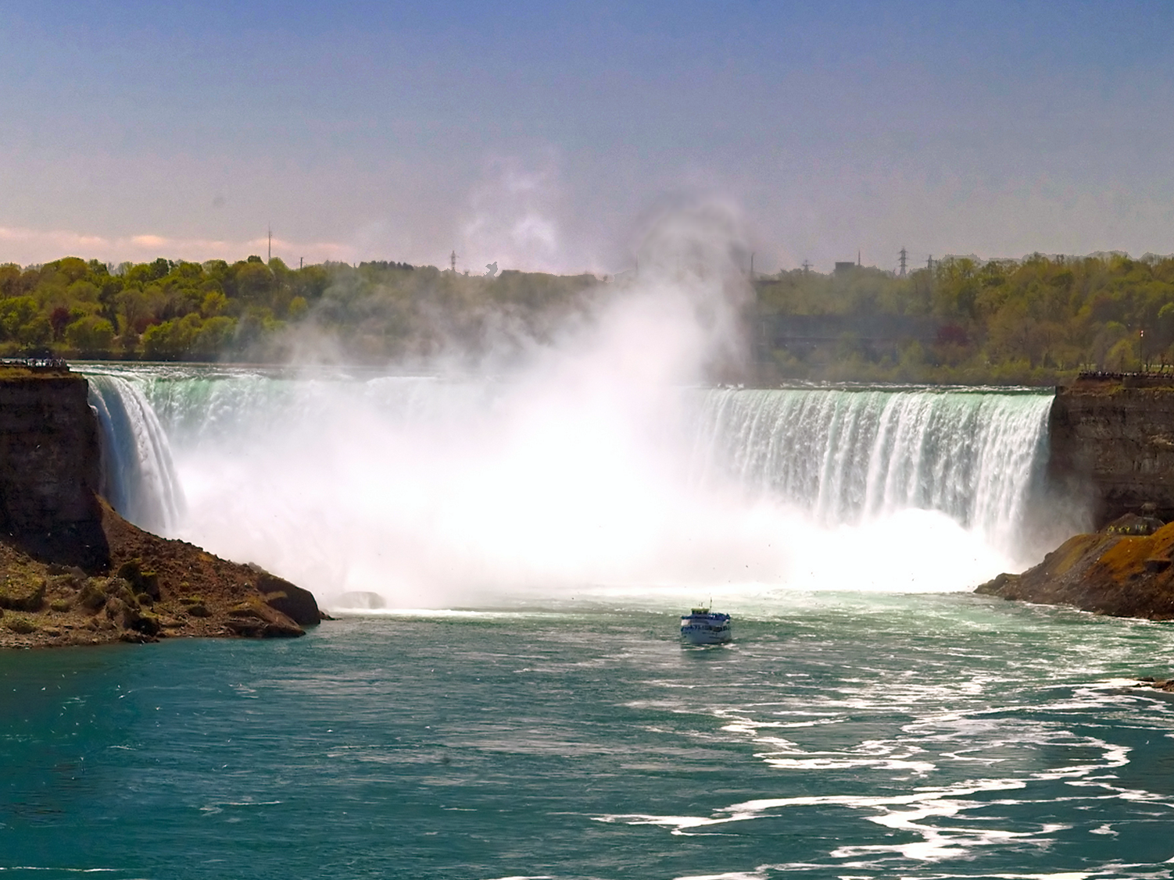
“The Great Blondin”
2,000 foot @ ½ mile
3 inch rope
25,000 onlookers
Notes:
Niagara Falls = FREE = from http://www.dreamstime.com/niagara-falls-free-stock-photography-imagefree2716427
Charles Blondin (born Jean François Gravelet, 28 February 1824 – 22 February 1897) was a French tightrope walker and acrobat. He toured the United States, and was known for crossing the 1,100 ft (340 m) Niagara Gorge on a tightrope.

Slide 3
Ephesians 4:1-6
Notes:
Background Sky = FREE = from http://www.sxc.hu/browse.phtml?f=download&id=1344746
Tightrope woalker = LICENSED and NOT FOR REUSE. To reuse get a license from http://www.bigstockphoto.com/image-12124376/stock-photo-businessman-walking-a-tightrope

Slide 4
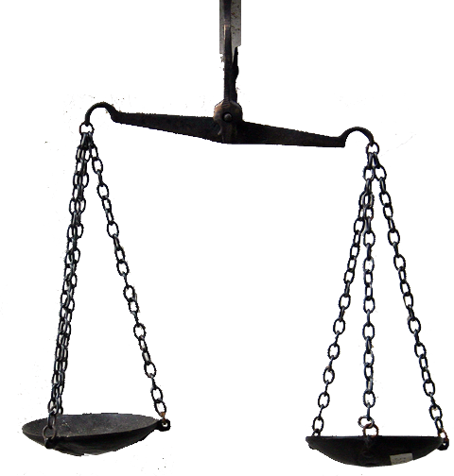
YES, it’s a fact,
God desires us to “Balance our Lives”
Teaching of Eph 1-3
Living of
Eph 4-6
Therefore,
walk
4:1 As a prisoner for the Lord, then, I urge you to live a life worthy of the calling you have received.
Notes:
Balance = LICENSED and NOT FOR REUSE. To reuse get a license from http://www.dreamstime.com/balance-image3364763
Worthy – literally means “to bring up the other beam of the scales” and hence indicates equivalence (TDNT, 1:379)

Slide 5
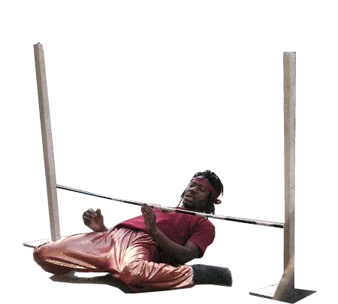
HOW? Answer: HUMBLY
² Be completely humble and gentle; be patient, bearing with one another in love. ³ Make every effort to keep the unity of the Spirit through the bond of peace.
Limbo
Lowliness
Notes:
Limbo = FREE = from http://en.wikipedia.org/wiki/File:Limbo.jpg

Slide 6

HOW? Answer: GENTLY
² Be completely humble and gentle; be patient, bearing with one another in love. ³ Make every effort to keep the unity of the Spirit through the bond of peace.
“Between two
extremes” --Aristotle
“A God-controlled
person” --Barclay
Meekness
Notes:
Limbo = FREE = from http://en.wikipedia.org/wiki/File:Limbo.jpg

Slide 7

HOW? Answer: PATIENTLY
² Be completely humble and gentle; be patient, bearing with one another in love. ³ Make every effort to keep the unity of the Spirit through the bond of peace.
“never make peace
under defeat” --Barclay
Notes:
Limbo = FREE = from http://en.wikipedia.org/wiki/File:Limbo.jpg

Slide 8
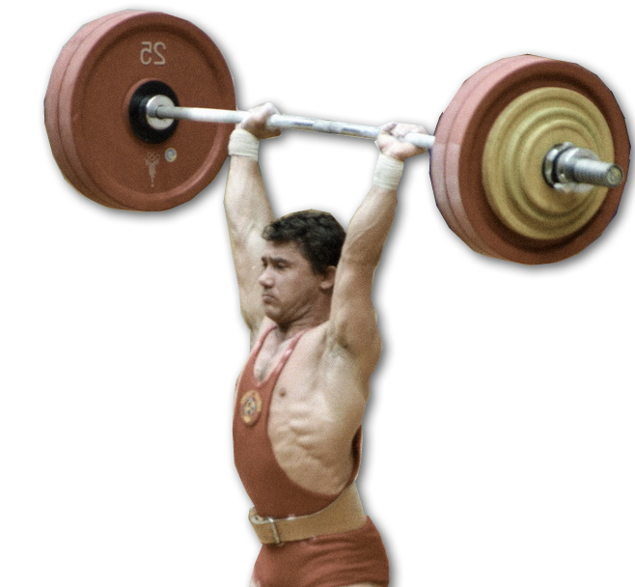
HOW? Answer: BEARING with
² Be completely humble and gentle; be patient, bearing with one another in love. ³ Make every effort to keep the unity of the Spirit through the bond of peace.
“To hold/lift up”
--Liddell-Scott
Notes:
Limbo = FREE = from http://en.wikipedia.org/wiki/File:Limbo.jpg

Slide 9

HOW? Answer: LOVINGLY
² Be completely humble and gentle; be patient, bearing with one another in love. ³ Make every effort to keep the unity of the Spirit through the bond of peace.
It’s a “thing,
not only of the emotions,
but of the
will.”
--Barclay
“This Christian
agape,
love, is not an
emotional
thing”
--Barclay
“Unconquerable
benevolence” --Barclay
Notes:
Limbo = FREE = from http://en.wikipedia.org/wiki/File:Limbo.jpg

Slide 10
HOW? Answer: SELFLESSLY
² Be completely humble and gentle; be patient, bearing with one another in love. ³ Make every effort to keep the unity of the Spirit through the bond of peace.
All depend on
one thing:
“the obliteration
of SELF.”
Notes:
Limbo = FREE = from http://en.wikipedia.org/wiki/File:Limbo.jpg

Slide 11
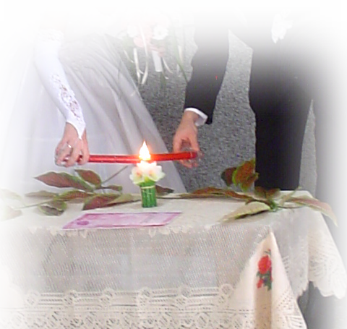
HOW? Answer: UNITINGLY
“A state of oneness, unity, unison.” --Thayer
² Be completely humble and gentle; be patient, bearing with one another in love. ³ Make every effort to keep the unity of the Spirit through the bond of peace.
Notes:
Limbo = FREE = from http://en.wikipedia.org/wiki/File:Limbo.jpg

Slide 12


HOW? Answer: PEACEFULLY
² Be completely humble and gentle; be patient, bearing with one another in love. ³ Make every effort to keep the unity of the Spirit through the bond of peace.
Notes:
Limbo = FREE = from http://en.wikipedia.org/wiki/File:Limbo.jpg

Slide 13
WHY
He desires us to “Balance our Lives”
1
O
N
E
N
E
S
S

Slide 14
WHY
He desires us to “Balance our Lives”
1
⁴ There is one body and one Spirit--just as you were called to one hope when you were called-- ⁵ one Lord, one faith, one baptism; ⁶ one God and Father of all, who is over all and through all and in all.
O
N
E
N
E
S
S

Slide 15

WHY? Answer: One BODY
⁴ There is one body and one Spirit--just as you were called to one hope when you were called-- ⁵ one Lord, one faith, one baptism; ⁶ one God and Father of all, who is over all and through all and in all.

Slide 16

WHY? Answer: One SPIRIT
⁴ There is one body and one Spirit--just as you were called to one hope when you were called-- ⁵ one Lord, one faith, one baptism; ⁶ one God and Father of all, who is over all and through all and in all.

Slide 17

WHY? Answer: One HOPE
⁴ There is one body and one Spirit--just as you were called to one hope when you were called-- ⁵ one Lord, one faith, one baptism; ⁶ one God and Father of all, who is over all and through all and in all.

Slide 18
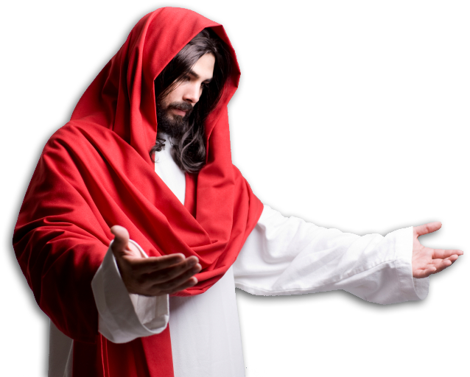
WHY? Answer: One LORD
⁴ There is one body and one Spirit--just as you were called to one hope when you were called-- ⁵ one Lord, one faith, one baptism; ⁶ one God and Father of all, who is over all and through all and in all.

Slide 19
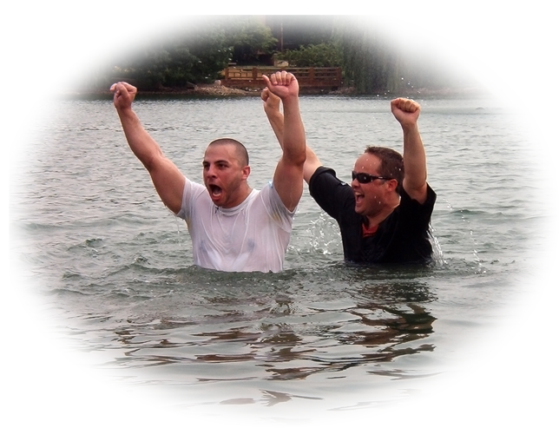
WHY? Answer: One BAPTISM
⁴ There is one body and one Spirit--just as you were called to one hope when you were called-- ⁵ one Lord, one faith, one baptism; ⁶ one God and Father of all, who is over all and through all and in all.

Slide 20

WHY? Answer: One GOD
⁴ There is one body and one Spirit--just as you were called to one hope when you were called-- ⁵ one Lord, one faith, one baptism; ⁶ one God and Father of all, who is over all and through all and in all.

Slide 21
WHY? Answer: One GOD
⁴ There is one body and one Spirit--just as you were called to one hope when you were called-- ⁵ one Lord, one faith, one baptism; ⁶ one God and Father of all, who is over all and through all and in all.

Slide 22
WHY? Answer: One GOD
⁴ There is one body and one Spirit--just as you were called to one hope when you were called-- ⁵ one Lord, one faith, one baptism; ⁶ one God and Father of all, who is over all and through all and in all.

Slide 23
WHY? Answer: One GOD
⁴ There is one body and one Spirit--just as you were called to one hope when you were called-- ⁵ one Lord, one faith, one baptism; ⁶ one God and Father of all, who is over all and through all and in all.
POWER
PROVIDENCE
PRESENCE

Slide 24

WHY? Answer: One FAITH
⁴ There is one body and one Spirit--just as you were called to one hope when you were called-- ⁵ one Lord, one faith, one baptism; ⁶ one God and Father of all, who is over all and through all and in all.

Slide 25
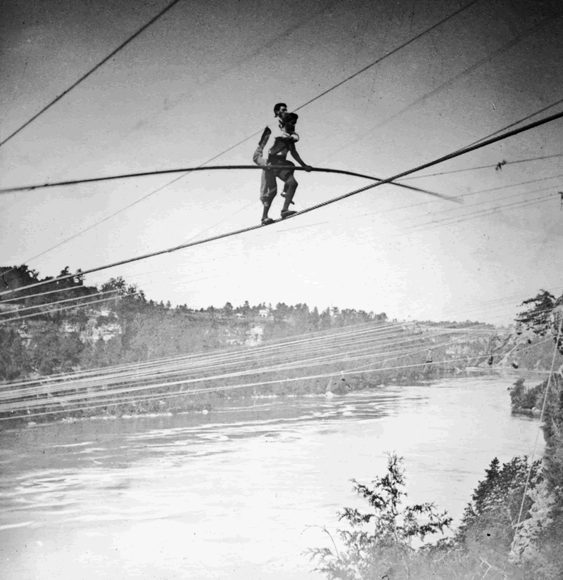
Returning to “The Great Blondin”
In 1859 – His greatest feat
involved his manager: Harry Colcord
Notes:
Blondin with Manager on back = actual photo

Slide 26
So, how about it?
Will you trust Him!

Slide 27
Let’s Pray!

