Slide 1

Notes:
Background gold bars are licensed from http://www.bigstockphoto.com/image-2766296/stock-photo-gold-bars to reuse go and license your own copy.
Copyright © 2006−2020. All rights reserved. Bible Point is a registered trademark of Dennis Henderson. All other trademarks acknowledged.
Bible Point contains graphics from Bible Point artists. These illustrations belong to Bible Point and the respective artists. You may use the designs and illustrations for graphical illustration of lessons free and without special permission, provided they are not used in any way that maligns the Christian faith. Furthermore, republication or production of any illustration by any other graphic service whether it be in book, in a machine-readable form, or in any other design resource is strictly prohibited. Furthermore, they cannot be duplicated or resold as any other form of publishing, clip art, or graphic resource.
So What does it mean? (A simple translations of the legal jargon)
So, if you don’t own the presentation(s), graphic(s), and text(s) how can you legally use them? The purchase of the license allows you to use all the images in the product. However, the actual ownership and copyright of the presentation(s), graphic(s), and text(s) remain the property of Bible Point and its licensors. If you had plans on using this product in your “for sale” work—think again!
License Agreement
Article 1: License Grant
All the graphics and text in Bible Point presentations (excluding quotes from the Bible and stated sources) are the intellectual and real property of Bible Point and its licensors, and is protected by law, including United States copyright laws and international treaties. Bible Point grants to you a license:
1. To use the presentation in a single church, single school, or single office of a Christian organization.
2. To make a single archival back-up copy of the program.
3. To modify the presentation(s) and merge with other presentations in a single church, school, or Christian organization.
4. To transfer to another party if that party agrees to accept the terms and conditions of this agreement, and you do not retain any copies of the presentation, whether printed, machine readable, modified, or merged form.
Article 2: Terms
This license is effective until terminated. You may terminate the license at any time by destroying the presentation(s), graphic(s), or text(s) together with all copies, modifications and merged portions in any form. Bible Point may terminate your license if you fail to comply with this Agreement. You agree, upon such termination, for any reason, to destroy the presentation(s), graphics, and text(s) with all copies, modifications, and merged portions in any form.
Article 3: Disclaimers
1. Bible Point presentations, graphics, and texts are licensed to you As Is. You, the consumer, bear the entire risk relating to the quality and performance of the presentation(s), graphic(s), or text(s). In no event will Bible Point be liable for damages resulting from any defect.
2. Thirty-day limited warrantee on disks. Bible Point warrants the disks to be free of defects in material and workmanship under normal use for 30 days after purchase. During the 30-day period you may return a defective presentation, graphic, or text with proof of purchase and it will be replaced without charge, unless the presentation is damaged by misuse.
Article 4: General
1. You may not sub-license, assign, or transfer the license of the presentation(s), graphic(s), or text(s) except as provided by this Agreement.
2. This Agreement will be governed by the laws of the State of Michigan.
So What does it mean? (A simple translations of the legal jargon)
May I let someone borrow or copy my licensed Bible Point presentation (even after I modified it)? As long as it is within your local church, or single school, or the immediate office of a Christian organization you may. Otherwise, please refer the person interested in borrowing to: http://www.biblepoint.com or E-mail: dennis@drdh.net with any related questions.

Slide 2



God the Father
Chose Us
Notes:
Check Mark = FREE = from BiblePoint art.

Slide 3

God the Son
Redeemed Us
Notes:
Nailed hand = LICENSED and NOT FOR REUSE. To reuse get a license from http://www.istockphoto.com/stock-photo-5625751-crucified.php

Slide 4

God the Holy Spirit
Sealed Us
Notes:
Scroll = LICENSED and NOT FOR REUSE. To reuse get a license at http://www.istockphoto.com/stock-photo-9551866-sealed-scroll-document.php

Slide 5
The Father, Son and
Holy Spirit did all that because …

Slide 6

God Has a
Wonderful Plan for Your Life

Slide 7
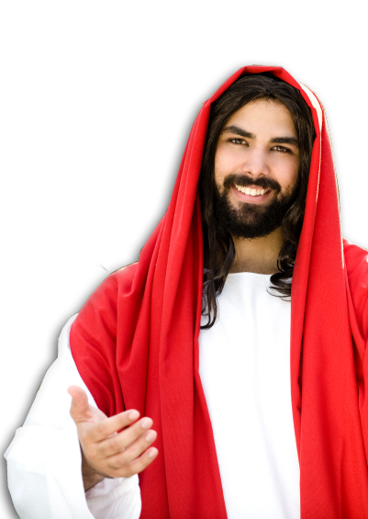
That we “Know” …
Him Better
His Hope Better
His Power Better
Notes:
Jesus = LICENSED and NOT for reuse elsewhere. To reuse get your own license from = istock_000007254772
According to the Greek-English Lexicon of the New Testament based on Semantic Domains, Vol 1., p.334., entry 28.2 epiginsko means : “to possess more or less definite information, possibly with a degree of thoroughness or competence“
Same page entry 27.61 says: “to identify newly acquired information with what had been previously learned or known –’to recognize.’ On page 382, entry 32.16 “to come to understand as the result of ability to experience and learn.”

Slide 8
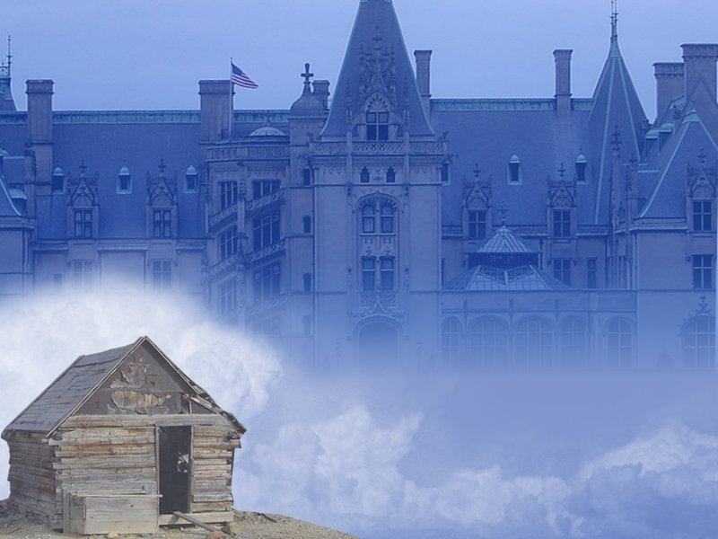
Next we learned that we:
Traded
Places
Notes:
Background: Biltmore Estate = FREE = http://upload.wikimedia.org/wikipedia/commons/8/8c/Biltmore_Estate-27527-2.jpg
Background: shack = FREE = http://upload.wikimedia.org/wikipedia/commons/1/1b/Animas_Forks_shack.jpg

Slide 9


We traded:
1-Our OLD place
Notes:
Feet = LICENSED and NOT FOR REUSE. To reuse get a license from http://www.dreamstime.com/dead-man-image5065173

Slide 10



For:
2-Our NEW place
Notes:
Jesus on Throne = FREE = from BiblePoint art.

Slide 11

and:
3-How it Changed
Notes:
Gift box = Licensed = NOT FOR REUSE. To reuse get your license from http://www.dreamstime.com/gift-image9378333

Slide 12


Slide 13



BEFORE
AFTER
Notes:
Hair to bald = FREE = BiblePoint photos.

Slide 14
Three Awesome
“Before & After” Pictures
Before After
Separated Near
Hostility Peace
Aliens Citizens

Slide 15
LAST TIME ...
We let you in on a secret ...

Slide 16

Ephesians 3: 1-11
Notes:
Secret Agent AKA Jesus Christ Logo = FREE = from BiblePoint art.

Slide 17

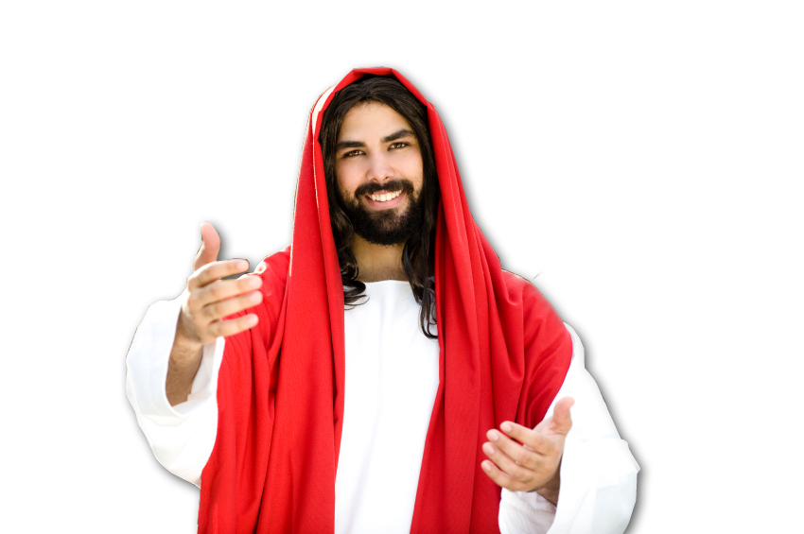
The Secret Agent Man
²⁷ … this mystery, which is Christ in you, the hope of glory. (Col 1:27 )
Notes:
Jesus = LICENSED and NOT FOR REUSE. Get a license from http://www.istockphoto.com/stock-photo-7302839-waiting-for-you.php
Man open shirt = BiblePoint photo.

Slide 18

DISCOURAGED?
Notes:
Couple = LICENSED and NOT FOR REUSE. To reuse get a license from http://www.istockphoto.com/stock-photo-4104003-breakfast.php

Slide 19
What I need is a miracle or something?
Notes:
Couple = LICENSED and NOT FOR REUSE. To reuse get a license from http://www.istockphoto.com/stock-photo-4104003-breakfast.php

Slide 20
I can’t help with
the miracle--
Notes:
Couple = LICENSED and NOT FOR REUSE. To reuse get a license from http://www.istockphoto.com/stock-photo-4104003-breakfast.php

Slide 21
but I can help
with the “or something.”
Notes:
Couple = LICENSED and NOT FOR REUSE. To reuse get a license from http://www.istockphoto.com/stock-photo-4104003-breakfast.php

Slide 22
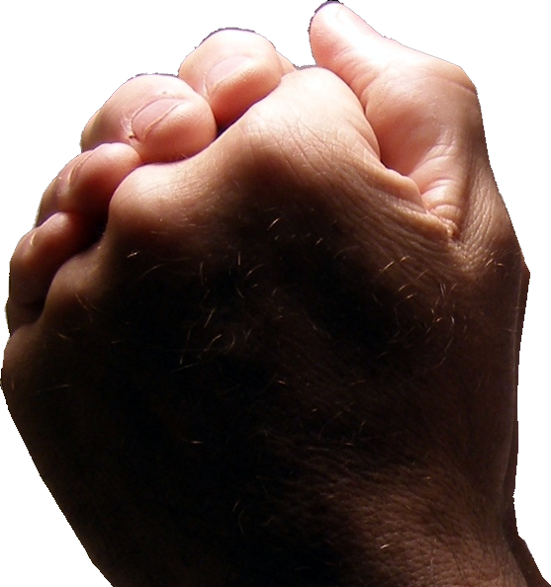
PRAYER
¹³ I ask you, therefore, not to be discouraged ..... ¹⁴ For this reason I kneel before the Father, ¹⁵ from whom his whole
family in heaven and on earth
derives its name. ¹⁶ I pray …
Notes:
Praying Hands = FREE = from http://www.sxc.hu/browse.phtml?f=download&id=405036

Slide 23

DISCOURAGMENT thrives on feeling
1) Powerless
2) Lonely
3) Unloved
4) Unfulfilled
1) Powerless
2) Lonely
3) Unloved
4) Unfulfilled
Notes:
Lady = LICENSED and NOT FOR REUSE. To reuse get a license from http://www.istockphoto.com/stock-photo-4104003-breakfast.php

Slide 24
PAUL PRAYS for…
Notes:
Praying Hands = FREE = from http://www.sxc.hu/browse.phtml?f=download&id=405036

Slide 25
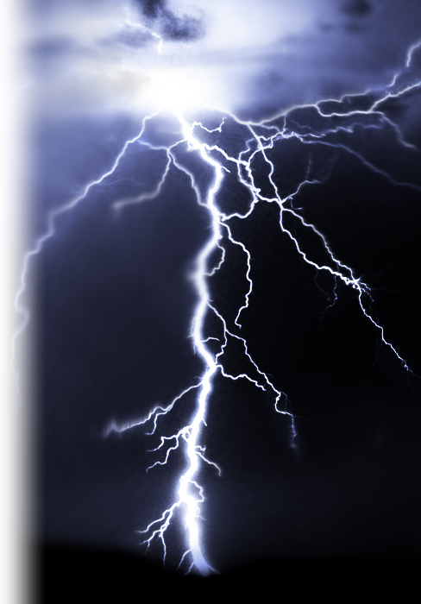
POWER of God
¹⁶ I pray that out of
his glorious riches he may strengthen you with power through his Spirit in your inner being,
Notes:
Lightning = FREE = from http://www.sxc.hu/browse.phtml?f=download&id=880253

Slide 26
POWER of God
¹⁶ I pray that out of
his glorious riches he may strengthen you with power through his Spirit in your inner being,
Notes:
Lightning = FREE = from http://www.sxc.hu/browse.phtml?f=download&id=880253

Slide 27
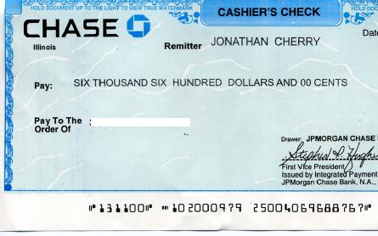
POWER of God
¹⁶ I pray that out of [according to] his glorious riches he may strengthen you with power through his Spirit in your
inner being,
Notes:
Lightning = FREE = from http://www.sxc.hu/browse.phtml?f=download&id=880253

Slide 28
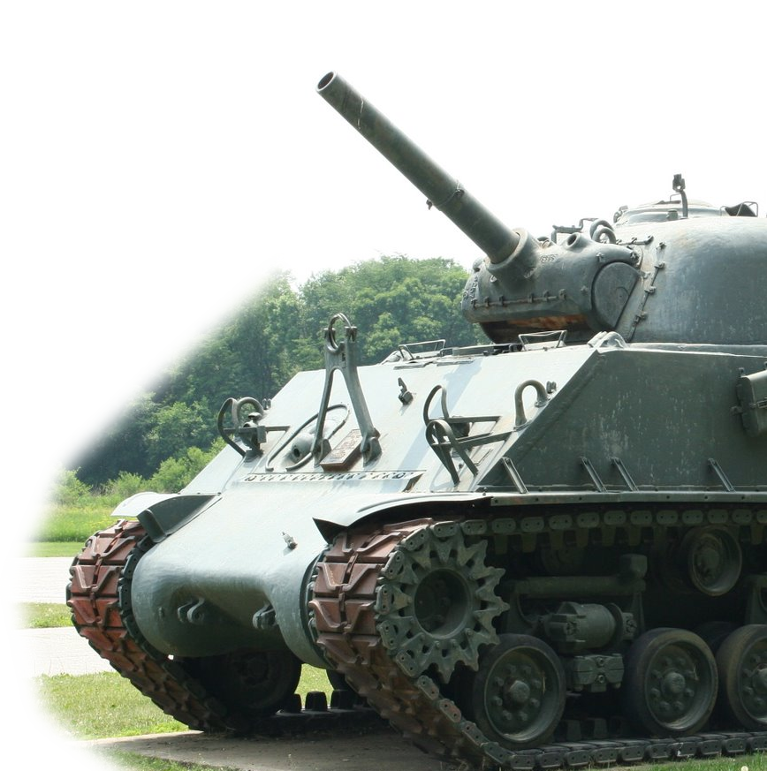
POWER of God
¹⁶ I pray that out of
his glorious riches he may strengthen you with power through his Spirit in your inner being,
Notes:
Lightning = FREE = from http://www.sxc.hu/browse.phtml?f=download&id=880253

Slide 29


POWER of God
¹⁶ I pray that out of
his glorious riches he may strengthen you with power through his Spirit in your inner being,
Notes:
Lightning = FREE = from http://www.sxc.hu/browse.phtml?f=download&id=880253

Slide 30

POWER of God
¹⁶ I pray that out of
his glorious riches he may strengthen you with power through his Spirit in your
inner being,
Notes:
Lightning = FREE = from http://www.sxc.hu/browse.phtml?f=download&id=880253

Slide 31
POWER of God
¹⁶ I pray that out of
his glorious riches he may strengthen you with power through his Spirit in your inner being,
Notes:
Lightning = FREE = from http://www.sxc.hu/browse.phtml?f=download&id=880253

Slide 32

DISCOURAGMENT thrives on feeling
1) Powerless
Notes:
Discouraged man = LICENSED and NOT FOR REUSE. To reuse get a license from http://www.istockphoto.com/stock-photo-4104003-breakfast.php

Slide 33
DISCOURAGMENT thrives on feeling
1) Powerless
2) Lonely
Notes:
Discouraged man = LICENSED and NOT FOR REUSE. To reuse get a license from http://www.istockphoto.com/stock-photo-4104003-breakfast.php

Slide 34
PRESENCE of Christ
¹⁶ I pray …
¹⁷ so that Christ may dwell
in your hearts through faith.
Notes:
Jesus = LICENSED and NOT FOR REUSE. Get a licensed from http://www.bigstockphoto.com/image-14746850/stock-photo-jesus-cried.-represented-by-portrait-of-jesus-looking-into-heaven-and-shedding-a-tear.

Slide 35
Why pray for something that already exists?
And if anyone does not have the Spirit of Christ, he does not belong to Christ. Romans 8:9
Notes:
Jesus = LICENSED and NOT FOR REUSE. Get a licensed from http://www.bigstockphoto.com/image-14746850/stock-photo-jesus-cried.-represented-by-portrait-of-jesus-looking-into-heaven-and-shedding-a-tear.

Slide 36
Jesus said …
⁴³ "When an evil spirit
comes out of a man, it
goes through arid places
seeking rest and does
not find it. ⁴⁴ Then it
says, 'I will return to the
house I left.' When it arrives,
it finds the house unoccupied, swept clean and put in order.
Notes:
Jesus = LICENSED and NOT FOR REUSE. Get a licensed from http://www.bigstockphoto.com/image-14746850/stock-photo-jesus-cried.-represented-by-portrait-of-jesus-looking-into-heaven-and-shedding-a-tear.

Slide 37
Jesus said …
⁴⁵ Then it goes and takes with
it seven other spirits more
wicked than itself, and they
go in and live
there. And the final
condition of that man is
worse than the first. That
is how it will be with this
wicked generation.“ Mat 12:43-45
Notes:
Jesus = LICENSED and NOT FOR REUSE. Get a licensed from http://www.bigstockphoto.com/image-14746850/stock-photo-jesus-cried.-represented-by-portrait-of-jesus-looking-into-heaven-and-shedding-a-tear.

Slide 38
Jesus said …
⁴⁵ Then it goes and takes with
it seven other spirits more
wicked than itself, and they
go in and live
there. And the final
condition of that man is
worse than the first. That
is how it will be with this
wicked generation.“ Mat 12:43-45
= “dwell”
Notes:
Jesus = LICENSED and NOT FOR REUSE. Get a licensed from http://www.bigstockphoto.com/image-14746850/stock-photo-jesus-cried.-represented-by-portrait-of-jesus-looking-into-heaven-and-shedding-a-tear.

Slide 39
Jesus said …
⁴⁵ Then it goes and takes with
it seven other spirits more
wicked than itself, and they
go in and live
there. And the final
condition of that man is
worse than the first. That
is how it will be with this
wicked generation.“ Mat 12:43-45
= “be at home”
Notes:
Jesus = LICENSED and NOT FOR REUSE. Get a licensed from http://www.bigstockphoto.com/image-14746850/stock-photo-jesus-cried.-represented-by-portrait-of-jesus-looking-into-heaven-and-shedding-a-tear.

Slide 40
PRESENCE of Christ
¹⁶ I pray …
¹⁷ so that Christ may dwell
in your hearts through faith.
= “be at home”
Notes:
Jesus = LICENSED and NOT FOR REUSE. Get a licensed from http://www.bigstockphoto.com/image-14746850/stock-photo-jesus-cried.-represented-by-portrait-of-jesus-looking-into-heaven-and-shedding-a-tear.

Slide 41
PRESENCE of Christ
¹⁶ I pray …
¹⁷ so that Christ may dwell
in your hearts through faith.
= “be at home”
Notes:
Jesus = LICENSED and NOT FOR REUSE. Get a licensed from http://www.bigstockphoto.com/image-14746850/stock-photo-jesus-cried.-represented-by-portrait-of-jesus-looking-into-heaven-and-shedding-a-tear.

Slide 42
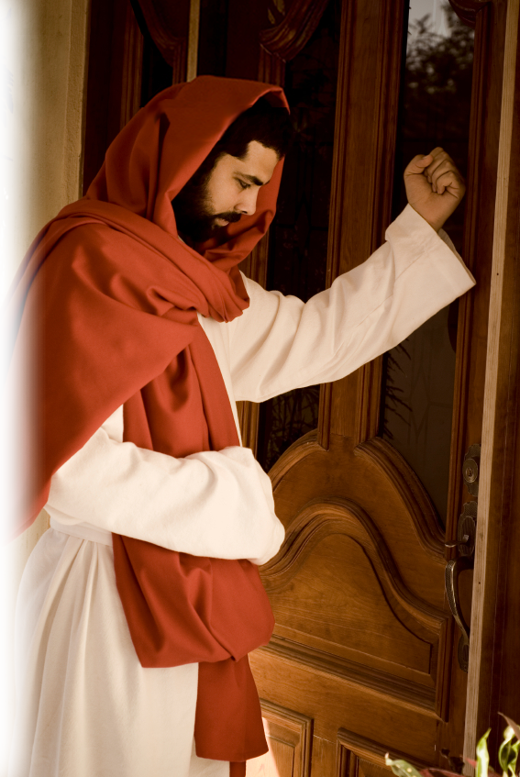
He also said …
²⁰ Here I am! I stand at the door and knock. If anyone hears my voice and opens the door, I will come in and eat with him, and he with me. Revelation 3:20
Notes:
Jesus knocking at the door = LICENSED and NOT FOR REUSE. To reuse get a license from http://www.istockphoto.com/stock-photo-3455310-jesus-knocking-the-door.php

Slide 43
DISCOURAGMENT thrives on feeling
1) Powerless
2) Lonely
3) Unloved
Notes:
Discouraged Lady = LICENSED and NOT FOR REUSE. To reuse get a license from http://www.istockphoto.com/stock-photo-4104003-breakfast.php

Slide 44
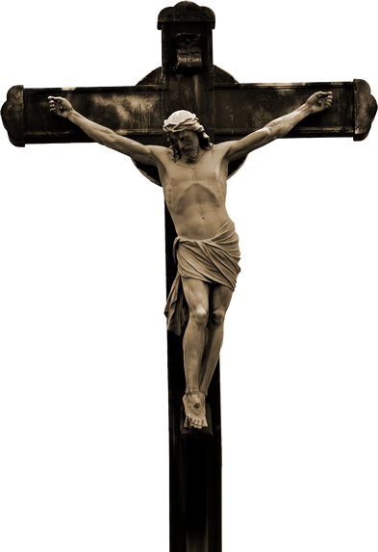
LOVE of Christ
And I pray that you, being rooted and established in love, ¹⁸ may have power, together with all the saints, to grasp how wide and long and high and deep is the love of Christ,
Notes:
Jesus on cross = FREE =from http://www.sxc.hu/browse.phtml?f=download&id=1364042

Slide 45
LOVE of Christ
And I pray that you, being rooted and established in love, ¹⁸ may have power, together with all the saints, to grasp how wide and long and high and deep is the love of Christ,
John 3:16
FOUR DIMENSIONS
Notes:
Jesus on cross = FREE =from http://www.sxc.hu/browse.phtml?f=download&id=1364042

Slide 46
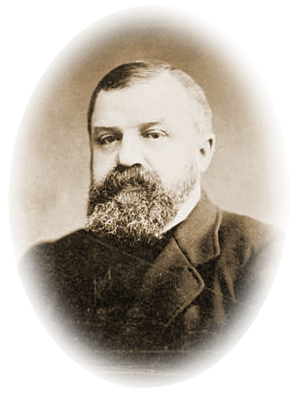
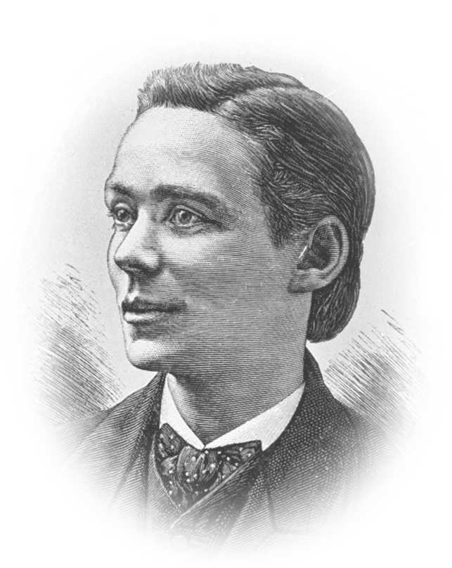
LOVE of Christ
And I pray that you, being rooted and established in love, ¹⁸ may have power, together with all the saints, to grasp how wide and long and high and deep is the love of Christ,
D.L. Moody
Harry Moorhouse
Notes:
Jesus on cross = FREE =from http://www.sxc.hu/browse.phtml?f=download&id=1364042

Slide 47
LOVE of Christ
¹⁹ and to know this love that surpasses knowledge--
Moorehouse knew it!
Notes:
Jesus on cross = FREE =from http://www.sxc.hu/browse.phtml?f=download&id=1364042

Slide 48
LOVE of Christ
¹⁹ and to know this love that surpasses knowledge--
Moody learned it!
Notes:
Jesus on cross = FREE =from http://www.sxc.hu/browse.phtml?f=download&id=1364042

Slide 49
LOVE of Christ
¹⁹ and to know this love that surpasses knowledge--
I want it too!
Notes:
Jesus on cross = FREE =from http://www.sxc.hu/browse.phtml?f=download&id=1364042

Slide 50
LOVE of Christ
A Love that
¹⁴ For Christ's love compels us,
2 Corinthians 5:14
Notes:
Jesus on cross = FREE =from http://www.sxc.hu/browse.phtml?f=download&id=1364042

Slide 51
LOVE of Christ
A Love that
³⁸ For I am convinced that … [nothing] … in all creation, will be able to separate us from the love of God that is in Christ Jesus our Lord. Romans 8:38-39
Notes:
Jesus on cross = FREE =from http://www.sxc.hu/browse.phtml?f=download&id=1364042

Slide 52
DISCOURAGMENT thrives on feeling
1) Powerless
2) Lonely
3) Unloved
4) Unfulfilled

Slide 53


FULLNESS of God
Personal
¹⁹ and to know this love that surpasses knowledge --that you may be filled to the measure of all the fullness of God.
Notes:
Fill with water = FREE = from http://www.dreamstime.com/blue-water-stock-photos-imagefree2799823

Slide 54
FULLNESS of God
Complete
¹⁹ and to know this love that surpasses knowledge --that you may be filled to the measure of all the fullness of God.
Notes:
Fill with water = FREE = from http://www.dreamstime.com/blue-water-stock-photos-imagefree2799823

Slide 55
If you could have …

Slide 56
If you could have …
1) God’s Power
Notes:
Lightning = FREE = from http://www.sxc.hu/browse.phtml?f=download&id=880253

Slide 57
If you could have …
1) God’s Power
2) Christ’s
Presence

Slide 58
If you could have …
1) God’s Power
2) Christ’s
Presence
3) Christ’s Love
Notes:
Jesus on cross = FREE =from http://www.sxc.hu/browse.phtml?f=download&id=1364042

Slide 59
If you could have …
1) God’s Power
2) Christ’s
Presence
3) Christ’s Love
4) God’s Fullness
Notes:
Fill with water = FREE = from http://www.dreamstime.com/blue-water-stock-photos-imagefree2799823

Slide 60
You might say…
You got a miracle or
SOMETHING!

Slide 61
IN A MOMENT
WE WILL PRAY
Notes:
Praying Hands = FREE = from http://www.sxc.hu/browse.phtml?f=download&id=405036

Slide 62
But, will it work?
Notes:
Praying Hands = FREE = from http://www.sxc.hu/browse.phtml?f=download&id=405036

Slide 63
Verse 20
Notes:
Praying Hands = FREE = from http://www.sxc.hu/browse.phtml?f=download&id=405036

Slide 64
God is able
to do ...
Notes:
Praying Hands = FREE = from http://www.sxc.hu/browse.phtml?f=download&id=405036

Slide 65
immeasurably
more
than ...

Slide 66
all we ask or
imagine ...
Notes:
Praying Hands = FREE = from http://www.sxc.hu/browse.phtml?f=download&id=405036

Slide 67
according to
His power ...
Notes:
Praying Hands = FREE = from http://www.sxc.hu/browse.phtml?f=download&id=405036

Slide 68
that is at work
within us.
Notes:
Praying Hands = FREE = from http://www.sxc.hu/browse.phtml?f=download&id=405036

Slide 69
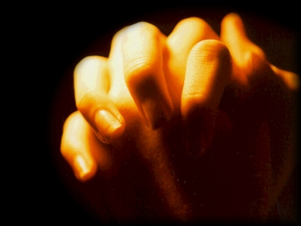
Blank check!
The LORD God Almighty
77 Hallelujah Street
New Jerusalem, Heaven
777
50-77777/99999 1
June 23
19
_____________20______
[Your Name Goes Here]
Pay to the
order of _________________________________________________ $ ____________
______________________________________________________according to Riches
[Your Request Goes Here] *
Heaven's Trust
777 Glory Avenue
123456789 12 34567890 777
James 4:2 “You do not have, because you do not ask God.”
Notes:
Check = FREE = BiblePoint art.

Slide 70
Blank check!
The LORD God Almighty
77 Hallelujah Street
New Jerusalem, Heaven
777
50-77777/99999 1
June 23
19
_____________20______
[Your Name Goes Here]
Pay to the
order of _________________________________________________ $ ____________
______________________________________________________according to Riches
[Your Request Goes Here] *
Heaven's Trust
777 Glory Avenue
123456789 12 34567890 777
³ When you ask, you do not receive,
Notes:
Check = FREE = BiblePoint art.

Slide 71
Blank check!
The LORD God Almighty
77 Hallelujah Street
New Jerusalem, Heaven
777
50-77777/99999 1
June 23
19
_____________20______
[Your Name Goes Here]
Pay to the
order of _________________________________________________ $ ____________
______________________________________________________according to Riches
[Your Request Goes Here] *
Heaven's Trust
777 Glory Avenue
123456789 12 34567890 777
because you ask with wrong motives,
Notes:
Check = FREE = BiblePoint art.

Slide 72
Blank check!
The LORD God Almighty
77 Hallelujah Street
New Jerusalem, Heaven
777
50-77777/99999 1
June 23
19
_____________20______
[Your Name Goes Here]
Pay to the
order of _________________________________________________ $ ____________
______________________________________________________according to Riches
[Your Request Goes Here] *
Heaven's Trust
777 Glory Avenue
123456789 12 34567890 777
that you may spend what you get on your pleasures.
Notes:
Check = FREE = BiblePoint art.

Slide 73
Paul’s blank check
¹⁹ Pray also for me, that whenever I open my mouth, words may be given me so that I will fearlessly make known
the mystery of the gospel, ²⁰ for
which I am an ambassador in
chains. Pray that I may declare it fearlessly, as I should. Eph 6:19-20
Notes:
Praying Hands = FREE = from http://www.sxc.hu/browse.phtml?f=download&id=405036

Slide 74
SO what did you come to church for?
Notes:
Praying Hands = FREE = from http://www.sxc.hu/browse.phtml?f=download&id=405036

Slide 75
A Miracle or Something?
Notes:
Praying Hands = FREE = from http://www.sxc.hu/browse.phtml?f=download&id=405036

Slide 76
Let’s Pray!
Notes:
Praying Hands = FREE = from http://www.sxc.hu/browse.phtml?f=download&id=405036

