Slide 1

In Christ we have
everything
money
can't buy!
Notes:
Background gold bars are licensed from http://www.bigstockphoto.com/image-2766296/stock-photo-gold-bars to reuse go and license your own copy.
Copyright © 2006−2020. All rights reserved. Bible Point is a registered trademark of Dennis Henderson. All other trademarks acknowledged.
Bible Point contains graphics from Bible Point artists. These illustrations belong to Bible Point and the respective artists. You may use the designs and illustrations for graphical illustration of lessons free and without special permission, provided they are not used in any way that maligns the Christian faith. Furthermore, republication or production of any illustration by any other graphic service whether it be in book, in a machine-readable form, or in any other design resource is strictly prohibited. Furthermore, they cannot be duplicated or resold as any other form of publishing, clip art, or graphic resource.
So What does it mean? (A simple translations of the legal jargon)
So, if you don’t own the presentation(s), graphic(s), and text(s) how can you legally use them? The purchase of the license allows you to use all the images in the product. However, the actual ownership and copyright of the presentation(s), graphic(s), and text(s) remain the property of Bible Point and its licensors. If you had plans on using this product in your “for sale” work—think again!
License Agreement
Article 1: License Grant
All the graphics and text in Bible Point presentations (excluding quotes from the Bible and stated sources) are the intellectual and real property of Bible Point and its licensors, and is protected by law, including United States copyright laws and international treaties. Bible Point grants to you a license:
1. To use the presentation in a single church, single school, or single office of a Christian organization.
2. To make a single archival back-up copy of the program.
3. To modify the presentation(s) and merge with other presentations in a single church, school, or Christian organization.
4. To transfer to another party if that party agrees to accept the terms and conditions of this agreement, and you do not retain any copies of the presentation, whether printed, machine readable, modified, or merged form.
Article 2: Terms
This license is effective until terminated. You may terminate the license at any time by destroying the presentation(s), graphic(s), or text(s) together with all copies, modifications and merged portions in any form. Bible Point may terminate your license if you fail to comply with this Agreement. You agree, upon such termination, for any reason, to destroy the presentation(s), graphics, and text(s) with all copies, modifications, and merged portions in any form.
Article 3: Disclaimers
1. Bible Point presentations, graphics, and texts are licensed to you As Is. You, the consumer, bear the entire risk relating to the quality and performance of the presentation(s), graphic(s), or text(s). In no event will Bible Point be liable for damages resulting from any defect.
2. Thirty-day limited warrantee on disks. Bible Point warrants the disks to be free of defects in material and workmanship under normal use for 30 days after purchase. During the 30-day period you may return a defective presentation, graphic, or text with proof of purchase and it will be replaced without charge, unless the presentation is damaged by misuse.
Article 4: General
1. You may not sub-license, assign, or transfer the license of the presentation(s), graphic(s), or text(s) except as provided by this Agreement.
2. This Agreement will be governed by the laws of the State of Michigan.
So What does it mean? (A simple translations of the legal jargon)
May I let someone borrow or copy my licensed Bible Point presentation (even after I modified it)? As long as it is within your local church, or single school, or the immediate office of a Christian organization you may. Otherwise, please refer the person interested in borrowing to: http://www.biblepoint.com or E-mail: dennis@drdh.net with any related questions.

Slide 2



God the Father
Chose Us
Notes:
Check Mark = FREE = from BiblePoint art.

Slide 3
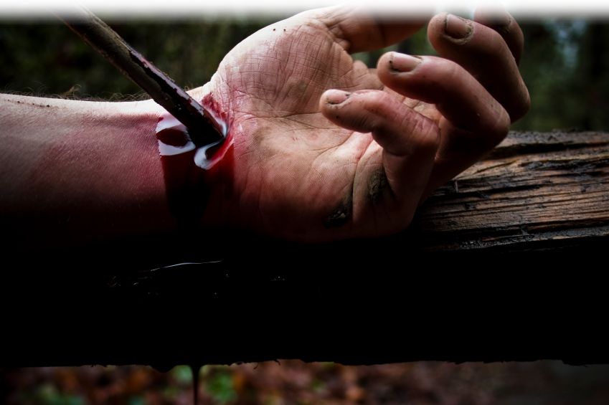
God the Son
Redeemed Us
Notes:
Nailed hand = LICENSED and NOT FOR REUSE. To reuse get a license from http://www.istockphoto.com/stock-photo-5625751-crucified.php

Slide 4

God the Holy Spirit
Sealed Us
Notes:
Scroll = LICENSED and NOT FOR REUSE. To reuse get a license at http://www.istockphoto.com/stock-photo-9551866-sealed-scroll-document.php

Slide 5
The Father, Son and
Holy Spirit did all that because …

Slide 6

God Has a
Wonderful Plan for Your Life

Slide 7

That we “Know” …
Him Better
His Hope Better
His Power Better
Notes:
Jesus = LICENSED and NOT for reuse elsewhere. To reuse get your own license from = istock_000007254772
According to the Greek-English Lexicon of the New Testament based on Semantic Domains, Vol 1., p.334., entry 28.2 epiginsko means : “to possess more or less definite information, possibly with a degree of thoroughness or competence“
Same page entry 27.61 says: “to identify newly acquired information with what had been previously learned or known –’to recognize.’ On page 382, entry 32.16 “to come to understand as the result of ability to experience and learn.”

Slide 8
Today we will focus on
“Where you LIVE.”

Slide 9
Any one here remember the TV show…
Trading Spaces?
Well, Ephesians 2
is a lot like that—only better. It's about …

Slide 10
Eph 2:1-10
Trading
Places

Slide 11

Our text has three movements:
1-Our OLD place

Slide 12

Our text has three movements:
2-Our NEW place

Slide 13
Our text has three movements:
3-How It Changed

Slide 14
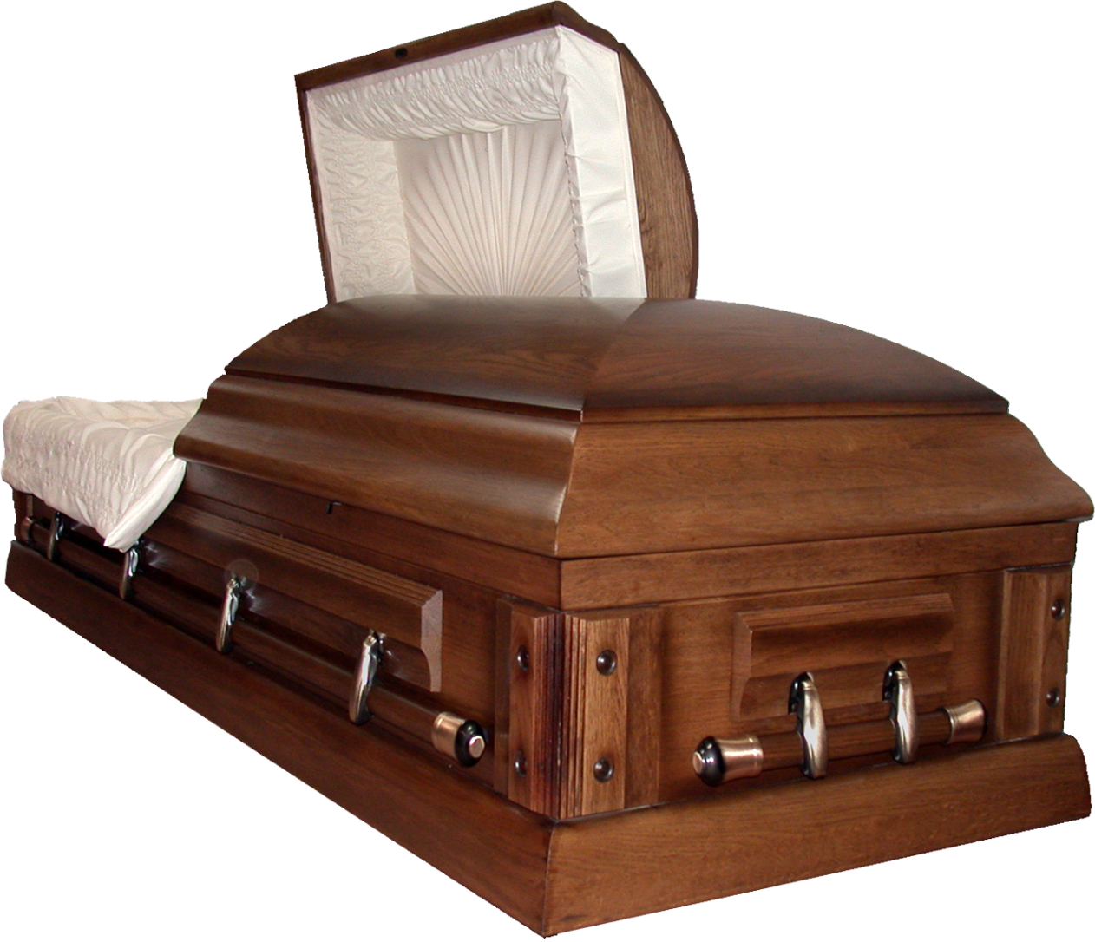
Our OLD Place
1—A Spiritual Morgue
2:1 As for you, you were dead in your transgressions
and sins, ² in which you
used to live ...
Notes:
Coffin = FREE = from http://www.sxc.hu/photo/165815

Slide 15


Our OLD Place
2—A Spiritual Dungeon
2:2 in which you used to live when you followed the ways of this world and
of the ruler of the kingdom
of the air, the spirit who
is now at work in those
who are disobedient.
Notes:
Devil = FREE = from http://www.sxc.hu/photo/229100
Earth = FREE = from http://www.sxc.hu/browse.phtml?f=download&id=1182976

Slide 16
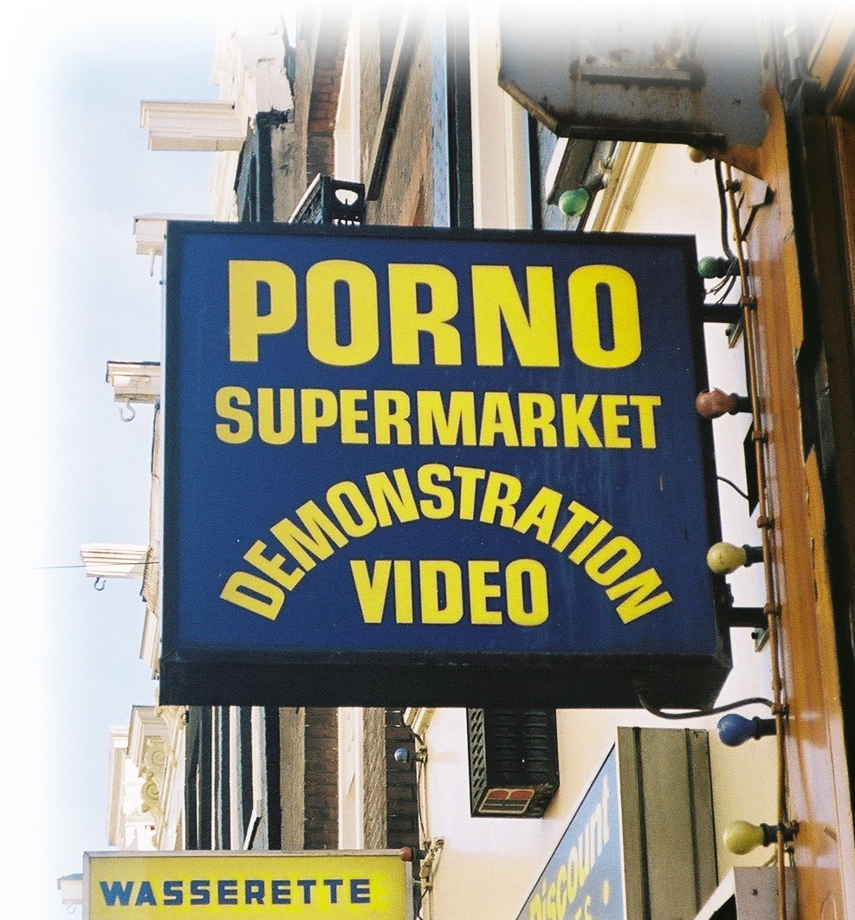
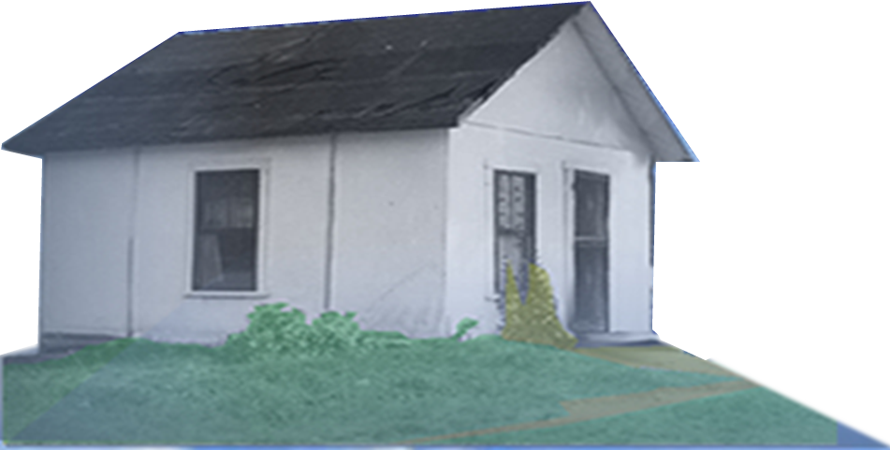
Our OLD Place
3—A Whitewashed Sleaze House
2:3 All of us also lived
among them at one time,
gratifying the cravings of
our sinful nature and
following its desires
and thoughts.
Notes:
Porn sign = FREE = from http://www.google.com/imgres?q=porn+sign&hl=en&client=firefox-a&rls=org.mozilla:en-US:official&biw=1025&bih=429&tbm=isch&tbnid=u-gXO15i_nENwM:&imgrefurl=http://www.pcfastlane.com/top-5-tech-do-withouts/&docid=4C9tbW6g1tQ0NM&imgurl=http://www.pcfastlane.com/wp-content/uploads/2009/02/porn-shop-sign.jpg&w=480&h=321&ei=zhHkTqHBLYrZiAK7uLmpBg&zoom=1&iact=hc&vpx=349&vpy=133&dur=118&hovh=183&hovw=275&tx=120&ty=124&sig=111822542821895118171&page=1&tbnh=107&tbnw=139&start=0&ndsp=14&ved=1t:429,r:2,s:0

Slide 17

Our OLD Place
4—A Demolition Bound House
2:3 .… Like the rest,
we were by nature
objects of wrath.
¹⁸ Whoever believes in him is not condemned, but whoever does not believe stands condemned already because he has not believed in the name of God's one and only Son. John 3:18
Whoever believes in the Son has eternal life, but whoever rejects the Son will not see life, for God's wrath remains on him.“ John 3:36
Notes:
Wrecking ball = LICENSED and NOT FOR REUSE. To reuse get a license from http://www.bigstockphoto.com/image-6204353/stock-photo-wrecking-ball
Jesus = LICENSED and NOT FOR REUSE. Tor reuse get a license from http://www.istockphoto.com/stock-photo-7302839-waiting-for-you.php

Slide 18

"BUT" 2:4
2:4 But ... because of his great love for us,
Notes:
Heart = FREE = from BiblePoint art

Slide 19

2-Our NEW place
1—A Compassionate Place
2:4 God, who is rich in mercy,
Notes:
Man falling to feet = LICENSED and NOT FOR REUSE. To reuse get a license from http://www.dreamstime.com/item.php?imageid=6252157

Slide 20

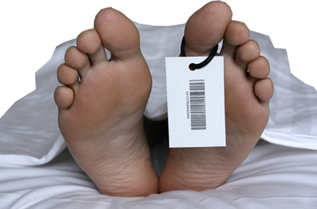
2-Our NEW place
2—A Rejuvenating Place
2:5 made us alive with Christ
even when we were dead
in transgressions--
DEAD IN SIN
Eph. 2:1
Notes:
Feet = LICENSED and NOT FOR REUSE. To reuse get a license from http://www.dreamstime.com/dead-man-image5065173
Cloud = FREE = BiblePoint art.

Slide 21
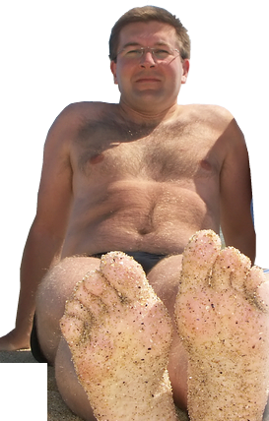
2-Our NEW place
2—A Rejuvenating Place
2:5 made us alive with
Christ even when we were
dead in transgressions--
Alive with Christ
Eph. 2:5
Notes:
Man = LICENSED and NOT FOR REUSE. To reuse get a license from http://www.dreamstime.com/fun-on-the-beach-image1238004

Slide 22

2-Our NEW place
3—A Gift Shop
2:5 …it is by grace you have been saved.
Notes:
Gift box = Licensed = NOT FOR REUSE. To reuse get your license from http://www.dreamstime.com/gift-image9378333

Slide 23

2-Our NEW place
4—A Rescue Center
2:5 …it is by grace
you have been saved.
Notes:
Life ring = LICENSED and NOT FOR REUSE. To reuse get a license from http://www.bigstockphoto.com/image-7198188/stock-photo-help!-ring-buoy-underwater
Stretched hand = FREE = from http://www.sxc.hu/browse.phtml?f=download&id=377625

Slide 24



2-Our NEW place
5—A Heavenly Mansion
2:6 And God raised us
up with Christ and seated
us with him in the heavenly
realms in Christ Jesus,
Notes:
Jesus on Throne = FREE = from BiblePoint art.

Slide 25

2-Our NEW place
6—A Show Case—Trophy Cabinet
2:7 in order that in the
coming ages he might
show the incomparable
riches of his grace,
expressed in his
kindness to us in
Christ Jesus.
Notes:
Gold cup trophy = LICENSED and NOT FOR REUSE. To reuse get a license from http://www.bigstockphoto.com/image-5671456/stock-photo-gold-trophy-cup-on-wood-pedestal

Slide 26
3-How it Changed
1—Based on Grace
2:8 For it is by grace you have been saved, … it is the gift of God--
Notes:
Gift box = Licensed = NOT FOR REUSE. To reuse get your license from http://www.dreamstime.com/gift-image9378333

Slide 27
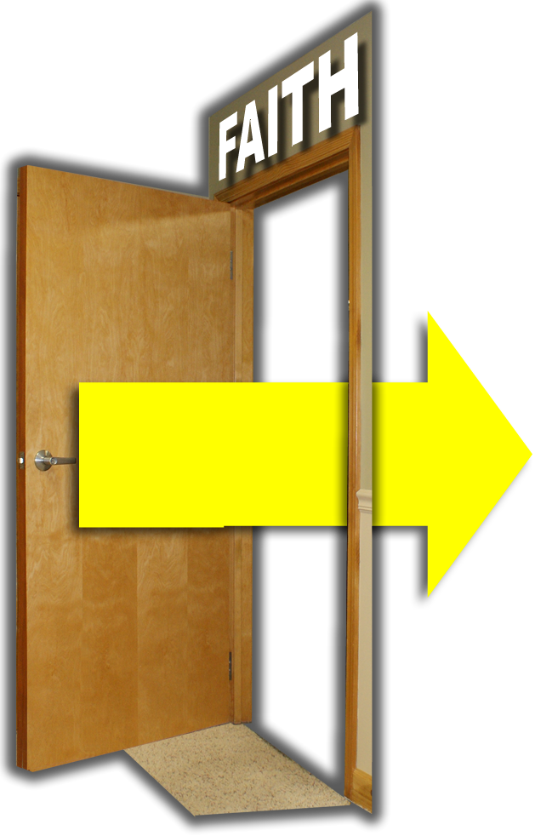
3-How it Changed
2—Through the Door of Faith
2:8 … through faith--
Notes:
Gift box = Licensed = NOT FOR REUSE. To reuse get your license from http://www.dreamstime.com/gift-image9378333
Door and arrow = FREE = BiblePoint art.

Slide 28

3-How it Changed
3—Self is left out
2:8 ---and this not from yourselves,
Notes:
Gift box = Licensed = NOT FOR REUSE. To reuse get your license from http://www.dreamstime.com/gift-image9378333
Door and arrow = FREE = BiblePoint art.
Look in mirror is LICENSED and NOT FOR REUSE. To reuse get a license from http://www.dreamstime.com/reflection-in-a-mirror-image2095515

Slide 29

3-How it Changed
3—Works left behind
2:9 … not by works,
Notes:
Gift box = Licensed = NOT FOR REUSE. To reuse get your license from http://www.dreamstime.com/gift-image9378333
Door and arrow = FREE = BiblePoint art.
Hand with wrench = FREE = from http://www.sxc.hu/browse.phtml?f=download&id=899403

Slide 30

3-How it Changed
3—Pride left behind
2:9 … so that no one can boast.
Notes:
Gift box = Licensed = NOT FOR REUSE. To reuse get your license from http://www.dreamstime.com/gift-image9378333
Door and arrow = FREE = BiblePoint art.
We’re #1 = LICENSED and NOT FOR REUSE. To reuse get a license from http://www.bigstockphoto.com/image-2125599/stock-photo-foam-finger-in-red

Slide 31
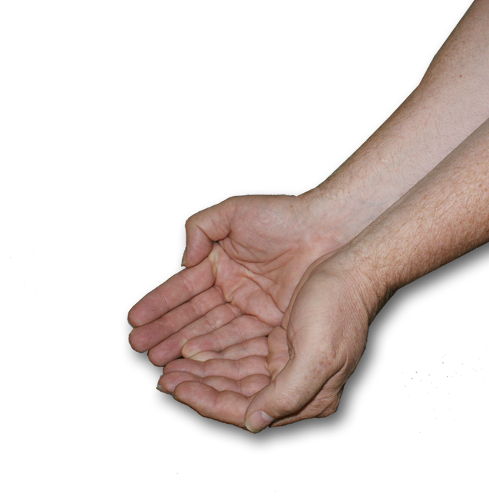
3-How it Changed
6—God does the work
2:10 For we are God's workmanship,
Notes:
Gift box = Licensed = NOT FOR REUSE. To reuse get your license from http://www.dreamstime.com/gift-image9378333
Door and arrow = FREE = BiblePoint art.
Hands = FREE = from BiblePoint photo.

Slide 32
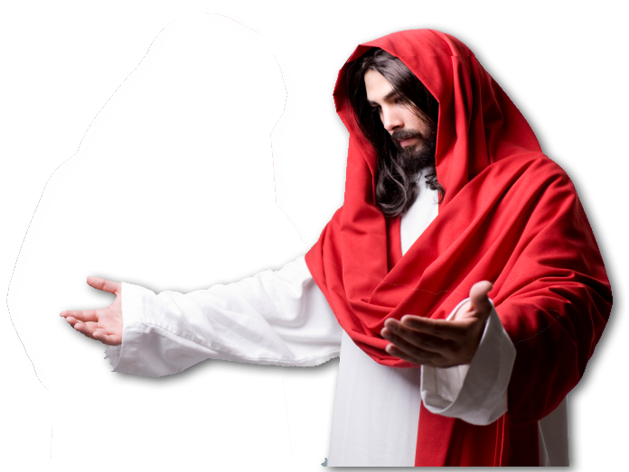
3-How it Changed
7—God Re-Creates
2:10 … created in Christ Jesus
Notes:
Gift box = Licensed = NOT FOR REUSE. To reuse get your license from http://www.dreamstime.com/gift-image9378333
Door and arrow = FREE = BiblePoint art.
Jesus with arms out = LICENSED and NOT FOR REUSE. To reuse get your license from http://www.istockphoto.com/stock-photo-7676043-jesus-is-waiting.php

Slide 33

3-How it Changed
8—For a Purpose
2:10 … to do good works,
Notes:
Gift box = Licensed = NOT FOR REUSE. To reuse get your license from http://www.dreamstime.com/gift-image9378333
Door and arrow = FREE = BiblePoint art.
Target with arrow in bull’s eye = FREE = from http://www.sxc.hu/browse.phtml?f=download&id=1078183

Slide 34
3-How it Changed
9—According to a plan
2:10 … which God prepared in advance for us to do.
God's Plan
Notes:
Gift box = Licensed = NOT FOR REUSE. To reuse get your license from http://www.dreamstime.com/gift-image9378333
Door and arrow = FREE = from BiblePoint art.
God’s plan = FREE = from BiblePoint art.

Slide 35
In conclusion ….
2 Corinthians 5:17 says:
17 Therefore, if anyone is in Christ, he is a new creation; the old has gone, the new has come!

Slide 36
The OLD is gone

Slide 37
the NEW has come

Slide 38
In Christ Jesus.

Slide 39
Isn't this incredible …
I've traded places.
You can trade places too!

Slide 40
LET’S PRAY
Trading
Places

