Slide 1

Last week we discovered that we …
Notes:
Background gold bars are licensed from http://www.bigstockphoto.com/image-2766296/stock-photo-gold-bars to reuse go and license your own copy.
Copyright © 2006−2020. All rights reserved. Bible Point is a registered trademark of Dennis Henderson. All other trademarks acknowledged.
Bible Point contains graphics from Bible Point artists. These illustrations belong to Bible Point and the respective artists. You may use the designs and illustrations for graphical illustration of lessons free and without special permission, provided they are not used in any way that maligns the Christian faith. Furthermore, republication or production of any illustration by any other graphic service whether it be in book, in a machine-readable form, or in any other design resource is strictly prohibited. Furthermore, they cannot be duplicated or resold as any other form of publishing, clip art, or graphic resource.
So What does it mean? (A simple translations of the legal jargon)
So, if you don’t own the presentation(s), graphic(s), and text(s) how can you legally use them? The purchase of the license allows you to use all the images in the product. However, the actual ownership and copyright of the presentation(s), graphic(s), and text(s) remain the property of Bible Point and its licensors. If you had plans on using this product in your “for sale” work—think again!
License Agreement
Article 1: License Grant
All the graphics and text in Bible Point presentations (excluding quotes from the Bible and stated sources) are the intellectual and real property of Bible Point and its licensors, and is protected by law, including United States copyright laws and international treaties. Bible Point grants to you a license:
1. To use the presentation in a single church, single school, or single office of a Christian organization.
2. To make a single archival back-up copy of the program.
3. To modify the presentation(s) and merge with other presentations in a single church, school, or Christian organization.
4. To transfer to another party if that party agrees to accept the terms and conditions of this agreement, and you do not retain any copies of the presentation, whether printed, machine readable, modified, or merged form.
Article 2: Terms
This license is effective until terminated. You may terminate the license at any time by destroying the presentation(s), graphic(s), or text(s) together with all copies, modifications and merged portions in any form. Bible Point may terminate your license if you fail to comply with this Agreement. You agree, upon such termination, for any reason, to destroy the presentation(s), graphics, and text(s) with all copies, modifications, and merged portions in any form.
Article 3: Disclaimers
1. Bible Point presentations, graphics, and texts are licensed to you As Is. You, the consumer, bear the entire risk relating to the quality and performance of the presentation(s), graphic(s), or text(s). In no event will Bible Point be liable for damages resulting from any defect.
2. Thirty-day limited warrantee on disks. Bible Point warrants the disks to be free of defects in material and workmanship under normal use for 30 days after purchase. During the 30-day period you may return a defective presentation, graphic, or text with proof of purchase and it will be replaced without charge, unless the presentation is damaged by misuse.
Article 4: General
1. You may not sub-license, assign, or transfer the license of the presentation(s), graphic(s), or text(s) except as provided by this Agreement.
2. This Agreement will be governed by the laws of the State of Michigan.
So What does it mean? (A simple translations of the legal jargon)
May I let someone borrow or copy my licensed Bible Point presentation (even after I modified it)? As long as it is within your local church, or single school, or the immediate office of a Christian organization you may. Otherwise, please refer the person interested in borrowing to: http://www.biblepoint.com or E-mail: dennis@drdh.net with any related questions.

Slide 2

Because …
Notes:
Background gold bars are licensed from http://www.bigstockphoto.com/image-2766296/stock-photo-gold-bars to reuse go and license your own copy.

Slide 3


God the Father
Chose Us
Notes:
Background gold bars are licensed from http://www.bigstockphoto.com/image-2766296/stock-photo-gold-bars to reuse go and license your own copy.
Check Mark = FREE = from BiblePoint art.

Slide 4

God the Son
Redeemed Us
Notes:
Nailed hand = LICENSED and NOT FOR REUSE. To reuse get a license from http://www.istockphoto.com/stock-photo-5625751-crucified.php

Slide 5

God the Holy Spirit
Sealed Us
Notes:
Scroll = LICENSED and NOT FOR REUSE. To reuse get a license at http://www.istockphoto.com/stock-photo-9551866-sealed-scroll-document.php

Slide 6
The Father, Son and Holy Spirit did all that because …
Notes:
Background gold bars are licensed from http://www.bigstockphoto.com/image-2766296/stock-photo-gold-bars to reuse go and license your own copy.

Slide 7

God Has a
Wonderful Plan for Your Life
Notes:
This background with the cross is FREE from BiblePoint art.

Slide 8
It's true . . .

Slide 9
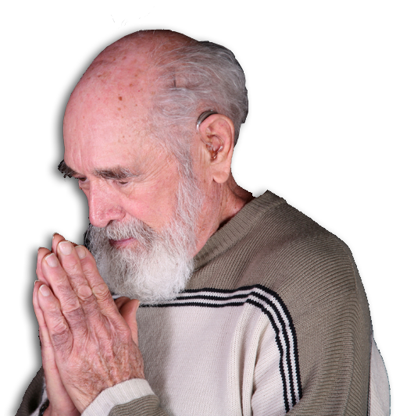
This plan is revealed in a
A PRAYER
Notes:
Praying man = LICENSED and NOT FOR REUSE. To reuse get a license from http://www.dreamstime.com/item.php?imageid=4611978

Slide 10
God’s Plan for Our Lives is ...

Slide 11
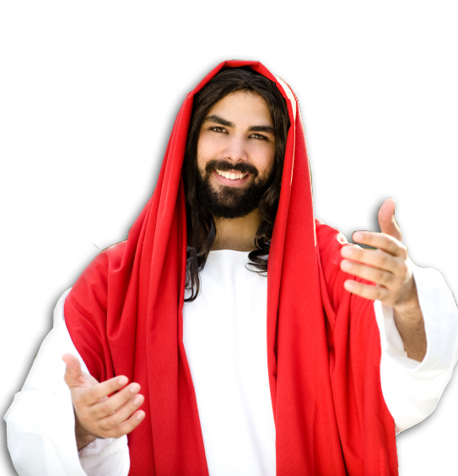
1. TO KNOW HIM BETTER 1:17
“so that you may know him better”

Slide 12
1. TO KNOW HIM BETTER 1:17
“so that you may know him better”
επιγινωσκω
1—Know THOROUGHLY
2—So you RECOGNIZE
3—From previous EXPERIENCE
οιδα

Slide 13

Through FAITH
¹⁵ For this reason, ever since I heard about your faith in the Lord Jesus
Notes:
https://pixabay.com/photos/faith-believe-trust-clouds-sky-3476253/

Slide 14

Through LOVE
¹⁵ For this reason, ever since I heard about your faith in the Lord Jesus and your love for all the saints,
Notes:
https://pixabay.com/photos/love-valentine-heart-in-love-3061483/

Slide 15

Through PRAYER
¹⁶ I have not stopped giving thanks for you, remembering you in my prayers. ¹⁷ I keep asking that the God of our Lord Jesus Christ, the glorious Father, ...
Notes:
https://pixabay.com/photos/prayer-hands-church-light-2544994/

Slide 16

Through THE SPIRIT
may give you the Spirit of wisdom and revelation,

Slide 17
All to know HIM BETTER
so that you may know him better.

Slide 18

2. TO KNOW HIS HOPE 1:18
the hope to which he has called you

Slide 19
2. To Know HIS HOPE 1:18
οιδα
This is knowledge of how to perform a particular activity.

Slide 20

It’s HEARTFELT
¹⁸ I pray also that the eyes of your heart may be enlightened

Slide 21

It’s SUMMONING
¹⁸ ... in order that you may know the hope to which he has
called you

Slide 22


It’s GLORIOUS
¹⁸ ... the hope to which he has called you, the
riches of his glorious inheritance ...

Slide 23
It’s PERSONAL
¹⁸ ... the hope to which he has called you, the
riches of his glorious inheritance in the saints,

Slide 24
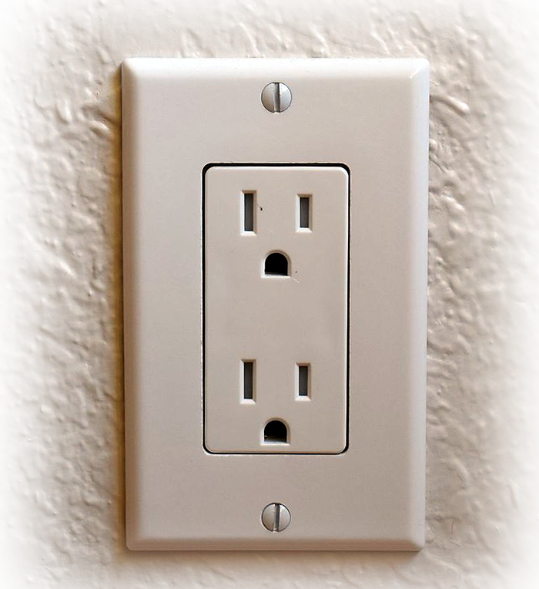
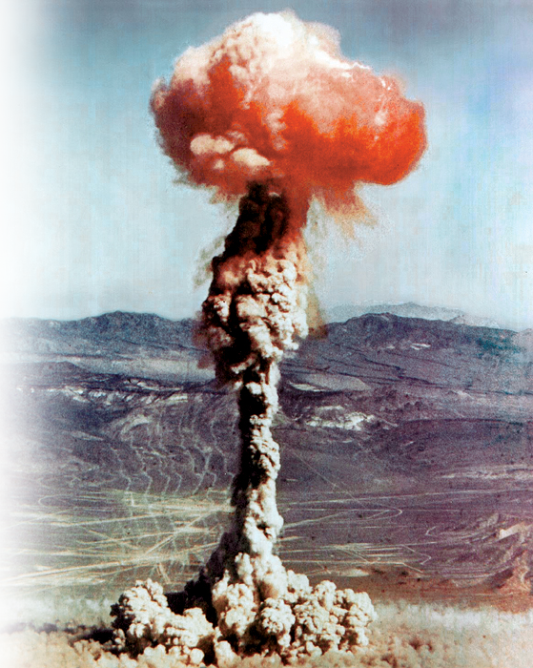
3. TO KNOW HIS POWER
¹⁹ and [that you may know] his incomparably great power

Slide 25
His INCOMPARABLE Power
¹⁹ and [that you may know] his incomparably great power

Slide 26
His INTERNAL Power
¹⁹ and [that you may know] his incomparably great power for us who believe.

Slide 27
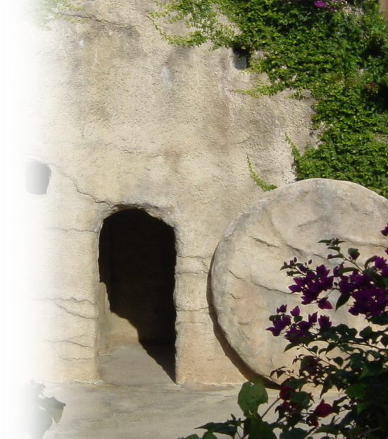
His RESURRECTION Power
¹⁹ ...That power is like the working of his mighty strength, ²⁰ which he exerted in Christ when he raised him from the dead

Slide 28
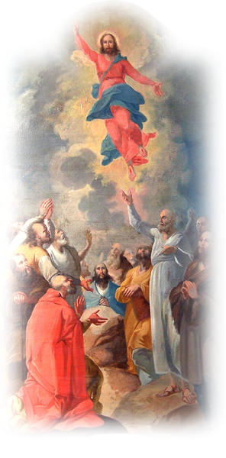
His EXALTATION Power
²⁰ ... and seated him at his right hand in the heavenly realms, ²¹ far above all rule and authority, power and dominion, and every title that can be given ...

Slide 29
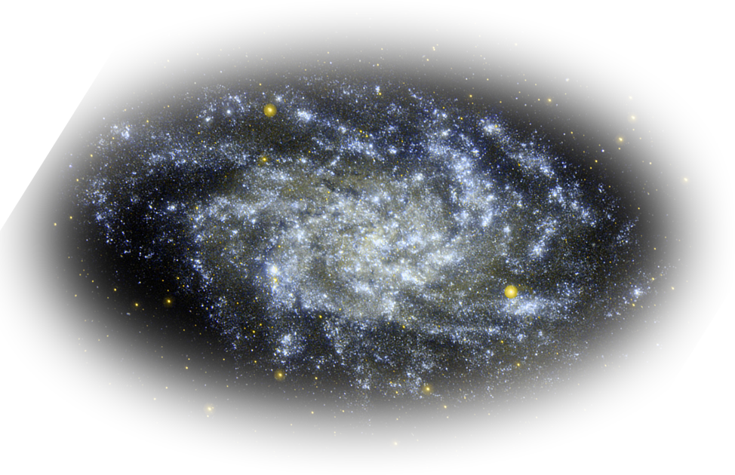
His ETERNAL Power
²⁰ ... not only in the present age but also in the one to come.

Slide 30

His RULING Power
²² And God placed all things under his feet

Slide 31
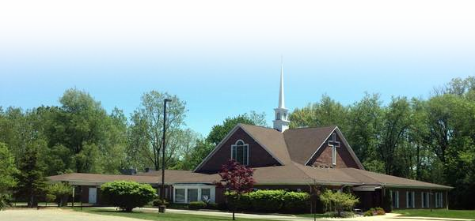
His CHURCH Power
²² ... and appointed him to be head over everything for the church, ²³ which is his body, the fullness of him who fills everything in every way.

Slide 32
2 Corinthians 10
3 For though we live in the world, we do not wage war as the world does. 4 The weapons we fight with are not the weapons of the world. On the contrary, they have divine power to demolish strongholds. 5 We demolish arguments and every pretension that sets itself up against the knowledge of God, and we take captive every thought to make it obedient to Christ.

Slide 33
HIM
GOD’S PAN FOR YOUR LIFE IS TO ...
Know His
Power Better
Hope
Know Him
Better
Know His
Hope Better
Know His
Power
Know Him
Know His
Hope

Slide 34
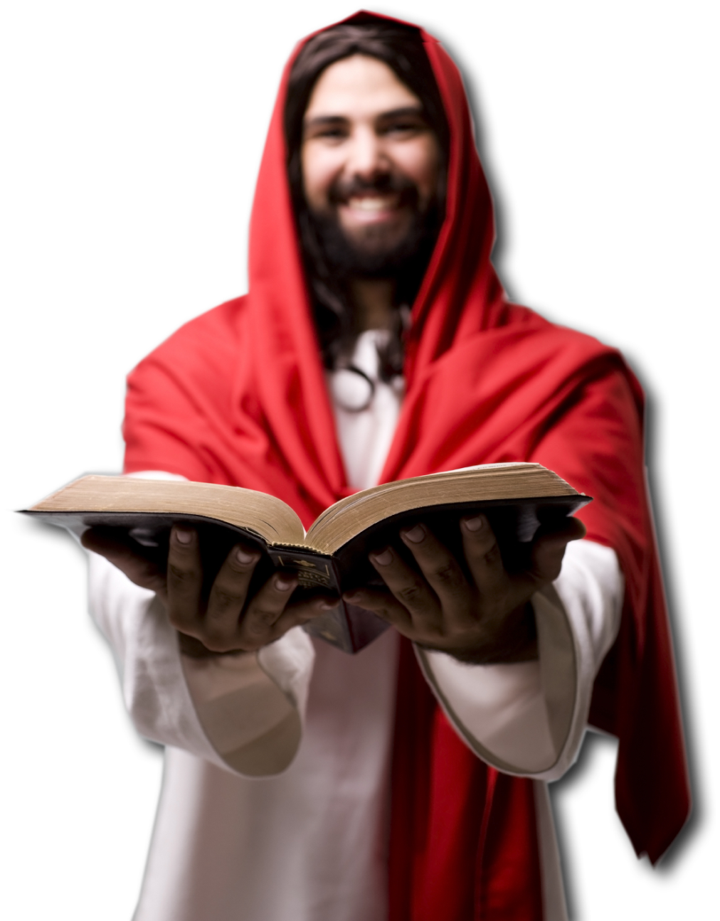
Conclusion:
God's plan for our lives is:
To Know HIM BETTER
To Know HIS HOPE
To Know HIS POWER
So let's do just that!

Slide 35
God Has a
Wonderful Plan for Your Life

Slide 36
LET’S PRAY!

